Slide 1
UKHSA Advisory Board Building the UKHSA Workforce Jac Gardner, Chief People Officer 24 January 2023

Slide 2
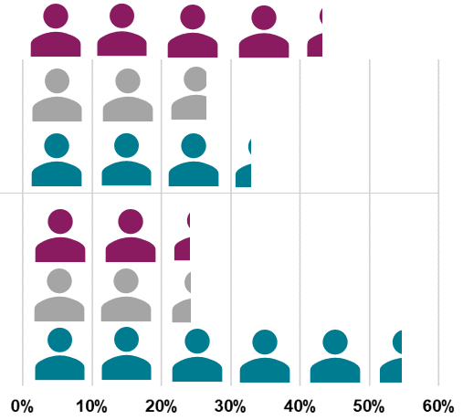
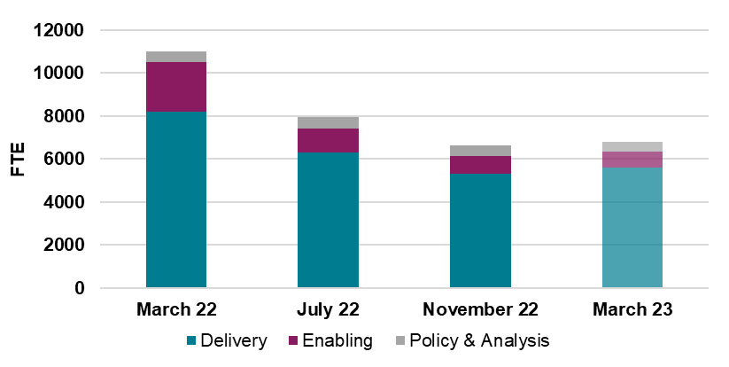
Current Workforce - Overview
We have achieved our planned 40% reduction in the workforce in line with the Government’s “Living with Covid” strategy, to time and budget.
As of November 2022, total UKHSA FTE was 6,700 – delivered 5 months ahead of target date
UKHSA Total Workforce (FTE) reductions between March and November 22 (%)
FTE
Alongside overall workforce reductions, we continue to increase our focus on Delivery functions, reduce our Enabling functions, and maintain our Policy & Analysis functions.
As of November 2022, approximately 80% of FTE was in delivery functions.
We also continue to increase the proportion of our permanent Civil Servant workforce and reduce our reliance on off-payroll workers*.
The remainder of the UKHSA workforce is comprised of fixed-term Civil Servants.
*Off-payroll workers include contractors, consultancy and agency staffing
Permanent Civil Servant vs Off-Payroll Proportion of the workforce (%)
42%
Mar 22
27%
UKHSA FTE by function (%)
Off-payroll
76%
Delivery
31%
Fixed Term Civil Servant
Planned end-year position
79%
Delivery
22%
80%
Delivery
83%
Delivery
Permanent Civil Servant
24%
Nov 22
54%
Despite having achieved these key workforce objectives, the largest workforce challenge continues to be stabilising the workforce through recruitment – with an immediate need to accelerate, scale up and meet recruitment demand.
All data is at end of November 22 unless otherwise specified

Slide 3
Challenges for the Future Workforce - Recruitment
Recruitment continues to be the key priority in stabilising the UKHSA workforce, with a significant volume of campaigns currently live, campaigns that are ready to go live, and campaigns being planned by UKHSA Groups.
These volumes planned are to recruit more permanent Civil Servants to replace both fixed-term contracts and contingent labour and account for turnover of approximately 14%.
We are therefore anticipating no significant net increase in our end year workforce position.
1,000
Live campaigns
680
Campaigns queued
1,100
In planning stages within Groups
Of which
270
Campaigns Outsourced
Alongside the significant pressure to respond to these levels of demand for recruitment, resourcing teams are also experiencing their own levels of attrition and instability as a permanent, enduring resourcing team is recruited to. To address these issues we have:
Worked closely with UKHSA Groups to understand their workforce plans, recruitment profiles and priority roles.
Quickly procured external support and outsourced some recruitment campaigns whilst our resourcing team is recruited into, which will address demand by March 2023 (see chart).
Improved our ways of working to account for both internal and outsourced recruitment, and to enable clearer prioritisation of campaigns.
Embedded a proactive reporting framework to enable greater oversight and tracking of campaigns, alongside regular tracking reports from our outsourced supplier.
Demand addressed as campaigns progress and is accelerated by outsourced recruitment
Permanent recruitment into the resourcing team by January offsets attrition
Outsourced recruitment to close gap by March 2023
Outstanding campaigns Campaigns addressed by outsourced recruitment
Recruitment team capacity Capacity addressed by stabilising team
Recruitment data as at mid-November

Slide 4
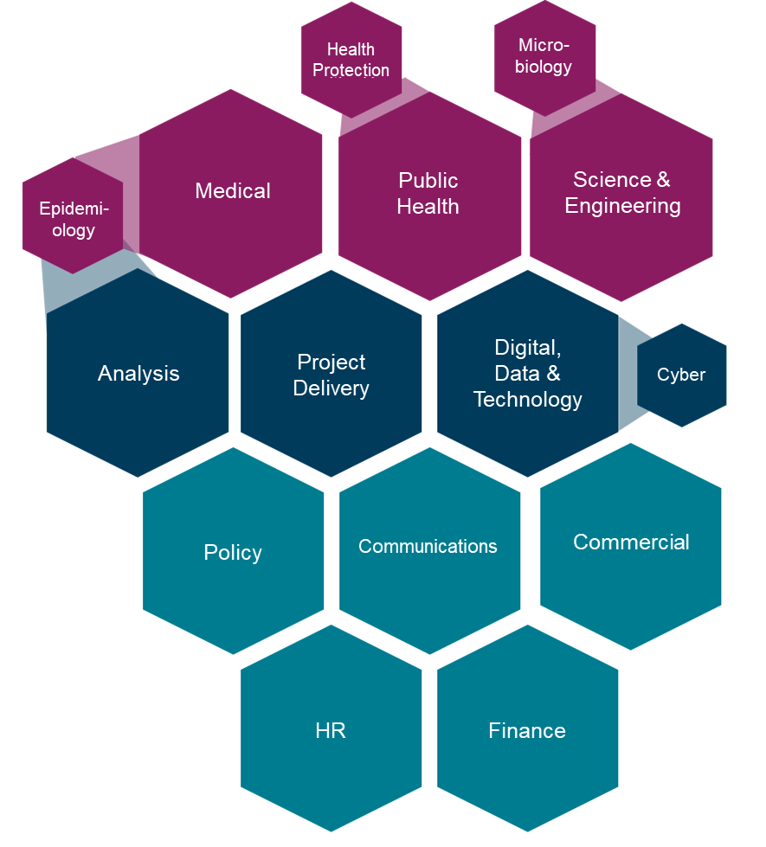
Challenges for the Future Workforce
Whilst we have achieved our planned workforce reduction, the organisation continues to face challenges which impact the stability and shape of the workforce:
UKHSA’s future funding position is uncertain, and we do not yet have an agreed budget for next financial year. Given the UK is facing a difficult economic and fiscal climate, the building of our future (and more permanent) Civil Servant workforce is being done at risk.
UKHSA continues to support work on multiple incidents, requiring a range of specialist and incident-trained resource, often at short notice - these ongoing demands highlight that the organisation's operating model must incorporate increased levels of flexibility and resilience.
In line with planned recruitment activity, accountabilities, teams and structures - particularly at a senior level - are still being shaped to meet the priorities and operating model of UKHSA - creating additional short-term instability.
Even as we address recruitment capacity, there are challenges in attracting, recruiting and retaining the specialist, technical skills we need due to competitive labour markets and inflexibility in our pay and reward offer, especially within Scientific, Digital, Data & Technology (DDAT) Professions.
Major UKHSA Professions and Associated Sub-Professions categorised by the ability to attract, recruit and retain them across the Civil Service
Unique UKHSA / uncommon Civil Service Professions (and associated sub-professions) that are hard to attract, recruit and retain
Common Cross-Civil Service Professions (and associated sub-professions) that are hard to attract, recruit and retain
Common Cross-Civil Service Professions
Smaller hexagons denote an associated sub-profession, hexagon size does not represent relative size of profession
All data is at end of November 22 unless otherwise specified

