Slide 1
Chapter 2. Antimicrobial resistance
ESPAUR report 2023. Chapter 2 figure appendix

Slide 2
Overview
Data presented in this appendix complements the data presented in the ESPAUR report 2023 in Chapter 2 ‘Antimicrobial resistance and communicable disease resistance’.
The graphs use data taken from the UKHSA Second Generation Surveillance System Antimicrobial Resistance, unless otherwise noted.
For interpretation of the data please refer to the ESPAUR report 2022 to 2023.

Slide 3
Figure 2.1 Incidence of bloodstream infection caused by key pathogens, per 100,000 population; England 2018 to 2022
* Data taken from mandatory surveillance
Notes:
Accessibility text
Title: Graph showing the trend in the rate of bloodstream infection per 100,000 population for key pathogens, England 2018 to 2022
* Data are based on mandatory surveillance reports

Slide 4
Figure 2.4 (a) E. coli bacteraemia resistance to key antimicrobials; England 2018 to 2022
Notes:
Accessibility text
Title: Antibiotic Susceptibility Test results for E. coli against key antibiotic agents by laboratories in England between 2018 and 2022
Description: Graph showing the number of E. coli bacteraemia reported by year in England between 2018 and 2022 and the number of reports with susceptibility testing and results to different key antimicrobials. The chart also shows the proportion resistant to the agents over the time period.

Slide 5
Figure 2.4 (b) K. pneumoniae bacteraemia resistance to key antimicrobials; England 2018 to 2022
Notes:
Accessibility text
Title: Antibiotic Susceptibility Test results for Klebsiella pneumoniae against key antibiotic agents by laboratories in England between 2018 and 2022
Description: Graph showing the number of Klebsiella pneumoniae bacteraemia reported by year in England between 2018 and 2022 and the number of reports with susceptibility testing and results to different key antimicrobials. The chart also shows the proportion resistant to the agents over the time period.

Slide 6
Figure 2.5 (a) Pseudomonas spp. bacteraemia resistance to key antimicrobials; England 2018 to 2022
Notes:
Accessibility text
Title: Antibiotic Susceptibility Test results for Pseudomonas spp. bacteraemia against key antibiotic agents by laboratories in England between 2018 and 2022
Description: Graph showing the number of Pseudomonas spp. bacteraemia reported by year in England between 2018 and 2022 and the number of reports with susceptibility testing and results to different key antimicrobials. The chart also shows the proportion resistant to the agents over the time period.

Slide 7
Figure 2.9 (a) S. pneumoniae bacteraemia resistance to key antimicrobials; England 2018 to 2022
Notes:
Accessibility text
Title: Antibiotic Susceptibility Test results for Streptococcus pneumoniae bacteraemia against key antibiotic agents by laboratories in England between 2018 and 2022
Description: Graph showing the number of Streptococcus pneumoniae bacteraemia reported by year in England between 2018 and 2022 and the number of reports with susceptibility testing and results to different key antimicrobials. The chart also shows the proportion resistant to the agents over the time period.

Slide 8
Figure 2.9 (c) Number of bloodstream isolates of S. aureus reported and the percentage resistant to methicillin; England, 2018 to 2022*
Notes:
Accessibility text
Title: Graph showing number of bloodstream infections (BSI) of S. aureus reported and the percentage resistant to methicillin in England between 2018 and 2022
* Data are based on mandatory surveillance reports

Slide 9
Figure 2.2 Annual estimated burden of antibiotic-resistant BSI; England 2018 to 2022
Notes:
Accessibility text
Title: Estimated trends in burden of bloodstream infections due to antibiotic-resistant pathogens in England, 2018 to 2022

Slide 10
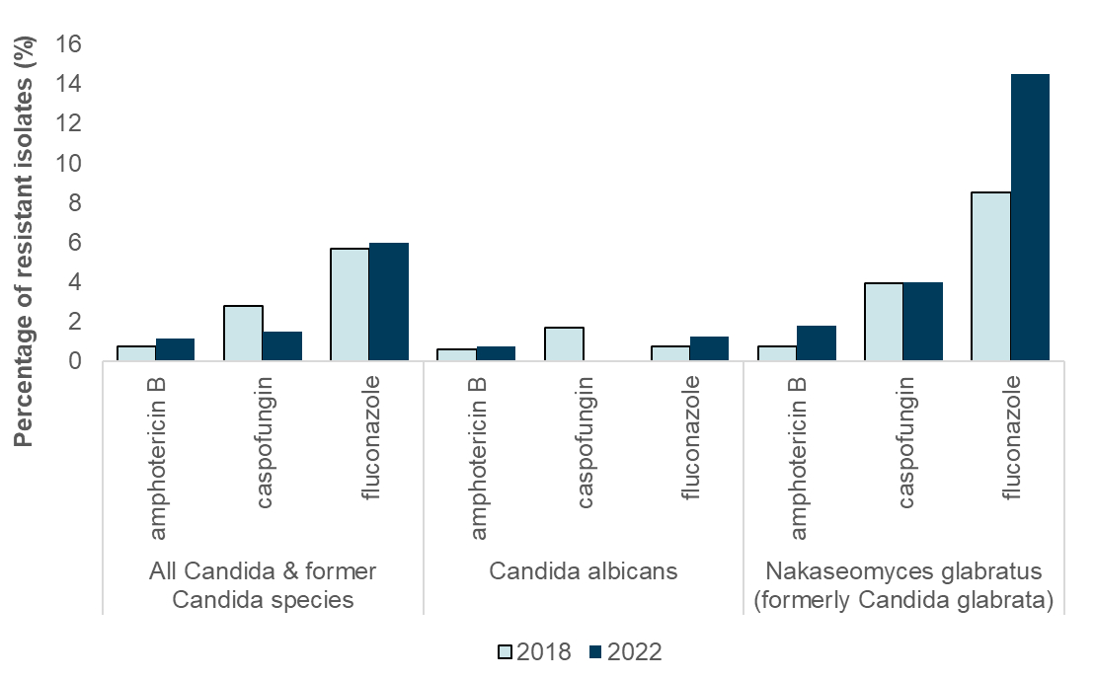
Figure 2.11. Percentage of Candida and former Candida species combined, and C. albicans and N. glabratus isolates from blood assessed separately, displaying resistance to key antifungals in England, 2018 and 2022

Slide 11
Additional figures

Slide 12
K. oxytoca bacteraemia resistance to key antimicrobials; England 2018 to 2022
Notes:
Accessibility text
Title: Antibiotic Susceptibility Test results for Klebsiella oxytoca against key antibiotic agents by laboratories in England between 2018 and 2022

Slide 13
Additional Figure 1 Acinetobacter spp. bacteraemia resistance to key antibiotics; England 2018 to 2022
Notes:
Accessibility text
Title: Graph showing Antibiotic Susceptibility Test results for Acinetobacter spp. bacteraemia against key antibiotic agents by laboratories in England between 2018 and 2022
Description: Graph showing the number of Acinetobacter spp. bacteraemia reported by year in England between 2018 and 2022 and the number of reports with susceptibility testing and results to gentamicin, ciprofloxacin and 3rd generation cephalosporin. The chart also shows the proportion resistant to the agents over the time period. The number of Acinetobacter spp. bloodstream infections (BSI) was fluctuant over the five-year period.

Slide 14
Additional Figure 2 Enterobacter spp. bacteraemia resistance to key antimicrobials; England 2018 to 2022
Notes:
Accessibility text
Title: Number of isolates of Enterobacter spp. bacteraemia reported and the proportion resistant to the indicated antibiotics, England 2018 to 2022
Description: Graph showing the number of Enterobacter spp. bacteraemia reported by year in England between 2018 and 2022 and the number of reports with susceptibility testing and results to different key antimicrobials. The chart also shows the proportion resistant to the agents over the time period.

Slide 15
Additional Figure 3 Citrobacter spp. bacteraemia resistance to key antimicrobials; England 2018 to 2022
Notes:
Accessibility text
Title: Number of isolates of Citrobacter spp. bacteraemia reported and the proportion resistant to the indicated antibiotics, England 2018 to 2022
Description: Graph showing the number of Citrobacter spp. bacteraemia reported by year in England between 2018 and 2022 and the number of reports with susceptibility testing and results to different key antimicrobials. The chart also shows the proportion resistant to the agents over the time period. The resistance to each antibiotic has remained fairly stable between 2018 and 2022, with the exception of piperacillin/tazobactam that increased to 11% in 2022 from 7% in 2018. Meropenem resistance has remained low, increasing from 0.2% to 0.4% between 2018 and 2022 respectively.

Slide 16
Additional Figure 4 Serratia spp. bacteraemia resistance to key antimicrobials; England 2018 to 2022
Notes:
Accessibility text
Title: Number of isolates of Serratia spp. bacteraemia reported and the proportion resistant to the indicated antibiotics, England 2018 to 2022
Description: Graph showing the number of Serratia spp. bacteraemia reported by year in England between 2018 and 2022 and the number of reports with susceptibility testing and results to different key antimicrobials. The chart also shows the proportion resistant to the agents over the time period. There has been a increase in the number of tested Serratia spp. reports when comparing 2018 to 2022. There has been an decrease in antibiotic resistance for ceftazidime, which saw a decrease from 13% in 2018 to 10% in 2022; other antibiotic resistance trends remained stable.

