Slide 1
Chapter 3: Antimicrobial consumption
ESPAUR report 2023. Chapter 3 figure appendix

Slide 2
Introduction
Data presented in this appendix complements the data presented in the ESPAUR report 2022 to 2023, Chapter 3 ‘Antimicrobial consumption’.
Data sources and method details are available in the Chapter Annexe.
For interpretation of the data presented here, please refer to the ESPAUR report 2022 to 2023, Chapter 3 ‘Antimicrobial consumption’.

Slide 3
Total antibiotic consumption by prescriber setting, expressed as DDDs per 1,000 inhabitants per day, England, 2018 to 2022

Slide 4
Total antibiotic consumption by antibiotic groups, expressed as DDDs per 1,000 inhabitants per day, England, 2018 to 2022
+ Statistically significant p-value (p<0.05) for trend from 2017 to 2021.
^ Anti-Clostridioides difficile agents: oral vancomycin and fidaxomicin.
* Other antibacterials (ATC 3rd level pharmacological subgroup ‘J01X’) include: glycopeptide antibacterials, polymyxin, steroid antibacterials, imidazole derivatives, nitrofuran derivatives, other antibacterials

Slide 5
Total antibiotic consumption by antibiotic groups and prescriber settings, expressed as DDDs per 1,000 inhabitants per day, England, 2022

Slide 6
Consumption of the most commonly utilised penicillin, expressed as DDDs per 1,000 inhabitants per day, England, 2018 to 2022

Slide 7
Consumption of the most commonly utilised cephalosporins expressed as DDDs per 1,000 inhabitants per day, England, 2018 to 2022

Slide 8
Consumption of tetracyclines, expressed as DDDs per 1,000 inhabitants per day, England, 2018 to 2022

Slide 9
Consumption of quinolones, expressed as DDDs per 1,000 inhabitants per day, England 2018 to 2022

Slide 10
Consumption of macrolides, expressed as DDDs per 1,000 inhabitants per day, England, 2018 to 2023

Slide 11
Consumption of sulfonamides and trimethoprim by prescriber setting, expressed as DDDs per 1,000 inhabitants per day, England, 2018 to 2022

Slide 12
Consumption of nitrofurantoin by prescriber setting, expressed as DDDs per 1,000 inhabitants per day, England, 2018 to 2022

Slide 13
Consumption of aminoglycosides by prescriber setting, expressed as DDDs per 1,000 inhabitants per day, England, 2018 to 2022

Slide 14
Consumption of parenteral glycopeptides and daptomycin by prescriber setting, expressed as DDDs per 1,000 inhabitants per day, England, 2018 to 2022

Slide 15
Consumption of parenteral glycopeptides and daptomycin, expressed as DDDs per 1,000 inhabitants per day, England, 2018 to 2022

Slide 16
Consumption of colistin in by prescriber setting, expressed as DDDs per 1,000 inhabitants per day, England, 2018 to 2022

Slide 17
Total antibiotic consumption in primary care, expressed as items and DDDs per 1,000 inhabitants per day, England, 2018 to 2022

Slide 18
Antibiotic items in primary care by prescriber group, expressed as items per 1,000 inhabitants per day, England, 2018 to 2022

Slide 19
Antibiotic items prescribed by GP, expressed as items per 1,000 inhabitants per day, England, 2018 to 2022
+ Statistically significant p-value (p<0.05) for trend from 2018 to 2022.
^ Anti-Clostridioides difficile agents: oral vancomycin and fidaxomicin.
* Other antibacterials (ATC third level pharmacological subgroup ‘J01X’) include: glycopeptide antibacterials, polymyxin, steroid antibacterials, imidazole derivatives, nitrofuran derivatives, other antibacterials

Slide 20
Total consumption in items in general practices by age group, expressed as items per 1,000 inhabitants per day, England, 2018 to 2022

Slide 21
Percentage of items in general practices by age group, England, 2018 to 2022

Slide 22
Other community antimicrobial consumption by setting, expressed as items per 1,000 inhabitants per day, England, 2018 to 2022

Slide 23
Dental antibiotic consumption for the most commonly used antibiotics, expressed as DDDs and items per 1,000 inhabitants per day, 2018 to 2022
Note: + Statistically significant p-value (p<0.05) for trend from 2018 to 2022.

Slide 24
Antibiotic prescribing in acute trusts, by trust type, expressed as DDDs per 1,000 admissions, England, 2018 to 2022

Slide 25
Antibiotic consumption in trusts, by antibiotic group, expressed as DDDs per 1,000 admissions, England, 2018 to 2022
+ Statistically significant p-value (p<0.05) for trend from 2018 to 2022.
^ Anti-Clostridioides difficile agents: oral vancomycin and fidaxomicin.
* Other antibacterials (ATC 3rd level pharmacological subgroup ‘J01X’) include: glycopeptide antibacterials, polymyxin, steroid antibacterials, imidazole derivatives, nitrofuran derivatives, other antibacterials.

Slide 26
Consumption of colistin in secondary care by administration route, expressed as DDDs per 1,000 admissions, England, 2018 to 2022

Slide 27
Consumption of colistin in secondary care by Trust type, expressed as DDDs per 1,000 admissions, England, 2018 to 2022

Slide 28
Consumption of carbapenems in secondary care, expressed as DDDs per 1,000 admissions, England, 2018 to 2022

Slide 29
Consumption of carbapenems in secondary care by trust type, expressed as DDDs per 1,000 admissions, England, 2018 to 2022

Slide 30
Consumption of piperacillin/tazobactam in secondary care by trust type, expressed as DDDs per 1,000 admissions, England, 2018 to 2022

Slide 31
Quinolone antibacterials and cephalosporins consumption in trusts, expressed as DDDs per 1,000 admissions, England, 2018 to 2022
Note:
+ Statistically significant p-value (p<0.05) for trend from 2018 to 2022.
- Not authorised for use in the UK.

Slide 32
Prescribing in secondary care by speciality, expressed as DDDs per admissions, England, 2018 to 2022

Slide 33
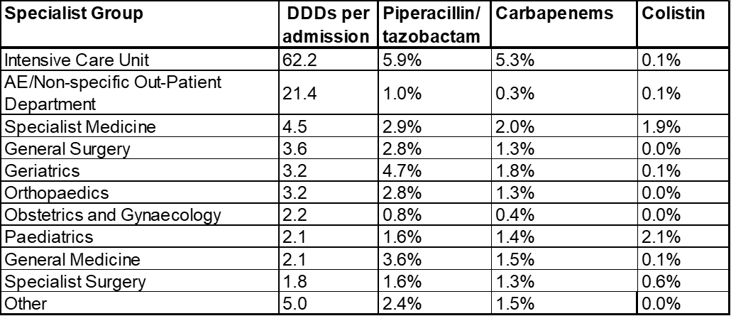
Proportion of all prescribing attributed to piperacillin/tazobactam, carbapenems and colistin in secondary care by speciality, expressed as DDDs per admissions, England, 2022

Slide 34
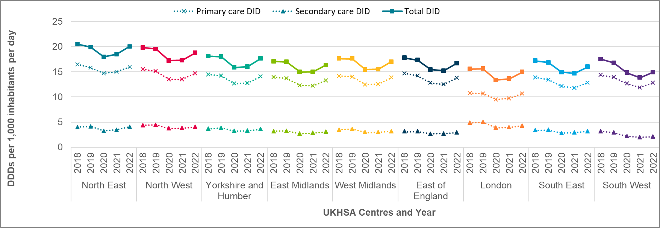
Total antibiotic consumption by UKHSA centres, expressed as DDDs per 1,000 inhabitants per day (DID), England, 2018 to 2022
Note: Total DID and primary care DID excludes dental practice data.

Slide 35
Total broad spectrum items and rate prescribed in primary care, expressed as items per 1,000 inhabitants per day, England, 2018 to 2022

Slide 36
Total consumption of systemic antifungals in the community and acute hospitals in England, expressed as DDDs per 1,000 population per day, 2018 to 2022

Slide 37
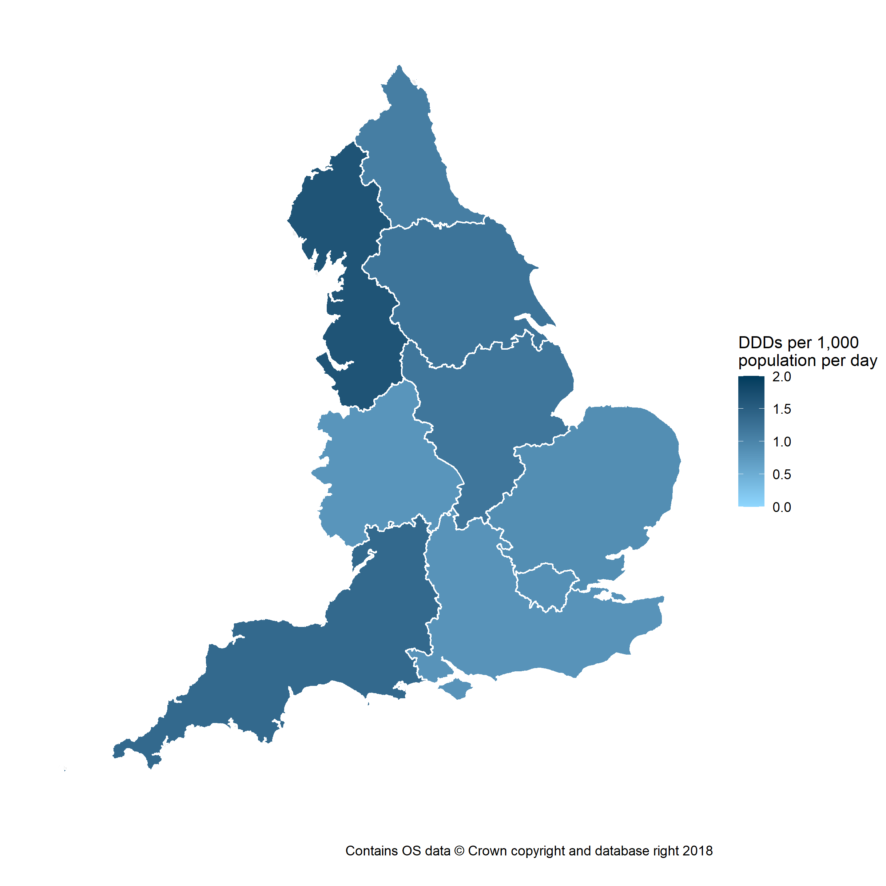
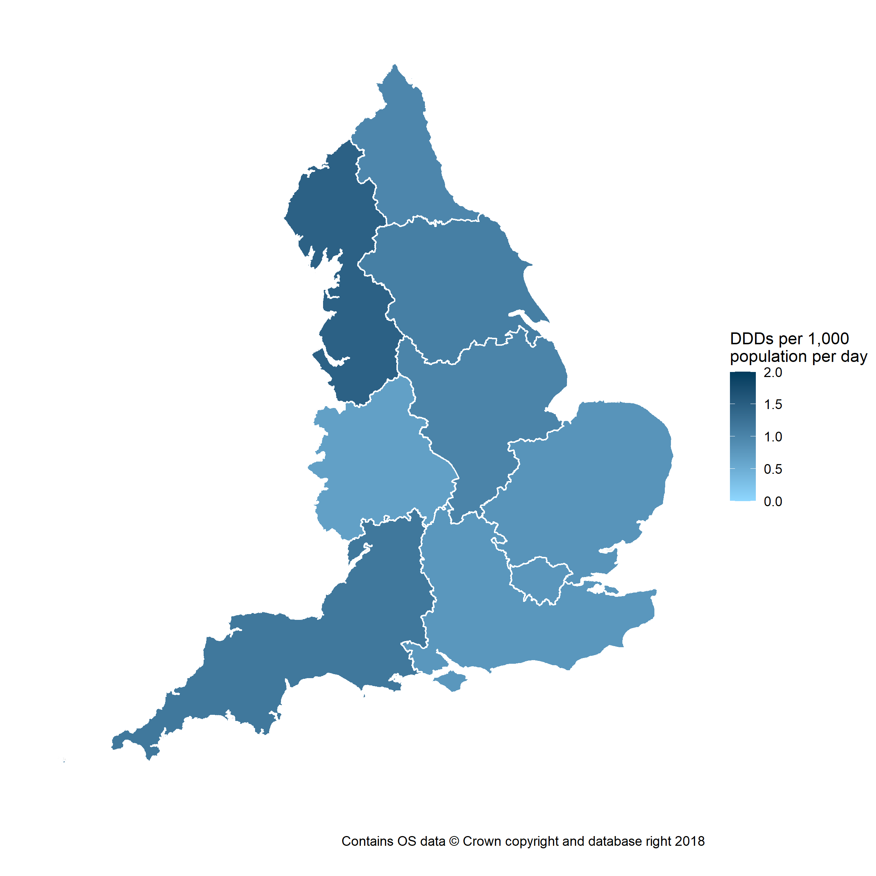
Total consumption (primary and secondary care) of systemic antifungals for UKHSA centres, expressed as DDDs per 1,000 inhabitants per day, (a) 2018, and (b) 2022
(a)
(b)

Slide 38
Total consumption of systemic antifungals in the community in England, expressed as DDDs per 1,000 population per day, 2018 to 2022

Slide 39
Total consumption of systemic antifungals by drug in the community in England, expressed as DDDs per 1,000 population per day, 2018 to 2022

Slide 40
Total consumption of systemic antifungals in NHS Acute hospital trusts in England, expressed as DDDs per 1,000 admissions, 2018 to 2022

Slide 41
Total consumption of antifungals by drug in NHS acute hospital trusts, 2018 to 2022

Slide 42
Antifungal consumption in NHS acute hospital trusts top 20 specialities, 2022

Slide 43
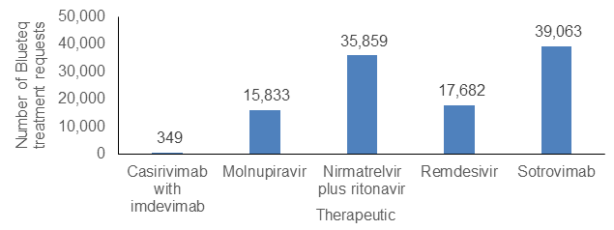
Antiviral consumption: total number of Blueteq treatment requests in England in 2022, by therapeutic

Slide 44
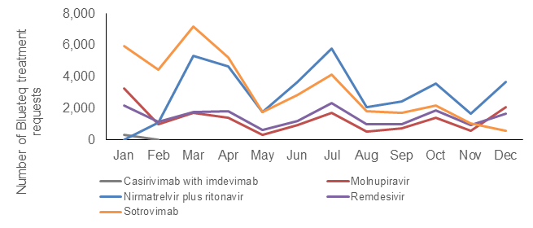
Antiviral consumption: number of Blueteq treatment requests in England by therapeutic and month from January to December 2022

Slide 45
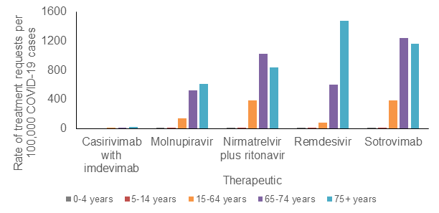
Antiviral consumption: rate of Blueteq treatment requests per 100,000 COVID-19 cases in England by therapeutic and age group in 2022

Slide 46
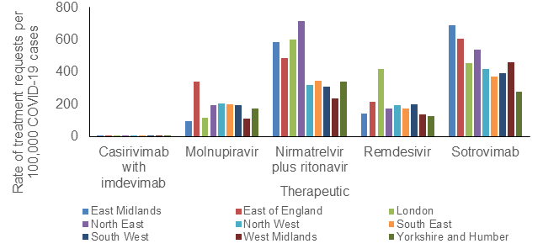
Antiviral consumption: rate of Blueteq treatment requests per 100,000 COVID-19 cases in England by therapeutic and UKHSA region in 2022

Slide 47
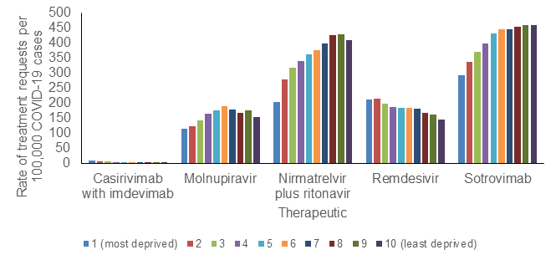
Antiviral consumption: rate of Blueteq treatment requests per 100,000 COVID-19 cases in England by therapeutic and IMD in 2022

Slide 48
Antimalarial consumption: Total antimalarial consumption in England, expressed as DDDs per 1,000 inhabitants per day, 2018 to 2022

