Slide 1
Health and Wellbeing Benefits of Swimming:
YoHPAKE Lunchtime Knowledge Session
20th Oct 2021

Slide 2
Myth: Swimming and aquatic activity are simply alternative forms of exercise to land based options.
More than 185,000 people attend adult swimming lessons in the UK.
Swim England insights, 2018
It’s estimated that almost a quarter of adult non-swimmers would like to learn how.
Swim England insights, 2018
Swimming is the number 1 participated sport for adults with a long term health condition or impairment
Swim England insights, 2019

Slide 3
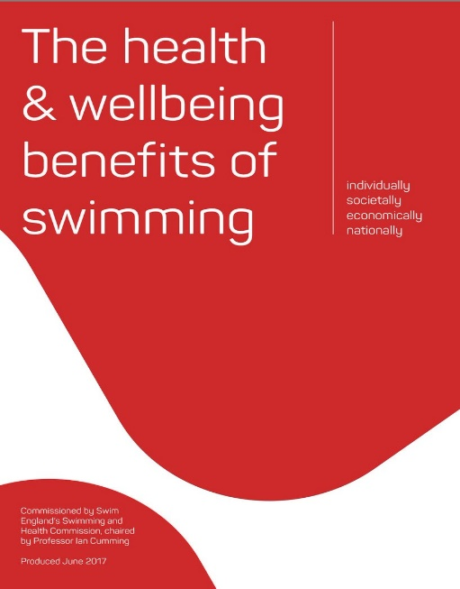
The benefits of swimming for people with long term health conditions
Water-based exercise has been demonstrated to offer several specific advantages compared to land-based exercise due to the weight-bearing benefits of buoyancy and the viscosity (friction) of water offering greater resistance and calorific expenditure compared to similar movements performed on land. Hydrostatic pressure has also been demonstrated to reduce swelling, improve circulation and modulate paid responses and the thermodynamic effects of water show that immersion alone can have health enhancing benefits.
https://www.swimming.org/swimengland/health-and-wellbeing-benefits-of-swimming/
Water-based exercise prescription should be a key consideration for all health care professionals, providers and commissioners!

Slide 4
Swimming and mortality rate
Chase et al 2008
40,547 male swimmers
Lower mortality rate than general population
…But also lower than sedentary, walkers or runners
Oja et al 2015
28% lower all cause mortality
41% CVD mortality

Slide 5
Swimming and physiological benefits
Anti-hypertensive properties
Reduction in BP in hypertensives of varying severity
Improvements in vascular function
Bartels et al (2016) Chen et al (2010)
Laurent et al (2009) Igarashi & Nogami (2018),
Igariashi & Nogami (2020) Park, Kwak & Pekas (2019)
Lipid and Glycaemic profile
Augmented atrial pressure in immersion causes hormonal/neural adjustments suppressing RAAS
?? Superiority to land based exercise
Lazar et al (2013) Delevatti et al (2015)
Igarashi & Nogami (2018a) Omar et al (2021)
Obesity?
Variable results: weight, %age body fat and fat distribution
Lazar et al (2013) Meredith-Jones et al (2011)

Slide 6
Swimming and MSK health
Barker et al 2014
Meta-analysis of 26 RCT/QRT investigating effects of aquatic exercise on mixed MSK conditions
Water = Land
Improvements in pain, function and QoL
Alkatan et al 2016
48 adults with osteoarthritis, 12 week programme
Enhanced effects on vascular function and inflammatory markers (relevant to OA pathogenesis and progression)

Slide 7
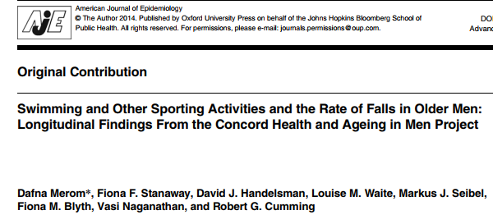
Swimming and frailty & falls
Lower postural sway
Faster narrow walk test

Slide 8
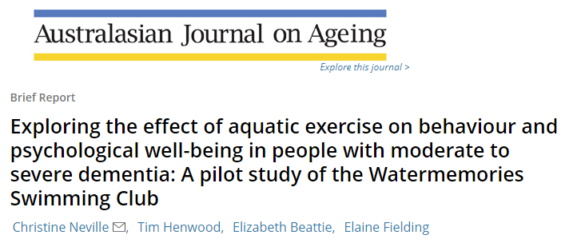
Swimming and dementia
9.9 million cases diagnosed globally each year
Neville et al (2014), Henwood et al (2015)

Slide 9
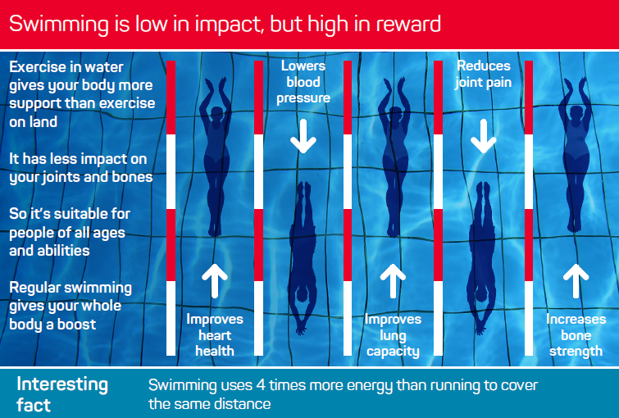

Slide 10
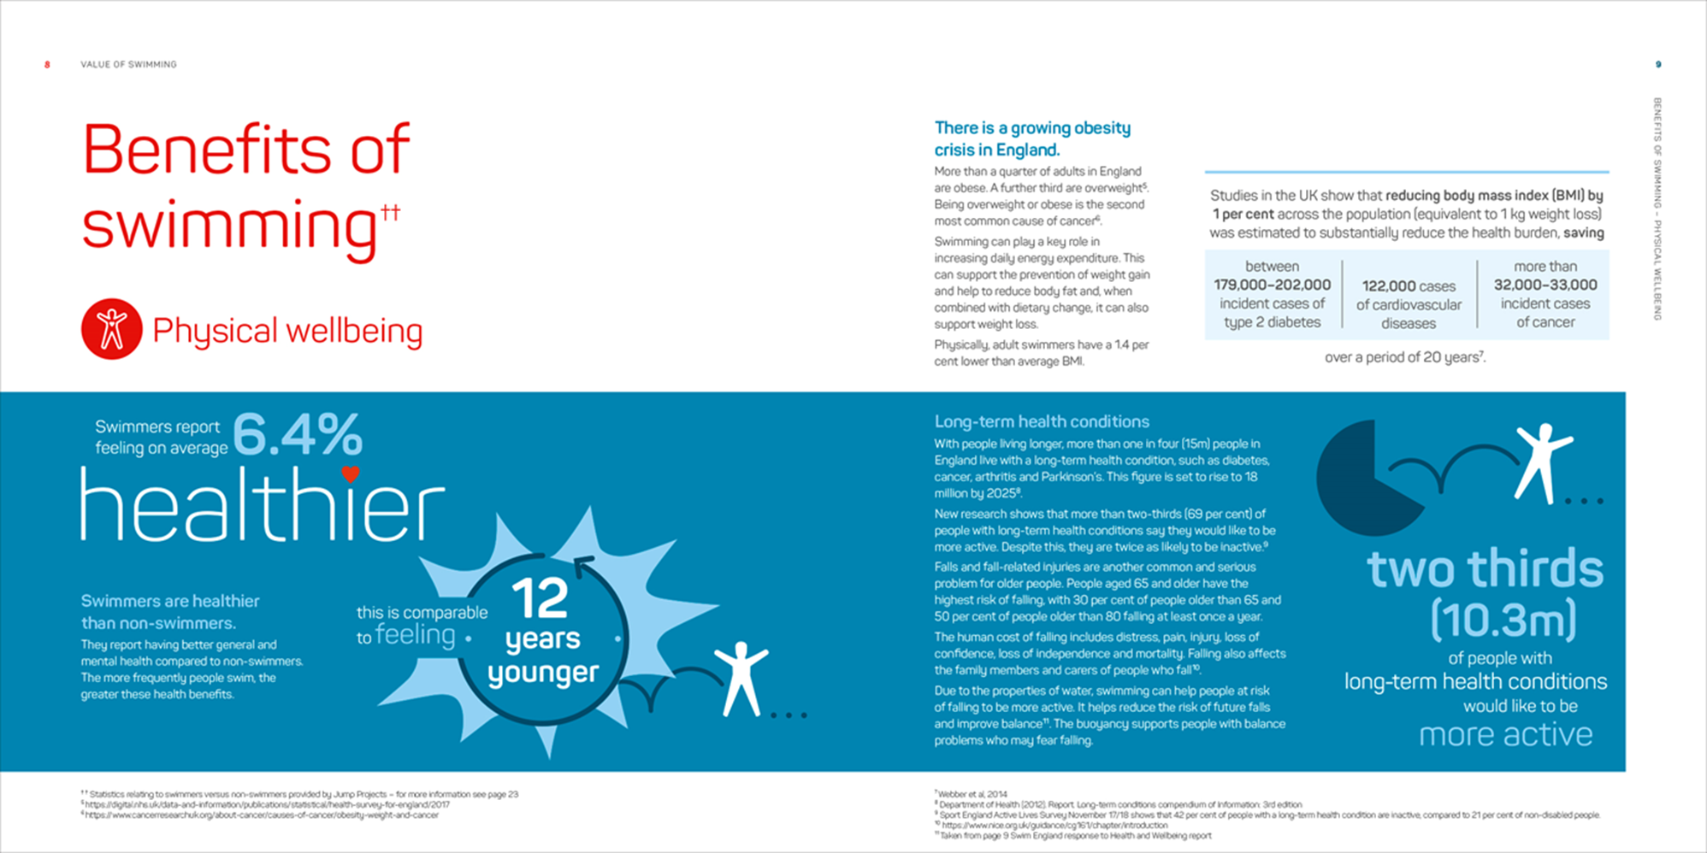
Value of Swimming (2019)
Key messages
• Swimming in England saves the health and social care system over £357 million pounds a year.
• Of this, over £139 million pounds of savings alone are made in dementia health and social care.
• Over £51 million is down to reduced GP and psychotherapy visits of adult swimmers (16+) compared to non-swimmers.
With 70 per cent of the NHS budget being spent on chronic diseases, increased swimming participation would further ease the pressures on health and social care spending.
https://www.swimming.org/swimengland/value-of-swimming/

Slide 11
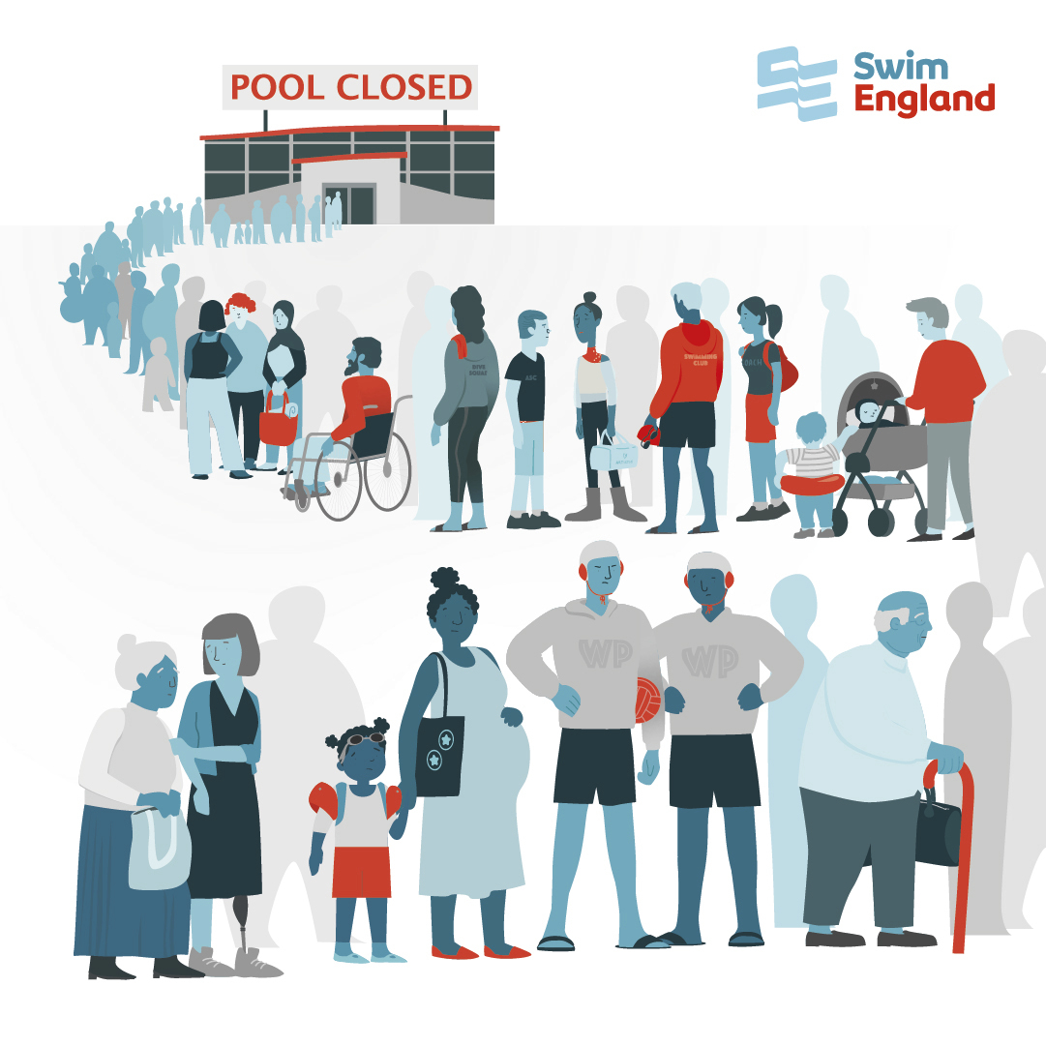
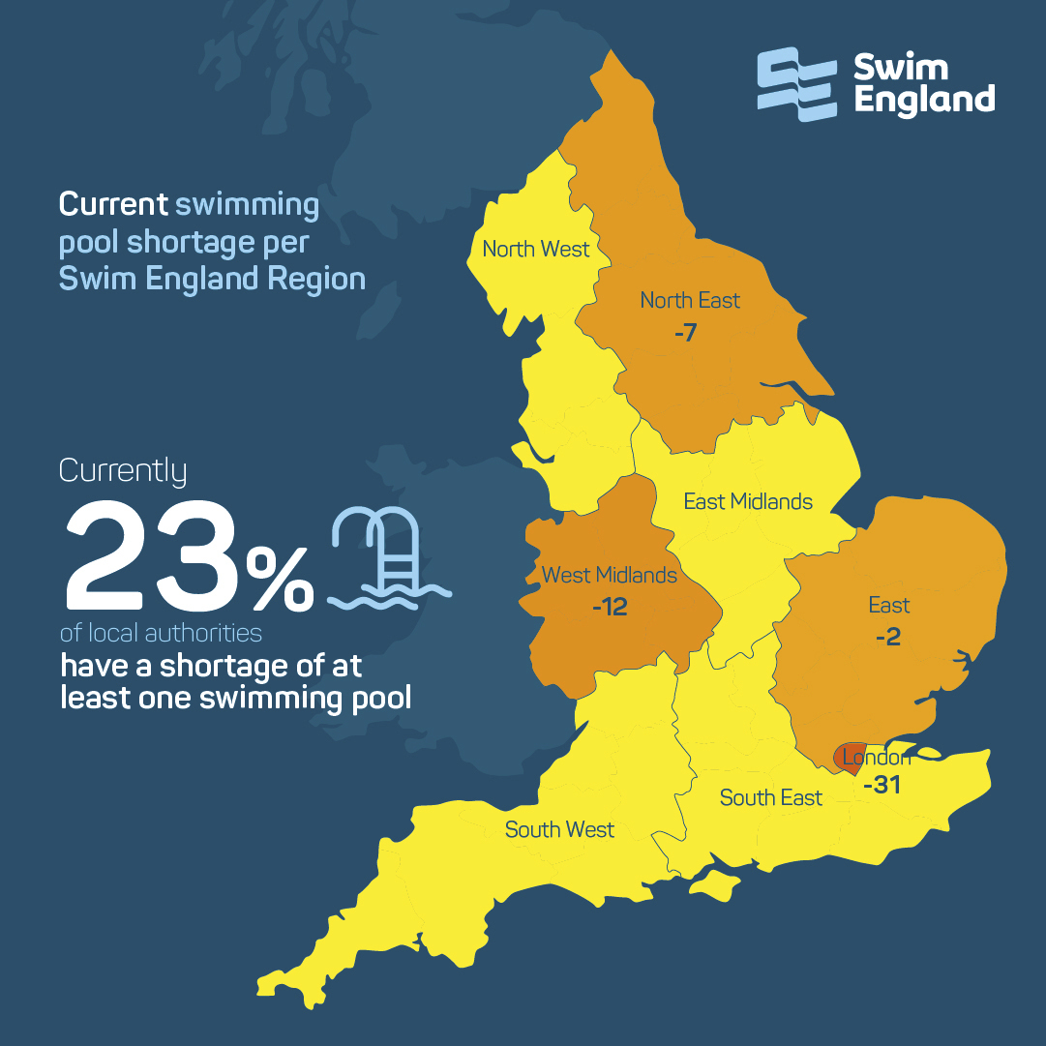
Decade of Decline Report (Sept 2021)
Key messages
Based on current pool build trends, the number of available pools could decrease by more than 40% by the end of the decade (2,000 pools)
3 million people not able to get into a pool to swim
https://www.swimming.org/swimengland/decadeofdecline/

Slide 12
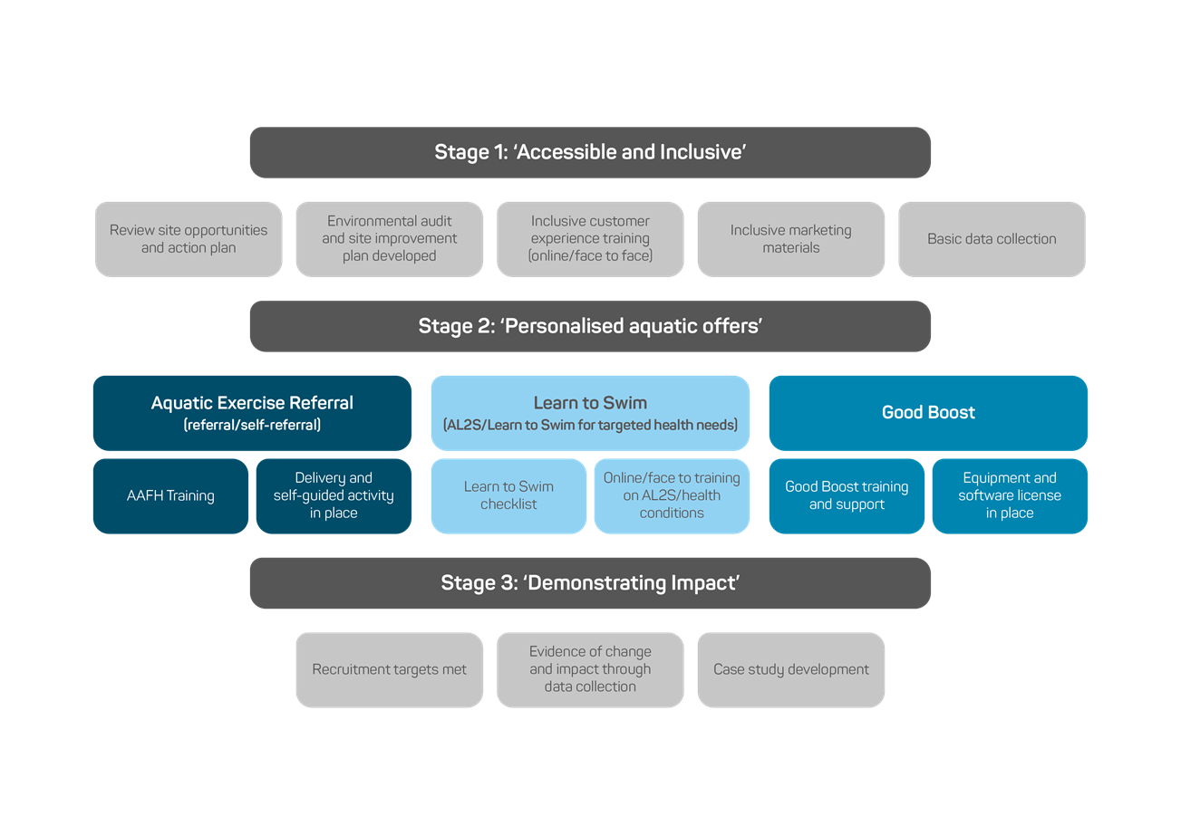
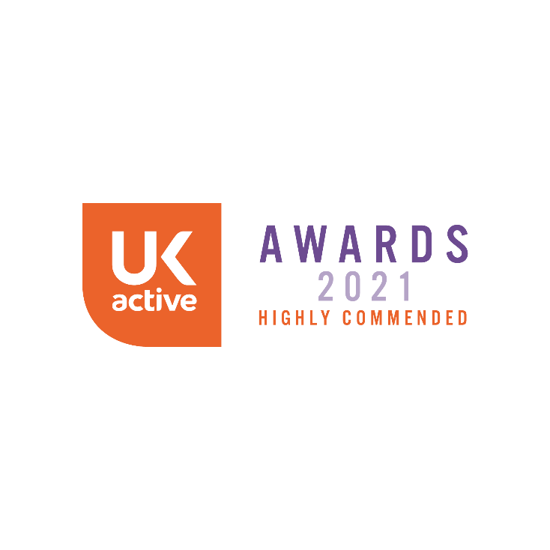
Water Wellbeing Programme (2018- )
Building on all previous learning
47 pilot sites in England + 1 each in Scotland / Wales / Northern Ireland
Accessible and welcoming
Personalised offers
Demonstrating impact and sharing good practice
https://www.swimming.org/swimengland/health-and-wellbeing/

Slide 13
Thank you!
health@swimming.org
https://www.swimming.org/swimengland/health-and-wellbeing/

