Slide 1
L&D: the GDS Academy's refreshed online course offer
Paul Schagen
GDS Academy
Wednesday 10 June 2020 at 11:00am
#6
Hi. Welcome. We will start soon.
Introduce yourself in text chat.
Name
What department
Your role

Slide 2
Paul Schagen
GDS Academy Government Digital Service @GDSacademy

Slide 4
Current offer

Slide 5
12 classroom courses
Foundation
Working level
Leadership
Notes:
We have 12 core courses - generally broken down into these three levels.
Foundation and awareness training - in core things like agile ways of working, UCD, AI in gov - for people from different professions who need to build their understanding, or want to start using traditionally ‘digital’ ways of working - most commonly working in agile.
Or a start on the journey to becoming DDaT professionals.
Practitioner / Working level - we train people in specific roles that are now part of government’s DDaT profession - e.g. UR, BA, DM.
And we do leadership training - practical training for people who are managing multidisciplinary teams working in agile, and new training for Service Owners
and we have a new course for SCS-equivalent - people who are leaders in gov but not in DDaT, and need to understand the profession, how it works and how they can lead in relation to digital.
Very popular already, helping bring government’s approach to digital public services closer together, and try to remove any remaining silos - “digital is over there…”
All courses funded by the organisations that use them, allowing us to scale.

Slide 6
Live online learning
Support for remote teams
Digital & Agile Basics

Slide 7
Notes:
Timeline of DABB - what it covers - starts with Service Standards - why they are so important, why it’s not just ‘digital’ and why it runs through everything. The other modules hang off those service standards.
The Service Standard
Agile delivery phases
Multi-disciplinary teams and the DDaT framework
Understanding user needs
Digital Accessibility
Introduction to Agile
Agile/ Scrum/ Kanban
User stories and Backlog refinement
Identity in government: an introduction (webinar)
Metrics and Measurement

Slide 8
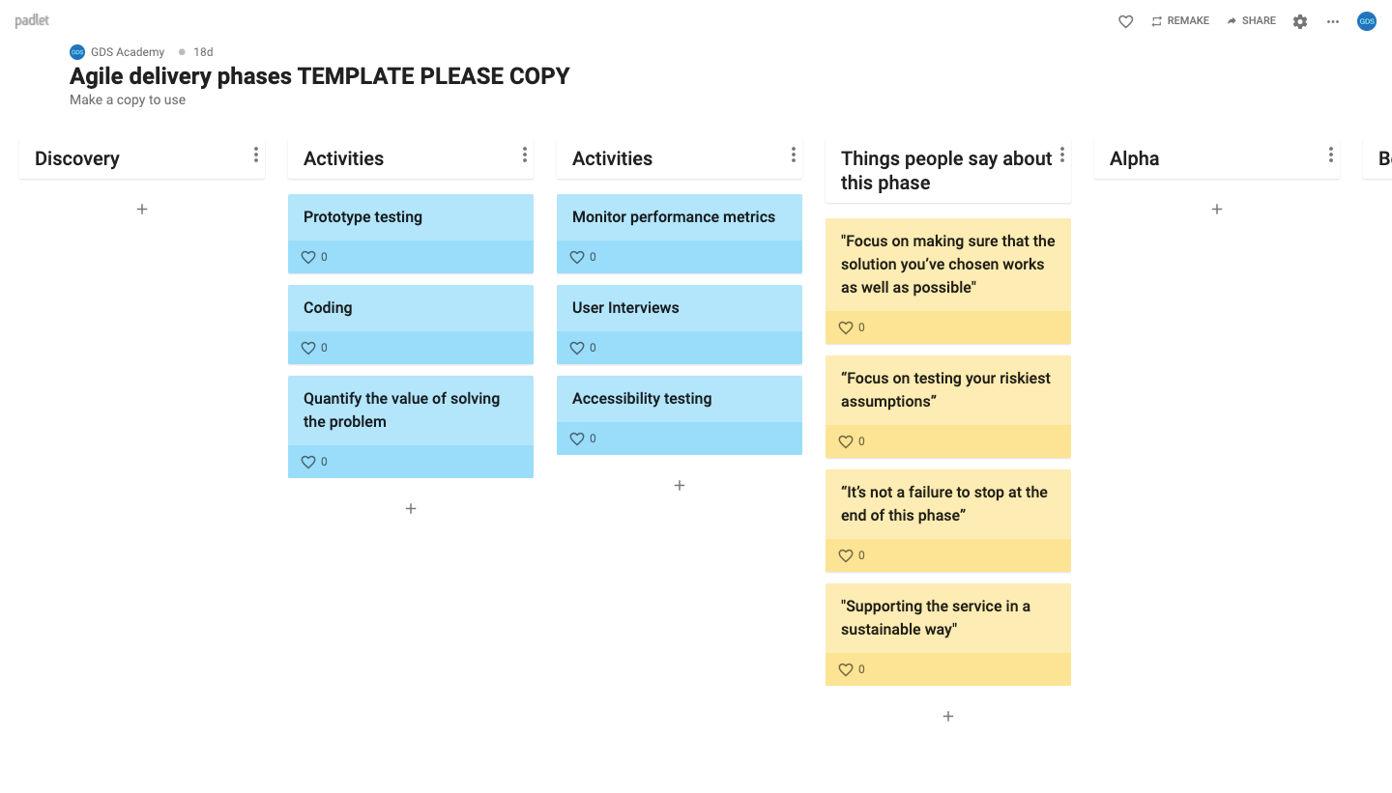
Notes:
Key thing is to make the learning impactful - interactive - elements of gamification. Starts the conversation and ensures people are engaged throughout.
Example padlet exercise, group uses ‘likes’ to vote on matching activities and ‘things people say’ to each of the phases.

Slide 9
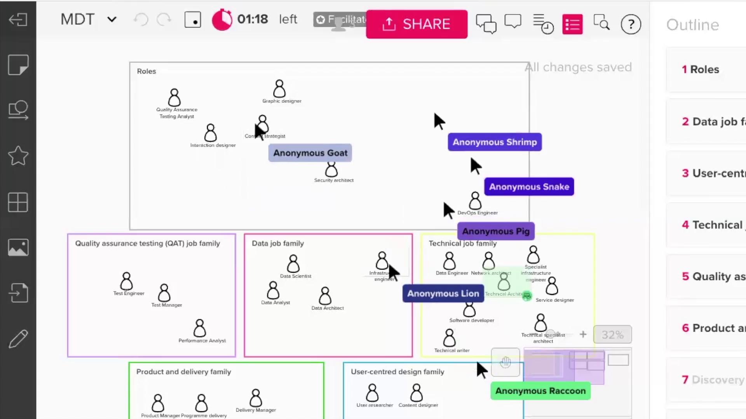
Notes:
DDaT capability framework. Matching roles to job families in a speed game.
Feedback and evaluation shows that the interactivity is what people enjoy most - what sets this apart from online training people are used to.
But - challenge is scalability. So while this approach works for some learning needs - others can be done in a more traditional e-learning style - we run one session on identity as a webinar.

Slide 10
Notes:
These courses are just finshing their second private beta test - will be live on the Academy’s Gov.uk site soon for individuals to book on one, some or all.
If you have new people who would benefit, please get in touch - we can arrange closed events at times that work for you.

Slide 11
What’s coming...

Slide 12
Leadership - SCS level
DDaT practitioners - how do we support?
GDS
Notes:
Blended courses for senior leaders.
For DDaT - know there is a need for more ‘point of need’ learning - and more at practitioner level.
How do we have the most meaningful impact to support the function at this critical time?

Slide 13
What do you need?
How do you want to access it?
Now?
Going forward?
GDS
Notes:
Think about - roles you need training for
Skills you need - in DDaT but also wider
Levels
Method - is online best? Self-paced? Etc.

Slide 14
Visit us:
www.gov.uk/gdsacademy
Contact us:
gds.academy@digital.cabinet-office.gov.uk
Follow us on twitter:
@GDSacademy
Notes:
Any questions?

Slide 15
Thanks!
Paul Schagen
@PaulistaSchagen
Notes:
Thanks!

Slide 16
Highlights from the April 2020 workforce commission
Sarah Benariba
Workforce insights and analysis
Wednesday 24 June 2020 at 11:00am
#7

