Slide 1
DDaT Workforce
Highlights
April 2020
Sarah Benariba
DDaT Workforce Insights Lead
#7
Hi, welcome. We will start soon.
Please introduce yourself in text chat.
Name
Department
Your role

Slide 2
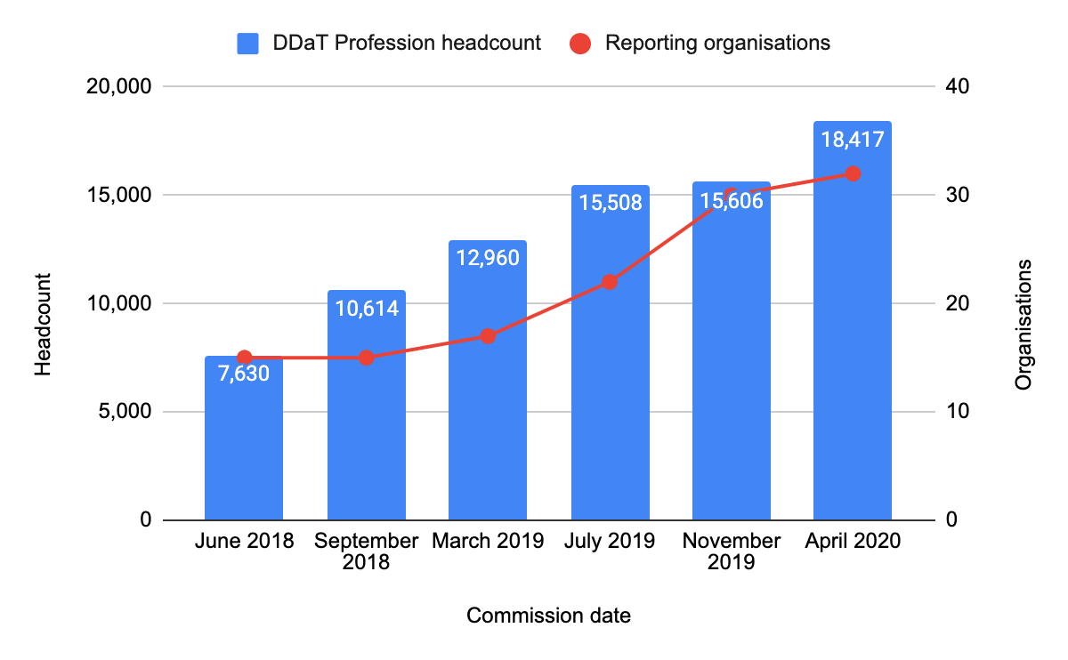
DDaT Profession reported headcount
Notes:
The increase in reported DDaT Profession headcount is due to an increase in organisations contributing to the commission over time and better data quality.
THANK YOU!

Slide 3
HMRC
HOME OFFICE
CABINET
OFFICE
18,417
DDaT Professionals
SCOTTISH GOVERNMENT
BEIS
DCMS
MOJ
DFE
DEFRA
ONS
MOD
DFID
DIT
MHCLG
DFT
HM LAND REGISTRY
DWP
DWP
Notes:
We’re now a profession of about 18,417 people across gov
Wherever possible our role to is find common solutions to common problems across the Profession and help join-up between the different departments...
...to help attract, develop and retain the right people and skills to transform public services. Our overall aim is to position government as a destination of choice for digital, data and technology professionals.
To do that, we run cross government early talent and apprenticeship programmes.
And we support the development of DDaT communities of practice, which bring together practitioners from across government to promote innovation and share best practice across organisational boundaries.

Slide 4
DDaT critical roles:
COVID-19

Slide 5
‘Critical’ = roles which are working on the delivery of COVID-19 services and critical to the delivery of national infrastructure
DDaT Profession
Notes:
Due to the impact of COVID-19 on organisations across government, at a time when personnel are working remotely, the data in this deck has been collected by workforce planners and capability leads as best as they can.
A number of organisations may have categorised all their DDaT roles or Business as Usual (BAU) critical roles as being critical from the above definition.
This data excludes organisations who did not report critical roles or supply data against the ‘COVID-19’ data field: MOD, HO, DCMS, DHSC, HMT, HMLR, FCO, Scottish Government, Companies House and CMA.

Slide 6
77 new services have been created across government in response to COVID-19
Notes:
with digital being at the heart of the response.

Slide 7
% of DDaT Profession in Critical roles
Critical roles: COVID-19 high level statistics
17.6% of the DDaT Profession is reported as being in critical roles, helping to deliver COVID-19 related services across government.
34% of critical roles are in the Technical job family.
Software Developer is the highest-filled critical (as well as non-critical) role in the DDaT Profession.
*Blank = unreported
DDaT Profession
DDaT Profession
Notes:
SD - This aligns with historical workforce data around demand.

Slide 8
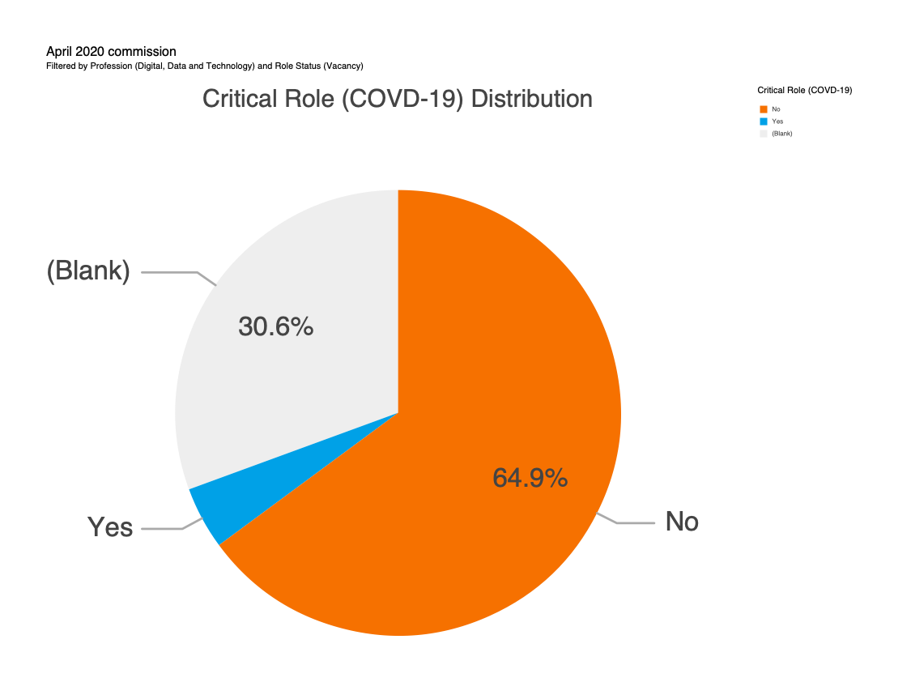
Critical vacancies: COVID-19
Of reported vacancies, 5% of DDaT roles were reported as ‘critical’:
Infrastructure Engineer
Software Developer
IT Service Manager
Technical Architect
Business Analyst
Content Designer
All DDaT Vacancies
*Blank = unreported
DDaT Profession
Notes:
It can be understood that number of critical vacancies are a direct result of COVID-19 and will need to be urgently filled.

Slide 9
Top 10 Critical roles: COVID-19
Job Family | Critical Role %
Technical | 34%
IT Operations | 31%
Product and Delivery | 16%
User Centred Design | 9%
QAT | 6%
Data | 4%
*Including filled and vacant positions
DDaT Profession
Notes:
Moe - COVID-19 other sources of data: SD consistent top role across these

Slide 10
How does the DDaT Profession compare to other industries?

Slide 11
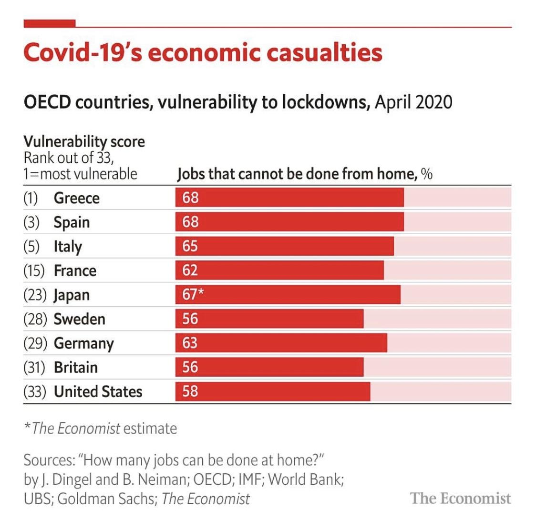
An external look at remote working
Approximately 44% of jobs in the UK can be carried out at home or remotely.
88% of DDaT Profession roles are currently reported as working remotely - this is double the national statistic.
DDaT falls into one of the top 5 global industries proven to be able to work remotely.
DDaT Profession
Notes:
Therefore there is potential for DDaT to move into working remotely on a more frequent basis.

Slide 12
Any questions?

Slide 13
A view from the top

Slide 14
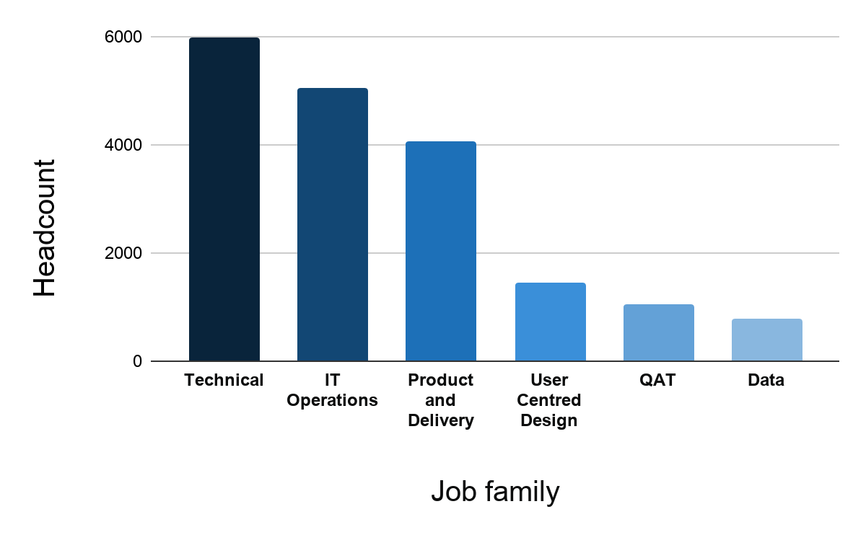
DDaT Profession Job Family breakdown
DDaT Profession

Slide 15
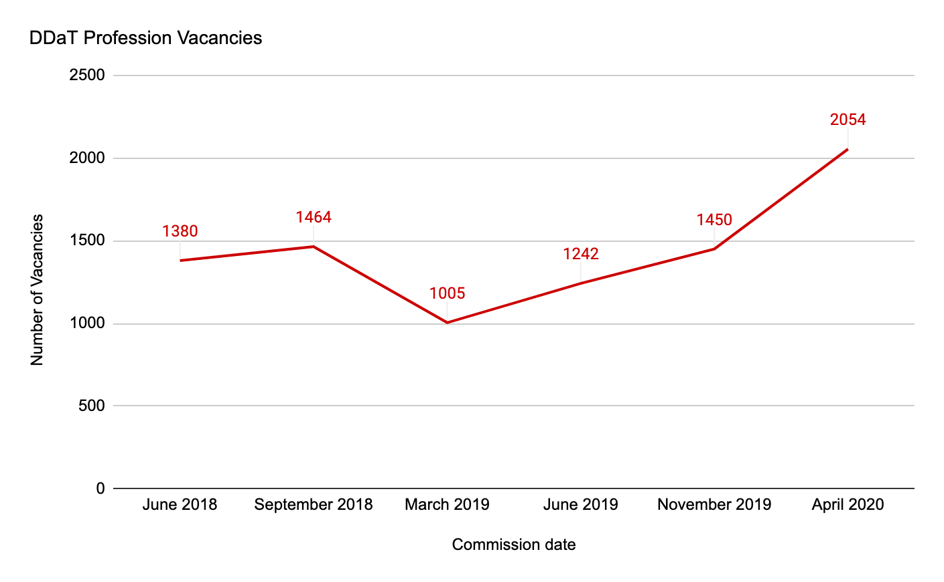
DDaT Profession vacancy trend
DDaT Profession
Notes:
There has been an overall increase in the number of reported DDaT vacancies over time, as we collect more data from organisations.
Despite the lowest number of vacancies reported in March 2019, there has been a steady increase and a significant spike in April 2020 - possibly due to business planning across organisations.

Slide 16
Top 10 in demand roles (vacancy numbers)
DDaT Profession
Notes:
We continue to monitor vacancies to identify which roles are in demand, as well as how this demand can be met across government.
GDS offer cross-government recruitment and Expert Services to departments who struggle to recruit for specialist DDaT roles.
Support is dependent on departmental needs and roles in demand. For additional information on meeting demand, please refer to the November 2019 Highlights Deck.

Slide 17
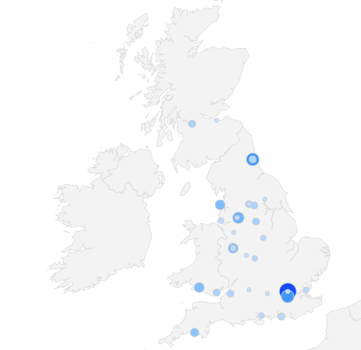
Location
Although 19% of DDaT Professionals are based in London, the DDaT footprint is widespread across all regions, making up 66% of the total workforce.
Updated location guidance is available to support organisations with their location strategy.
Notes:
We continue to track location across the DDaT Profession to identify existing hubs across the UK, as well as potential locations for future hubs.

Slide 18
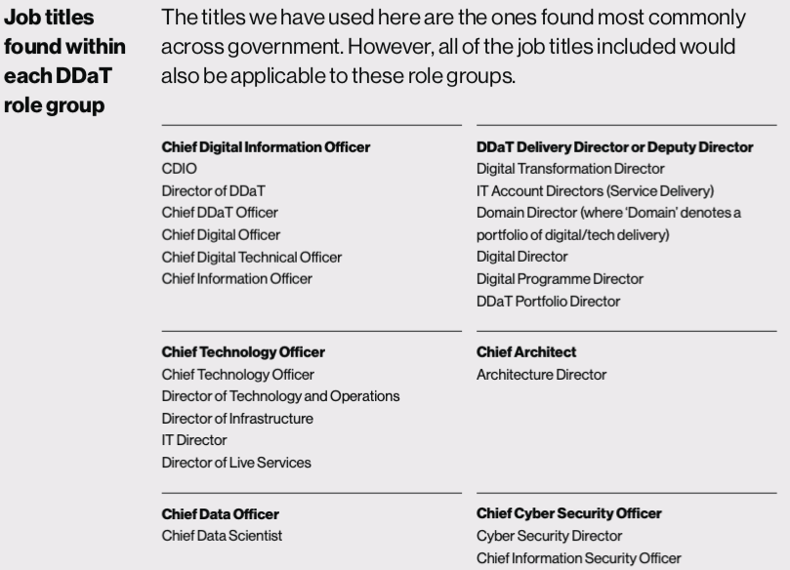
SCS Framework guidance example:
For more information,
Please contact Adam Sales
Notes:
The framework is being piloted with a small number of organisations.SCS Pay is currently in development and is expected to be finalised later in the year.

Slide 19
You asked. We listened.
Notes:
E.g. UR

Slide 20
Key priorities for the next commission include:
DDaT Function data: A focus on broader enabling roles as well as the Profession.
Improved SCS data: We will ask planners to map SCS roles to inform our SCS capability-based pay model.
Improved diversity data: In order to further understand this space, we need better data.
Focus on data - Security & Data: We will collect aim to collect data on security and data roles in response to streamlining workforce data requests.
Notes:
Our understanding of the DDaT Function is still developing. We intend to focus future commissions on getting a better view of DDaT roles across the Function.

Slide 21
Our service offer
Support with data commissions (recharge model)
Pay modelling
Location insights
Bespoke analysis
Notes:
We’re offering support with commissions (recharge), happy to answer Qs/have calls around this. Currently in talks with analysis function, security etc. / Location insights (future re-charge model) / bespoke analysis/ pay modelling (future re-charge model)

Slide 22
Upcoming data return dates
31st March 2019
24th April 2020
29th November 2019
30th October 2020
DDaT Profession

Slide 23
Thank you
any questions?

