Slide 1
Indicative grades - v2 analysis
Delwar Ali & Sarah Benariba
Workforce insights and analysis
Wednesday 13 May 2020 at 11:00am
#4
Notes:
Hi. Welcome. We will start soon.
Introduce yourself in text chat.
Name
What department
Your role

Slide 2
Introductions

Slide 3
Delwar Ali - Senior Business Analyst for the Digital, Data and Technology Profession in GDS. I head up the Workforce insights and analysis team.
Sarah Benariba - Insights and Analysis Lead for the Digital, Data and Technology Profession in GDS.
Notes:
Describe Sarah’s role in this work

Slide 4
Purpose
Focussed on guidance and not the actual grades we have on the product
For individual organisational grading concerns, please discuss these with internal HR teams

Slide 5
What is it

Slide 6
The Indicative grades product shows how roles in the DDaT Profession tend to be graded in accordance to the civil service grades
DDaT Profession
Notes:
A massive thank you to everyone as we would not be able to produce without the support of the organisations who share the data through our workforce commission.

Slide 7
Background

Slide 8
User need
A need for something to show how roles are graded across government
Departments looking for a coherent approach
Ensure that it is simple to understand
DDaT Profession
Notes:
There was nothing previously available that could portray this type of information for the profession. This would help organisations get a better understanding of how their grading structure compares against others.
V1 was released prior to the Pay Approach guidance. Another source of guidance to support organisations.
We wanted to make sure that the visualisation was simple to understand and have a specific purpose instead of trying to do too many things.

Slide 9
Process

Slide 10
How we do it
Use the DDaT profession workforce data that we hold
Analyse the data to see which grades majority of the role levels fall into
Role levels spanned across two grade levels max (in order to keep consistency)
Size and scale of organisation taken into account
Notes:
Workforce data - collected via the commission. Plug the completeness of the data set- i.e thanks to you/ur department we able to do this sort of work and its really important you keep giving this data to us and reinforce the achievement relative to other professions that we have this data
A lot of roles do span more than the two grades. This could be due to data quality or because of size and scale of the organisation.
Example of a grade where it spans across more than one grade. CDIO can span across from the delegated space to SCS4 or a Senior Developer in GDS for example is Grade 7 and in ONS it is SEO.
We will continue to work with CSEP to ensure consistency as we appreciate some organisations may have some concerns.

Slide 11
Product

Slide 12
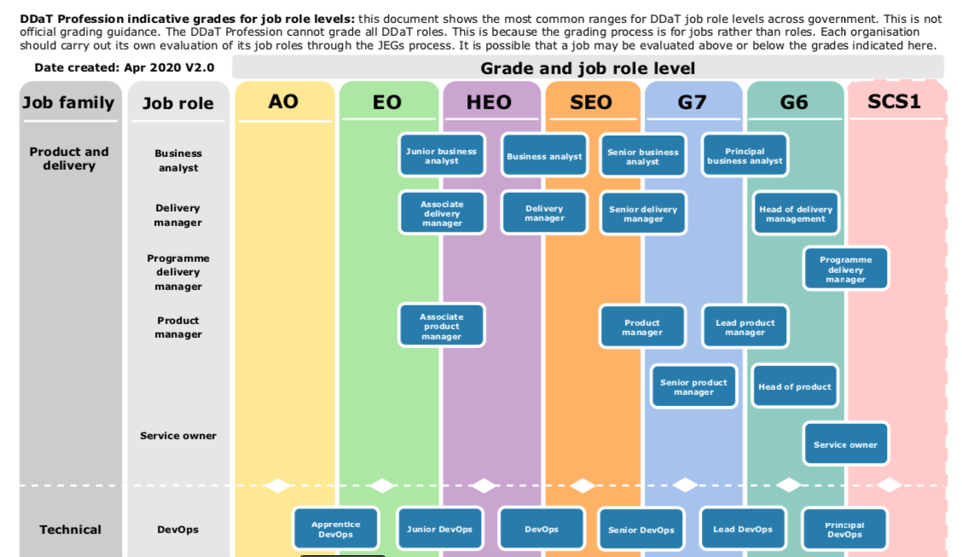
DDaT Profession

Slide 13
How it should be used

Slide 14
REMINDER
The DDaT Profession indicative grades are the most common ranges for DDaT job role levels across government
This is not official grading guidance
Grading is for jobs and not roles
Each organisation should carry out its own evaluation of its job roles through the job evaluation process
It is possible that a job may be evaluated above or below the indicative grades
Notes:
Job evaluation - normally done using the JEGs methodology

Slide 15
As with the other products that the DDaT Profession team owns (e.g. The DDaT Pay Approach) this indicative grades product is solely used as guidance to departments
It does not represent a central view of what grades should/shouldn't be granted for roles, nor does it require any department to change their grading to fit the norm.
Job grading remains in the delegated authority of departments

Slide 16
Example case use
I'm a department looking to do high level workforce planning on a DDaT expansions
or
You are looking to do a litmus test that sparks a wider regrading exercise
Notes:
These are just example of how this can be used
Litmus test - an organisation may seem that they have a lot of roles that are very different from the indicative grades and may want to assess their own roles
Pay approach - answers some of the questions around grade inflation and issues around pay. Alignment to the Pay Approach is a mechanism of solution to this problem. Jack on call and we can set up a call with Pay Leads for more info.

Slide 17
V2 updates

Slide 18
Workforce data
DDaT Profession headcount - June 18 dataset: 7,851
DDaT Profession headcount - November 19 dataset: 15,606 (98% increase in data)
Notes:
A big increase in the size of the data but also a massive improvement to the quality of data as organisations have become much better in completing our template

Slide 19
Summary
10 roles have been adjusted as a result of a clear majority in the data
No changes for User Centred Design
The changes are based on an increased quality dataset (better accuracy)
A range of departments at different sizes were considered for the changes - 1 department with a majority not necessarily prioritised over multiple departments
Notes:
10 roles - changes in the role levels within the role and not necessary the entire role
UCD - no changes as the data was consistent
Better quality as mentioned previously
Size and scale of departments were taken in to account as mentioned previously. We collect data from more organisations now (25+)

Slide 20
Roles where there have been some changes are:
Product manager, Technical architect, Data architect, Test engineer, QAT analyst, Incident manager, Change and release manager, Command and control centre manager and Service transition manager.
We have also included Data analyst to the chart as this is the latest role added to the Capability Framework.

Slide 21
QAT analyst
Version 1 - 2018 | Tester | QAT analyst | Senior QAT A | Lead QAT A
 | EO | HEO-SEO | SEO-G7 | G7-G6
Version 2 - 2020 | Tester | QAT analyst | Senior QAT A | Lead QAT A
 | AO-EO | EO-HEO | SEO-G7 | G7-G6
Notes:
One of the changes made in v2

Slide 22
Breakout

Slide 23
An opportunity to discuss in groups of how you find the Indicative grades and maybe have some common themed questions you wish to ask
Notes:
5mins
Groups of 4?

Slide 24
Resource

Slide 25
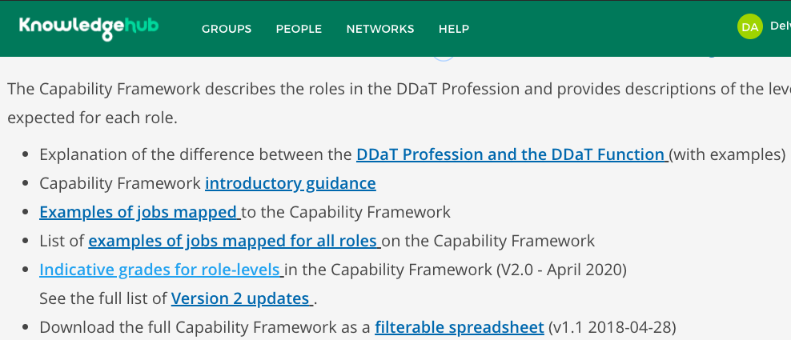
DDat Profession
Notes:
The indicative grade is available on KHub to download along with a slide deck highlighting the changes made

Slide 26
Who should use it
The product will only be accessible for Capability Leads, Pay and Reward Leads, HR (business partners, workforce planners and recruiters)
DDat Profession

Slide 27
Questions
Notes:
5-10mins

Slide 28
Other service offers

Slide 29
Service offers
Bespoke analysis using the workforce data
Grading analysis
Location analysis
Pay modelling analysis for Pay Approach affordability
Includes analysis for Pay Framework business case
For any support that you require from the DDaT Profession team please contact us on ddatprofession@digital.cabinet-office.gov.uk
DDat Profession
Notes:
All analysis are free of charge at the moment but is currently being reviewed by GDS in to an Expert Services model
Pay guidance information is not on KHub - only available on request via Pay leads

Slide 30
Trade union
Jack Hunnaball
Capability Lead - Pay
Wednesday 27 May 2020 at 11:00am
#5
Notes:
This slide format is for headings or section breaks

Slide 31
Thank you
Delwar Ali - Senior Business Analyst
Sarah Benariba - Insights and Analysis Lead
workforce-insights-and-analytics@digital.cabinet-office.gov.uk

