Slide 1
DDaT Capability Framework Team: Change request process

Slide 2
Governance Process
Notes:
Due to release a standard commission but due to special circumstances, we had to gear it towards COVID-10

Slide 3
Governance
User story
As a user or stakeholder of the Capability Framework I need to know how I make a request for change, how the change request is assessed and how long it takes for a change request to be actioned.
Notes:
Wednesday

Slide 4
The change request process
Request
Triage
Implementation
Completion
Notification
A Five Step Process

Slide 5
Step 2: Triage
Head of Community working with DDaT Capability Framework Team triage the request according to a set of criteria. Evidence is submitted using the change request form and supplemented by the DDaT Capability Framework Team.
Criteria: evidence provided by requestor
Is this a specialist skill role needed for build, design or delivery of digital products Services?
What is the main reason/ motivation behind the request?
If new role: how does this role link to an existing or potential career pathway?
If this isn’t a specialist role -how is it critical to functional delivery?
Do we have enough detail to begin implementation process (e.g. content of change request).
Criteria: evidence provided by DDaT Capability Framework Team
Is there a clear cross government need?
What patterns/ trends are we seeing in the wider market relating to this request?

Slide 6
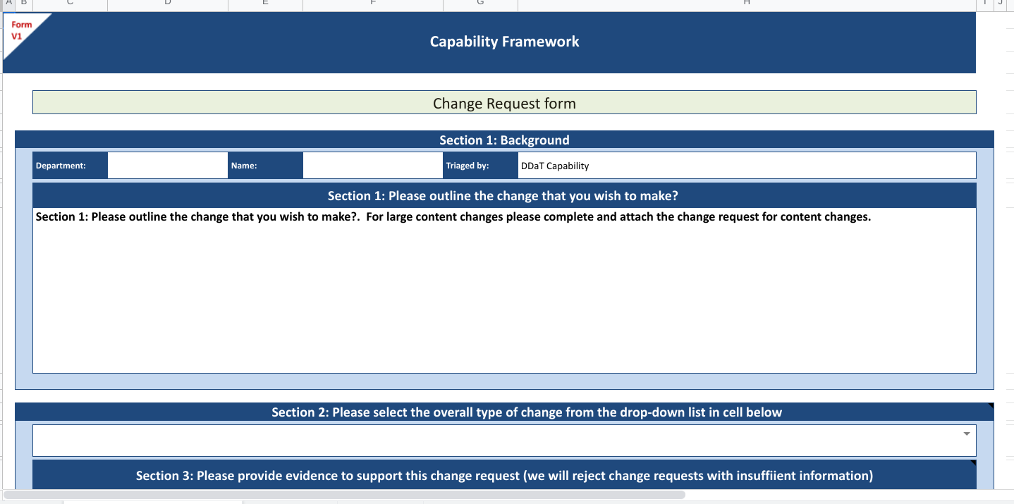
Change Request Form
All forms to be sent to ddatprofession@digital.cabinet-office.gov.uk
Link here for Change request form.
Link here for Content change request form.

Slide 7
Implementation: major changes
Triaged with HOC- sponsor change progressing to implementation
Community Review Board: review, amend and develop content
Final Content Review
Pay alignment
Cross profession alignment
Head of Community & Head of DDaT Cap Team sign off
Where needed FLG/DTLN awareness
Completion
Minor changes go for content development, alignment where needed and final sign off

Slide 8
Governance Process: Timeline for Change Requests
Requests submitted by end of month | Requests sized, backlog management | Triage to Completion (4-6 weeks) | GOV.UK publication & Assets
February | March | April | May
May | June | July | August
August | September | October | November
November | December | January | February
Who’s involved? | Capability Framework Team | HOC, Content & Community Members | Content
Notes:
Isabella

Slide 9
Our ask of you as a change requestor
CHANGE REQUESTS FOR CAPABILITY FRAMEWORK | DEADLINES FOR CHANGE REQUESTS
Complete Change request form Detailed information on the nature of the request Involvement with Communities of Practice in reviewing content changes. | End of February End of May End of August End of November

Slide 10
Annex

Slide 11
Governance Process: Roles and Responsibilities
DDaT Capability Framework Team : manage end to end change request process. Triage request with Head of Community. POC with requestor, Community Manager, GOV.UK and network.
Community Manager: organises and facilitates Community Review Boards (including outputs) and coordinates triage meetings.
Heads of Community: triage change requests, act as sponsor for change progressing to implementation phase. Final sign off on major changes.
Community Review Boards (made up be relevant members of the community for the change/job family along with content). Develop content of change requests, identify issues, user considerations.
Head of DDaT Capability Team: acts as joint final sign off on major changes
Content: ensure adoption of UCD principles, support development of change requests through community review boards, final content sign off and publish to GOV.UK.
Pay Lead: ensure alignment of pay to relevant pay grouping. Engage departments on pay.
Notes:
James

