Slide 1
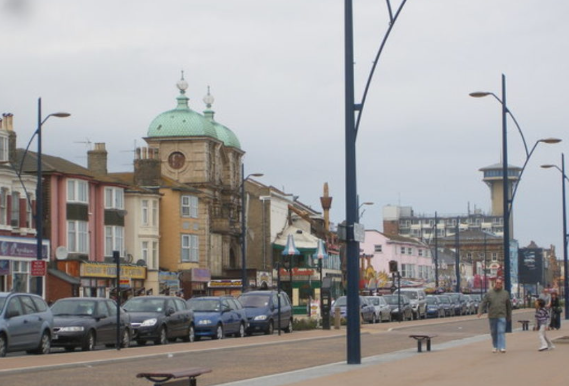
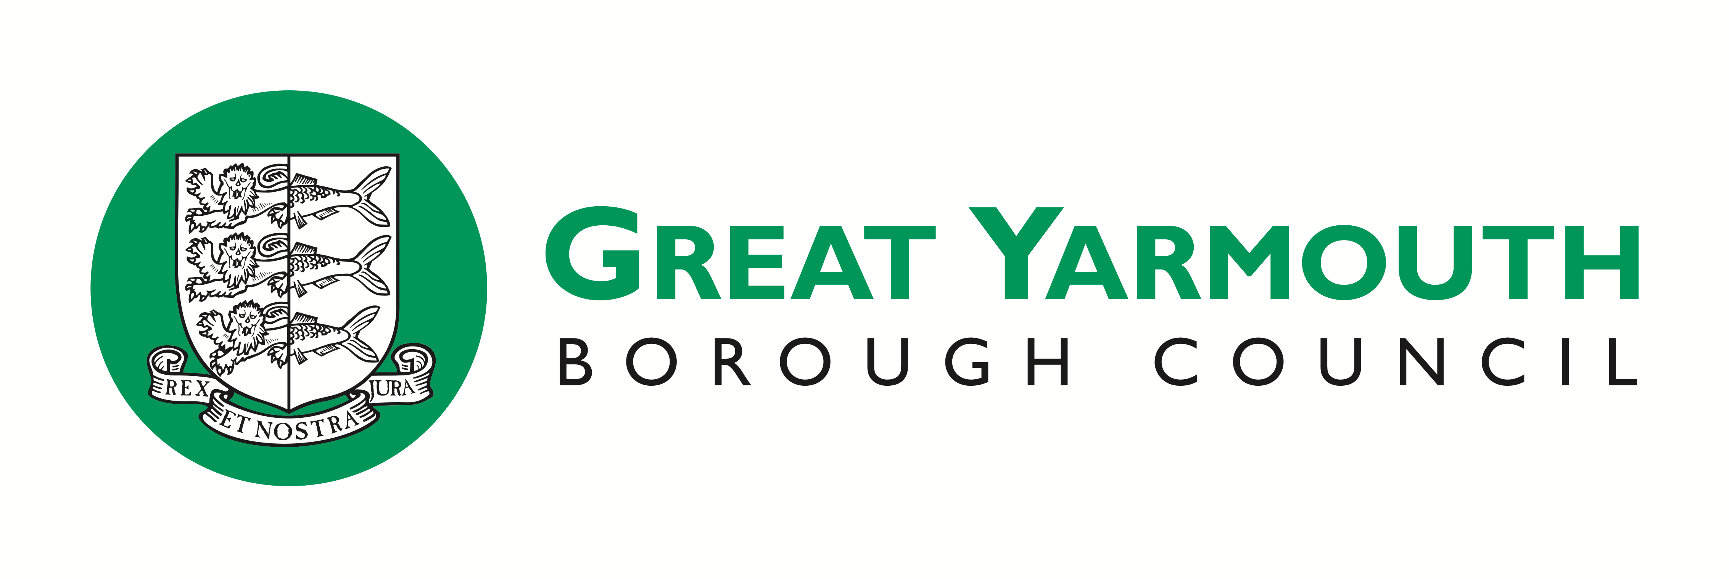

Community
District, Unitary
Public Health
Neighbourhoods that work
Role of the Authority
Managing Expenditure
The Neighbourhoods that Work Project (NTW) is a nationally-pioneering joined-up approach to strengthening and enhancing communities in the Great Yarmouth borough. This innovative way of working helps communities
to develop their own ideas for improving lives, helps existing services to work better together to support vulnerable people, and helps people into training, volunteering and work. Funded with a £3m grant from the Big Lottery Fund,
NTW is a manifestation of Great Yarmouth’s place-based approach to building stronger, better connected and more resilient communities, to improving the efficiency and responsiveness of support services, and to making the economy work for everyone.
592 new connections, 739 new friendships, support to 40 community-led self-help groups;
183 people reported improved wellbeing from having support to address personal challenges;
302 long-term unemployed people reported improvement in employability skills;
65 long-term unemployed people overcame issues preventing them from holding down a job, with 40 people entering into employment and sustaining it for the first time.
https://mycommunity.org.uk/case_study/our-place-great-yarmouth-the-neighbourhoods-that-work-approach/
http://apse.org.uk/apse/assets/File/Respectful%20Funeral%20Power%20Point-%20Updated%2027th%20September%202018.pdf
https://www.east-ayrshire.gov.uk/news/article/east-ayrshire-council-launch-respectful-funeral-service
https://www.east-ayrshire.gov.uk/news/article/respectful-funeral-service-one-year-on
iESE Innovation Mandate

