Slide 1
Consensus statement on healthy ageing
Thank you for joining the webinar
The session will start at 15:00

Slide 2
Housekeeping Rules
Please keep your skype and phones on MUTE
• Please note that this session will be recorded
• This is an interactive session and questions can be asked via the skype messaging system.
• Please note that everyone can see your questions
• We will aim to answer your questions after the presentations.
• We will post the Q&A, the presentation and recording on the K-hub after the webinar

Slide 3
Outline
Welcome, overview of webinar and introduction to the PHE/Centre for Ageing Better partnership
Prof Yvonne Doyle, Medical Director & Director for Health Protection, PHE
Introduction to the consensus statement on healthy ageing, Dame Carol Black, chair, Centre for Ageing Better
The importance of the consensus statement to system partners, Prof Martin Vernon, NHSE clinical lead for older people, Mandy Murphy, director, Council for Work and Health
The consensus statement commitments and next steps, Dr Alison Giles, associate director, PHE and Centre for Ageing Better
Panel Q and A – Audience
Webinar closing remarks, Dame Carol Black

Slide 4
Professor Yvonne Doyle Medical Director & Director for Health Protection Public Health England

Slide 5
Dame Carol Black Chair, Centre for Ageing Better

Slide 6
Prof Martin Vernon NHSE clinical director for older people

Slide 7
Mandy Murphy Director, Council for Work & Health

Slide 8
The consensus statement on healthy ageing
Dr Alison Giles, associate director, PHE and Centre for Ageing Better

Slide 9
Vision
We want England to be the best place in the world to grow old

Slide 10
The inequality gap in disability-free life expectancy
Source: PHE analysis of ONS mortality data
Consensus statement on healthy ageing launch 16.10.2019

Slide 11
What is productive healthy ageing?
The influence on health outcomes:
30% healthcare factors
20% behaviours
50% the wider environment
11
Consensus statement on healthy ageing launch 16.10.2019
Notes:
There is increasing recognition that older people should be seen as positive assets, and that given the right framework across the system, ageing can be seen as an exciting and challenging stage of life, with opportunities, financial security and connectedness, resilience and the ability to live independently. Personal choice is key.

Slide 12
Policy landscape – now is the time!
Industrial Strategy (2018) – Grand Challenge on Ageing sets out the vision for everyone to have 5 extra years of healthy and independent life by 2035, whilst inequalities are reduced
NHS Long Term plan (2018) – prevention increased, including for people living with frailty, dementia and range of risk factors
WHO (2019) – proposal for a decade of healthy ageing 2020-2030
Prevention Green Paper (2019) – specific focus on “Active Ageing”, Healthy Ageing Consensus Statement, Decade of Healthy Ageing
12
Consensus statement on healthy ageing launch 16.10.2019

Slide 13
Healthy Ageing Consensus Statement
Putting prevention first and ensuring timely access to services and support when needed
Removing barriers and creating more opportunities for older adults to contribute to society
Ensuring good homes and communities
Narrowing inequalities
Challenging ageist and negative language, culture and practices
13
Consensus statement on healthy ageing launch 16.10.2019

Slide 14
Putting prevention first and ensuring timely access to services and support when needed
Renewed focus on social determinants of health
Access to individual-level interventions to support healthier behaviours
Population-level policies across government
Timely access to health, care and rehabilitation services
Timely access to personalised support and adaptations to maintain independence.
14
Consensus statement on healthy ageing launch 16.10.2019

Slide 15
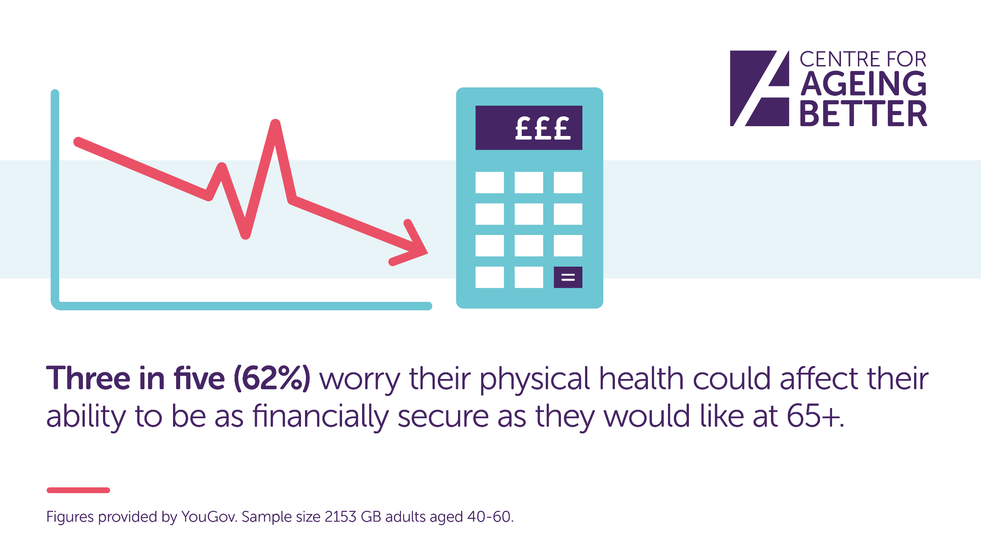
Removing barriers and creating more opportunities for older adults to contribute to society

Slide 16
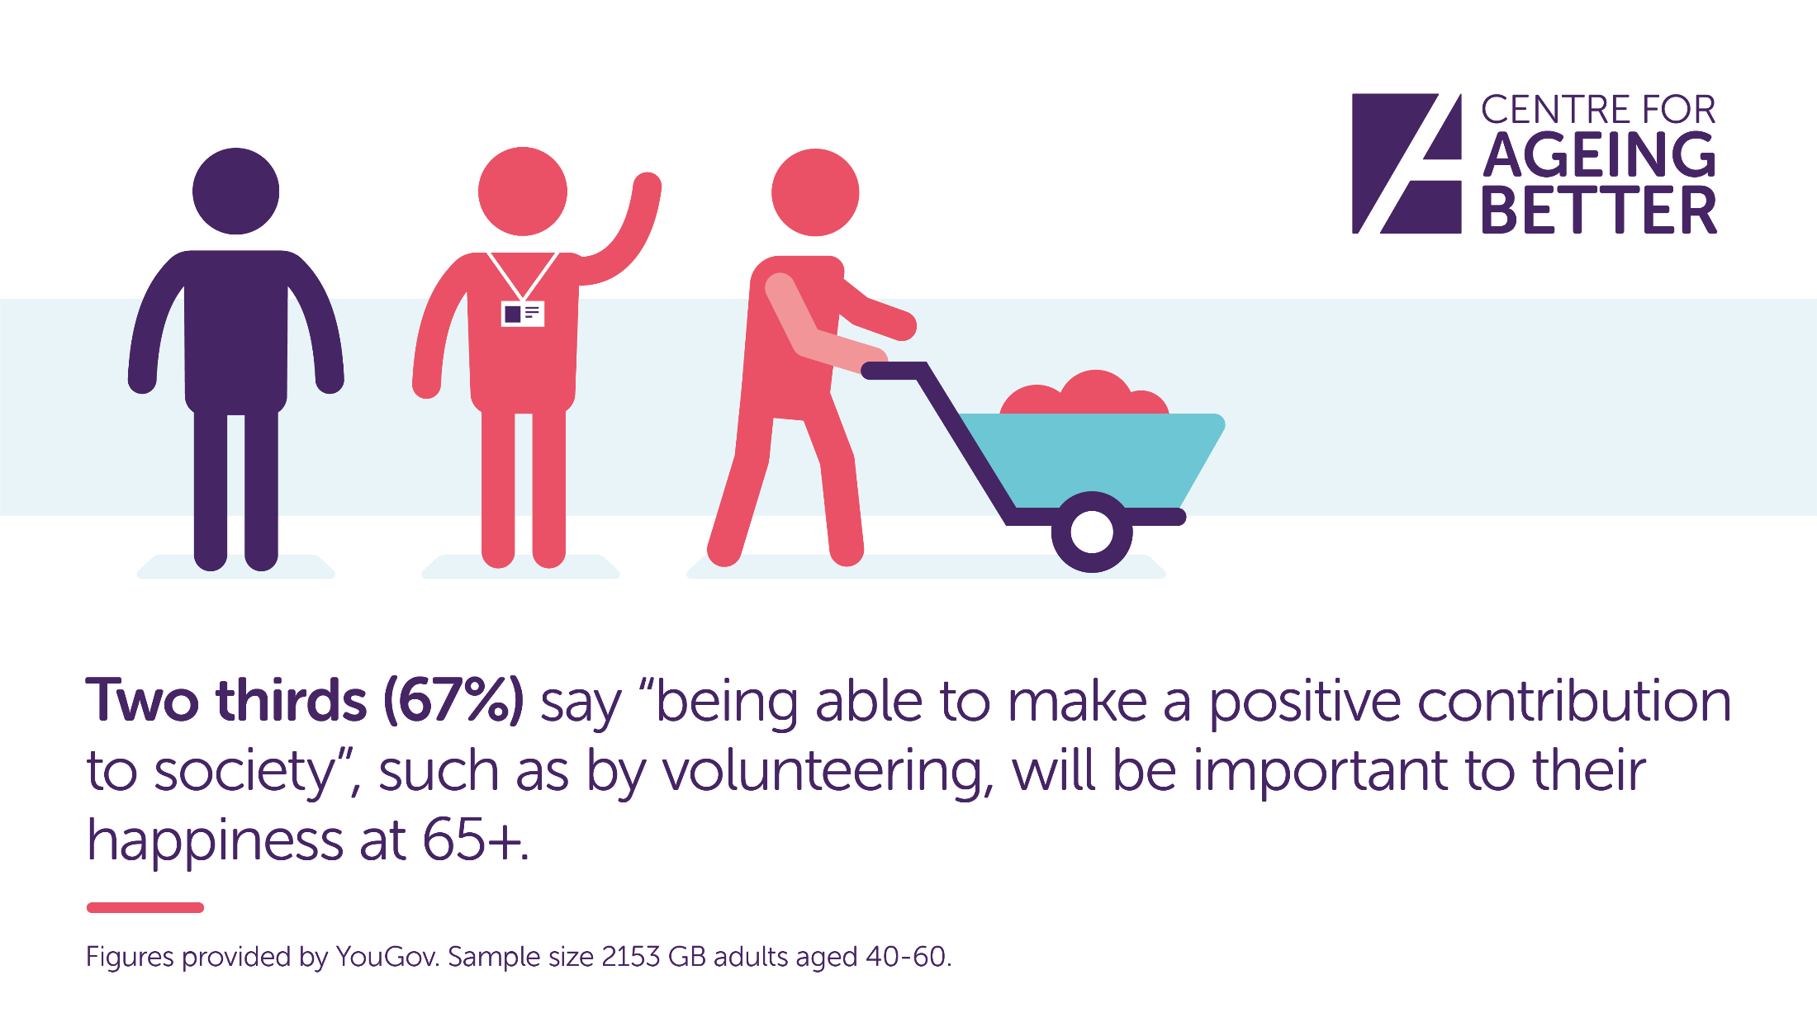
Removing barriers and creating more opportunities for older adults to contribute to society

Slide 17
Removing barriers and creating more opportunities for older adults to contribute to society
Workplaces that support health at work
Flexibility in roles to support those with caring responsibilities or who want to volunteer
Employer policies to recruit, develop, promote and retain staff of every age
Extended range of opportunities for people to engage with creative, learning and cultural activities and to volunteer
17
Consensus statement on healthy ageing launch 16.10.2019

Slide 18
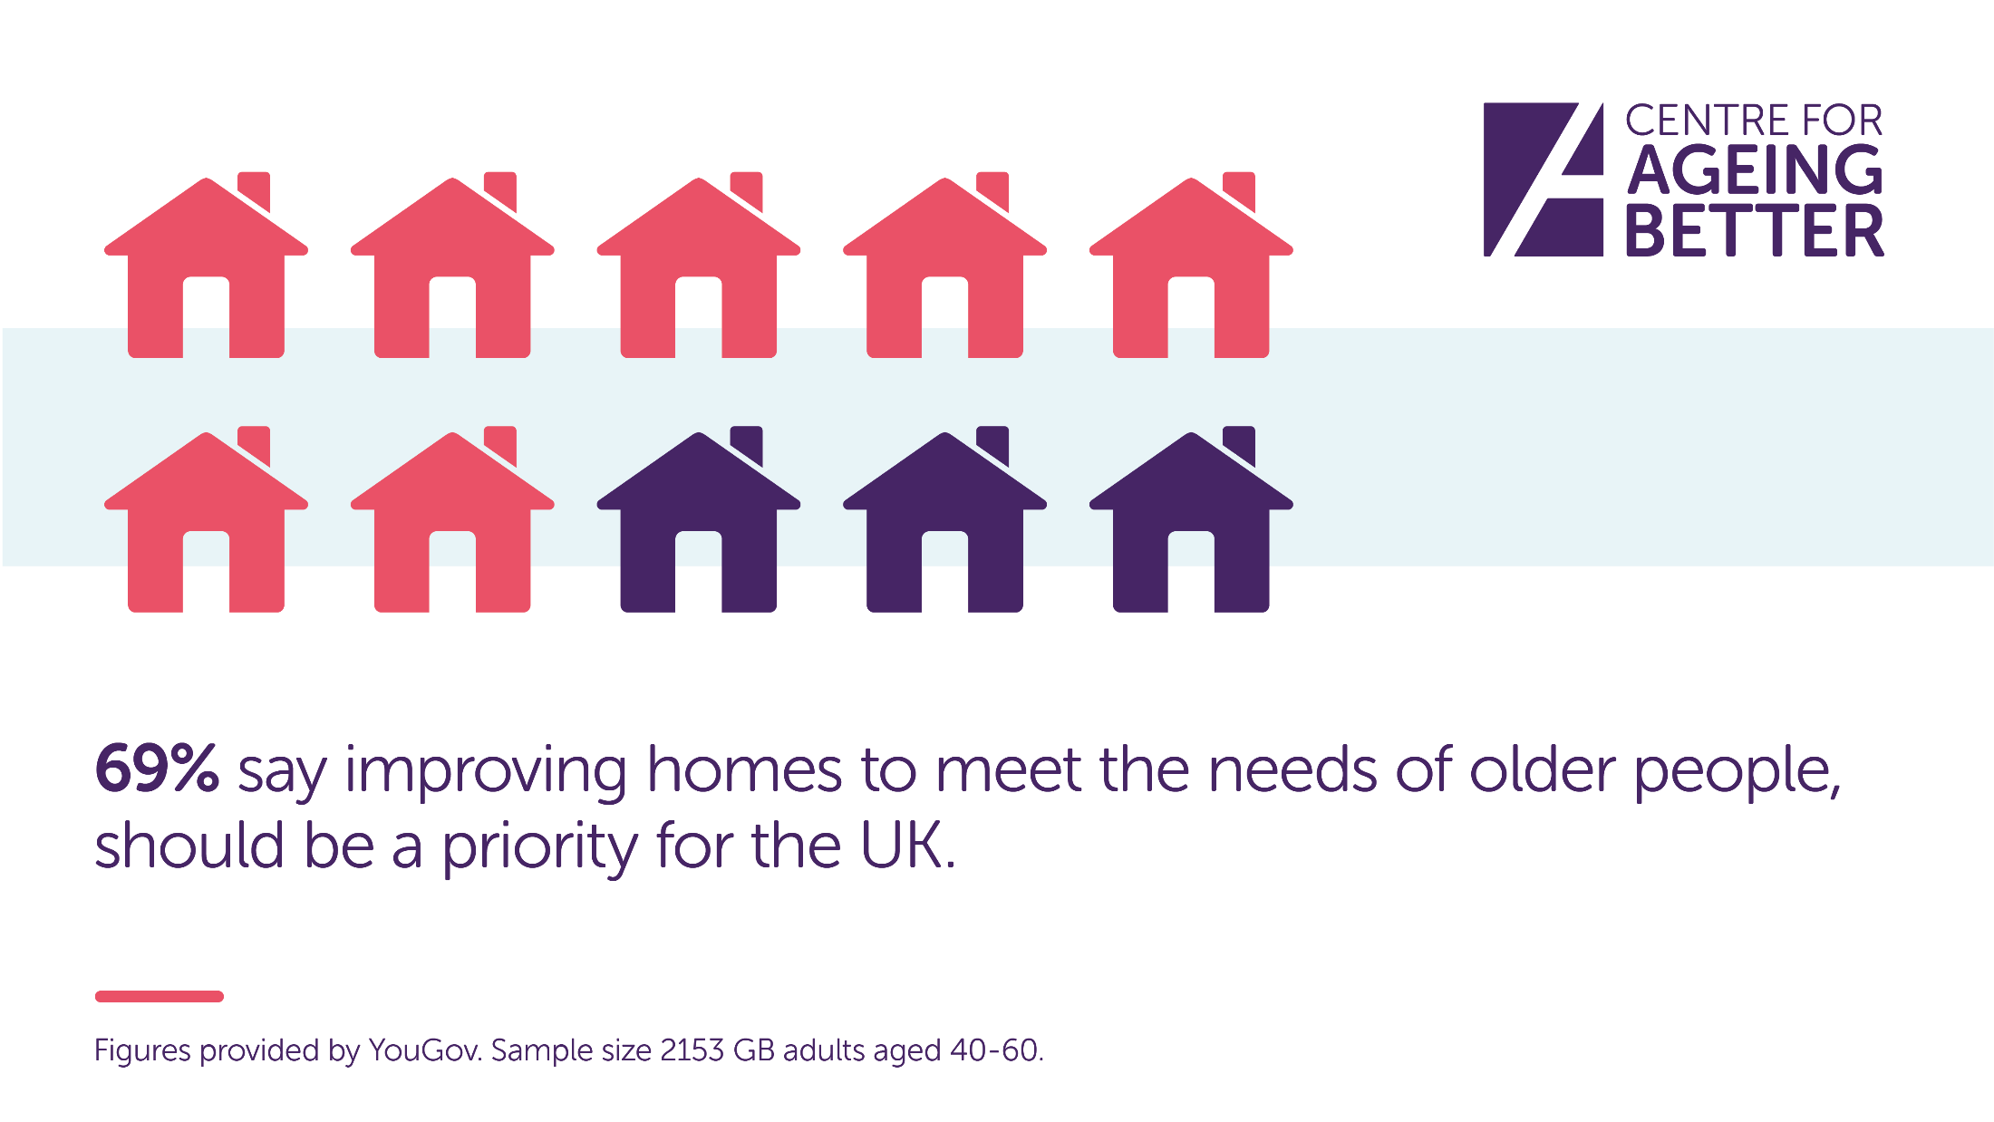
Ensuring good homes and communities

Slide 19
Ensuring good homes and communities
Improve quality of existing mainstream housing, including private rented
Future-proof new homes to be accessible and adaptable
More diverse housing options to meet the needs of older adults across all tenures
Support low-income owner-occupiers to access funds to repair and improve homes
19
Consensus statement on healthy ageing launch 16.10.2019

Slide 20
Ensuring good homes and communities

Slide 21
Ensuring good homes and communities
Support people to remain connected as they age:
Accessible transport links
Good quality green spaces
Maintain services and facilities as close to people’s homes as possible
Adopt range of community-centred approaches that support and encourage community participation among people of all ages.
21
Consensus statement on healthy ageing launch 16.10.2019

Slide 22
Narrowing inequalities
Act across the lifecourse to ensure everybody has the same opportunities to achieve:
A good education
Good work
Financial security
A decent home
Meaningful connections
Access to timely and appropriate health and social care services
22
Consensus statement on healthy ageing launch 16.10.2019
Notes:
Irrespective of wealth or geography

Slide 23
Challenging ageist and negative language, culture and practices
Offer a more realistic and representative picture of later life that values ageing and older people
Recognise the diversity of backgrounds, experience and ambition of the millions of people who are older
Celebrate the successes and benefits of an ageing population.
23
Consensus statement on healthy ageing launch 16.10.2019

Slide 24
Challenging ageist and negative language, culture and practices

Slide 25
What next?
Promote the five commitments with other national bodies, the private sector and amongst local organisations to encourage signatories and action
Explore broadening to UK-wide
Follow up with signatories to capture good practice that will inspire others
Relaunch the statement in a year’s time to highlight progress
25
Consensus statement on healthy ageing launch 16.10.2019

Slide 26
What next?
Produce resources in support of each of the five commitments covering the top line evidence and good practice examples from signatories
Publish a reference document to underpin the consensus statement itself, setting out the relevant evidence for each of the commitments.
26
Consensus statement on healthy ageing launch 16.10.2019

Slide 27
Call to Action
Sign up to the consensus! ageingwell@phe.gov.uk
Raise awareness of the consensus statement and the five commitments.
Use and raise awareness of the available resources to inform practice and impact.
Join our Healthy Ageing K-hub community today.
27
Consensus statement on healthy ageing launch 16.10.2019

Slide 28
Knowledge Hub Site
The PHE Life Course team has developed a Knowledge hub site.
Join the group to share knowledge and keep up-to-date with the latest news, events and resources.
Please note that any information or activity posted via this forum by others does not necessarily represent the view, or have the endorsement of PHE, unless expressly identified as such.
An account must be set-up in order to access the page.
Free access: https://khub.net/group/healthy-ageing
28
Consensus statement on healthy ageing launch 16.10.2019
Notes:
Knowledge hub is a free to use platform for public service professionals to share knowledge, experiences and learning. The MSK team has recently developed a Knowledge hub site, with the aim of raising awareness, enhancing and reinforcing communications, and ensuring a wider reach. Join the group to share knowledge and keep up-to-date with the latest news, events and resources. An account must be set-up with knowledge hub in order to access the page.

Slide 29
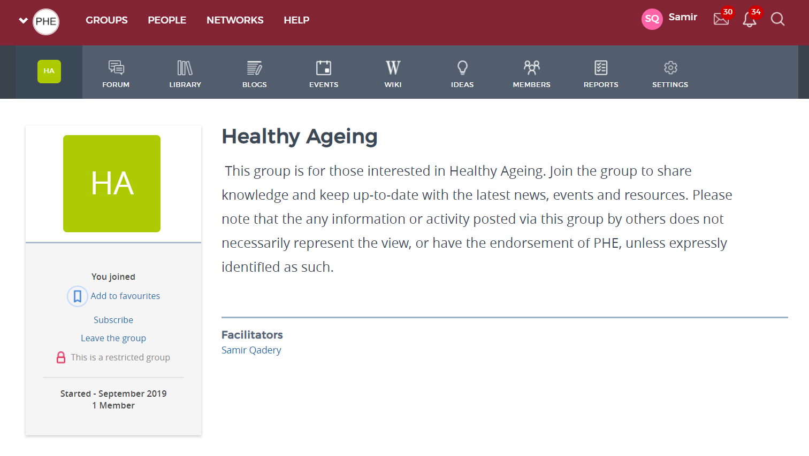
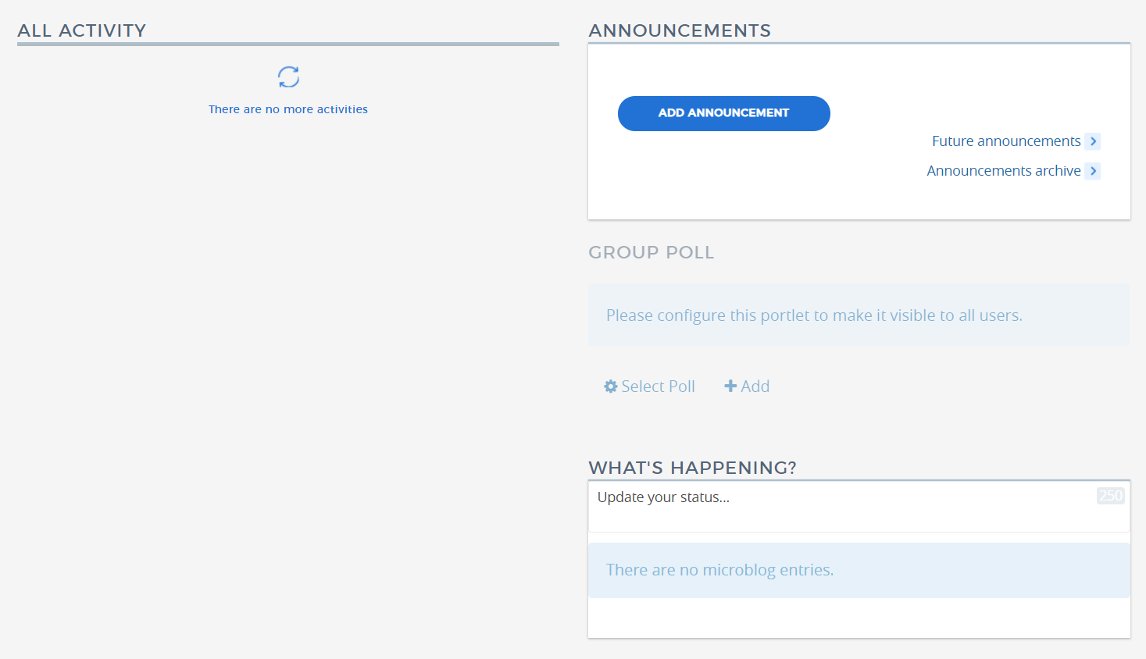
Healthy Ageing
K-Hub
Facilitators – Life Course Team
Forum – interactions/ threads on questions, issues raised etc
Group Blogs – Life Course Team set out professional perspectives on issues not PHE representative.
Events – Posting MSK related events
Announcements –Facilitators post updates to keep things moving.
4
2
3
1
5
5

Slide 30
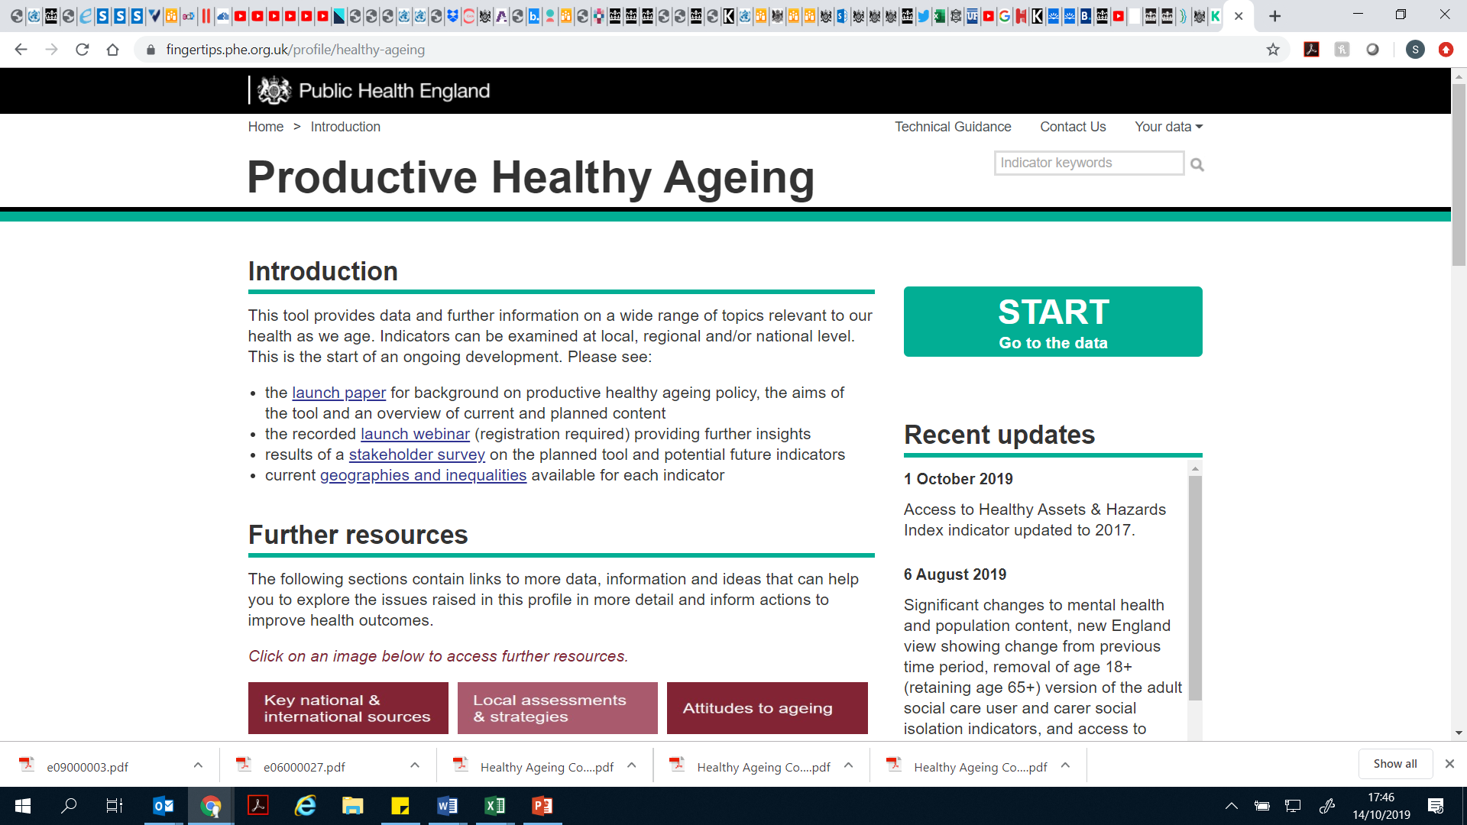
Healthy Ageing Finger tips Profile
Consensus statement on healthy ageing launch 16.10.2019

Slide 31
Thank you. Questions and comments

