Slide 1
Trends in children's body mass index between 2006 to 2007 and 2017 to 2018
Analysis of data from the National Child Measurement Programme July 2019

Slide 2
Summary of key findings 2006 to 2007 and 2017 to 2018
Obesity and severe obesity prevalence shows a significant downward trend in Reception boys and a significant increasing trend in Year 6 boys and girls.
Excess weight (obesity and overweight combined) shows a significant downward trend in Reception boys and a significant increasing trend in Reception girls and Year 6 boys and girls.
Underweight prevalence shows a significant downward trend in Reception boys and girls and Year 6 girls.
The trend in the prevalence of each weight category varies by deprivation (Index of Multiple Deprivation (IMD) quintile) and shows widening inequalities. For example, for Year 6 boys and girls, although the prevalence of excess weight and obesity is increasing overall, there is a downward trend in the least deprived areas (quintile 5).
This is supported by increases in the slope index of inequality. The inequalities gap is widening at a faster rate in Year 6 than in Reception and is greater in Year 6 for both boys and girls.
The trend in the prevalence of each weight category also varies among different ethnic groups. Obesity prevalence shows a significant upward trend in all ethnic groups for boys and girls in Year 6, apart from Chinese girls where no significant trend was identified. White British girls were the only ethnic group that had an upward trend in obesity in Reception.
2

Slide 3
Introduction
This slide pack presents trends in children’s body mass index from 2006/07 to 2017/18 using National Child Measurement Programme (NCMP) data. The NCMP is an annual programme that measures the height and weight of over 1 million children in Reception (aged 4 to 5 years) and Year 6 (aged 10 to 11 years) in mainstream state-funded schools in England. Although the NCMP only covers certain age groups, it includes the majority of children in those year groups and around 95% of eligible pupils have taken part since 2014 to 2015.
The slides depict the trends in child body mass index from the NCMP in clear, easy to understand charts and graphics. They display overall trends in obesity, overweight, excess weight, severe obesity and underweight prevalence over time. The slope index of inequality for obesity provides an indication of whether existing health inequalities are widening or narrowing.
Logistic regression models were used to assess the significance of the trends, using a Bonferroni correction for multiple hypothesis testing. A least squares trend line is depicted on the slides for illustrative purposes.
The slides will be a useful tool for practitioners and policy makers working on child weight and obesity at local, regional and national level.
There are accompanying notes in the document that can be viewed if the file is downloaded. These notes provide additional detail to what is presented in the slides.
NCMP website:
https://digital.nhs.uk/data-and-information/publications/statistical/national-child-measurement-programme
3
Notes:
R software was used to conduct the analyses and produce all of the charts in this slide pack:
R Core Team (2017). R: A language and environment for statistical computing. R Foundation for Statistical Computing, Vienna, Austria. URL https://www.R-project.org/
A logistic regression model and the Bonferroni correction was not applied to Slope Index of Inequality (SII) (slide 16). Linear regression was used to assess the significance of the trends for SII.

Slide 4
BMI classification definitions for population monitoring
For population monitoring purposes BMI is classified according to the following table using the British 1990 growth reference (UK90¹):
BMI classification | Centile of UK90 BMI distribution
Underweight | Less than or equal to 2nd
Healthy weight | Greater than 2nd and less than 85th
Overweight | Greater than or equal to 85th and less than 95th
Obese | Greater than or equal to 95th (obese plus severely obese)
Excess weight | Greater than or equal to 85th (overweight plus obese)
Severely obese | Greater than or equal to 99.6th
¹ Cole TJ, Freeman JV, Preece MA. Body mass index reference curves for the UK, 1990. Archives of Disease in Childhood 1995 73:25-29.
Notes:
Assessing the BMI of children is more complicated than for adults because a child’s BMI changes as they mature. Growth patterns differ between boys and girls, so both the age and sex of a child needs to be taken into account when estimating whether BMI is too high or too low. In England the British 1990 growth reference (UK90) for BMI is recommended for use to determine weight status according to a child’s age and sex. Each child’s BMI is calculated and compared with the BMI distribution for children of their age and sex from the UK90 growth reference.

Slide 5
Key findings 2006 to 2007 and 2017 to 2018: weight categories
 | Reception |  | Year 6
 | Boys | Girls | Boys | Girls
Prevalence of obesity | Downward trend | No upward or downward trend | Upward trend
Prevalence of excess weight | Downward trend | Upward trend | Upward trend
Prevalence of overweight* | Downward trend | Upward trend | Downward trend | No upward or downward trend
Prevalence of severe obesity | Downward trend | No upward or downward trend | Upward trend
Prevalence of underweight | Downward trend |  | No upward or downward trend | Downward trend
All increasing or decreasing trends reported are statistically significant
*Overweight has not been given a red/green rating. Overweight needs to be viewed in context of the other weight categories (see notes)
Notes:
Overweight has not been given a red or green rating that would indicate whether it was “bad” (red) or “good” (green). Increases or decreases in overweight prevalence over time, compared with other weight categories will highlight shifts in the BMI distribution of the population measured. For example an increase in overweight prevalence alongside a decrease in obesity prevalence is a positive change, whereas an increase in overweight prevalence alongside a decrease in the prevalence of healthy weight is an unhealthy change in the population. Therefore a clear direction as to what is considered good or bad is not possible for ‘overweight’ on its own and should be considered with other weight categories.

Slide 6
Key findings 2006 to 2007 and 2017 to 2018: deprivation
 | Reception |  | Year 6
 | Boys | Girls | Boys | Girls
Changes by deprivation quintile (quintile 1 is most deprived, quintile 5 is least deprived) | Downward trends in excess weight and obesity prevalence in quintiles 2 to 5; severe obesity in quintiles 4 and 5; overweight in boys in quintiles 1 to 5; and underweight in boys in quintile 1 | Upward trend in excess weight, obesity, severe obesity and overweight in girls in quintile 1 | Upward trend in excess weight, and obesity in boys in quintiles 1 to 3; severe obesity in boys in quintiles 1 to 4; and underweight in quintiles 4 and 5 | Upward trend in excess weight, obesity and severe obesity in girls in quintiles 1 to 3; and overweight in girls in quintile 1
 |  | Downward trends in excess weight and obesity in girls in quintile 5 and underweight in girls in quintiles 1 to 5
 |  |  | Downward trends in excess weight obesity, overweight in boys in quintile 5; and overweight in boys in quintile 4 | Downward trends in excess weight obesity, and overweight in girls in quintile 5; and underweight in girls in quintile 1
All increasing or decreasing trends reported are statistically significant

Slide 7
Key findings 2006 to 2007 and
2017 to 2018: ethnicity and inequality
 | Reception |  | Year 6
 | Boys | Girls | Boys | Girls
Weight category prevalence by ethnic group¹ | Downward trends in excess weight and obesity prevalence in Bangladeshi, Black Caribbean, Indian and White British boys; severe obesity in Indian boys; and overweight in White British boys; and underweight in White British boys | Upward trend in excess weight, obesity, overweight and severe obesity in White British girls, and excess weight in Chinese girls | Upward trend in obesity in all groups, and in severe obesity for Bangladeshi, Black African, Black Caribbean, Pakistani and White British boys | Upward trend in obesity and excess weight in all groups except Chinese girls, and in severe obesity for Black African, Black Caribbean, Pakistani and White British girls
 |  | Downward trends in excess weight, obesity and severe obesity in Indian girls and underweight in White British and Pakistani girls | Downward trend in underweight in Pakistani boys and in overweight in White British boys | Downward trend in underweight in Pakistani and Indian girls and in overweight in White British girls
Slope index of inequality (SII) for obesity | Increasing SII showing widening health inequalities |  | Greater inequality in Year 6 than in Reception, SII increasing at a faster rate in Year 6
All increasing or decreasing trends reported are statistically significant
¹variation in coding means that trends over time by ethnic group must be interpreted with caution
7

Slide 8
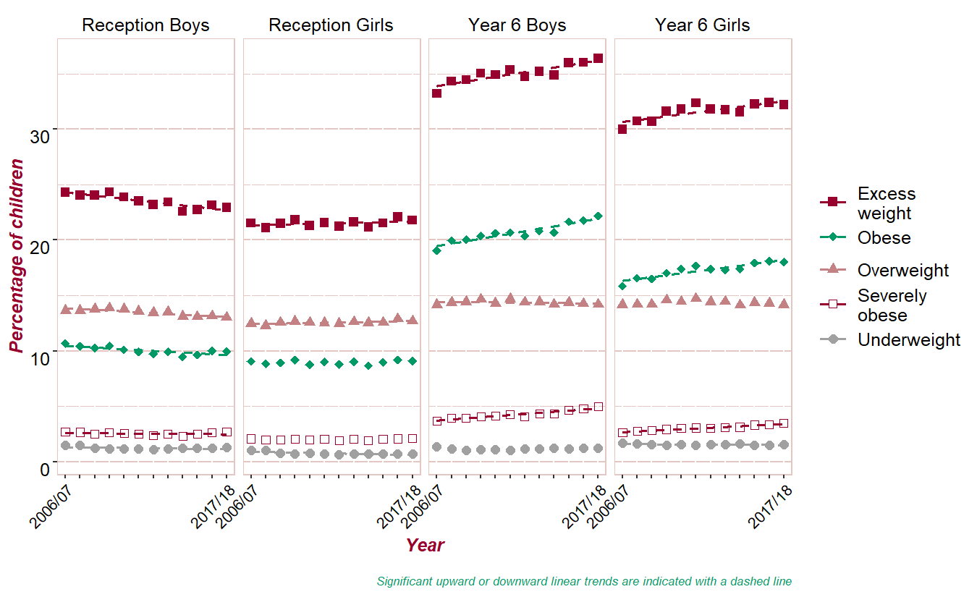
Prevalence of obesity, severe obesity, excess weight, overweight and underweight by school year and sex
Percentage of children
Upward trends in obesity, severe obesity and excess weight in Year 6 boys and girls.
Downward trend in overweight prevalence in Year 6 boys.
Downward trends in Reception boys excess weight, obesity, severe obesity and overweight.
Upward trends in Reception girls excess weight and overweight
Year
Significant upward or downward linear trends are indicated with a dashed line
8
Notes:
The regression analysis provides statistics that calculate the change (increase or decrease) per year for each group. Those with the biggest annual change are listed first in the lists below.
The following groups had a significant annual increase in weight category prevalence over the time period, greatest estimated increase first: Year 6 Boys severely obese; Year 6 Girls severely obese; Year 6 Boys obese; Year 6 Girls obese; Year 6 Boys excess weight; Year 6 Girls excess weight; Reception Girls overweight; Reception Girls excess weight.
The following groups had a significant annual decrease in weight category prevalence over the time period, greatest estimated decrease first: Reception Girls underweight; Reception Boys underweight; Reception Boys excess weight; Reception Boys obese; Reception Boys overweight; Year 6 Girls underweight; Reception Boys severely obese; Year 6 Boys overweight.

Slide 9
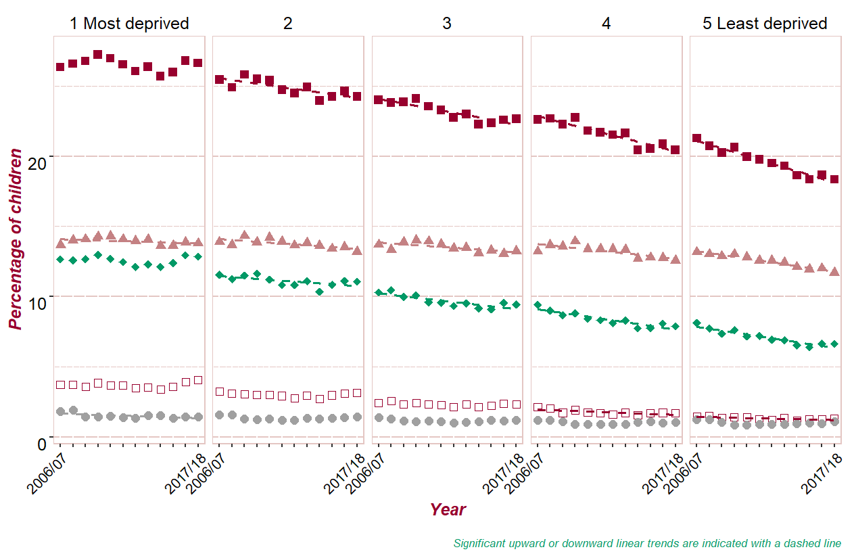
Reception Boys weight category prevalence by deprivation quintile
Percentage of children
Downward trends in excess weight and obesity prevalence in boys in quintiles 2 to 5; severe obesity in boys in quintiles 4 and 5; overweight in boys in quintiles 1 to 5; and underweight in boys in quintile 1
Year
Significant upward or downward linear trends are indicated with a dashed line
9
Notes:
The regression analysis provides statistics that calculate the change (increase or decrease) per year for each group. Those with the biggest annual change are listed first in the lists below.
Reception boys by deprivation quintile
There were no groups with a significant annual increase in weight category prevalence over the time period.
The following groups had a significant annual decrease in weight category prevalence over the time period, greatest estimated decrease first: Reception Boys quintile 5 obese; Reception Boys quintile 5 excess weight; Reception Boys quintile 1 underweight; Reception Boys quintile 5 severely obese; Reception Boys quintile 4 obese; Reception Boys quintile 4 severely obese; Reception Boys quintile 4 excess weight; Reception Boys quintile 5 overweight; Reception Boys quintile 3 obese; Reception Boys quintile 4 overweight; Reception Boys quintile 3 excess weight; Reception Boys quintile 2 excess weight; Reception Boys quintile 3 overweight; Reception Boys quintile 2 overweight; Reception Boys quintile 2 obese; Reception Boys quintile 1 overweight.

Slide 10
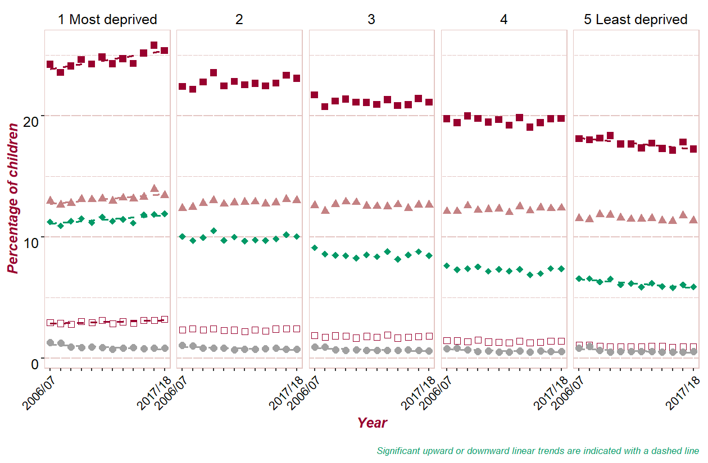
Reception Girls weight category prevalence by deprivation quintile
Percentage of children
Upward trends in excess weight, obesity, severe obesity and overweight in girls in quintile 1
Downward trends in excess weight and obesity in girls in quintile 5 and underweight in girls in quintiles 1 to 5
Year
Year
Significant upward or downward linear trends are indicated with a dashed line
NCMP Trends 2006 to 2007 and 2017 to 2018
Notes:
The regression analysis provides statistics that calculate the change (increase or decrease) per year for each group. Those with the biggest annual change are listed first in the lists below.
Reception girls by deprivation quintile
The following groups had a significant annual increase in weight category prevalence over the time period, greatest estimated increase first: Reception Girls quintile 1 severely obese; Reception Girls quintile 1 excess weight; Reception Girls quintile 1 overweight; Reception Girls quintile 1 obese.
The following groups had a significant annual decrease in weight category prevalence over the time period, greatest estimated decrease first: Reception Girls quintile 5 underweight; Reception Girls quintile 1 underweight; Reception Girls quintile 4 underweight; Reception Girls quintile 3 underweight; Reception Girls quintile 2 underweight; Reception Girls quintile 5 obese; Reception Girls quintile 5 excess weight.

Slide 11
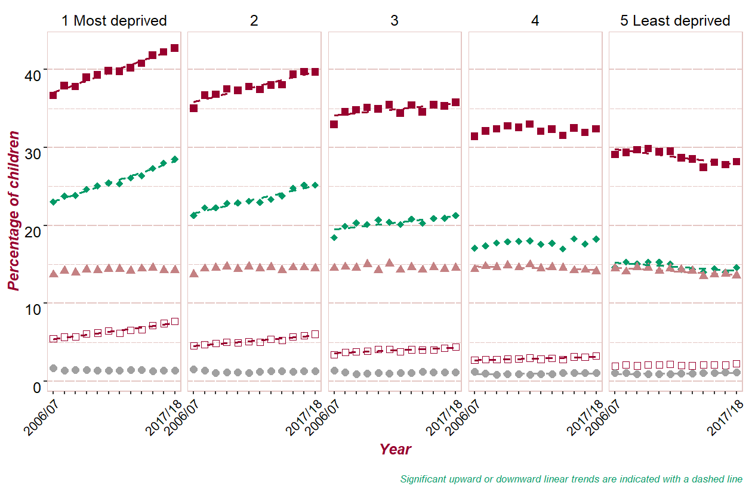
Year 6 Boys weight category prevalence by deprivation quintile
Percentage of children
Upward trends in excess weight, and obesity in boys in quintiles 1 to 3; severe obesity in boys in quintiles 1 to 4; and underweight in quintiles 4 and 5
Downward trends in excess weight obesity, overweight in boys in quintile 5; and overweight in boys in quintile 4
Year
Year
Year
Significant upward or downward linear trends are indicated with a dashed line
Notes:
The regression analysis provides statistics that calculate the change (increase or decrease) per year for each group. Those with the biggest annual change are listed first in the lists below.
Year 6 boys by deprivation quintile
The following groups had a significant annual increase in weight category prevalence over the time period, greatest estimated increase first: Year 6 Boys quintile 1 severely obese; Year 6 Boys quintile 1 obese; Year 6 Boys quintile 2 severely obese; Year 6 Boys quintile 1 excess weight; Year 6 Boys quintile 2 obese; Year 6 Boys quintile 5 underweight; Year 6 Boys quintile 3 severely obese; Year 6 Boys quintile 4 underweight; Year 6 Boys quintile 2 excess weight; Year 6 Boys quintile 4 severely obese; Year 6 Boys quintile 3 obese; Year 6 Boys quintile 3 excess weight.
The following groups had a significant annual decrease in weight category prevalence over the time period, greatest estimated decrease first: Year 6 Boys quintile 5 excess weight; Year 6 Boys quintile 5 obese; Year 6 Boys quintile 5 overweight; Year 6 Boys quintile 4 overweight.

Slide 12
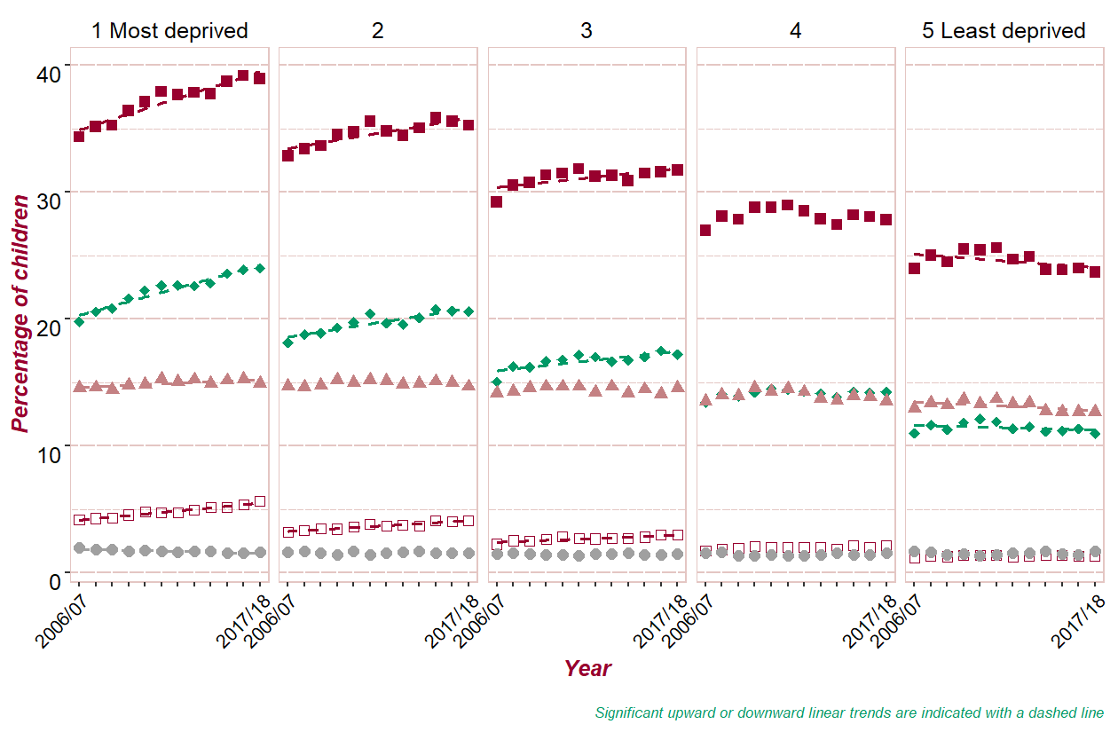
Year 6 Girls weight category prevalence by deprivation quintile
Percentage of children
Upward trends in excess weight, obesity and severe obesity in girls in quintiles 1 to 3; and overweight in girls in quintile 1
Downward trends in excess weight obesity, and overweight in girls in quintile 5; and underweight in girls in quintile 1
Year
Year
Significant upward or downward linear trends are indicated with a dashed line
12
Notes:
The regression analysis provides statistics that calculate the change (increase or decrease) per year for each group. Those with the biggest annual change are listed first in the lists below.
Year 6 girls by deprivation quintile
The following groups had a significant annual increase in weight category prevalence over the time period, greatest estimated increase first: Year 6 Girls quintile 1 severely obese; Year 6 Girls quintile 2 severely obese; Year 6 Girls quintile 1 obese; Year 6 Girls quintile 3 severely obese; Year 6 Girls quintile 1 excess weight; Year 6 Girls quintile 2 obese; Year 6 Girls quintile 2 excess weight; Year 6 Girls quintile 3 obese; Year 6 Girls quintile 3 excess weight; Year 6 Girls quintile 1 overweight.
The following groups had a significant annual decrease in weight category prevalence over the time period, greatest estimated decrease first: Year 6 Girls quintile 1 underweight; Year 6 Girls quintile 5 excess weight; Year 6 Girls quintile 5 overweight; Year 6 Girls quintile 5 obese.

Slide 13
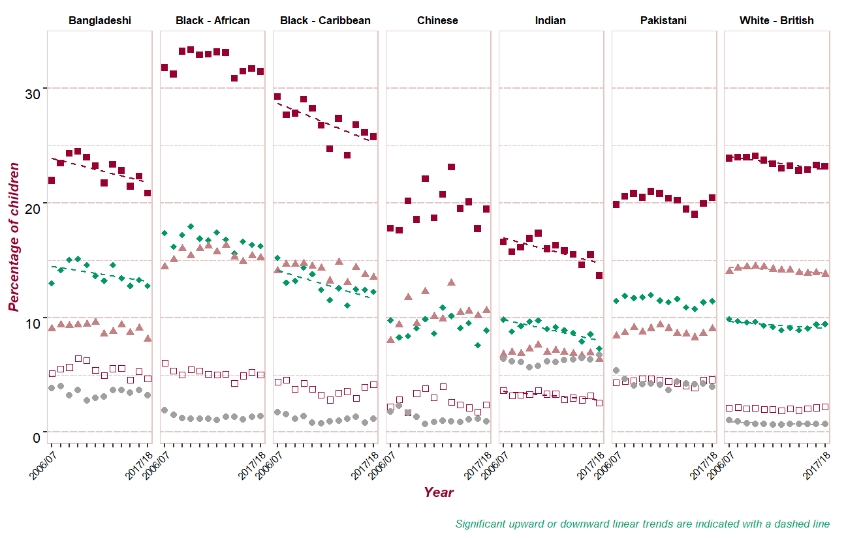
Reception Boys weight category prevalence by ethnic group
Percentage of children
Downward trends in excess weight and obesity prevalence in Bangladeshi, Black Caribbean, Indian and White British boys; severe obesity in Indian boys; and overweight in White British boys; and underweight in White British boys
Year
Year
Significant upward or downward linear trends are indicated with a dashed line
13
Notes:
The regression analysis provides statistics that calculate the change (increase or decrease) per year for each group. Those with the biggest annual change are listed first in the lists below.
Reception boys by ethnic group
There were no groups with a significant annual increase in weight category prevalence over the time period.
The following groups had a significant annual decrease in weight category prevalence over the time period, greatest estimated decrease first: Reception Boys Indian obese; Reception Boys Indian severely obese; Reception Boys Black - Caribbean obese; Reception Boys White - British underweight; Reception Boys Indian excess weight; Reception Boys Black - Caribbean excess weight; Reception Boys Bangladeshi excess weight; Reception Boys Bangladeshi obese; Reception Boys White - British excess weight; Reception Boys White - British overweight; Reception Boys White - British obese.

Slide 14
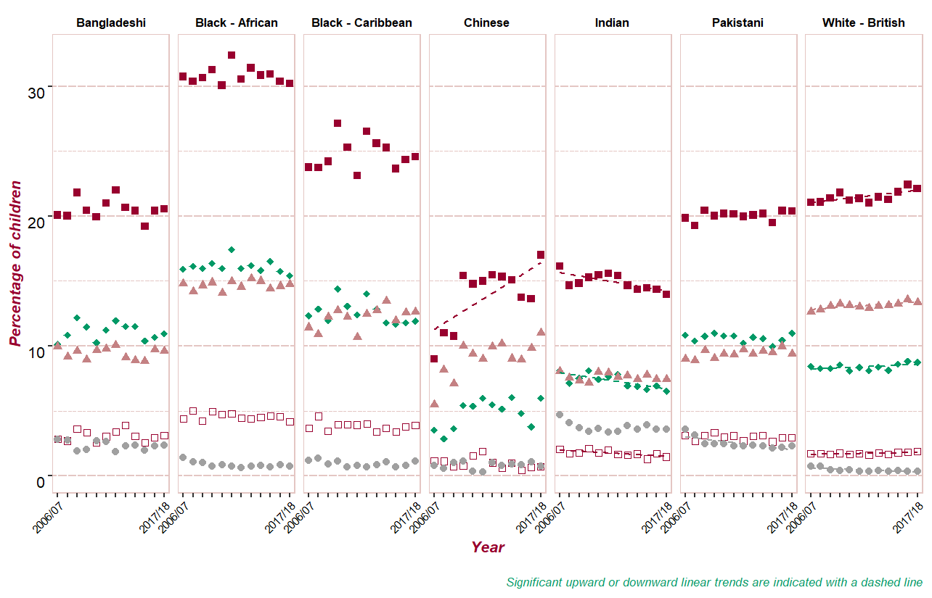
Reception Girls weight category prevalence by ethnic group
Percentage of children
Upward trends in excess weight, obesity, overweight and severe obesity in White British girls, and excess weight in Chinese girls
Downward trends in excess weight, obesity and severe obesity in Indian girls and underweight in White British and Pakistani girls
Year
Year
Significant upward or downward linear trends are indicated with a dashed line
14
Notes:
The regression analysis provides statistics that calculate the change (increase or decrease) per year for each group. Those with the biggest annual change are listed first in the lists below.
Reception girls by ethnic group
The following groups had a significant annual increase in weight category prevalence over the time period, greatest estimated increase first: Reception Girls Chinese excess weight; Reception Girls White - British severely obese; Reception Girls White - British obese; Reception Girls White - British excess weight; Reception Girls White - British overweight.
The following groups had a significant annual decrease in weight category prevalence over the time period, greatest estimated decrease first: Reception Girls White - British underweight; Reception Girls Pakistani underweight; Reception Girls Indian severely obese; Reception Girls Indian obese; Reception Girls Indian excess weight.

Slide 15
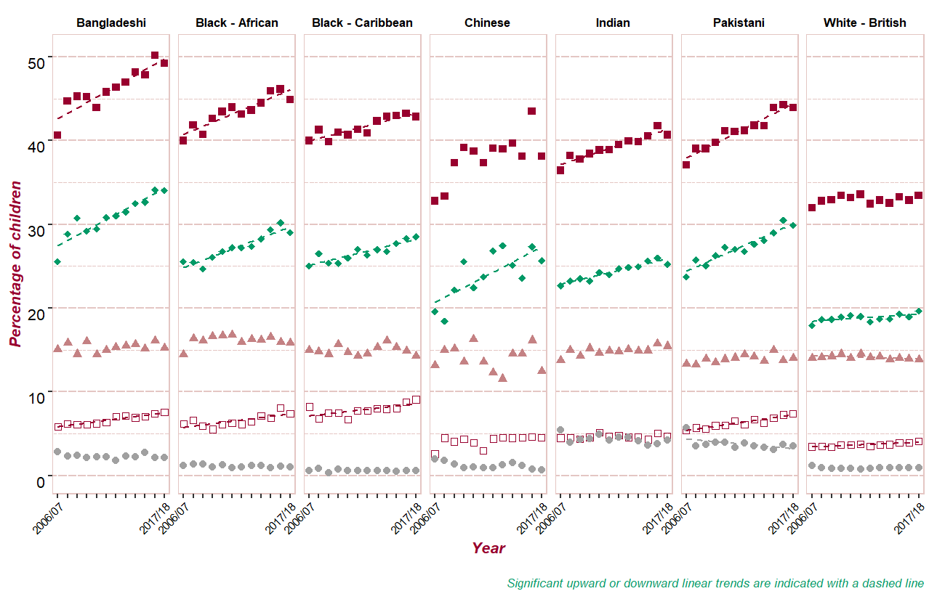
Year 6 Boys weight category prevalence by ethnic group
Percentage of children
Upward trends in obesity in all groups, and in severe obesity for Bangladeshi, Black African, Black Caribbean, Pakistani and White British boys
Downward trends in underweight in Pakistani boys and in overweight in White British boys
Year
Year
Significant upward or downward linear trends are indicated with a dashed line
15
Notes:
The regression analysis provides statistics that calculate the change (increase or decrease) per year for each group. Those with the biggest annual change are listed first in the lists below.
Year 6 boys by ethnic group
The following groups had a significant annual increase in weight category prevalence over the time period, greatest estimated increase first: Year 6 Boys Chinese obese; Year 6 Boys Pakistani severely obese; Year 6 Boys Black - African severely obese; Year 6 Boys Bangladeshi obese; Year 6 Boys Pakistani obese; Year 6 Boys Bangladeshi severely obese; Year 6 Boys Bangladeshi excess weight; Year 6 Boys Pakistani excess weight; Year 6 Boys Black - African obese; Year 6 Boys Black - Caribbean severely obese; Year 6 Boys Black - African excess weight; Year 6 Boys Indian excess weight; Year 6 Boys White - British severely obese; Year 6 Boys Indian obese; Year 6 Boys Black - Caribbean obese; Year 6 Boys Black - Caribbean excess weight; Year 6 Boys White - British obese.
The following groups had a significant annual decrease in weight category prevalence over the time period, greatest estimated decrease first: Year 6 Boys Pakistani underweight; Year 6 Boys White - British overweight.

Slide 16
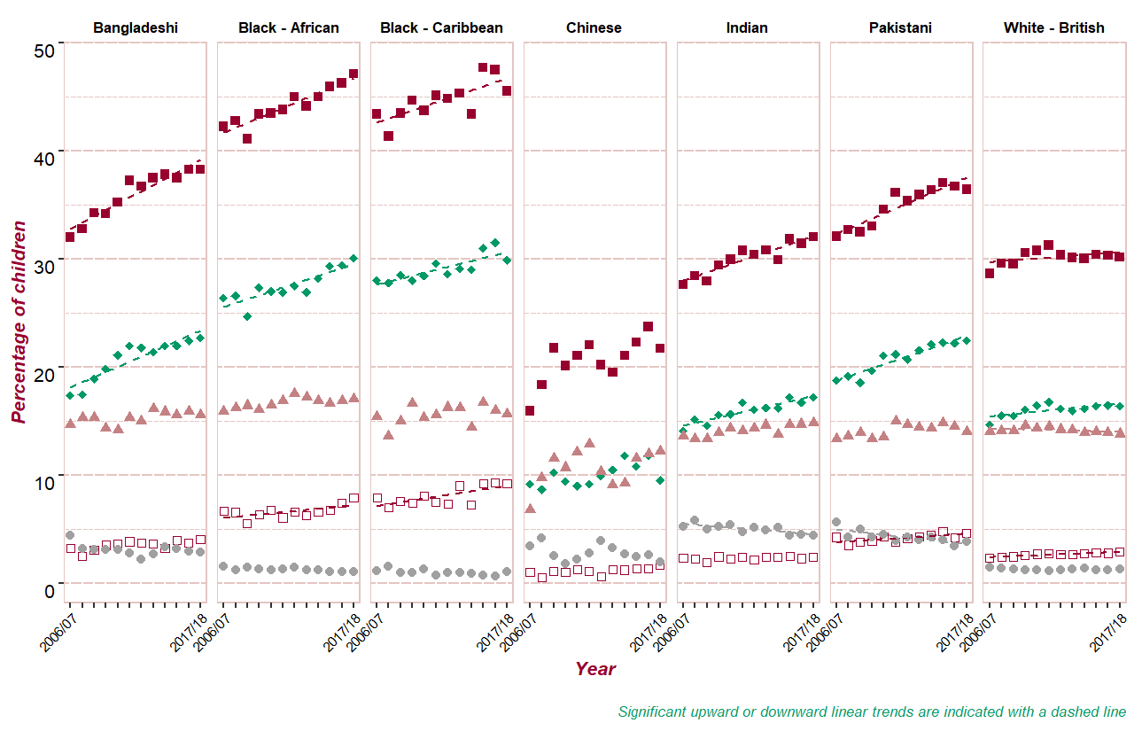
Year 6 Girls weight category prevalence by ethnic group
Percentage of children
Upward trends in obesity and excess weight in all groups except Chinese girls, and in severe obesity for Black African, Black Caribbean, Pakistani and White British girls
Downward trends in underweight in Pakistani and Indian girls and in overweight in White British girls
Year
Year
Significant upward or downward linear trends are indicated with a dashed line
16
Notes:
The regression analysis provides statistics that calculate the change (increase or decrease) per year for each group. Those with the biggest annual change are listed first in the lists below.
Year 6 girls by ethnic group
The following groups had a significant annual increase in weight category prevalence over the time period, greatest estimated increase first: Year 6 Girls Bangladeshi obese; Year 6 Girls Black - Caribbean severely obese; Year 6 Girls Bangladeshi excess weight; Year 6 Girls Pakistani obese; Year 6 Girls Black - African severely obese; Year 6 Girls Pakistani severely obese; Year 6 Girls Pakistani excess weight; Year 6 Girls Black - African obese; Year 6 Girls Black - African excess weight; Year 6 Girls Indian obese; Year 6 Girls Indian excess weight; Year 6 Girls White - British severely obese; Year 6 Girls Black - Caribbean excess weight; Year 6 Girls Black - Caribbean obese; Year 6 Girls White - British obese; Year 6 Girls White - British excess weight.
The following groups had a significant annual decrease in weight category prevalence over the time period, greatest estimated decrease first: Year 6 Girls Pakistani underweight; Year 6 Girls Indian underweight; Year 6 Girls White - British overweight.

Slide 17
Slope Index of Inequality
The slope index of inequality (SII) for obesity presented in this report measures how obesity prevalence varies by levels of deprivation in communities of the population. Child obesity prevalence is calculated for each deprivation group (deciles representing approximately 10% of the population), then the SII is calculated based on these figures.
The SII takes account of health inequalities across the whole range of deprivation within England and summarises this in a single number.
The higher the value of the SII. The greater the inequality in obesity prevalence.
Increasing SII over time indicates widening inequality.
For further information on the SII see: Regidor E. Measures of health inequalities: part 2. Journal of Epidemiology & Community Health 2004 –58:900-903.

Slide 18
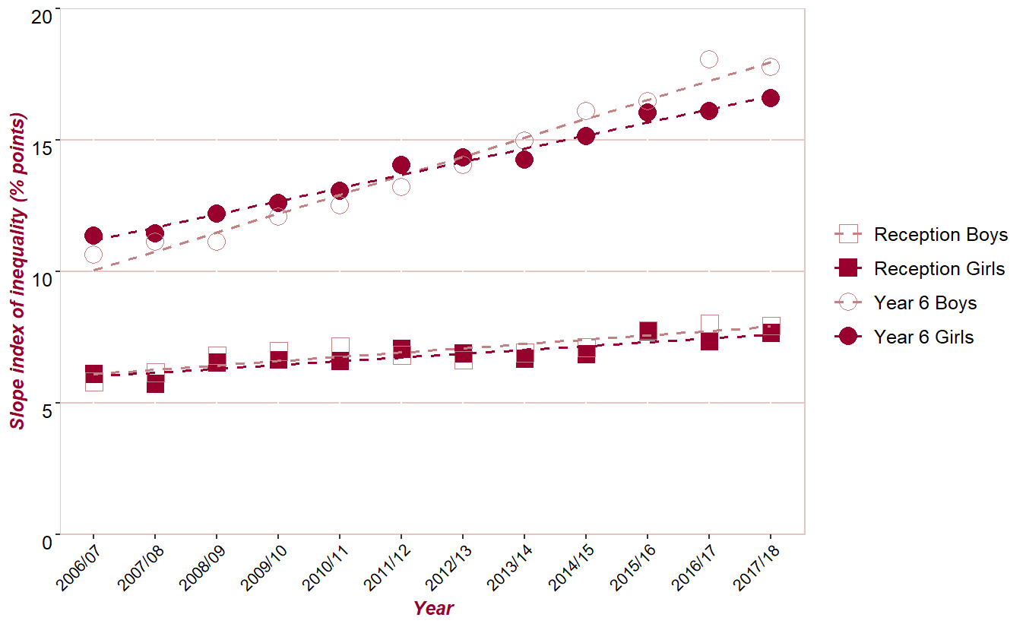
Trend in Slope Index of Inequality for obesity
Slope index of inequality (% points)
The slope index of inequality for obesity is greater in Year 6 boys and girls than in Reception boys and girls, and is widening at a faster rate in Year 6 than in Reception
Year
Notes:
Linear regression models were used to assess the significance of the trend for slope index of inequality (SII). No Bonferroni correction was applied.
The slope index of inequality for obesity is a measure of the difference in obesity prevalence between the most and least deprived deciles of the population. The higher the value of the SII, the greater the inequality. The SII is greater in Year 6 boys and girls than in Reception boys and girls, and has been increasing at a faster rate in Year 6 than in Reception.
For further information on the SII see:
Regidor E. Measures of health inequalities: part 2. Journal of Epidemiology & Community Health 2004;58:900-903

Slide 19
For more information:
PHE Web:
https://www.gov.uk/guidance/phe-data-and-analysis-tools#obesity-diet-and-physical-activity
PHE Obesity Intelligence Knowledge Hub public library (no need to join):
https://khub.net/web/phe-obesity-intelligence/public-library
PHE Obesity Intelligence Knowledge Hub:
Register on https://khub.net and join the PHE Obesity Intelligence group
Email: ncmp@phe.gov.uk
Twitter: @PHE_Obesity
19
NCMP Trends 2006 to 2007 and 2017 to 2018

Slide 20
About Public Health England
Public Health England exists to protect and improve the nation's health and wellbeing, and reduce health inequalities. We do this through world-leading science, knowledge and intelligence, advocacy, partnerships and the delivery of specialist public health services. We are an executive agency of the Department of Health and Social Care, and a distinct delivery organisation with operational autonomy. We provide central government, local government, the NHS, Parliament, industry and the public with evidence-based professional, scientific and delivery expertise and support.
Public Health England, Wellington House, 133-155 Waterloo Road, London SE1 8UG Tel: 020 7654 8000
www.gov.uk/phe
Twitter: @PHE_uk
Facebook: www.facebook.com/PublicHealthEngland
© Crown copyright 2019 You may re-use this information (excluding logos) free of charge in any format or medium, under the terms of the Open Government Licence v3.0. To view this licence, visit www.nationalarchives.gov.uk/doc/open-government-licence/version/3 or email psi@nationalarchives.gsi.gov.uk. Where we have identified any third party copyright information you will need to obtain permission from the copyright holders concerned.
Published July 2019 PHE publications gateway number: GW-517
20
NCMP Trends 2006 to 2007 and 2017 to 2018

