Slide 1
Patterns and trends in child obesity in the East of England
A presentation of the latest data on child obesity at regional level February 2021

Slide 2
National Child Measurement Programme
The data in this slide pack is from the National Child Measurement Programme (NCMP).
The NCMP is an annual programme that measures the height and weight of children in Reception (aged 4 to 5 years) and Year 6 (aged 10 to 11 years) in England. Although the NCMP only covers certain age groups, it normally includes the majority of children in those year groups (usually around 95% of eligible children).
The number of children measured in the East of England in 2019/20 was 42,110 in Reception, and 57,550 in Year 6.
School closures, in March 2020, due to the Covid-19 pandemic meant that in 2019/20 the number of children measured was around 75% of previous years. Analysis by NHS Digital and PHE shows that national and regional level data is reliable and comparable to previous years although some caution should be exercised as less children were measured than usual. The data at local authority level and below is not as robust, as a result a small number of areas do not have published data for 2019/20 and data for some areas have a reliability flag indicating that figures need to be interpreted with caution. Further information is available to download from the Obesity Profile on Fingertips and in the NHS Digital 2019/20 annual report.
NCMP website:
National Child Measurement Programme - NHS Digital
2 Patterns and trends in child obesity in the East of England

Slide 3
NCMP data reliability note
In 2019/20 in the East of England the number of children measured was 74% of the number in the previous three years. In Reception 60% of children were measured compared to the previous three years and 90% in Year 6. Some caution should be exercised when looking at regional level results as less children were measured than usual, however PHE analysis has shown that the children measured have similar characteristics to those measured in previous years and are therefore still representative of the region.
At local authority level, where the number of children measured in 2019/20 ranged from 25% up to 75% of the number measured in previous years the data has been published, but with an ‘interpret with caution’ reliability flag. In the East of England 35 out of 45 unitary authorities and district councils have this data flag for Reception, and 10 out of 45 for Year 6. Detailed data quality tables are available to download from the Obesity Profile on Fingertips.
Where the number of children measured in 2019/20 is less than 25% of the number measured in previous years, the data has been suppressed from publication. This is due to small sample sizes which may present an unreliable estimate of prevalence in that local authority. This is the case for 1 district council for Reception, and 1 for Year 6 in the East of England.
3 Patterns and trends in child obesity in the East of England

Slide 4
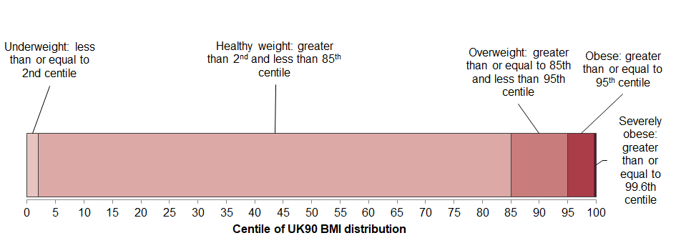
Child BMI classification definitions for population monitoring
For population monitoring purposes body mass index (BMI) is classified according to the following image using the British 1990 growth reference (UK90 ). This helps examine patterns in children’s weight status across the country and over time.
1
1 Cole TJ, Freeman JV, Preece MA. Body mass index reference curves for the UK, 1990. Archives of Disease in Childhood 1995 73:25-29.
4 Patterns and trends in child obesity in the East of England

Slide 5
Child obesity in the East of England
Prevalence of excess weight by sex and age
2019/20
Around 1 in 5 children in Reception (aged 4-5 years) are overweight or obese (21.8%)
Boys: 22.1%
Girls: 21.4%
Around 1 in 3 children in Year 6 (aged 10-11 years) are overweight or obese (32.7%)
Boys: 35.0%
Girls: 30.3%
5 Patterns and trends in child obesity in the East of England

Slide 6
Child obesity in the East of England
Prevalence of obesity by age and sex
2019/20
Around 1 in 10 children in Reception (aged 4-5 years) are obese (9%)
Boys: 9.2%
Girls: 8.8%
Around 1 in 5 children in Year 6 (aged 10-11 years) are obese (19.1%)
Boys: 21.2%
Girls: 16.8%
6 Patterns and trends in child obesity in the East of England

Slide 7
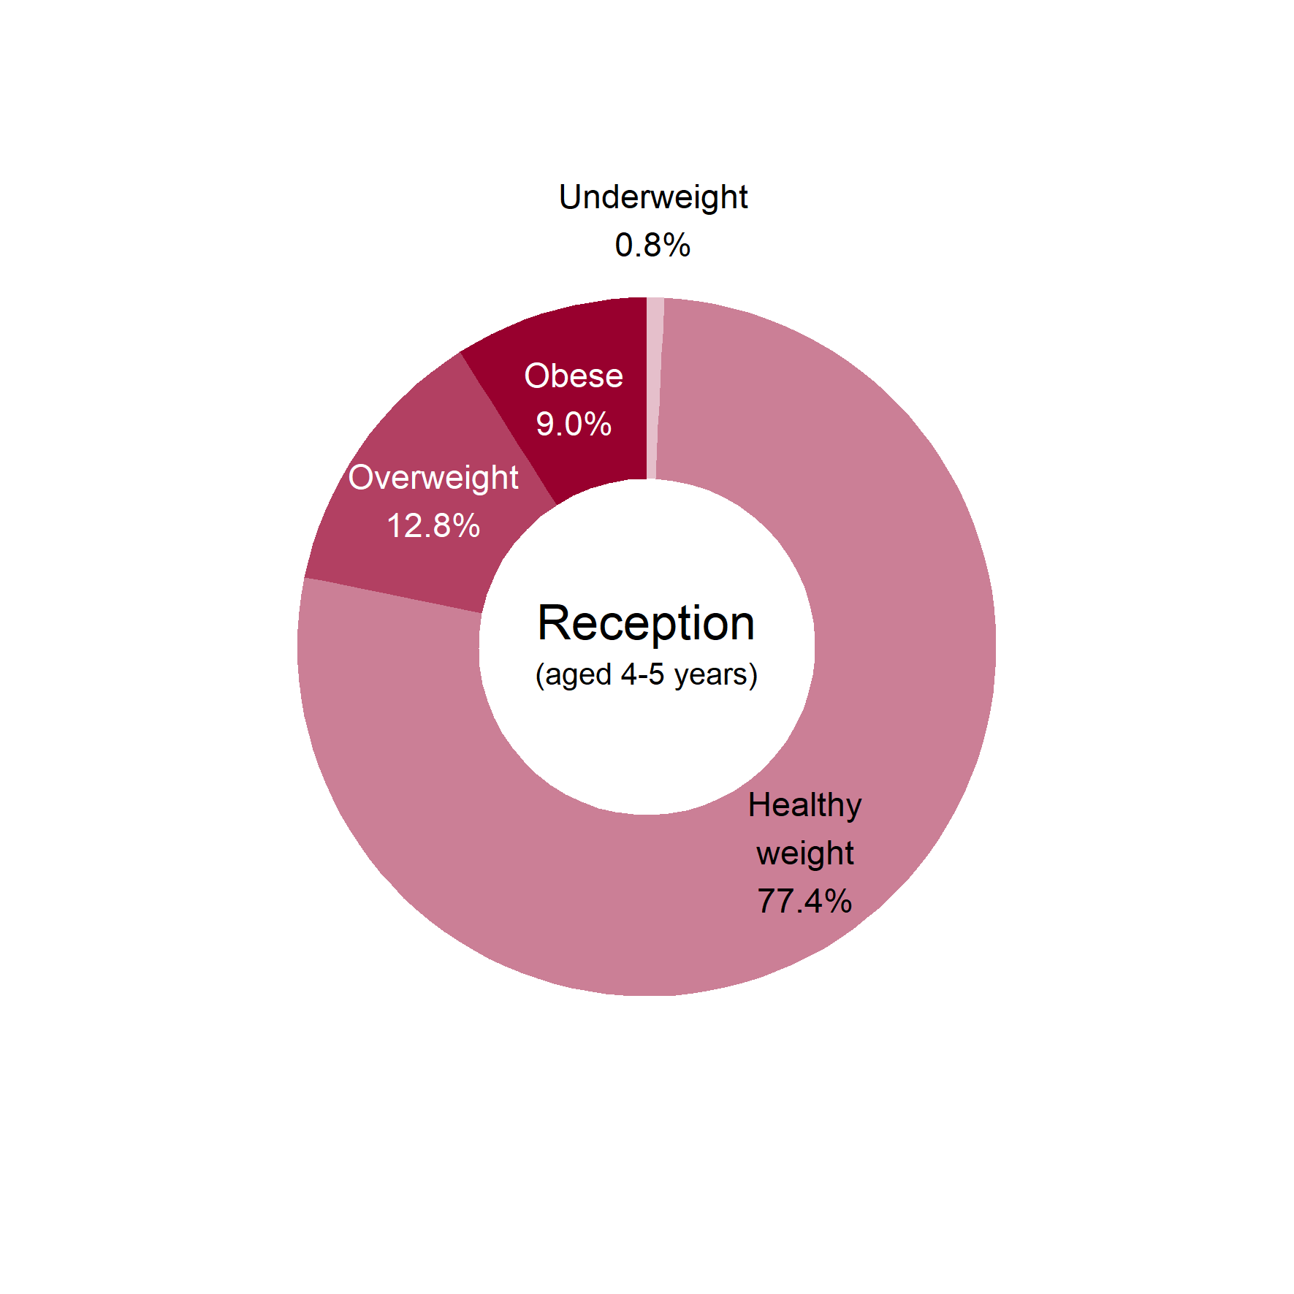
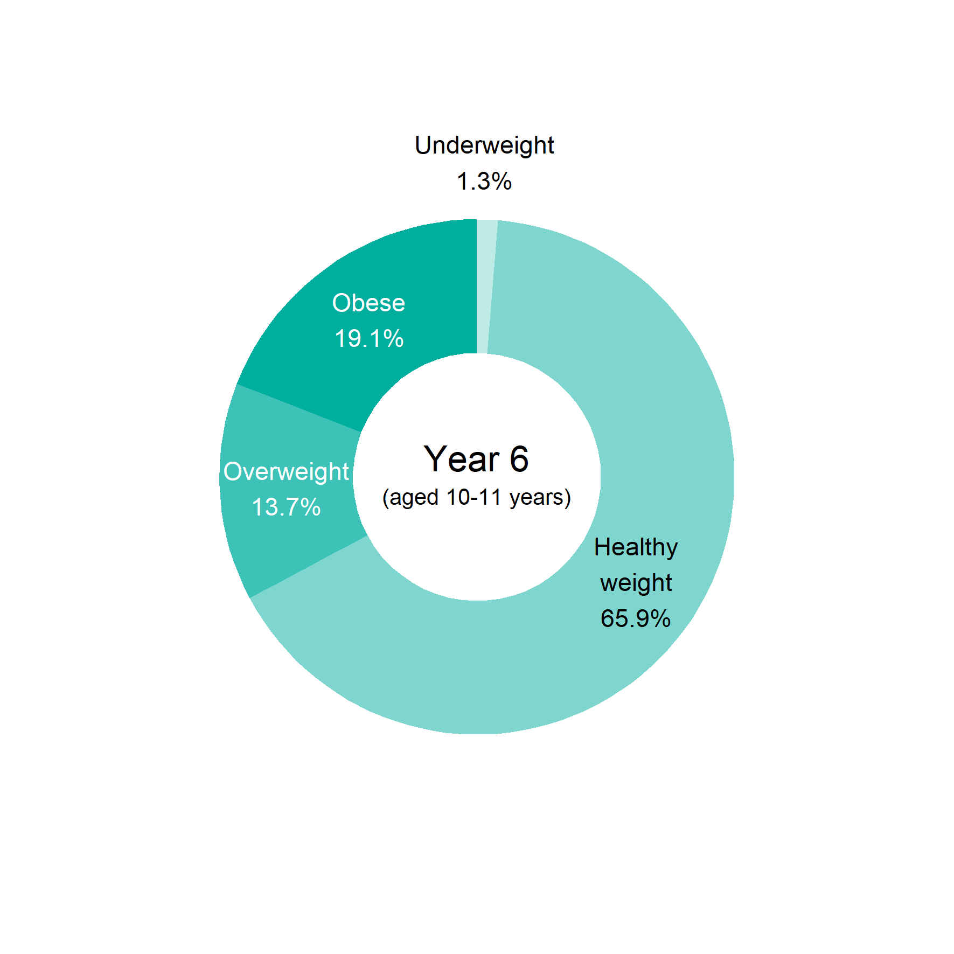
Child obesity in the East of England
BMI status of children by age
2019/20
7 Patterns and trends in child obesity in the East of England

Slide 8
Child obesity in the East of England
BMI status of children by age
2019/20
Reception
Year 6
8 Patterns and trends in child obesity in the East of England

Slide 9
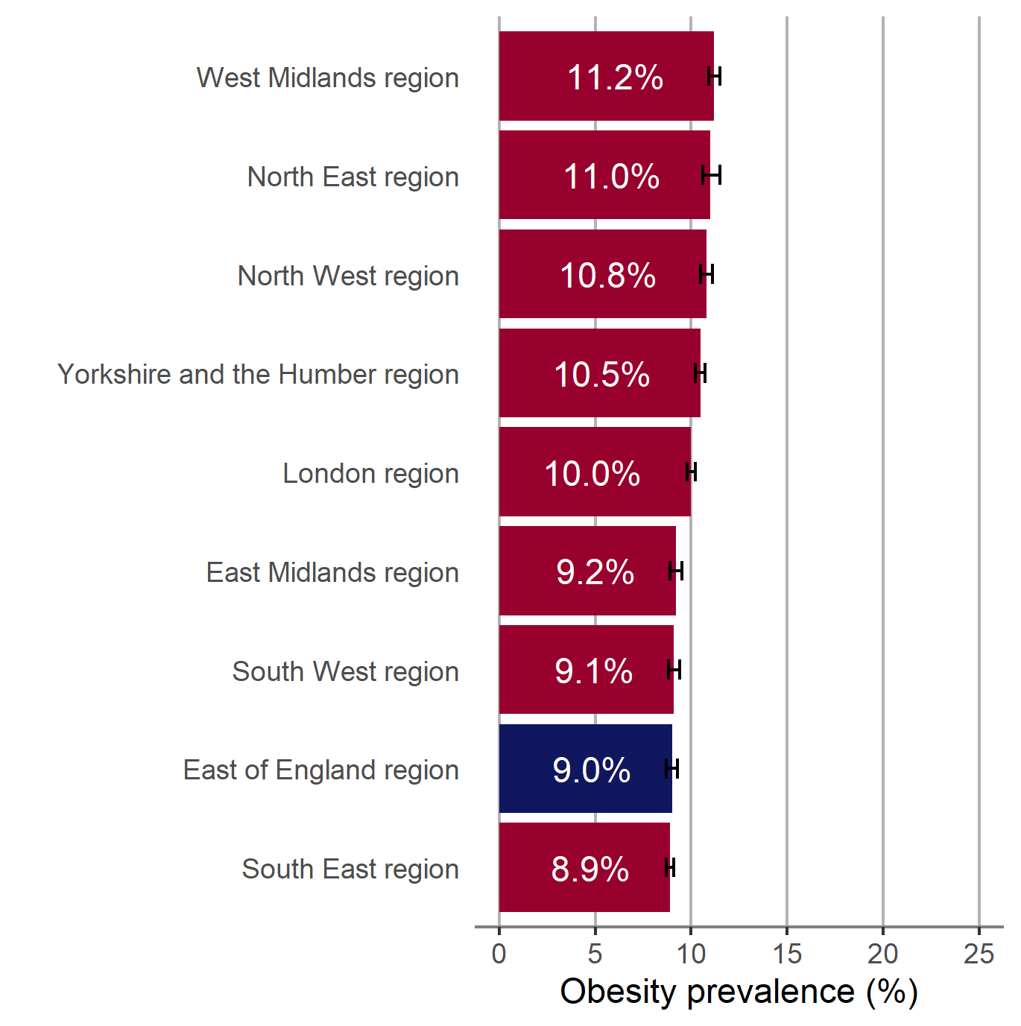
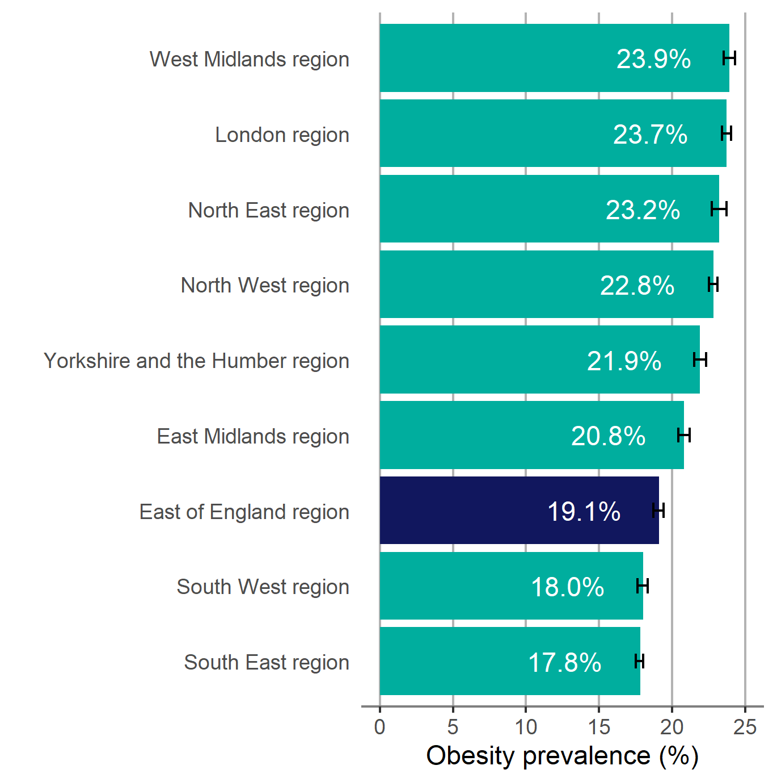
Child obesity in the East of England
Prevalence of obesity by region and age
2019/20
Children in Reception (aged 4-5 years)
Children in Year 6 (aged 10-11 years)
95% confidence intervals are shown
9 Patterns and trends in child obesity in the East of England

Slide 10
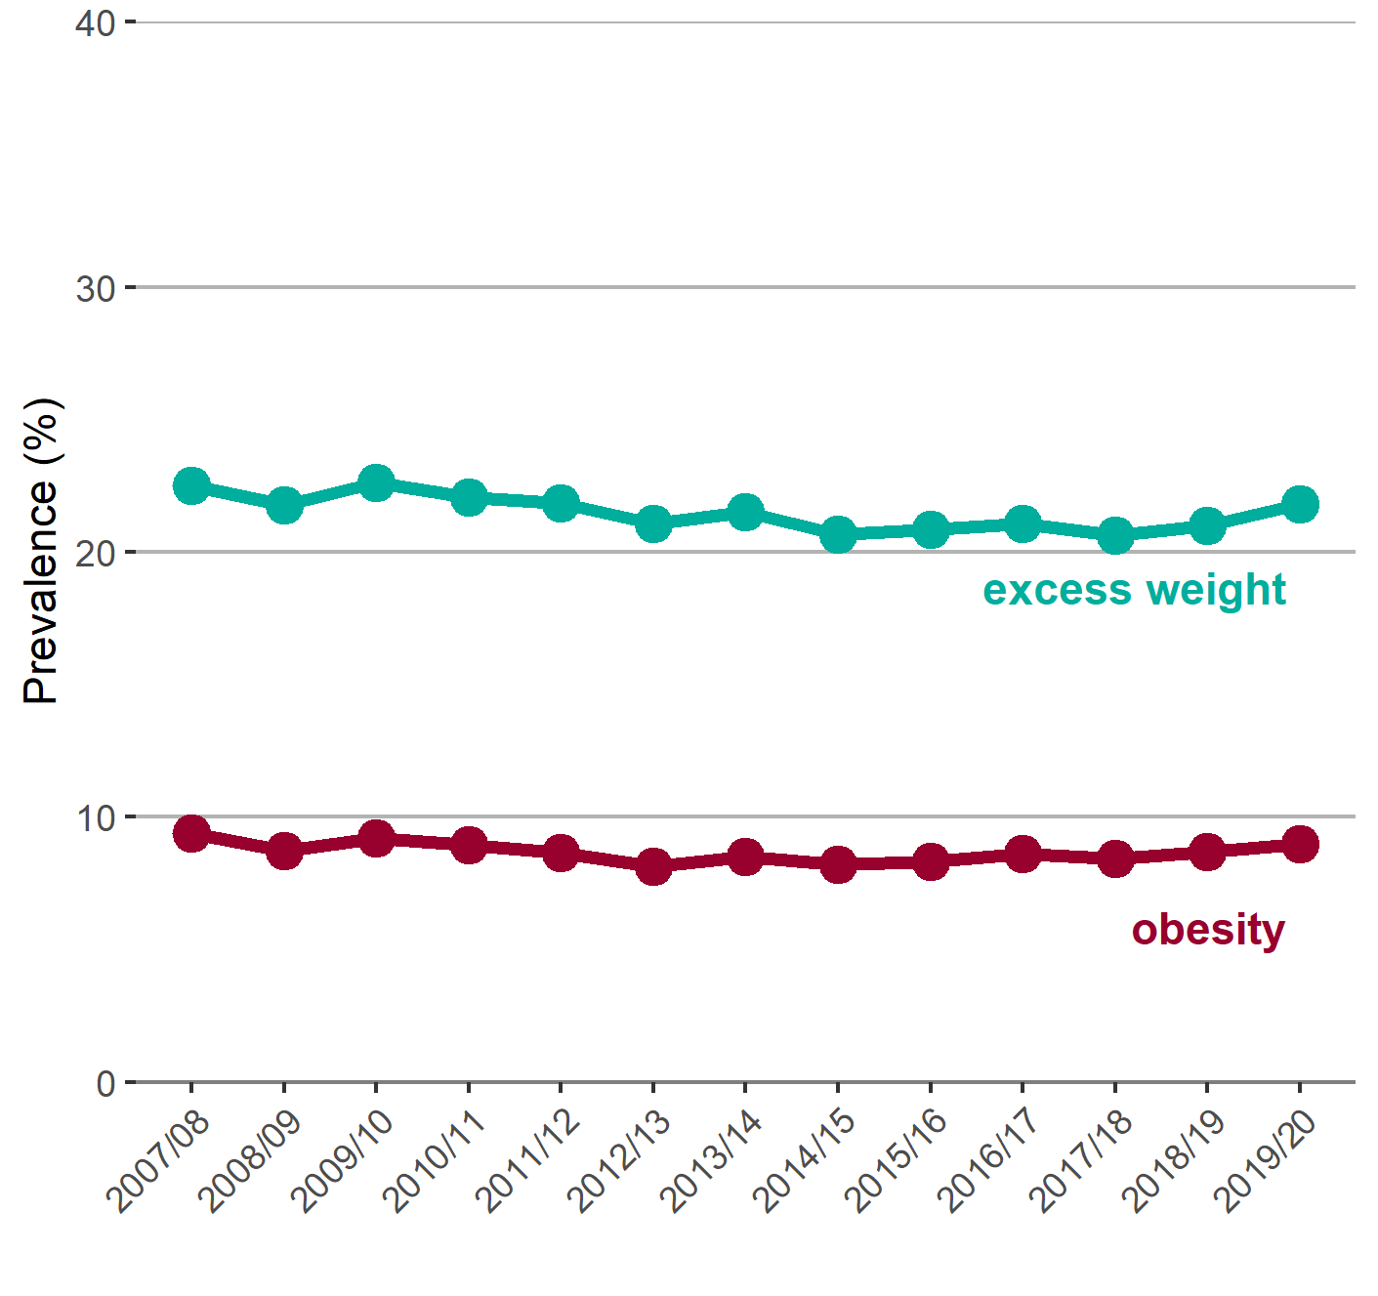
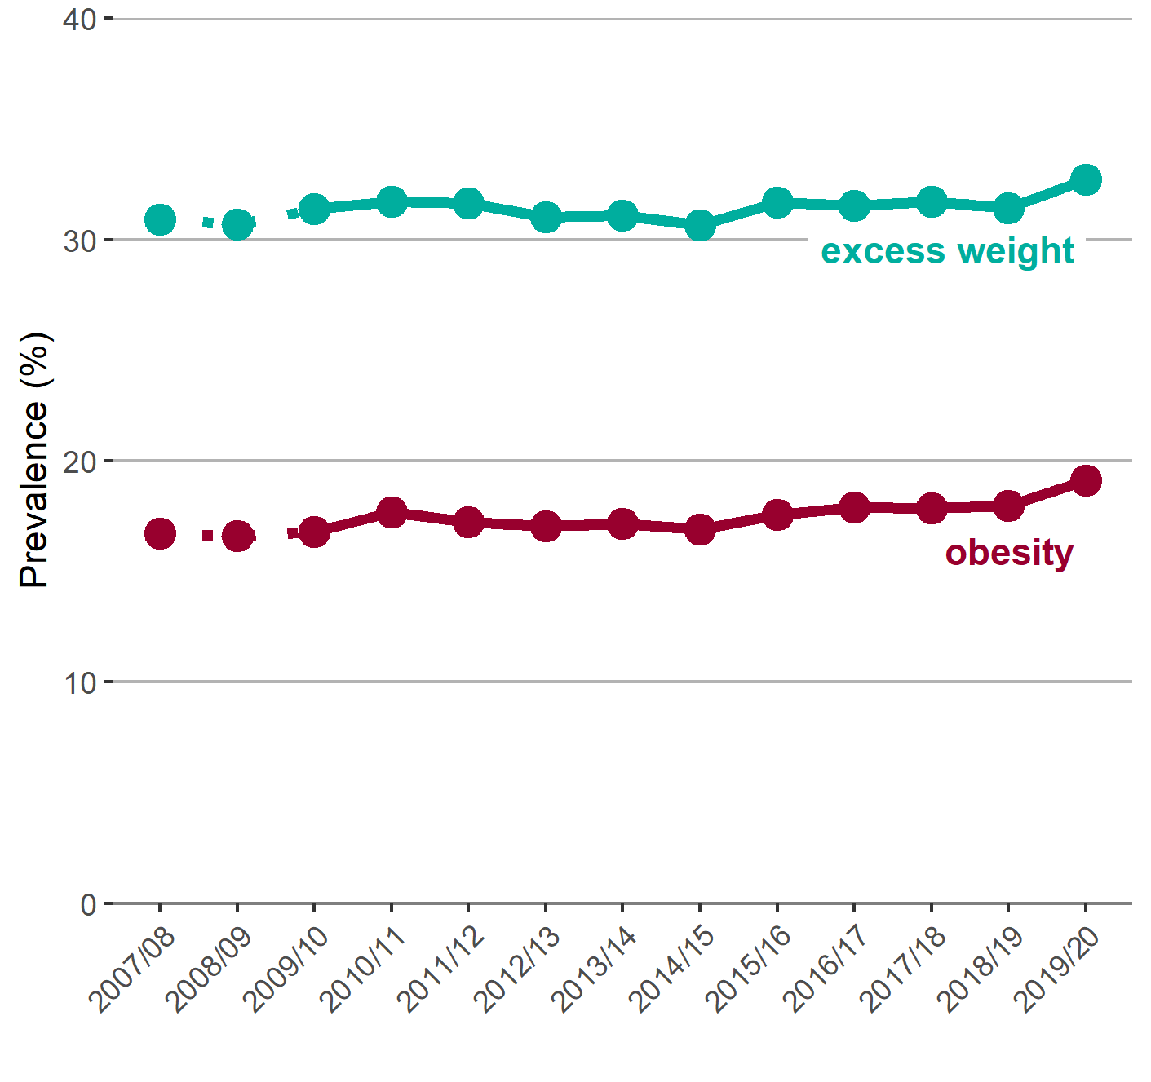
Child obesity in the East of England
Trend in the prevalence of obesity and excess weight by age
Children in Reception (aged 4-5 years)
Children in Year 6 (aged 10-11 years)
Note: for Year 6, comparisons are not possible with the first years of the NCMP (2007/08 to 2008/09) as low participation levels led to underestimation of obesity prevalence
10 Patterns and trends in child obesity in the East of England

Slide 11
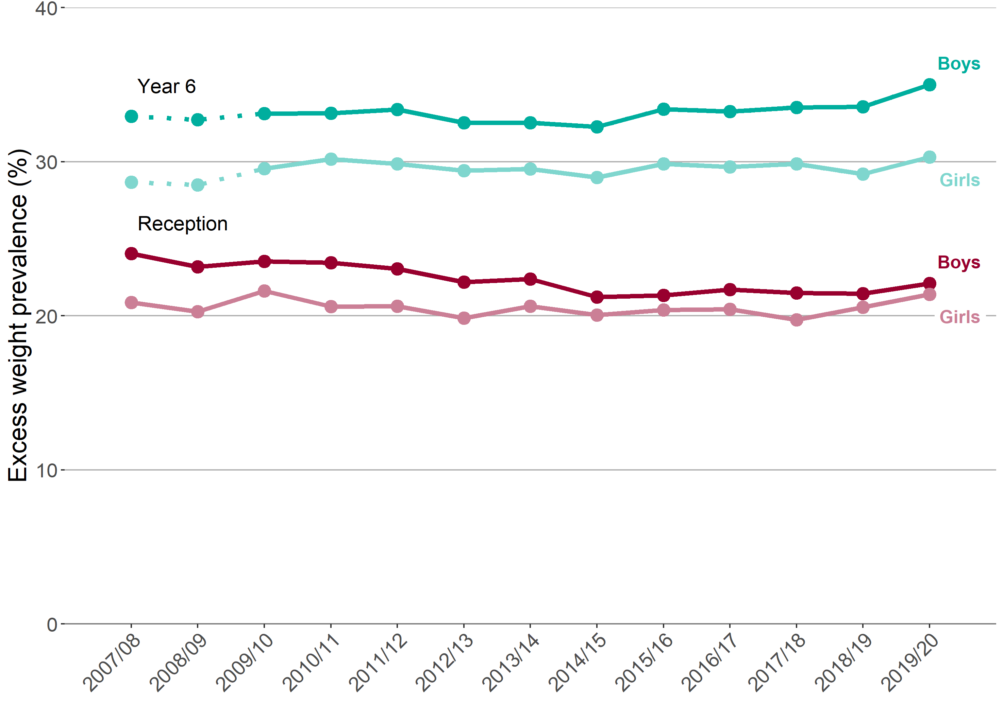
Child obesity in the East of England
Trend in the prevalence of excess weight by sex and age
Reception (aged 4-5 years) and Year 6 (aged 10-11 years)
Note: for Year 6, comparisons are not possible with the first years of the NCMP (2007/08 to 2008/09) as low participation levels led to underestimation of obesity prevalence
11 Patterns and trends in child obesity in the East of England

Slide 12
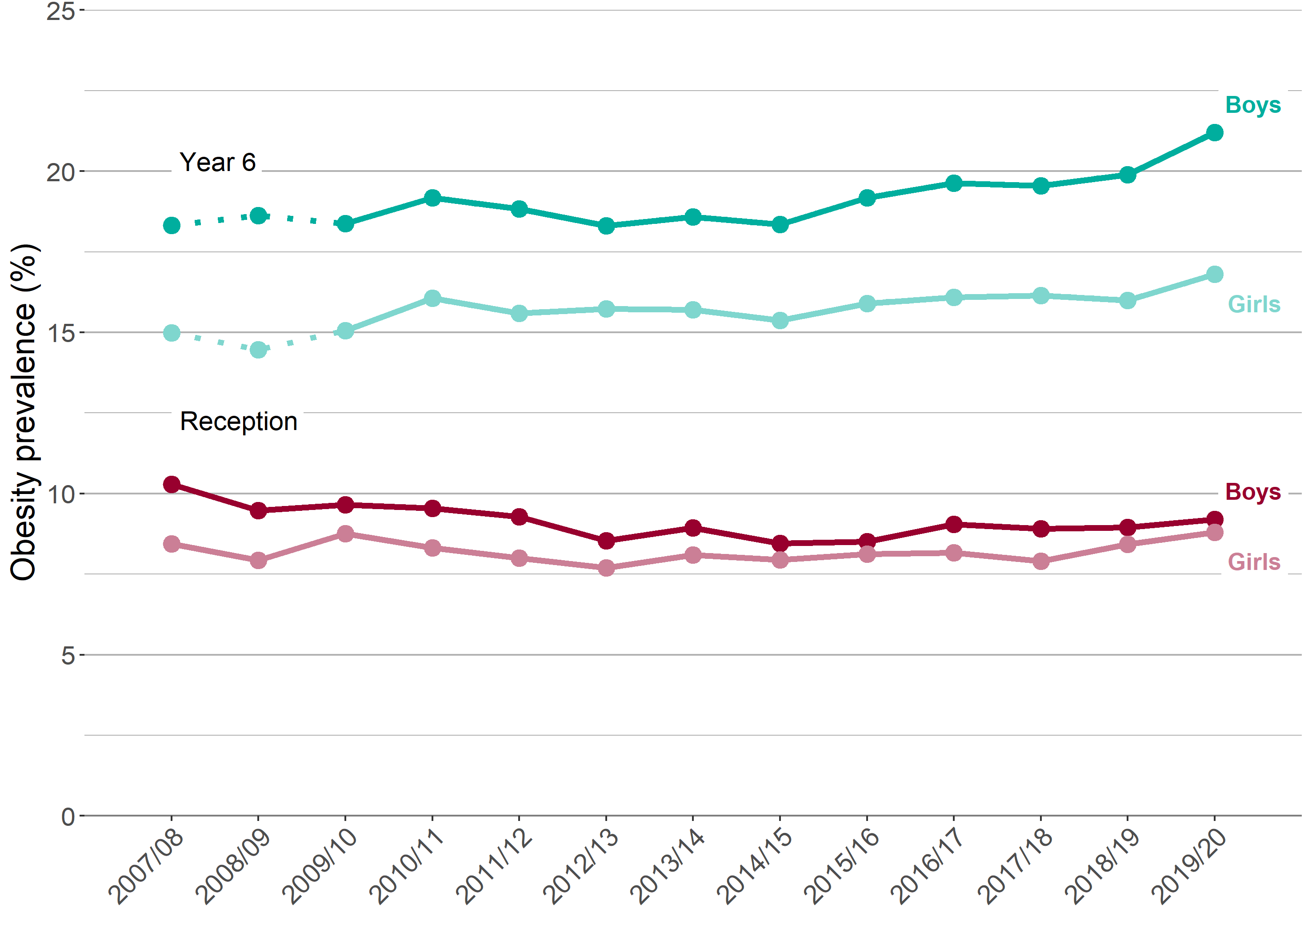
Child obesity in the East of England
Trend in the prevalence of obesity by sex and age
Reception (aged 4-5 years) and Year 6 (aged 10-11 years)
Note: for Year 6, comparisons are not possible with the first years of the NCMP (2007/08 to 2008/09) as low participation levels led to underestimation of obesity prevalence
12 Patterns and trends in child obesity in the East of England

Slide 13
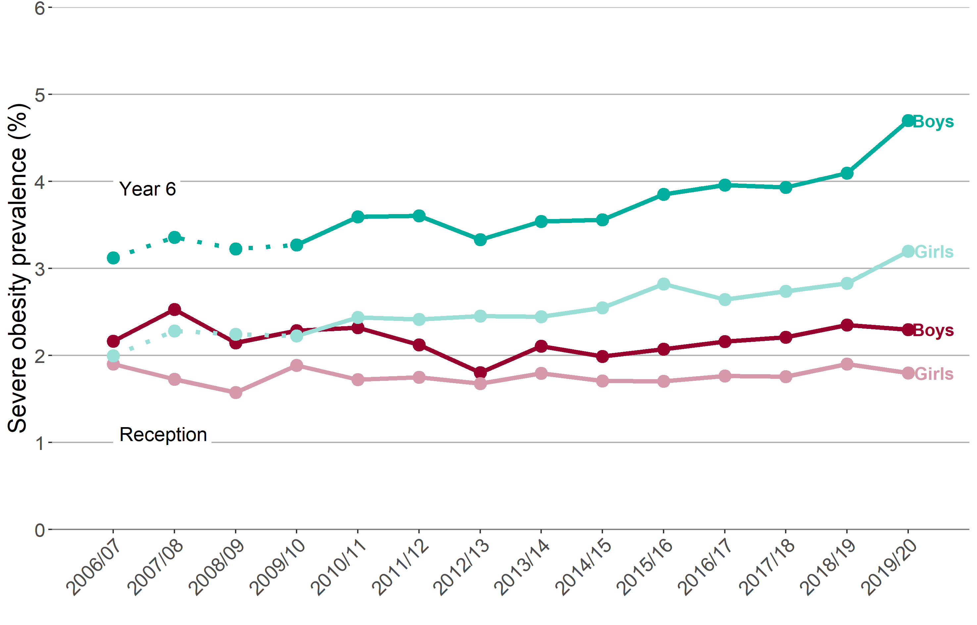
Child obesity in the East of England
Trend in the prevalence of severe obesity by age and sex
Reception (aged 4-5 years) and Year 6 (aged 10-11 years)
Note: for Year 6, comparisons are not possible with the first years of the NCMP (2006/07 to 2008/09) as low participation levels led to underestimation of obesity prevalence
12 Patterns and trends in child obesity in the East of England

Slide 14
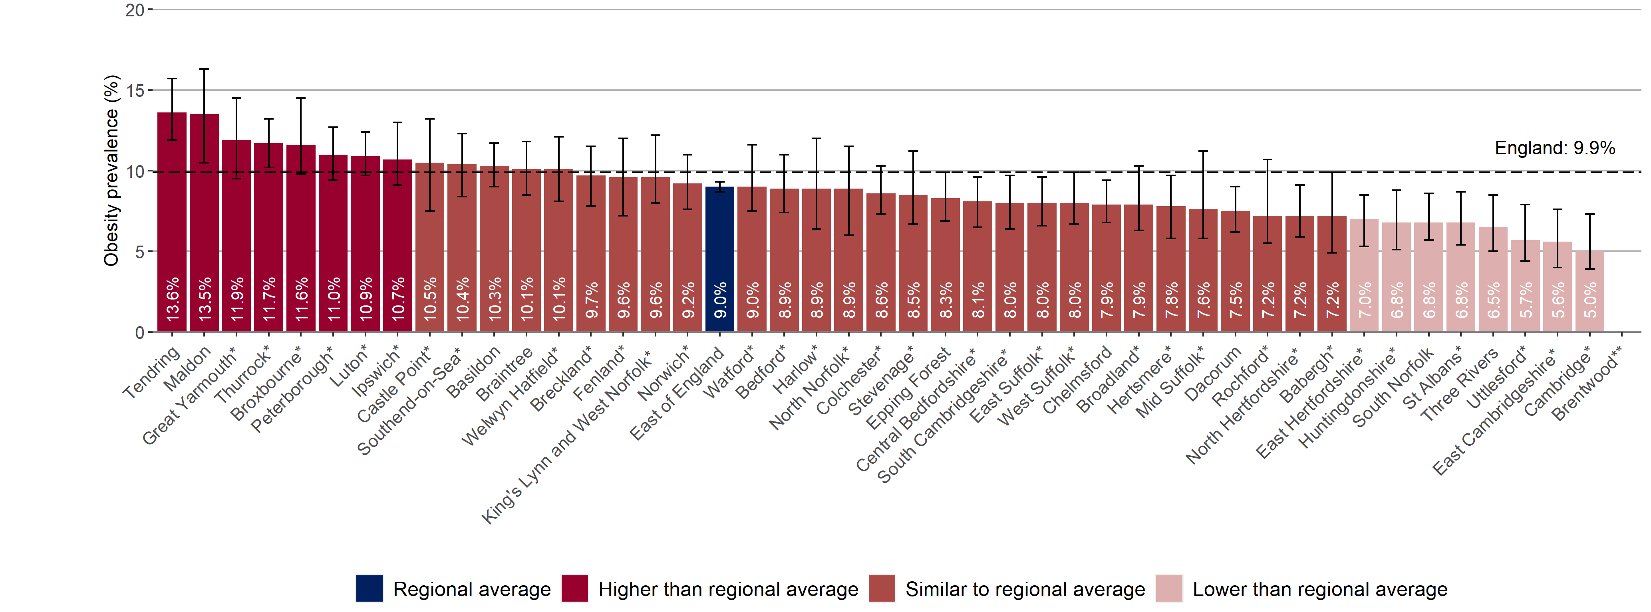
Child obesity in the East of England
Prevalence of obesity, 2019/20
East of England District and Unitary Authorities
Children in Reception (aged 4-5 years)
95% confidence intervals are shown
*Interpret with caution: see Excel file for detail
**Data value suppressed
14 Patterns and trends in child obesity in the East of England

Slide 15
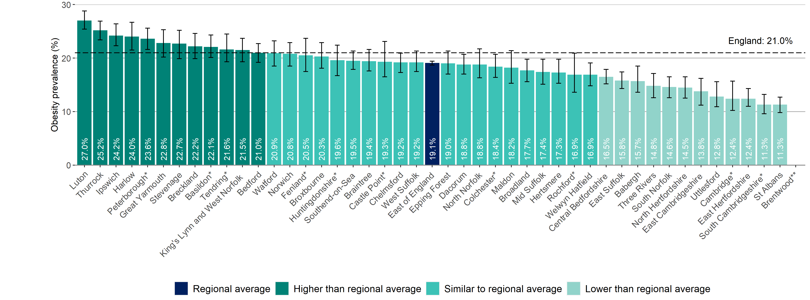
Child obesity in the East of England
Prevalence of obesity, 2019/20
East of England District and Unitary Authorities
Children in Year 6 (aged 10-11 years)
95% confidence intervals are shown
*Interpret with caution: see Excel file for detail
**Data value suppressed
15 Patterns and trends in child obesity in the East of England

Slide 16
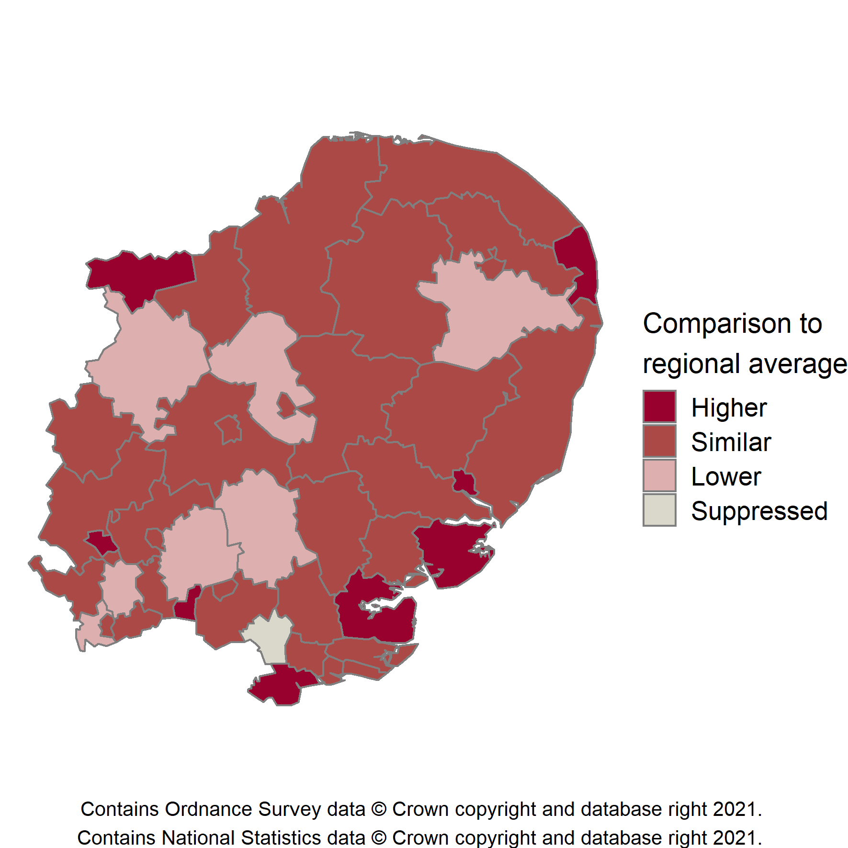
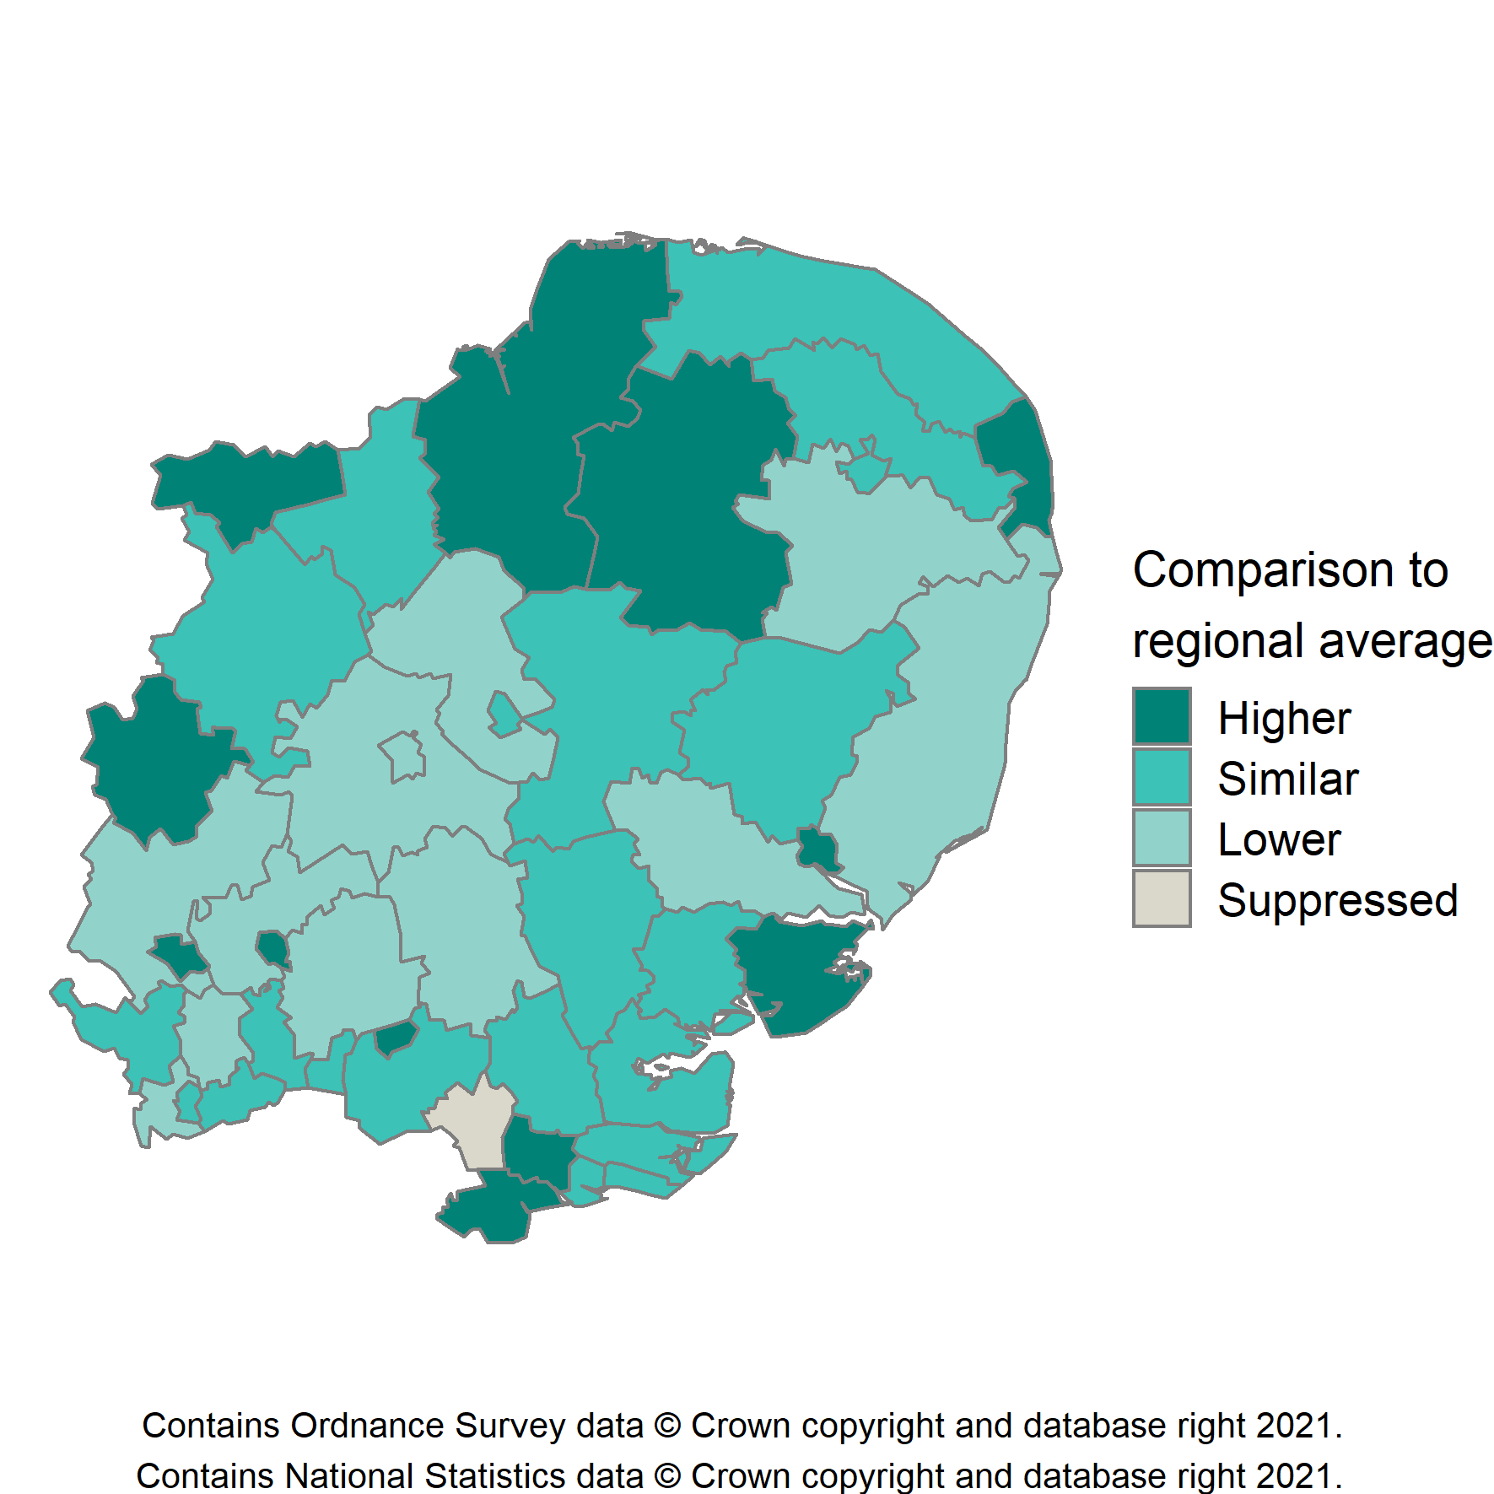
Child obesity in the East of England
Prevalence of obesity by age, 2019/20
East of England District and Unitary Authorities
Children in Reception (aged 4-5 years)
Children in Year 6 (aged 10-11 years)
Some local authority areas have a
data reliability flag
indicating that figures need to be interpreted with caution
16 Patterns and trends in child obesity in the East of England

Slide 17
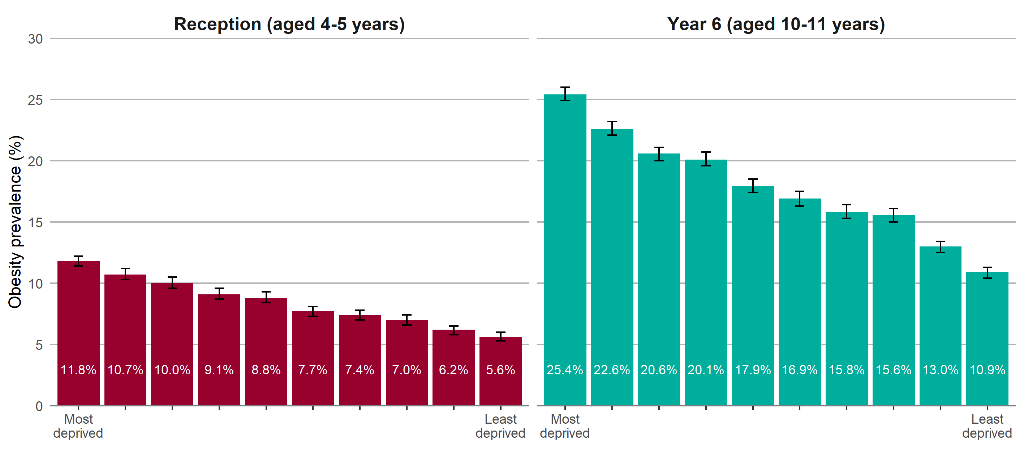
Child obesity in the East of England
Obesity prevalence by regional deprivation and age
Data grouped over 3 years ( 2017/18-2019/20 ) Region-specific deprivation deciles displayed (IMD 2019) 95% confidence intervals are shown
17 Patterns and trends in child obesity in the East of England

Slide 18
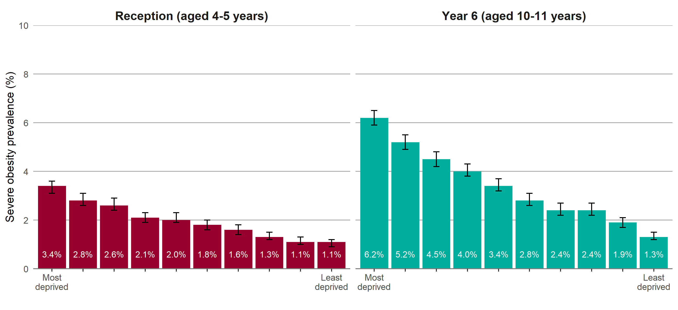
Child obesity in the East of England
Severe obesity prevalence by regional deprivation and age
Data grouped over 3 years ( 2017/18-2019/20 ) Region-specific deprivation deciles displayed (IMD 2019) 95% confidence intervals are shown
18 Patterns and trends in child obesity in the East of England

Slide 19
Slope Index of Inequality
The Slope Index of Inequality (SII) is a measure of the social gradient in an indicator and shows how much the indicator varies with deprivation (by deprivation decile).
It takes account of inequalities across the whole range of deprivation within each region and summarises this into a single number.
The higher the value of the SII, the greater the inequality within an area. The SII is greater in Year 6 children than in Reception.
Increasing SII over time indicates widening inequality.
For further information on the SII see: Regidor E. Measures of health inequalities: part 2. Journal of Epidemiology & Community Health 2004 –58:900-903.
19 Patterns and trends in child obesity in the East of England

Slide 20
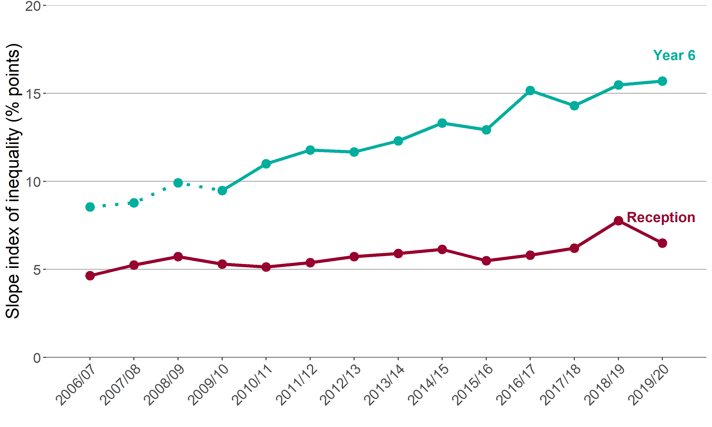
Child obesity in the East of England
Trend in the slope index of inequality by age
Reception (aged 4-5 years) and Year 6 (aged 10-11 years)
Note: for Year 6, comparisons are not possible with the first years of the NCMP (2006/07 to 2008/09) as low participation levels led to underestimation of obesity prevalence
20 Patterns and trends in child obesity in the East of England

Slide 21
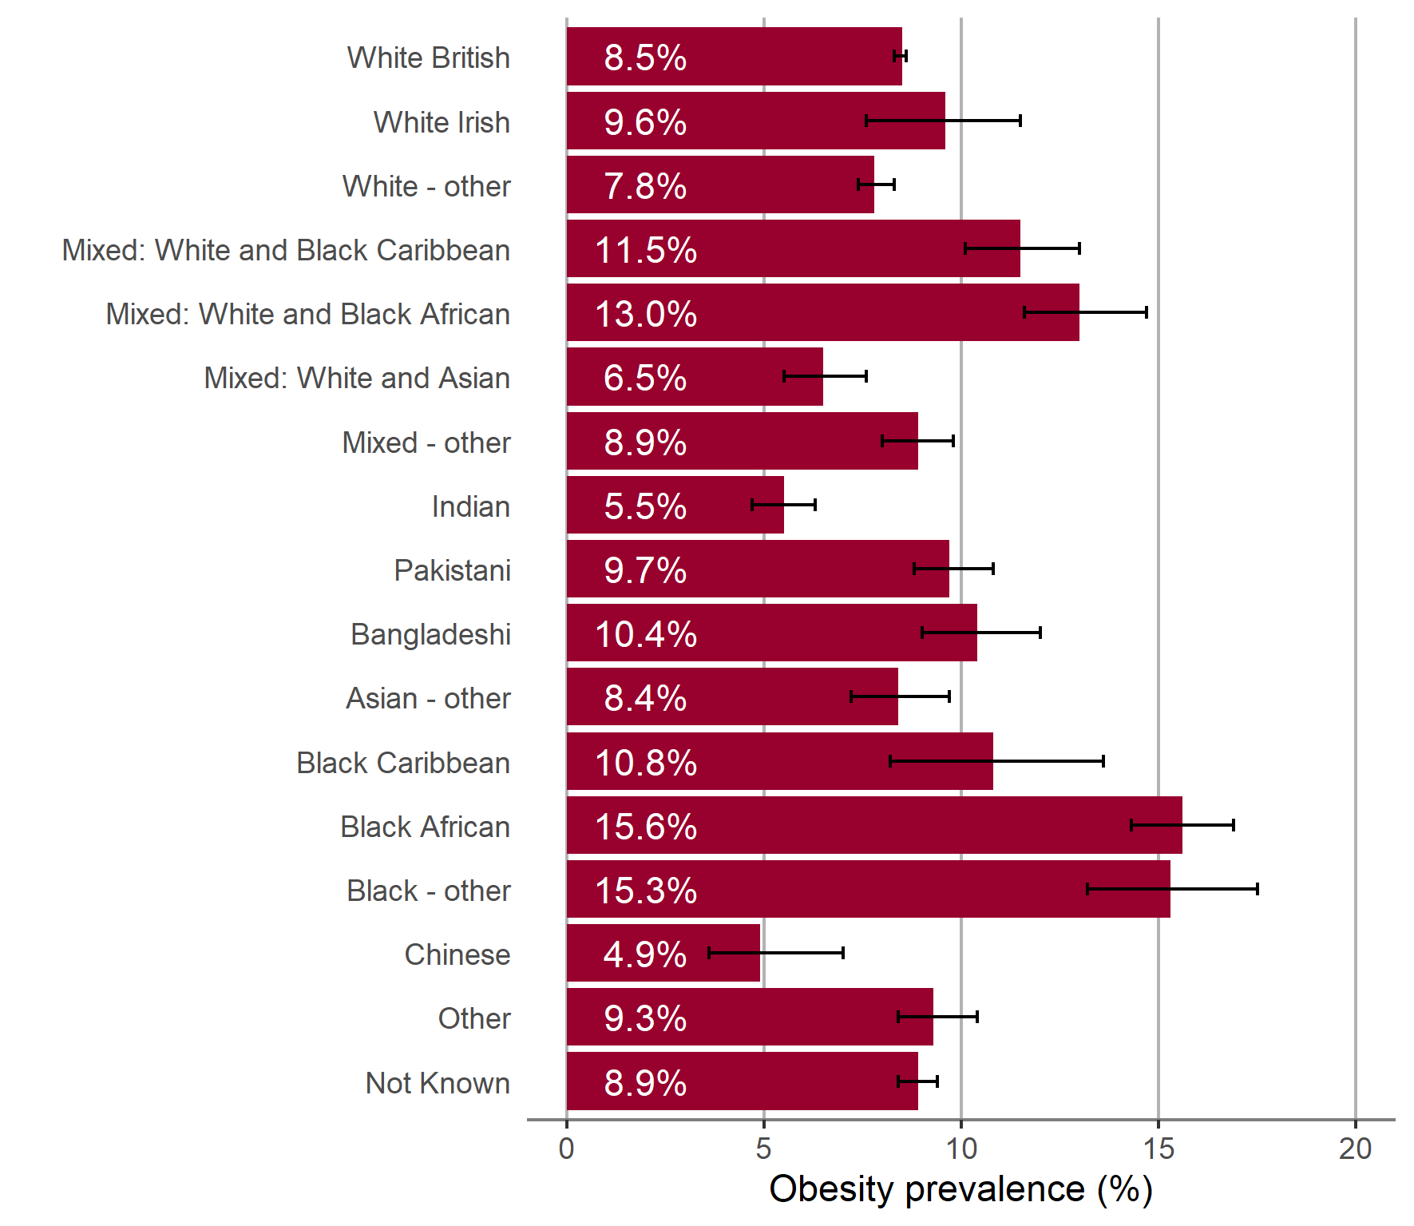
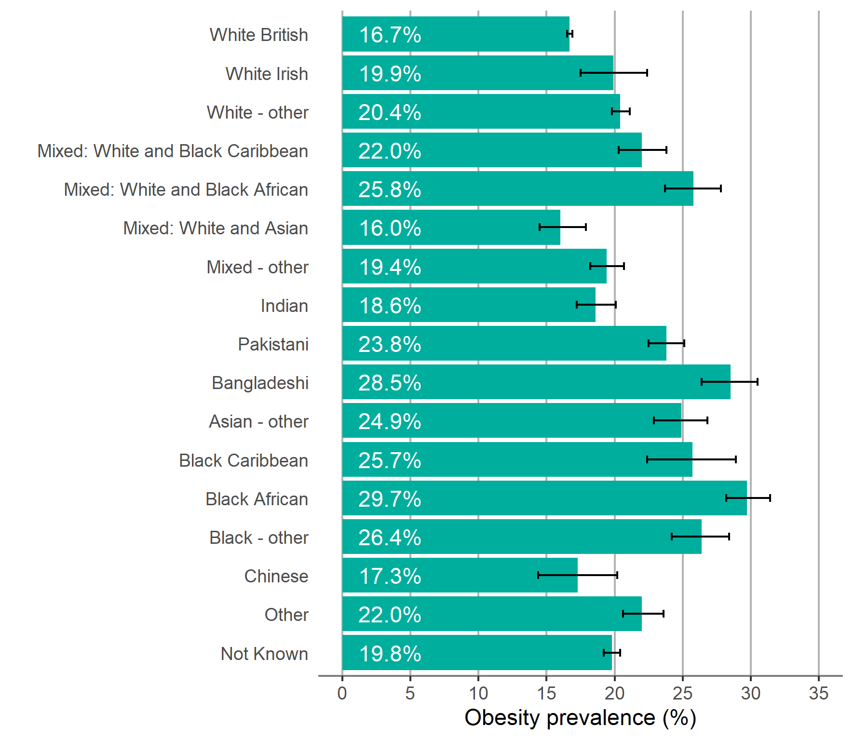
Child obesity in the East of England
Obesity prevalence by ethnic group and age
Children in Reception (aged 4-5 years)
Children in Year 6 (aged 10-11 years)
Data grouped over 3 years ( 2017/18-2019/20 ) 95% confidence intervals are shown
21 Patterns and trends in child obesity in the East of England

Slide 22
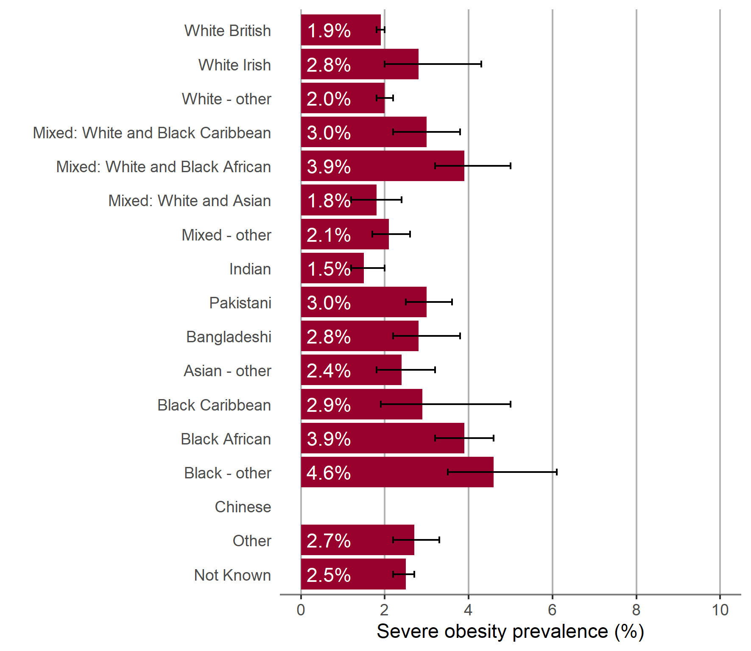
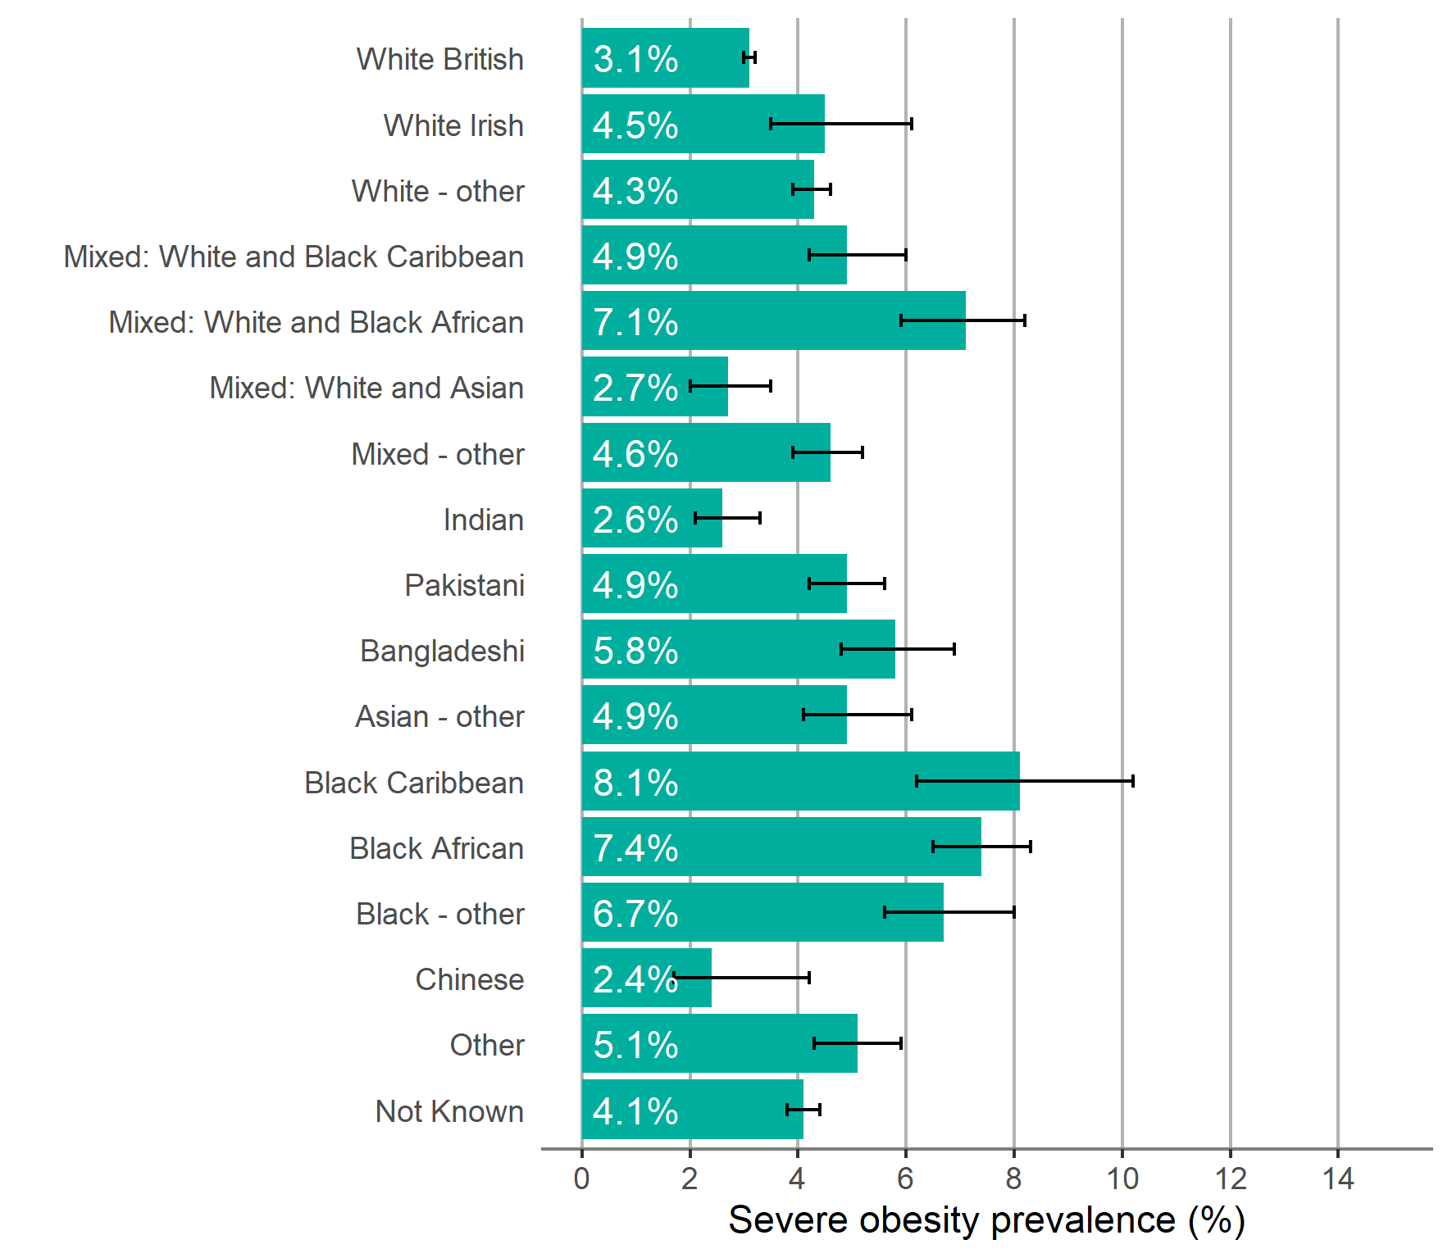
Child obesity in the East of England
Severe obesity prevalence by ethnic group and age
Children in Reception (aged 4-5 years)
Children in Year 6 (aged 10-11 years)
Data missing on the chart is due to suppression for disclosure control reasons
Data grouped over 3 years ( 2017/18-2019/20 ) 95% confidence intervals are shown
22 Patterns and trends in child obesity in the East of England

Slide 23
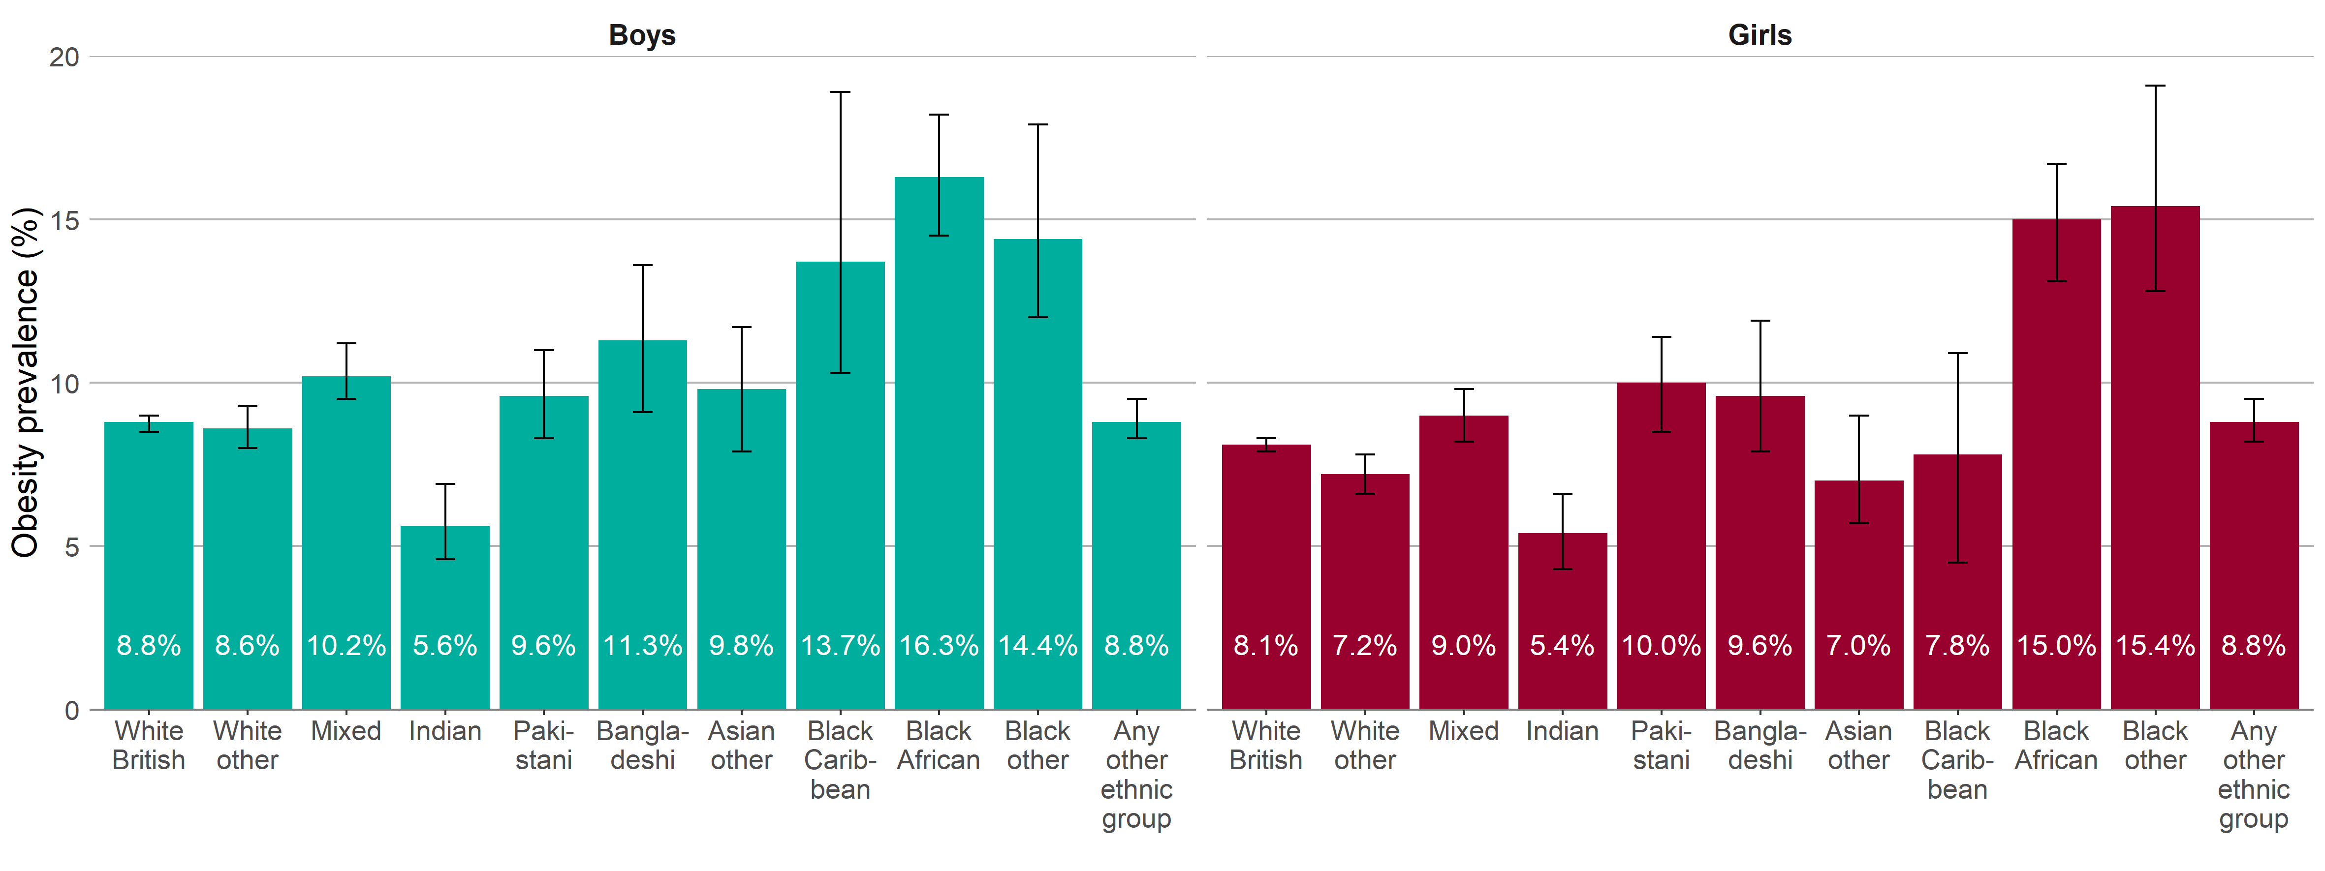
Child obesity in the East of England
Obesity prevalence by ethnic group and sex
Children in Reception (aged 4-5 years)
Data grouped over 3 years ( 2017/18-2019/20 ) 95% confidence intervals are shown
22 Patterns and trends in child obesity in the East of England

Slide 24
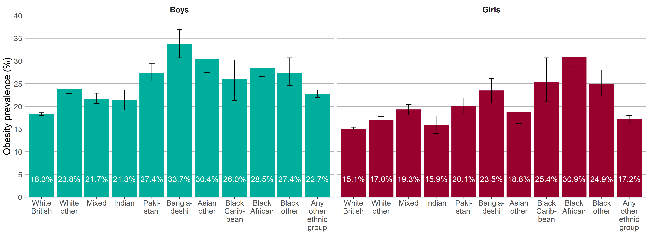
Child obesity in the East of England
Obesity prevalence by ethnic group and sex
Children in Year 6 (aged 10-11 years)
Data grouped over 3 years ( 2017/18-2019/20 ) 95% confidence intervals are shown
24 Patterns and trends in child obesity in the East of England

Slide 25
Obesity Profile - an online tool
Child obesity data from the NCMP 2006/07 to 2019/20 is available in an online tool. The tool provides local authority level child data (underweight, healthy weight, overweight, obesity, excess weight - overweight including obesity, severe obesity) for Reception (aged 4-5 years) and Year 6 (aged 10-11 years). The tool also presents trend data and enables easy comparison of local authority data, allowing users to compare regional neighbours and local authorities with similar characteristics. Inequalities data (sex, deprivation and ethnic group) is also available by local authority. View the online tool:
http://fingertips.phe.org.uk/profile/national-child-measurement-programme
Screenshot of webpage
25 Patterns and trends in child obesity in the East of England

Slide 26
Further information:
PHE Obesity Intelligence Knowledge Hub:
Sign up on https://khub.net/ and join the PHE Obesity Intelligence group
PHE Obesity Intelligence Knowledge Hub public library (no need to join):
https://khub.net/web/phe-obesity-intelligence/public-library
PHE Web:
https://www.gov.uk/guidance/phe-data-and-analysis-tools#obesity-diet-and-physical-activity
Email:
ncmp@phe.gov.uk
26 Patterns and trends in child obesity in the East of England

Slide 27
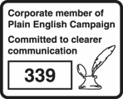
About Public Health England
Public Health England exists to protect and improve the nation’s health and wellbeing, and reduce health inequalities. We do this through world-leading science, knowledge and intelligence, advocacy, partnerships and the delivery of specialist public health services. We are an executive agency of the Department of Health and Social Care, and a distinct delivery organisation with operational autonomy. We provide government, local government, the NHS, Parliament, industry and the public with evidence-based professional, scientific and delivery expertise and support.
Public Health England, Wellington House, 133-155 Waterloo Road, London SE1 8UG Tel: 020 7654 8000
www.gov.uk/phe
Twitter:
@PHE_uk
Facebook:
www.facebook.com/PublicHealthEngland
© Crown copyright 2021 You may re-use this information (excluding logos) free of charge in any format or medium, under the terms of the Open Government Licence v3.0. To view this licence, visit https://www.nationalarchives.gov.uk/doc/open-government-licence/version/3/ Where we have identified any third party copyright information you will need to obtain permission from the copyright holders concerned.
Published February 2021 PHE publications gateway number: GW-1889
27 Patterns and trends in child obesity in the East of England

