Slide 1
Patterns and trends in child obesity in the South West
A presentation of the latest data on child obesity at regional level February 2019

Slide 2
National Child Measurement Programme
The data in this slide pack is from the National Child Measurement Programme (NCMP).
The NCMP is an annual programme that measures the height and weight of children in Reception (aged 4 to 5 years) and Year 6 (aged 10 to 11 years) in England. Although the NCMP only covers certain age groups, it includes the majority of children in those year groups.
The number of children measured in the South West in 2017/18 was 54,932 in Reception, and 50,768 in Year 6. The participation rate in the South West in 2017/18 was 93.0% in Reception children and 89.8% for children in Year 6.
NCMP website:
http://content.digital.nhs.uk/ncmp
2 Patterns and trends in child obesity in the South West

Slide 3
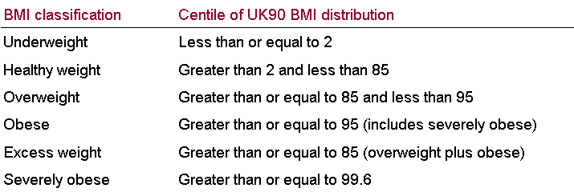
Child BMI classification definitions for population monitoring
For population monitoring purposes, to help examine patterns in children’s weight status across the country and over time, BMI is classified according to the following table using the British 1990 growth reference (UK90¹):
1 Cole TJ, Freeman JV, Preece MA. Body mass index reference curves for the UK, 1990. Archives of Disease in Childhood 1995 73:25-29.
3 Patterns and trends in child obesity in the South West

Slide 4
Child obesity in the South West
Prevalence of excess weight by age
Reception (aged 4-5 years) and Year 6 (aged 10-11 years)
Around 1 in 5 children in Reception are overweight or obese
Boys: 22.5%
Girls: 21.3%
Around 1 in 3 children in Year 6 are overweight or obese
Boys: 32.3%
Girls: 28.2%
Child excess weight (overweight including obesity): BMI greater than or equal to the 85 centile of the UK90 growth reference Source: National Child Measurement Programme 2017/18
th
4 Patterns and trends in child obesity in the South West

Slide 5
Child obesity in the South West
Prevalence of obesity by age
Reception (aged 4-5 years) and Year 6 (aged 10-11 years)
Around 1 in 12 children in Reception are obese
Boys: 8.8%
Girls: 8.1%
Around 1 in 5 children in Year 6 are obese
Boys: 18.6%
Girls: 14.9%
Child obesity: BMI greater than or equal to the 95 centile of the UK90 growth reference Source: National Child Measurement Programme 2017/18
th
5 Patterns and trends in child obesity in the South West

Slide 6
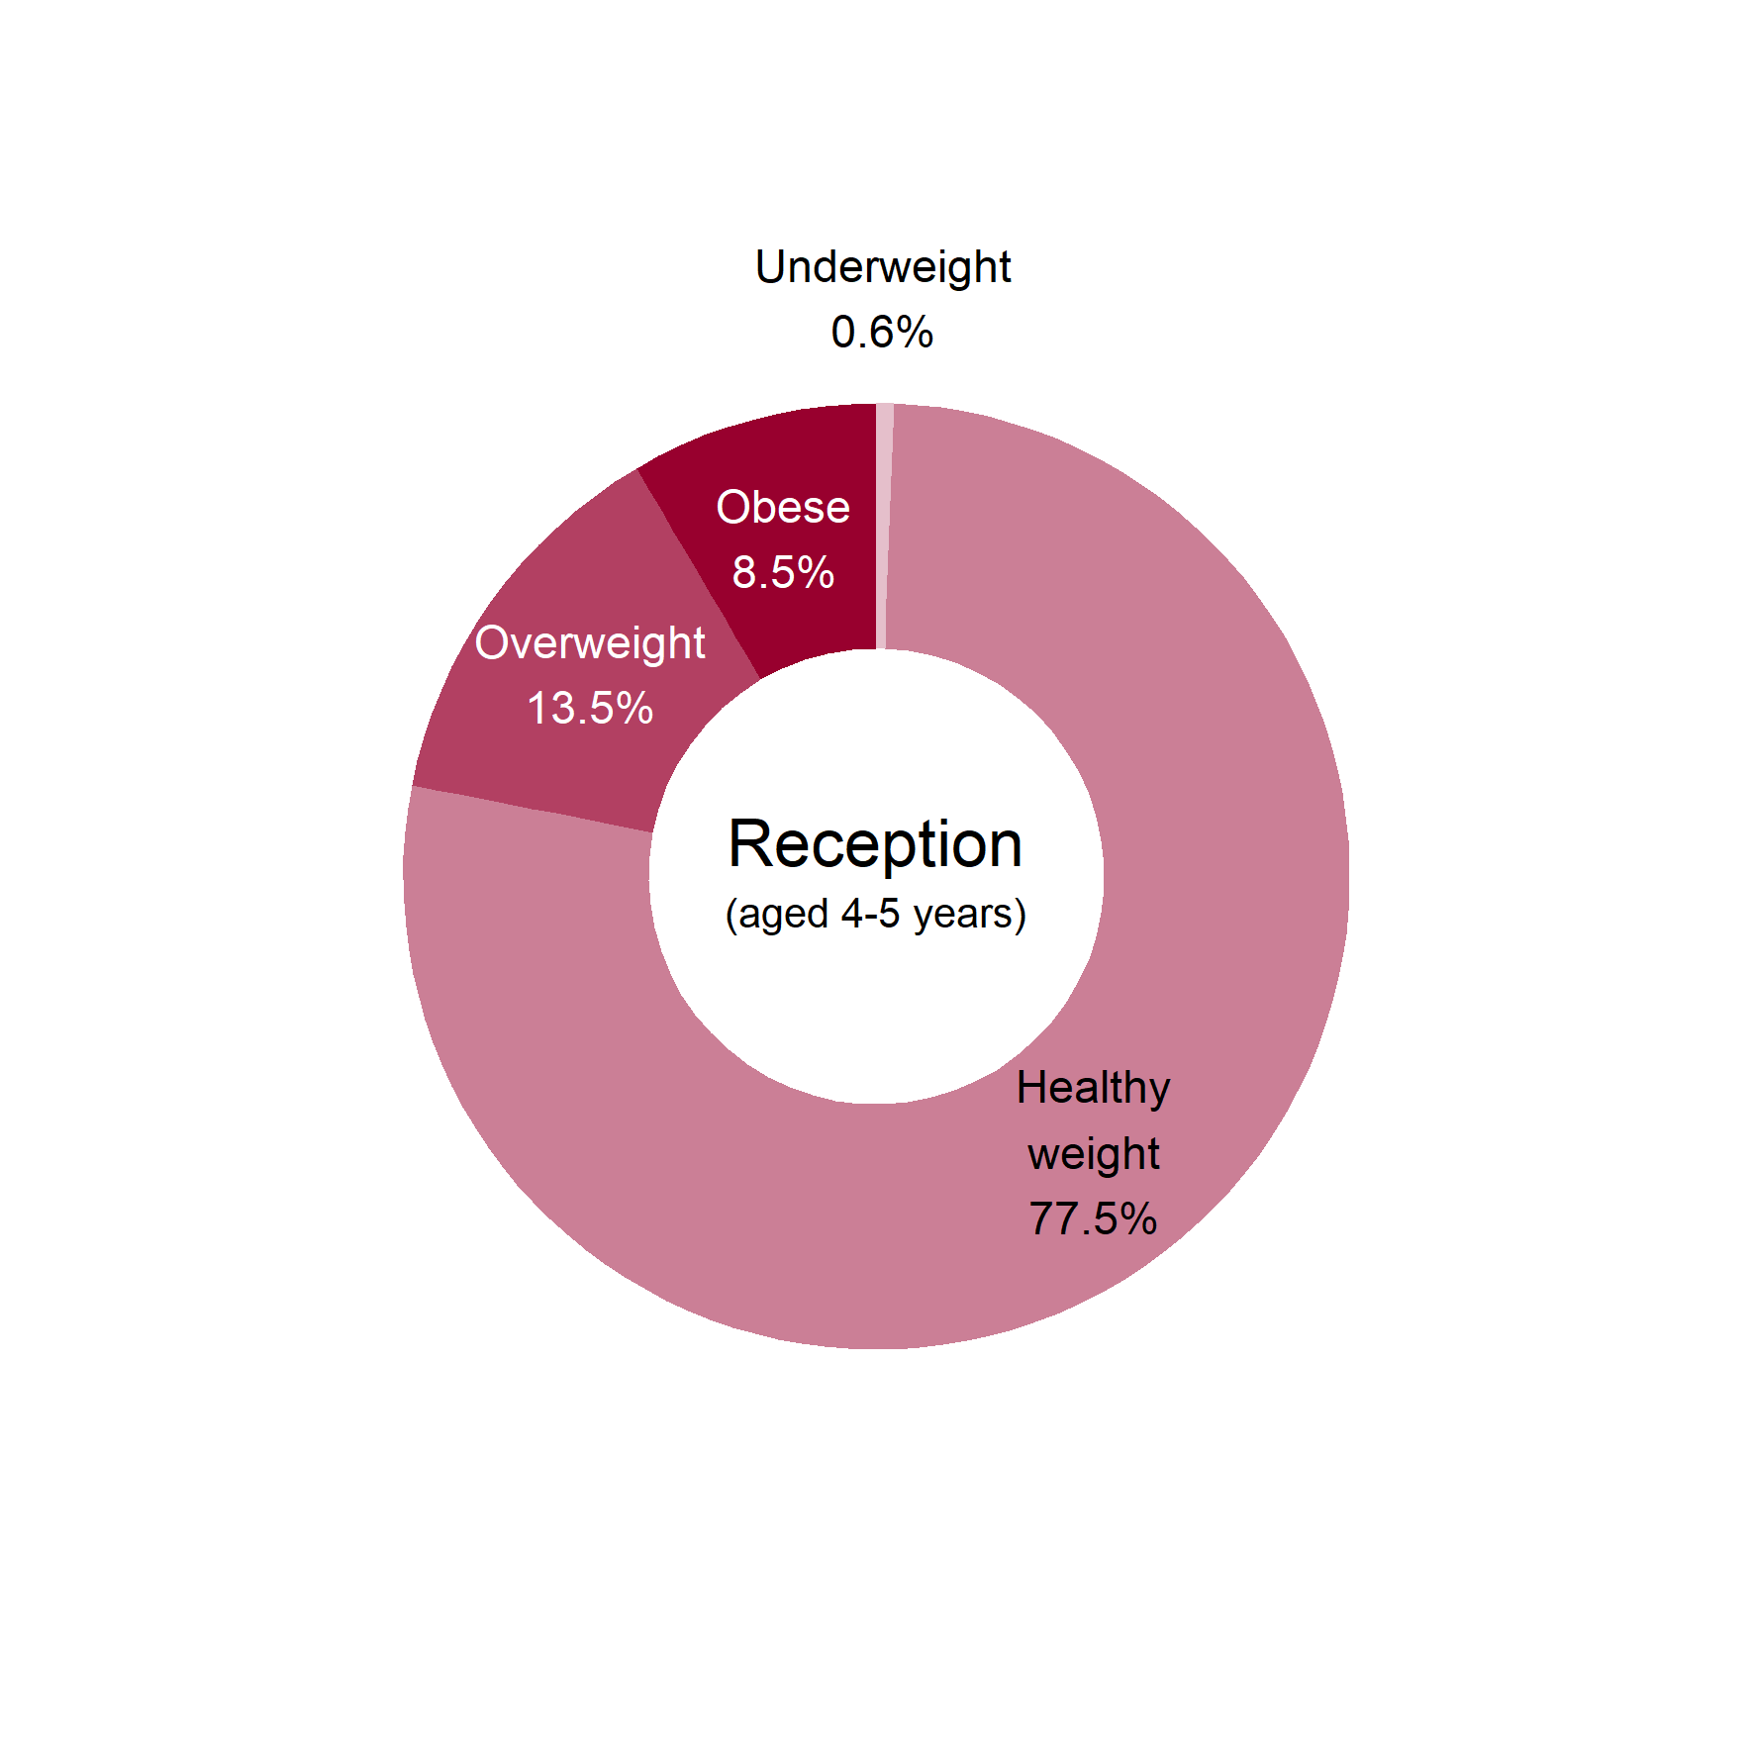
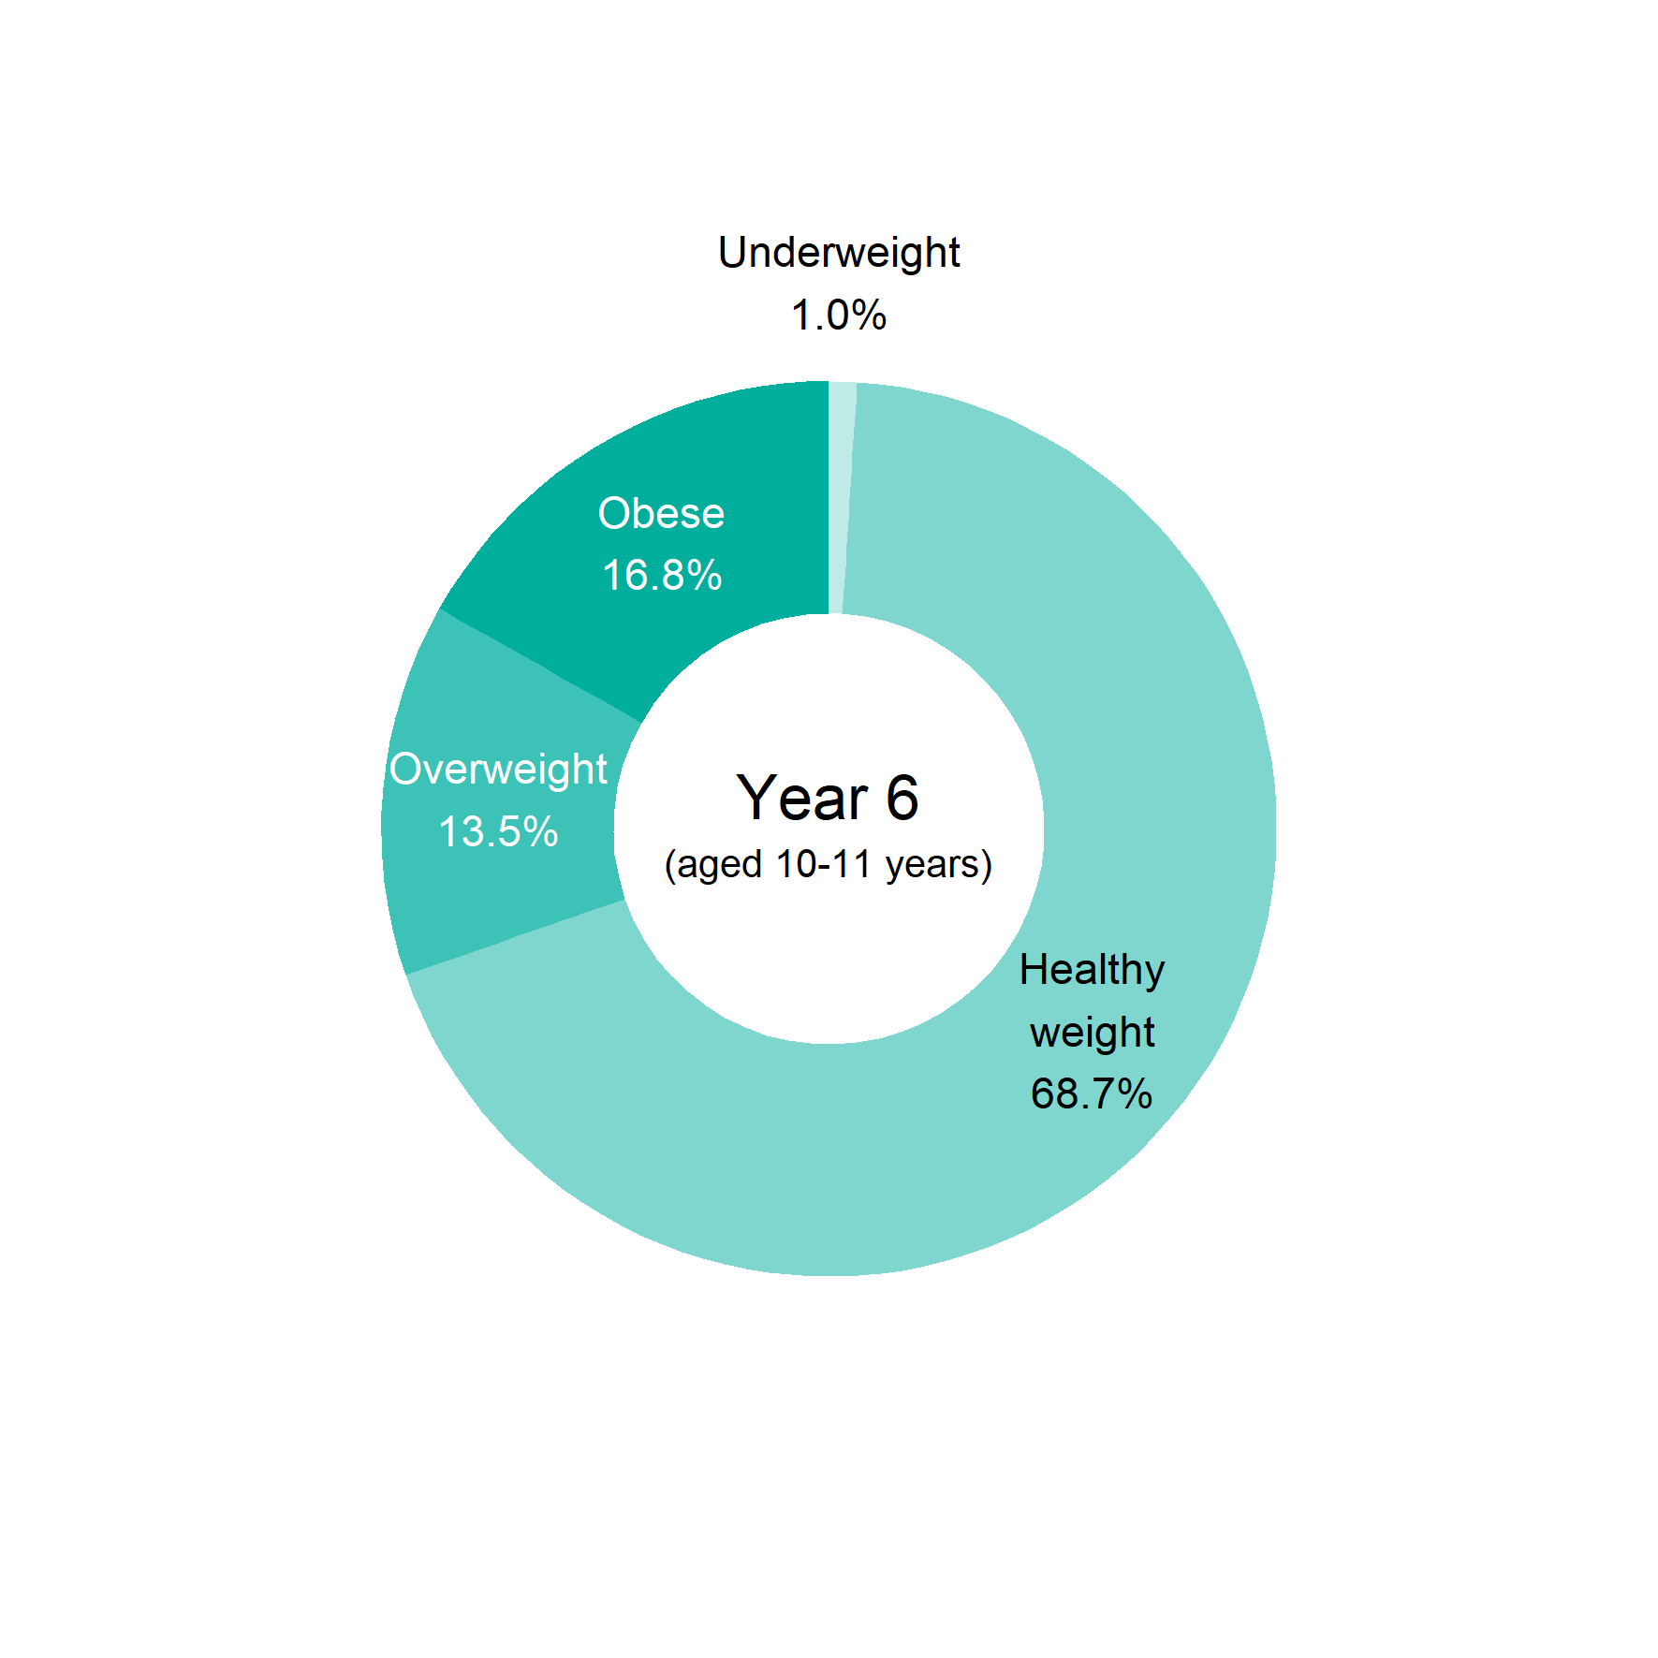
Child obesity in the South West
BMI status of children by age
This analysis uses the 2 , 85 and 95 centiles of the British 1990 growth reference (UK90) for BMI to classify children as underweight, healthy weight, overweight and obese. Source: National Child Measurement Programme 2017/18
nd
th
th
6 Patterns and trends in child obesity in the South West

Slide 7
Child obesity in the South West
BMI status of children by age
Reception
Year 6
This analysis uses the 2 , 85 and 95 centiles of the British 1990 growth reference (UK90) for BMI to classify children as underweight, healthy weight, overweight, obese or severely obese. Source: National Child Measurement Programme 2017/18
nd
th
th
7 Patterns and trends in child obesity in the South West

Slide 8
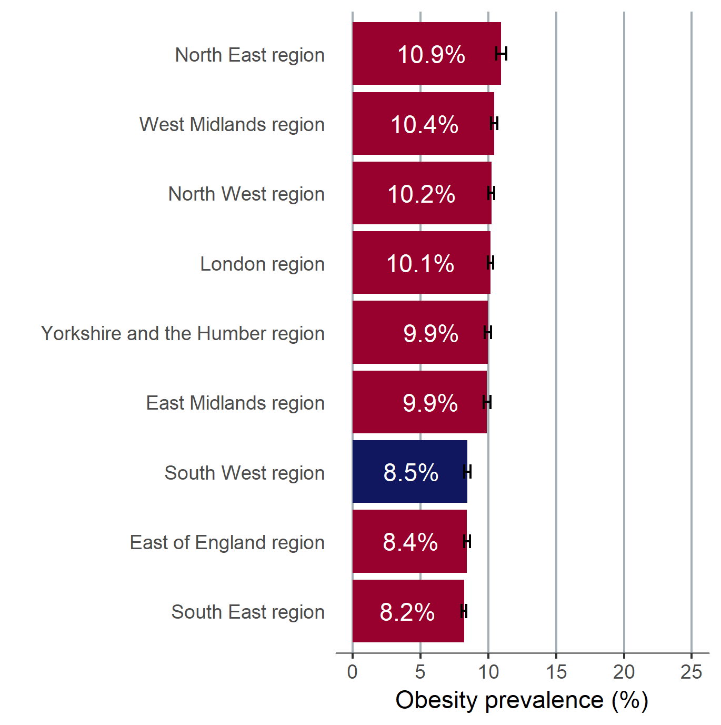
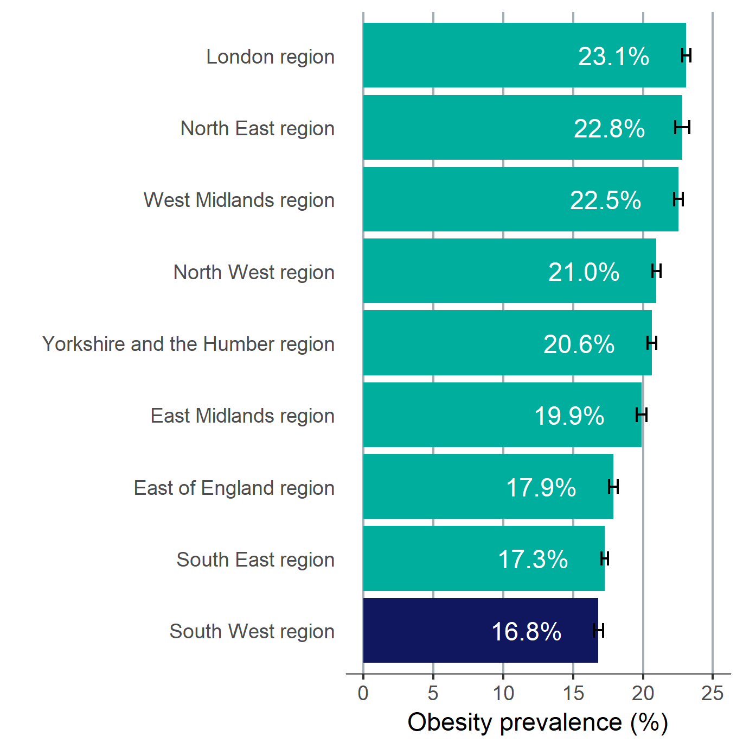
Child obesity in the South West
Prevalence of obesity by age
England and Regions
Children in Reception (aged 4-5 years)
Children in Year 6 (aged 10-11 years)
Child obesity: BMI greater than or equal to the 95 centile of the UK90 growth reference. 95% confidence intervals are displayed on the chart. Source: National Child Measurement Programme 2017/18
th
8 Patterns and trends in child obesity in the South West

Slide 9
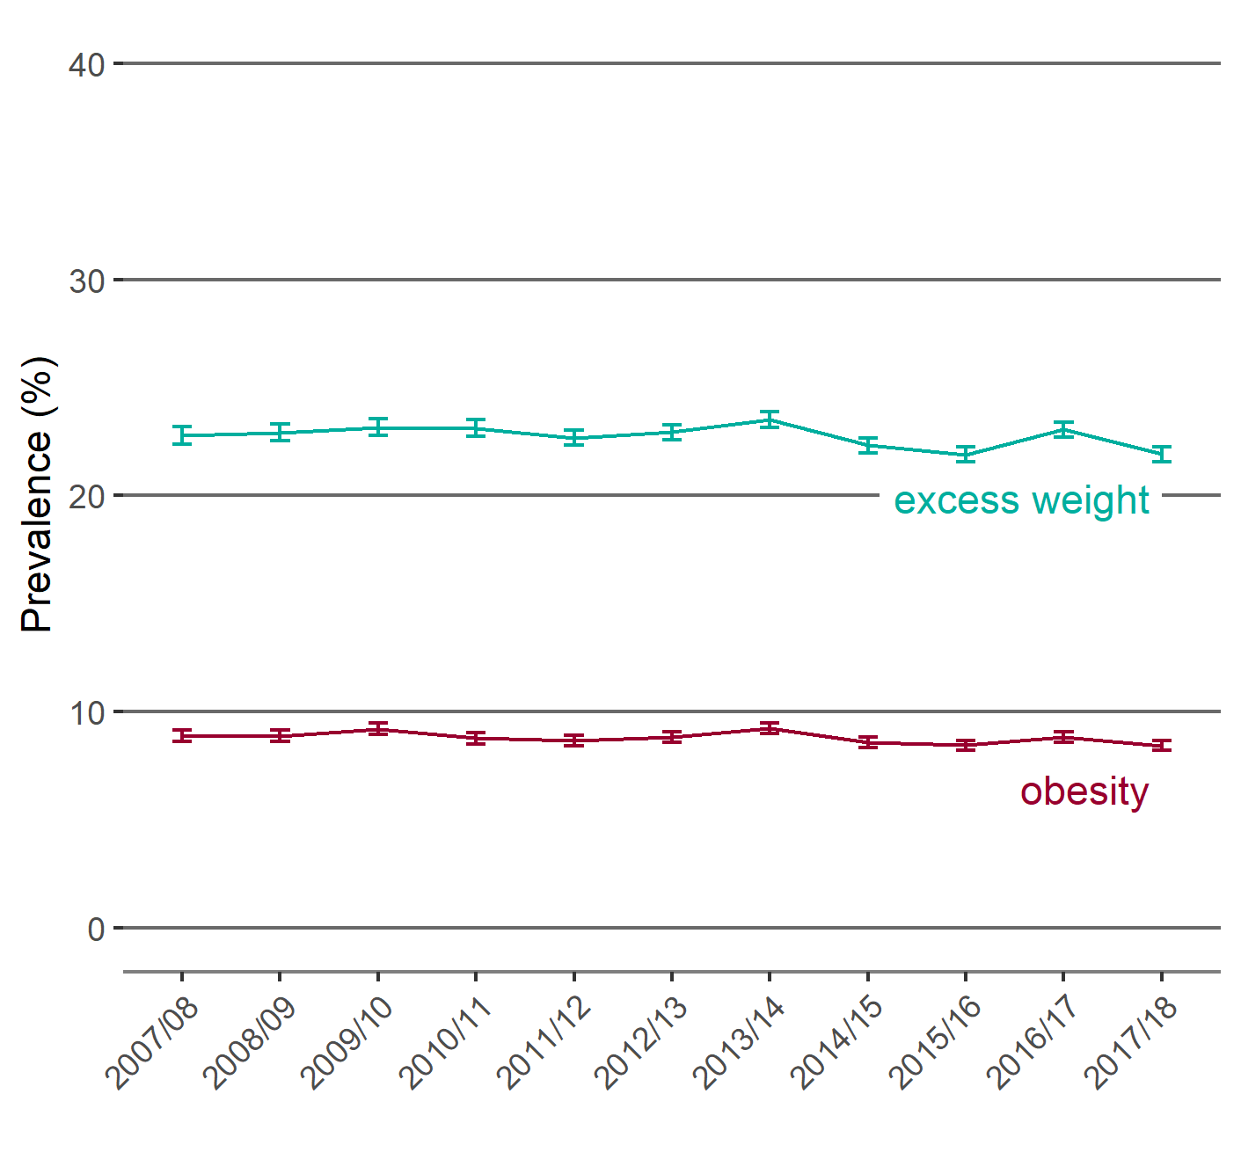
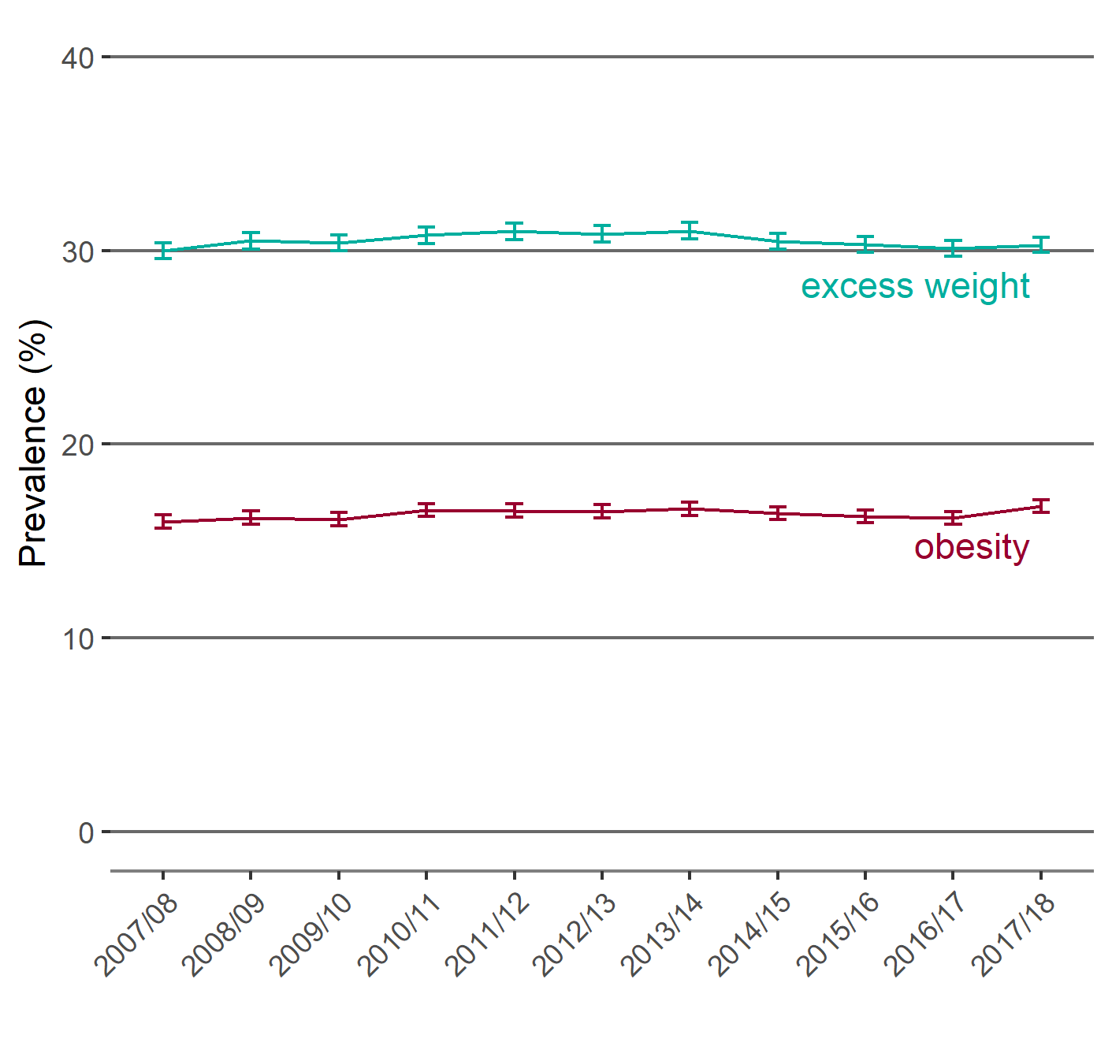
Child obesity in the South West
Trend in the prevalence of obesity and excess weight by age
Reception and Year 6
Children in Reception (aged 4-5 years)
Children in Year 6 (aged 10-11 years)
Prevalence (%)
Prevalence (%)
Child excess weight (overweight including obesity): BMI greater than or equal to the 85 centile of the UK90 growth reference. Child obesity: BMI greater than or equal to the 95 centile of the UK90 growth reference. 95% confidence intervals are displayed on the chart. Source: National Child Measurement Programme 2017/18
th
th
9 Patterns and trends in child obesity in the South West

Slide 10
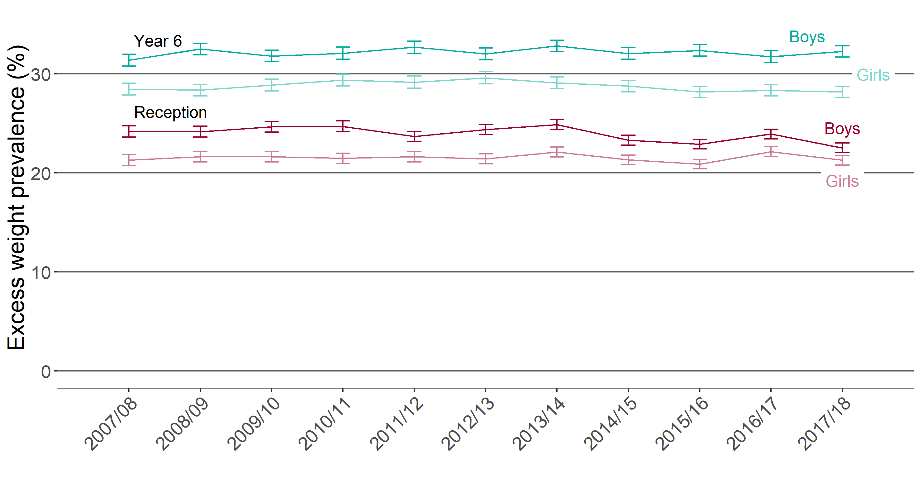
Child obesity in the South West
Trend in the prevalence of excess weight by sex and age
Reception and Year 6
Prevalence of excess weight (%)
Child excess weight (overweight including obesity): BMI greater than or equal to the 85 centile of the UK90 growth reference. 95% confidence intervals are displayed on the chart. Source: National Child Measurement Programme 2017/18
th
10 Patterns and trends in child obesity in the South West

Slide 11
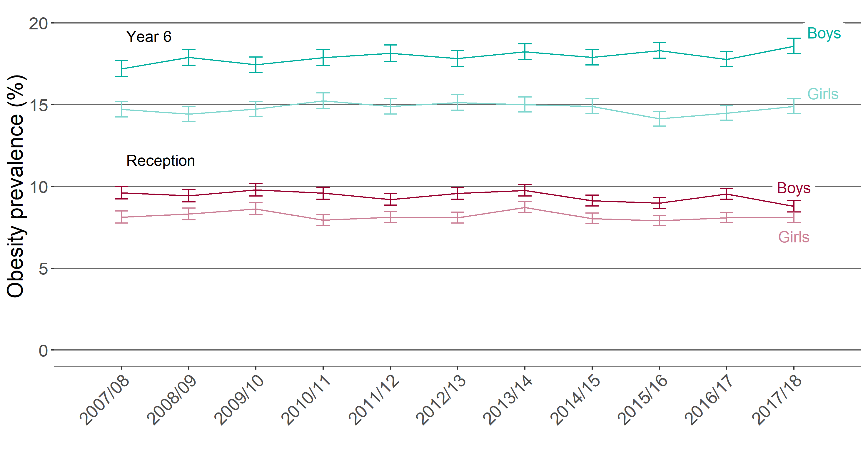
Child obesity in the South West
Trend in the prevalence of obesity
by sex and age (Reception and Year 6), South West
Prevalence of obesity (%)
Child obesity: BMI greater than or equal to the 95 centile of the UK90 growth reference. 95% confidence intervals are displayed on the chart. Source: National Child Measurement Programme 2017/18
th
11 Patterns and trends in child obesity in the South West

Slide 12
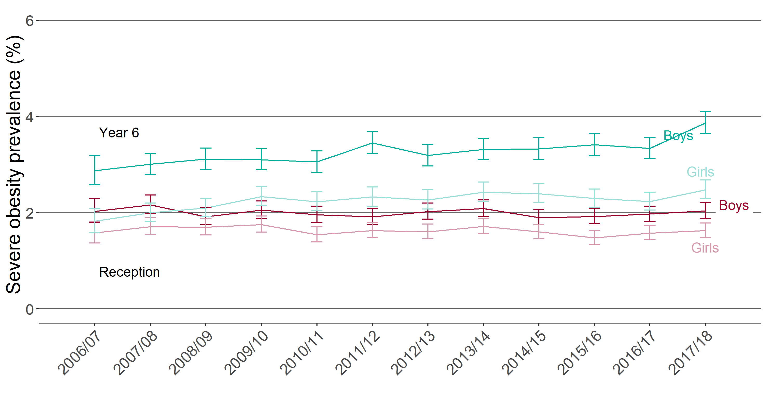
Child obesity in the South West
Trend in the prevalence of severe obesity
by sex and age (Reception and Year 6), South West
Prevalence of severe obesity (%)
Child obesity: BMI greater than or equal to the 99.6 centile of the UK90 growth reference. 95% confidence intervals are displayed on the chart. Source: National Child Measurement Programme 2017/18
th
12 Patterns and trends in child obesity in the South West

Slide 13
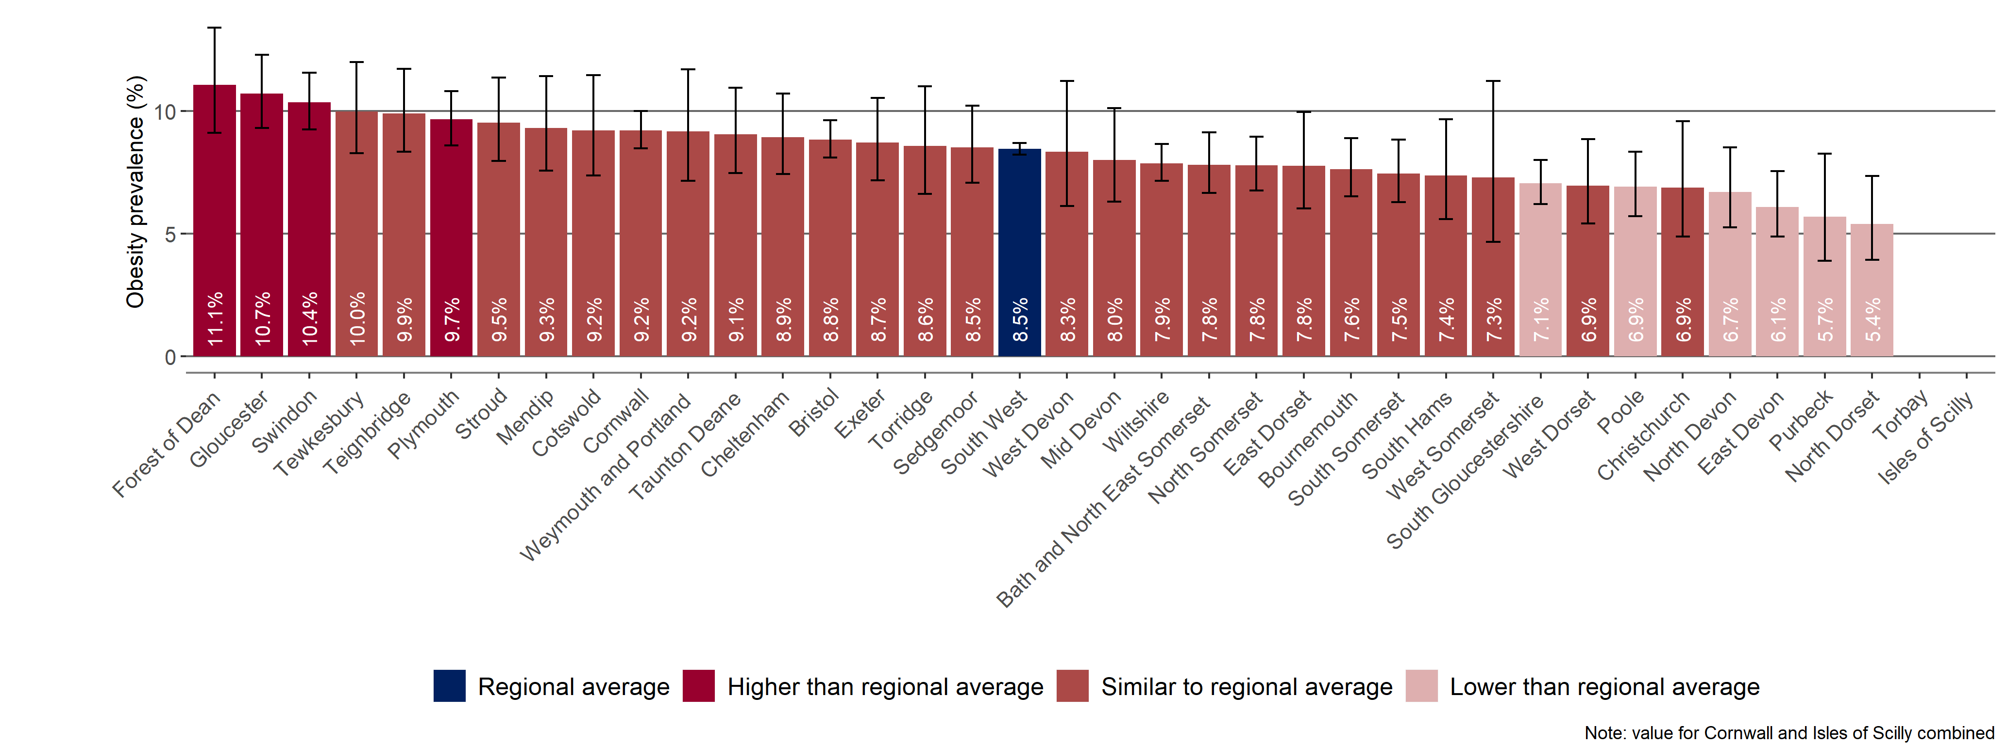
Child obesity in the South West
Prevalence of obesity 2017/18
South West District and Unitary Authorities
Children in Reception (aged 4-5 years)
Torbay data has not been included in this chart due to data quality issues
Child obesity: BMI greater than or equal to the 95 centile of the UK90 growth reference. 95% confidence intervals are displayed on the chart. Source: National Child Measurement Programme 2017/18
th
13 Patterns and trends in child obesity in the South West

Slide 14
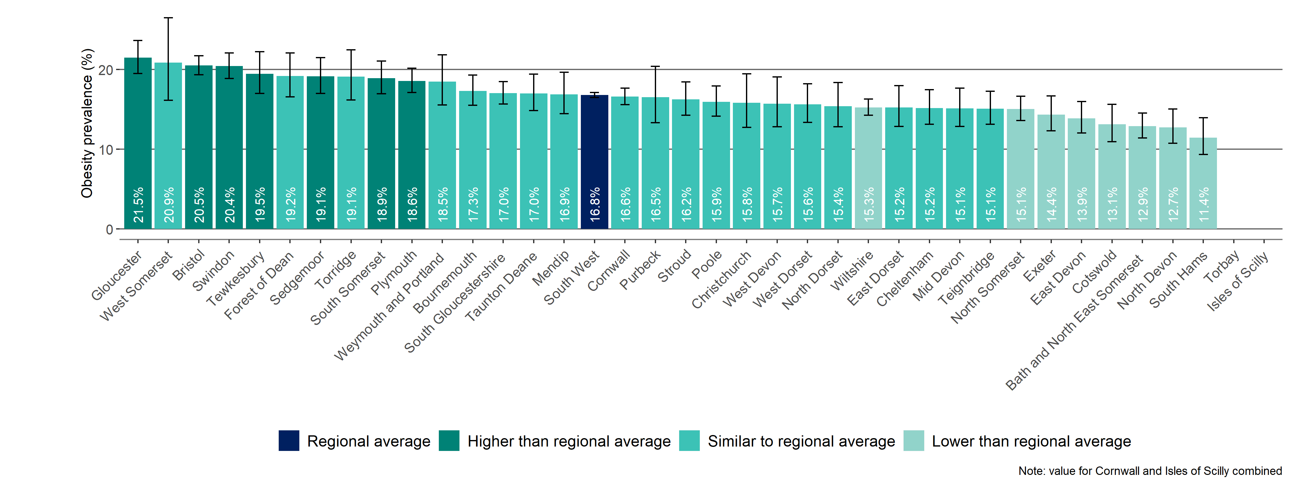
Child obesity in the South West
Prevalence of obesity 2017/18
South West District and Unitary Authorities
Children in Year 6 (aged 10-11 years)
Torbay data has not been included in this chart due to data quality issues
Child obesity: BMI greater than or equal to the 95 centile of the UK90 growth reference. 95% confidence intervals are displayed on the chart. Source: National Child Measurement Programme 2017/18
th
14 Patterns and trends in child obesity in the South West

Slide 15
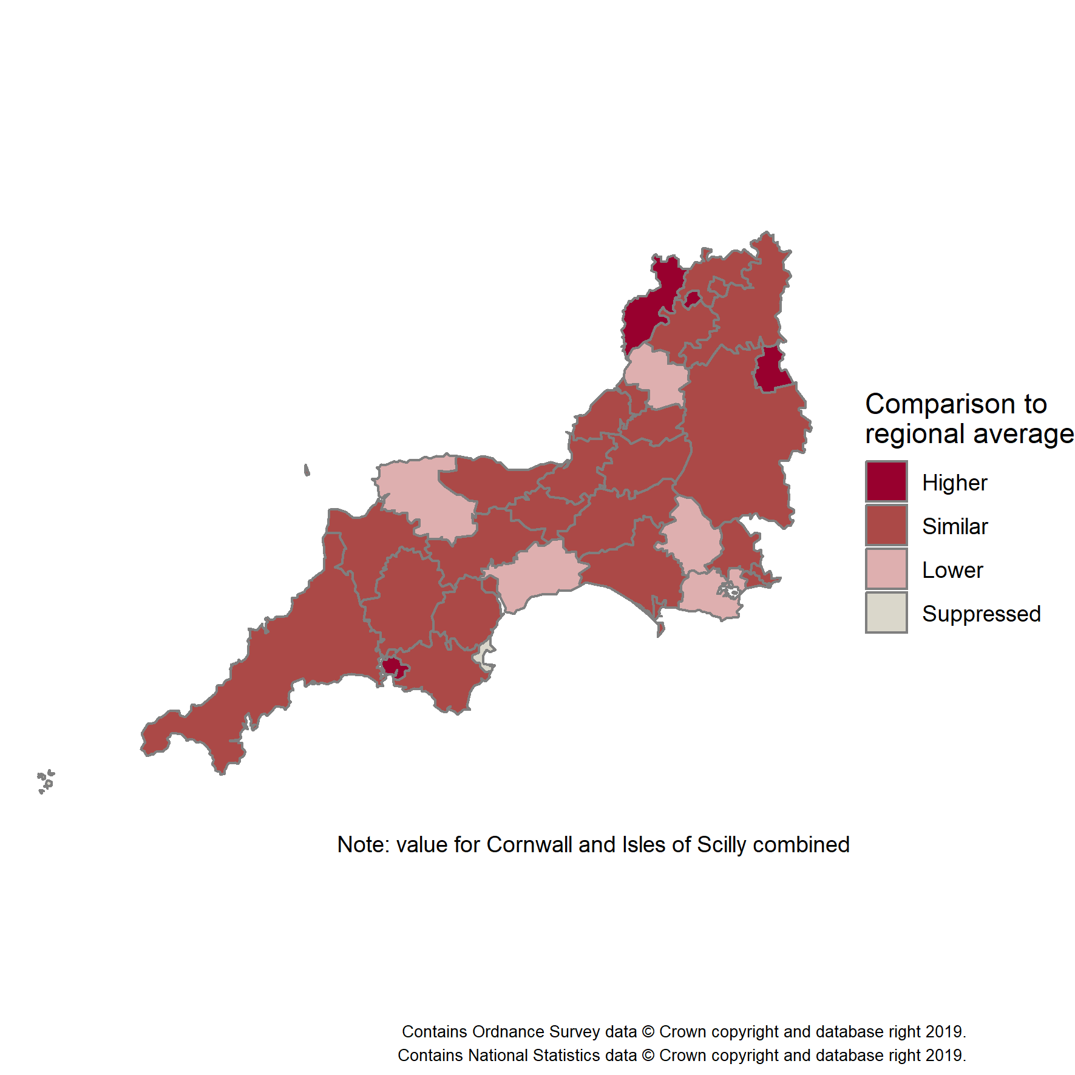
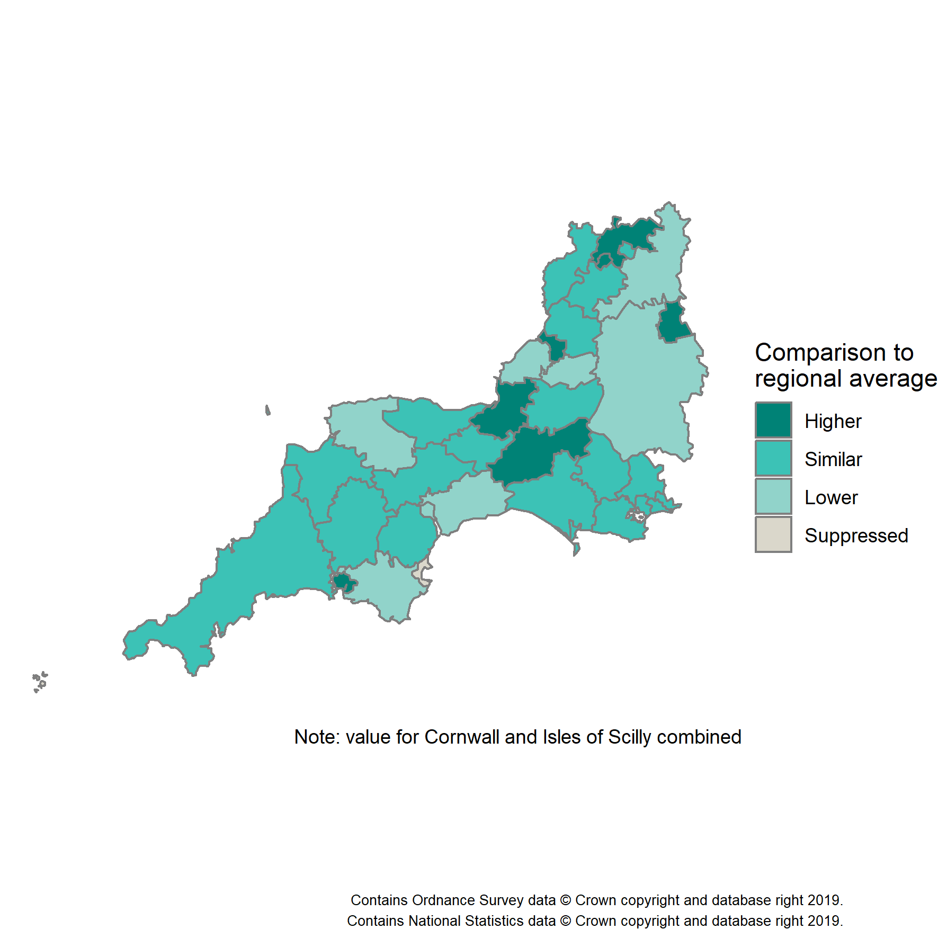
Child obesity in the South West
Prevalence of obesity by age
South West District and Unitary Authorities
Children in Reception (aged 4-5 years)
Children in Year 6 (aged 10-11 years)
Torbay data has been suppressed in these maps due to data quality issues
Child obesity: BMI greater than or equal to the 95 centile of the UK90 growth reference Source: National Child Measurement Programme 2017/18
th
15 Patterns and trends in child obesity in the South West

Slide 16
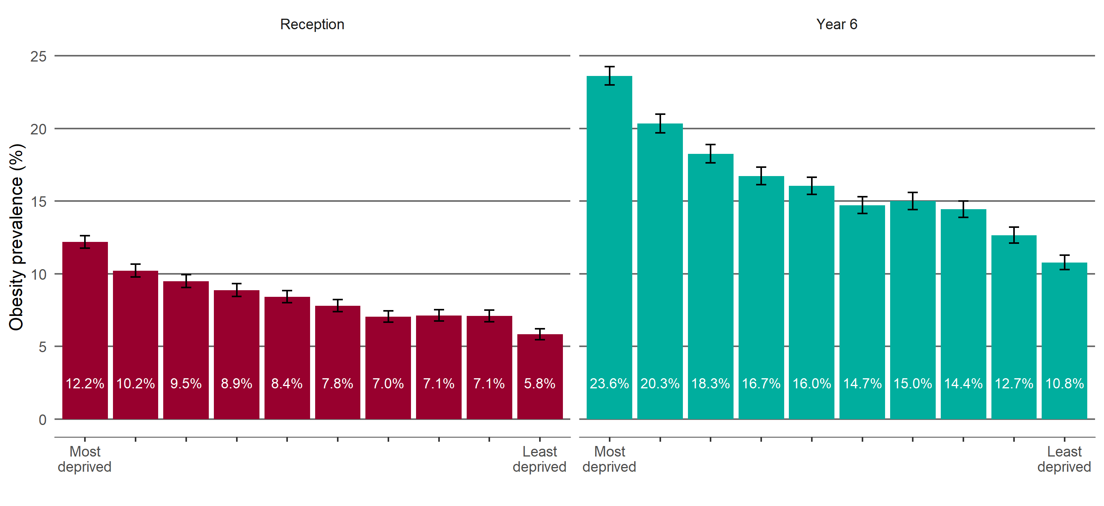
Child obesity in the South West
Obesity prevalence by regional deprivation and age
Reception and Year 6
Child obesity: BMI greater than or equal to the 95 centile of the UK90 growth reference 95% confidence intervals are displayed on the chart. Source: National Child Measurement Programme 2015/16-2017/18
th
Data grouped over 3 years Region-specific deprivation deciles displayed
16 Patterns and trends in child obesity in the South West

Slide 17
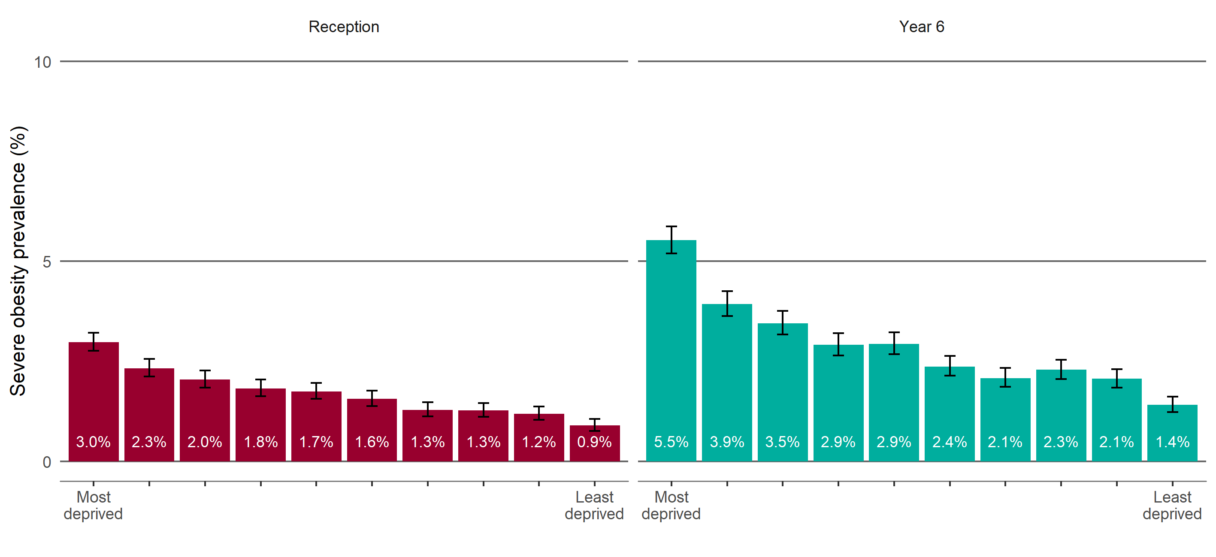
Child obesity in the South West
Severe obesity prevalence by regional deprivation and age
Reception and Year 6
Child obesity: BMI greater than or equal to the 99.6 centile of the UK90 growth reference 95% confidence intervals are displayed on the chart. Source: National Child Measurement Programme 2015/16-2017/18
th
Data grouped over 3 years Region-specific deprivation deciles displayed
17 Patterns and trends in child obesity in the South West

Slide 18
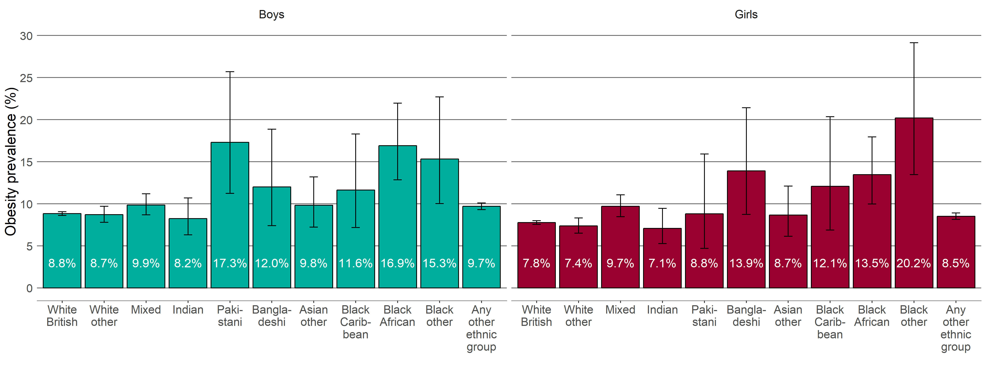
Child obesity in the South West
Obesity prevalence by ethnic group: Reception
Aged 4-5 years
Children in Reception
Child obesity: BMI greater than or equal to the 95 centile of the UK90 growth reference 95% confidence intervals are displayed on the chart. Source: National Child Measurement Programme 2015/16-2017/18
th
Data grouped over 3 years
18 Patterns and trends in child obesity in the South West

Slide 19
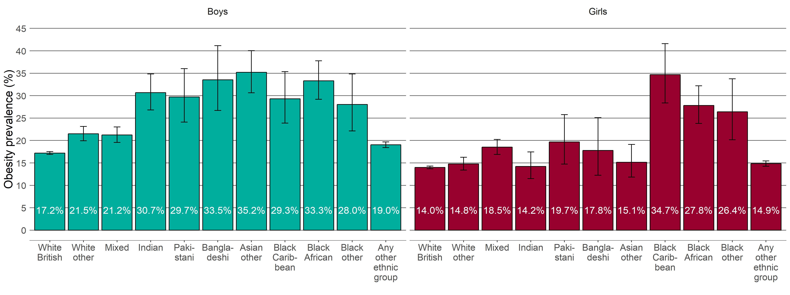
Child obesity in the South West
Obesity prevalence by ethnic group: Year 6
Aged 10-11 years
Children in Year 6
Child obesity: BMI greater than or equal to the 95 centile of the UK90 growth reference 95% confidence intervals are displayed on the chart. Source: National Child Measurement Programme 2015/16-2017/18
th
Data grouped over 3 years
19 Patterns and trends in child obesity in the South West

Slide 20
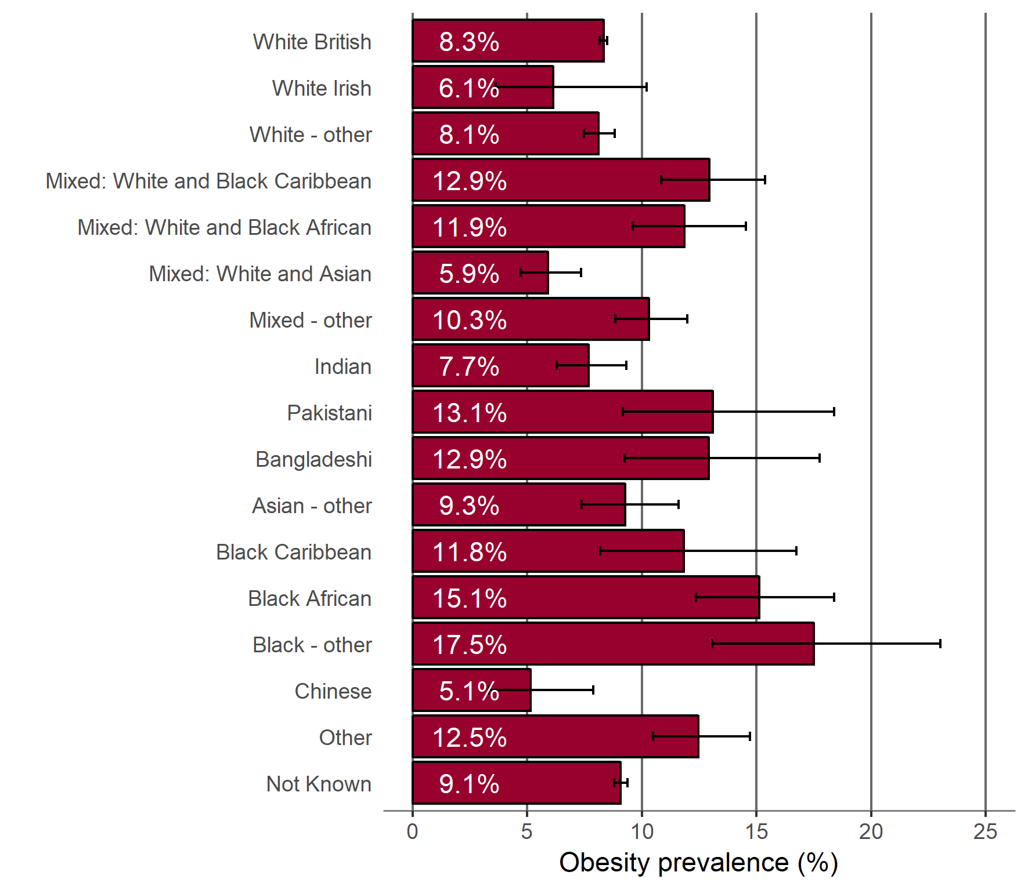
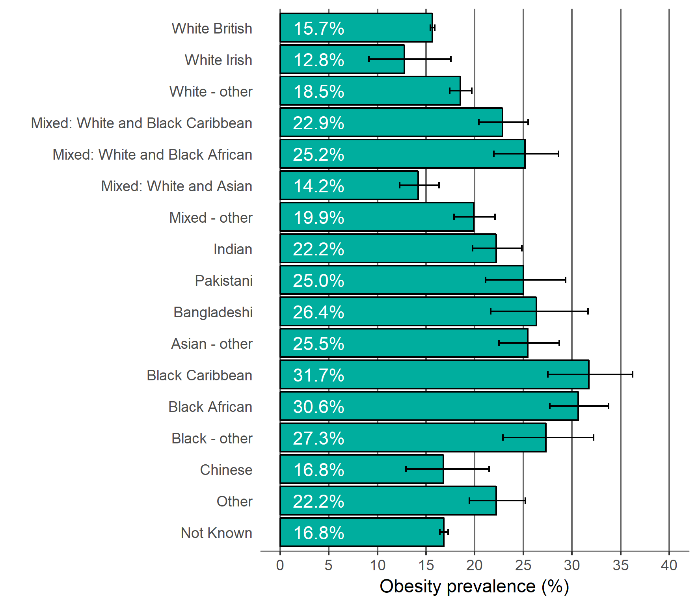
Child obesity in the South West
Obesity prevalence by ethnic group
Children in Reception (aged 4-5 years)
Children in Year 6 (aged 10-11 years)
Child obesity: BMI greater than or equal to the 95 centile of the UK90 growth reference 95% confidence intervals are displayed on the chart. Source: National Child Measurement Programme 2015/16-2017/18
th
Data grouped over 3 years
20 Patterns and trends in child obesity in the South West

Slide 21
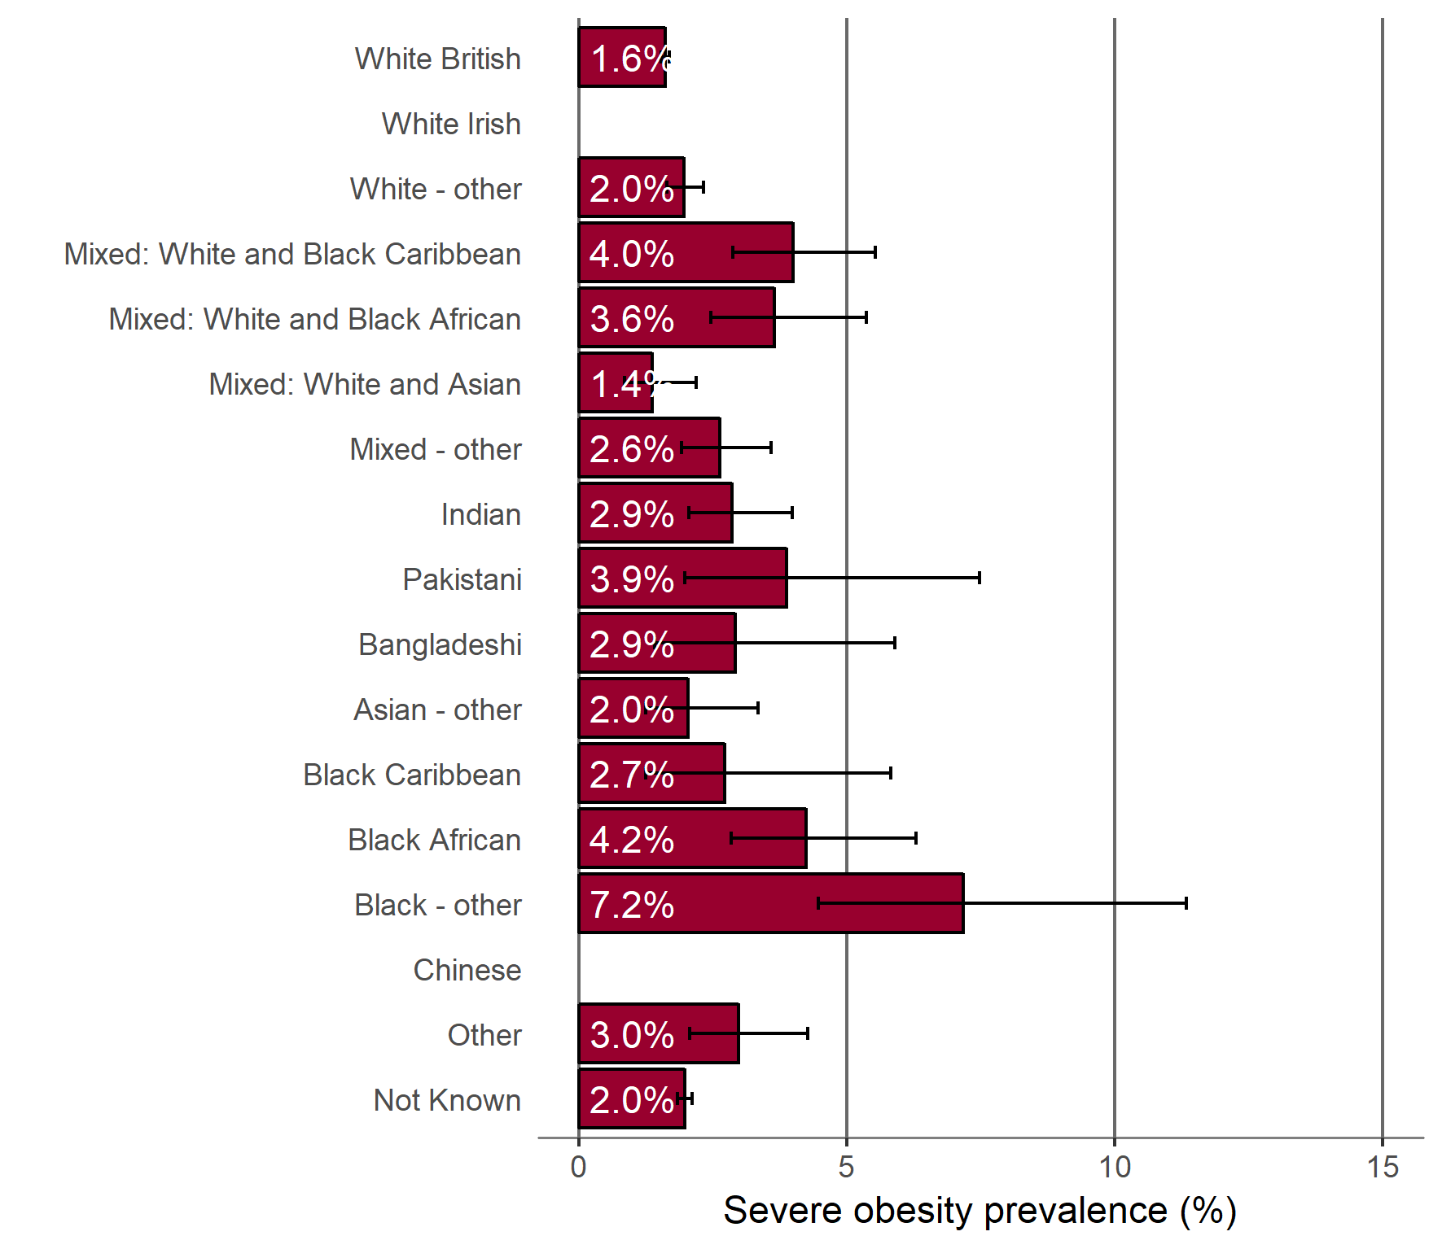
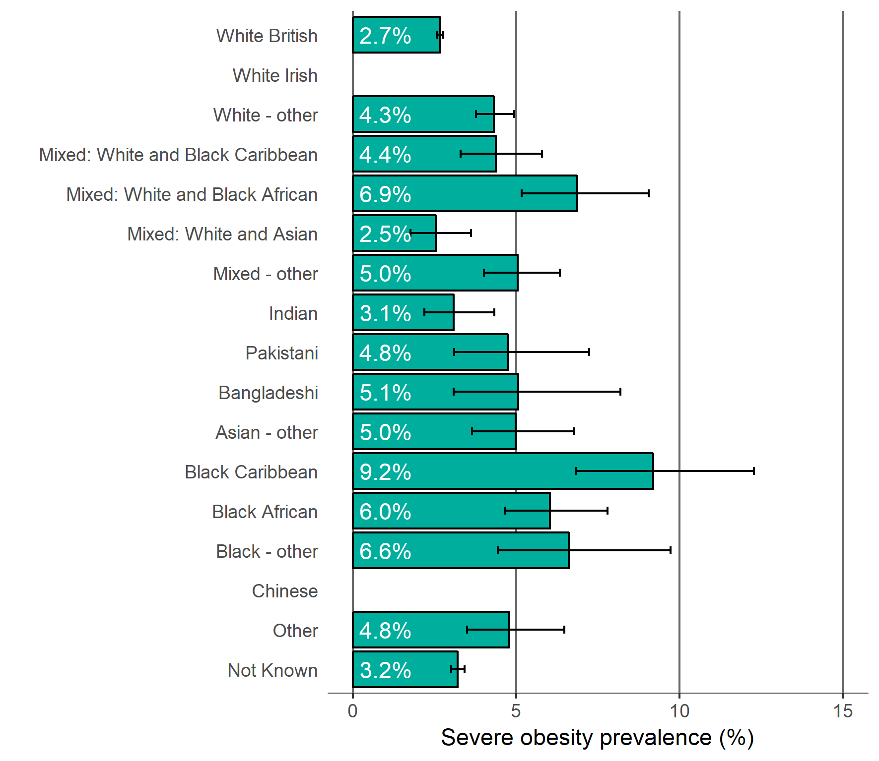
Child obesity in the South West
Severe obesity prevalence by ethnic group
Children in Reception (aged 4-5 years)
Children in Year 6 (aged 10-11 years)
Child obesity: BMI greater than or equal to the 99.6 centile of the UK90 growth reference 95% confidence intervals are displayed on the chart. Source: National Child Measurement Programme 2015/16-2017/18
th
Data grouped over 3 years
21 Patterns and trends in child obesity in the South West

Slide 22
NCMP and Child Obesity Profile - an online tool
Child obesity data from the NCMP 2006/07 to 2017/18 is available in an online tool. The tool provides local authority level child data (underweight, healthy weight, overweight, obesity, excess weight - overweight including obesity, severe obesity) for Reception (aged 4-5 years) and Year 6 (aged 10-11 years). The tool also presents trend data and enables easy comparison of local authority data, allowing users to compare regional neighbours and local authorities with similar characteristics. Inequalities data (sex, deprivation and ethnic group) is also available by local authority. View the online tool:
http://fingertips.phe.org.uk/profile/national-child-measurement-programme
Screenshot of webpage
22 Patterns and trends in child obesity in the South West

Slide 23
Further information:
PHE Obesity Intelligence Knowledge Hub:
Sign up on https://khub.net/ and join the PHE Obesity Intelligence group
PHE Obesity Intelligence Knowledge Hub public library (no need to join):
https://khub.net/web/phe-obesity-intelligence/public-library
PHE Web:
https://www.gov.uk/guidance/phe-data-and-analysis-tools#obesity-diet-and-physical-activity
noo.org.uk website archive:
http://webarchive.nationalarchives.gov.uk/20170110165428/https://www.noo.org.uk/
(snapshot as of Jan 2017, will not be updated)
Email:
obesity-riskfactorsintelligence@phe.gov.uk
Twitter:
@PHE_Obesity
23 Patterns and trends in child obesity in the South West

Slide 24
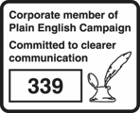
About Public Health England
Public Health England exists to protect and improve the nation’s health and wellbeing, and reduce health inequalities. We do this through world-leading science, knowledge and intelligence, advocacy, partnerships and the delivery of specialist public health services. We are an executive agency of the Department of Health and Social Care, and a distinct delivery organisation with operational autonomy. We provide government, local government, the NHS, Parliament, industry and the public with evidence-based professional, scientific and delivery expertise and support.
Public Health England Wellington House 133-155 Waterloo Road London SE1 8UG Tel: 020 7654 8000
www.gov.uk/phe
Twitter:
@PHE_uk
Facebook:
www.facebook.com/PublicHealthEngland
© Crown copyright 2019 You may re-use this information (excluding logos) free of charge in any format or medium, under the terms of the Open Government Licence v3.0. To view this licence, visit OGL. Where we have identified any third party copyright information you will need to obtain permission from the copyright holders concerned.
Published February 2019 PHE publications gateway number: GW-129
24 Patterns and trends in child obesity in the South West

