Slide 1
Patterns and trends in child physical activity
A presentation of the latest data on child physical activity
Updated February 2018
Notes:
These PowerPoint slides present key data and information on child physical activity in clear, easy to understand charts and graphics. They have been produced by the Risk Factors Intelligence team in the Health Improvement Directorate and can be used freely with acknowledgement to ‘Public Health England’.

Slide 2
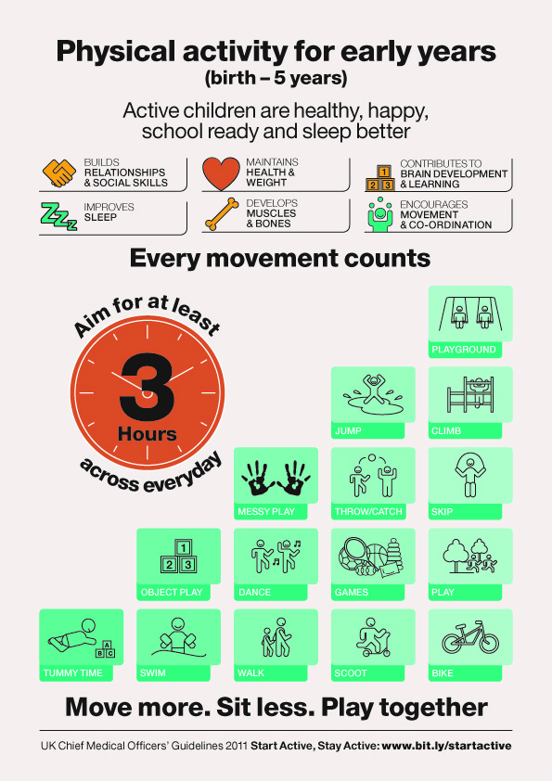
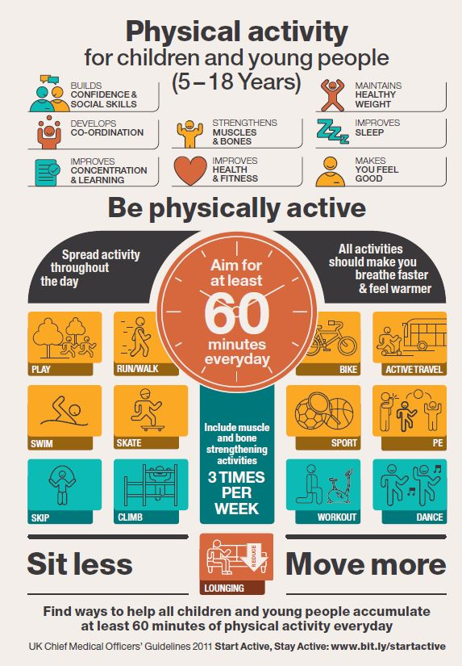
UK Chief Medical Officers’ physical activity guidelines for children and young people
www.gov.uk/government/publications/start-active-stay-active-infographics-on-physical-activity
Notes:
The UK Chief Medical Officers’ physical activity guidelines 2011 for children are:
Early years (under 5s): 180 minutes (three hours) spread throughout the day, once a child is able to walk. For children who are not yet walking, physical activity should be encouraged from birth, particularly through floor-based play and water-based activities in safe environments.
Children and young people (5–18 year olds): At least 60 minutes and up to several hours every day. This should be a mix of moderate intensity aerobic activity (such as walking to school or riding a bike) and vigorous intensity aerobic activity (such as running, gymnastics and football). Vigorous intensity activities strengthen muscle and bone and should be included at least three days a week.
In addition, all children and adults are advised to minimise the time spent being sedentary for extended periods.
Children and young people should take part in activities that are appropriate for their age and stage of development.
Guidance from the UK Chief Medical Office (CMO) on how much physical activity people should be doing, along with supporting documents, is available from: www.gov.uk/government/publications/uk-physical-activity-guidelines

Slide 3


Physical activity in young children
Proportion of children aged 2 to 4 meeting physical activity recommendations, 2015
Boys
10%
Girls
9%
Source: Health Survey for England 2015, NHS Digital http://www.content.digital.nhs.uk/catalogue/PUB22610
Meets recommendations | At least 180 minutes (3 hours) of physical activity on all 7 days in the last week.
Notes:
Around one in ten children aged 2-4 years met the CMOs’ recommendations for physical activity
Excludes walking or cycling to/from school, nursery or playgroup.
The UK Chief Medical Officers’ report (2011) recommends that children aged 2 -4 years should engage in at least 180 minutes activity spread throughout the day www.gov.uk/government/uploads/system/uploads/attachment_data/file/213738/dh_128143.pdf

Slide 4


Physical activity in children
Proportion of children aged 5 to 15 meeting physical activity recommendations (excluding activities in school lessons), 2015
Boys
23%
Girls
20%
Source: Health Survey for England 2015, NHS Digital http://www.content.digital.nhs.uk/catalogue/PUB22610
Meets recommendations | At least 60 minutes (1 hour) of moderate to vigorous physical activity (MVPA) on all 7 days in the last week.
Notes:
Around two in ten children aged 5-15 years met the CMOs’ recommendations for physical activity.
Excludes walking or cycling to/from school.
The UK Chief Medical Officers’ report (2011) recommends that children aged 5-15 years should engage in at least 60 minutes and up to several hours physical activity per day www.gov.uk/government/uploads/system/uploads/attachment_data/file/213739/dh_128144.pdf

Slide 5


Low physical activity in children
Proportion of children aged 5 to 15 with low physical activity levels (excluding activities in school lessons), 2015
Boys
36%
Girls
45%
Source: Health Survey for England 2015, NHS Digital http://www.content.digital.nhs.uk/catalogue/PUB22610
Low activity | Low activity refers to lower levels of physical activity (less than 30 minutes of MVPA on all 7 days in the last week, or less than 60 minutes of MVPA on 3 to 6 days in the last week).
Notes:
Around four in ten children aged 5-15 years reported low physical activity levels.
Excludes walking or cycling to/from school.

Slide 6
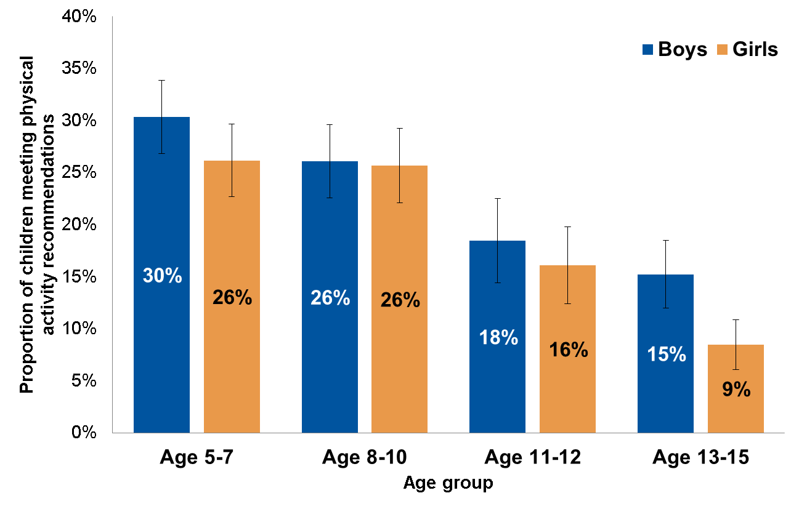
Physical activity in children by age
Proportion of children aged 5 to 15 meeting physical activity recommendations (excluding activities in school lessons), by age and sex, 2015
Source: Health Survey for England 2015, NHS Digital http://www.content.digital.nhs.uk/catalogue/PUB22610
Meets recommendations | At least 60 minutes (1 hour) of moderate to vigorous physical activity (MVPA) on all 7 days in the last week.
Notes:
The proportion of children meeting the guidelines was higher for boys than for girls (23% and 20% respectively), and decreased with age for both sexes.
Excludes walking or cycling to/from school.
The UK Chief Medical Officers’ report (2011) recommends that children aged 5-15 years should engage in at least 60 minutes and up to several hours physical activity per day www.gov.uk/government/uploads/system/uploads/attachment_data/file/213739/dh_128144.pdf
Error bars (I) on the charts are 95% confidence intervals. These indicate the level of uncertainty about each value on the chart. Wider intervals mean more uncertainty.

Slide 7
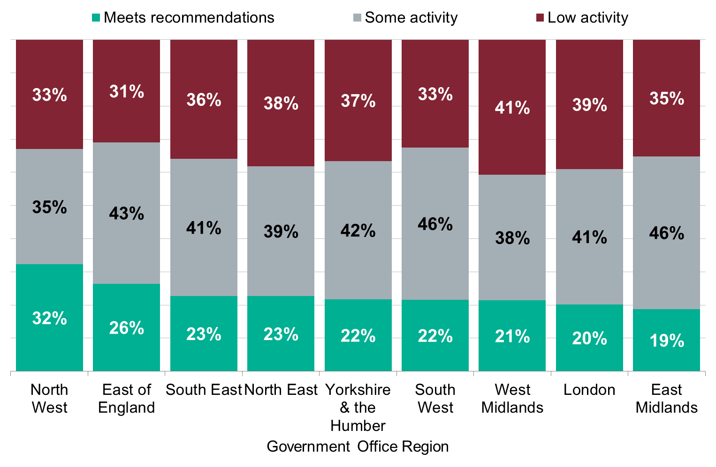
Physical activity in boys by region
Proportion of boys aged 5 to 15 meeting physical activity recommendations (excluding activities in school lessons), by region, 2015
Source: Health Survey for England 2015, NHS Digital http://www.content.digital.nhs.uk/catalogue/PUB22610
Meets recommendations | At least 60 minutes (1 hour) of moderate to vigorous physical activity (MVPA) on all 7 days in the last week.
Some activity | 30-59 minutes of MVPA on all 7 days in the last week or at least 60 minutes of MVPA on 3 to 6 days in the last week.
Low activity | Lower levels of physical activity.
Notes:
There is variation in physical activity levels across the country, as well as between boys and girls within regions. The proportion of boys meeting the UK CMOs’ physical activity recommendations ranges from 32% in the North West to 19% in the East Midlands.
Excludes walking or cycling to/from school.
Regions are ranked from highest to lowest by proportion of boys meeting the physical activity recommendations.

Slide 8
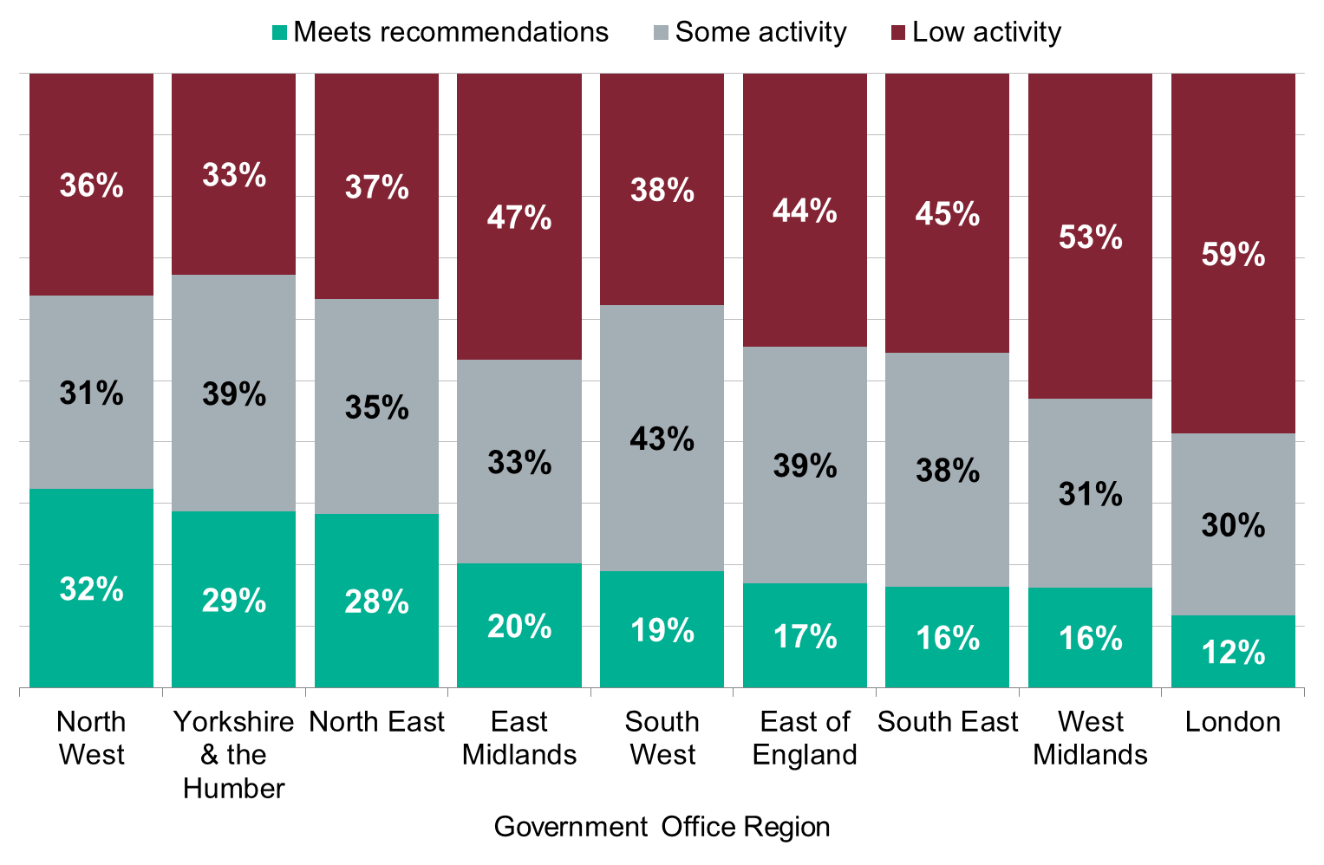
Physical activity in girls by region
Proportion of girls aged 5 to 15 meeting physical activity recommendations (excluding activities in school lessons), by region, 2015
Source: Health Survey for England 2015, NHS Digital http://www.content.digital.nhs.uk/catalogue/PUB22610
Meets recommendations | At least 60 minutes (1 hour) of moderate to vigorous physical activity (MVPA) on all 7 days in the last week.
Some activity | 30-59 minutes of MVPA on all 7 days in the last week or at least 60 minutes of MVPA on 3 to 6 days in the last week.
Low activity | Lower levels of physical activity.
Notes:
There is variation in physical activity levels across the country, as well as between boys and girls within regions. The proportion of girls meeting the UK CMOs’ physical activity recommendations ranges from 32% in the North West to 12% in London.
Excludes walking or cycling to/from school.
Regions are ranked from highest to lowest by proportion of girls meeting the physical activity recommendations.

Slide 9
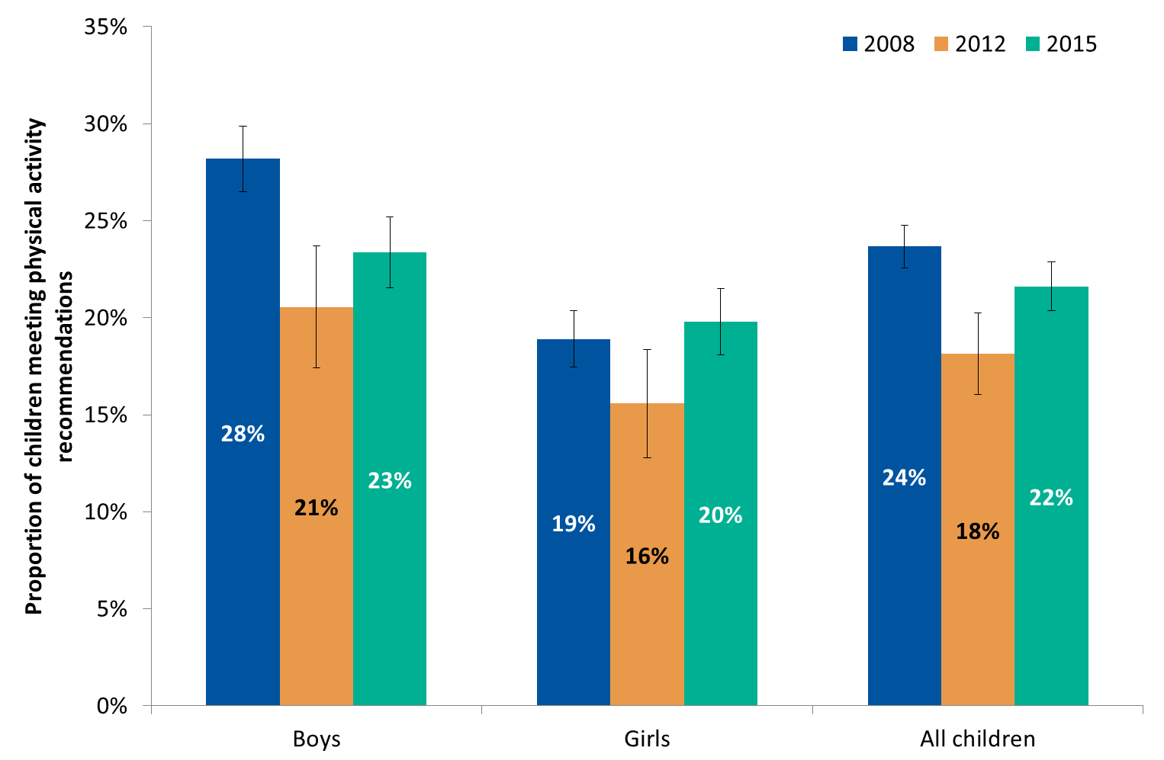
Trends in physical activity
Proportion of children aged 5 to 15 meeting physical activity recommendations (excluding activities in school lessons)
in 2008, 2012 and 2015
Source: Health Survey for England 2015, NHS Digital http://www.content.digital.nhs.uk/catalogue/PUB22610
Meets recommendations | At least 60 minutes (1 hour) of moderate to vigorous physical activity (MVPA) on all 7 days in the last week.
Notes:
Compared with 2012, the proportion of children aged 5 to 15 who met the physical activity guidelines for children and young adults (at least one hour of moderately intensive physical activity per day) increased in 2015. This is a statistically significant increase.
Despite this increase, the proportion of boys meeting the recommended levels of physical activity remains significantly lower than in 2008.
Error bars (I) on the charts are 95% confidence intervals. These indicate the level of uncertainty about each value on the chart. Wider intervals mean more uncertainty.

Slide 10
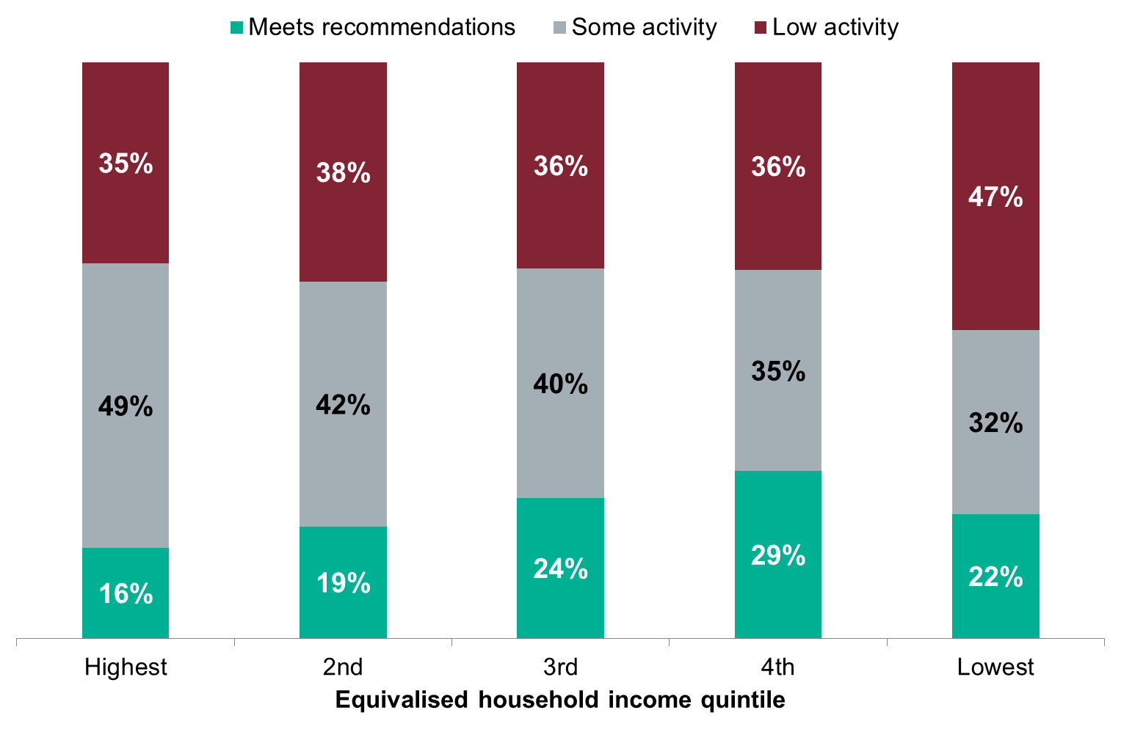
Physical activity levels by income
Proportion of children aged 5 to 15 meeting physical activity recommendations (excluding activities in school lessons), by incomeª, 2015
95% CI: 39%-48%
95% CI: 26%-37%
Source: Health Survey for England 2015, NHS Digital http://www.content.digital.nhs.uk/catalogue/PUB22610
ª Equivalised household income is a measure that takes account of the number of people in the household. For this analysis, households were split into 5 equal-sized groups banded by income level (income quintiles). Physical activity levels were compared between these groups.
Low activity | Low activity refers to lower levels of physical activity (less than 30 minutes of MVPA on all 7 days in the last week, or less than 60 minutes of MVPA on 3 to 6 days in the last week).
Notes:
The proportion of children aged 5 to 15 achieving current recommendations varied by household income. The proportion of children meeting current recommendations was smaller in the higher income quintiles than in the lower income quintiles. Conversely, the proportion of children classified in the low activity group was larger in the lower income quintiles than in the higher income quintiles.

Slide 11
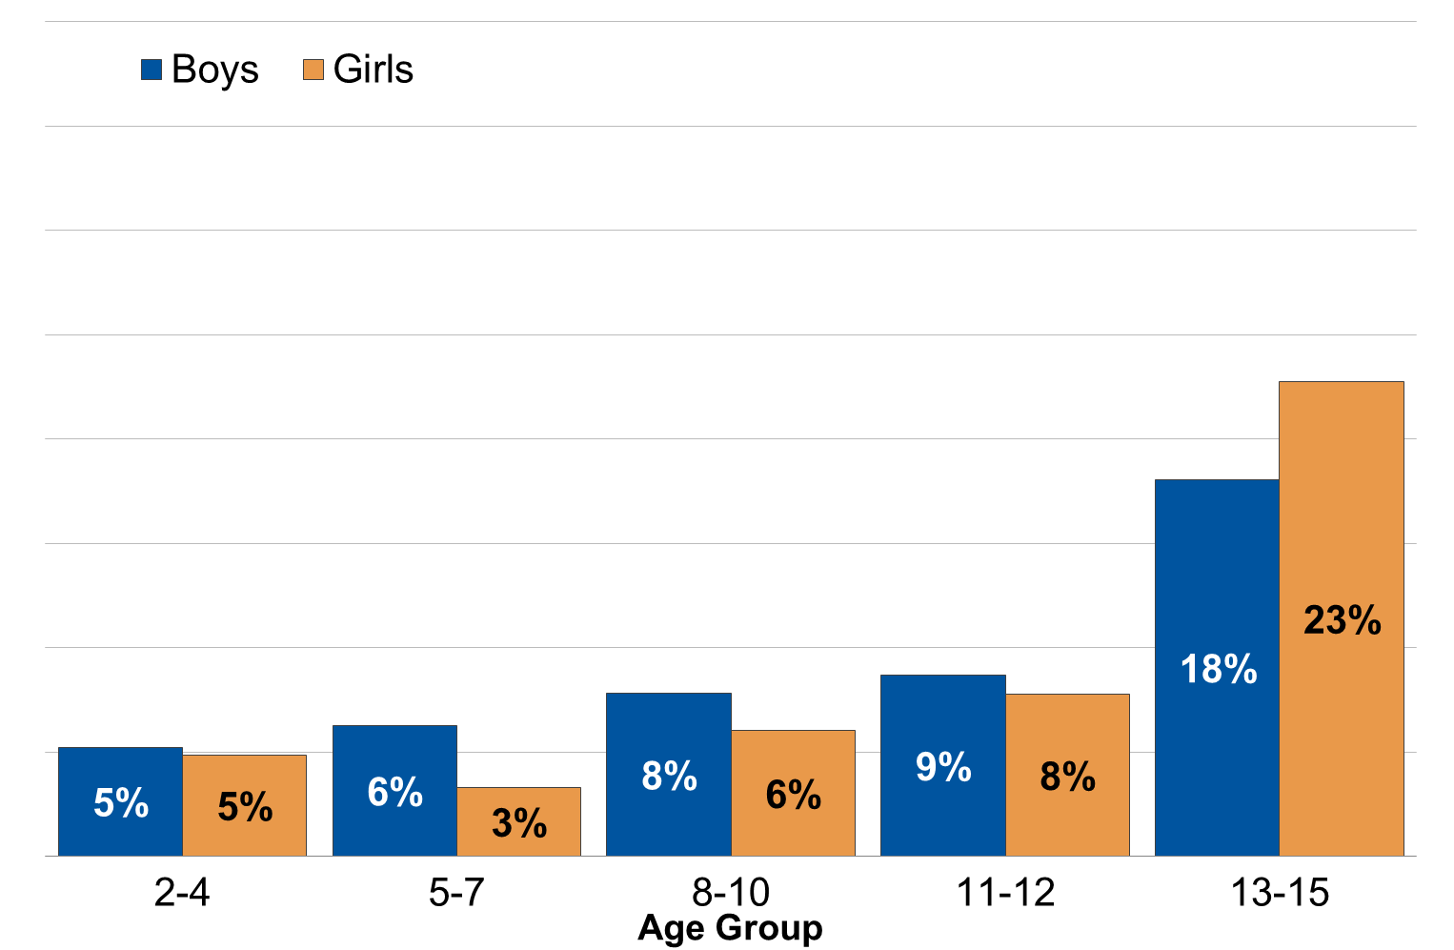
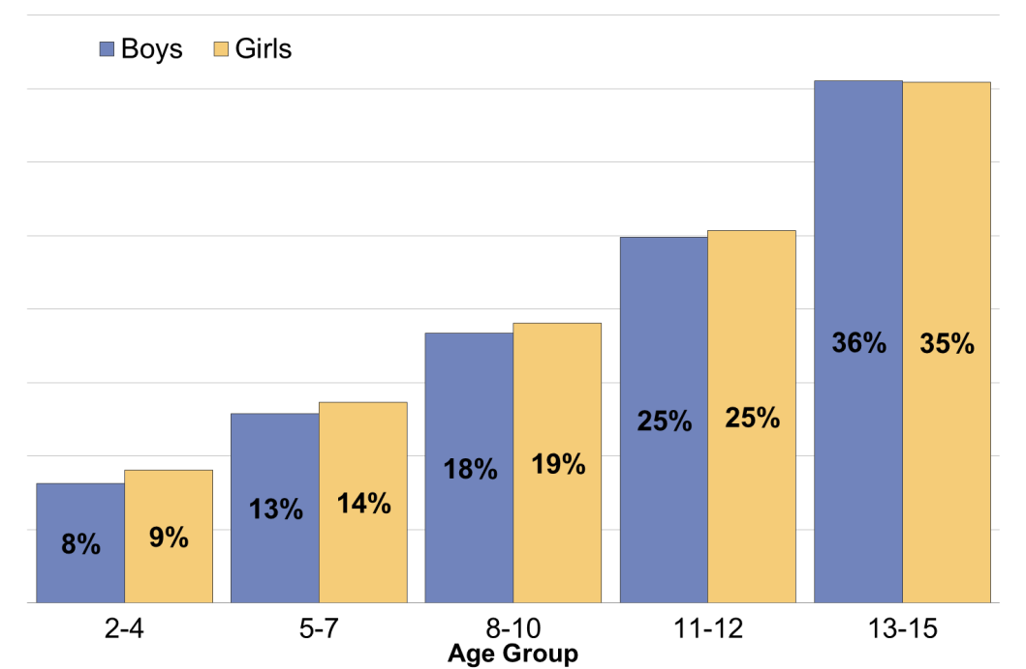
Time spent sedentary in leisure time
Proportion of children aged 2 to 15 who were sedentary for 6 or more hours per day on weekdays and weekend days, by age and sex, 2015
Weekdays
Weekends
Source: Health Survey for England 2015, NHS Digital http://www.content.digital.nhs.uk/catalogue/PUB22610
Sedentary time | Average time children spend watching TV or sitting down doing any other activity. For example, reading, doing homework, using a computer, or playing video games. Sedentary time excludes time at school.
Notes:
The proportion of children who were sedentary increased with age on both weekdays and weekend days. Amongst all age groups time spent sedentary was higher on weekends compared to weekdays.
On weekdays, there was a steeper increase with age among girls (from 5% for those aged 2 to 4 to 23% for those aged 13 to 15, compared with 5% to 18% for boys). The proportion of children who were sedentary for six hours or more per day on weekend days increased with age with similar gradients for boys and girls.
The UK Chief Medical Officers’ report recommends that the amount of time spent being sedentary should be minimised.

Slide 12
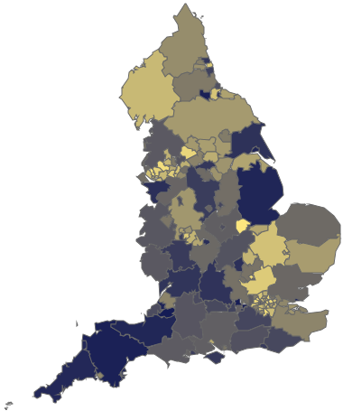
Physical activity by local authority
Proportion of young people aged 15 meeting physical activity recommendations, by local authority, 2014/15
One in seven 15 year olds in England (14%) reported they were physically active for at least an hour on all seven days in the previous week.
(8%)
(19%)
Map available from PHE’s Physical Activity tool https://fingertips.phe.org.uk/profile/physical-activity
Geographical variation amongst upper tier local authorities shown.
Source: What About YOUth? Survey, 2014/15, NHS Digital
Notes:
In 2014/15, one in seven 15 year olds in England (14%) reported they were physically active for at least an hour on all seven days in the previous week, with the highest rates of physical activity found in Bath and North East Somerset (19%) and the lowest rates reported in Westminster (8%).
Data from the What About YOUth? Survey 2014/15, published by NHS Digital http://content.digital.nhs.uk/catalogue/PUB19244

Slide 13
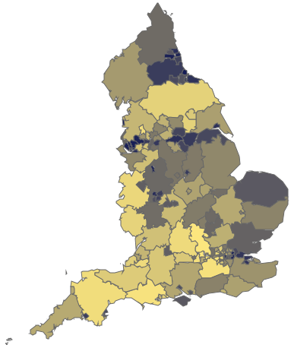
Sedentary time by local authority
Proportion of young people aged 15 with an average daily sedentary time of 7 hours or more in the last week (weekdays only), by local authority, 2014/15
Seven out of ten of 15 year olds (70%) reported they were sedentary for seven hours or more a day on weekdays in their free time.
(59%)
(81%)
Map available from PHE’s Physical Activity tool https://fingertips.phe.org.uk/profile/physical-activity
Geographical variation amongst upper tier local authorities shown.
Source: What About YOUth? Survey, 2014/15, NHS Digital
Notes:
In 2014/15, seven out of ten of 15 year olds (70%) reported they were sedentary for 7 hours or more a day on weekdays in their free time, with the highest rates of sedentary behaviour found in Hartlepool (81%) and the lowest rates reported in Windsor and Maidenhead (59%).
The What About YOUth? survey asked respondents about time spent on 5 specific sedentary activities. Young people often engage in more than one sedentary activity at a time, so these figures may overestimate sedentary time.
Data from the What About YOUth? survey 2014/15, published by NHS Digital http://content.digital.nhs.uk/catalogue/PUB19244

Slide 14
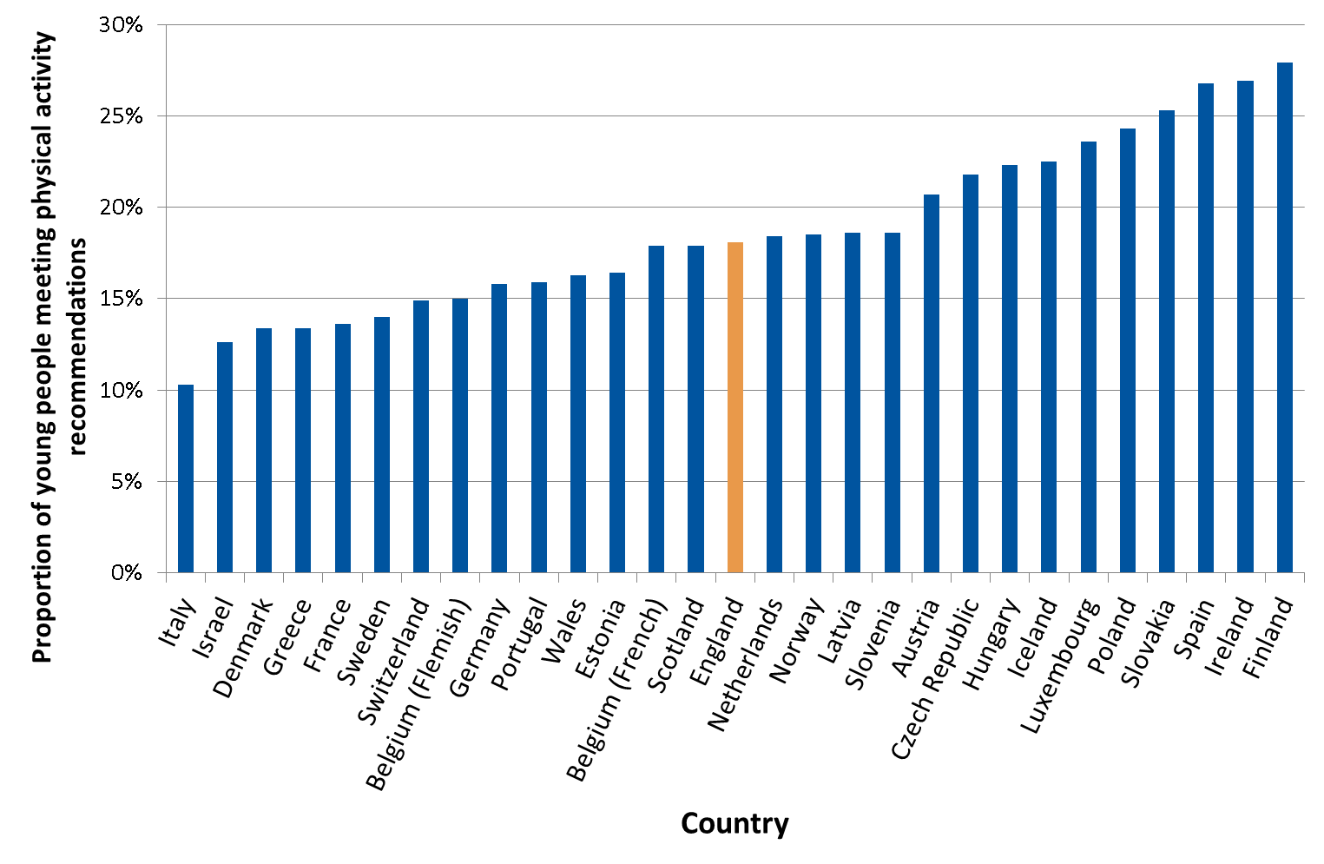
European comparisons of physical activity in young people
Proportion of young people aged 11, 13 and 15 meeting physical activity recommendations, by country, 2014
Source: Health Behaviour in School-aged Children (HBSC) survey, WHO Regional Office for Europe, 2014.
Available from http://www.euro.who.int/__data/assets/pdf_file/0019/339211/WHO_ObesityReport_2017_v3.pdf?ua=1
Meets recommendations | At least 60 minutes (1 hour) of moderate to vigorous physical activity (MVPA) on all 7 days in the last week.
Notes:
In 2014, 18% of children aged 11, 13 and 15 in England reported they were physically active for at least an hour on all seven days in the previous week. The highest rates of physical activity were reported in Finland (28%) and the lowest rates reported in Italy (10%).
The Health Behaviour in School-aged Children (HBSC) survey is a WHO collaborative cross-national study that monitors the health behaviours, health outcomes and social environments of boys and girls aged 11, 13 and 15 years every four years.

Slide 15
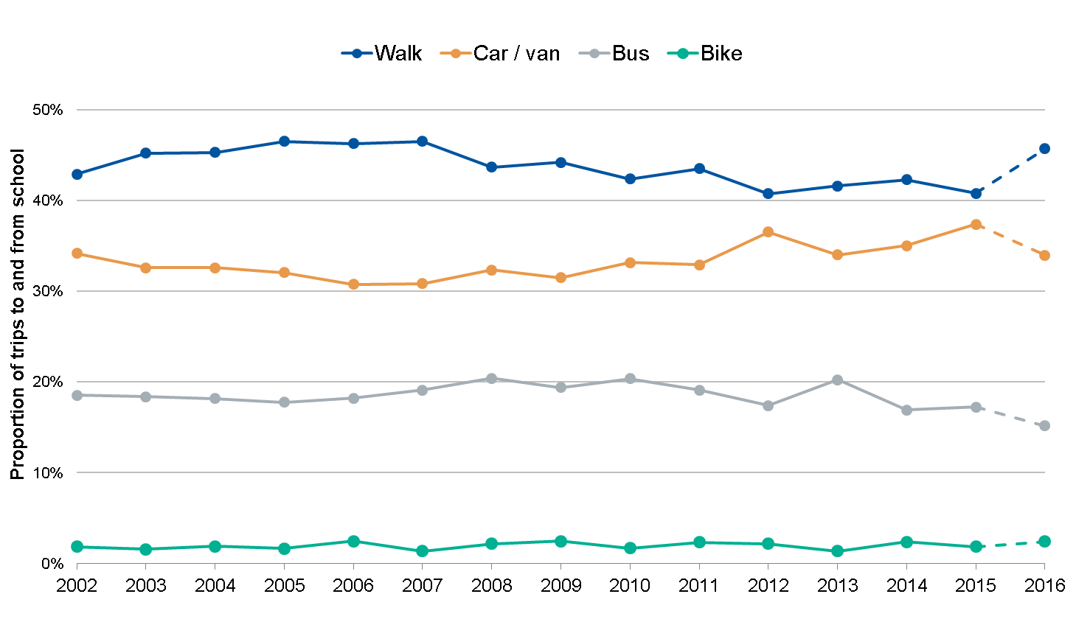
Trends in travel to school
Proportion of trips to and from school for children (aged 5–16 years) by main mode of transport, 2002 to 2016ª
Source: National Travel Survey 2016, Department for Transport https://www.gov.uk/government/statistics/national-travel-survey-2016
ª In 2016 short walks (of less than a mile in length or less than 20 minutes duration) were recorded on day one for half the sample, and day 7 for the other half of the sample. In previous years, short walks have only been recorded on day 7 of the travel diary. Collecting data on short walks on day one of the travel week has increased the number of short walks reported, which means a break in the time series between 2016 and earlier years.
Notes:
In England, walking was reported as the most common way children travelled to and from school in 2015. However, the difference between walking and travelling by car or van is the smallest reported during the last 14 years. Cycling rates have remained consistent with 2% cycling to school in 2015.

Slide 16
Data sources
Health Survey for England 2015
The Health Survey for England 2015 is the latest in a series of surveys commissioned by NHS Digital which includes physical activity data for children. The surveys are representative of adults and children in England, and are used to monitor the nation's health and health-related behaviours.
What About YOUth? Survey 2014/15
The What About YOUth? (WAY) survey provides data on a range of indicators for 15 year-olds across England. Data has been collected on general health, diet, use of free time, physical activity, smoking, drinking, emotional wellbeing, drugs and bullying.
Health Behaviour in School-aged Children (HBSC) survey 2014
The Health Behaviour in School-aged Children survey is a World Health Organization collaborative cross-national study that monitors the health behaviours, health outcomes and social environments of boys and girls aged 11, 13 and 15 years every 4 years.
National Travel Survey 2016
The National Travel Survey is a series of continuous household surveys on personal travel. It uses an interview and week-long travel diary to measure all aspects of personal travel, including walking and cycling. The survey is designed to pick up long-term trends and is not suitable for monitoring short-term trends.

Slide 17
Other PHE physical activity resources
Physical activity tool
Everybody active, every day: an evidence-based approach to physical activity
What works in schools and colleges to increase physical activity
Obesity and the environment: increasing physical activity and active travel
Active travel briefings for local authorities
Standard evaluation framework for physical activity interventions
Guide to physical activity data sources
Guide to online tools for valuing physical activity, sport and obesity programmes
E-learning modules on physical activity and health
Change4Life campaign resources
Start active, stay active: infographics on physical activity

Slide 18
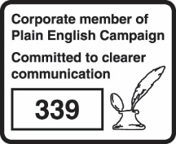
About Public Health England
Public Health England exists to protect and improve the nation’s health and wellbeing, and reduce health inequalities. We do this through world-leading science, knowledge and intelligence, advocacy, partnerships and the delivery of specialist public health services. We are an executive agency of the Department of Health and Social Care, and are a distinct delivery organisation with operational autonomy to advise and support government, local authorities and the NHS in a professionally independent manner.
Public Health England
Wellington House
133-155 Waterloo Road
London SE1 8UG
Tel: 020 7654 8000
www.gov.uk/phe
Twitter: @PHE_uk @PHE_Obesity
Facebook: www.facebook.com/PublicHealthEngland
© Crown copyright 2018
You may re-use this information (excluding logos) free of charge in any format or medium, under the terms of the Open Government Licence v3.0. To view this licence, visit https://www.nationalarchives.gov.uk/doc/open-government-licence/version/3/ or email psi@nationalarchives.gsi.gov.uk. Where we have identified any third party copyright information you will need to obtain permission from the copyright holders concerned.
Published: February 2018
PHE publications gateway number: 2017742

