Slide 1

Business Cases
Who needs them anyway?
© Kevin McPhillips
SentiaPlus Ltd

Slide 2


Expectations & proportionality
A good business case shows clearly
              Why we should make the investment
              That we have considered how to get best value
              That delivery, cost and risk are managed & controlled
Expectations vary – manage them & keep it proportionate
Notes:
Key messages
A Business Case is management tool for scoping and planning the proposal and documenting the outcome. It is a requirement of the approval process.
The 5 Case Business Case process complies with the Scottish Public Finances Manual (SPFM), which also references HM Treasury Green Book and related guidance on this model.
A comprehensive business case requires a lot of thinking and analysis up front, including an options appraisal. This helps prevent surprises down the line, and gives assurance to the decision makers that they are considering a proposal supported by comprehensive and reliable information.

Slide 3
Typical environment for project management
Policies, strategies & targets
Transformed Operations
Outcomes & Benefits
Programmes
Projects & related activities
  Planning

Slide 4
The evolving business case
(know your decision points)
Case for change
More detail on options
Update & specific recommendations
Strategic Outline Case (SOC)
Outline Business Case (OBC)
Full Business Case (FBC)
DECISION
to do appraisal of shortlisted options
DECISION to proceed & procure
DECISION to contract (or not)
Notes:
Animated slide
Key messages
There are also other assurance activities e.g. Gateway reviews– plan in time for them
where there is only a single option for delivering, there is no need to contort the business case into artificial assessments. It would be sufficient to put in a statement explaining why there is only a single option, and then building the Economic case around that one.
Similarly, where ‘do nothing’ is not an option this does not have to be considered artificially

Slide 5
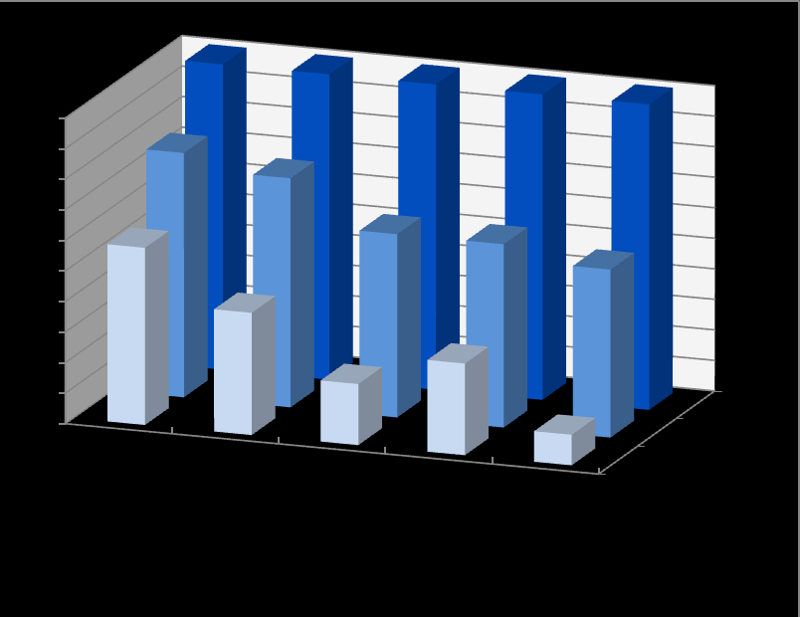
Building and updating the case
FBC
OBC
SOC

Slide 6
Building and updating the case
FBC
OBC
SOC

Slide 7
Strategic
5 case model
Economic
Management
WHY?
Financial
Commercial

Slide 8

Strategic Case
The case for change
Alignment with the organisation’s strategies
Other strategies
How to bridge the gap & measure the difference
Strategic
Notes:
Key messages
Show the strategic case for change, alignment with other strategies, and mention any strategic risks
Consider what can be directly signposted to the Programme OBC or Agency OBC
If using data or inputs from other sources, ensure that the data is adequately described and referenced. This is because the context and traceability is critical, and including them aids review

Slide 9

Economic Case
The “analytical heart of a business case”
Value of the proposed investment
Costs, benefits, risks
Compare options
Economic
Notes:
Key messages
CAD involvement is not expected on every Business Case, for example, where the case is considering what platform to use, CAD would not see themselves involved in this. Where it is a decision about whether to use local delivery partners for a Benefit, or whether a Benefit is to be delivered via inter-agency agreements, then CAD may expect to be part of the options appraisal if their expertise can aid decision making in the Economic case. They may also have expertise to help plan for delivery in other parts of Business Cases.
As with any people inputting to the Business Case, CAD will need to be given sufficient notice to take forward this work and be involved at the outset.
Multi Criteria Analysis: The 5 high level Criteria sets used in the Agency OBC (P58-59) to conduct Multi-Criteria Analysis should be the lens through which options should be assessed. The full list of 27 criteria in the OBC may be relevant for some decisions but should be used flexibly.
For the more technical business cases/investment appraisals, a subset of this should be used.
Avoid embeedded docs
EXTRACT FROM: Stage 1 Report on the Social Security (Scotland) Bill: Scottish Government Response
124. In addition to the positive impact the creation of the agency will have on the economy, the Scottish Government will continually assess the impact of social security benefits on public finances. The Scottish Fiscal Commission has key responsibility for producing forecasts for devolved benefits and the Scottish Government will work with them, as appropriate, to help develop forecasts that are of a high quality. All significant resource commitments, and investment decisions, are subject to the development of robust business cases that fully consider value for money (in line with the Scottish Public Finance Manual). Business cases assess cost, risk, critical success factors and outcomes (which the Scottish Government also refers to as ‘measurable improvements’). Measurable improvements identified for the programme so far can be found in published business cases and those which are currently in development.

Slide 10
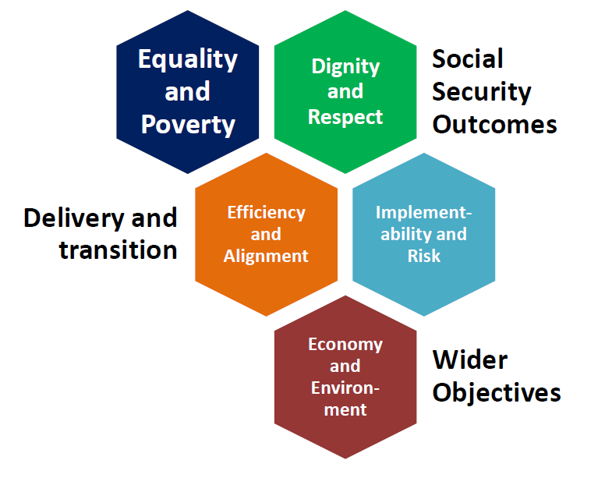
Economic Case
Multi Criteria Analysis (MCA) used for comparing options
Economic
Example from Scottish Social Security programme

Slide 11

Commercial Case
Best value viable option
Supply side ability to deliver
Compliance with procurement regulations
Procurement timelines
Commercial

Slide 12
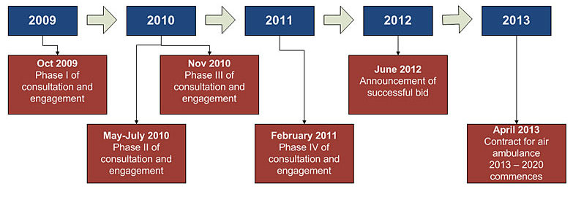
Commercial Case
Scottish Air Ambulance procurement
Develop, agree and distribute tender specification to shortlist, to generate market response, and award contract
Commercial

Slide 13
Commercial Case
Example procurement timeline
List all key procurement tasks and dates
Incorporate in overall planning
In public sector, these will be published, and may inform future contractual arrangements
Commercial
Notes:
Key messages
This is an example of a procurement timetable, which may be inserted in the planning checklist for a BC.
Note that it allows for holiday periods, and should reflect availability of both staff and potential respondents.

Slide 14

Financial Case
Affordability
Funding
Amounts
Timing
Source
People
Return on investment / cashable benefits
Running costs
Financial
Notes:
Key messages
Engage early with the Finance team, so they know what is coming to them, when.
Finance team typically has the final say on the Financial Case before it goes for approval.
Finance team may “crunch the numbers”, apply appropriate accounting treatment, advise on matters such as VAT, capital expenditure and sources of funding. However, before they can do this, they will need the source numbers, which should be provided by the project team, derived from plans and estimates.

Slide 15
Financial Case
Financial

Slide 16

Management Case
Achievability
Timeline for delivery
Resourcing
Transition
Risks
Dependencies
Control
  time, cost, quality
Management
Notes:
Key messages
The Management Case includes controls around delivery – it should signpost the Programme OBC, and state that it will comply with PMO controls and reporting. Where known, it should mention expected assurance activities
The management case must contain a timeline, a resource plan, and a statement of “do-abilty”, including risks to delivery

Slide 17
Keep it Simple
Structure & plan the BC work, inc. review & rework
Know your inputs & dependencies
Engage early & often, and set expectations
Plan assurance activities
Make the BC clear & readable
Know what decisions are required
- by whom
- when

Slide 18
Business Cases
Who needs them anyway?
Slides, checklists and links will be available via LinkedIN
Kevin McPhillips
SentiaPlus Ltd

