Slide 1

Carer Awareness Training
Madeleine Martin
Interim Carer Service Development Manager
Integrated Carers Team
Tel: 553-8391
E:Madeline.martin@nhslothian.scot.nhs.uk

Slide 2


Outline for today
Introductions
Teams etiquette
Interactive session
Write issues and questions through the chat function
Enjoy & Look after yourself
Stick with us!

Slide 3
Learning Outcomes
  Understand:
  who carers are & how to identify them
  the impacts a caring role has on individuals
  the benefits of supporting carers
  Demonstrate:
  a basic understanding of the Carers (Scotland) Act 2016 and the key duties for Health Boards and Local Authorities’
  a basic knowledge of local carer organisations and their services
  connecting carers to appropriate services
rini

Slide 4
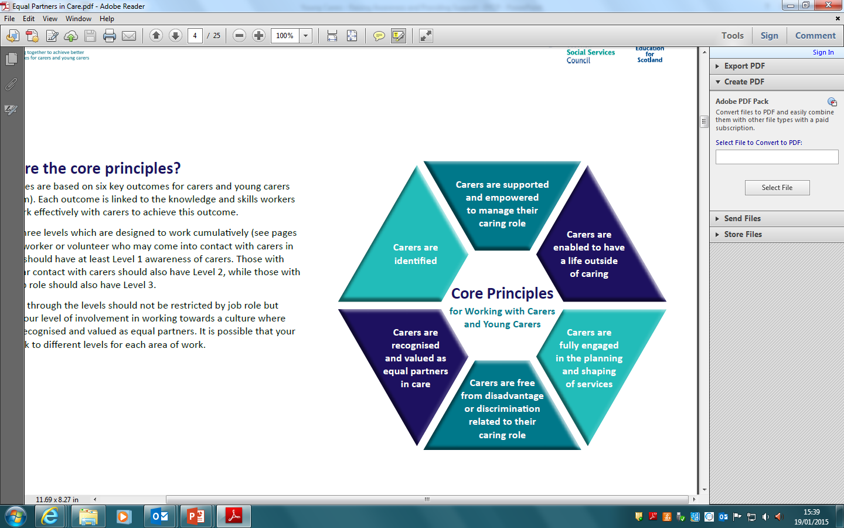




The EPiC Principles

Slide 5


Please score your overall confidence in identifying and supporting unpaid carers on a scale of 1 to 5
I dread supporting unpaid carers- I won’t know what to say or do
I am confident in supporting carers- I know what to say and how to connect them

Slide 6

Edinburgh Carers’ Strategy
Legal requirement
NHS Lothian and The City of Edinburgh Council recognise the crucial role that carers contribute to their communities across Edinburgh
Carer identification and information is seen as a key way of improving outcomes for carers and the lynchpin for accessing other forms of support
A range of good quality support needs
to be available to carers at the right time and place

Slide 7

Supporting Working Carers within NHS Lothian
Link to Intranet Page: Supporting Working Carers
http://intranet.lothian.scot.nhs.uk/Directory/NursingMidwifery/SupportingCarers/Pages/default.aspx

Slide 8


Carer Awareness Training

Slide 9
Who are “Carers”?
““carer” means an individual who provides or intends to provide care for another individual (the “cared-for person”).
...does not apply... to the extent that the care is or would be provided (i) under or by virtue of a contract, or (ii) as voluntary work.”
“‘Young Carer’ means a carer who is under 18 years old or has attained the age of 18 years while a pupil at school and [has since remained] a pupil at…school”
Carers (Scotland) Act 2016
This means....
...carers can be anyone:
Partner
Family
Neighbour
Friend
...caring for any condition:
Physical illness
Mental illness
Disability
Frailty
...for any length of time.
Intermittently
Months
Years
Decades

Slide 10

Am I a Carer?
*Carers Scotland, Missing Out- the identification challenge.
Report published in November 2016
In Scotland- 56% of carers took over a year to recognise their caring role*
26% took over 5 years to identify themselves as a carer*
Some groups of carers such as, Parent carers, mental health carers and distance carers , take longer than average to identify their role*

Slide 11
Carer Identification is Key
Carer
I am a spouse
I am a Parent
I am an adult child
I am a friend
Key Identifiers..
Primary Care Staff
Social Workers
OT’s
Pharmacists
Hospital Staff
YOU!!
“Isn’t this what I am supposed to do?”
“Please help me..
I am in pain...
I can’t sleep...
I feel
Stressed...
I can’t cope…”
“We can help you with this, let me refer you for support…”

