Slide 1
Carer Champion Session
VOCAL- Voice of Carers Across Lothian
Notes:
When you join the carer champion session, the session is already underway, so you won’t necessarily know who is attending – but likely a wide range of health and social care professionals, though sometimes a wider audience.
This session is a short introduction to VOCAL and our service. You’ll hear more about that near the end of the presentation and we’re also going to spend some time reflecting on how carers are supported, and I’ll give simple tips that you can use to support positive interactions with carers.
Informal and interactive session (I like to encourage delegates to unmute if they would like to ask a question, or respond. Also remind them to use the chat and that we’ll keep an eye on it.

Slide 2
Session aim
This session aims to highlight:
the number of carers in Scotland and the UK
the impact of caring including why carers need support
the support that VOCAL offers to carers
Notes:
This session aims to highlight:
the number of carers in Scotland and the UK
the impact of caring including why carers need support
the support that VOCAL offers to carers

Slide 3
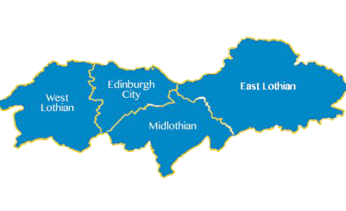
Carers in Scotland: The bigger picture
72,217
1.1 Million
2 years
£13.4 billion
87%
£36 billion
Notes:
Interactive – This works well as a ‘guessing’ game by asking delegates to shout out numbers .
In slide order:
Scotland Flag: Ask delegates if they know how many carers there are in Scotland (embrace the silence as you wait for someone to answer!). It’s possible Keith may have covered this already, so I’ve often made a joke about a ‘recap’ and to check if they were paying attention.
1.1 million: In June, 2020 , Carers Scotland published a report estimating that there are now 1.1 million carers in Scotland. That number rose as a result of the pandemic, but our previous carer estimate is based on the 2011 census. The current population of Scotland is estimated at 5.5-6 million, so for argument’s sake, assume 1 in 5 people in Scotland are carers.
Map of Lothian – how many carers do you think there are across NHS Lothian?
72,217 – the number of carers across NHS Lothian as reported in the 2011 census. However, if we take the current estimate of 1.1 million, and 1 in 5 in Scotland, statistically, it’s likely that there are approx. 160,000 (based on 1 in 5 carers and the population of NHS Lothian estimated at 800,000)
Sad emoji: it’s not surprising that 87 % of Scotland’s carers feel that their caring responsibilities have had a negative impact on their physical and mental health .
It takes carers on average 2 years for someone to acknowledge their role as a carer. In some cases, caring kind of sneaks up on people, you start providing a little support then it becomes apparent that the person needs more support and can’t manage without you, or sometimes someone becomes a carer virtually overnight as a result of an event (ie heart attack, stoke…) Professionals (the people in the room) have a role to play in ensuring carers are identified. You may be the first person to say to someone that they’re a carer and to let them know that help and support is available. So if you think of someone not knowing they’re a carer for 2 years, its’ unsurprising the amount of people who say it has had a negative impact. We want to help people recognise their role and access support from an early stage to help mitigate some of the challenges of being an unpaid carer.
£13.4 Billion was the NHS Scotland’s operating budget in 2019. If all the 1.1 million carers across Scotland decided they no longer could provide care, or wanted to provide care, we’d need to find £36 billion to replace the care provided by unpaid carers. These two figures are from the Feely Report. Even if we could find £36 billion in Scotland’s budget, we also know that health and social care services are at crisis point – both in terms of funding and staffing shortages. But this number really helps highlight how much money unpaid carers are saving the economy annually. It’s also makes a strong point of why we need to ensure carers are supported in every sense of the word especially through service provision and also financially

Slide 4
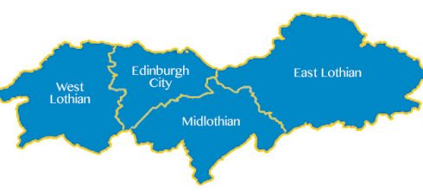
EPiC vs Think Carer
Think Carer
Notes:
This session is based on VOCAL’s Think Carer training. It also echoes the key principles of the EPIC Framework . (Pause and ask who has heard of EPIC, what do they know etc. possible Keith already covered some of this info – if he hasn’t covered it yet, he will).
Equal Partners in Care (EPiC) is the national framework for workforce learning and development related to unpaid carers. It was developed by NHS and SSSC (Triple S C). The framework also has associated learning modules accessible on TURAS. It’s easy to find, available even if you’re not employed by NHS so I’d encourage you to check it out.
It comprises of a set of core principles which are based on six outcomes for carers and young carers. It has been developed in partnership with a range of stakeholders including carers and non carers
Unless someone is new to their caring role they will have skills and knowledge about the person they care for, and the care they require, which healthcare professionals can draw on to ensure an effective care plan is put in place.
Think CARER is the Lothian specific Carer Awareness Training which has been developed and is delivered by VOCAL
Think Carer raises healthcare professionals’ awareness of unpaid carers, the impact their caring role has on their health and wellbeing, and how healthcare professionals can support them. Healthcare professionals are in an ideal position to identify carers and help them access the support and resources they need to improve their quality of life as well as that of the person they care for.
Whatever their role, healthcare professionals are likely to come into contact with people who are carers; some know a carer or be an unpaid carer themselves. Becoming more aware of carers will help the healthcare professionals to ensure that carers have the information and support they need when they need it, to enable them to continue in their caring role for as long as they wish to. Both Think Carer and EPIC draw on the same principles of carer identification and support. You will hear more about Think Carer at the end of this presentation

Slide 5
The House of Care Model
Find out more by visiting Health and Social Care Alliance Scotland
Notes:
The House of Care Model (from the Health and Social Care Alliance Scotland) highlights the importance of valuing unpaid carers and working in partnership with unpaid carers. The house would break, and fall down without them.
Working in partnership with unpaid carers is at the heart of person centred care. You’ll notice in the image on the screen that Individuals and their carers are on the same level as the health professionals. So with Care, support and planning at the centre, engaging, informing individuals – and their carers is a core element of support. It highlights the importance of valuing carers – the house would collapse without them. They’re an equal partner in care.
Person centred care – Working in partnership with carers is at the heart

Slide 6
Recognise: Carers as equal partners
Every conversation with a carer can make a difference
Recognise carers and acknowledge their role and input
Involve carers in planning and decisions related to the person they care for
Notes:
In terms of some practical tips, just remember than every interaction you have with a carer can make a difference. Ensure carers are given opportunities to share their concern and also ensure that you recognise carers and value their input. Carers are experts on the people they care for and quite often able to provide additional insight into what’s going on with the person they care for. As well as recognising carer’s for their knowledge and expertise, another simple way to support a carer is by recognising their involvement and the way they care for someone. So even saying something to a carer like ‘you handled that situation really well’ or ‘you’re doing such a great job’ can give carers a mental boost and help them feel valued and recognised.
Carers have a right to be involved in the planning and decisions of the person they care for. Quite often, carers are also going to be an important part of the success of a care plan by the support they provide the person they care for, so again, working with them in partnership, involving them in planning and decisions and valuing their contributions will have a positive impact all around.

Slide 7
Carers as equal and expert partners in care
Better outcomes for carers and the people they care for
Can help reduce stress and some of the impact of caring
Supports carers to continue caring for as long as they wish
Notes:
Working in partnership with carers will have better outcomes for carers including improved physical and mental well-being. If carers are engaged and empowered, then this will support them to feel more confident in their ability to care and valued as a carer which can also help them manage changing relationships that are impacted due to the caring role. Engaging carers can also help carers to feel better informed about issues linked to their caring role and have improved confidence to shape services and support. Improving carers confidence and engagement through partnership working can also contribute to better social well-being.
Better outcomes for carers and the people they care for quite often also translates to better outcomes for services too. If carers and the people they care for are feeling confident, and able to manage, it could mean less pressure on services, fewer hospital re-admissions, less need for follow up and monitoring. So it can have benefits, but at the heart of this is carers who feel engaged, supported and valued.
Supporting carers to continue caring for as long a they wish is one of the core aims of the Carers Scotland Act (note – the act will be covered later in the session by Keith, so this is just to highlight how this all slots in with the national policy picture)
If carers feel valued as equal partners, then this can help to reduce their stress and the impact of caring ensuring better outcomes for everyone.

Slide 8
Impact of Caring
Notes:
This next section looks at some of the impacts of caring. The next slide is a bit overwhelming – but on purpose. It’s meant to illustrate what’s going on under the surface for carers, or how over time the little drops become big ripples.
Thinking about the impact of caring and the challenges carers face can help us understand better what we can do to support carers. It isn’t about waving a magic wand and solving all the problems, but it is about understanding some of the challenges. By understanding the impacts and supporting carers we can help them to keep doing what they’re doing for longer- early identification can lead to earlier support
Caring can be positive and rewarding
But it can be exhausting too – even if people are caring because they want to . We can’t take that for granted, and still need to acknowledge how caring can caring can affect many aspects of a person’s life. And some of the challenges
Note to trainer: Also important to acknowledge that some delegates may be unpaid carers, so some of these themes might hit a bit close to home.

Slide 9
Social Isolation
Time pressures
Financial Loss
Tiredness/Exhaustion
Self Care
Mental Ill Health
Debt
Hardship
Changing Relationships
Relationships/Family
Loss of Identity
Sleep Deprivation
Guilt
Impact of Caring
General Health Issues
Poor Diet & Lifestyle
Unemployment
Depression
Conflicting Emotions
Constant fear of further illness to cared for
Anxiety
Reduced Career Prospects
Work Issues
Low Self Esteem
Alcohol or drug misuse
Loss
Notes:
This slide may look overwhelming but it’s meant to illustrate how caring can become overwhelming. It’s not to say that all carers will experience all these impacts, and maybe not all at the same time. But these are common themes around the challenges that carers experience.
This could be presented as a discussion – give delegates a minute to have a look and reflect on what jumps out at them. Ask them to share either in the chat or by unmuting. Tailor chat/commentary and discussion to group’s interests .
You don’t have to be caring full time for it to have an impact – and carers may cope differently with different impacts and as they juggle multiple priorities (family, care, employment… ). Also highlight ‘sandwich’ carers who are caring for young children, or their children with ASN and also caring for ageing and elderly relatives/parents etc.
Think about the impact:
Providing practical and emotional support to the person they care for
Getting multiple phone calls – at work or even in your own leisure time
Fitting family time and responsibilities around work and caring
Attending appointments and school meetings
All these things make it difficult for carers to get a balance in their lives
Highlight key themes:
carers own physical and mental health (increased risk of diabetes, exhaustion, mental health implications, self care, depression, fear…)
Financial impact – 1 in 5 carers gives up work because they struggle to balance work and caring, increased expenses –medical supplies, food, financially supporting person they care for
Impact on relationships – with the person they care for, in their wider circle of family and friends, work (can also link this to sense of loss). Also family relationships – family member may have more than one carer- what happens when the family doesn’t agree (relate this back to person centred care)
Guilt – I’m not providing enough or good enough care, guilty for using services, or arranging a care home (I should be doing the care, my person doesn’t like living in the nursing home) choosing different care options to suit you and the person you care for, guilt of feeling like you’re neglecting your own family and friends because of the caring responsibilities
Other key points:
None of us know where a caring role may head – could be short or long term
Sometimes we become carers overnight – circumstance changes and our family member/friend can no longer manage without extra help (i.e. Stroke, traumatic injury)
A caring role can also creep up on you – start by offering a bit of support, and gradually the level and frequency of support increases over time
Could be limited time – post op recovery etc.
Life gets turned upside down, relationships change
Cared for loses ability to wash, dress, feed themselves. Impact on their communication
Most people don’t know what supports are out there – they’ve never needed to access
Having someone tell them there is support and making a referral can make all the difference when so much is going on
Different scenarios:
Your parent has a stroke and you still have a family to support and you’re still working
The hospital discharge your parent, and you’re busy dealing with a team of professionals and sorting out home care
You may need to adapt their home
Could be worried about finances – having someone else in the home, being unable to work, purchasing food and medical supplies for the person you care for.

Slide 10
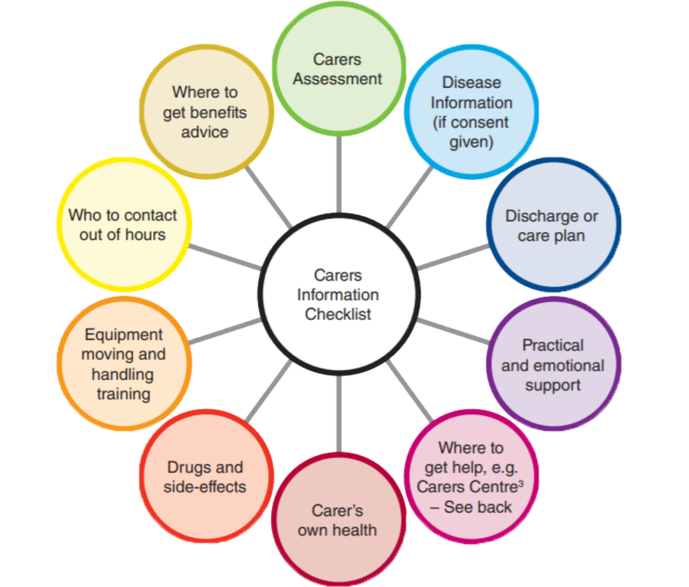
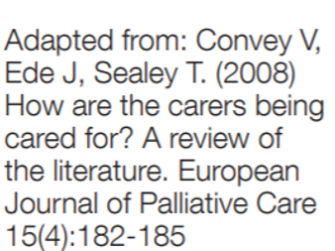
Notes:
**Need to highlight that this isn’t about bombarding Carers with information –especially if they don’t identify as carers, or their still getting to grips with the change of role and new circumstances
People can only take on so much information, and they have to be ‘ready’ for it or in a place where they can hear it – approach with sensitivity and ask carers what would they like to know, or asking if they feel confident with an aspect of care or would they like more help. Conversations should be person centred, and value the care provided by carers.
This is an illustrated example that highlights the range of information we can share with carers. It helps us to reflect on what might be important to the carer and what might support them in their caring role
Involving Carers in discussions and finding out what concerns they have, or what might be useful for them to know . What information would support them in their caring role? Also remember that carers quite often take on the role of multiple professionals – helping with physio, feeding, bathing and personal care, admin – making appointments, co-ordinating services etc. so thinking about what we share with carers is about recognising their role and what would support them.
Carers may not even know about carer support services such as VOCAL (next slide)

Slide 11
Carer Support @ VOCAL
General carer support
Family support: addictions
Financial and legal surgeries
Peer mentoring
Counselling
Learning and leisure events- Visit the Carer Training Website
Wee Breaks – Visit the Wee Breaks Website
Notes:
By supporting carers practically and emotionally we can give them tools and techniques that help them to look after their own well being and access support
And of course one of the most important pieces of info to share with carers is the support they will find at their local Carer’s centre.
Talk through VOCAL service overview and highlight key message of asking professionals to refer to VOCAL
Referrals are quick and easy, can be done on our website. Please get the permission of the carer as we need their contact details and we will actively follow up with them.
They will have a short phone call with a carer support practitioner and they will receive a welcome pack. Carer doesn’t need to know what support they’re looking for at point of referral – we’ll help them figure it out. The earlier carers are referred in to VOCAL the better – ideally want people aware of our service before they reach a crisis – though of course we will still help and support.

Slide 12
Edinburgh
Midlothian
Carers of West Lothian
Carers of East Lothian
Notes:
Highlight that VOCAL is Edinburgh and Midlothian but there is a carers centre in every local authority and these are the 4 Lothian Carers Centres
Where to refer in the different areas

Slide 13
Why refer to Carers Centres?
“My situation hasn’t changed but I have. Through all the help and support. I feel more empowered and knowledgeable.”
“VOCAL gave me knowledge that I was a carer and that my problems were real and I didn’t have to cope on my own. The 1:1 meetings were transformational for me in that I came back from the brink of despair. I have on-going challenges and knowing that VOCAL is there makes me feel safer and better able to cope with my caring responsibilities.”
Quotes from VOCAL Service Evaluation
Notes:
These quotes came from a VOCAL service evaluation – it just goes to show the importance of linking carers in with support. And how it can help them view their situation differently, or feel more able to cope

Slide 14
Think Carer Training
Think: Consider
Acknowledge
Recognise
Empower
Refer
Sessions available:
15 minute Taster session
1 hour full session
1.5 hours in depth session
Contact VOCAL : centre@vocal.org.uk for more information
Notes:
Today’s training has been a short taster of a Think Carer session we run. Think Carer goes into more depth around carer identification and support. We’re always happy to come and speak to different teams and groups to highlight carer identification and support. If you’d be interested in a session for your organisations, don’t hesitate to get in touch using the contact details on the slide

Slide 15
centre@vocal.org.uk
0131 622 6666
vocal.org.uk
VOCAL - Voice of Carers Across Lothian
Scottish Charity: SC020755 | Company Registration: SC183050

