Slide 2
Adult Carer Support Plans and Young Carer Statements
Madeleine Martin
Interim Carer Service Development Manager
Integrated Carers Team
Health and Social Care

Slide 3
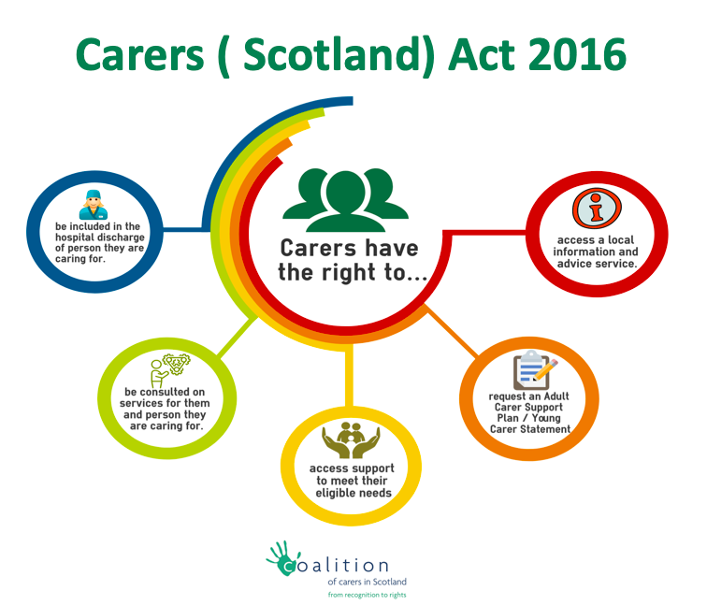

Slide 4
Purpose of a carer assessment and support plan
Impact of the caring role on the individual
Age of carer and amount of time spent caring
Powerful conversation with an unpaid carer
How is the Carers physical and mental health?
Establish outcomes for the carer
Develop a support plan and carer support
The assessment itself shouldn’t assume the carer wants to take on a caring role or continue caring
The carer may still care about the person they look after, but may no longer be able to care for them

Slide 5
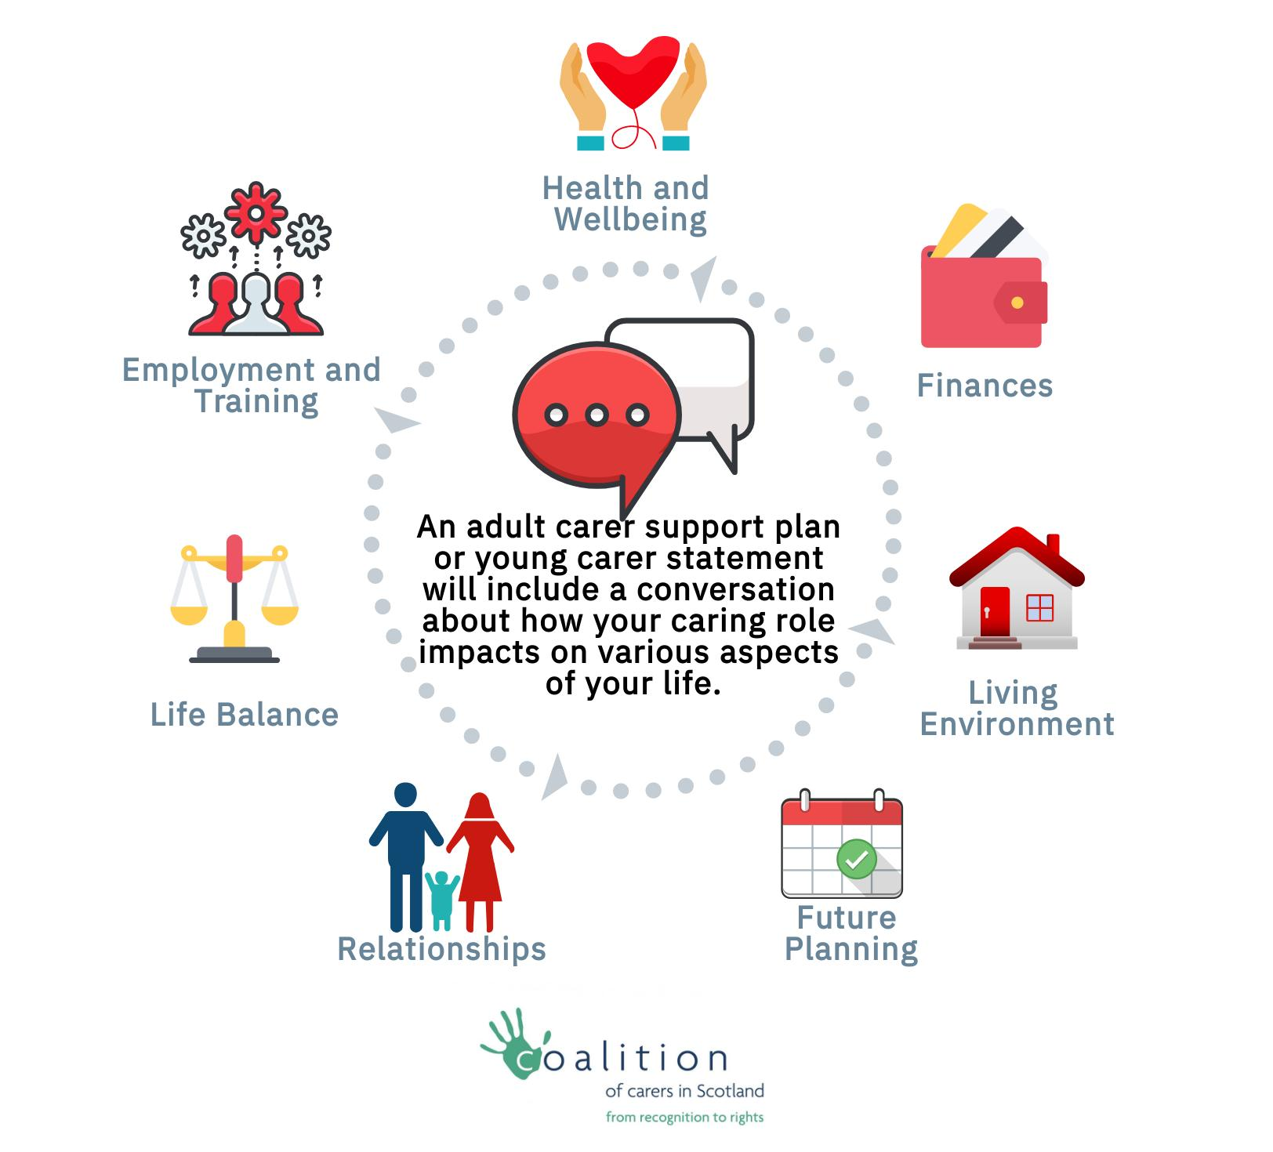
Adult Carer Support Plan/Young Carer Statement
Notes:
Under section 3 of the Social Care (Self-directed Support) (Scotland) Act 2013 (“the 2013 Act”) local authorities have a power to provide support to adult carers following an assessment completed under section 12AA of the Social Work
(Scotland) Act 1968 (“the 1968 Act”) (carer’s assessments relating to carers of those aged 18 or over) and under section 24 of the Children (Scotland) Act 1995 (“the 1995 Act”) (carer’s assessments relating to carers of those under the age of 18).
As stated, section 3 of the 2013 Act about support to adult carers gives local authorities a power, as opposed to a duty. This means that local authorities have discretion rather than an obligation about whether to support carers.
The Carers (Waiving of Charges for Support) (Scotland) Regulations 2014
4.1 The Regulations state that a local authority must waive charges where services are provided to adult carers under section 3(4) of the 2013 and where services are provided to children who are in need under section 22 of the 1995 Act because they are young carers.
4.2 The Regulations also have the effect that local authorities cannot means test or require a contribution from a carer or young carer where the support is being delivered by way of a direct payment.
4.3 Charges will not be made for support provided to carers either directly by local authorities or commissioned by the local authority through other statutory, independent and third sector bodies. However, if a carer wishes to supplement and pay for support above the agreed level they will receive through self-directed support, then this is a matter entirely for the individual carer.
have discretion rather than an obligation about whether to support carers.

Slide 6
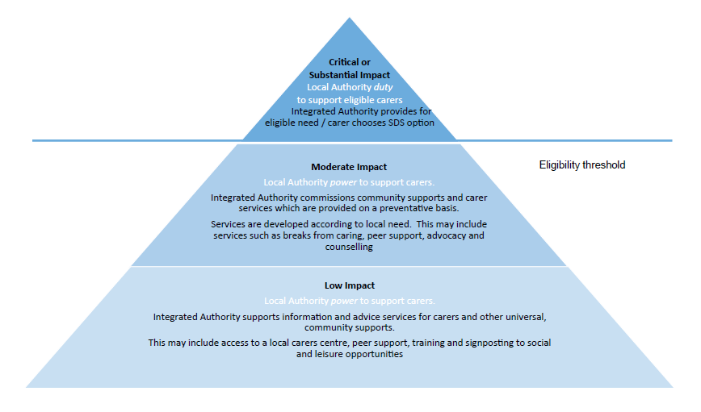

Slide 7
Eligibility for Services is decided in terms of risk to an individual.
There are five indicator categories:
No Impact (5)
Indicates that there are no quality of life issues resulting from the caring situation and at this moment no need for support or advice.
Low Impact (4)
Indicates that there may be some quality of life issues but low risk to a carer’s capacity for independence or health and wellbeing.
Moderate Impact (3)
Indicates that there is some risk to a carer’s capacity for independent living and health and wellbeing. This may call for provision of some health and social care services.
Substantial Impact (2)
Indicates that there is major risk to a carer’s capacity for independent living and health and wellbeing. Likely to require urgent provision or health and social care services.
Critical Impact (1)
Indicates that there are significant risks to a carer’s capacity for independent living and health and wellbeing. Likely to require immediate provision or social care services.
Notes:
Under section 3 of the Social Care (Self-directed Support) (Scotland) Act 2013 (“the 2013 Act”) local authorities have a power to provide support to adult carers following an assessment completed under section 12AA of the Social Work
(Scotland) Act 1968 (“the 1968 Act”) (carer’s assessments relating to carers of those aged 18 or over) and under section 24 of the Children (Scotland) Act 1995 (“the 1995 Act”) (carer’s assessments relating to carers of those under the age of 18).
As stated, section 3 of the 2013 Act about support to adult carers gives local authorities a power, as opposed to a duty. This means that local authorities have discretion rather than an obligation about whether to support carers.
The Carers (Waiving of Charges for Support) (Scotland) Regulations 2014
4.1 The Regulations state that a local authority must waive charges where services are provided to adult carers under section 3(4) of the 2013 and where services are provided to children who are in need under section 22 of the 1995 Act because they are young carers.
4.2 The Regulations also have the effect that local authorities cannot means test or require a contribution from a carer or young carer where the support is being delivered by way of a direct payment.
4.3 Charges will not be made for support provided to carers either directly by local authorities or commissioned by the local authority through other statutory, independent and third sector bodies. However, if a carer wishes to supplement and pay for support above the agreed level they will receive through self-directed support, then this is a matter entirely for the individual carer.
have discretion rather than an obligation about whether to support carers.

Slide 8
ACSP/YCS- Outcomes for carers
1
Carers are identified early and assessed quickly
Carers report being well informed about issues relevant to their carers role
2
Carers are supported to address their own health and wellbeing
3
Carers have choice, collaboration and control in their caring roles
Carers have accessible and up to date appropriate information
Carers feel supported by services and have increased confidence towards their caring responsibility
Carers are offered help with financial planning/benefits advice/ general advice
Carers sustain their physical, social and mental wellbeing
Carers report economic wellbeing

Slide 9
Short Break Service Statement
Available on this link:
http://www.edinburgh.gov.uk/info/20077/carers/103/short_breaks_for_carers

Slide 10
Short Break Service Statement
The Carers (Scotland) Act 2016 places a new duty on local authorities to prepare and publish a Short Breaks Services Statements (SBSS) Section 35 states that:
A SBSS means a statement of information about the short breaks services available in Scotland for carers and cared-for persons
The information must be accessible to, and proportionate to the needs of, the persons to whom it is provided
Scottish Ministers may by regulations make further provision about the preparation, publication and review of short breaks services statements

Slide 11
More Information
Please see the handout in your pack from Carers Scotland
Go to this website for further information:
http://www.gov.scot/Topics/Health/Support-Social-Care/Unpaid-Carers/CarersBill

