Slide 1
Adult Carer Support Plans and Young Carer Statements
Keith Lugton
Carer Coordinator
Integrated Carers Team
Health and Social Care

Slide 2
Purpose of an Adult Carer Support plan
Impact of the caring role on the individual
Age of carer and amount of time spent caring
Powerful conversation with an unpaid carer
How is the Carers physical and mental health?
Establish outcomes for the carer
Develop a support plan and carer support
The plan itself shouldn’t assume the carer wants to take on a caring role or continue caring
The carer may still care about the person they look after, but may no longer be able to care for them
Notes:
Starts with a conversation about the caring role. The carer may not have had much opportunity to talk about providing care and how they are feeling.
Through this conversation we can identify the impact of the caring role on the carer’s wellbeing:
Physical and mental wellbeing (fatigue and stress)
Emotional wellbeing (changing relationships)
Finances (have they reduced or given up work?)
Relationships out with the caring role (do they still see friends and family? Do they have a life out with the caring role?)
Age of carer and hours spent providing care. Not to determine eligibility but assess impact.
Example: 15 hours of care per week may be manageable for a fit and healthy 30 year old but could have significant impact on an 80 year old with their own health issues.
Establish outcomes: what does the carer want to achieve or change?
Develop an ACSP plan with actions to help meet outcomes and keep plan under review (we will offer an annual review but can be brought forward if carer wishes due to a change in circumstances).
EHSCP staff upload plan to AIS. Third sector staff submit plan to Social Care Direct if required.

Slide 3
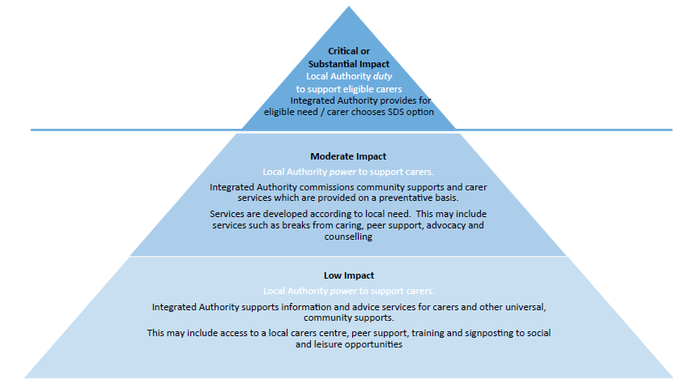
Notes:
Edinburgh’s eligibility model.
Other local authorities will have similar criteria.
Compare & contrast with pre Carer’s Act: eligibility criteria, power and duty to support.
Example of respite and SDS: need for respite shown through ACSP as a supporting document. Replacement care part of cared-for person’s package of support.
Carer payments: Awarded to support ‘unmet need’ identified through ACSP. Also warded at preventative level.
Examples from where other funding streams are not available or appropriate:
Gym & leisure club membership
Technology such as smart speakers, e.g. Amazon Echo
Complementary therapies
Transport costs, e.g. Train fares, bus pass

Slide 4
Eligibility for Services is decided in terms of risk to an individual.
There are five indicator categories:
No Impact (5)
Indicates that there are no quality of life issues resulting from the caring situation and at this moment no need for support or advice.
Low Impact (4)
Indicates that there may be some quality of life issues but low risk to a carer’s capacity for independence or health and wellbeing.
Moderate Impact (3)
Indicates that there is some risk to a carer’s capacity for independent living and health and wellbeing. This may call for provision of some health and social care services.
Substantial Impact (2)
Indicates that there is major risk to a carer’s capacity for independent living and health and wellbeing. Likely to require urgent provision or health and social care services.
Critical Impact (1)
Indicates that there are significant risks to a carer’s capacity for independent living and health and wellbeing. Likely to require immediate provision or social care services.
Notes:
These are the indicators for eligibility criteria and they are based on the risk to an individual.
This is determined through the Adult Carer Support Plan or Young Carers Statement.

Slide 5
Timescales for ACSPs for carers of terminally ill cared-for persons
What do we need to know and do?
A person is terminally ill if they suffer from a progressive disease and
death in consequence of that disease can reasonable be expected
within 6 months
Once an authority identifies an adult carer of someone who is terminally ill, the authority must offer that carer an ACSP within five working days
As soon as a carer feels ready to participate in the ACSP preparation process, they should benefit from accelerated time limits for receiving an ACSP and associated support
Once a carer requests an ACSP or accepts an offer of an ACSP, the authority has a duty to prepare one and follow these steps:
Notes:
The above criteria also applies to Young Carers Statements.

Slide 6
Timescales for ACSPs for carers of terminally ill cared-for persons
Step 1: Substantive Conversation
The carer should be contacted within 2 working days and substantive conversation must take place within 5 working days of the notification date
The local authority must prepare the plan within ten working days from the date when the carer originally requested or accepted the offer of an ACSP
Step 2- Light Touch ACSP
Step 2 is completing a light touch ACSP, based on the substantive conversation
The light touch ACSP is intended to address urgent issues and does not have to cover all the information required under section 9(1) of the 2016 Act
The authority and the carer should agree when the plan should be reviewed to include the rest of the information which should be contained in a plan

