Slide 1
Adult Carer Support Plans and Young Carer Statements
Keith Lugton
Carer Coordinator
Integrated Carers Team
Health and Social Care

Slide 2
Purpose of an Adult Carer Support plan
Impact of the caring role on the individual
Age of carer and amount of time spent caring
Powerful conversation with an unpaid carer
How is the Carers physical and mental health?
Establish outcomes for the carer
Develop a support plan and carer support
The plan itself shouldn’t assume the carer wants to take on a caring role or continue caring
The carer may still care about the person they look after, but may no longer be able to care for them
Notes:
Starts with a conversation about the caring role. The carer may not have had much opportunity to talk about providing care and how they are feeling.
Through this conversation we can identify the impact of the caring role on the carer’s wellbeing:
Physical and mental wellbeing (fatigue and stress)
Emotional wellbeing (changing relationships)
Finances (have they reduced or given up work?)
Relationships out with the caring role (do they still see friends and family? Do they have a life out with the caring role?)
Age of carer and hours spent providing care. Not to determine eligibility but assess impact. Example: 15 hours of care per week may be manageable for a fit and healthy 30 year old but could have significant impact on an 80 year old with their own health issues.
Establish outcomes: what does the carer want to achieve or change?
Develop a support plan with actions to help meet outcomes and keep plan under review (we will offer an annual review but can be brought forward if carer wishes due to a change in circumstances).

Slide 3
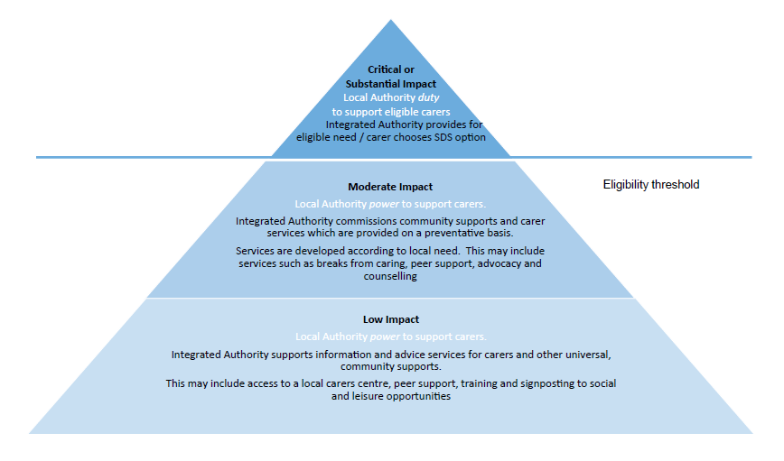
Notes:
Edinburgh’s eligibility threshold. Other local authorities will have similar criteria.
Compare & contrast with pre Carer’s Act.
Example of respite and SDS.

Slide 4
Eligibility for Services is decided in terms of risk to an individual.
There are five indicator categories:
No Impact (5)
Indicates that there are no quality of life issues resulting from the caring situation and at this moment no need for support or advice.
Low Impact (4)
Indicates that there may be some quality of life issues but low risk to a carer’s capacity for independence or health and wellbeing.
Moderate Impact (3)
Indicates that there is some risk to a carer’s capacity for independent living and health and wellbeing. This may call for provision of some health and social care services.
Substantial Impact (2)
Indicates that there is major risk to a carer’s capacity for independent living and health and wellbeing. Likely to require urgent provision or health and social care services.
Critical Impact (1)
Indicates that there are significant risks to a carer’s capacity for independent living and health and wellbeing. Likely to require immediate provision or social care services.
Notes:
These are the indicators for eligibility criteria and they are based on the risk to an individual.
This is assessed through the Adult Carer Support Plan or Young Carers Statement.

Slide 5
ACSP/YCS- Outcomes for carers
1
Carers are identified early and assessed quickly
Carers report being well informed about issues relevant to their carers role
2
Carers are supported to address their own health and wellbeing
3
Carers have choice, collaboration and control in their caring roles
Carers have accessible and up to date appropriate information
Carers feel supported by services and have increased confidence towards their caring responsibility
Carers are offered help with financial planning/benefits advice/ general advice
Carers sustain their physical, social and mental wellbeing
Carers report economic wellbeing
Notes:
As previously mentioned we use an outcomes focussed approach in order to meet the provisions of the Carers Act. These are our service level outcomes which we hope to achieve:
Identified early and can access appropriate information so they feel well informed.
Supported to address their own health & wellbeing. Supported by services and have increased confidence and resilience. Supported with financial planning and benefits.
Carers have choice, collaboration and control and are able to sustain all aspects of their wellbeing.

Slide 6
Short Break Service Statement
The Carers (Scotland) Act 2016 places a new duty on local authorities to prepare and publish a Short Breaks Services Statements (SBSS) Section 35 states that:
A SBSS means a statement of information about the short breaks services available in Scotland for carers and cared-for persons
The information must be accessible to, and proportionate to the needs of, the persons to whom it is provided
Scottish Ministers may by regulations make further provision about the preparation, publication and review of short breaks services statements
Notes:
The key point of Short Break Service Statement is the Carers Act places a duty on local authorities to state how they are going to provide short breaks to maintain carer health and wellbeing.
For most local authorities this will be linked to the local Carer’s Strategy.

Slide 7
Short Break Service Statement
Available on this link:
http://www.edinburgh.gov.uk/info/20077/carers/103/short_breaks_for_carers

Slide 8
More Information
Please see the handout in your pack from Carers Scotland
Go to this website for further information:
http://www.gov.scot/Topics/Health/Support-Social-Care/Unpaid-Carers/CarersBill

