Slide 1
Jenny Lewis- School Project Manager
Jennifer.lewis@youngcarers.org.uk

Slide 2
What is a young carer?
A young carer is somebody who cares for or is affected by someone else at home – usually a parent or sibling – who suffers from physical or mental ill health, or who has substance misuse issues. Edinburgh Young Carers works with young people aged 5 to 25 years old.
The person they care for may suffer from:
mental health problems
disability
chronic ill-health
drug and alcohol misuse
Definition of a young carer

Slide 3
The Carers Trust estimates that there are 100,000 young carers in Scotland
Children as young as 5 are
accessing counselling support
to help them to cope
with their caring role
Young carers are more likely to come from
a single parent household and often
care for more than one person
In Scotland, young carers are entitled to support, information and respite. They are entitled to a Young Carers Statement
1 in 5 secondary school
children could be young carers

Slide 4
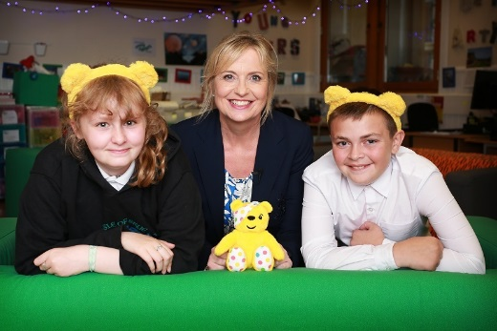
Edinburgh Young Carers
Our mission is to make a positive difference in the lives and futures of young carers through support, information, respite and personal development and training.
Provide support to 5 – 25 years old
Working with over 300 young carers per year
Range of services, including: individual and group support, residentials and day trips, information, awareness-raising, advocacy
Support is young person centred, determined by priority or need, and not time-limited
Specialist Drug & Alcohol Development Workers, Therapeutic Play Project and In-House Counsellor

Slide 5
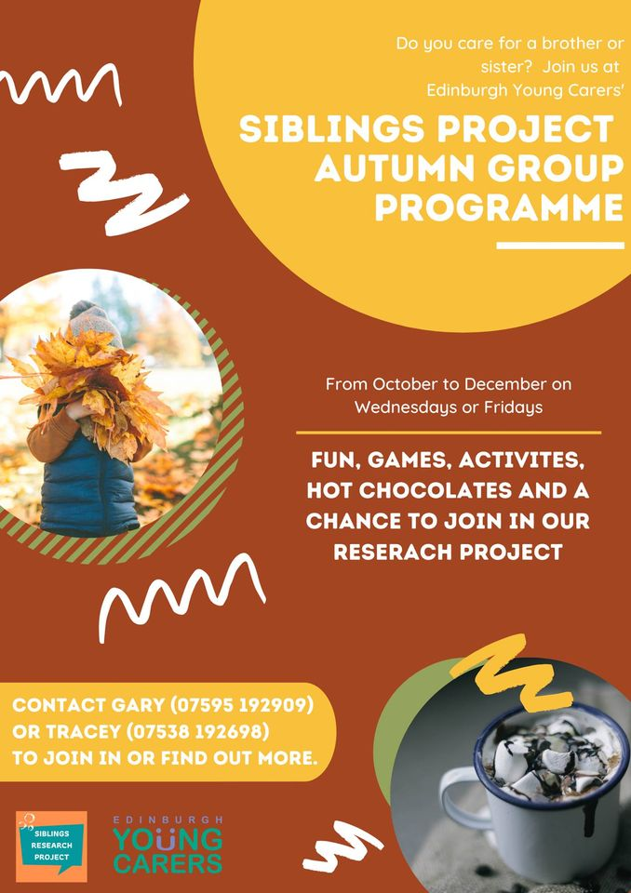
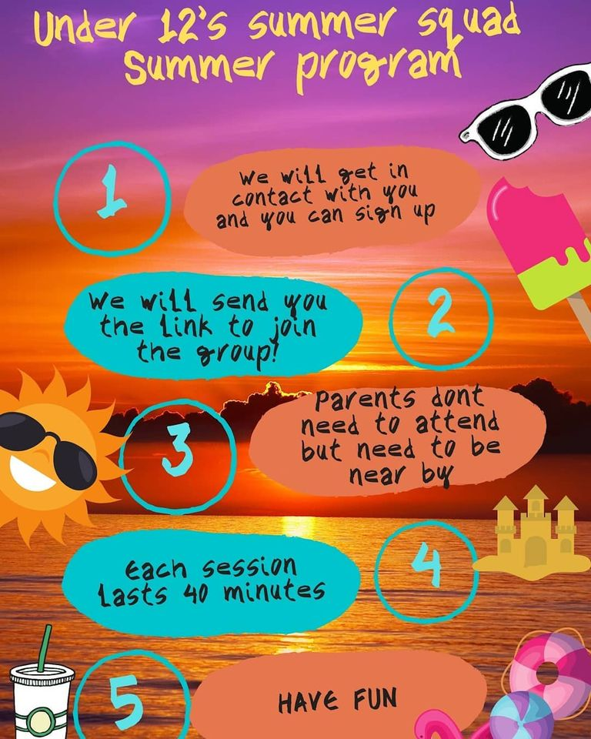
What does a referral to us mean?
Notes:
How to make a referral.

Slide 6
How to make a referral
Identify the young carer
Speak to parents/ guardians/ social worker
Speak to the young person
Go to Edinburgh Young Carers website –download referral form
Email form to info@youngcarers.org.uk
Development worker & footprint
Home visit to young person and family
Young
Carers
Statement
Edinburgh Young Carers contact you

Slide 7
How you can help….
Ask who is providing care?
If an adult is accompanied by a child ask what the child does at home?
Have leaflets and posters available of supportive services
Provide opportunities for children to ask questions
Consider young people during hospital discharge
Be mindful of ‘hidden illness’
Consider inappropriate caring roles- safeguarding

Slide 8
Jenny Lewis- School Project Manager
Jennifer.lewis@youngcarers.org.uk

