Slide 1
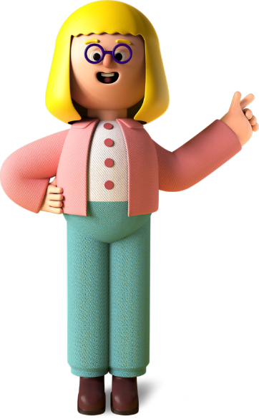
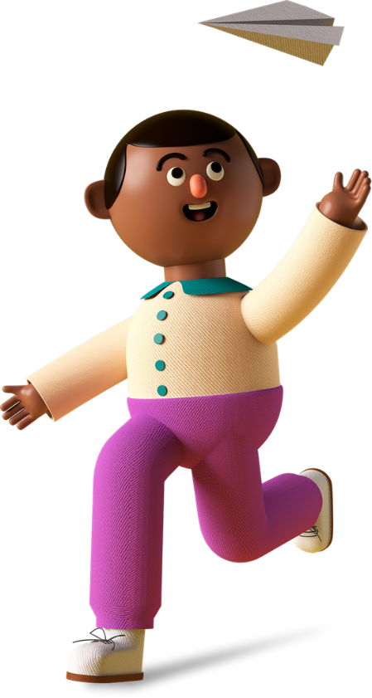
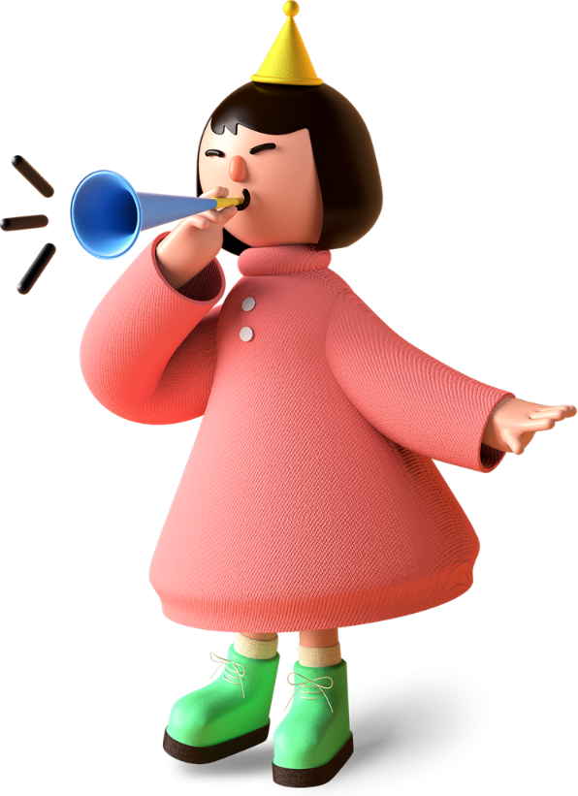
Young Carers - raising awareness and providing support

Slide 2
What is the definition of a Young Carer?
Interpreting or signing for someone
Collecting prescriptions, giving medication
"Young Carer’ means a carer who is under 18 years old or has attained the age of 18 years while a pupil at school and [has since remained] a pupil at…school” - Carers (Scotland) Act 2016
A young carer is someone under 18 who helps look after someone in their family, or a friend, who is ill, disabled, has a mental health condition or misuses drugs or alcohol.
Looking after siblings
Keeping someone
company
and listening
to their worries
Supporting
to wash,
toilet,
dress etc

Slide 3
Young Carers and Covid-19
“Anxiety has dramatically
increased and find myself
crying at night and don't
know why”
Young carer, 15
38% of young carers feel less able to cope
24% of young carers and 34% of young adult carers care for more people than they did before the pandemic
59% of young carers care for more hours every week
20% of young carers now care for more than 50 hours every week
Information from The Carers Trust Scotland; 2020 VISION: HEAR ME, SEE ME, SUPPORT ME AND DON’T FORGET ME.
The impact of Coronavirus on young and young adult carers in Scotland, and what they want you to do next. July 2020

Slide 4
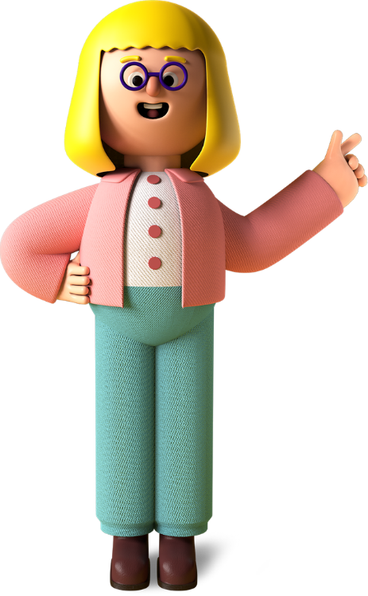
Young Carers Statements
A young carer statement is something every young carer in Scotland has a right to under the Carers Act 2016.
A young carer statement will help to identify and highlight a young carers personal goals and any support that they may require as a young carer, as well as record who is responsible for providing that support.
It’s a summary of their caring role that they can use to let people like teachers and doctors know how they can support them.

Slide 5
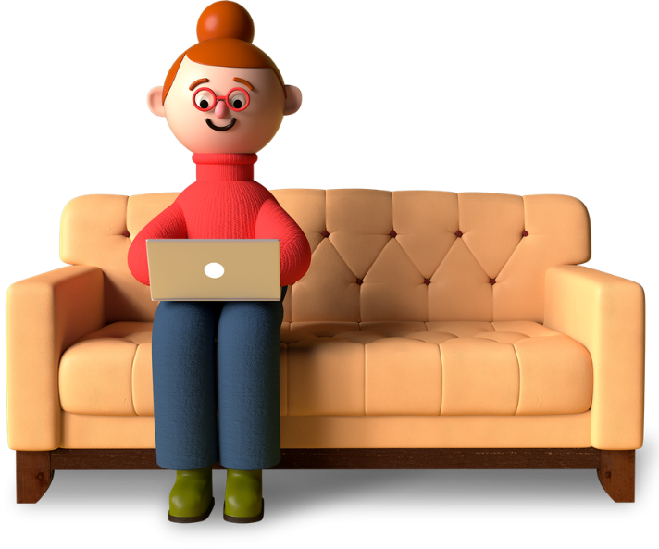
HOW WE SUPPORT YOUNG CARERS
Person centred
Trauma Informed
Rights focussed
Individual Support
Group work
School support (training, awareness raising, young carer policy advice)
Young Carers Statements
Respite
Referrals to other specialist support (i.e. CAMHS)

Slide 6
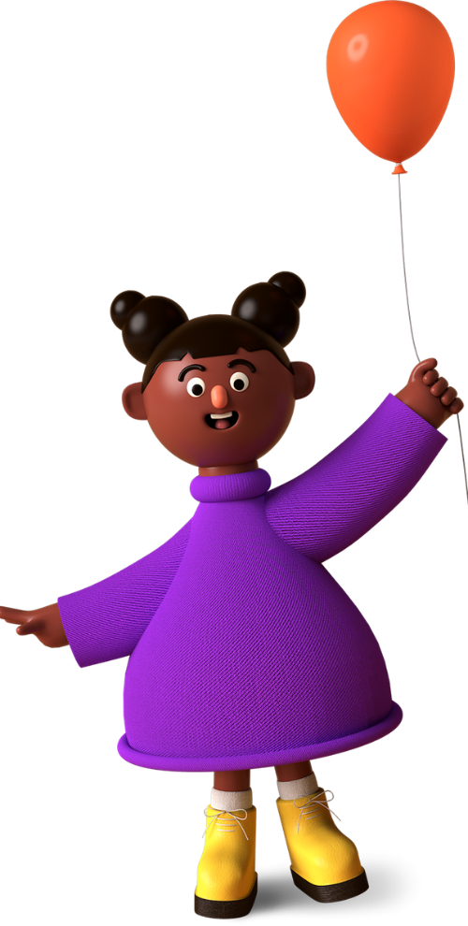
Young Carers and the NHS
Young carers often prioritise the care of the cared for person and neglect to attend appointments for themselves - especially the dentist and optician
Did you know there is a Young Carers ID card for 12-16 years - to support them with identification, medication, diagnosis, prognosis, prescription collection
8 Young Adult Carers who have had parents discharged from hospital in the last 6 months told us that none of them were consulted about the discharge.
Young Carers should be registered as a young carer with their GP practice.
We have had some young people refer themselves to us, just to receive the vaccine, but it is the GP practice and their records that are used.

Slide 7
What can you do?
Ask if there are children in the household
Think about young carers when you are talking to individuals and families, think about the roles they are doing – are they translating, explaining health issues to the cared for person, helping more than other children would or completing inappropriate care tasks.
All carers should be involved in the process of hospital discharge - include young carers in these conversations
Provide information about young carers organisations to families
Make a referral to one of the young carer organisations or call us and ask for advice or more information

