Slide 1
Young Carers - raising awareness and providing support
Shona James
Capital Carers
Erin Clark
SPACE
Jennifer Lewis
Edinburgh Young Carers

Slide 3
What is the definition of a Young Carer?
"Young Carer’ means a carer who is under 18 years old or has attained the age of 18 years while a pupil at school and [has since remained] a pupil at…school” - Carers (Scotland) Act 2016
A young carer is anyone aged 5-18 years, who has practical and emotional caring responsibilities because someone in their family is disabled, elderly, has a long term illness, a mental health condition, developmental disorder or issues with substance misuse.

Slide 4
Young Carers and Covid-19
38% of young carers feel less able to cope
24% of young carers and 34% of young adult carers care for more people than they did before the pandemic
59% of young carers care for more hours every week
20% of young carers now care for more than 50 hours every week
Information from The Carers Trust Scotland; 2020 VISION: HEAR ME, SEE ME, SUPPORT ME AND DON’T FORGET ME.
The impact of Coronavirus on young and young adult carers in Scotland, and what they want you to do next. July 2020

Slide 5
Notes:
ASL Act - This broad and inclusive term applies to children or young people who, for whatever reason, require additional support, in the long or short term, in order to help them make the most of their school education and to be included fully in their learning. – includes Young Carers

Slide 6
Young Carers Statements
A young carer statement is something every young carer in Scotland has a right to under the Carers Act 2016.
A young carer statement will help to identify and highlight a young carers personal goals and any support that they may require as a young carer, as well as record who is responsible for providing that support.
It’s a summary of their caring role that they can use to let people like teachers and doctors know how they can support them.
Notes:
The young carer statement (YCS) provides a framework for identification.
Personal outcomes and individual needs for support of young carers by the responsible authority
The substantive provision of support by the responsible local authority to meet those identified needs.
Terminal illness statement provision

Slide 7
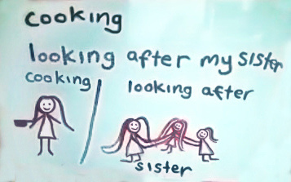
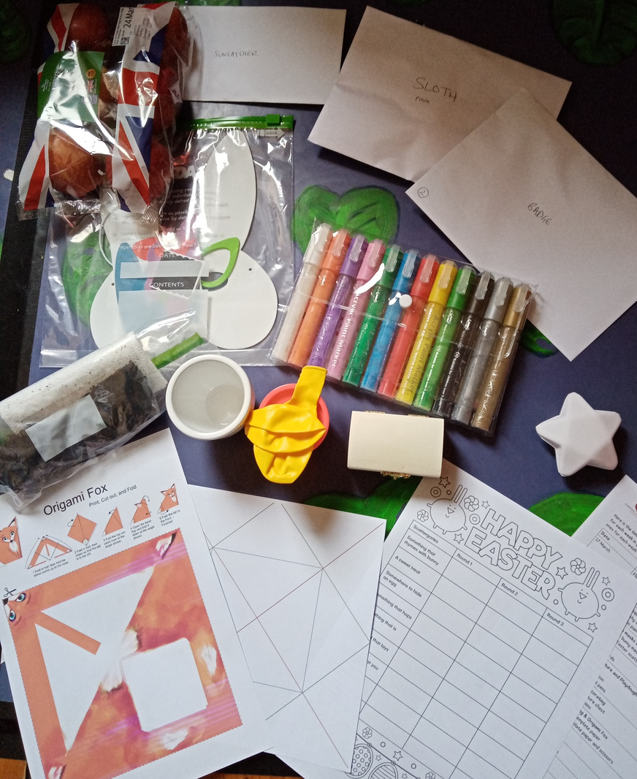
School support (training, awareness raising, young carer policy advice)
Referrals to other specialist support (i.e. CAMHS)
Person centred
Trauma Informed
Rights focussed
How we support young Carers
Individual Support
Group work
Young Carers Statements
Respite

Slide 8
Young Carers and the NHS
Young Carers Health
Young carers often prioritise the care of the cared for person and neglect to attend appointments for themselves - especially the dentist and optician
Hospital Discharge
Young Adult Carers who have had parents discharged from hospital, previously, told us that none of them were consulted about the discharge.
GP's
Young Carers should be registered as a young carer with their GP practice.
We have had some young people refer themselves to us, just to receive the vaccine, but it is the GP practice and their records that are used.
Young Carer ID Card
Did you know there is a Young Carers ID card for 12-16 years - to support them with identification, medication, diagnosis, prognosis, prescription collection

Slide 9
Think about young carers when you are talking to individuals and families, think about the roles they are doing – are they translating, explaining health issues to the cared for person, helping more than other children would or completing inappropriate care tasks.
Ask if there are children in the household
Make a referral to one of the young carer organisations or call us and ask for advice or more information
What can you do?
#beyoungcareraware
All carers must be informed and involved in the process of hospital discharge - include young carers in these conversations
Provide information about young carers organisations to families

Slide 10
REFERRAL IS MADE TO YOUR LOCAL YOUNG CARERS SERVICE
REFERRER IS CONTACTED, YOUNG CARER IS ACCEPTED AS APROPRIATE REFERRAL
YES
NO
REFERRER IS CONTACTED, YOUNG CARER IS EXITED FROM THE SERVICE
FAMILY AND YOUNG CARER IS CONTACTED
YOUNG CARER AND FAMILY WISH TO PROCEED WITH REFERRAL
YOUNG CARER AND FAMILY DO NOT WISH TO PROCEED WITH REFERRAL
YOUNG CARER RECEIVES ONE TO ONE SUPPORT
YOUNG CARER ATTENDS GROUPS
YOUNG CARER CONTINUES WITH SERVICE AS REQUIRED.
YOUNG CARERS STATEMENT CHECKED EVERY SIX MONTHS.

Slide 11
For questions or anything else we can help you with, please email us at;
shona@nwcarers.org.uk
erin@SPACESCOT.ORG
jennifer.lewis@youngcarers.org.uk

