Slide 1
Supporting Carers with Protected Characteristics
Olivia Nathan
National Training &
Capacity building Officer
MECOPP
29nd May 2024

Slide 2
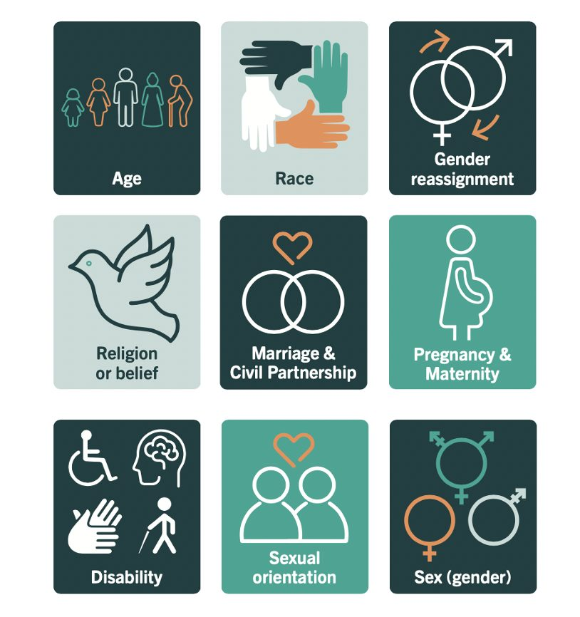
Protected Characteristics

Slide 3
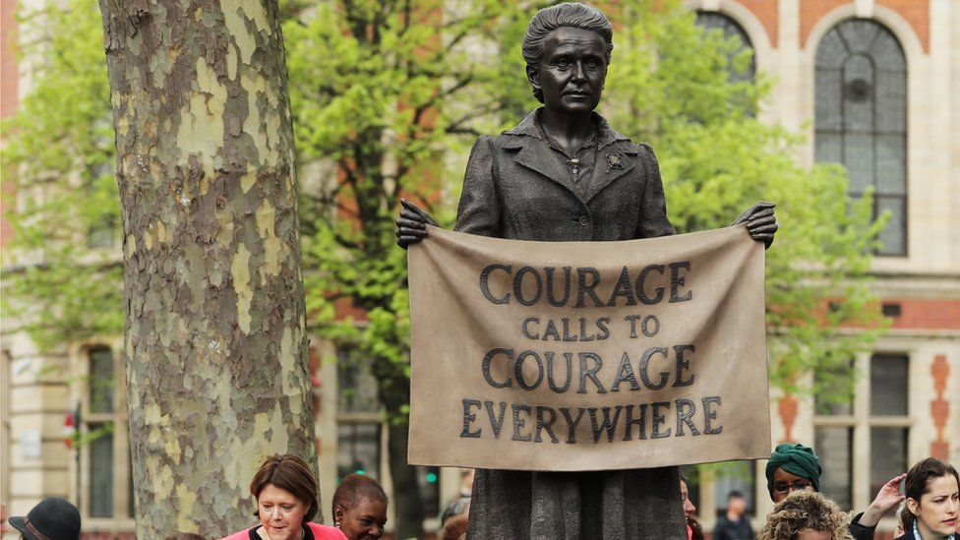
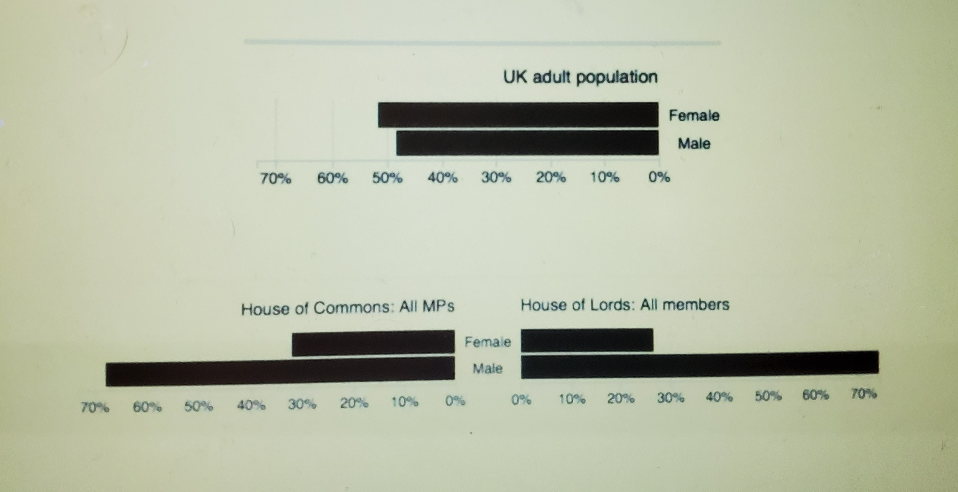

Slide 4
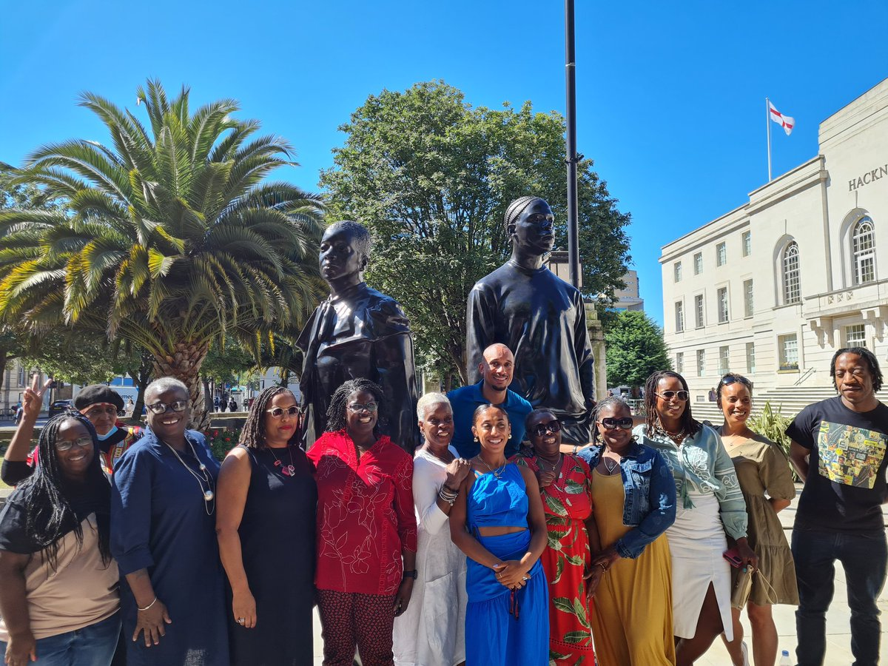

Slide 5
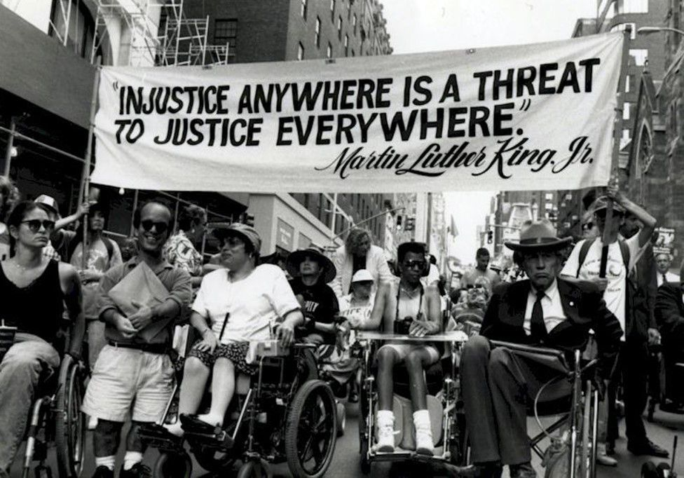

Slide 6
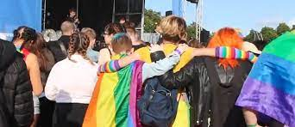

Slide 7
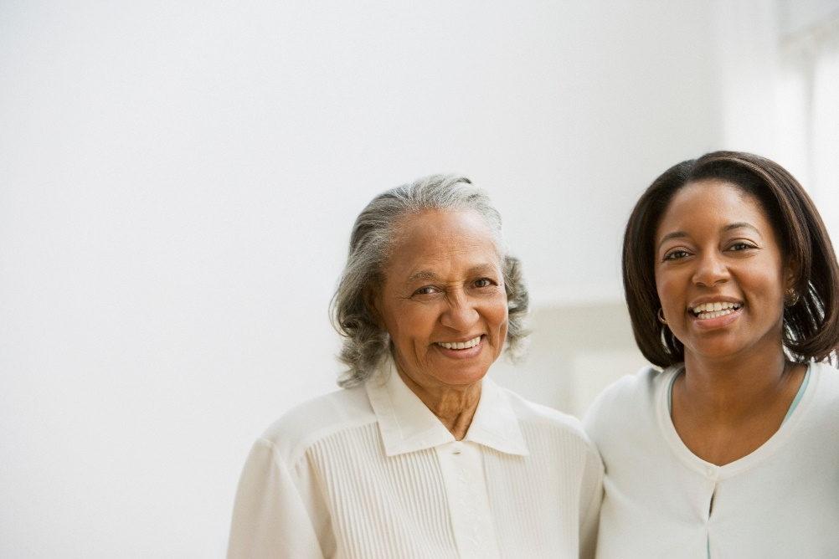
Scotland’s only dedicated Black and Minority Ethnic carers’ organisation
‘Using local knowledge to improve national outcomes for Black and Minority Ethnic Carers’

Slide 8
ENGLISH

Slide 9
BME Carers
All Minority Ethnic groups can experience racism, stigma & discrimination

Slide 10
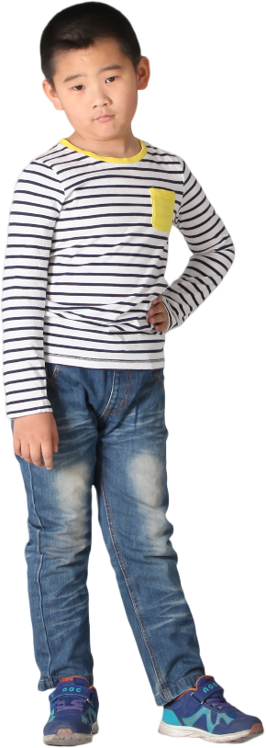
BME Carers
All Minority Ethnic groups can experience racism, stigma & discrimination
Polish, Bosnian, Serb, Ukrainian, Jewish, Gypsy/ Travelling communities, Middle Eastern and South & East Asian

Slide 11
BME Carers
All Minority Ethnic groups can experience racism, stigma & discrimination
Polish, Bosnian, Serb, Ukrainian, Jewish, Gypsy/ Travelling communities, Middle Eastern and South & East Asian
The Census - 2001 to 2011 BME carers doubled ++

Slide 12
BME Carers
ONLY 5/30 LA carers strategies have demographics of their BME populations

Slide 13
Barriers – inaccessible information
Language literacy
Computer literacy,
Relying on a friend of family member
Other access needs
Data poverty
Discrimination and stigma
Lack of trust

Slide 14
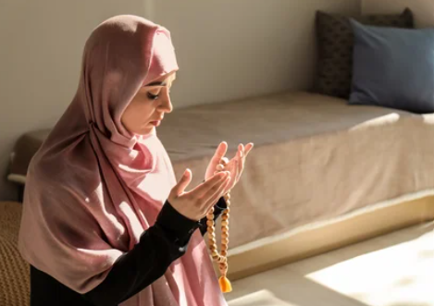
Barriers – I’m not a carer
I’m simply a good mother, father, husband, daughter…

Slide 15
Barriers – Cultural differences
“I wanted to join the street party
they put on for carers week but it
was scheduled on a Friday evening.
I’m Jewish so I was observing
Shabbat any other night that
week would have worked for me”
Emily
“When they organised the
baking competition they gave us all
the ingredients which was great
but a key ingredient was gelatine
- we didn’t know if it was halal
so my son couldn’t take part.”
Rasheed

Slide 16
Our Work
Support Equal Access
to appropriate services
Raise Voices
Minority Ethnic carers to a national level
Develop Strategic Responses
to gaps in service
provision
Develop Opportunities
for active involvement of B&ME carer voice
Work With
Chinese healthy living project, Gypsy/Traveller community, BME groups
Assist Service Providers
e.g in developing cultural competency

Slide 17
Our work
Multilingual advice and information
Advocacy and casework support
Recreational, social & therapeutic activities
Policy and services development
Training and learning opportunities including Healthy living programmes

Slide 18
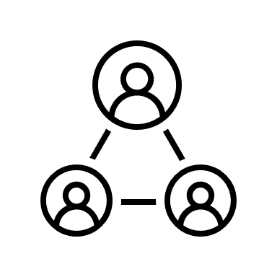
MECOPP supports Health and Social care practitioners by
Sharing good practice and resources in accessible formats.
MECOPP and COCIS have established a network for staff supporting BME carers.
Full or half day training including ‘achieving cultural competency.
Support with equality impact assessments.
Ongoing development of Carers and Equalities E-Network to share good practice, disseminate information.
Delivery of awareness raising sessions on equality requirements within the Carers Act.

Slide 19
Questions?
MECOPP
57 Norton Park, Albion Road,
Edinburgh, EH7 5QY
Tel: 0131 467 2994
Email: info@mecopp.org.uk
Website: www.mecopp.org.uk
Twitter: @MECOPP1
Thank you for listening

