Slide 1


Care for Carers
Short breaks services for carers

Slide 2

Stepping Out® - Residential Breaks
  1 - 5 night breaks across Scotland
  Group breaks with other carers
  City breaks/remote rural/themed breaks
  Fully supported by C4C staff and all accommodation, travel, meal & activity costs paid for

Slide 3

Stepping Out® - How to apply
  Register with Care 4 Carers
  Fill out an application form
  Contact steppingout@care4carers.org.uk for any enquiries

Slide 4
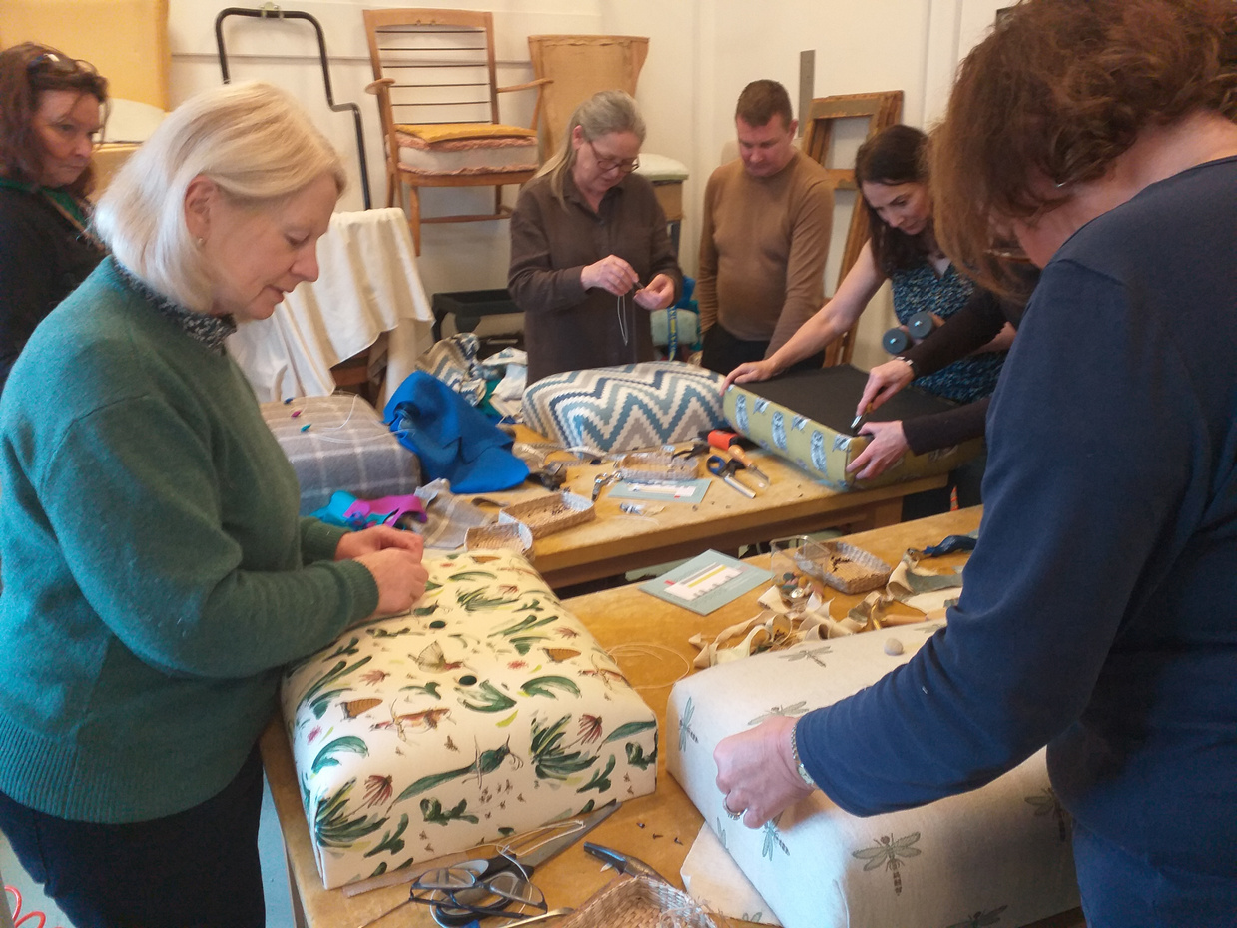
Still Caring - Day and evening activities
  Short day/evening breaks, workshops and courses for groups of carers
  Big Days Out
  Wide range of activities from theatre trips to foraging walks
  Some events are open to carer and cared for person to come together

Slide 5
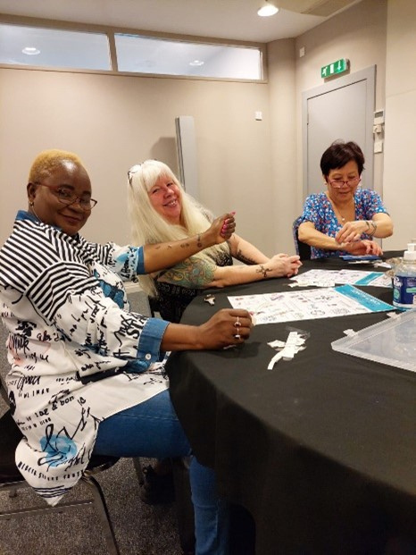
Still Caring - Day and evening activities
  Register with Care 4 Carers
  Contact us to register an interest in events.
  Contact stillcaring@care4carers.org.uk for any enquiries

Slide 6
Respitality & Carefree
  We are Respitality & Carefree partners
  Respitality: we will match registered carers with appropriate events, carers can take the person they care for, friends and family
  Carefree: Carers register directly with Carefree and are sent email notifications about short breaks. Carers cannot take the person they care for but can take a friend or relative

