Slide 1
Carers Wellbeing Campaign
November 2020

Slide 2
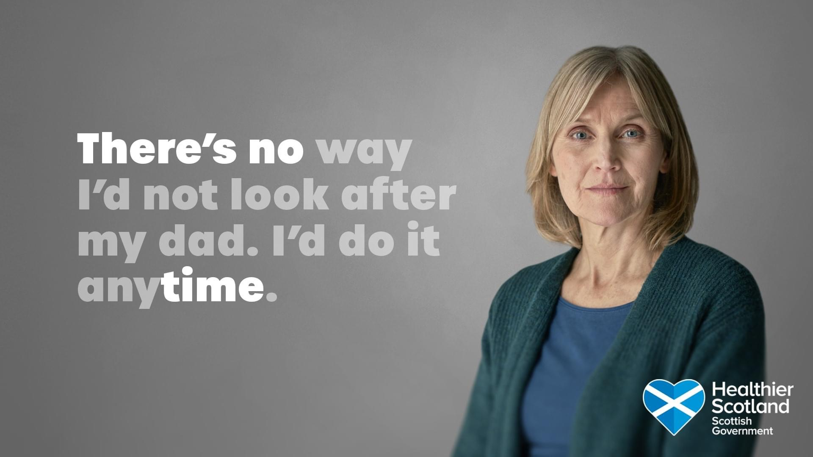
On Radio….

Slide 3
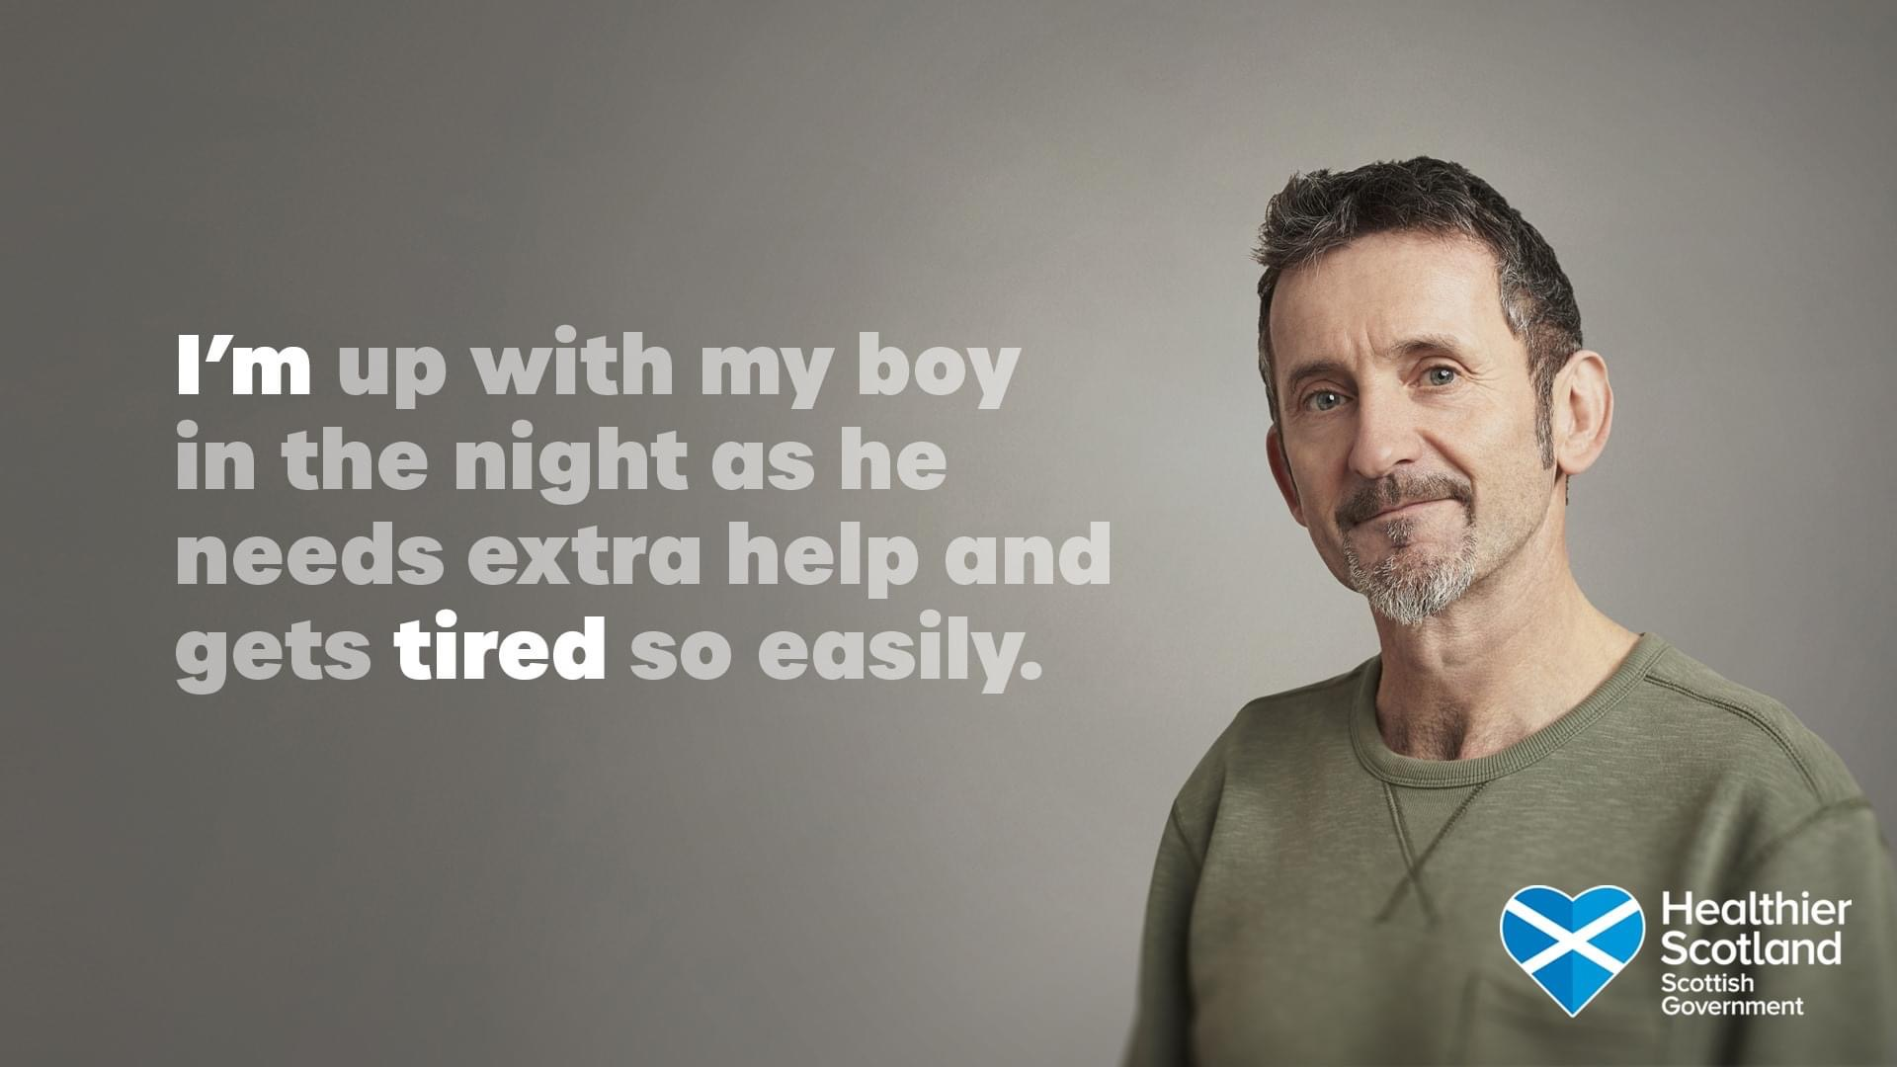
On TV…

Slide 4
On Social Media…

Slide 5
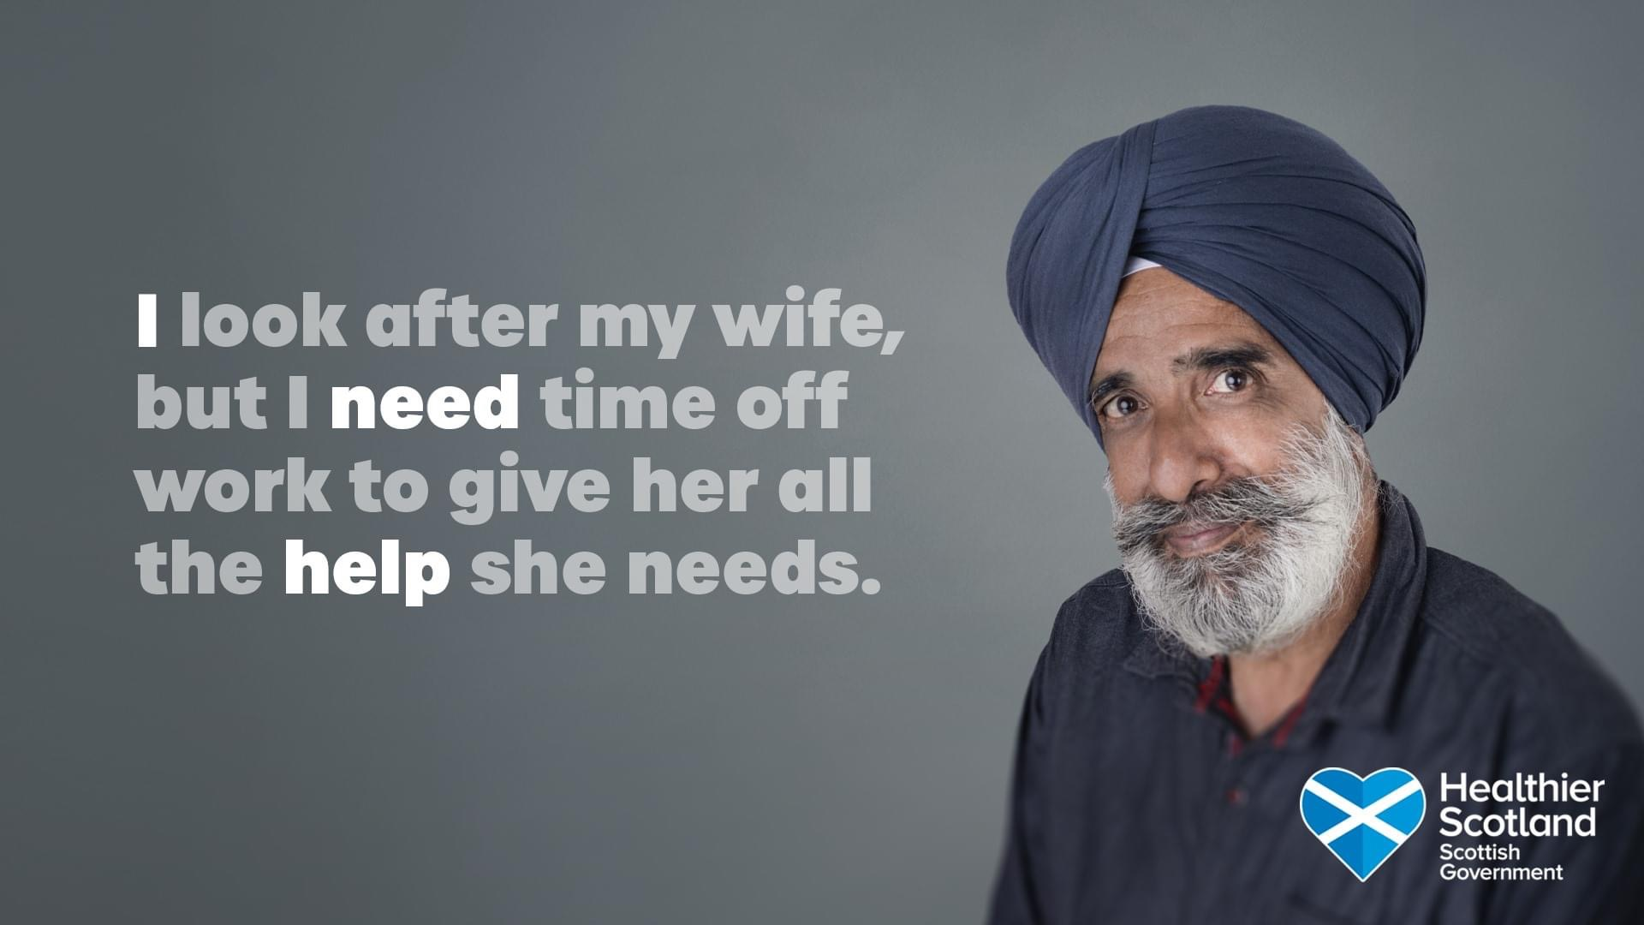
Help us make more people aware…

