Slide 1

Cost of Living, Food Insecurity & the Birmingham Food System Strategy
Dr Rosie Jenkins
Senior Public Health Officer (Food System team)
Lead, Food Provision Group (Cost of Living response)

Slide 2
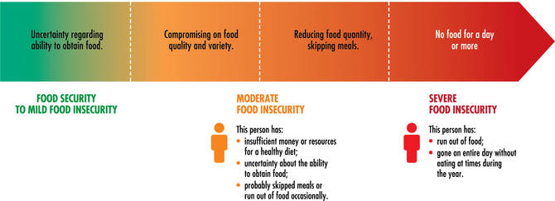
Food Insecurity
Food insecurity is defined by the UN Food and Agriculture Association (FAO) as “limited access to food… due to a lack of money or other resources” and is a spectrum from mild to severe insecurity.

Slide 3
Food Insecurity and Health
Food insecurity is associated with poor diets, low vitamin and mineral intakes, overweight and obesity in adults and children
It can have a negative impact on children’s health including children being more likely to be hospitalised, have chronic conditions (including cardiovascular impacts), have poor mental health, and have lower educational attainment.
It is also associated with poorer health in adults, including increased cardiovascular disease, diabetes, oral health, mental health and lower cognitive function.

Slide 4
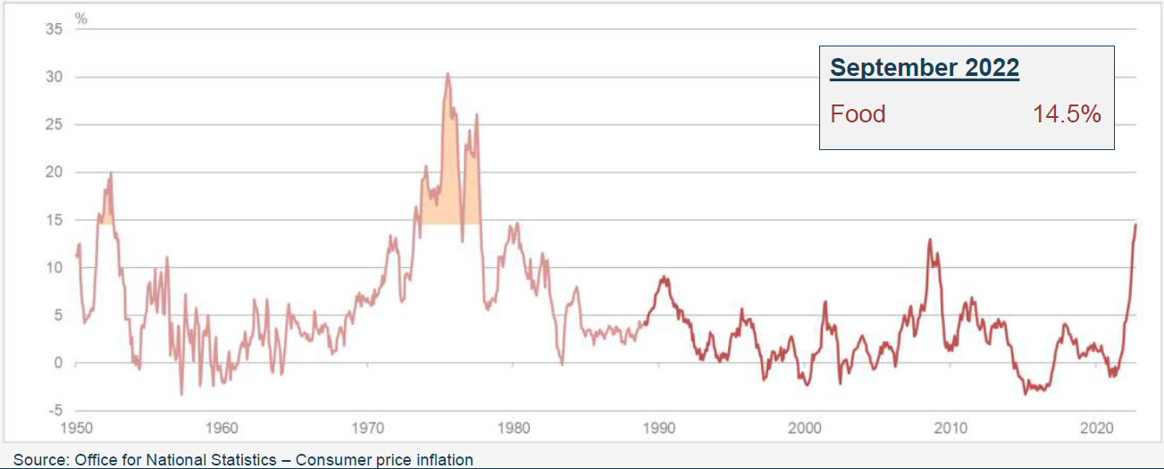
Inflation – food inflation at a 42 year high

Slide 5
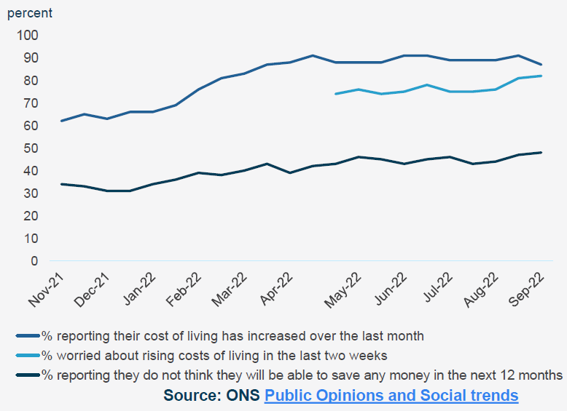
National CoL perspectives
Between 31 August to 11 September 2022:
87% adults reported their cost of living increased over last month
82% reported being very or somewhat worried about the rising cost of living in last 2 weeks.
48% reported they do not think they will be able to save any money in next 12 months

Slide 6
Food Insecurity in Birmingham
90% of wards more deprived that the national average
37% of children eligible for Free School Meals
~ 1 in 4 people in Birmingham are food insecure
In some wards, 37% of households experiencing fuel poverty – heating vs. eating

Slide 7
Demand Increasing…
51,000 food parcels were given out in the 2021-22 financial year by Trussell Trust foodbanks in Birmingham (2019-20: 40,000)
This year, there has been a ~40% increase between April and August at time when foodbanks traditionally quietest (summer).
Several Trussell Trust foodbanks are having to run additional sessions to meet demand.
A non-Trussell Trust city centre foodbank has seen ~ 3 times more users in September of this year compared to September last year.

Slide 8
Demand Increasing while Supply Decreasing
At the same time as demand is increasing, these projects are also seeing decreases in food available through their usual channels, due to:
Individuals donating less food at supermarkets etc. due to impacts of the increased cost of living on their finances
Individuals donating less money to such projects
Supermarkets are being more careful to prevent food waste, which is leading to less surplus food going to organisations like FareShare
General food inflation

Slide 9
The cost of living crisis has shone a light…
… but food system change has been needed for a while.
Issues of healthfulness, sustainability, affordability of food – locally and nationally
Importance of food economy
Food system challenges and impacts on health and wellbeing

Slide 10
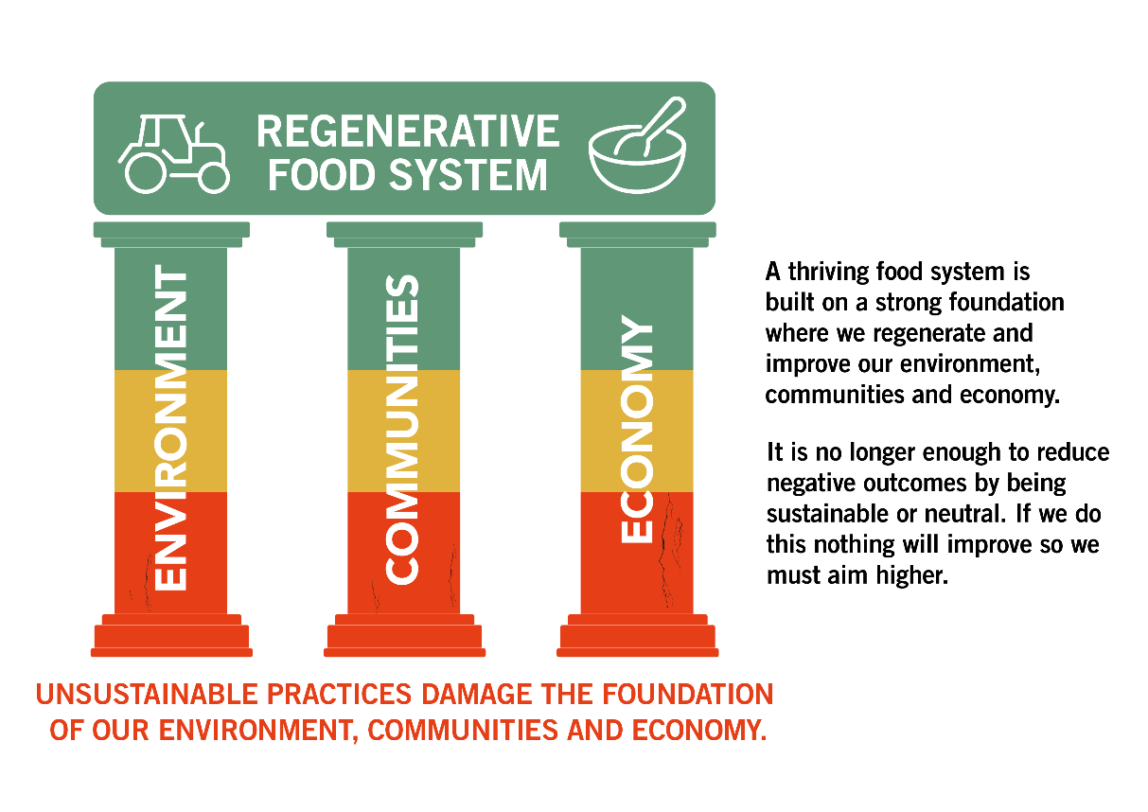
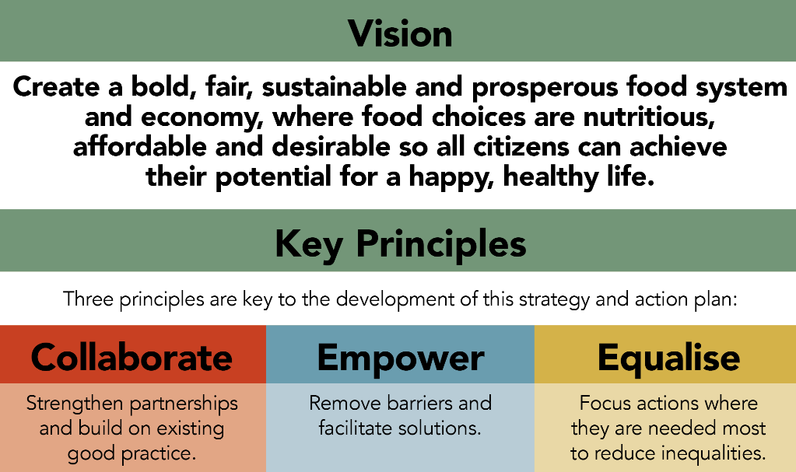
Context: The Birmingham Food System Strategy

Slide 11
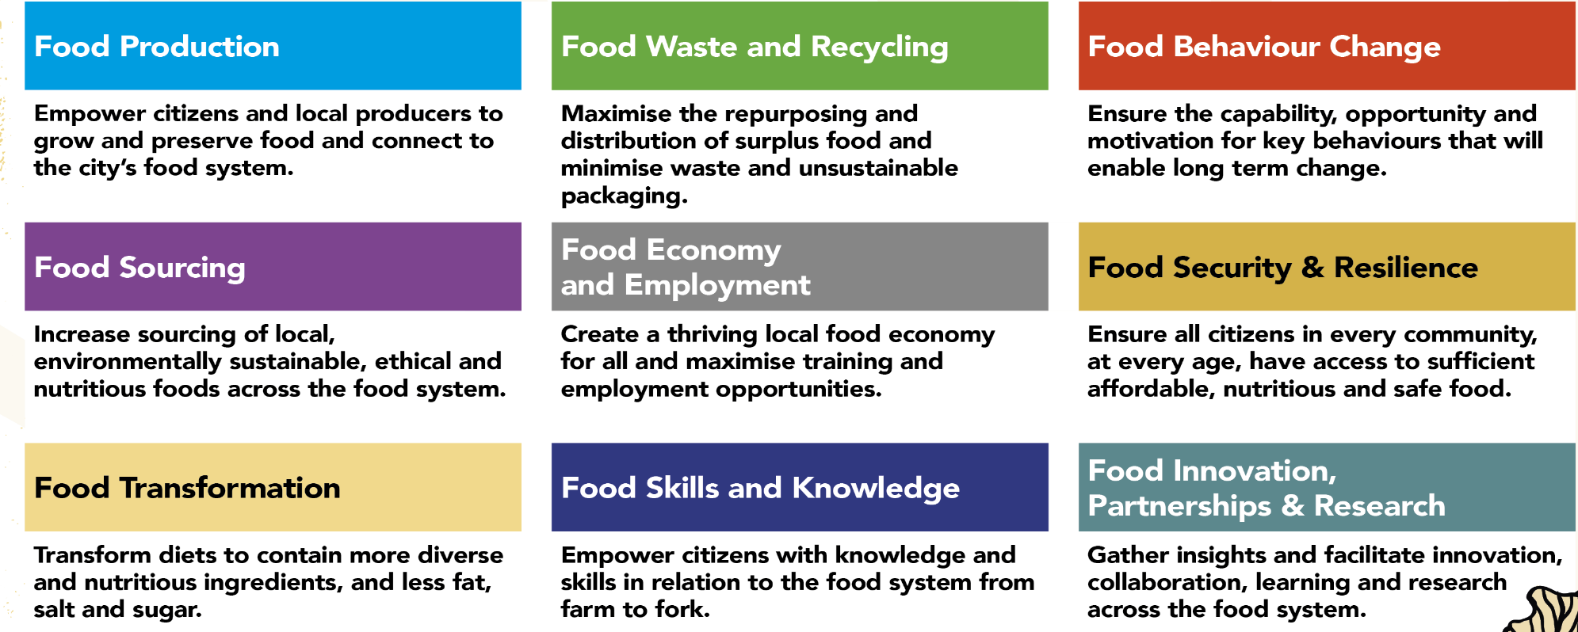
Context: The Birmingham Food System Strategy

Slide 12
The Food Justice Pledge
Birmingham has launched the Food Justice Pledge for cities
Emphasising importance of actions to address food justice
Recognition that all our citizens are entitled to safe, nutritious and sustainable food at all times
Signed by the Leader of Birmingham City Council, Cllr Ian Ward, on 28th July
Interested in your city signing? Send me an email rosemary.jenkins@birmingham.gov.uk

Slide 13
Birmingham City Council of Living Response
Improving the availability of advice to residents, with a focus on increasing benefit take up
Increasing energy efficiency, with a focus on reducing costs
Ensuring the provision of a network of warm spaces across the city, starting with libraries
Supporting council staff
Increasing food provision across the city

Slide 14
Birmingham City Council of Living Response
Improving the availability of advice to residents, with a focus on increasing benefit take up
Increasing energy efficiency, with a focus on reducing costs
Ensuring the provision of a network of warm spaces across the city, starting with libraries
Supporting council staff
Increasing food provision across the city

Slide 15
Key Principles
Introduce actions that will bring both short and long term impact
Learn from the pandemic emergency food response
Ensure delivery is informed and co-created with the Food Justice Network
Use existing evidence, insights and recommendations to guide the delivery plan

Slide 16
The Emergency Food Aid Fund
£480,000 of grants available to projects providing food to citizens
£800 per month for 6 months
For consumables – food, hygiene products, baby food, pet food
Cash provision – recognises food projects as local experts

Slide 17
HAF Food Parcels
Another aspect of the Food Provision group is maximising opportunities provided by the Holidays, Activities and Food Programme (HAF)
The HAF programme, Bring it on Brum, programme provides food and activities for children in Birmingham (particularly, but not exclusively, aimed at children on Free School Meals) during the summer, Christmas and Easter holidays.
Christmas holidays → DfE funding for food parcels
We match-funded this to double parcels

Slide 18
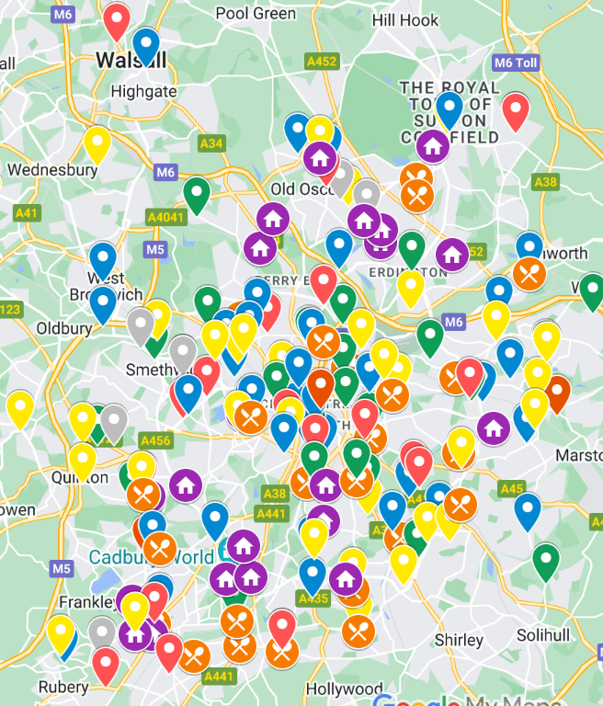
Signposting
Food Justice Network Map
Webpages & cost of living leaflet
Helping people be aware of local support

Slide 19
Reducing stigma and shame so people access support
Review of how and why shame and stigma can be associated with foodbank use
Recommendations for how to reduce shame and stigma
Ranging from tablecloths on tables in foodbanks to national narratives around benefit receipts and foodbank use
Sharing across channels & informing cost of living comms and work

Slide 20
Increasing uptake of food benefits for children/families
Helping people make the most of benefits they are entitled to!
Increasing uptake of Healthy Start
  Digitalisation challenges
  Engaging with people who can signpost e.g. midwives, Early Help
  Increasing vendors accepting Healthy Start Cards
Increasing uptake of Free School Meals
  Explored registration approaches with benefits team
  Working with schools to increase uptake

Slide 21
Potential future work around…
Infrastructure and capacity – food clubs, pantries, supermarkets
Food for youth
Maximising surplus food
Cooking, skills etc.

Slide 22
Cash-first hierarchy (IFAN)
Emergency food parcels / foodbanks
Vouchers and affordable food models e.g. food clubs
Cash grants
Adequate benefit payments and fair wages

