Slide 1
Supporting Buckinghamshire residents and staff with the cost of living
March 2023

Slide 2
Background
The national cost of living crisis is well documented
Energy costs have increased
Inflation has increased
Household income has decreased
Across the country, people are struggling to heat their homes, buy food, pay bills and manage other essential costs
We are also seeing this in Buckinghamshire, where local research suggests that demand at Buckinghamshire food banks has increased by 162% from 2019 to 2021​

Slide 3
Cost of Living Programme
As a Council, we recognise the growing pressures being faced by our residents linked to the increases in the cost of living
We have seen an increasing level of demand for financial help and wellbeing support from Buckinghamshire residents, and have made further provision to support residents who are in need, developed through close partnership working, particularly with the voluntary and community sector.
In September 2022 we started a programme to coordinate our response to the cost of living crisis

Slide 4
Programme Objectives
Ensure that residents keep warm, have sufficient food and essentials for themselves and their families by:
Signposting to support and advice with income, finance and debt problems
Providing direct support
Encouraging community and business responses
Promoting energy efficiency measures
This was the starting point for the cross-council Cost of Living Programme, which grew into nine workstreams: Communications, Helping Hand, Food and Essentials, Fuel and Energy, Warmth, Money and Debt, Community Activity, Public Health and Support for Staff.

Slide 5
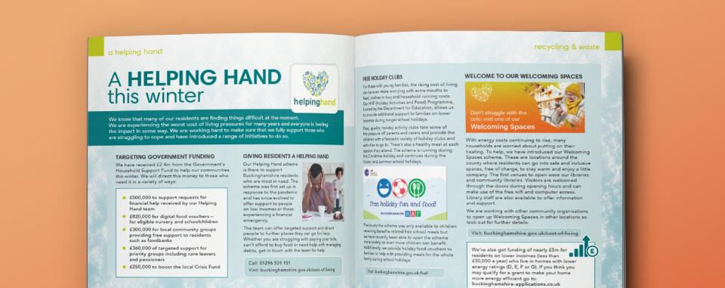
1. Communications
Our Communications workstream has underpinned all workstreams, focussing on delivering a wide-reaching promotion campaign covering multiple media as appropriate for each workstream so that residents are aware of the council and partners’ initiatives and know how to access cost of living support in the county.

Slide 6
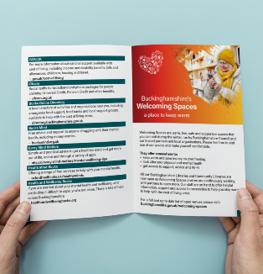
Key activities have included:
Developing a dedicated 'Help with the Cost of Living' website section
Signposting residents to help using social media, posters, leaflets etc
Launch of Food Champions Network
Sustainable Warmth campaign encouraging those eligible to sign up for the scheme
Your Buckinghamshire Magazine spread
Christmas Giving campaign partnering with Inspire Bucks
Printed Residents Support Leaflet
Coordinated with partners on activity – e.g Fire service safety campaign, health service, housing associations

Slide 7
2. Helping Hand - Crisis Support
The Helping Hand team have directed support to those who need it most and informed other workstreams with intelligence about emerging need. The Helping Hand team is available to help individuals or families in need, those on low incomes and those who are experiencing a financial emergency or crisis.

Slide 8
Key activities have included:
Raising profile of Helping Hand support available, including engaging with key partners to promote support offered by Helping Hand
Coordinating use of the Household Support Fund (£2.4m from October to March); using this to support over 5000 residents since October
Delivery of HAF scheme and Free School Meal Vouchers
Christmas Giving Campaign (partnering with Inspire Bucks)
Developing hygiene offer for Bucks residents in 9 county libraries
Referrals to the Getaway Foundation for free holidays for families in financial poverty
Launch of Crisis Appeal with Heart of Bucks - £182k donated so far
Development of a Poverty Predictive Model

Slide 9
3. Food and Essentials
This workstream was focused on developing support mechanisms for food and essential items, ensuring that people who are vulnerable are well signposted and these are easy for residents to access.

Slide 10
Key activities have included:
Launch of Food Champions Network – currently 46 food champions
Christmas giving appeal - organising food bank collections in council offices and encouraging donations in supermarkets
Ongoing financial support for food banks, community food schemes such as hot meals, community fridges, hampers, Bucks New University food scheme
Ongoing signposting and referral to food banks and other meal schemes via the Helping Hand team
Developing new models for food support with Bucks Food Partnership, and area-based Food Action Plans under the Opportunity Bucks Programme
Currently developing plans for Easter

Slide 11
4. Fuel and Energy
This workstream aimed to develop new and innovative measures to ensure that we target support to residents struggling with fuel and energy costs who need it the most.

Slide 12
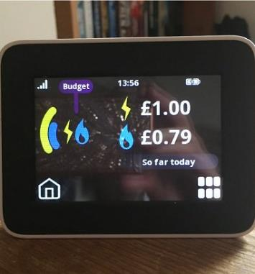
Key activities have included:
Providing assistance with fuel bills and pre-payment meter cards through Helping Hand where residents have been unable to get help from their energy companies
Promoting existing energy schemes such as the Sustainable Warmth Fund
Promoting energy saving measures and link to energy companies via a social media campaign
Investment in relevant schemes, for example Better Housing Better Health
Development of an Energy Doctor scheme (soon to launch) to support eligible households with smaller energy efficiency measures such as draft proofing and energy saving lightbulbs

Slide 13
5. Warmth
The Warmth workstream is focused on developing and providing practical support to residents, to enable them to keep warm during the cold winter months.

Slide 14
Key activities have included:
Launch of ‘welcoming spaces’ where people can come together in a warm, safe and supportive environment - currently 56 listed on the Bucks Online Directory
Phase 1 - Libraries and community libraries (29 locations across Buckinghamshire)
Phase 2 - Community venues, publicised on the Directory and other warm spaces websites; toolkit/guidance Community toolkit: register as a Welcoming Space | Buckinghamshire Council
Many spaces have information/signposting to different forms of support; Warm Boxes in 9 libraries key community venues. 198 currently issued; delivery of warm boxes targeted to Opportunity Bucks wards.
These initiatives were featured on BBC News London and South East, see the link below to access the clip:
https://twitter.com/KatharineDC/status/1633205096145367040?s=20
Library fines amnesty in January and February.
Hosting Citizens Advice Bucks 'Money Matters' sessions in Aylesbury Library.

Slide 15
6. Money and Debt
Through our Money and Debt workstream we recognise the financial pressures residents our facing and have sought opportunities to reduce these pressures whilst ensuring residents are linked in to the support available to them.

Slide 16
Key activities have included:
We commission a dedicated debt support service, delivered by Citizens Advice Bucks
Advice services are provided by Revenues and Benefits and Housing teams
Proactive referral of those in arrears to Helping Hand to avoid council tax arrears
Social media campaign benefit support activity and campaigns
We have updated council tax reminder and annual bill messages highlighting available support
Administration of Alternative Fuel Payments scheme for off-grid residents claiming energy rebate (due to be launched imminently)
Launch of option to spread council tax evenly over 12 months, and financial support through the Council Tax Support Fund

Slide 17
7. Community Activity
Our Community Activity workstream has focused on developing and supporting community-led initiatives, maximising the use of detailed community knowledge to extend support into communities and to residents who need it the most.

Slide 18
Key activities have included:
Community Boards have supported with:
Supporting the development of the ‘welcoming spaces’ network
Communicating signposting information
Investing in more hot meals sessions/supper clubs
Hot meals community toolkit launched
Guidance for developing Community Fridges including funding options
Food waste residents toolkit
Sharing signposting information with key partners

Slide 19
8. Public Health
Our Public Health workstream has helped to provide an evidence base to inform our approach, conducting research to support targeting of interventions.

Slide 20
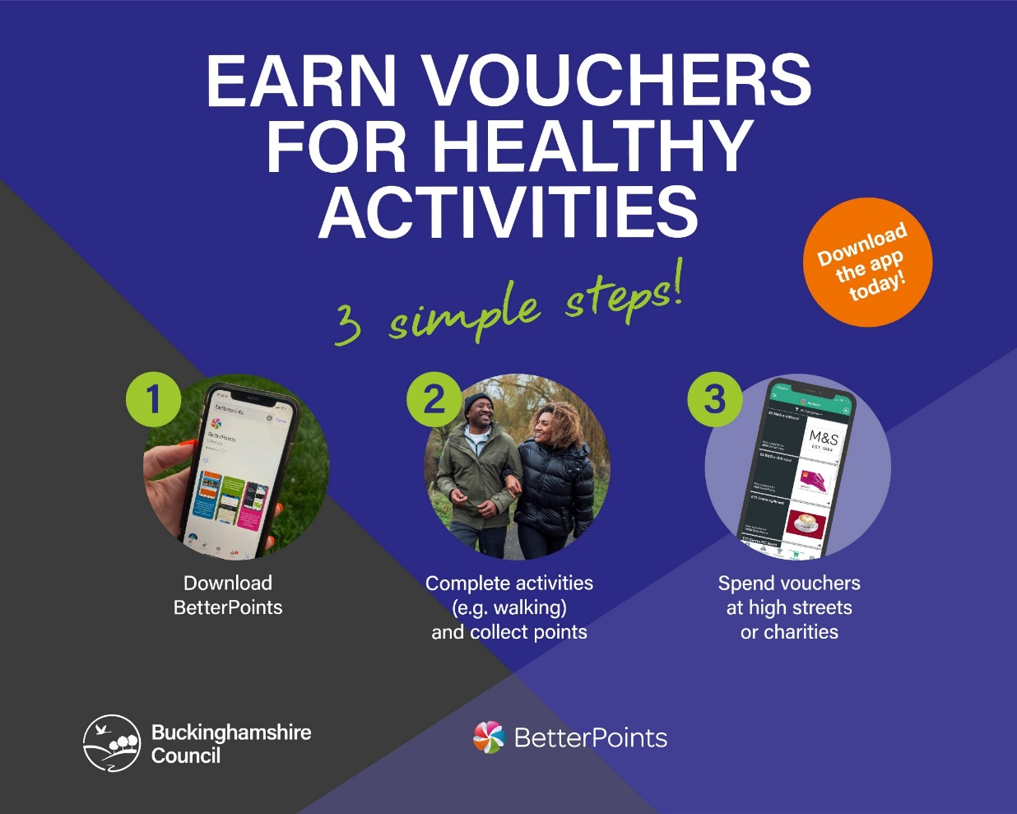
Key activities have included:
Input into internal and external cost of living comms content
Linking in with key public health partners for signposting
Exploring the potential benefits of conducting a cost of living survey to explore behavioural aspects of accessing cost of living support
Launched the Better Points app

Slide 21
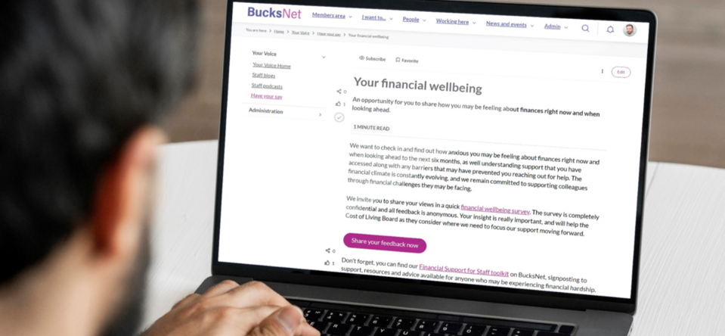
9. Support for Staff (Internal)
We recognise that we also need to support our staff during the cost of living crisis. We have developed a comprehensive package of support, including a dedicated internal network, to ensure that we provide support to staff who need it.

Slide 22
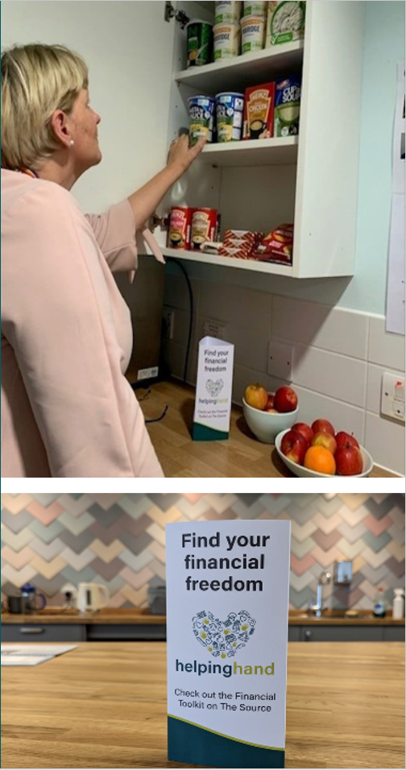
Key activities have included:
Internal comms campaign highlighting support available (including digital, events and print content)
Staff mileage loan and extension of working hours parking scheme
Employee hardship fund
Cost of Living staff network support group
CAB Money Matters webinars
Office pantry and hygiene item scheme
Flexible working pool
Extra staff payments in July and January
Staff Financial Wellbeing surveys to inform and target activity
Nominated for a PPMA award

Slide 23
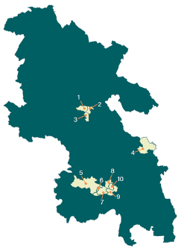
Opportunity Bucks programme
We want to ensure that all Buckinghamshire residents have the opportunity to succeed in life, to play their part in and share in the success of the county.
Our ambitions of developing the local economy and reducing inequalities are intrinsically linked.
The framework we’ve developed will establish a shared vision for what levelling up means in Buckinghamshire.

Slide 24
If you have any questions, please contact:
Dorota Leclerc – dorota.leclerc@buckinghamshire.gov.uk

