Slide 1
Tackling Food Poverty - Making Cambridge a Right To Food City
Cllr. Alex Collis
Executive Councillor for Food Justice

Slide 2
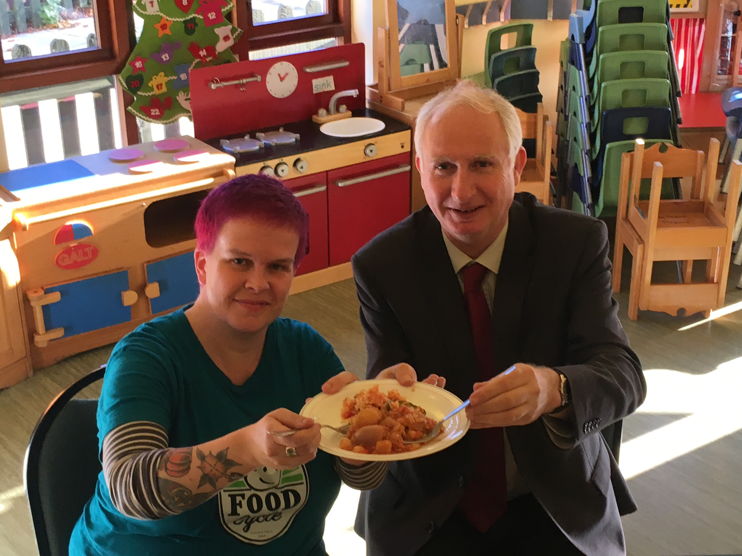
Notes:
Background – reason for becoming a councillor
Personal experience, King’s Hedges ward
Practical experience – wanted to make a political difference (not on people’s radar – discussing Breadline Challenge with MP

Slide 3
In search of food justice
Oct 2019 – motion to support the Food Poverty Alliance Action Plan
July 2020 – motion calling for stronger national Government action on food poverty (noting u-turn on free school meals)
Feb 2022 - £115k committed to redistribution centre
July 2022 – motion declaring a Cost of Living Emergency (incl. Right to Food)
Notes:
In the council chamber
Unanimity
Motion 1
Noted cookery workshops and holiday lunches
More joint, preventative action needed (getting it on the agenda)
Call to support Fair Food Act and endorse Action Plan 5 aims (formed Oct 2017):
1. to ensure children’s access to food 365 days a year
2. to ensure there is emergency support so that people in Cambridge do not go hungry
3. aim to tackle the underlying causes of food poverty in Cambridge
4. to promote and support community responses to food poverty
5. to monitor and evaluate the extent of food poverty in Cambridge

Slide 4
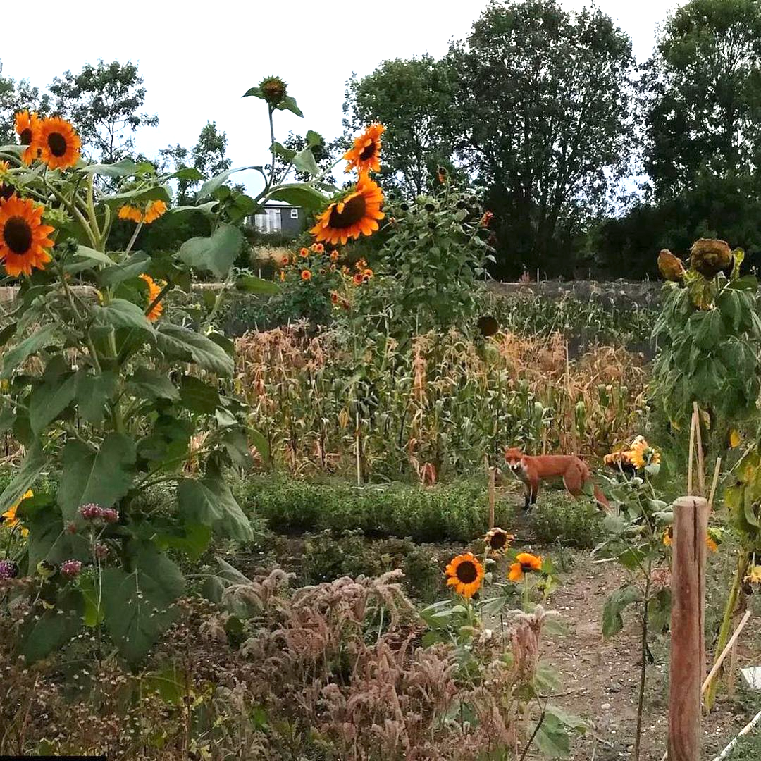
Notes:
4.5 tonnes in 2020

Slide 5
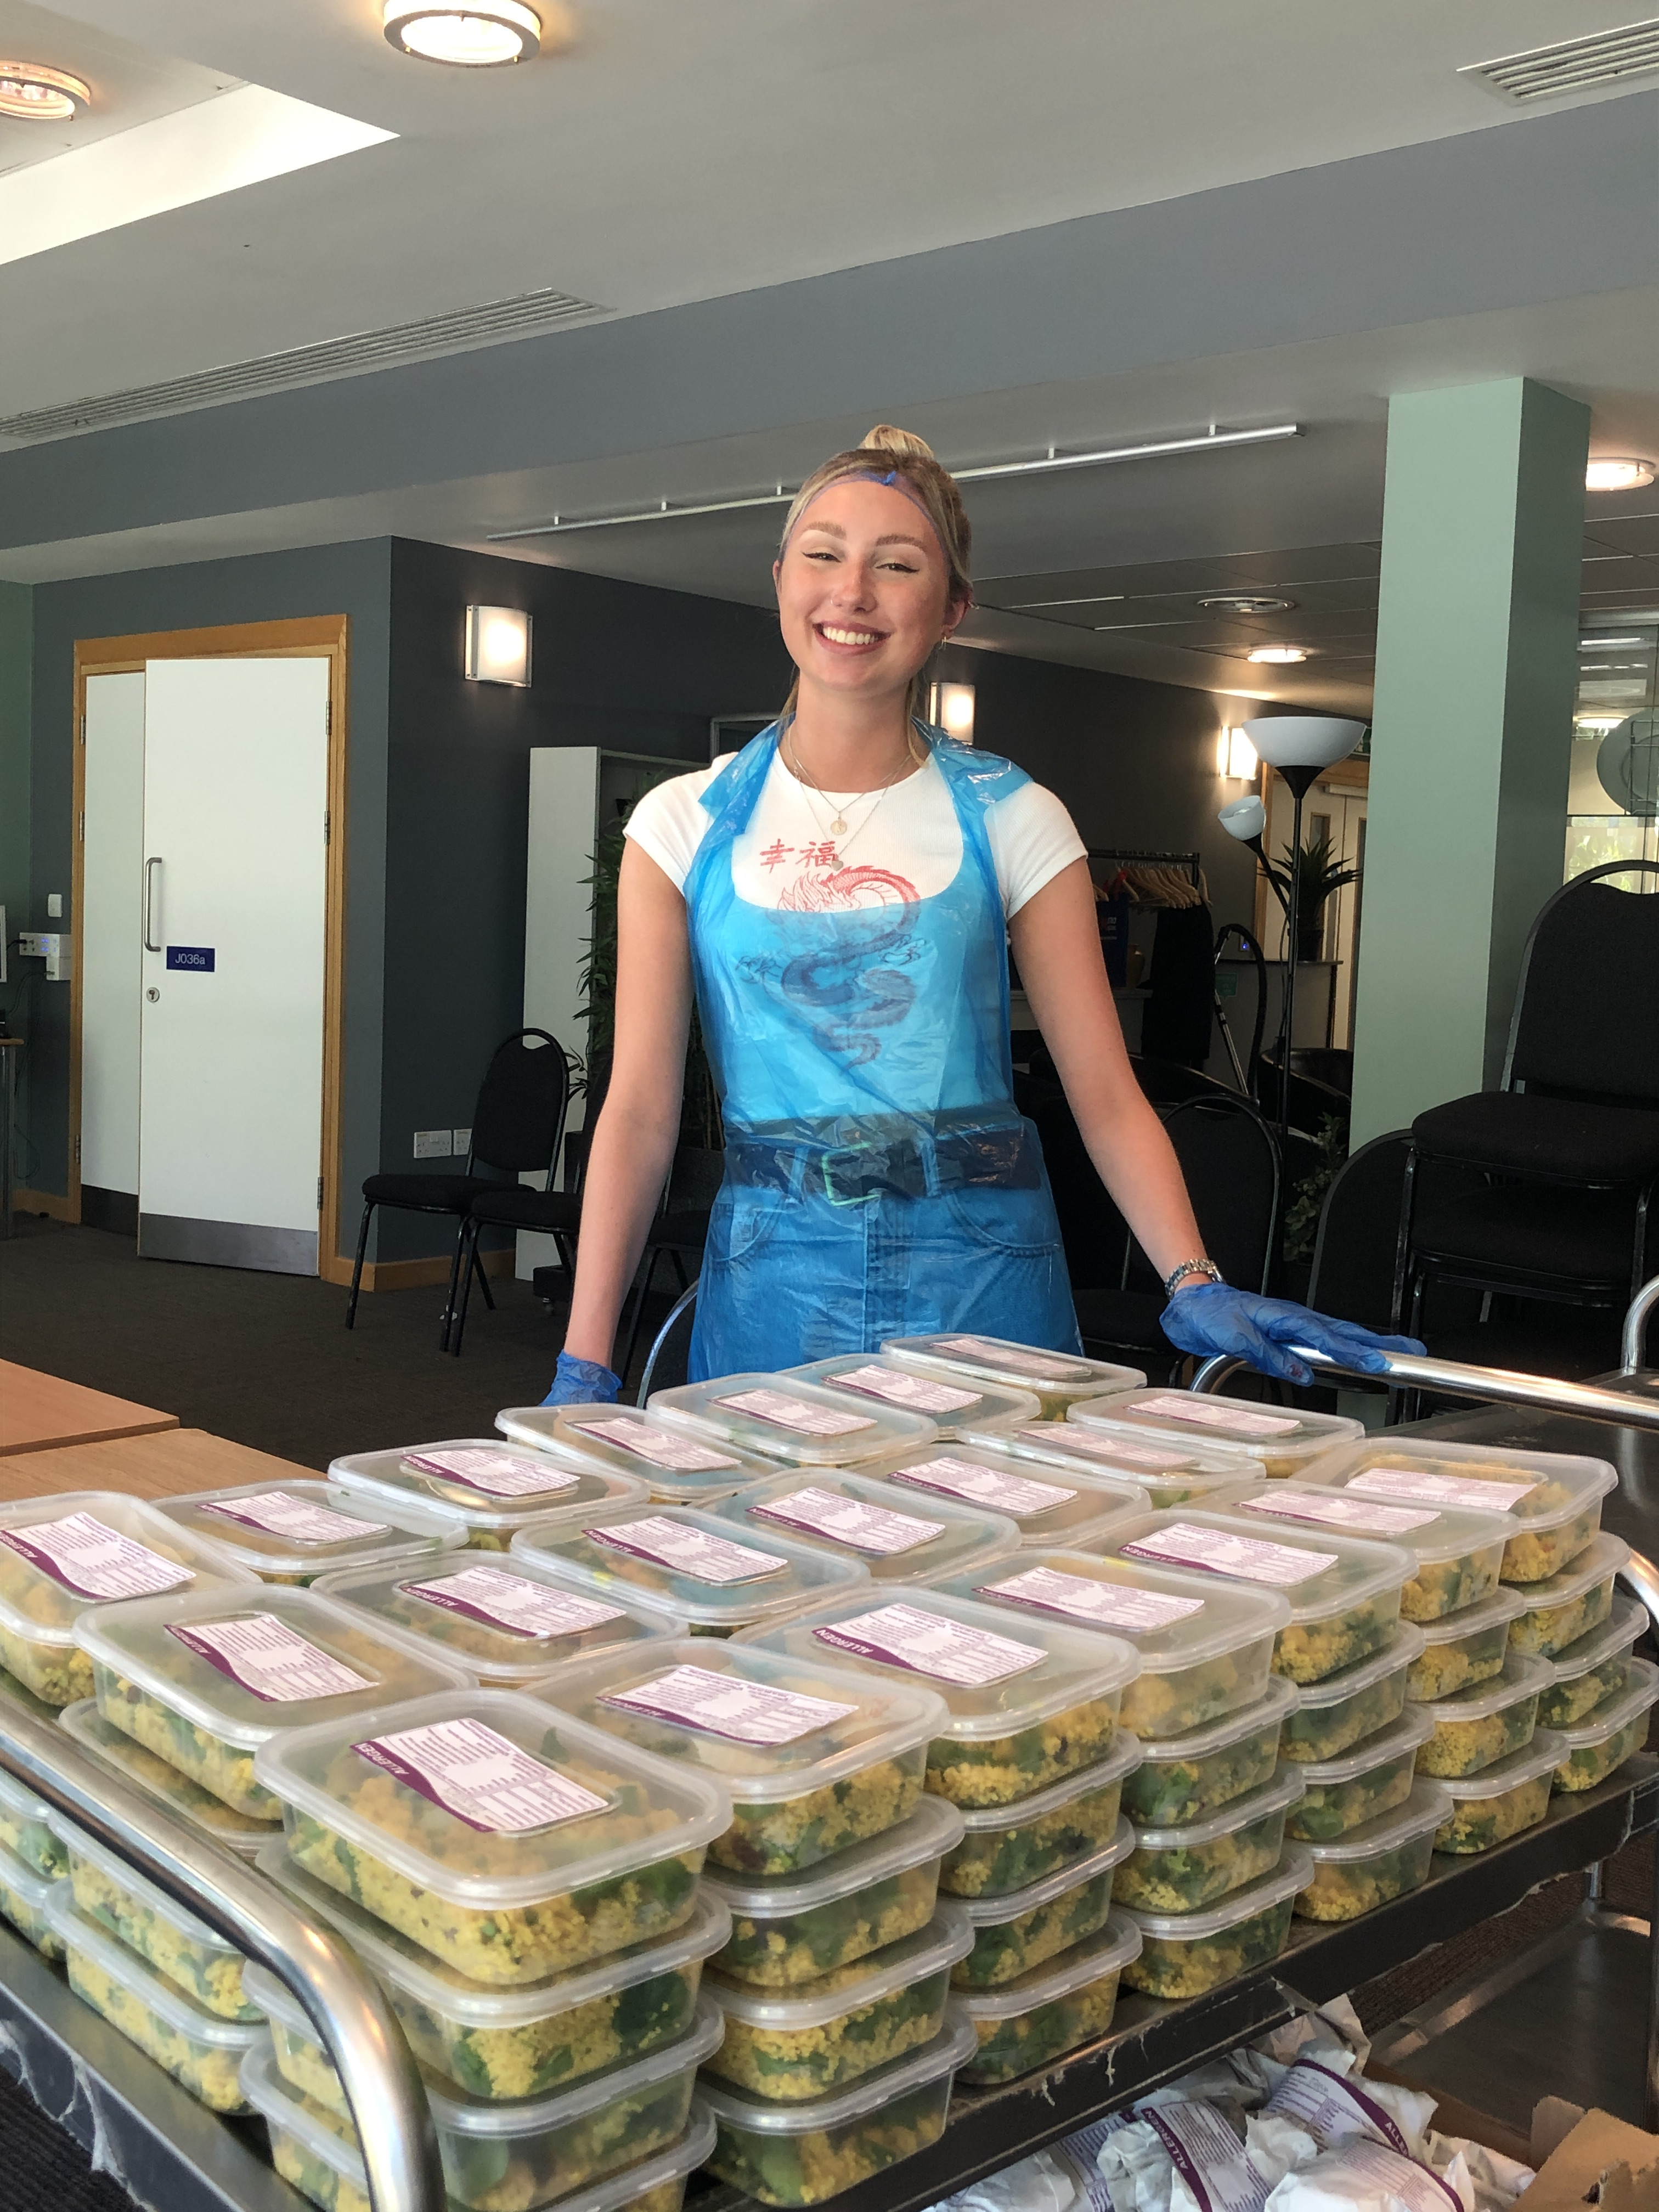
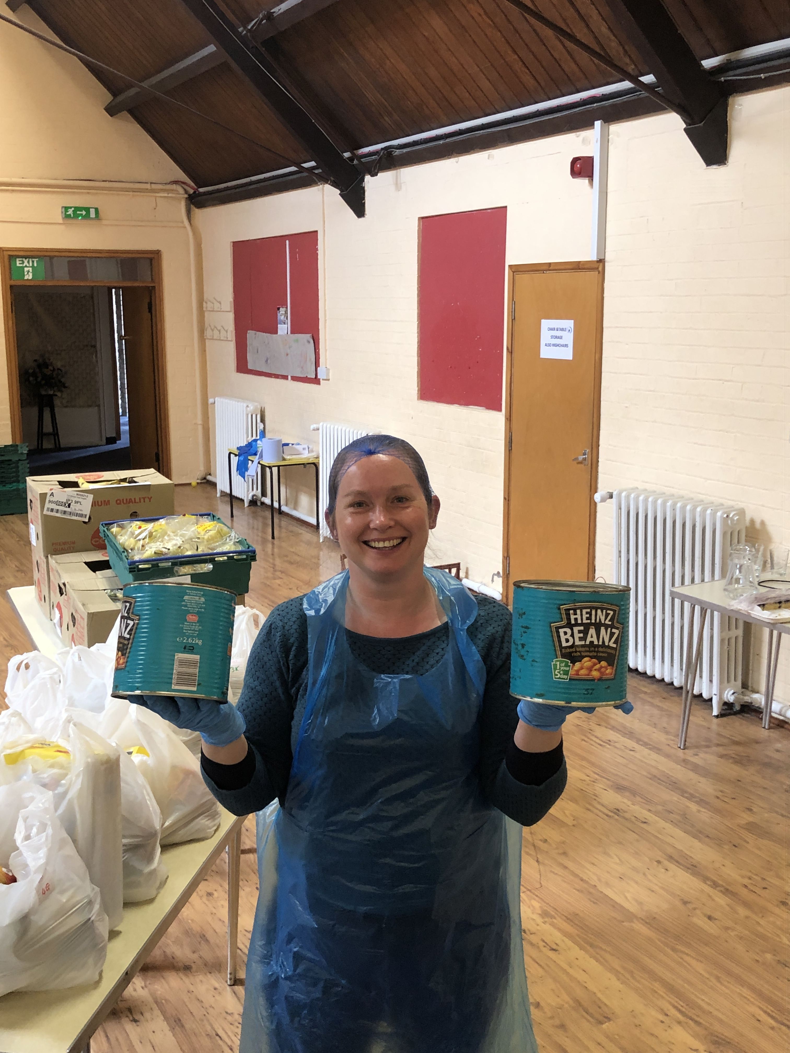
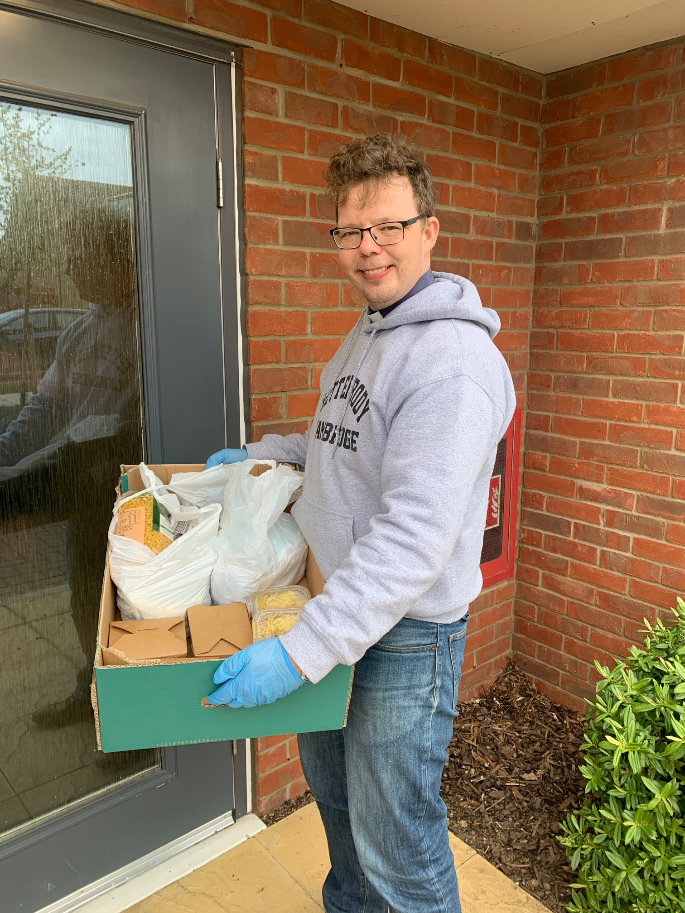
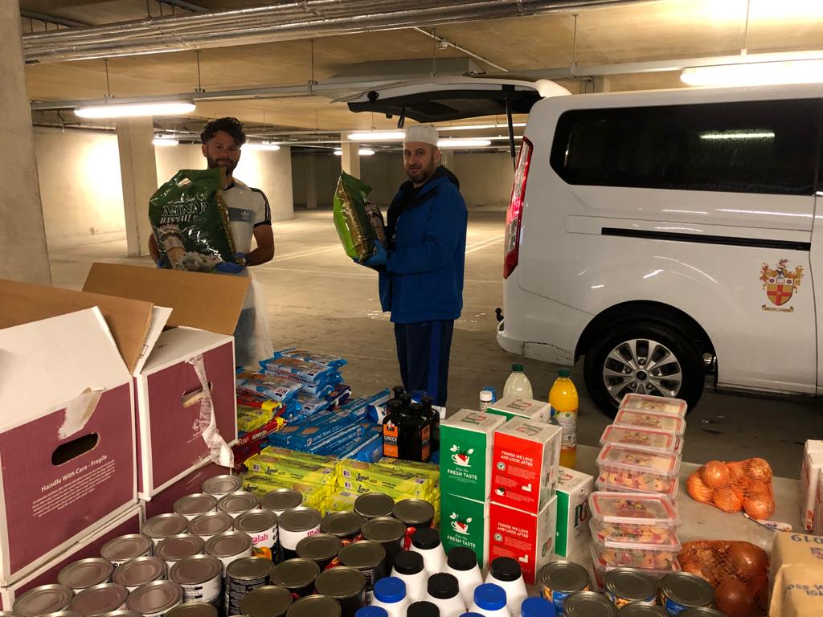
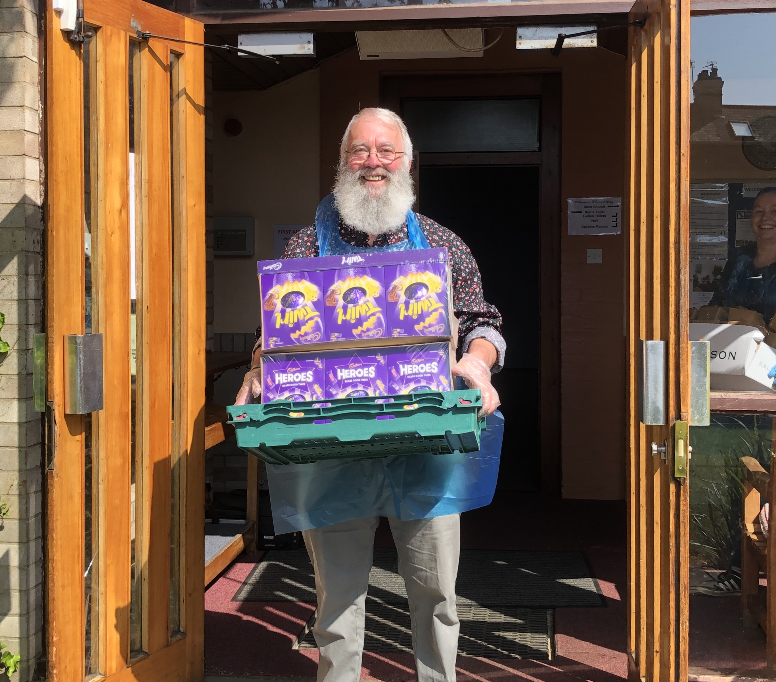
Pandemic Response
Notes:
CRC
Faith groups
Numbers?
Success but also…Pandemic strengthened local partnerships, networks and services and highlighted inequalities - e.g. ethnicity / access to culturally diverse foods

Slide 6
Where we are now, and where do we go next?
8 food hubs (21,200 visits 21/22)
Food distribution centre (204 tonnes surplus)
CSF Christmas seniors’ meals (250 in ‘21)
Christmas hamper appeal (650 expected)
Existing alliance monthly meetings (27 organisations)
Cost of Living popups and warm spaces programme (breakfasts)
Fundraiser @ £25,000
Notes:
Feb 22 76% of hub visitors said the rise in food and energy prices meant that they were finding it difficult to afford food and pay their bills
GOLD FOOD AWARD
38 warm spaces incl. 4 city council community centres
Given £1000 grant to provide food
8 CoL popups

Slide 7
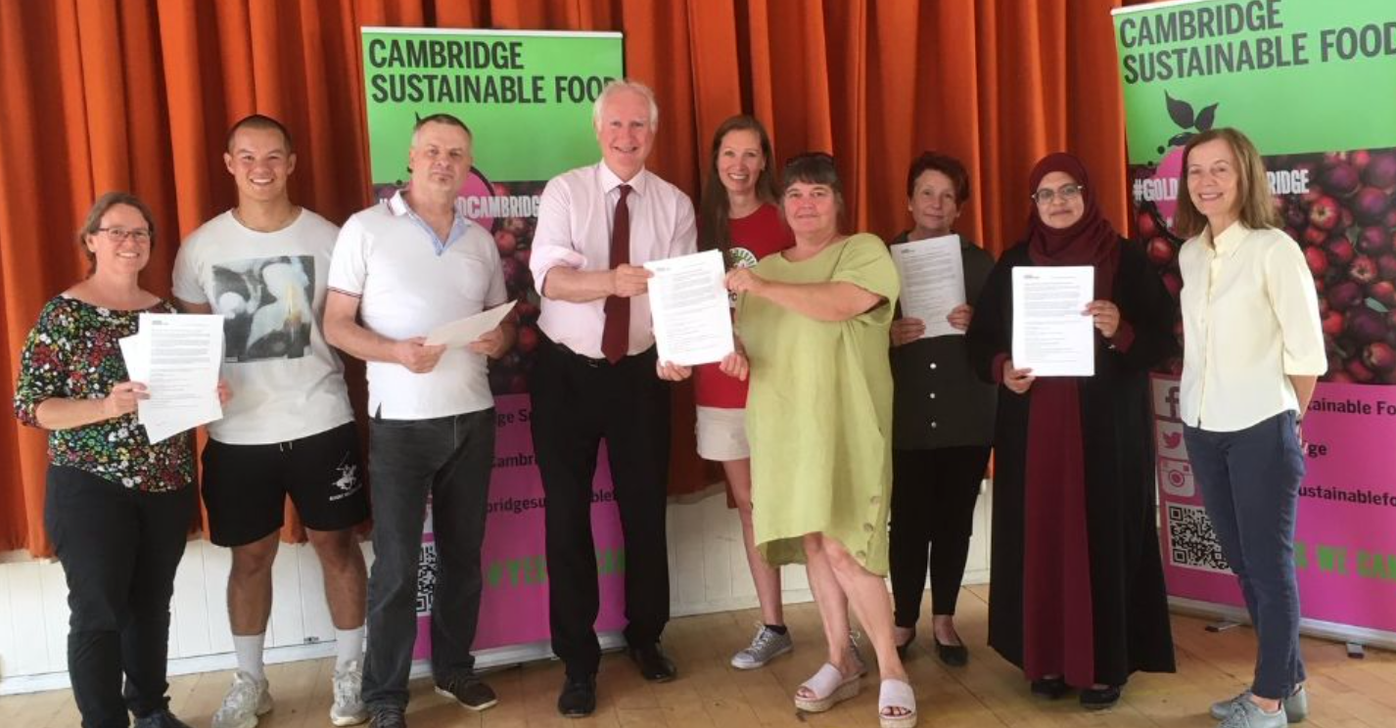
Notes:
Background – reason for becoming a councillor
Personal experience, King’s Hedges ward
Practical experience – wanted to make a political difference (not on people’s radar – discussing Breadline Challenge with MP

Slide 8
“My kids don’t sleep hungry.”
“It means I don’t have to steal food.”
Notes:
People’s stories from report
Cost of Living Crisis – food price inflation
Ovens
A food system that is built on on temporary support for those in need and does nothing to help people out of food insecurity or prevent them from becoming food insecure in the first place, is a failed system. And that, I’m afraid, is the system we have at the moment.

