Slide 1
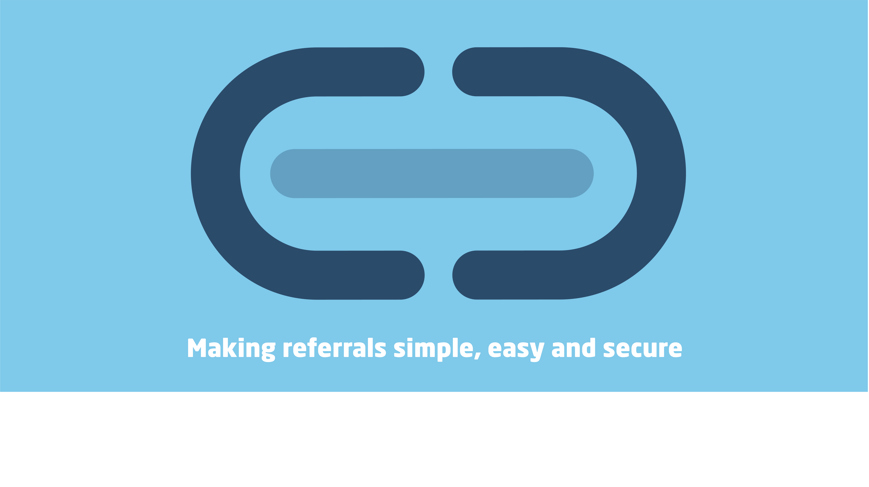
Strengthening Referrals for those at risk of or experiencing financial hardship
Kent County Council
Stacey Clark, Project Manager

Slide 2










Signposting Verses referral
Signpost
Verses
Referral

Slide 3
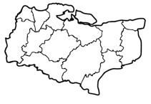
Strengthen referrals to support residents at risk of or experiencing financial hardship
Pandemic/cost-of- living crisis
Kent has a population of 1,589,000 people
UC claimant rate has steadily risen
Unmet demand for debt advice

Slide 4
Strengthen referrals to support people in
financial hardship
Provide targeted support to low income households and households in financial distress
ReferKent
Money Advice Network
Vulnerability Registration Service

Slide 5


ReferKent
Making referrals safe, easy and secure!
Many people seeking support were subjected to signposting, often from one organisation to another. This left them feeling deflated and falling further into hardship. ReferKent takes the pressure off the individual to reach out. There was no system in place that would allow secure referrals to be made.
www.kent.gov.uk/referkent
Launched Sept’22

Slide 6









































Some of our existing user’s
62 organisation/ teams on board
100 + agencies in process of onboarding
Notes:
Logo slide needs updating

Slide 7

‘The most important thing that we can do for our residents, is to ensure that we do everything we can to support them to make their financial/ and or personal situation better long term. ReferKent gives us the opportunity to do this. The support that ReferKent provides KSAS is immeasurable, and with how easy the platform is to use, and the speed at which they contact the applicants, means I can be assured that our residents are receiving the best assistance that we can offer.
The service is constantly updated with new agencies and I find new ways to support people through ReferKent every day’. - KSAS Assistant
Impact - ReferKent
Fuel 57%
Housing 8%
Benefits 9%
Debt advice 6%
Employability 2%
Money management and budgeting 8%
Food 4%
780 referrals made

Slide 8
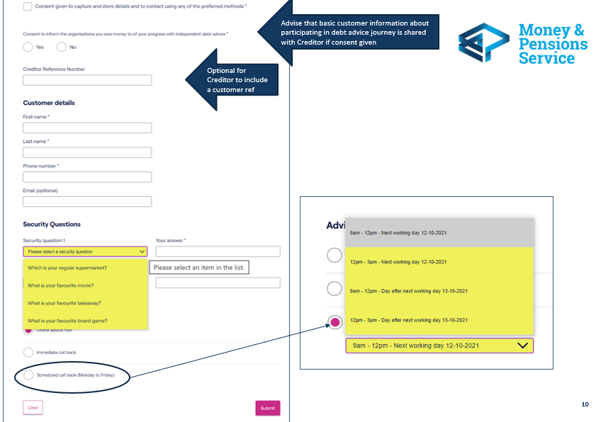
Money Advice Network
Making referrals safe, easy and secure!
Refers individuals to free regulated debt advice
Online debt self help referral tool
Immediate call back
Scheduled call back

Slide 9

Impact – Money Advice Network (MAN)
657 referrals made by KCC to debt advisors

Slide 10
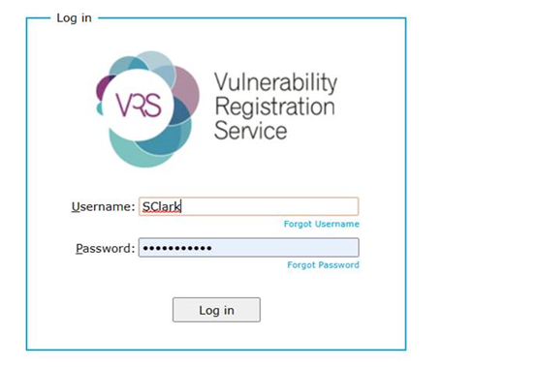

Vulnerability Registration Service (VRS)
A place to register financially vulnerable residents, so that creditors and lenders are aware of a persons vulnerability
Upload spreadsheet

Slide 11
Next Steps
Engage & promote
Spotlight sessions
Embed across Kent
Contact: stacey.clark@kent.gov.uk

