Slide 1
Emergency response, community resilience, and long-term prevention
16 March 2023

Slide 2
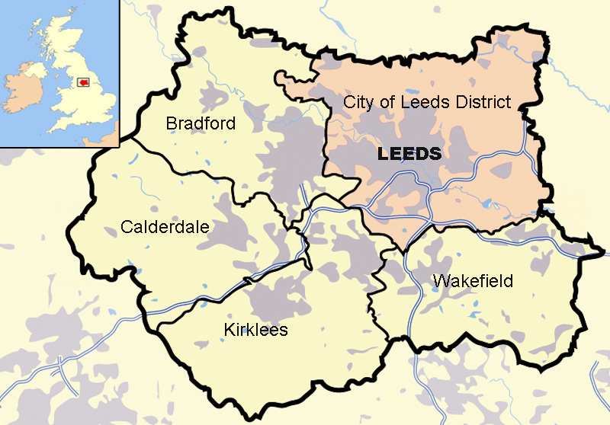

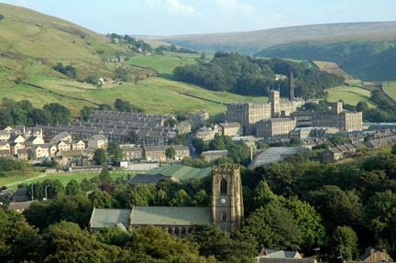
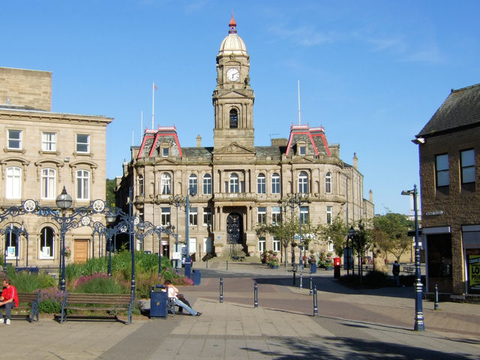
Kirklees
Mix of urban and rural
Distinct places, distinct identities
One of the largest authorities by population – 433k
Partner of West Yorkshire Combined Authority

Slide 3
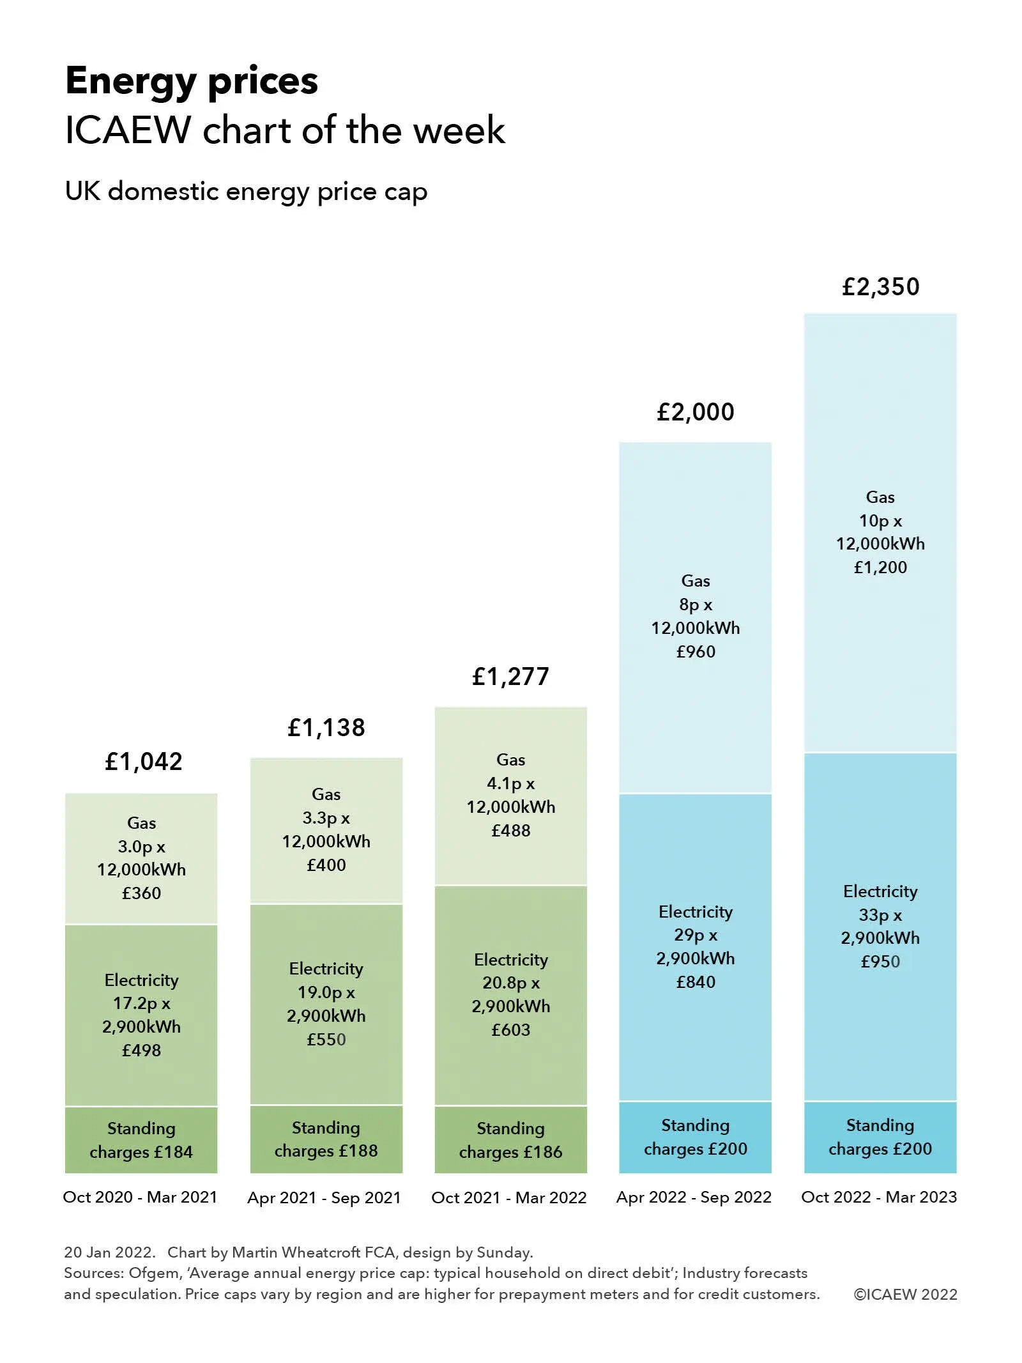
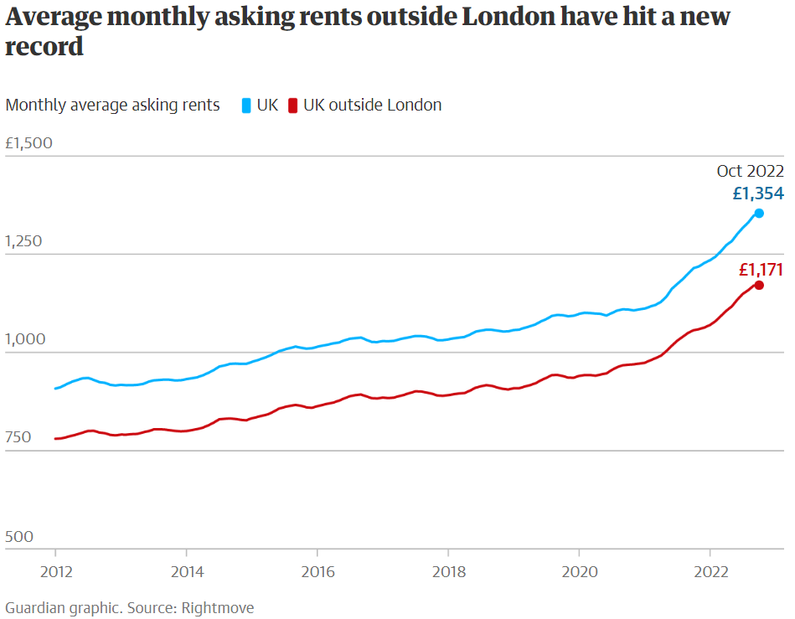
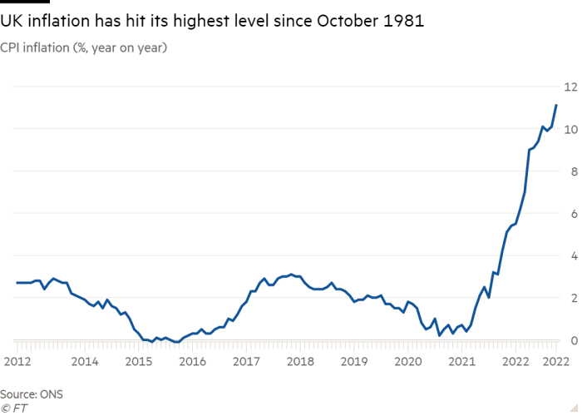
- People who have faced crisis for a long time
- People who previously weren’t in crisis, but now would be
- People at increasing risk of crisis
- Long-term
Impact on residents

Slide 4
Priority 1: Emergency Response
Our focus now for people already in crisis
Priority 2: Resilience
Our focus now to build places where people look after each other
Priority 3: Prevention
Acting now to address the medium- and long-term challenges and prevent future economic crisis
Our Approach

Slide 5
- Provide communication structure
- Connection and collaboration
- Light touch reporting and assurance
Organisation
Council Officers
Programme Board
Corporate Portfolio Holder
Corporate Strategic Director
Executive Team
Cabinet
Council

Slide 6
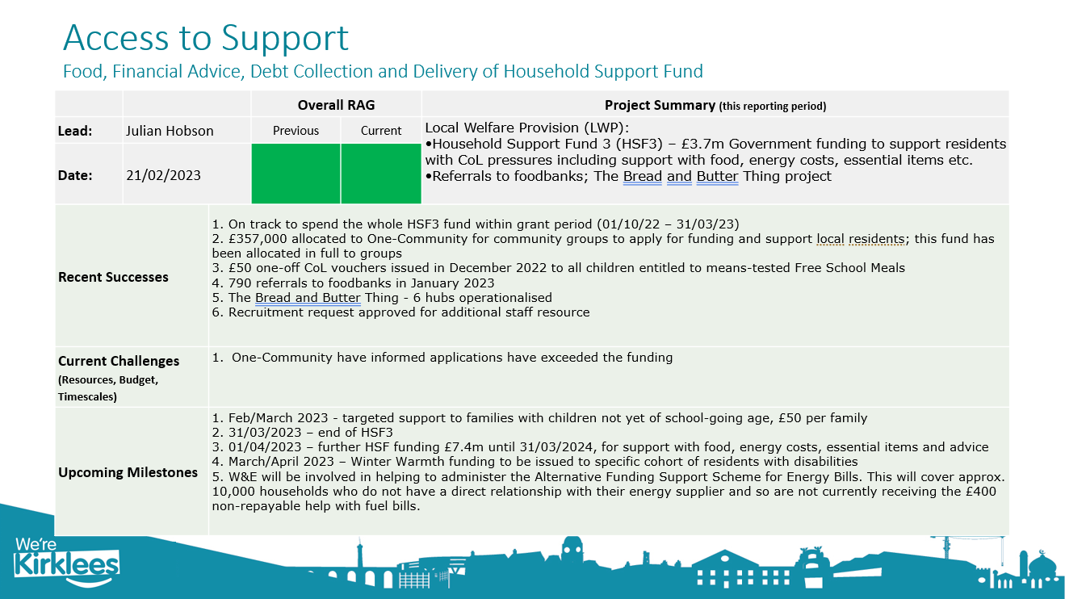
Organisation

Slide 7
- Warm spaces
- West Yorkshire Mayor’s Fund
- Communications
- Access to support (Food, Financial Advice, Debt Collection and Delivery of Household Support Fund)
- Support for businesses
- Housing services
Priority 1: Emergency response
Our focus now for people already in crisis

Slide 8

Emergency response example

Slide 9
- Community response: inclusive communities, local integrated partnerships, and local area coordination
- Community power: role of councillors, VCSE investment strategy, and ward cross-sector partnership working
Priority 2: Resilience
Our focus now to build places where people look after each other

Slide 10
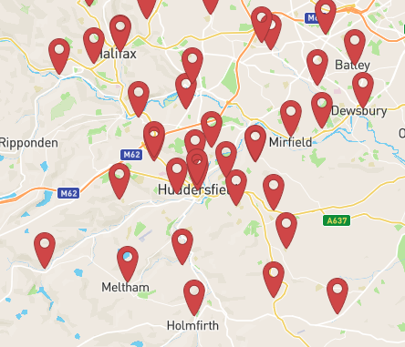
Resilience example (1/2)
24 libraries - working across communities
A warm and comfortable environment
Free wi-fi
Free access to computers
Free books
Free events and activities
Support and advice
Friendly and helpful staff

Slide 11
Resilience example (2/2)
  Next steps
  Support where there is less library access (in terms of local libraries or library hours)
  Increasing role for libraries in local VCSE networks, including via VCSE investment strategy
  Increasing role for libraries in Access Strategy
  Support (e.g. resources, training) for staff so they are aware of cost of living and confident in signposting to support
  More digital support via libraries
  External funding to support any of the above
  Links to businesses

Slide 12
Priority 3: Prevention
Acting now to address the medium- and long-term challenges and prevent future economic crisis
- Economic strategy and long-term recovery: cooperative development, community wealth building, developments/investments, and role of businesses in place-based working
- Working, volunteering, participating, and aspiring: employment and life skills
- Lobbying (national and regional)

Slide 13
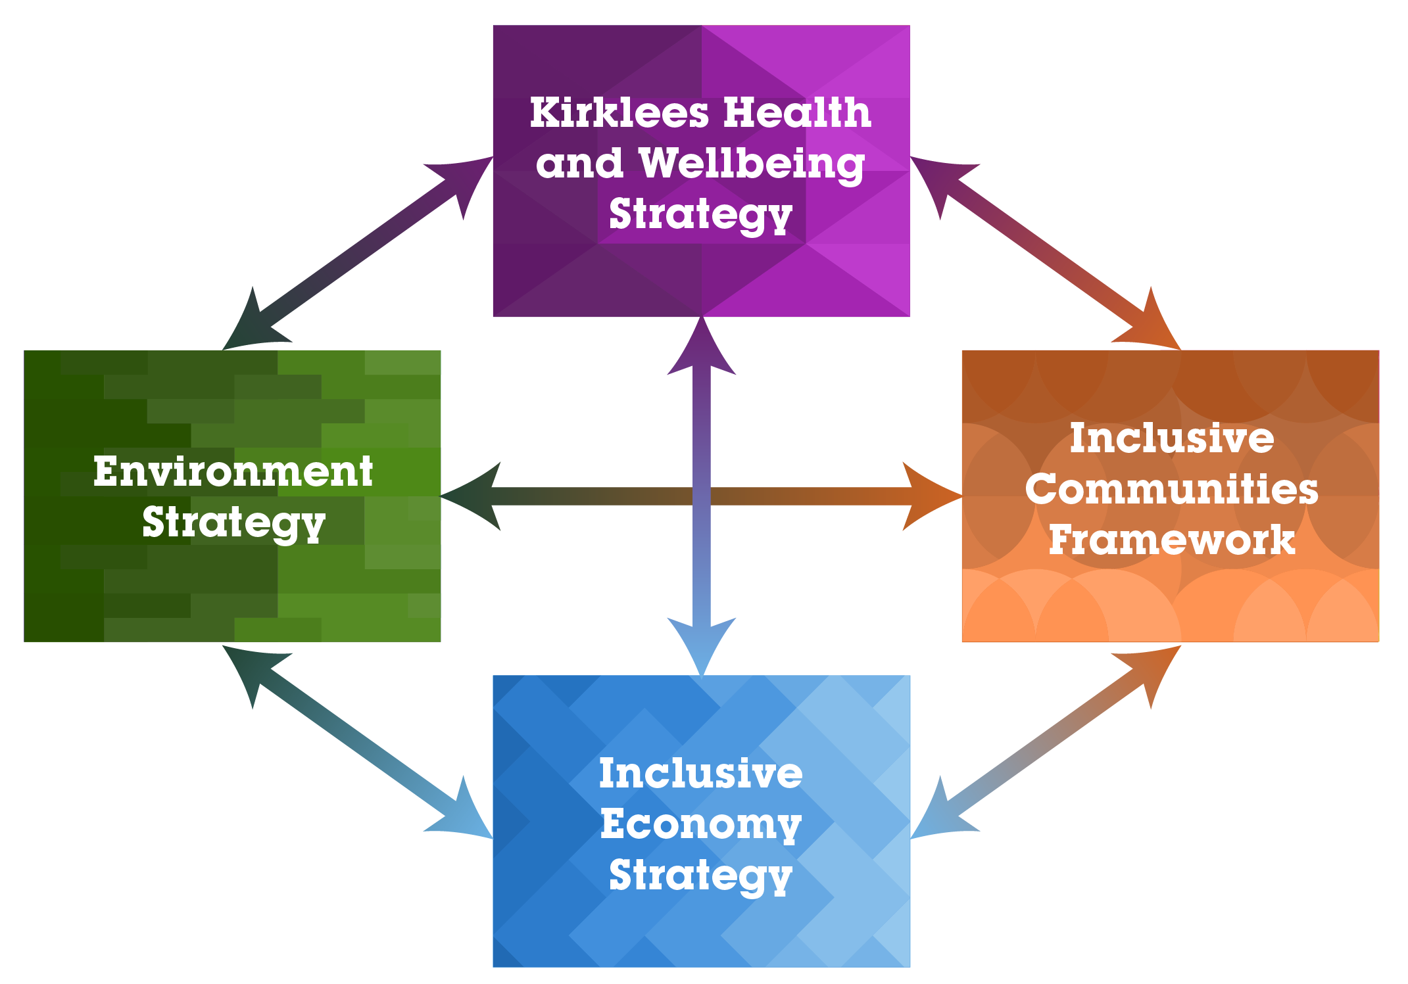
Prevention

Slide 14
Prevention
Spend for local impact
Understanding local impact
Good employment
Kirklees Inclusive Economy
Housing
Assets
Just transition
Tackling poverty
Grassroots

Slide 15
Questions or comments
Get in touch:
Stephen.Bonnell@kirklees.gov.uk

