Slide 1
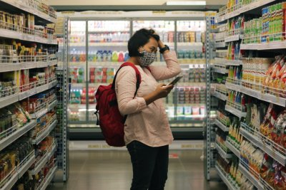


Food insecurity and long-term change: role of food partnerships
Sofia Parente, Campaigns and Policy Coordinator, Sustain
Credit: pexels-arthouse-studio

Slide 2
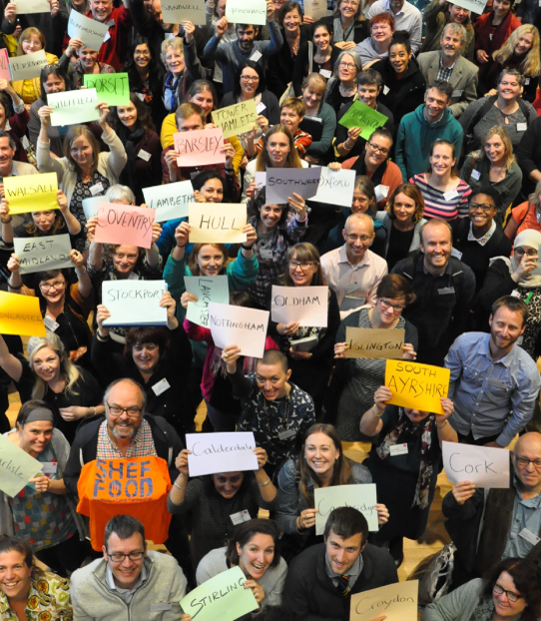

Sustain is an alliance of over 100 organisations and communities working together for a better food and farming system.
Sustainable Food Places is a partnership programme led by the Soil Association, Food Matters and Sustain. Our Network brings together pioneering food partnerships that are driving innovation and best practice on all aspects of healthy and sustainable food.
Notes:
https://www.sustainablefoodplaces.org/

Slide 3
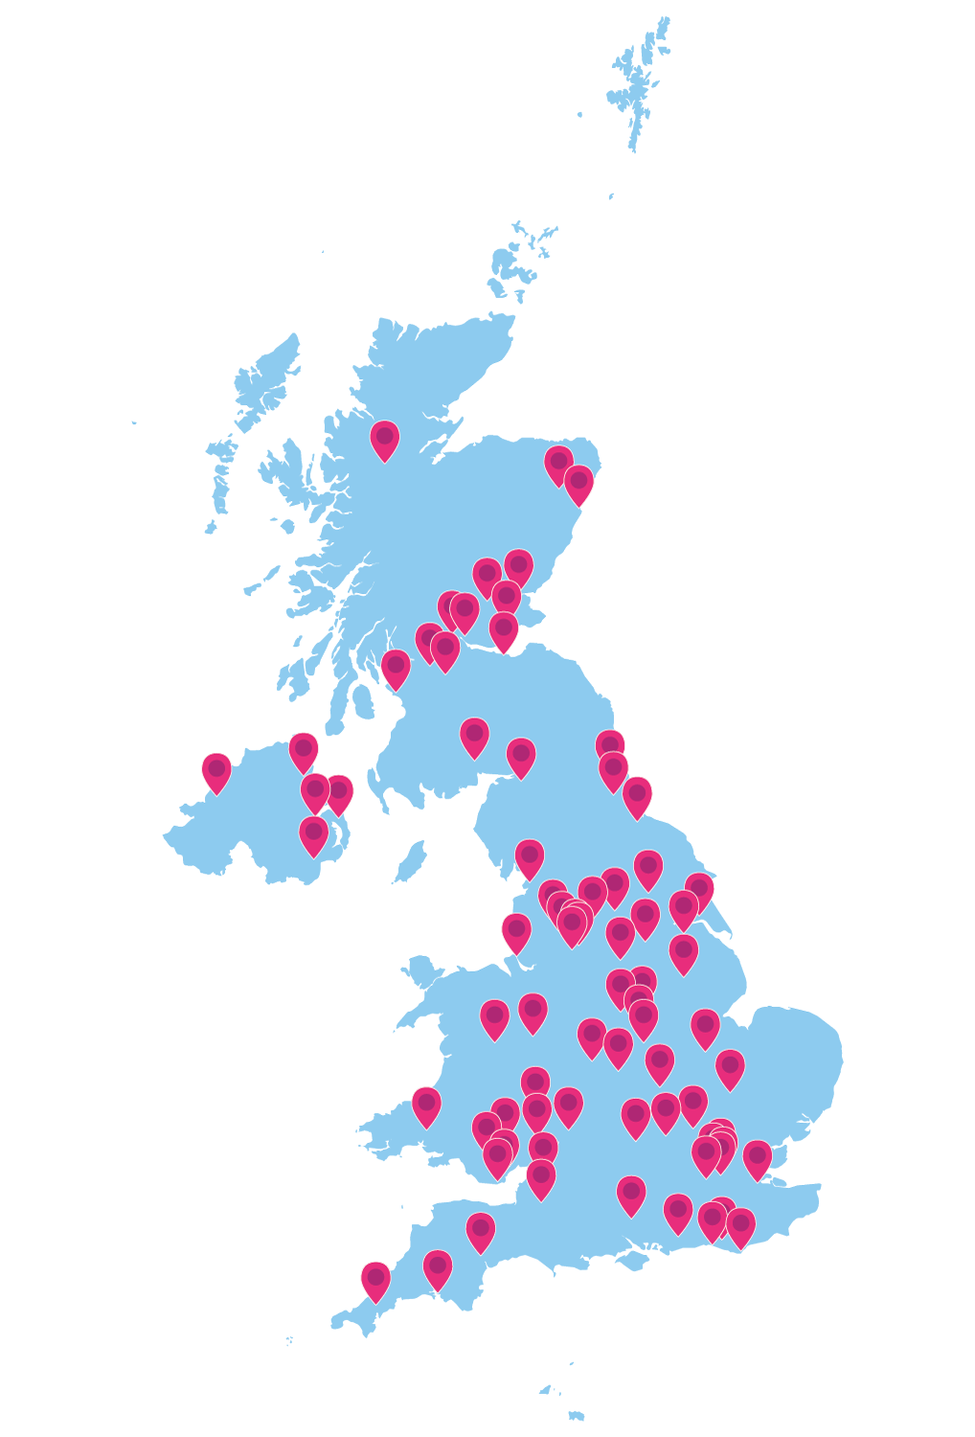
85 food partnerships
Brings together public, private and voluntary sector stakeholders to transform the food system
Hosted by the council, other local org or separate entity
Both short-term action plan & long-term strategy
Support delivery of Government policy and programmes: HAF programme, Healthy Start, public sector food, Levelling Up, Net Zero…
Notes:
https://www.sustainablefoodplaces.org/members/

Slide 4
Notes:
Food poverty alliance often sits under or operates as a working group of the food partnership

Slide 5
Government support
Good Food Nation Bill in Scotland
Private Members Bill in Wales + £3m support from Minister for Social Justice
Recognition in Government Food Strategy in England

Slide 6
Government Food Strategy
Under section 2.2, ‘Encouraging healthier and more sustainable dietary choices’
“Local Food Partnerships have already brought together councils and partners from the public sector, voluntary and community groups, and businesses to reduce diet-related ill health and inequality, while supporting a prosperous local food economy. We will learn from their approaches and work to understand and identify best practice in addressing food affordability and accessibility to healthy food. As part of our levelling up mission to narrow the gap in healthy life expectancy, government will identify the areas most in need of this insight, and Defra will work with local authorities and food charities in these priority areas.”

Slide 7

Unlocking action: evidence from covid
Providing leadership for both the short-term and the long-term
Helping to channel public resources to meet population needs
Acting as hubs for information gathering and sharing
Driving forward a strategic city food plan through the pandemic
Creating urban-rural collaborations across larger geo. areas
Promoting nutritional quality and pushing back on junk food
From crisis response to action on affordable food
Cultivating a local good food movement
Notes:
What we’ve learned from covid:
https://www.sustainablefoodplaces.org/news/uwe_report_value_of_food_partnerships_apr22-/

Slide 8
Unlocking action: evidence from covid
Setting an agenda for neighbourhood food growing and sharing
Harnessing energy in the food hospitality sector
Towards dynamic purchasing
Putting food at the centre of planetary health

Slide 9
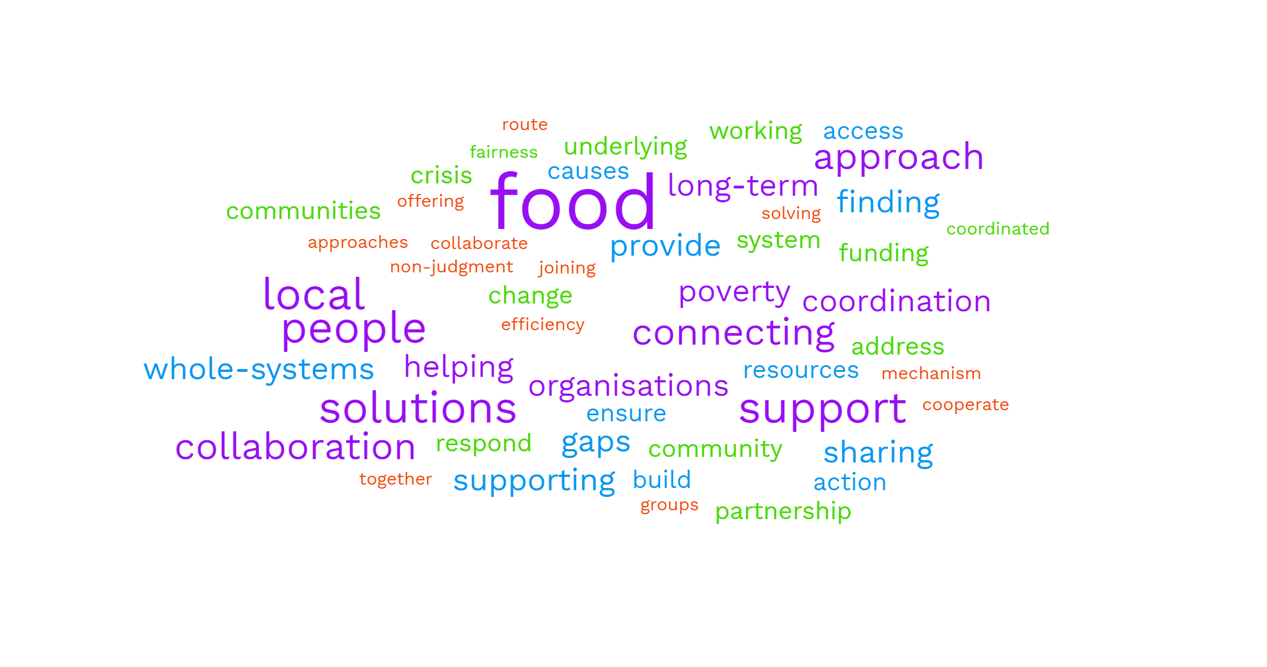
Food partnerships in the cost of living
Notes:
https://www.sustainweb.org/events/oct22-cost-of-living-food-partnerships/

Slide 10
Food partnerships in the cost of living
Building on existing work and structures set up during covid
‘Cash first approach’
Strong partnership between council and local partners
Multiple delivery partners; coordination via food poverty alliance or similar structure
Food hubs to centralise buying, storage, distribution
Strategies to diversify funding, food and donations

Slide 11
Food partnerships in the cost of living
Innovation: fundraising, ‘grow a row’ projects, local campaigns
Combine emergency response + long term solutions + food system transformation

Slide 12
Notes:
Examples of local innovations and campaigns

Slide 13

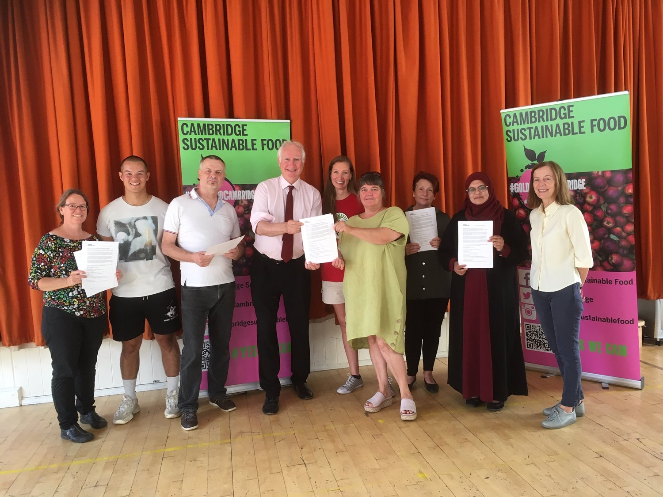
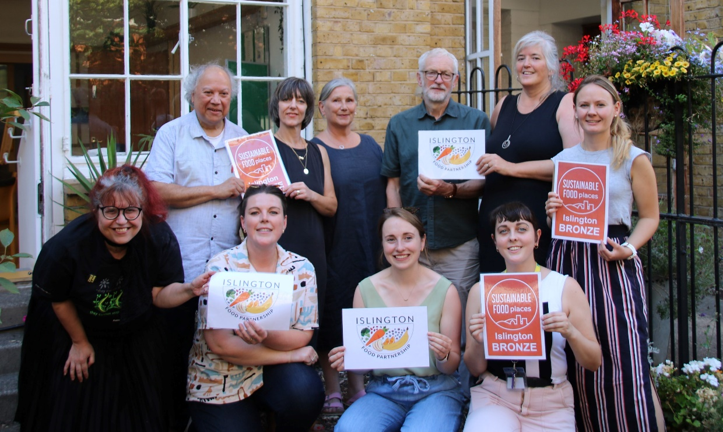
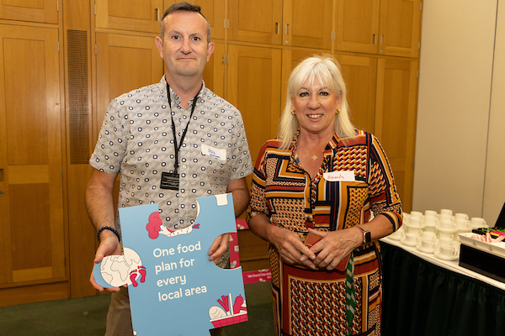
Notes:
National voice

Slide 14
How you can get involved
Is there a food partnership in your area?
Support your food partnership/set up a food partnership
Check resources in SFP toolkit and sign up to our comms
Opportunity under Household Support Fund 2023/24?
Notes:
https://www.sustainablefoodplaces.org/get_involved/

Slide 15
Thank you
Sofia Parente
sofia@sustainweb.org
info@sustainablefoodplaces.org
https://www.sustainablefoodplaces.org/

