Slide 1


Slide 2
What we will cover
Newham’s overall response
Some of our activities:
  Help is Here campaign
  Cost of Living Champions
  One Stop Shops
  Cost of Living Wellbeing Team

Slide 3
Newham’s Cost of Living Crisis Response – why?
The Cost of Living is creating emergency levels of demand and need in Newham where thousands of residents will face catastrophic financial instability due to inflation, soaring energy bills, housing costs that follows more than 12 years of austerity;
The ethnic diversity and age profile of our borough’s population (73% ethnic minority, significant youth / under 24-year old profiles) means that Newham residents face structural inequalities that leave them disproportionality vulnerable to the cost of living emergency;
Covid-19 proved in times of crisis our community response can make fundamental difference;
It is clear that national government has a responsibility to take urgent action but, even if this intervention is forthcoming, more has to be done locally driven by our collective efforts;

Slide 4
A ladder of support
Public information
Help is Here Content: e.g. Where to Find Support in Newham , on-line map, Cost of Living website
Help is Here Campaign
Cost of living Champions: infographics, videos, social media and direct conversation over whatsapp and email
Well Newham outreach team
Cost of living pop-up events
Specific services: Our Newham Money, Our Newham Work, Money A&E
Cost of living wellbeing service
From the most general / broadest to the most detailed / individual.
General
Lots of people
Specific
Targeted small group

Slide 5
Why a ladder of support
People want information and help when they have a need and are not likely to retain information that is not immediately necessary
Friends, family, trusted community members are often the first port of call – although not always.
  Sometimes people don’t want to share with those they know out of shame, fear of stigma or judgement. This can be particularly true around debt, finances and stress
Everyone in our shared village plays their unique and important role, supporting and reinforcing each other
The more ways people have to access information, advice and support the more likely they are to get what they need
  As capacity pressures grow across the system having as many opportunities as possible can help spread the pressure and burden
The issue that people present with is often not the underlying cause and / or the only problem
Providing respite even if not solving the underlying problem has value.
  Many of the big drivers of cost pressures sit outside the agency of the local authority (housing and inflation) and at the same time local authorities and our partners have ever-reducing resources to respond.

Slide 6

Help is Here Campaign
This week we launched a new campaign called ‘Help is Here’ to help residents know where to go for help throughout the borough.
The Help is Here campaign is the latest phase in the collaboration between the Council, local partners and voluntary organisations, community organisations and faith organisations to support residents across Newham.
A key feature of the campaign is a new suite of information and resources to help increase awareness amongst residents, voluntary sector, local businesses and partners of all the help that is available in Newham to help people manage the increase in the cost of living.
The Council’s Help is Here booklet lists a range of help that is available to support people around finances, housing, energy bills, food, work, health and emotional wellbeing. An online map has also been created showing where all this help is provided in person.
The Council has produced a new toolkit of promotional assets for its voluntary sector partners to use in their own work promoting their services.
Notes:
Signposting to services – providing information all available
On the spot support

Slide 7




Help is Here Campaign
Notes:
Signposting to services – providing information all available
On the spot support

Slide 8

One stop shops
Weekly One Stop Shops in one of our biggest and most used Libraries
To provide additional information to residents on Newham’s Cost of Living Response through signposting and offering on the spot support.
To improve the accessibility to cost of living support for resident’s living in Newham delivering this in one space.
To build cost of living knowledge in all frontline staff and services within the council and across organisations in Newham to better support vulnerable residents.
Notes:
Signposting to services – providing information all available
On the spot support

Slide 9














Services that join
WEEKLY COST OF LIVING SERVICES IN ATTENDANCE
ONE-OFF THEMED SERVICES IN ATTENDANCE
Notes:
Attach info about SEND surgery – share Eventbrite links

Slide 10
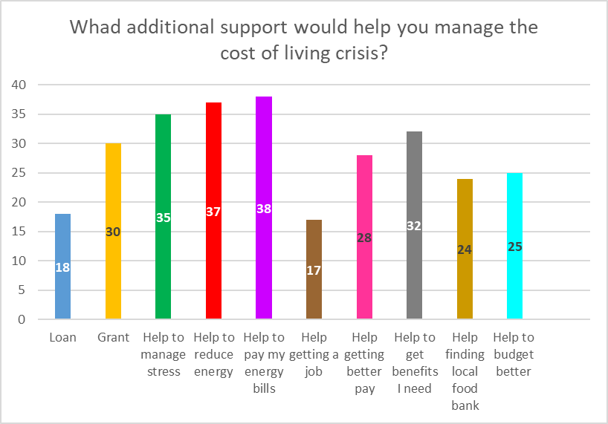
Feedback from residents (n=50)
Key findings from resident’s survey:
49% of respondents lived in the E6 area.
86% of respondents have stated their stress level has increased since the Cost of Living Crisis started.
Residents average rating of the one stop shop
Notes:
We have developed two surveys which aim to capture the essence of the one stop shop focusing on areas where we have successfully delivered and identify gaps to develop this model further.
This includes: (1) Residents survey (n = 29) (2) Feedback from services (n = 15)

Slide 11
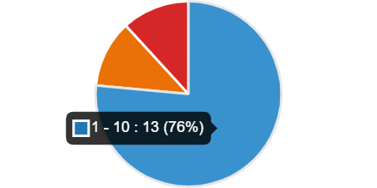
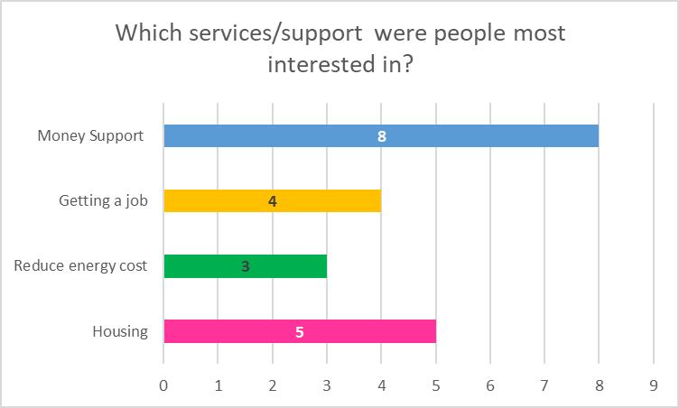
Feedback from services (n=20)
1. 76% of services attending the one stop shop spoke to around 1 – 10 people (more in-depth 1:1 conversations) with the PH outreach team talking to 50 people.
2. 141 people have been supported by various services including PH outreach, housing, energy and finance since the one stop shop began.
3. Most common support people were interested in was financial/money
4. Common questions asked include:
How to find a job with higher pay?
What financial support is available?
How can I be rehoused?
Is digital training free?
What is the current bidding status?
Notes:
To capture the essence of the one stop shop focusing on areas where we have successfully delivered and identify gaps to develop this model further.
Most common support needed : Housing (homelessness, lettings) Council Tax and Benefits Advice and Money
Key findings from residents survey:
55% of respondents lived in the E6 area.
Information given at the one stop shop has been helpful with residents who have answered the survey giving the service an average of 4 out of 5 rating.
Most common support to help manage the cost of living crisis includes:
- Grant (n = 19), loan (n = 17), help to pay my energy bills (n = 17)
90% of respondents have stated their stress level has increased since the cost of living crisis started.

Slide 12
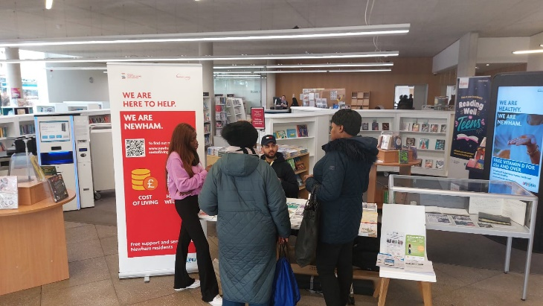
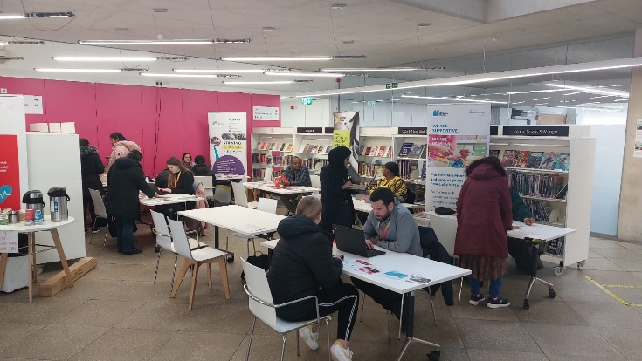
Feedback from services (n=20)
What worked well?
High levels of engagement
Having services work in conjunction and learning about support services available in Newham.
Open plan – residents could come to each table and free to speak to whoever they wanted.
What didn’t work so well (28th Feb)?
The location should be more inviting and have more banners to make it clearer to residents.
Fairly noisy – would be better to have smaller individual tables for each team to be able to speak to residents.
How did we improve the next one stop shop? (7th /14th March)
Smaller individual tables enabling services to have more private 1:1 conversations with residents.
Better promotion and signage – we now have banners and signs.
Notes:
To capture the essence of the one stop shop focusing on areas where we have successfully delivered and identify gaps to develop this model further.
Most common support needed : Housing (homelessness, lettings) Council Tax and Benefits Advice and Money
Key findings from residents survey:
55% of respondents lived in the E6 area.
Information given at the one stop shop has been helpful with residents who have answered the survey giving the service an average of 4 out of 5 rating.
Most common support to help manage the cost of living crisis includes:
- Grant (n = 19), loan (n = 17), help to pay my energy bills (n = 17)
90% of respondents have stated their stress level has increased since the cost of living crisis started.

Slide 13
Cost of Living Champions / peer support
Cost of Living support
3-4 hrs training on the top 5-10 questions and then fortnightly check in
Money Mentors
Partnership with Money A&E with more training and commitment to 1+ years
Cost of living champions
Give out info / share back questions
Currently have 700+ people on a distribution list – this includes about 30 official Champions
Launching a big recruitment campaign in next few weeks alongside Help is Here campaign
Focusing Cost of Living Support on: form filling and signposting to benefits and housing advice
Notes:
Signposting to services – providing information all available
On the spot support

Slide 14
Being a Champion
Notes:
Signposting to services – providing information all available
On the spot support

Slide 15
Cost of Living Wellbeing Team
The purpose and aim of the team
Protect and promote the health of residents at high risk of illness or death in the cost of living crisis through offering and facilitating access to emergency support and services
What are our objectives:
To define and identify high-risk residents
Reach out to those residents to check on their welfare and assess their needs.
Where applicable, directly provide emergency support
Facilitate access to other key services to protect and promote health.
Monitor and evolve the service in line with learning and emerging evidence.
Being delivered by:
A team of 6 members of staff embed in the councils financial wellbeing service – Our Newham Money
The team includes one operational lead and 5 outreach officers
7 days a week - 9 am to 8pm depending on business needs

Slide 16
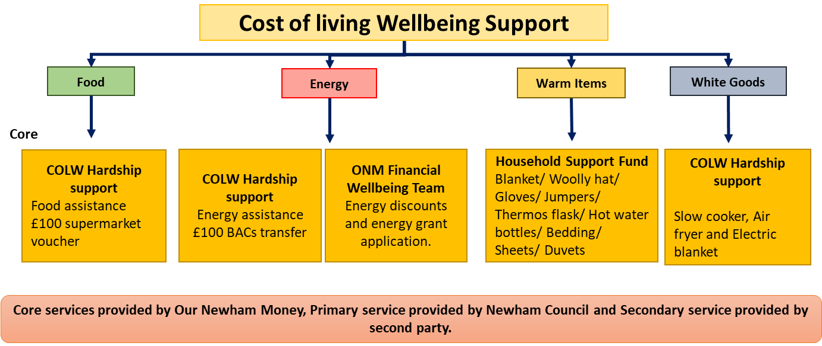
Wellbeing Team: what support is provided
How are we supporting residents
Contact residents by phone and through in-person visits to conduct a welfare check, identify support needs and connect residents to the offer.
Continually review and iterate the model based on outputs and learning about what works and what residents need.
Because the Cost of Living wellbeing team are embedded in Our Newham Money, this creates a streamlined approach between contacting residents and providing emergency support as well as other support offers.
The service can offer the following to residents (depending on eligibility):
Hardship support (often referred to as Local welfare assistance) and from the Household Support Fund for food, energy and warm packs during winter months
Support to access Newham Food Alliance.
Support to access Warm Havens.
Referral to Our Newham Money for financial advice and support.

Slide 17
Wellbeing Team: so far
Support provided to date
A targeted approach has been taken to reach out to residents aged over 75, living alone and on a low income. Data has been provided by council tax to highlight this cohort of residents.
The conversations that take place with residents has been created on a strength based approach to promote a residents wellbeing.
Since Jan 2023:
Over 1200 residents have been contacted.
93 residents have received direct financial support.
£13,010 has been issued in food/energy/warm packs.
Resident B at E6 required assistance with food vouchers and is digitally excluded, a hardship support fund was made over the phone and she was awarded a £100 Tesco voucher. When dropping off the voucher, resident B invited us into her home; where the opportunity arose to discuss any secondary support that she may require. She explained how she had been living in the same flat from the age of 31 and is reluctant to going into a residential home due to her mother struggling when she did so.
Resident B also expressed although she was of a certain age, she knows how to budget and take good care of things, this was evident when looking around the house, and all furniture was clean and intact even though they were 10+ years old. Resident B also expressed that she has social anxiety and finds it hard to open up over the phone, and was greatly appreciative that we visited her and started to open up about her personal life.
She needed further assistance as she wanted a blanket for when she is watching t.v. to keep warm and has held on to a knitted blanket that was given to her by her mother 15 years ago. Upon this request, we ordered a thermal blanket and will be delivered to her house.

Slide 18
Continuing to add along the ladder
Public information
Help is Here Content: e.g. Where to Find Support in Newham , on-line map, Cost of Living website
Help is Here Campaign
Cost of living Champions: infographics, videos, social media and direct conversation over whatsapp and email
Well Newham outreach team
Cost of living pop-up events
Specific services: Our Newham Money, Our Newham Work, Money A&E
Cost of living wellbeing service
From the most general / broadest to the most detailed / individual.
General
Lots of people
Specific
Targeted small group

