Slide 1

Stoke-on-Trent City Council
Current Epidemiology
Focussed Large Scale Testing
LGA & ADPH Webinar on Mass Testing
Thursday 10th December 2020
Dr Paul Edmondson-Jones
Director Adult Social Care, Health Integration & Wellbeing
Director of Public Health (temporarily acting)

Slide 2
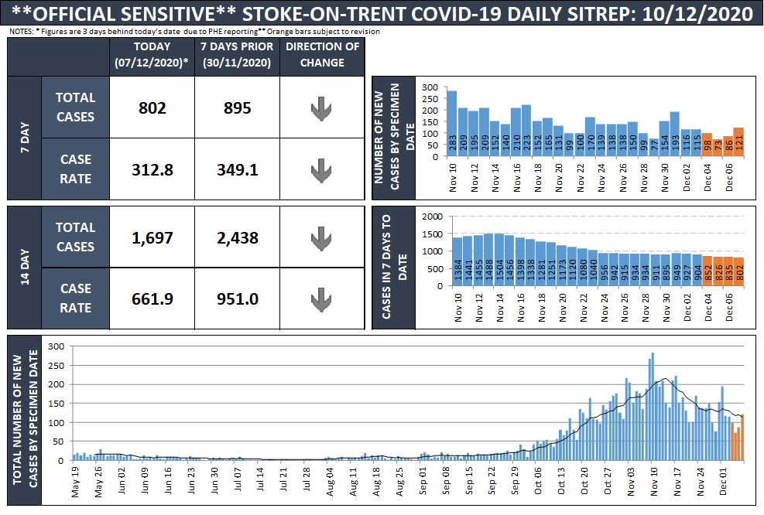

Slide 3
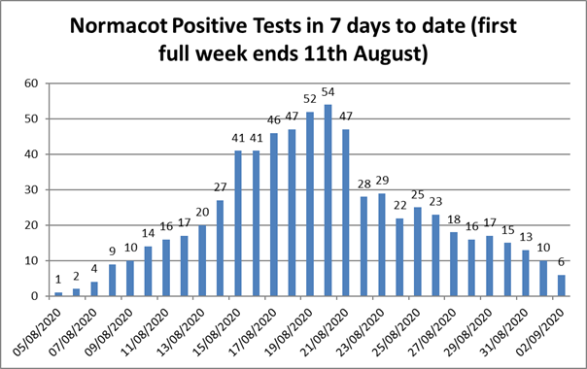

Slide 4
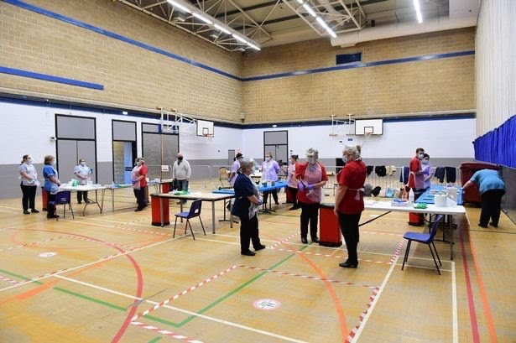
Stoke-on-Trent LFT Site - Dimensions

Slide 5
Stoke-on-Trent Tests to 06 Dec
Setting | Positives | Negatives | Invalids | Total Tests
Business Organisation | 0 | 1234 | 0 | 1234
NHS and F&R | 5 | 480 | 1 | 486
City Council Staff | 4 | 487 | 0 | 491
Public Facing | 61 | 1542 | 1 | 1604
Secondary School | 0 | 148 | 0 | 148
Total Stoke-on-Trent | 70 | 3891 | 2 | 3963
800 to Mental Health Trust
525 to our 3 Local Hospices

Slide 6

Hunting down the positives
PCR Testing needs to be used better (currently 40%) but low car ownership ratios & can cause delay
Target High Prevalence Communities with testing, enforcement, contact tracing and communications
Train the Trainer Programme for schools, colleges, hospices, large businesses and high risk settings
Aspiration for LFT is to reach 10% local population by 31 Jan 21 but must target high risk populations
Stoke.gov.uk

Slide 7
Learning the Lessons
Admin needs to be perfect – booking, registration, test analysis, results and is rate limiting factor!
Clinically led Process is best but unaffordable and not cost effective albeit most effective
Train the Trainer Programme works well but is very time consuming and need to think about revalidation
Instant works best – keep people for results, do 2nd LFT and while waiting for that do CT
Hub and Spoke – works well alongside PPE and Test bulk storage with push not pull resupply
Stoke.gov.uk

Slide 8
Current Issues with Mass Testing
Confirmatory PCR is suddenly part of national SOP – we disagree – kills community testing where the advantage is instant result and immediate CT
Multiple Initiatives centrally directed and randomly announced with little coordination are distracting
Funding the programme promised £14 a head but discussion around top slicing for overheads
Aspiration for LFT is to reach 10% local population by 31 Jan 21 but must allow DPH to lead as appropriate
Focussed Large Scale Testing – Don’t widen inequality
Stoke.gov.uk

