Slide 1
Materials for a Webinar on COVID-19 in Educational and Childcare Settings
Delivered by the south west health protection team information correct on 13th June 2020
04/08/2020

Slide 2
Key info
These webinar materials were compiled by the South West Health Protection Team
Please include an acknowledgement of the SW HPT in any use
If you have any questions on the content of the webinar, please contact Chaamala Klinger Chaamala.Klinger@phe.gov.uk

Slide 3
Comments on running the webinar, by Chaamala Klinger (I)
Question | Answer
Who attended? And how did you invite them? | The webinars were initially attended by children’s leads and public health leads in local authorities and then by teachers and child care managers. I also ran a specific session for school nurses. We ran webinars every Tuesday, Wednesday and Thursday at 1600-1700. One of my colleagues created an Eventbrite system for people to book themselves into the webinars. This ensured that the skype system did not get overloaded as we limited the number of attendees to 100 per session. On the day of the webinar, my colleague sent a PDF of the slides to the people attending on the day (emails were sent to us from the Eventbrite system). We found our audience in two ways Every time an educational setting called the Health Protection Team, the webinar website was sent. The webinar website was shared with all public health teams in local authorities and this was cascaded

Slide 4
Comments on running the webinar, by Chaamala Klinger (II)
Question | Answer
How did you run the presentation? | We always had a presenter and a buddy- just in case one person didn’t know the answer to any questions. Buddy also helped with technical glitches and kept an eye on the chat box which sometimes had questions. We paused at the end of most slides to check to understanding and questions. For the scenarios slides we would pause and ask for audience interaction
Do you have any advice or tips? | Make sure the audience understands your role and your power / or lack of power! (see comments below)
Did you encounter any challenges? How did you overcome them? | It’s important to note that we don’t have all the answers. We are just trying to make the guidelines more accessible. We don’t have a say over the guidelines- they come from the government and have been decided by people much higher up than us. Sometimes the questions are very specific to specific cases/ situations- in these circumstances I advised the attendee to call me off line so that we can talk through specific risk assessments.

Slide 5
COVID-19 Educational and Childcare Settings
Delivered by the South West Health Protection Team
Information correct on 13th June 2020

Slide 6
What we will cover today
Recap on infection prevention principles
Scenarios to illustrate this
Key resources
This does not replace national guidance which is updated regularly. Please check online for the most recent guidance

Slide 7
1. Recap of infection prevention

Slide 8
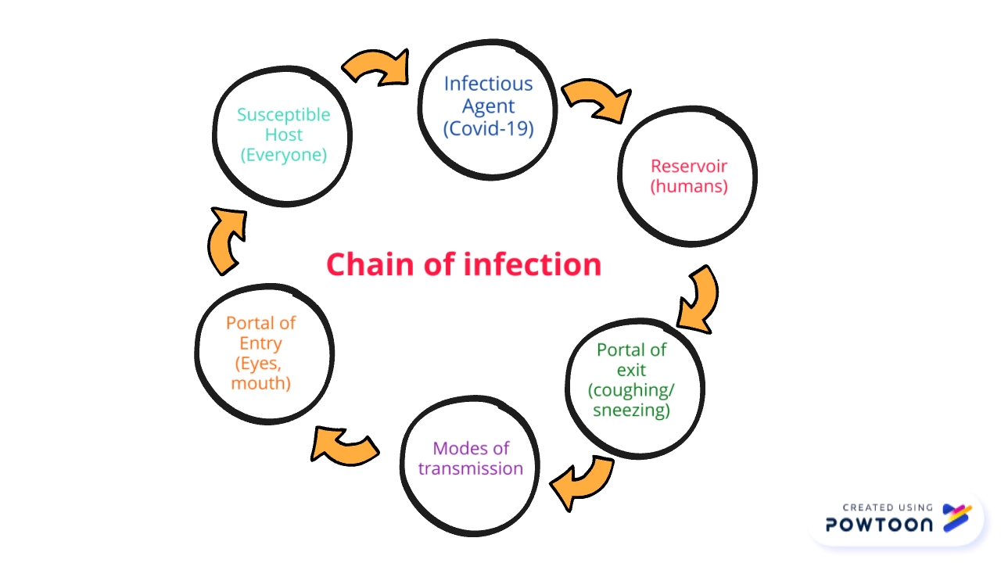

Slide 9
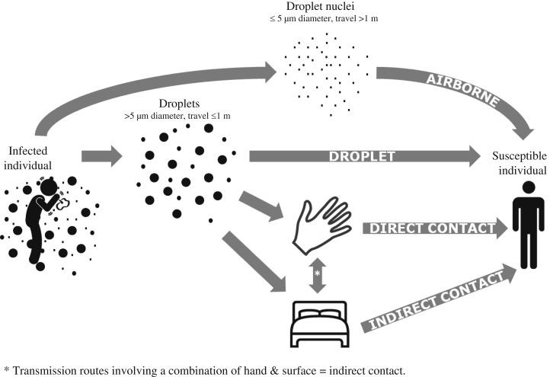
Droplet transmission routes
Notes:
Droplets < 5um can:
*enter the airways
•can reach deep lung
•may remain suspended in air
order of production of highest prevalence of large particles is
•coughing
•speaking
•breathing
•based upon ejection velocity
•speaking droplets can reach 2-10 m/s (<1m range)
•coughing 10-20 m/s (<2m range)

Slide 10
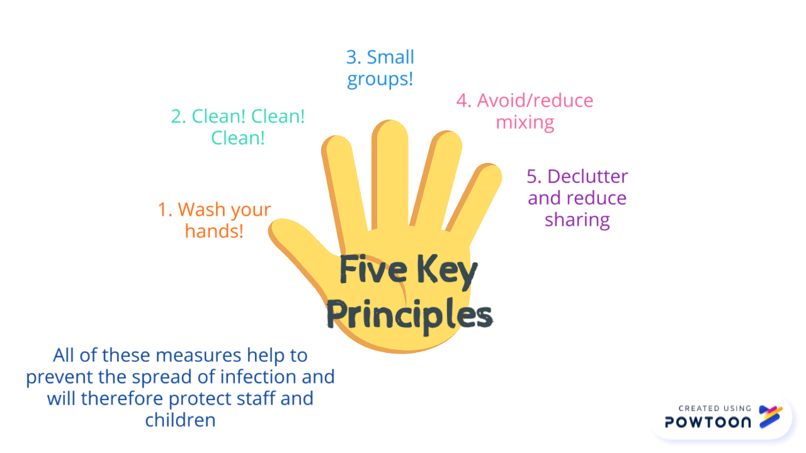

Slide 11
Principles
People with symptoms = possible case
Isolate- do not come to setting!
Get tested- NHS portal/ 119
People with a positive test = confirmed case
Isolate the case
Contacts isolate for 14 days
Incubation Period =
time between exposure to the virus and developing symptoms
= up to 14 days (most likely shorter)
Infectious period = from 48 hours prior to symptom onset (or date of swab) to 7 days after
Notes:
CONTACTS ISOLATE FOR 14 DAYS – whether they get a negative result or not.
POSSIBLE CASES- GET TESTED- IF TEST NEGATIVE AND THE CASE IS WELL- CAN RETURN TO SCHOOL AND HOUSEHOLD STOP ISOLATING
If case remains unwell and has symptoms of COVID need to assess the case/ situation= ?False negative test

Slide 12
A few definitions!
Case (possible vs confirmed case)
COVID-19 Case Definition: (as of 18/05/20)• A high temperature• A new, continuous cough•
A loss of, or change to, your sense of smell or taste
Contact
Direct close contacts: Face to face contact with a case for any length of time within 1m
eg being coughed on, a face to face conversation, unprotected physical contact (skin to skin)
This includes exposure within 1 metre for 1 minute or longer
For educational settings, children and staff within the class and or bubble will fall into this category
Proximity contacts: Extended close contact (within 2m for more than 15 minutes) with a case
Travelled in a small vehicle with a case
Household of CONTACTS do not need to isolate
Outbreak
2 or more CONFIRMED cases in the same group or class
Cluster
2 or more confirmed cases among students or staff in the same setting within 14 days
Notes:
Outbreak suggests spread of infection within the school
Cluster- more likely to be community spread
A case is defined as ……
An outbreak is defined as …….
Outbreak definition
“Two or more confirmed cases of COVID-19 among students or staff who are direct close contacts, proximity contacts or in the same cohort or ‘bubble’* in the school/college within 14 days”.
* a cohort or ‘bubble’ might be a class, year group or other defined group within the school/college. This definition aims to distinguish between transmission occurring in the community versus transmission occurring within the school/college setting.
Cluster definition
“Two or more confirmed cases of COVID-19 among students or staff in a school/college within 14 days”
or
“Increase in background rate of absence due to suspected or confirmed cases of COVID-19 (does not include absence rate due to individuals shielding or self-isolating as contacts of cases)”.
It’s really important to isolate suspected cases early
This helps to prevent the spread of infection within the school

Slide 13


PPE
Cleaners: gloves and aprons
Accompanying/ caring for suspected/ confirmed case: gloves, aprons, masks +/- eye protection
Risk assess need for eye protection: Splashes? Coughing? Vomiting? Spitting?
Safe removal of PPE and thorough handwashing after removal
Notes:
• As a minimum, disposable gloves and aprons should be worn during cleaning.
• Adults who accompany/ care for a suspected or confirmed child in isolation and coming within 2 m distance of the child should wear gloves, aprons and masks.
• .
• If a risk assessment of the setting indicates that a higher level of virus may be present (for example, where unwell individuals have slept such as a boarding school dormitory) or there is visible contamination with body fluids, then the need for additional PPE to protect the cleaner’s eyes, mouth and nose might be necessary. Eye, mouth and nose protection may be required when coming into close contact with a person who is vomiting/ coughing/ spitting. Again, these situations need to be risk assessed.
• The local Public Health England (PHE) Health Protection Team (HPT) can advise on risk assessing complex scenarios.
It is important that staff know how to safely remove PPE – videos explaining this can be found online
Really important for staff to thoroughly wash their hands after removal of PPE

Slide 14
Scenario 1- what would you do? …/1
A child becomes unwell whilst at the setting and is displaying COVID symptoms and their parents can’t collect them straight away
Isolate the child in a room behind closed doors until collected by parent/guardians/carers
Young people who can make their own way home can do so but should avoid using public transport or coming into contact with others
If isolation is not possible, they should be moved to an area at least 2 metres from other people
If adult needs to accompany to child and needs to come within 2m of the child they need to wear PPE- gloves, mask (FRSM), apron +/- eye protection
If child needs to go to the bathroom, this should be a separate bathroom and the bathroom should be cleaned thoroughly with standard cleaning products before being used by others cont’d….
Notes:
https://www.gov.uk/government/publications/coronavirus-covid-19-implementing-protective-measures-in-education-and-childcare-settings/coronavirus-covid-19-implementing-protective-measures-in-education-and-childcare-settings#personal-protective-equipment-ppe-including-face-coverings-and-face-masks

Slide 15
Scenario 1 cont’d… /2
What happens to the other children in the bubble?
  nothing at this point
What happens to the teacher in the bubble?
  nothing
What happens to the staff member who has assisted the child?
  nothing
  If the child’s test is then positive how will they find out?
parent will get a text message and an email
asked to complete an email questionnaire describing contacts and activities
when an educational setting is mentioned it will be flagged to PHE Health Protection Team who will contact the educational setting and the parent
What will happen if the child has a positive result?
follow guidance for a confirmed case CALL THE HPT ON 0300 303 8162

Slide 16
Scenario 2: An immediate family member (who lives in the same household) of a child who attends my setting, has a confirmed case of COVID.
The child and the household need to self isolate for 14 days and get tested if they develop symptoms
No action is needed by the setting unless family member has spent time in the setting

Slide 17



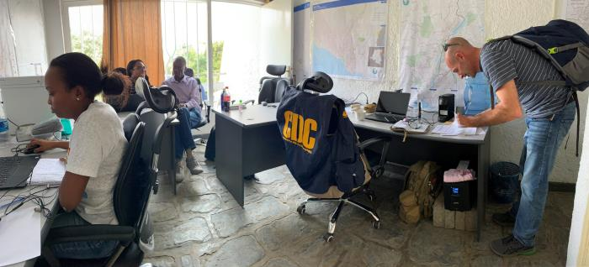
Contacts of contacts DO NOT need to isolate
Father of child confirmed with COVID-19
Whole household has to isolate (including children coming to your setting
People in setting have not had contact with the father
Other close contacts have to isolate
People who have been in contact with contact- do not isolate
Therefore they do NOT need to isolate
`
Notes:
Images from CDC PHIL

Slide 18
Scenario 3
A child who attends my setting has become unwell with COVID symptoms. The child travels to my setting on transport with pupils from the same setting who are all in different bubbles and members of the public.
This is a possible case
Isolate child and advise them to get tested
Household members need to isolate
Call PHE Health Protection Team to discuss communications and cleaning
Bubbles do no isolate unless the case is confirmed
Official contact tracing will not happen until the case tests positive

Slide 19
Scenario 4: A child who was at setting yesterday became unwell overnight with COVID symptoms
Scenario 5: A staff member has COVID symptoms while at setting
Possible cases
Test and isolate those with symptoms
Don’t need to send anyone else home to isolate unless they are part of the same household as the possible case
Call PHE Health Protection Team to discuss cleaning and any communications
Official contact tracing will not happen until the case is confirmed

Slide 20
Scenario 6
A child who attends after school club has tested positive – impact for all the bubbles of the other children who attend after school provision?
Key actions:
Call the HPT on 0300 303 8162
Identify and isolate of contacts
Test those with symptoms
Clean any ‘contaminated’ areas
Communicate with parents/ others

Slide 21

Communications and media handling
The process
Local authority comms to lead on local comms - will receive regular updates from PHE comms about cases and outbreaks in education settings.
LA comms will always involve setting staff in signing off any reactive statements they are working on (or the comms lead if a university or part of an academy) as well as PHE comms.
Dealing with media approaches
Settings do not need to speak to the media – please contact your LA comms team for support.
If you do take a call from a journalist, avoid giving away too much detail or mentioning numbers of staff / pupils affected as this risks disclosing patient-identifiable information.
If media persist in contacting you, either in person, via phone or email, then the best course of action is to look to the Police for support.
Academies
If academies have their own comms teams, please make sure to link up with the LA and PHE comms team before issuing any statements.

Slide 22
Clinically vulnerable groups
Pregnant members of staff
https://www.rcog.org.uk/globalassets/documents/guidelines/2020-04-27-occupational--health--advice--for--employers-and--pregnant-women.pdf
Extremely clinically vulnerable
https://www.gov.uk/government/publications/guidance-on-shielding-and-protecting-extremely-vulnerable-persons-from-covid-19/guidance-on-shielding-and-protecting-extremely-vulnerable-persons-from-covid-19
Clinically vulnerable
https://www.gov.uk/government/publications/coronavirus-covid-19-guidance-on-vulnerable-children-and-young-people/coronavirus-covid-19-guidance-on-vulnerable-children-and-young-people
https://www.gov.uk/government/publications/preparing-for-the-wider-opening-of-schools-from-1-june/planning-guide-for-primary-schools
Notes:
When we use the term vulnerable we are using this in a clinical sense rather than a safe guarding sense

Slide 23
Resources
NHS Resources and videos
Handwashing for teachers
Handwashing for children
Coronavirus factsheet for kids
eBug
https://e-bug.eu/
PHE webcasts for all professionals working in educational settings
Breaking the chain of infection

Slide 24
Any questions?
Please contact the health protection team:
swhpt@phe.gov.uk
Tel: 0300 303 8162

Slide 25
Extra information

Slide 26
Laundry
Use the warmest water setting and dry items completely. Dirty laundry that has been in contact with an unwell person can be washed with other people’s items.
Do not shake dirty laundry, this minimises the possibility of dispersing virus through the air.
Clean and disinfect anything used for transporting laundry with your usual products, in line with the cleaning guidance above.
People dealing with laundry from a suspected/ confirmed case should wear gloves and aprons when handling the laundry

Slide 27

Waste
Waste from people with symptoms of COVID-19, waste from cleaning of areas where they have been (including disposable cloths and tissues):
should be put in a plastic rubbish bag and tied when full
the plastic bag should then be placed in a second bin bag and tied
it should be put in a suitable and secure place and marked for
storage for 72 hours. Waste should be stored safely and securely
kept away from children
You should not put your waste in communal waste areas until the waste has
been stored for at least 72 hours. Storing for 72 hours saves unnecessary
waste movements and minimises the risk to waste operatives

