Slide 1
Life in the UK

Slide 2
Welcome
Today we will:
Explore life in the UK including British culture
Discuss education system
Discuss Housing in the UK
Explore the role of social services
Discuss positive parenting
Discuss health system

Slide 3
Housekeeping rules
- Confidential space
- Safe space
- Be respectful
- Non-judgemental
- Talk one at a time
- Phones on silent

Slide 4
Life in the UK
United Kingdom
Scotland
England
Wales
Northern Ireland
Population
68 million
Languages
English; Welsh; Scots Gaelic; Irish/Gaelic; Cornish
Religion
33.2 million Christianity
2.7 million Islam
Notes:
Emphasise freedom of religion in the UK

Slide 5
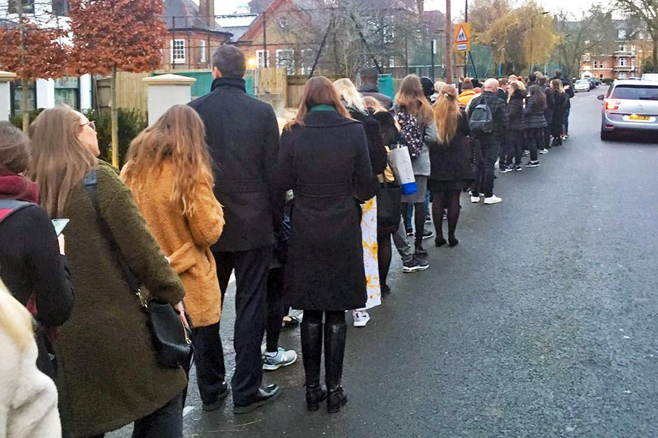
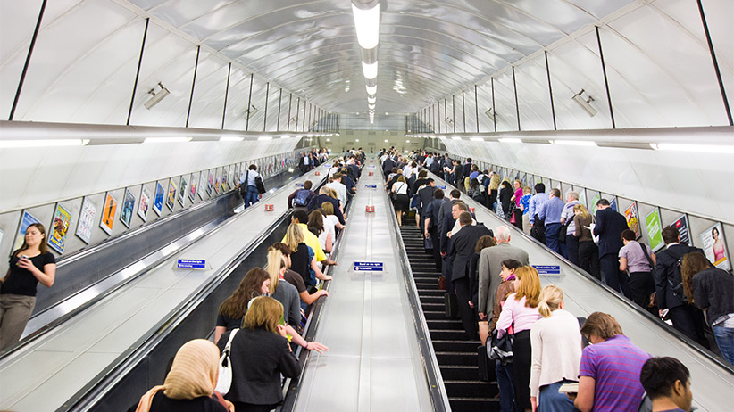
British Culture
Pubs
Tea
Pronunciation
Queuing
Escalator
Notes:
Queuing- In the UK there is really no excuse for jumping to the front of the queue. Even if you are in a hurry you should not cut in front of others as this is seen as incredibly rude.
Pub/Alcohol- It is a place to socialise, eat, drink, watch sport and take part in the great British pursuit that is called the “pub quiz”. Alcohol is a big part of the British culture.
Escalator- stand on the right when you step on an escalator. If you want to walk up or down, stick to the left.
Greetings- In Newcastle you’ll hear ‘alright pet’, ‘ey up duck’ is the standard greeting in Derby and ‘hiya’ in an informal greeting used throughout the country.
Tea- Tea is the “national” drink, in the UK they add milk to their tea.
Time keeping- It is very important that you’re always on time for work, appointment, meetings, school, etc. If you have an appointment and do not arrive on time you might have to reschedule it.
Some place name scan be tricky! Worcestershire- woo-stuh-sher; Marylebone- maa-luh-bn
Haggling- It’s not a common practice in the UK and can be considered rude.

Slide 6
Shopping
Notes:
Food shopping
Halal butchers can be easily found in the UK
Asian food stores available around the UK
Clothing and other items can be bought on hight street shops or online.

Slide 7
Transport
Public Transport
Bus
Train
Tram
You must always have a valid ticket when travelling on public transport otherwise you will be fined.
Notes:
In some areas like London buses do not accept cash must have an oyster or debit card.
Advance booking or online booking, i.e. First bus app, is an advantage, it allows you to find cheaper tickets for trains and buses.

Slide 9
Adult Education
In the UK you can find information online on how to apply for further education, apprenticeships, online courses, funding and volunteering opportunities.
England, The National Careers Service www.nationalcareers.service.gov.uk
Scotland, My World of Wok www.myworldofwork.co.uk/learn-and-train
Wales, Careers Wales www.careerswales.gov.wales
Northern Ireland, NI Direct www.nidirect.gov.uk/campaigns/careers
National Higher Education Courses
https://www.prospects.ac.uk/
Apprenticeships
https://www.gov.uk/topic/further-education-skills/apprenticeships
Free online courses
Skillshare; LinkedIn Learning; Coursera; EDX; Khan Academy; Udemy

Slide 10
Housing
Social housing
Council
Housing associations
Private renting
Local lettings agents
Property listings websites
Notes:
Housing in the UK
Shelter, a national charity, provide advice on your rights and entitlements
“Social Housing” is accommodation provided by the government for people who are facing homelessness, but many people in the UK rent privately from a landlord or own their houses.
The government can help to house families in some situations, for example if accommodation is overcrowded, or in a very poor condition, if you are at risk of violence or if you are at risk of homelessness. The Council oversee who can get a social house. They do a “homelessness assessment” and look at what they can offer. It may be a long wait to get long term housing. You may be put in a bed and breakfast or a hostel.
When looking at whether they can help you the Local Authority will ask for evidence to assess your needs such as:
- Evidence of your immigration status. This means they will want to know you have a visa or the right to be in the UK and under what conditions.
- Evidence of a ‘priority need. This means asking personal questions like whether anyone in the family is pregnant, has a disability, health condition or are at risk of violence, or are any of the family under 18 years old.
- Evidence that you are not homeless through any fault of your own. This could mean that you can show you didn’t choose to leave a home, or that you didn’t reject an offer of help that was made.
- Evidence of a ‘local connection’. This means that they want to know that they have responsibility for you. A local connection to that local authority usually means having lived there for a period of time, having family who live there or working there. Usually, on refugee family reunion, the area where families have a local connection is the area where the sponsor was living when they were granted refugee status. If you move to an area where you don’t have a local connection the local authority may not be able to help.

Slide 11
Employment
The UK has employment laws that protect employees and ensure minimum standards:
National Minimum Wage
Working hours' time regulation
Health and safety laws
Non-discrimination laws
Paid holiday, sick and maternity or paternity leave laws
Pension contribution laws
Notes:
Employment in the UK
The UK has employment laws that protect employees and ensure minimum standards:
National Minimum Wage, details the amount your employer must pay you as a minimum which varies according to your age
Working hours' time regulation states adults shouldn't work more than 40 hours a week for an employer unless you have specifically opted to do that in your contract
Health and safety laws and rules designed to keep employees safe.
Non-discrimination laws that say your employer cannot treat you differently because of a protected characteristic (age, race, sex, sexuality, religion, gender, disability etc)
Paid holiday, sick and maternity or paternity leave laws which outline the duration of, and amount of paid leave employees are entitled to in these circumstances
Pension contribution laws that require your employer to have pension arrangement in place

Slide 12
Social Services
Social services have a statutory obligation to safeguard and promote the welfare of children and adults at risk
Children social services
Adult social services
The person who needs help.
Vulnerable adults who have learning difficulties, physical or mental health problems, or addictions.
Who can refer:
Friends, family members and health professionals.
Any child who is at risk of abuse or harm.
Who can refer:
Family directly asks children social services for help
Police, teachers, health services.

Slide 13
Children social services
Harm
section 31(1) Children Act 1989 “(…) ill-treatment or the impairment of health or development (…) including, for example, impairment suffered from seeing or hearing the ill-treatment of another”
Harm can include seeing or hearing someone else being harmed or abused. This could be a child seeing or hearing domestic abuse in the home for example (see section 31(9) Children Act 1989).
Physical abuse
Emotional abuse
Sexual abuse
Neglect
Notes:
https://www.gov.uk/government/publications/working-together-to-safeguard-children--2
Physical abuse is when someone hurts a child or young person on purpose.
hitting, slapping, shaking or throwing
burning or scalding
drowning, suffocating or choking
pushing or kicking
inappropriate restraint or false imprisonment
using physical force to discipline
misusing medication
Sexual abuse is when a child is enticed or forced to take part in sexual activities. This kind of abuse does not always involve a high level of violence and the child may or may not be aware of what is happening. The abuse may be committed by adult men and women, or by other children.
causing or inciting a child to watch or engage in sexual activities
encouraging a child to behave in sexually inappropriate ways
involving a child in looking at sexual images or videos
involving a child in the production of sexual images or videos
grooming a child in preparation for abuse (including via the internet)
Emotional abuse happens in many different ways. It can affect how a young person or child feels about themselves, or how they fit in with friends, at school, or where they live.
being made to feel inadequate, worthless or unloved
being unfairly blamed
being bullied, including over the internet (cyber-bullying)
being made to feel frightened or in danger
witnessing the abuse of others such as domestic abuse
Neglect is when a child or young person’s basic needs are persistently not being met by their parent or guardian. These basic needs include:
adequate food, clothing and shelter
protection from physical and emotional harm or danger
adequate supervision (including not being left at home alone)
access to appropriate medical care including dental treatment

Slide 14
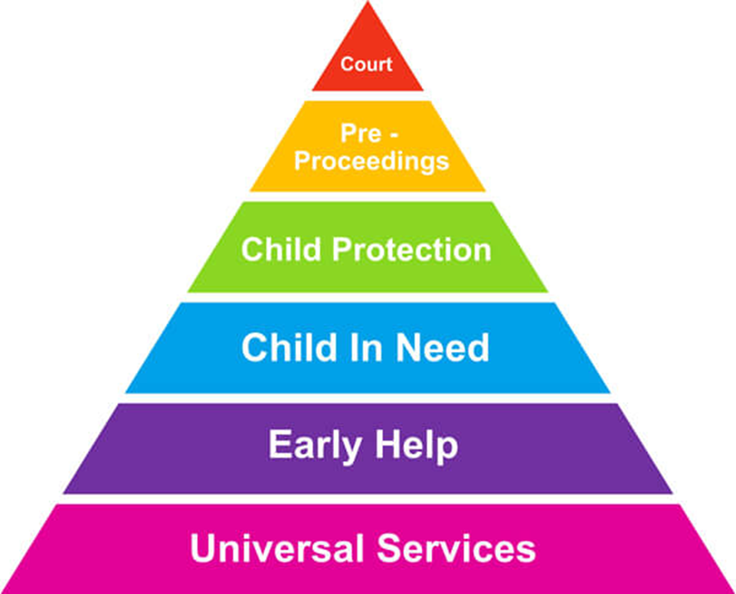
Children Social services
Child In Need s.17
Need local authority services to prevent significant or further harm to health or development
Disabled
Child Protection s.47
They suspect a child is suffering significant harm
They suspect a child is likely to suffer significant harm
A child is in police protection
Notes:
Universal services- Services that are available to everyone, health, education etc.
Early Help- Early help means providing support as soon as a problem emerges, at any point in a child's life, from the early years through to the teenage years. If this is unsuccessful referral is then made to the social services.
Child in need- Need local authority services to achieve or maintain a reasonable standard of health or development. What support parents might receive.
day care facilities for children under 5;
advice, guidance and counselling;
occupational, social, cultural and recreational activities;
assistance for the child and family to have a holiday;
family centres, where parents can receive family support and practical parenting advice, while children have a safe space to play;
financial assistance, which may be in the form of a loan, a cash payment, or payment in kind, for example, vouchers for a particular shop, or an item of food, clothing or furniture;
respite care (temporary relief care for the family, where the children are placed with a carer on a regular or one-off basis); and
accommodation.
Child Protection s.47 Children are identified as suffering or likely to suffer significant harm.
A full child protection plan should set out clear actions which aim to ensure the child will be kept safe and well. For example, that their parent or carer will engage with a specific course. Or that the child must be taken to appointments, for example with the GP
Only on very serious cases the court can only issue a care order if is satisfied that the child is suffering or likely to suffer significant harm, and the cause of the harm is because: of the care that the child is getting, or. the child is beyond parental control. Local authority will have parental responsibility for the child and will decide where the child should live.
https://frg.org.uk/get-help-and-advice/what/child-protection/child-protection-plans/

Slide 15
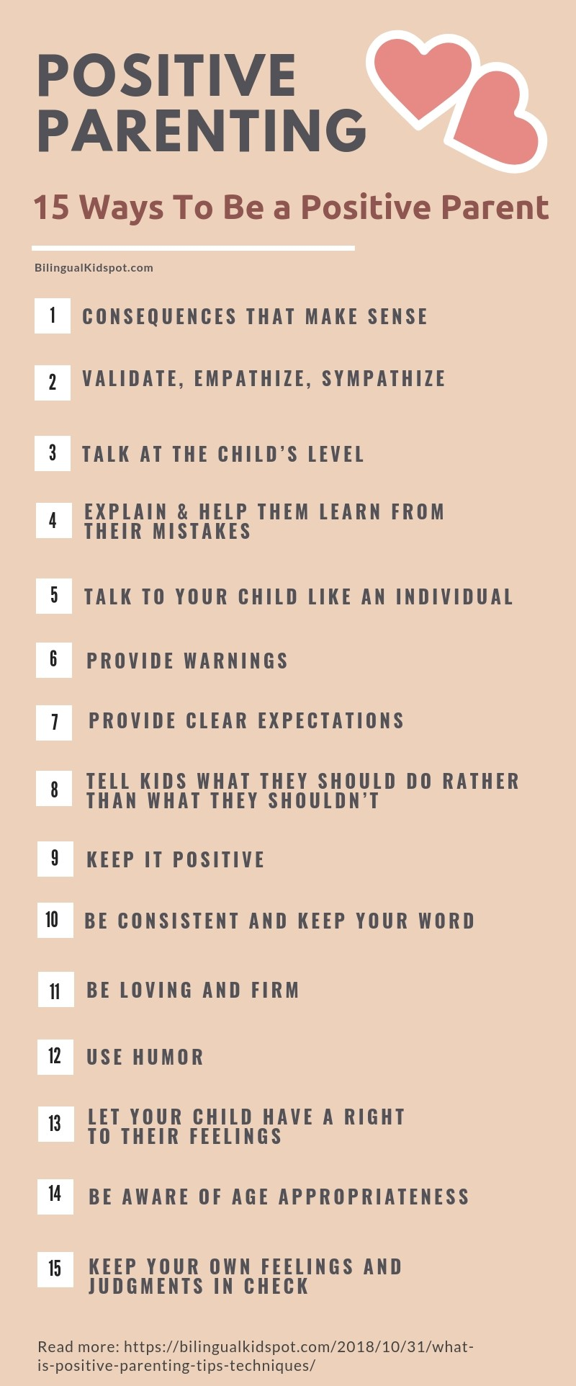
Positive Parenting
Notes:
Positive parenting approaches can vary slightly but the central thought is to emphasise positive interactions. You recognise, reward and reinforce positive behaviours and impulses. You aim to show empathy, and offer warmth and support. You also create an environment to make it easier for your child to behave cooperatively and constructively.
It is Illegal in Scotland to smack a child. It is unlawful for a parent or carer to smack their child, except where this amounts to ‘reasonable punishment’.
NSPCC website has several support guides for parents.
https://learning.nspcc.org.uk/research-resources/leaflets/positive-parenting
https://www.nspcc.org.uk/keeping-children-safe/support-for-parents/

Slide 16
Healthcare
Notes:
The UK has a government-sponsored universal healthcare system called the National Health Service (NHS). The NHS consists of a series of publicly funded healthcare systems in the UK. It includes the National Health Services (England), NHS Scotland, NHS Wales and Health and Social Care in Northern Ireland.
Primary care is often the first point of contact for people in need of healthcare, usually provided by professionals such as GPs, dentists and pharmacists. Secondary care, which is sometimes referred to as 'hospital and community care', can either be planned (elective) care such as a cataract operation, or urgent and emergency care such as treatment for a fracture.Tertiary care refers to highly specialised treatment such as neurosurgery, transplants and secure forensic mental health services.
GP- In the UK, family doctors are called General Practitioners “GPs”.// A GP is the first doctor you will see when accessing healthcare. // They work at GP surgeries and are a gateway service to other health services.// A GP provides general medical care and makes referrals on to other specialist medical services.//

Slide 17
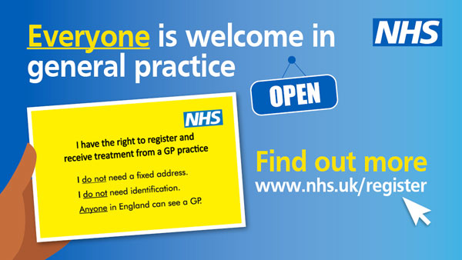
Registering with a GP
In the UK to receive medical treatment, you and any children you have must register with a GP as soon as possible, all parents must register their children with a GP.
To register the GP surgery may ask you for some identification documents and something to prove your UK address. However, you can register without them. You should not be asked about your immigration status.
Notes:
GP
To receive medical treatment, you and any children you have must register with a GP as soon as possible, even if you are not ill. In the UK all parents must register their children with a GP. To register the GP surgery may ask you for some identification documents and something to prove your UK address. However, you can register without them. You should not be asked about your immigration status. If you have problems registering with your GP, you can contact:
If your GP cannot give you an appointment and you need urgent help, you can try to go to a walk-in centre. This is for a problem that needs medical attention but isn’t life threatening such as minor burns, cuts, bites and ear infections.
Can a GP surgery refuse to register me?
A GP surgery can refuse to register you because:
they are not taking any new patients
you live outside the practice boundary and they are not accepting patients from out of their area
you have been removed from that GP surgery register before
it's a long way from your home and you need extra care, for example home visits
Changing GP surgeries
You can change your GP surgery if you need to.
This might be because:
- you have moved
- you have had problems with your current practice
- you were removed from the patient list
Once registered with a GP surgery, you may be able to access some health services online:
- contact your GP for advice and support
- order repeat prescriptions
- see parts of your health record, including information about medicines, vaccinations and test results
- see communications between your GP surgery and other services, such as hospitals
- book, check or cancel appointments with a GP, nurse or other healthcare professional
This can also be accessed on the NHS app.

Slide 18
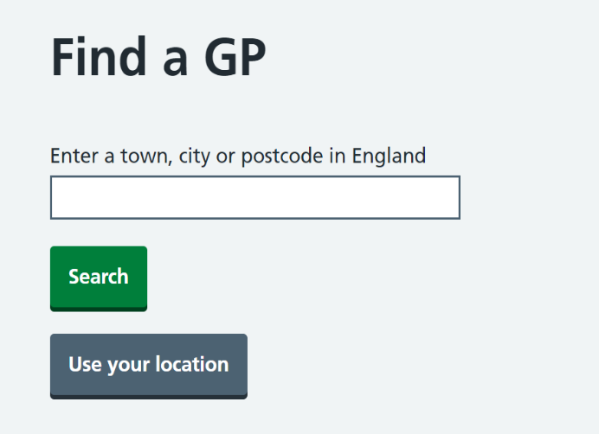
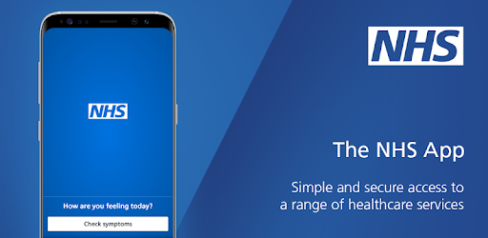
Online access to health services
The NHS website has a list of all GP surgeries in the UK.
You can use this to check reviews of the nearest GP surgeries to you.
Check the GP surgery website to see if you can register online.
Via your GP website or the NHS app you can also:
Order repeat prescriptions
Book GP appointments
Notes:
Online access to health services
Finding a GP: You will need to fill in a form to register with a GP. You can:
- check the GP surgery website to see if you can register online
- download a GMS1 registration form on GOV.UK
- pick up a registration form from the GP surgery. You can ask the GP surgery for help filling in the form if you need it.

Slide 19
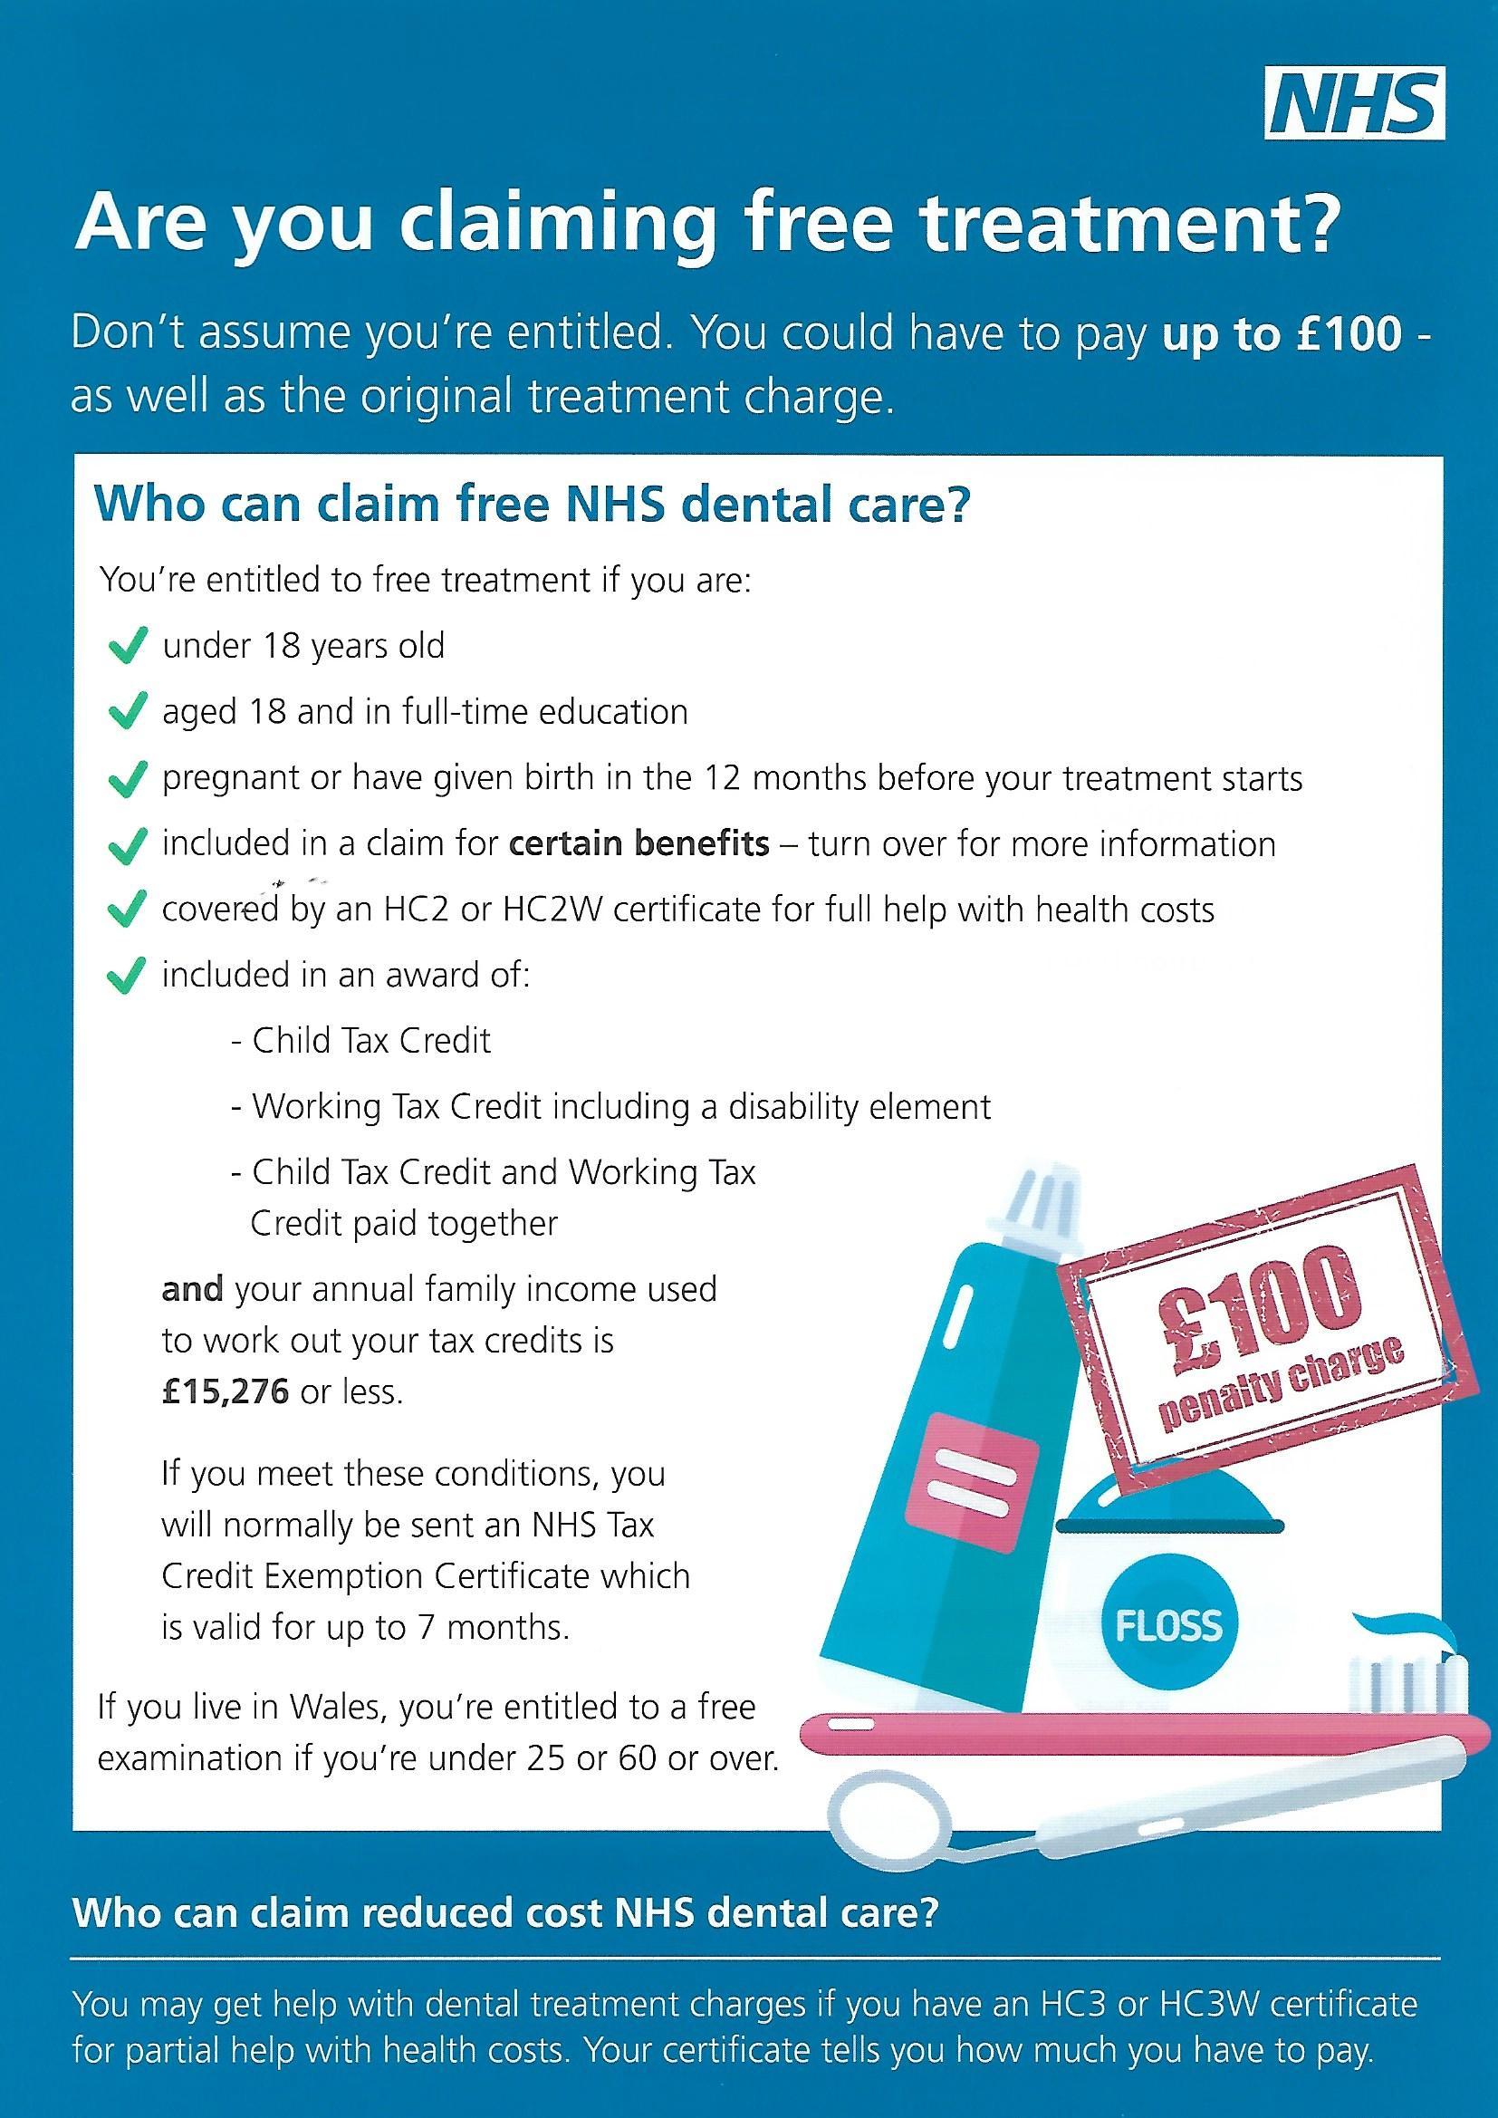
Dentist
How to register:
Find a NHS dentist near you
Fill in a registration form
Book an appointment you can request an interpreter if there’s language barriers
Dentists do not require proof of identity, proof of address or proof of immigration status from individuals applying to become an NHS patient.
Notes:
How do I register with a dentist? You can search for an NHS dentist near you on this site.
Dental surgeries will not always have the capacity to take on new NHS patients. You may have to join a waiting list, look for a different dentist who is taking on new NHS patients, or be seen privately.
Once you find a dental surgery, you may have to fill in a registration form at your first visit, which is just to add you to their patient database. But that does not mean you have guaranteed access to an NHS dental appointment in the future.
Go through the info on the picture, Who can claim free NHS treatment.
Exemption for pregnant women
Pregnant women and women who have had a baby in the last 12 months get free NHS dental treatment. You may have to show proof, such as a maternity exemption certificate (MatEx), a maternity certificate (MATB1), or your baby's birth certificate.

Slide 20
Where can I find online information about health services?
England | https://www.nhs.uk/ www.111.nhs.uk
Northern Ireland | http://online.hscni.net/
Scotland | https://www.nhsinform.scot/ www.nhs24.scot
Wales | www.111.wales.nhs.uk
Notes:
Where can I find online information about health services?
England
Northern Ireland
Scotland
Wales
Discussion: where do participants get information about health?
Do they know where to search for Multi-lingual resources?
What can these websites be used for:
Finding information about health services: registering with a GP, finding a dentist, finding the nearest clinic.
Information about health conditions
Sometimes to book appointments, order repeat prescriptions

Slide 21
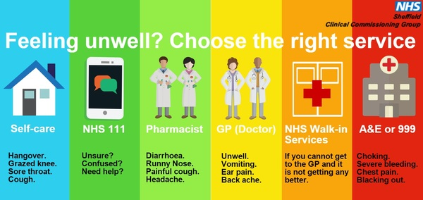
Emergency
Contact 111 for non-emergencies The service is available 24hrs a day, 7 days a week and operates across most of the UK using the same phone number.
Contact 999 emergency number if someone is seriously ill or injured, or their life is at risk.
You can also ask for an interpreter or translator if you need one.
Notes:
Online access to health services
Go through the image info.
If you have an urgent medical problem and do not know what to do, you can phone 111. (NOT NORTHERN IRELAND)
The service is available 24hrs a day, 7 days a week and operates across most of the UK using the same phone number. Calls to 111 are free from mobiles and landlines.
When calling, you will be asked to answer questions about your symptoms and depending on this assessment you will be connected to a nurse, emergency dentist, pharmacist or a GP who will then give you advice on what to do next.
You can also ask for an interpreter or translator if you need one.

Slide 22
What to expect in a health appointment
It doesn’t matter if I am a few minutes late for a GP appointment – they will see me because they have to, as I am unwell.
My GP can only see me for one matter at a time.
My elderly mother also has an issue she wants to see the doctor about; I can bring her to my appointment, and we can both be seen at the same time to avoid making two trips.
I should take someone with me who speaks English to my appointment.
I will always see the same Doctor.
Notes:
What to expect in a health appointment
It doesn’t matter if I am a few minutes late for a GP appointment – they will see me because they have to, as I am unwell.
My GP can only see me for one matter at a time.
My elderly mother also has an issue she wants to see the doctor about; I can bring her to my appointment, and we can both be seen at the same time to avoid making two trips.
I should take someone with me who speaks English to my appointment.
I will always see the same Doctor.
1. It doesn’t matter if I am a few minutes late for a GP appointment – they will see me because they have to as I am unwell.
No.
2. My GP can only see me for one matter at a time.
Allocated short time of usually only 10 minutes. May have to book double appointment if need to discuss multiple issues. Ask at time of booking if need to discuss multiple issues.
3. My elderly mother also has an issue she wants to see the doctor about; I can bring her to my appointment and we can both be seen at the same time to avoid making two trips
No – Its perfectly understandable that you may want to be practical particularly if it is difficult for you to arrange travel. If you are shy and want someone to support you with your appointment that is different (see the next question) but your doctor will not be able to help multiple people in one appointment. If you want moral support but would prefer this not to be a family member you can you can also ask for someone (called a chaperone) to come to appointments with you. This can be someone you know, or another professional, like a nurse or another doctor who are trained to provide moral support.
4. I should take someone with me who speaks English to my appointment
You can ask for an interpreter for medical appointments and request their gender for GP appointments. You can also request the gender of the medical professional you want to see. In most primary care services (like hospitals) NHS trust good practice says that a family member should not be allowed to interpret for you unless you can make it very clear independently that is what you want (this is to ensure that you are able to be entirely open with the doctors and aren’t embarrassed or afraid to say something that you don’t want your family member, friend or loved one to hear).
5. I will always see the same doctor.
Not always possible. Can ask for female/male if preferred. Some GP surgeries will assign the same doctor to see you each time, but this is becoming less common. If you feel that continuity of care is important to you, you can ask to access the same GP or Nurse again
How much will you be asked?
A health professional may ask you background questions about your health. All the answers will be confidential and the only reason they are asking is to diagnose your needs. Medical history can often be helpful for diagnosis, so a medical professional will likely need to take this in to account when they see you for the first time. If this is difficult for you to share, because of bad feelings or trauma, a letter can sometimes help provide some of this information so that you don’t have to.
- If you have any other specific requirements, such as mobility or disability access, you have the right to make these known to the clinic so that they can ensure they take this into account when arranging an appointment.
(https://www.youtube.com/watch?v=Oe9dzyCDtvc)

Slide 23
Concerns and worries
Many people will experience feelings of worry at some point in their life and others may experience signs such as:
Low mood
Problems sleeping
Stomach pain
Headaches
Feeling tired most of the time
Changes in appetite
Negative thoughts and feelings
Feeling pain without any known reason
“Jigar khoon”
“Fishar bala, fishar payeen”
Asabi
“Tashweesh”
Notes:
How afghan may describe mental health problems:
Tashweesh- Worry
Jigar Khoon- Heartbroken
Asabi- Description of extreme anger
Fishar bala, fishar payeen- in literal sense means high and low blood pressure bur afghans use this when hit Extreme emotions of anger and sadness
Explain that in the UK many people will experience feelings of worry at some point in their life and others may experience signs such as:
Low mood
Problems sleeping
Stomach pain
Headaches
Feeling tired most of the time
Changes in appetite
Negative thoughts and feelings
Feeling pain without any known reason
https://thriveldn.co.uk/wp-content/uploads/2021/11/Thrive-LDN-Afghan-wellbeing-brochure-singles.pdf

Slide 24
Concerns and worries
What you can do:
Connect with others
Be Physically active
Learn something new
Be kind
Pay attention to the present moment
Contact your GP
Notes:
Connect with others
It’s natural during difficult times to want to be alone with your worries, however staying connected with others is important as it can provide: - A chance to talk about your experiences and gain perspective on them - Affirmation of our identity and helps share compassion for our struggles - Emotional support and allow you to support others
Be Physically active
Being active reduces stress and helps us sleep better. If it is safe for you to get outside, then each day get some fresh air or take time to exercise by going for a walk or a run. If getting out and moving around is not easy or possible for you, keep moving about indoors as often or as much as you can.
It is not only great for your physical health and fitness, it can also: Reduce feelings of worry or stress; Help you to feel more positive; Lower your risk of long-term health conditions
Learn something new
Continued learning through life improves selfesteem and encourages social interaction and a more active life. Research also shows that learning new skills can improve your wellbeing by: – Boosting self-confidence and reducing low mood – Helping you to find a sense of purpose – Keeping your mind busy
Be kind
People who show a greater interest in helping others are more likely to rate themselves as happy. Acts of kindness, however small, can improve your wellbeing and happiness. You can do this by: – Asking friends, family or colleagues how they are – Being a good listener without interrupting is very supportive – Volunteering or participating in new activities in your local community
Pay attention to the present moment
Sometimes you may feel as though you have one foot here and one foot in your home country, and it can be difficult to connect to the present moment. It’s important to take a break from the things that may be distressing you, such as the news or social media.
In the Uk – access to mental health services is facilitated through your family doctor (GP) Mental health services are free on the NHS, but in some cases you'll need a referral from your GP to access them. Your GP will assess your circumstances and offer appropriate advice or treatment.
They can also refer you to a psychological therapy service or a specialist mental health service for further advice or treatment.
These services may be provided by your GP surgery, a large local health centre, a specialist mental health clinic or a hospital.
The treatment may be provided on a one-to-one basis or in a group with others with similar difficulties. Therapy can also sometimes involve partners and families.

Slide 25
Covid 19
Notes:
The main symptoms of coronavirus (COVID-19) are:
a high temperature – this means you feel hot to touch on your chest or back (you do not need to measure your temperature)
a new, continuous cough – this means coughing a lot for more than an hour, or 3 or more coughing episodes in 24 hours (if you usually have a cough, it may be worse than usual)
a loss or change to your sense of smell or taste – this means you've noticed you cannot smell or taste anything, or things smell or taste different to normal
Treating a high temperature
If you have a high temperature, it can help to:
get lots of rest
drink plenty of fluids (water is best) to avoid dehydration – drink enough so your pee is light yellow and clear
take paracetamol or ibuprofen if you feel uncomfortable
Is it safe to take ibuprofen if I have symptoms of COVID-19?
Treating a cough
If you have a cough, it's best to avoid lying on your back. Lie on your side or sit upright instead.
To help ease a cough, try having a teaspoon of honey. But do not give honey to babies under 12 months.
If this does not help, you could contact a pharmacist for advice about cough treatments.
How long you need to self-isolate
If you test positive, your self-isolation period includes the day your symptoms started (or the day you had the test, if you do not have symptoms) and the next 10 full days.
If you get symptoms while you're self-isolating, the 10 days restarts from the day after your symptoms started.
When to stop self-isolating
You can stop self-isolating after the 10 days if either:
you do not have any symptoms
you just have a cough or changes to your sense of smell or taste – these can last for weeks after the infection has gone
When to keep self-isolating
If you have a high temperature after the 10 days, or are feeling unwell, keep self-isolating and seek medical advice.

Slide 26
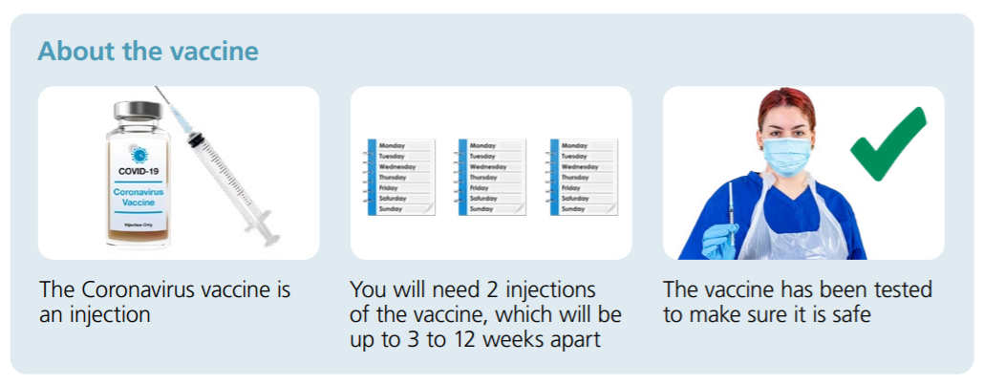
COVID-19 Vaccination
The coronavirus (COVID-19) vaccines are safe and effective, they give you the best protection against COVID-19.
.
Who can get a COVID-19 vaccine
People aged 18 and over can get a 1st and 2nd dose of a vaccine.
Most children and young people aged 12 to 17 are currently only being offered a 1st dose.
How to get your COVID-19 vaccine
If you're aged 16 or over you can:
book your COVID-19 vaccination appointments online for an appointment at a vaccination centre or pharmacy
find a walk-in COVID-19 vaccination site to get vaccinated without needing an appointment
wait to be contacted by your GP surgery and book your appointments with them
If you cannot book appointments online, you can call 119 free of charge. You can speak to a translator if you need to.
Notes:
The coronavirus (COVID-19) vaccines are safe and effective. They give you the best protection against COVID-19.
The COVID-19 vaccines currently approved for use in the UK are:
Moderna vaccine
Oxford/AstraZeneca vaccine
Pfizer/BioNTech vaccine
Janssen vaccine (available later this year)
Who can get a COVID-19 vaccine
People aged 18 and over can get a 1st and 2nd dose of a vaccine.
Most children and young people aged 12 to 17 are currently only being offered a 1st dose.
How to get your COVID-19 vaccine
If you're aged 16 or over you can:
book your COVID-19 vaccination appointments online for an appointment at a vaccination centre or pharmacy
find a walk-in COVID-19 vaccination site to get vaccinated without needing an appointment
wait to be contacted by your GP surgery and book your appointments with them
If you cannot book appointments online, you can call 119 free of charge. You can speak to a translator if you need to.
Children aged 12 to 15
Most children aged 12 to 15 can:
get their COVID-19 vaccine at school
book their COVID-19 vaccination appointment online for an appointment at a vaccination centre or pharmacy
check if there is a walk-in COVID-19 vaccination site near them to get vaccinated without needing an appointment
Not all walk-in vaccination sites can vaccinate children aged 12 to 15. More sites will become available over time.
Which vaccine will I get?
You cannot usually choose which vaccine you have. When you book, you'll only be offered appointments for vaccines that are suitable for you.
Most people can have any of the COVID-19 vaccines, but some people are only offered certain vaccines.
Side effects: Slight pain in the arm at the site of injection.
Tenderness in the arm which usually lasts 1-2 days.
Some people will experience tiredness, headaches, general aches and mild flu like symptoms.
Even if you have symptoms after the first dose you still need to have the second dose which will give you the best protection against the virus.

Slide 27
Signposting
Shelter
Housing advice
Citizen Advice Bureau
General advice, including employment, housing, law, etc.
National Health Service ( NHS)
General health advices and health services.
National Society for the Prevention of Cruelty to Children (NSPCC)
Children charity that provide help, advice and support.

Slide 28
Any Questions?

Slide 29
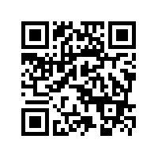
Feedback
https://feedback.redcross.org.uk/s/U7312S/

