Slide 1
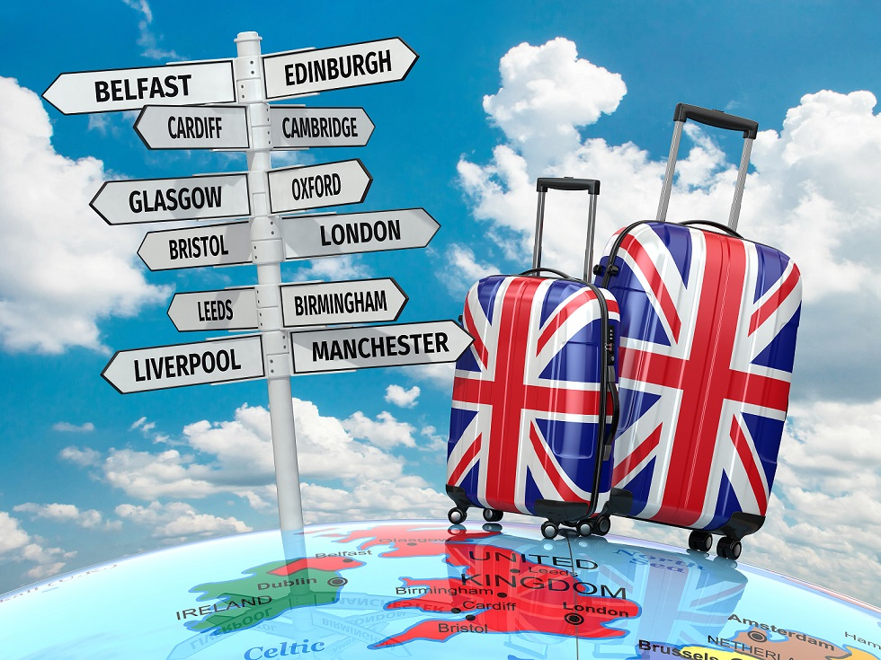
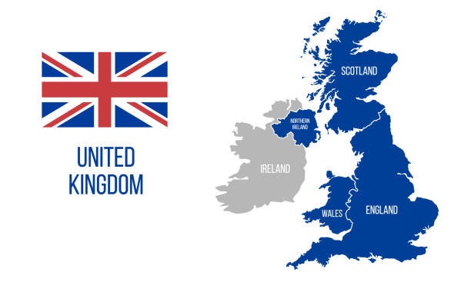
UK Life
Useful facts and information

Slide 2
UK weather
The UK is well known for the variability of its weather. Its position on the edge of the Atlantic Ocean with its relatively warm waters, yet close to the continental influences of mainland Europe, plays a major role in this. Changes in topography and land use over relatively short distances, together with a long coastline and numerous islands, all add to the variety of weather.
In general, places in the east and south of the UK tend to be drier, warmer, sunnier and less windy than those that are further west and north. Also, these favourable weather conditions usually occur more often in the spring and summer than in autumn and winter. But that is by no means the whole story, and there are climate descriptions on the Met Office website that illustrate the all-important regional and seasonal variations in more detail: UK regional climates Office https://www.metoffice.gov.uk/
Meteorological Seasons
spring runs from March 1 to May 31;
summer runs from June 1 to August 31;
fall (autumn) runs from September 1 to November 30; and.
winter runs from December 1 to February 28 (February 29 in a leap year).

Slide 3
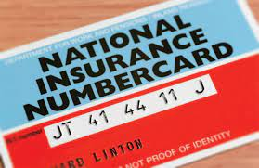
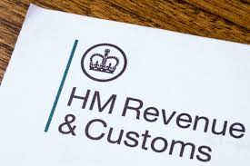

Slide 4
Local Government
In the UK, local government is responsible for a range of vital services for people and businesses in defined areas. Among them are well known functions such as social care, schools, housing and planning and waste collection, but also less well-known services such as licensing, business support, registrar services and pest control.
Local authorities receive funding from a range of sources, including Government grants, council tax and fees and charges. Council tax is set by each individual local authority each year, and the amount each household has to pay depends on the value of their house and their income. Some exemptions may apply; more information can be found at: https://www.gov.uk/council-tax
Councillors represent and work with local people and partners, such as local businesses and other organisations, to agree and deliver on local priorities. The decisions are implemented by permanent council staff and council officers. You can also contact your councillors if you have any local issues you feel that they can raise on your behalf: https://www.gov.uk/find-your-local-councillors
Further information on how to find your local council is available at: https://www.gov.uk/find-local-council

Slide 5
The Law in the UK
Respect for the law is very important in the UK and everyone must obey the law. If you break the law, there are consequences. You could receive a fine or you could go to prison.
The law applies to everyone in the UK. Cases are decided by judges in a court of law. In every case both sides are treated fairly. Every person can be represented by a lawyer.
There are two types of law in the UK:
• Civil Law, which settles disputes between people
• Criminal Law, which covers crime and punishment
Both govern what you can and cannot do in the UK.
Some specific laws vary between England, Wales, and Scotland
The police and their duties
The police exist to protect the public, their rights and the law. The police are there to help and assist you and you should not be afraid to approach them if you are the victim of a crime, see a crime happening, or for general assistance for example if you are lost.
If you need the police because of a crime, then you should call the following telephone numbers:
999 – This is the number to call if you have an emergency,
101 – This is the number to call for less urgent situations

Slide 6
Paying Tax in the UK
In the UK the Government (through Her Majesty’s Revenue and Customs (HMRC)) https://www.gov.uk/government/organisations/hm-revenue-customs collects tax on labour and assets. Central government revenues come primarily from income tax, National Insurance contributions, value added tax, corporation tax and fuel duty.
Foreign income of United Kingdom residents is taxed as United Kingdom income, but to prevent double taxation the United Kingdom has agreements with many countries to allow offset against United Kingdom tax what is deemed paid abroad. These deemed amounts paid abroad are not necessarily as much as actually paid.
Taxpayer's income is assessed for tax according to a prescribed order, with income from employment using up the personal allowance and being taxed first, followed by savings income (from interest or otherwise unearned) and then dividends.
You have a responsibility to pay the right amount of income tax. Income tax is a set percentage of your yearly income. If you are employed by someone else, it is often deducted directly from your monthly salary through a system called Pay As You Earn (PAYE). If you are not employed by a company or another person but earn an income, you have a responsibility to declare that income and pay the right amount of tax. The amount of tax you pay depends on how much you earn. You can check this at https://www.gov.uk/estimate-income-tax

Slide 7
National Insurance
Why do you need a National Insurance number ( NINo) ?
You have a National Insurance (NI) number to make sure your National Insurance contributions and tax are recorded against your name only. It’s made up of letters and numbers and never changes.
You can look for and start work without a National Insurance number if you can prove you can work in the UK. Employers are required to conduct mandatory Right to Work checks on all prospective employees. Having a National Insurance number is not part of these checks, and the possession of a National Insurance number does not prove that an individual has a right to work.
If you do not have a NI number you can find further information on how to obtain one at: https://www.gov.uk/apply-national-insurance- when making an application you will need to provide a copy of your passport and proof that you have the right to work. You will be advised of the documents you will need to provide when making your application.
Your National Insurance number will look like this : AB123456A

Slide 8
Universal Credit
What is Universal Credit?
Universal Credit is a new benefit for working age people that replaces a number of existing benefits and tax credits. It is designed to support people who have a low (or no) income with their basic living expenses and housing costs.
The amount you can get depends on your circumstances and how much other income you have. You can continue to get Universal Credit if you are in work but have low earnings. For more information see our guide to how Universal Credit is worked out.
Universal Credit is also different because it is administered by one benefit department the DWP( Department of work and Pensions )
When you start a claim your first payment should be made after five weeks.
How earnings affect your Universal credit benefit https://www.gov.uk/universal-credit/how-your-earnings-affect-your-payments
Advice on what might affect your Universal credit is available from https://www.citizensadvice.org.uk/

Slide 9
Job Centre Plus
Jobcentre Plus is a government-funded employment agency and social security office that can be found in most cities, whose aim it is to help people of working age find employment in the UK. It is a part of the Department for Work and Pensions (DWP).
Jobcentre Plus provides resources to enable job-searchers to find work, through Jobpoints (touch-screen computer terminals), Jobseeker Direct (telephone service) and the Jobcentre Plus website. They offer information about training opportunities for the chronically unemployed. They administer claims for Universal Credit benefits
https://www.gov.uk/find-a-job

Slide 10
Healthcare during pregnancy
Maternity care and services
Maternity services cover care from the beginning of pregnancy through to sign off by a midwife: this is usually around 10 days after the birth but can be up to 6 weeks postnatally. Midwives ensure that personalised care is provided throughout pregnancy, childbirth and the postnatal period. Much of this care will be provided directly by midwives, who will also coordinate the provision of obstetric or other medical involvement if necessary.
Anyone settling in the UK should contact a GP or midwife as soon as you find out you're pregnant. It's important to see a midwife or GP as early as possible to get the pregnancy (antenatal) care and information you need to have a healthy pregnancy. Information on all you need to know about pregnancy, labour, birth and NHS maternity services can be found at: Pregnancy - NHS (www.nhs.uk).

Slide 11
Child Benefit
Child Benefit if you move to the UK
Everyone needs to meet the eligibility rules to claim Child Benefit. If you’re moving to the UK from abroad you also need to prove that you:
have the right to reside in the UK
live in the UK as your main home - except for short periods, like holidays
In most cases, your child must live with you.
How it works
You get Child Benefit if you’re responsible for bringing up a child who is:
under 16
under 20 if they stay in approved education or training
Only one person can get Child Benefit for a child.
It’s paid every 4 weeks and there’s no limit to how many children you can claim for.
Eligibility
Only one person can get Child Benefit for a child.
You normally qualify for Child Benefit if you’re responsible for a child under 16 (or under 20 if they stay in approved education or training) and you live in the UK.
You’ll usually be responsible for a child if you live with them or you’re paying at least the same amount as Child Benefit (or the equivalent in kind) towards looking after them, for example on food, clothes or pocket money.
Eligibility rules are different if your child:
goes into hospital or care
lives with someone else
Child Benefit continues for 20 weeks if 16 or 17 year olds leave education or training and register with the armed services or a government-sponsored careers service.

Slide 12
Public Transport
There is an extensive train and bus network across the UK. To use public transport, you usually have to buy a ticket before travelling. For national trains or buses, tickets are usually much cheaper if bought in advance. You can find out more information on the national rail website: www.nationalrail.co.uk
You don’t need to show identification to travel between England, Scotland or Wales unless you are travelling by plane.
Many towns and cities have a good local bus service and some major cities also have a tram service .
There is also an extensive coach service network across the UK . https://www.nationalexpress.com/en

