Slide 1
Digital Safety and Protection

Slide 2
Welcome
Today we will :
Look at digital safety and discuss how you can try and stay safe online
Discuss fraud in the UK
Understand the different types of law in the UK ​
Discuss how to report a crime
Discuss hate crime, discrimination and anti-social behaviour

Slide 4
Digital Safety
The Internet is used to find information, communicate with people around the world, manage your finances, shop from home, listen to music, watch videos, etc.
It is very important to be safe when using the internet. Digital safety is protecting ourselves, our families and others as we connect through digital devices.
Notes:
Ask questions on digital safety.
Do you know what digital safety is? How do you keep safe online?
Do you use internet often in Afghanistan?
Explain that in the UK many services are online, from internet banking, booking appointments, shopping, etc. Therefore, very important to keep safe.

Slide 5
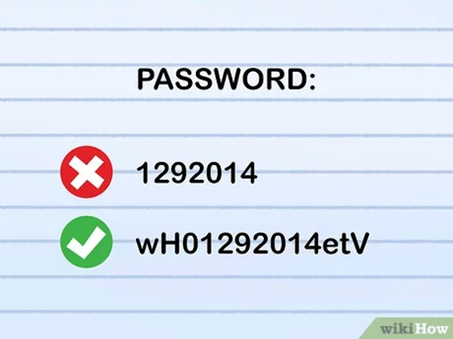
Digital Safety
Strong password
Make your passwords difficult, so that this cannot easily be guessed by other people.
Change passwords regularly
Don’t use the same password for every account
Set up security questions in case you forget your password
Protect devices from viruses
Install anti-virus software. Computers, phones and other devices can get viruses which can cause a lot of damage.
Safe sites
Check for a padlock symbol and/or https to show whether a website is secure.
Do not click on Pop-ups

Slide 6
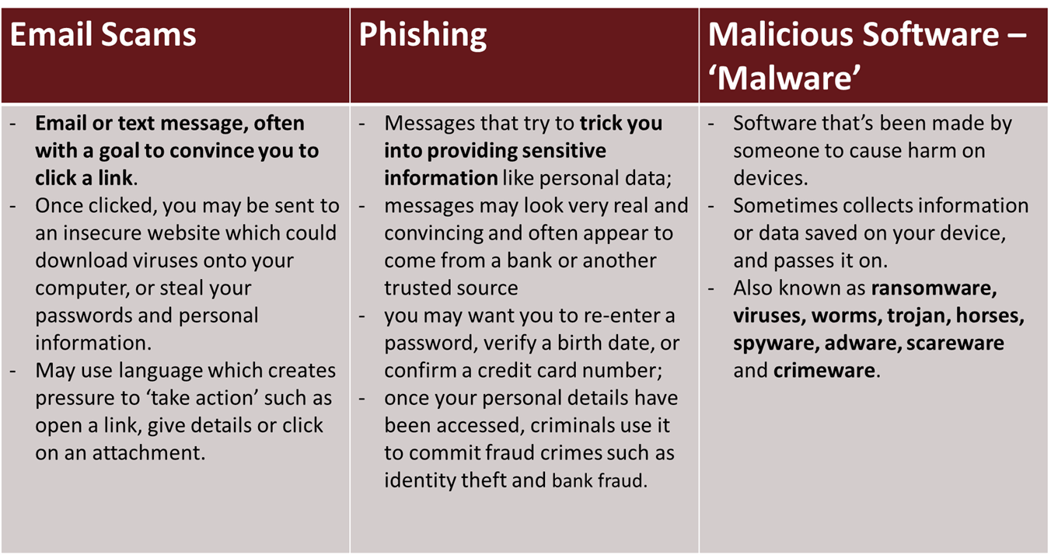
Online threats

Slide 7
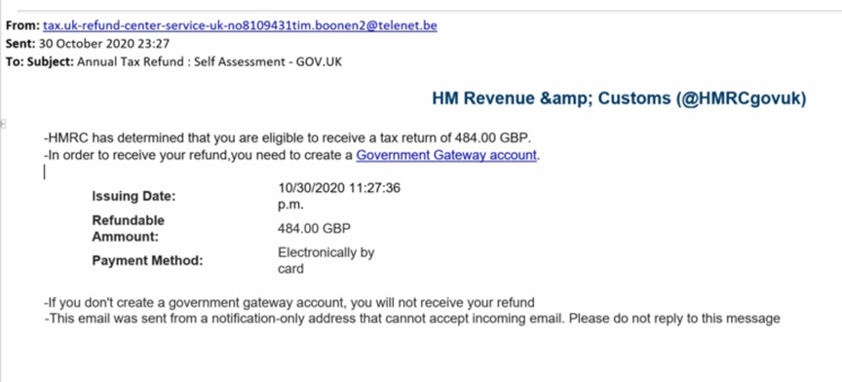
Online threats

Slide 9
Fraud
The crime of using dishonest methods to take something valuable from another person.
Romance Fraud
Phishing
HMRC scam
Home Office scam
Car Crash Scam
Remember:
Don't reveal personal details
Hang up
Ring the organisation
Don't be rushed
Notes:
Romance fraud
This happens when you start to develop what you believe is a genuine relationship with someone, only to discover later that they were only interested in your money. Often romance fraud takes many months, with the victim slowly being groomed by their supposed new partner. The scammer will gradually start to request money, often starting with small sums and then requesting larger sums as time goes on.
Phishing
Occurs when someone tries to get hold of your personal information by sending out e-mails usually containing a link to a bogus website. Any information you submit via these websites can then be used by fraudsters.
HMRC
May involve emails, text, whatsapp texts offering a tax refund.
Automated phone call scam which will tell you HMRC is filing a lawsuit against you, and to press 1 to speak to a caseworker to make a payment. https://www.gov.uk/government/publications/phishing-and-bogus-emails-hm-revenue-and-customs-examples/phishing-emails-and-bogus-contact-hm-revenue-and-customs-examples
Home Office
They may go to your home to ask for money to process your partner’s visa. Legitimate visa officers will only meet you at their offices and will never contact you to ask for money in person or by email or phone.
Phone call threatening deportation and demanding payments
Car crash phone scam- You will receive a call where they will mention that you’ve been involved in a car accident.
https://www.gov.uk/government/publications/frauds-tricks-and-scams/fraud-tricks-and-scams
Don't reveal personal details. Never give out personal or financial information (such as your bank account details or your PIN) over the phone, even if the caller claims to be from your bank.
Hang up. If you feel harassed or intimidated, or if the caller talks over you without giving you a chance to speak, end the call. It may feel rude to hang up on someone, but you have the right not to be pressurised into anything.
Ring the organisation. If you're unsure whether the caller is genuine, you can always ring the company or bank they claim to be from. Make sure you find the number yourself and don’t use the one provided by the caller.
Don't be rushed. Scammers will try to rush you into providing your personal details. They may say they have time-limited offer or claim your bank account is at risk if you don't give them the information they need right away.

Slide 10
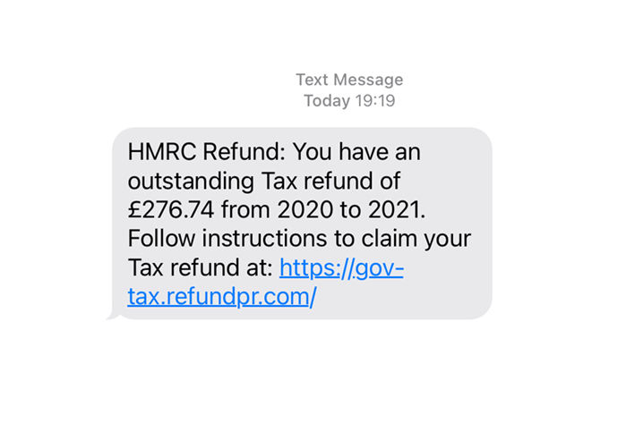
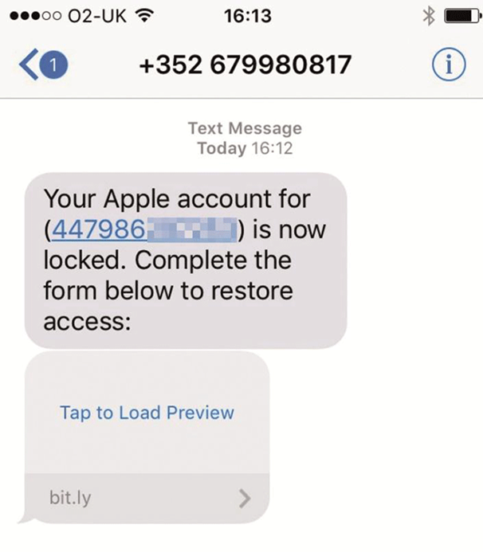
Fraud

Slide 11
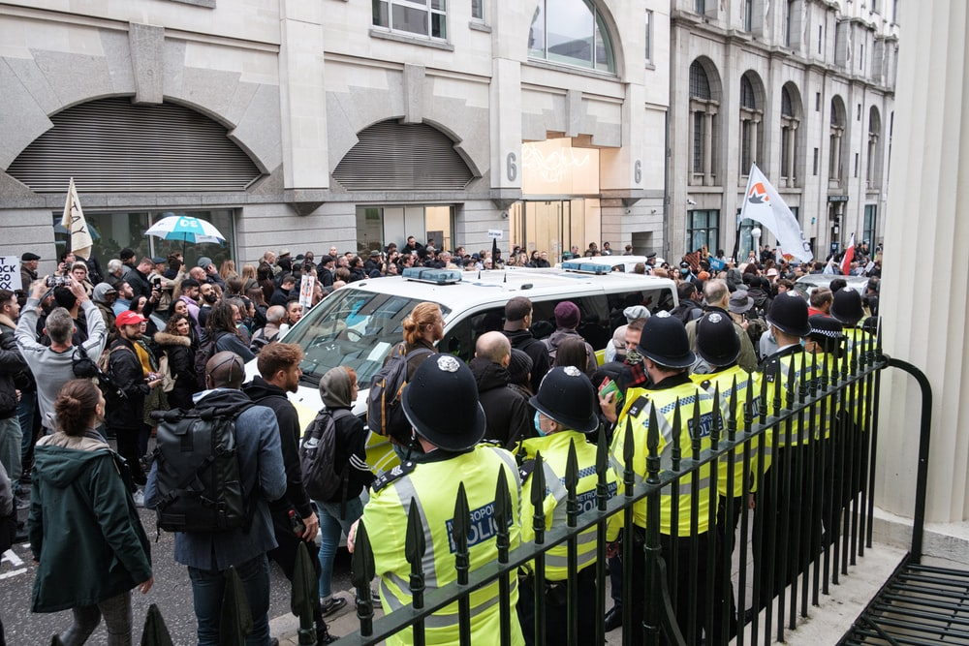
Physical Safety
and UK laws

Slide 12
Types of law in the UK
Civil Law | Criminal Law
Private matters between individuals or individuals and public bodies | Public wrongs, punish individuals that commit crimes
Claimant (Individual) initiates legal action | Police and Crown Prosecution Service initiate legal action
Compensation | Custodial sentence, fine, community service
Road traffic accidents, medical and clinical negligence Breach of contract Debt and Housing An employee suffers discrimination Divorce, dissolution of civil partnerships, children’s issues, childcare arrangement and Domestic violence | Burglary, theft, arson and criminal damage Murder, Assault, sexual assault and battery Harassment and controlling behaviour Forced marriage, Female Genital Mutilation; Human Trafficking Fraud, money laundering and Drug dealing
Notes:
Criminal law essentially relates to offences and breaches that negatively affect society as a whole, rather than just one person.
Civil law is quite different from criminal law. It’s concerned with the rights and property of individual people or organisations, which may not always be protected by criminal laws.
Civil law settles disputes between individuals and organisations, and it often involves compensation being awarded. No one is sent to prison in a civil case.

Slide 13
Sexual Violence
Sexual violence is a term we use to describe any sexual activity or act that happened without consent. There are a range of crimes that can be considered as sexual offences, including non-consensual crimes such as rape or sexual assault, crimes against children including child sexual abuse or grooming, and crimes that exploit others for a sexual purpose, whether in person or online.
The legal definition of consent is that someone agrees to sexual activity by choice, and also that they have the freedom and capacity to make that choice.
Freedom to make that choice means they not been forced, manipulated, threatened or pressured into sexual activity.
- Capacity means they are not drunk, asleep, drugged or unconscious.
Notes:
Law Sexual Offences Act 2003, Section 74.
If someone knows or suspects you do not give consent, the law says they must stop.
Sexual violence is any sexual activity that takes place without someone’s consent. If someone consents to sex, it means they agree by choice, and also that they have the freedom and capacity to make that choice..
Child sexual abuse
When an adult or older child scares, manipulates, tricks or forces a child into taking part in sexual activity. This can include contact activity (e.g. rape, masturbation, kissing and touching), as well as non-contact activity (e.g. explicit sexual talk or showing pornography to children). It often involves a process known as ‘grooming’.
Rape
This is defined in English and Welsh law as the intentional penetration with a penis of another person's vagina, anus or mouth without their consent. It is also rape if someone removes a condom without the other person’s consent during sex – what is commonly known as ‘stealthing’. Marital rape is illegal in the UK.
Sexual assault
This is defined in English and Welsh law as sexual touching of another person without their consent, with any part of the body or with anything else. This includes unwanted kissing or touching, or being forced to perform sexual acts. It could also include the touching of someone’s clothing.
In law, penetration of another person’s vagina or anus with any part of the body other than the penis, or with any object, without their consent is defined as ‘assault by penetration’. This crime carries the same sentence as rape.
Sexual harassment
Any unwanted behaviour of a sexual nature that makes a person feel upset, scared or ashamed. It can take lots of different forms. For example, a person’s body being stared at or being sent messages with sexual content

Slide 14
Female Genital Mutilation
Female genital mutilation (FGM) is a procedure where the female genitals are deliberately cut, injured or changed, but there's no medical reason for this to be done.
It's illegal in the UK:
Perform FGM
Assist a girl to carry out FGM on herself
Assist (from England or Wales) a non-UK person to carry out FGM outside the UK on a UK national or UK resident
A person guilty of an offence can be sentenced to up to 14 years in prison.
Notes:
In England, Wales and Northern Ireland, civil and criminal legislation on FGM is contained in the Female Genital Mutilation Act 2003 (“the 2003 Act”). In Scotland, FGM legislation is contained in the Prohibition of Female Genital Mutilation (Scotland) Act 2005.
FGM is a form of child abuse
Effects of FGM
There are no health benefits to FGM and it can cause serious harm, including:
constant pain
pain and difficulty having sex
repeated infections, which can lead to infertility
bleeding, cysts and abscesses
problems peeing or holding pee in (incontinence)
depression, flashbacks and self-harm
problems during labour and childbirth, which can be life threatening for mother and baby
Some girls die from blood loss or infection as a direct result of the procedure.

Slide 15
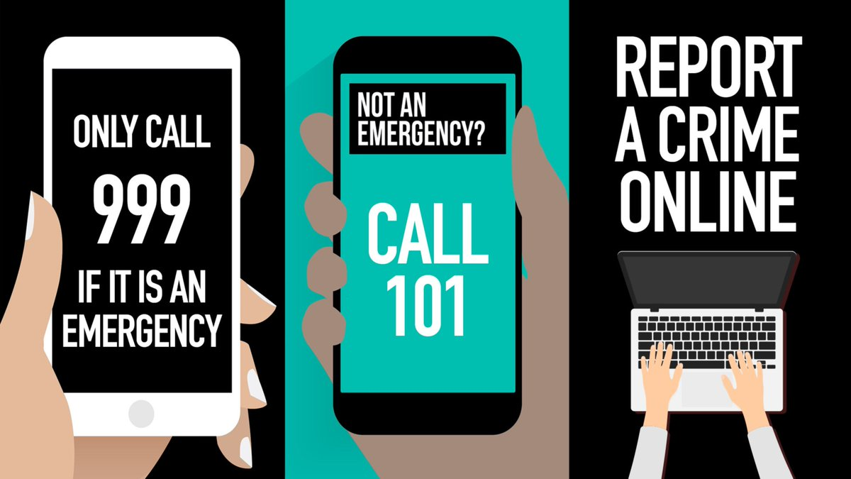
Hate Crime
"Any criminal offence which is perceived by the victim or any other person, to be motivated by hostility or prejudice, based on a person's disability or perceived disability; race or perceived race; or religion or perceived religion; or sexual orientation or perceived sexual orientation or transgender identity or perceived transgender identity.“
Notes:
Discuss types of behaviour that can be seen as hate crime:
threatening behaviour Threatening behaviour is intentional behaviour which would cause a person to feel fear of injury or harm
Assault (make a physical attack on)
robbery
damage to property
inciting others to commit hate crimes
Harassment (Harassment is unwanted behaviour which you find offensive or which makes you feel intimidated or humiliated.)
online abuse
Reporting a crime to police
Call 999 if you’re reporting a crime that’s in progress or if someone is in immediate danger.
If the crime isn’t an emergency, call 101 or contact your local police.
You can also call 101 to give information to the police or make an enquiry.
Note: Online reporting does not work nationally, therefore, advise to contact the police instead.

Slide 16
Discrimination
It is against the law to discriminate against anyone because of a protected characteristic
What you can do:
Complain directly to the person or organisation
Use someone else to help you sort it out (called ‘mediation’ or ‘alternative dispute resolution’)
Make a claim in a court or tribunal
Notes:
Discrimination is the unfair or prejudicial treatment of people and groups based on characteristics such as race, gender, age or sexual orientation.

Slide 17
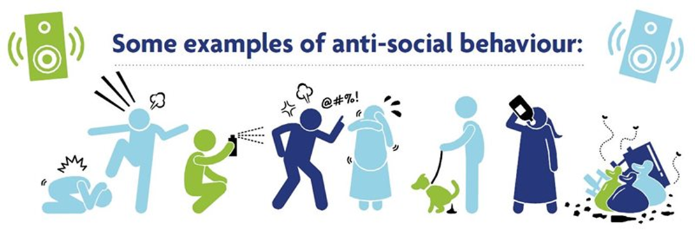
Anti-social behaviour
“(…) acting in a manner that caused, or was likely to cause, harassment, alarm or distress to any persons.”
Notes:
Question: What do you know about anti-social behaviour?
Talk about anti-social behaviour examples.
noise
shouting, swearing and fighting
intimidation of neighbours and others through threats or actual violence
harassment, including racial harassment or sectarian aggression. More about harassment
verbal abuse
bullying of children in public recreation grounds, on the way to school or even on school grounds, if normal school disciplinary procedures do not stop the behaviour
abusive behaviour aimed at causing distress or fear to certain people, for example, elderly or disabled people
driving in an inconsiderate or careless way, for example, drivers congregating in an area for racing
dumping rubbish
animal nuisance, including dog fouling
vandalism, property damage and graffiti
https://www.citizensadvice.org.uk/scotland/housing/problems-where-you-live-s/antisocial-behaviour-s/
https://www.westyorkshire.police.uk/form/report-anti-social-behaviour

Slide 18
Anti-social behaviour
What you can do:
Ask landlord to take action
Report it to the local council
Report it to the Police
Mediation
If you experience antisocial behaviour, you may have to help provide evidence before action can be taken, e.g. keeping a diary of things that happen. You might be asked to have recording equipment in your property for noise nuisance.
Notes:
What you do will depend on the type of behaviour you are complaining about and on the result you want.
You might want:
the antisocial behaviour to stop
compensation for any damage, loss or injury suffered
an apology
to be rehoused elsewhere
the people responsible for the behaviour to be moved or evicted.
https://www.citizensadvice.org.uk/scotland/housing/problems-where-you-live-s/antisocial-behaviour-s/

Slide 19
Exploitation
When a person benefits by forcing someone else to do things he or she does not want, or under bad circumstances.
The person may see no other option than to accept the situation. The force can be subtle, like deception, threats or a debt which needs to be repaid.
People do not always see themselves as a victim of exploitation, or do not know that they can access support. This is okay and there may be many reasons for why this is difficult. The official term for this is ‘human trafficking’.
This also occurs in the UK and it can happen to literally anyone: men, women and children.
Sometimes a person has agreed to something, but the conditions and promises might change over time.
The Red Cross can talk to people more about the process and what support is available.
FLEX Labour Exploitation Video

Slide 20
Signposting
Citizen Advice Bureau (CAB)
General advice, including employment, housing, law, etc.
Greater London Authority
Information about employment rights
CAB rights at work
Information about worker’s rights.
National Health Service ( NHS)
General health advices and health services.
The National Cyber Security CentreThe National Cyber Security Centre
General information about cybersecurity.

Slide 21
Any Questions?

Slide 22
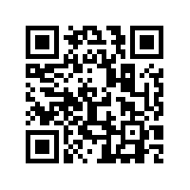
Feedback
https://feedback.redcross.org.uk/s/IJD2EY/

