Slide 1
Knowledge Hub Walkthrough
August 2013
https://knowledgehub.local.gov.uk

Slide 2
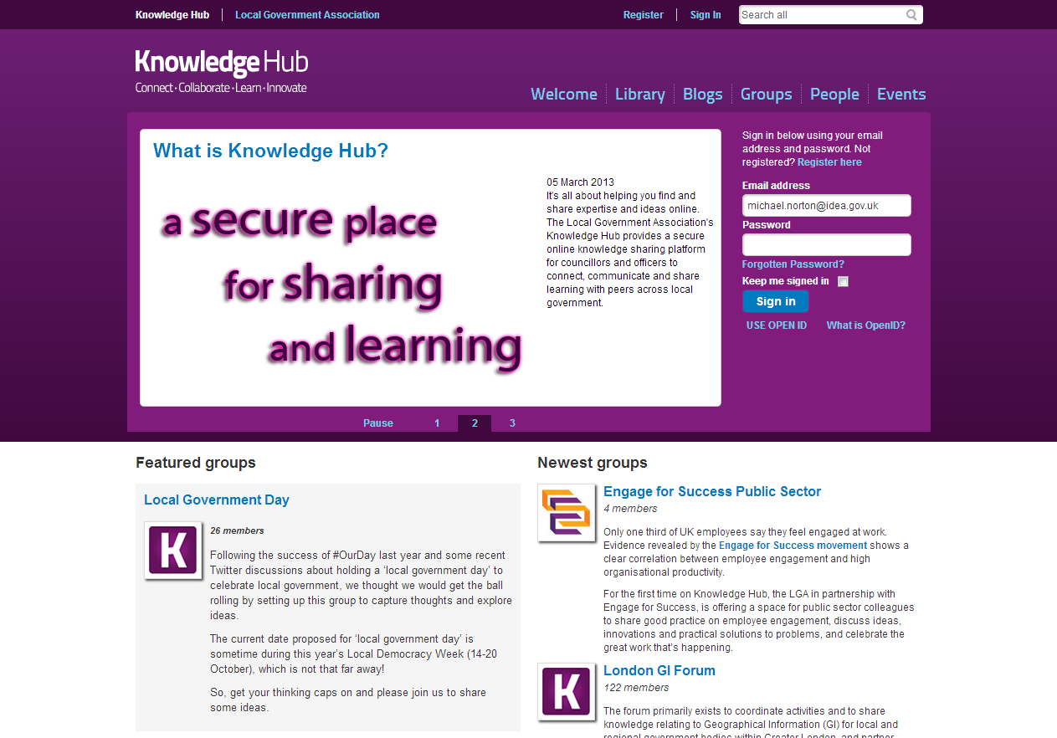
Welcome Page
Featured Groups
Let us know and we can promote your group on the Welcome Page
Newest Groups
Shows the open and restricted groups on the Knowledge Hub

Slide 3
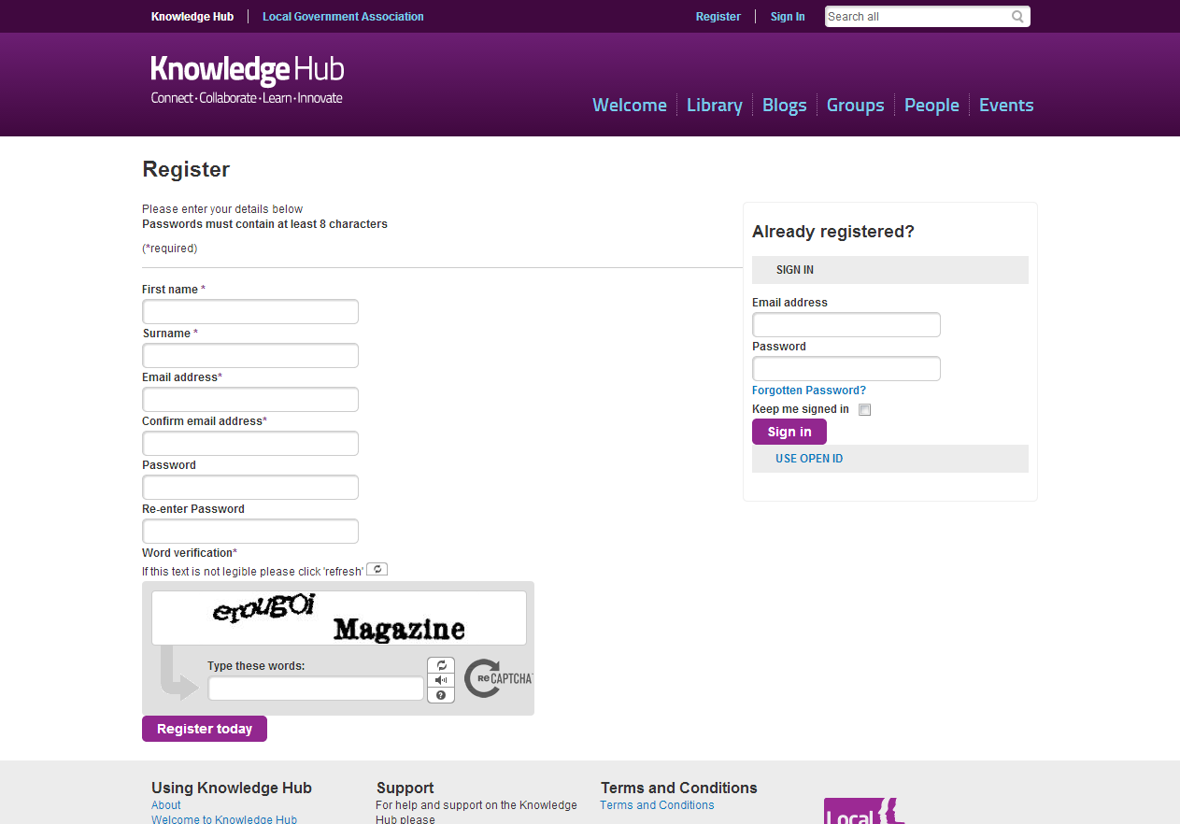
Register
Register
Are you new to the LGA Websites, then please register a new account
Already registered
Use your LGA account or CoP account to sign in or you can use Open ID

Slide 4
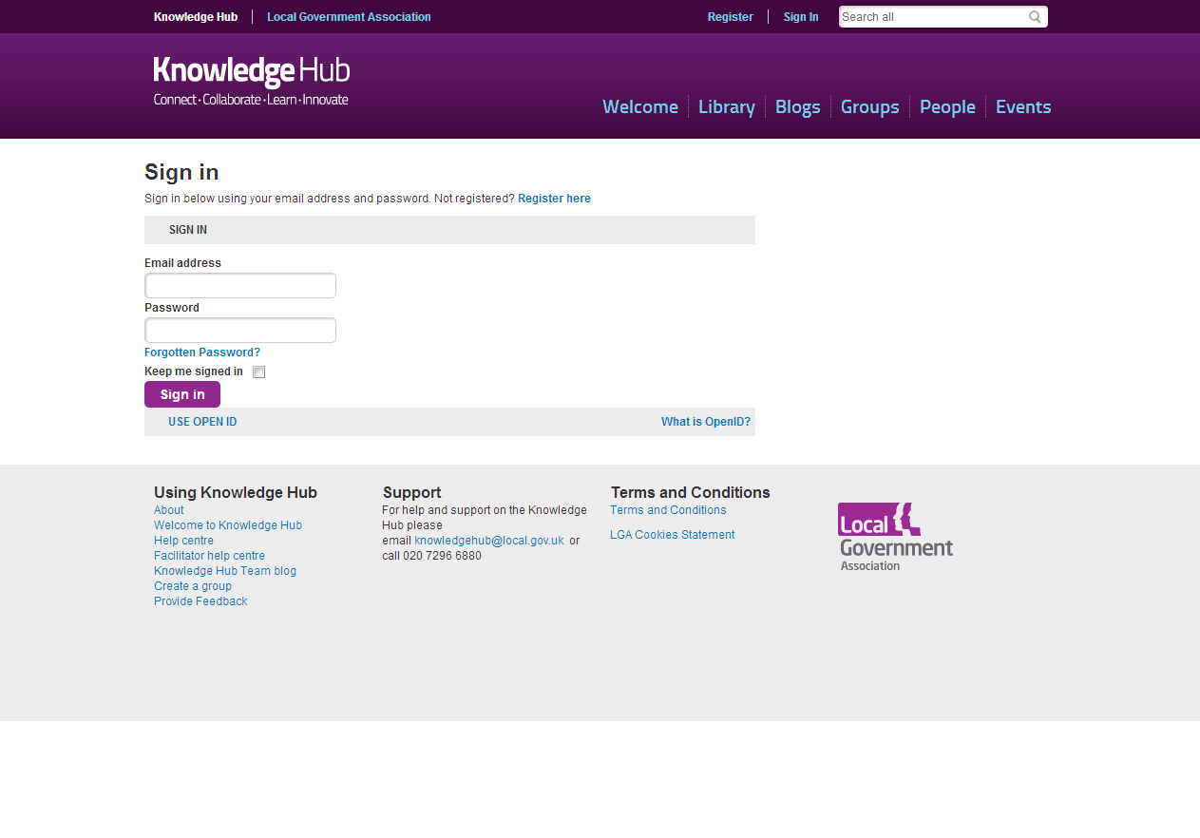
Sign in
Sign in
Use your LGA account or CoP account to sign in
Forgotten Password?
Enter your email address and complete a Captcha.
A temporary password will then be sent by email
Open ID
Use Open ID to login to the Knowledge Hub

Slide 5
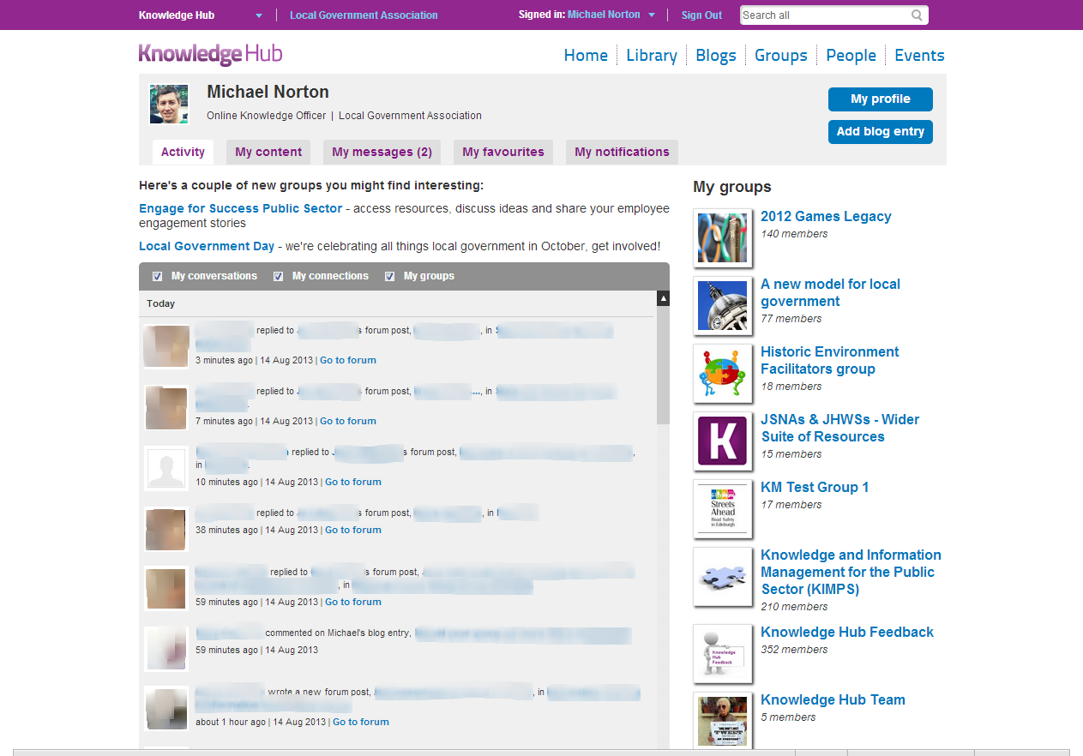
Activity
Activity
An activity stream of all content that you have permission to see on the Knowledge Hub
My groups
An A-Z list of all my Groups

Slide 6
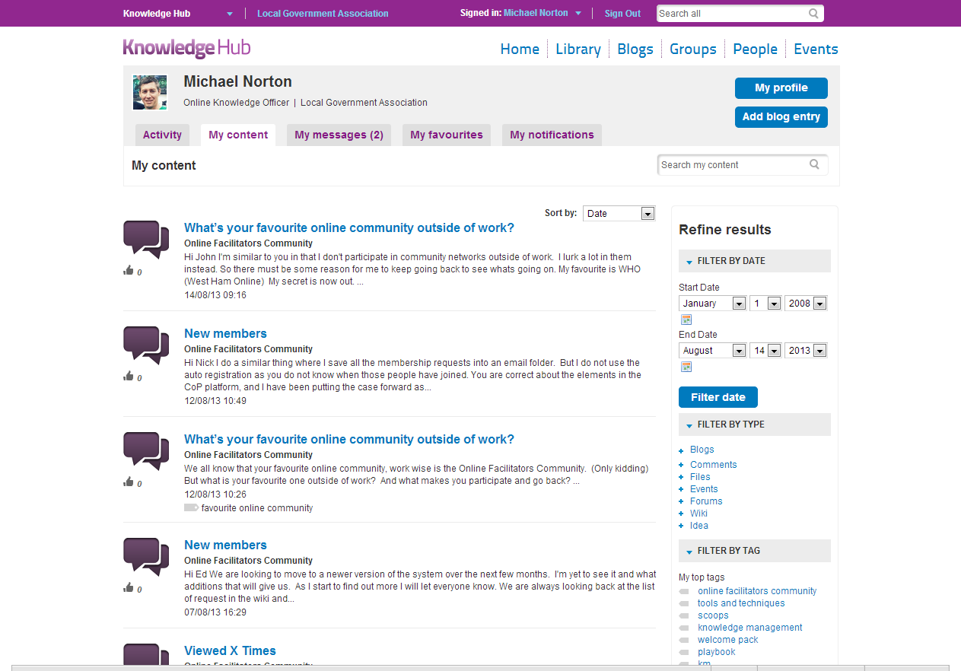
My content
My content
All the content you have created in one place
Filter by date
Find your content by date it was created
Filter by type
Filter your search by content type
Filter by tags
Find your content by tags

Slide 7
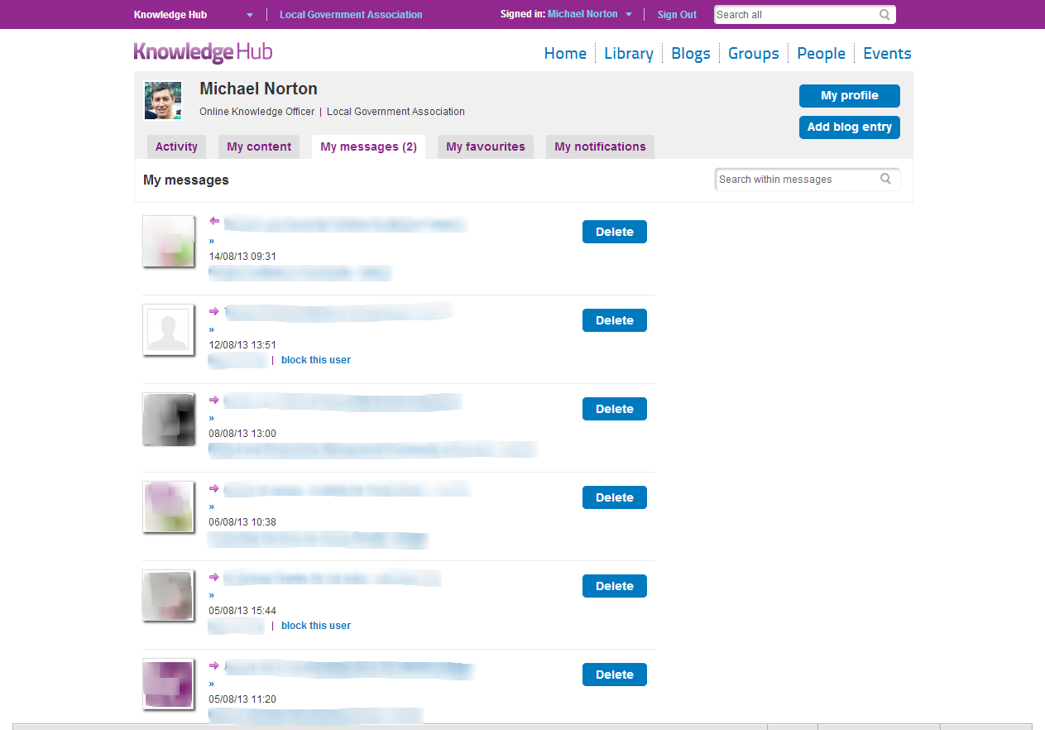
My messages
Group messages
View all group messages sent from facilitators of the groups you are a member of
Private messages
View and reply to private messages sent from members of the Knowledge Hub
Block users
Use this if you no longer wish to receive private messages from a member on the Knowledge Hub

Slide 8
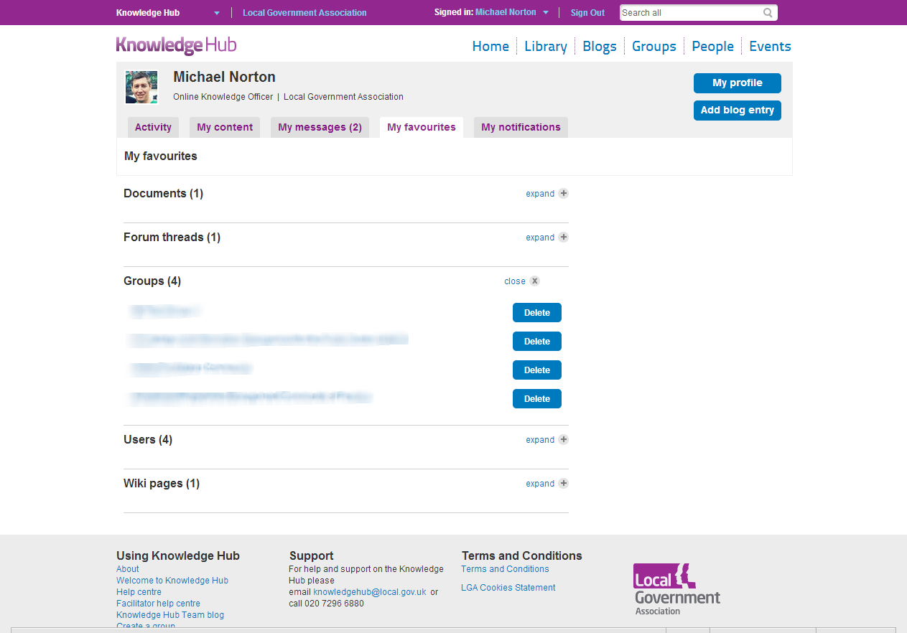
My favourites
My favourites
Throughout the Knowledge Hub you will have the ability to add to my favourites.
All you favourites will be strored here

Slide 9
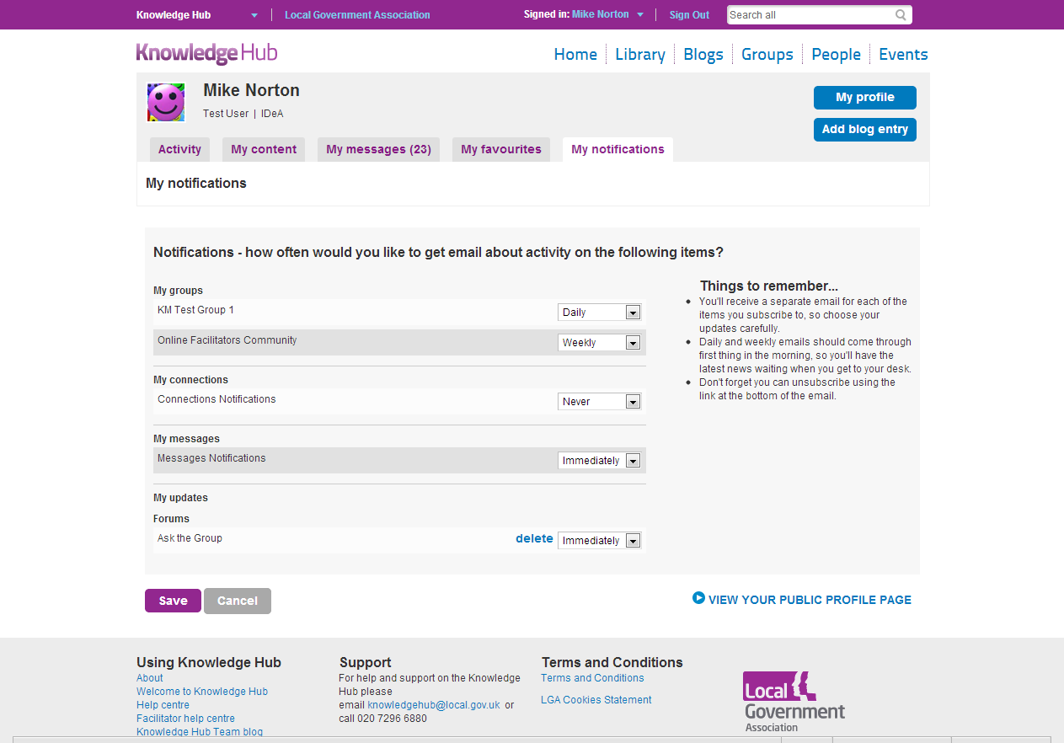
My notifications
My groups
Throughout the Knowledge Hub you will have the ability to add to my favourites.
All you favourites will be strored here

Slide 10
Chat
Online connections
View which of your connections are online
Settings
Amend your settings and choose your status
Chat
Instantly chat with a connection on the Knowledge Hub

Slide 11
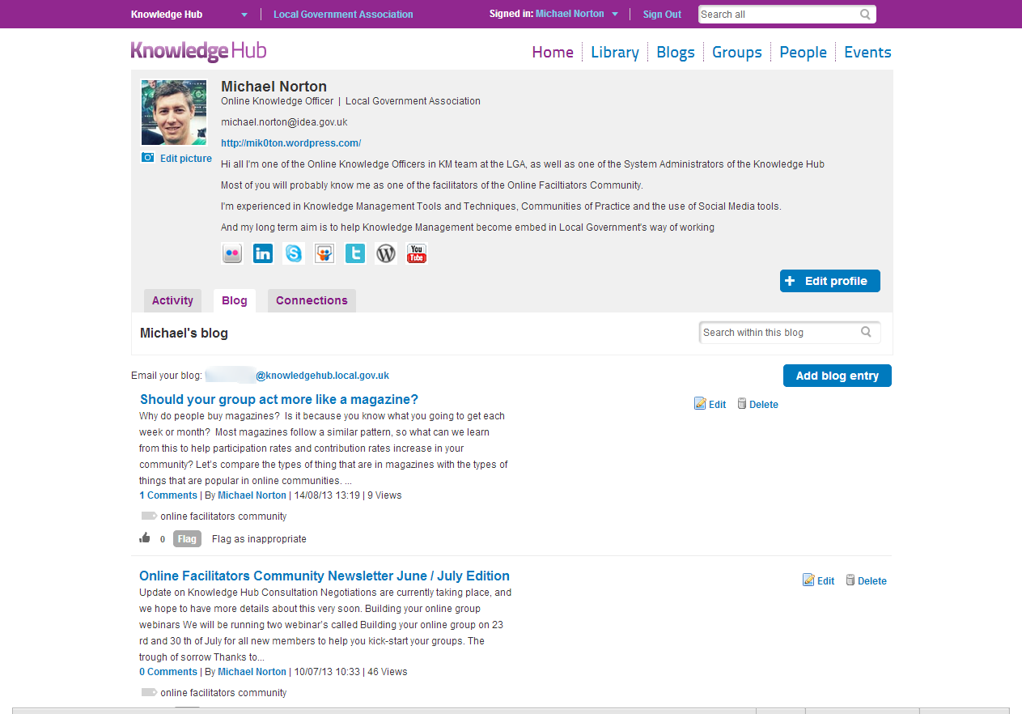
My blog
My blog
All your blogs in one place and searchable
Email your blog
Your unique email address to email your blog
Add blog entry
An easy way to add a new blog entry
Edit / Delete
Edit and delete your blog at anytime
Share and Like
See how many people liked your blog and share it with other social networks

Slide 12
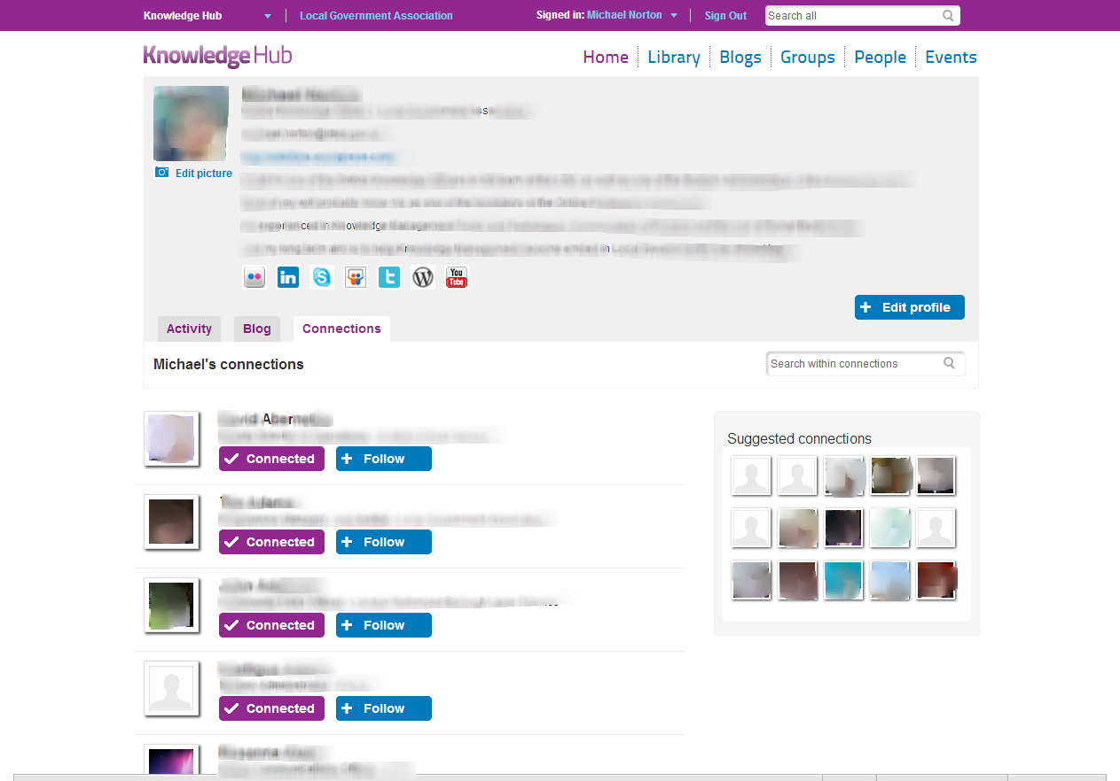
My connections
My connections
View all your connection in alphabetical order
Suggested connections
The Knowledge Hub will suggestion connection based on the groups you have joined

Slide 13
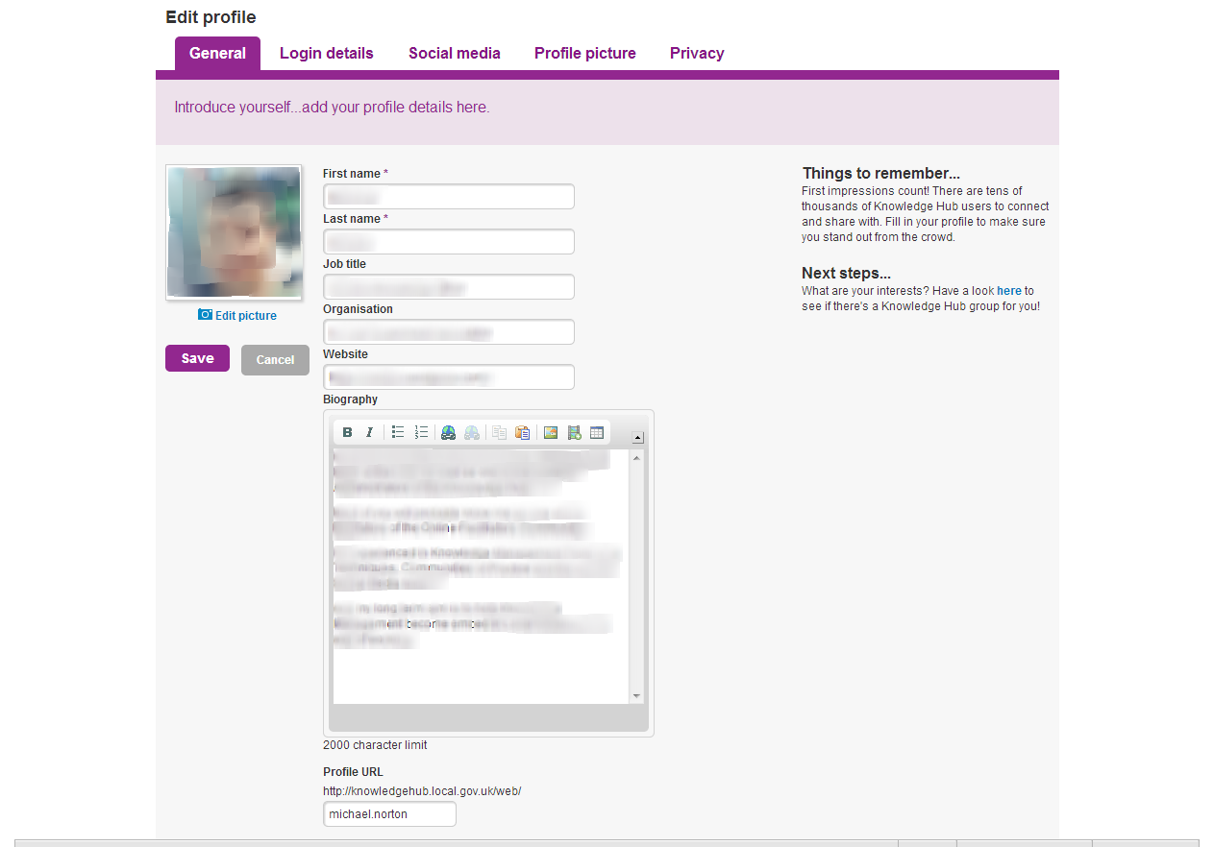
My Profile
My Profile
All your details including organisation and biography
Profile URL
A link to your public profile on the knowledge hub

Slide 14
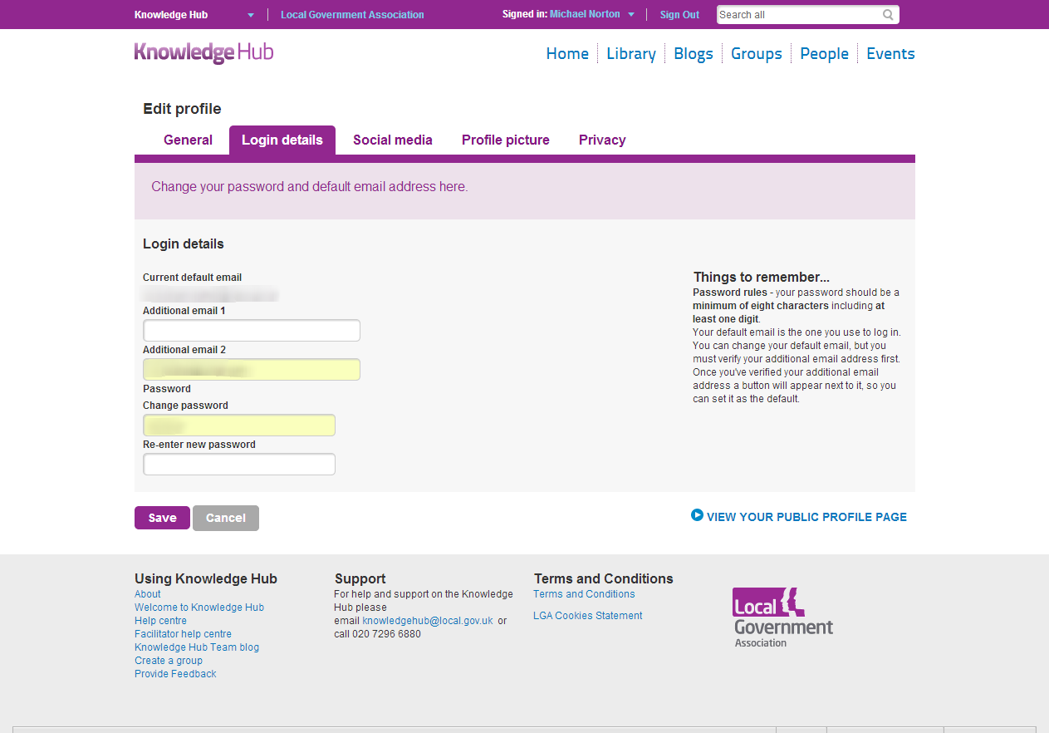
Login details
Email
Add more than one email address and choose your default
Password
Change your password (minimum of 8 characters with at least 1 number)

Slide 15
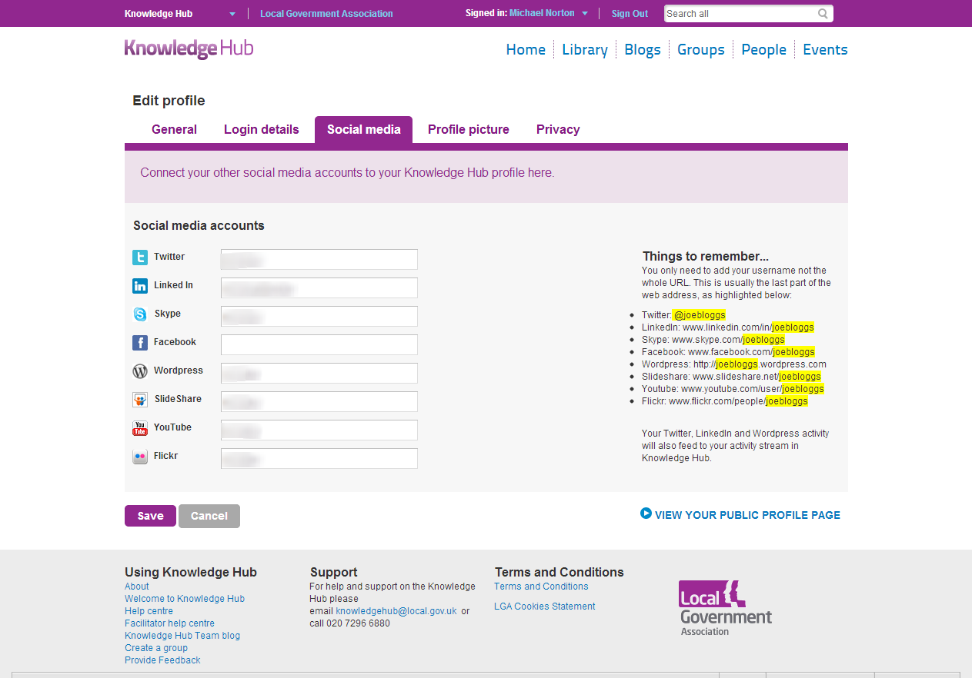
Social media
Social media
Easily add your social media accounts so members of the Knowledge Hub can follow you
Things to remember
Gives you advice on how you add your social media sites to your profile

Slide 16
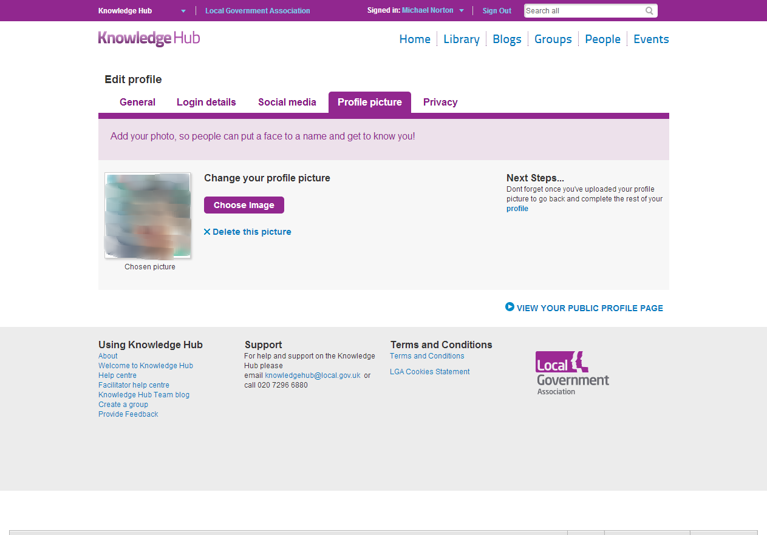
Picture profile
Choose image
Upload a photo of yourself so everyone can put a face to a name

Slide 17
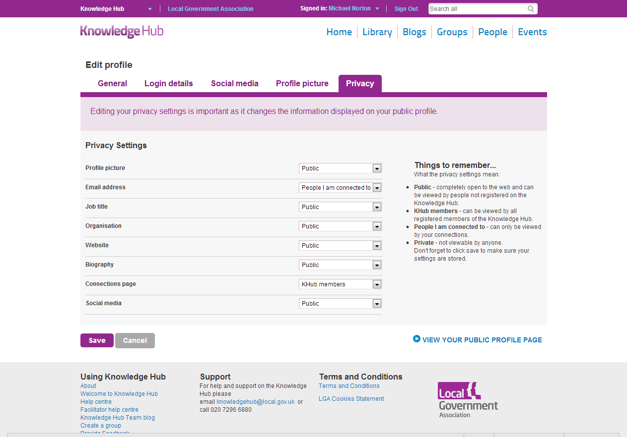
Privacy
Social media
Your customisable settings for privacy options on the Knowledge Hub
Things to remember
Gives you advice on each privacy setting

Slide 18
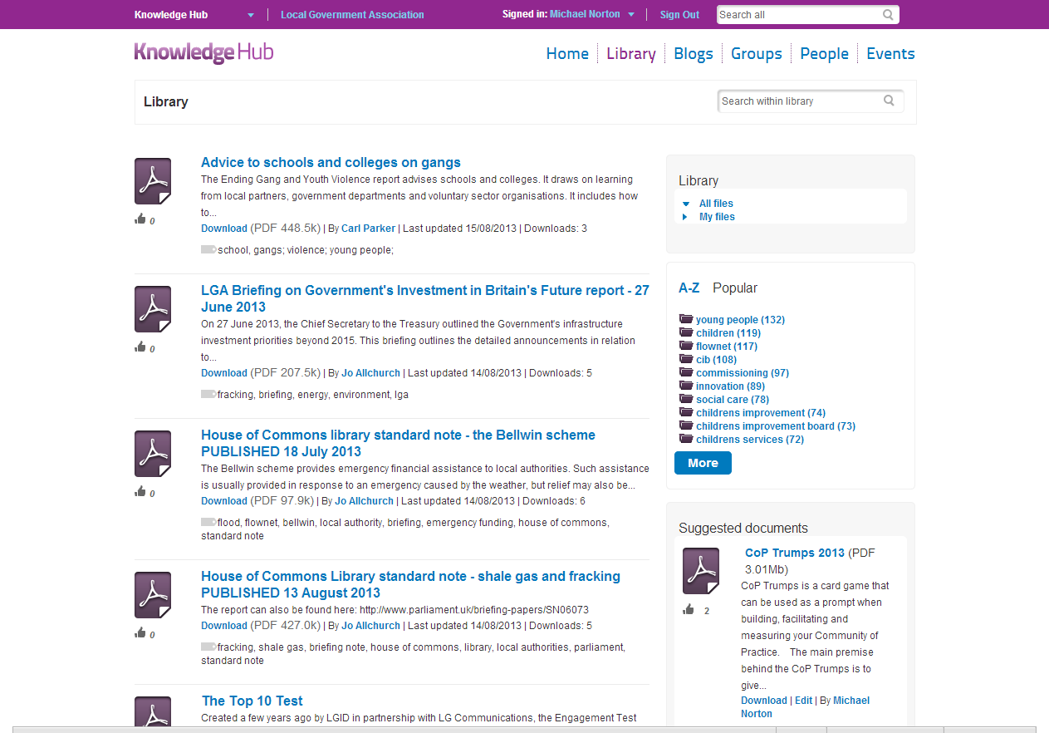
Public - Library
Library
All the public documents from across the Knowledge Hub
Choose
From all the public files or files you have uploaded that have been made public
Filter by tag
Filter your search by tag
Suggested documents
View the documents that are suggested to you

Slide 19
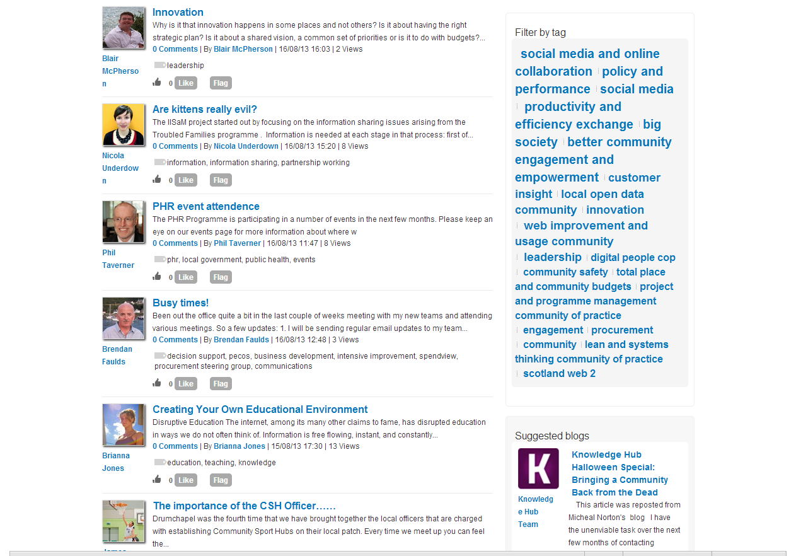
Public - Blogs
Blogs
All the public and open blogs from across the Knowledge Hub
Filter by tag
Filter your search by tag
Suggested blogs
View the blogs that are suggested to you

Slide 20
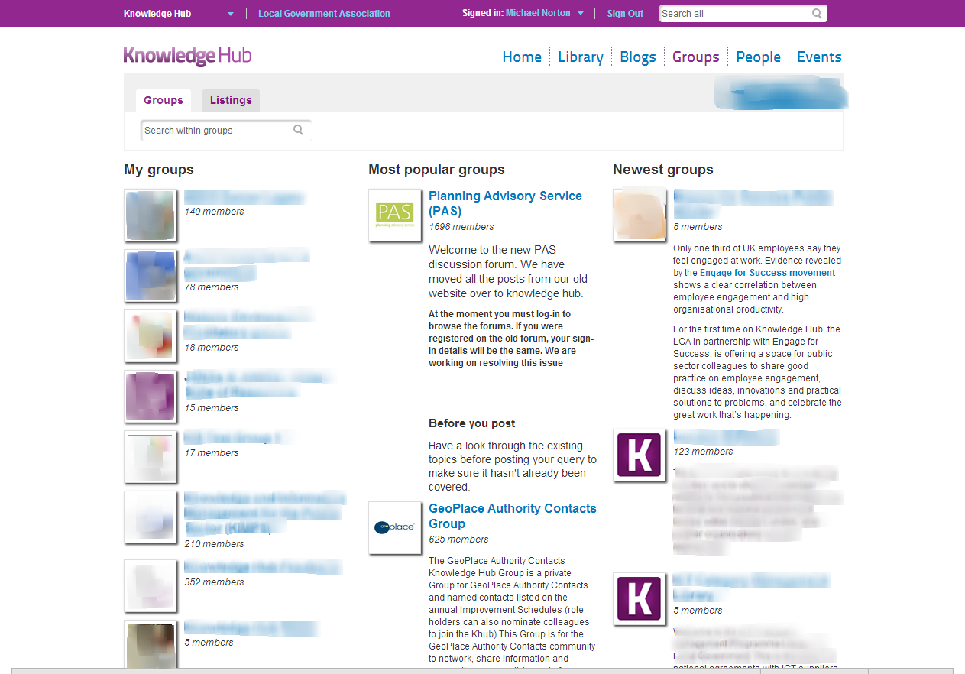
Groups
Find a group
Use the search to find a group
My groups
View all my groups
Most popular groups
View the current 20 most popular groups
Newest groups
View the newest groups on the Knowledge Hub

Slide 21
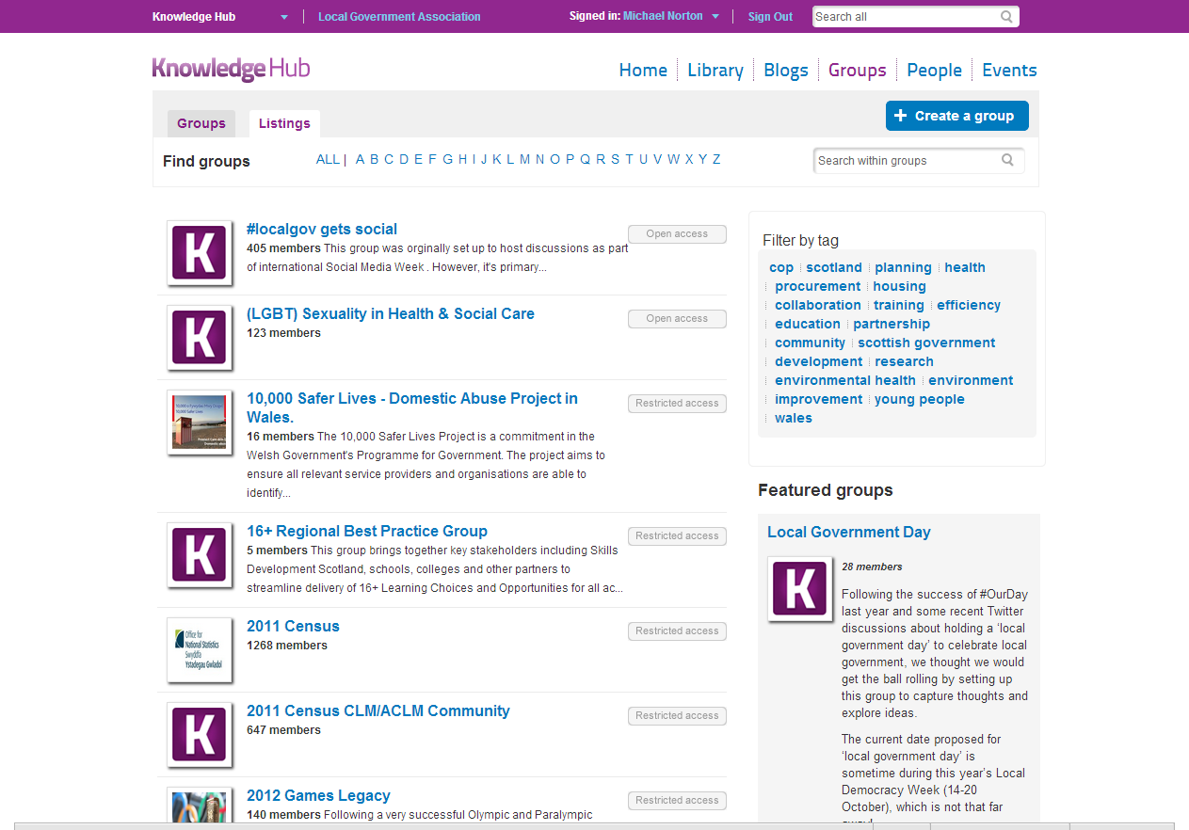
Listings A-Z
Find groups A-Z
Find a group by using the A-Z
Filter by tag
Filter your search by tag
Featured groups
View the featured groups for this week

Slide 22
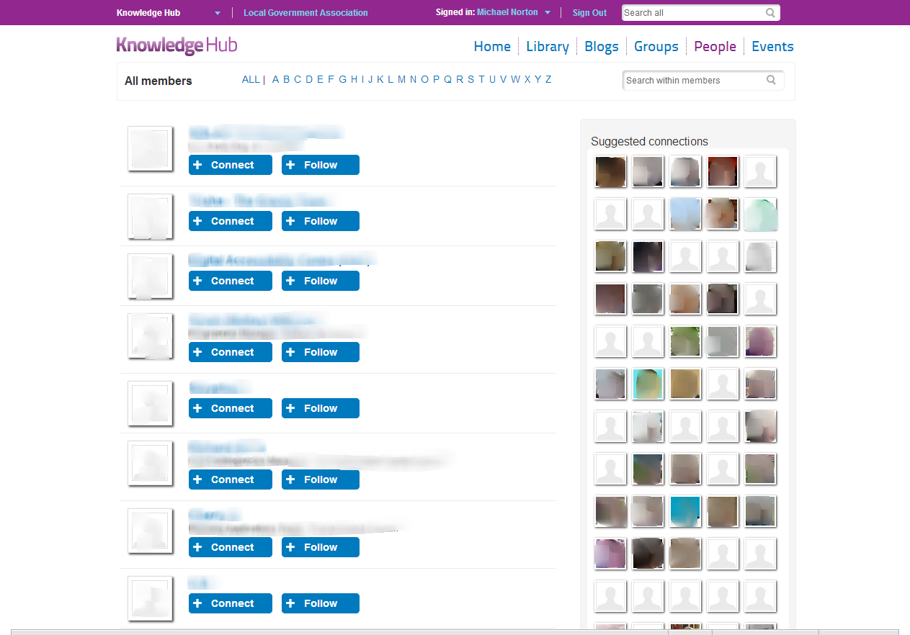
People
Find people A-Z
Find members of the Knowledge hub by using the A-Z
Suggested connections
The Knowledge Hub will suggestion connection based on the groups you have joined

Slide 23
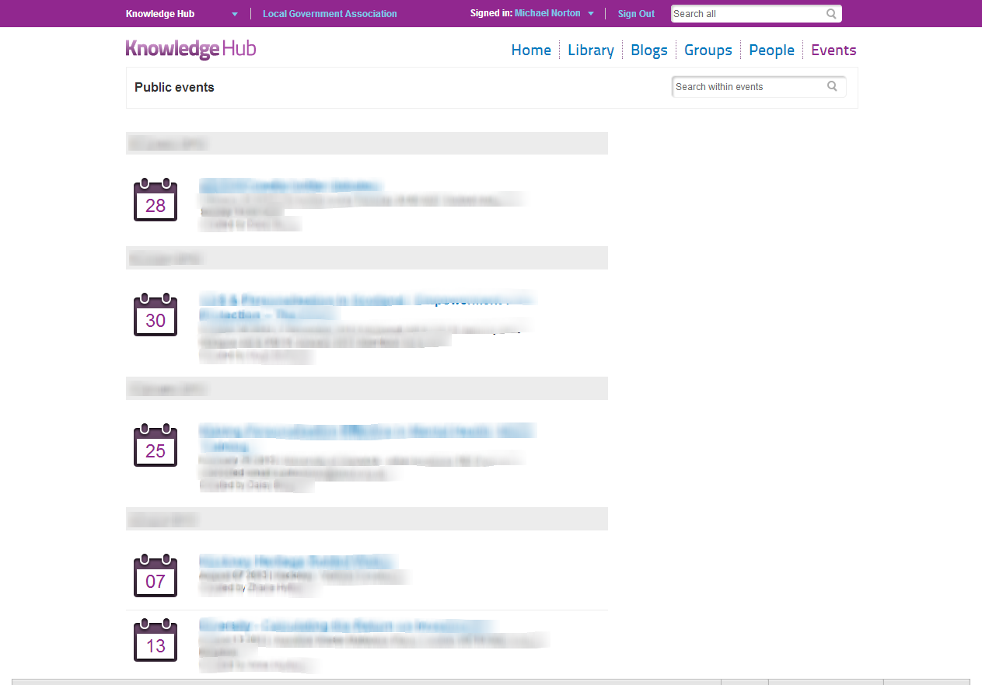
Public - Events
Events list
Events that have been made public from within a group

Slide 24
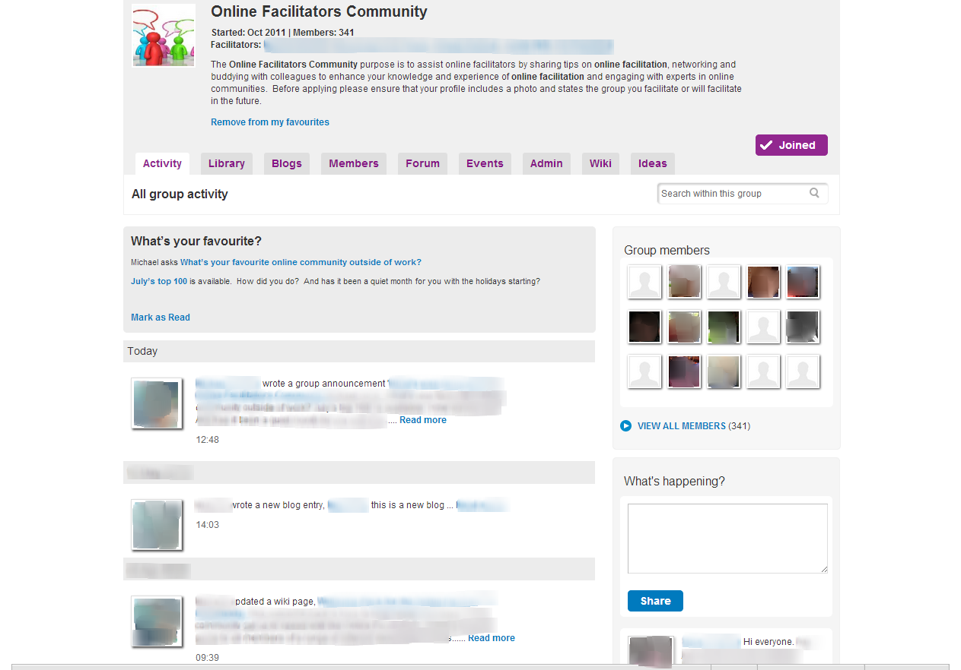
Group - Activity
Description
Shows the group description, start date, members and facilitators
Announcement
Controlled by the group facilitators to announce new and interesting content
Activity stream
View all the activities in the group
What’s happening
Update the group on what’s happening in the area of work

Slide 25
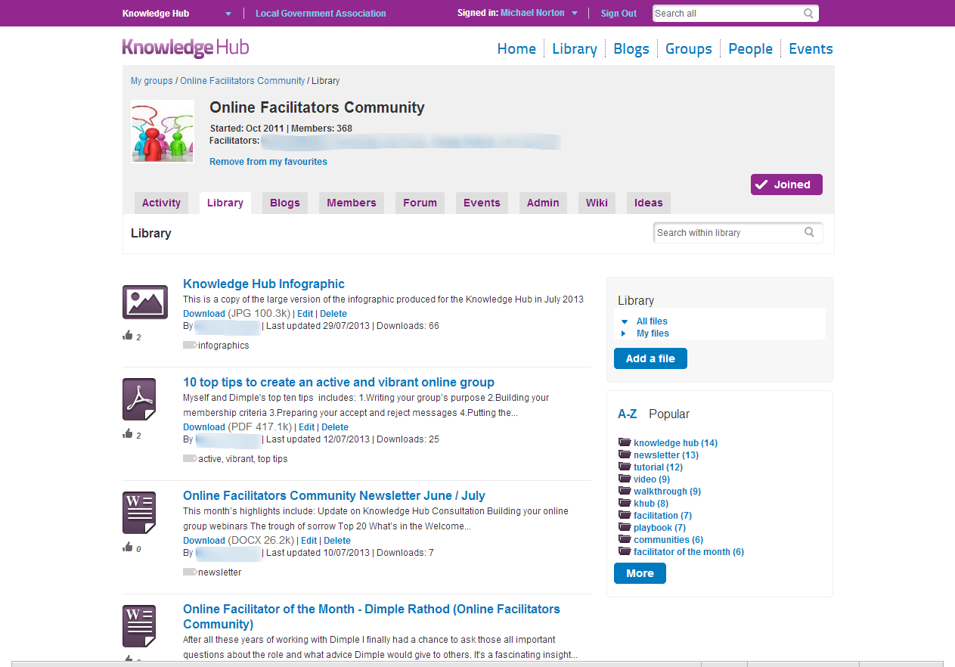
Group - Library
Library items
View all the latest files, vote and comment
Add a file
Add a new file to the library
Filter by tags
Filter the library by tag

Slide 26
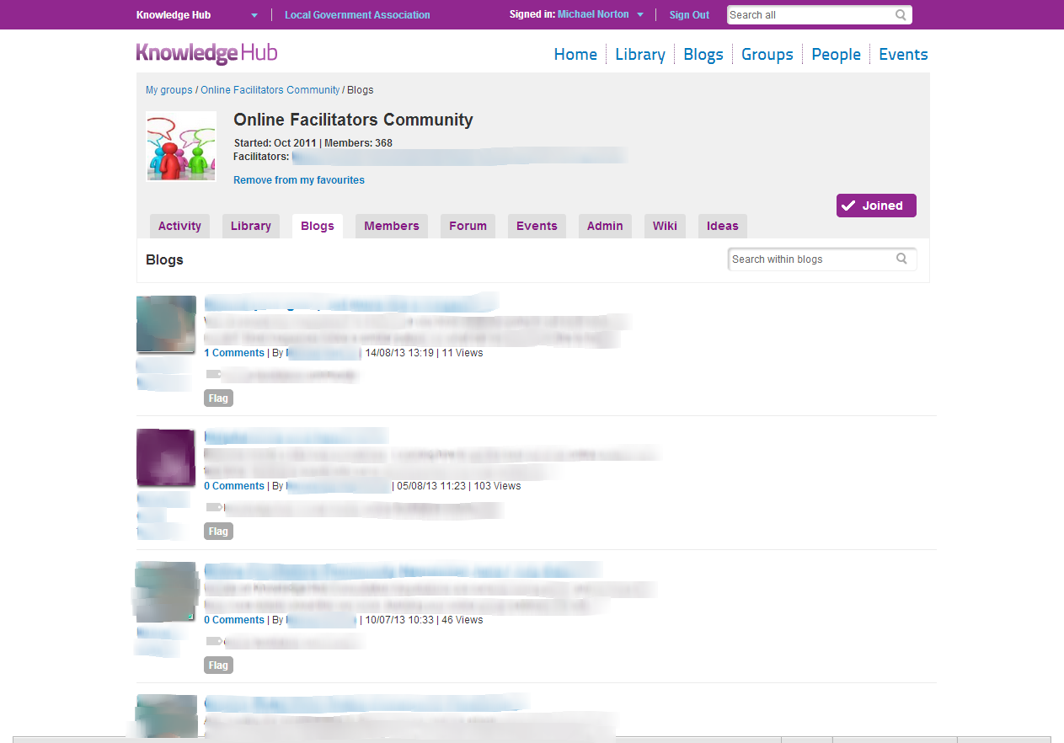
Group - Blogs
Blogs
View the latest blogs in your group
Blog selection
Facilitators have the option of choosing blogs by tag or member to appear in the group

Slide 27
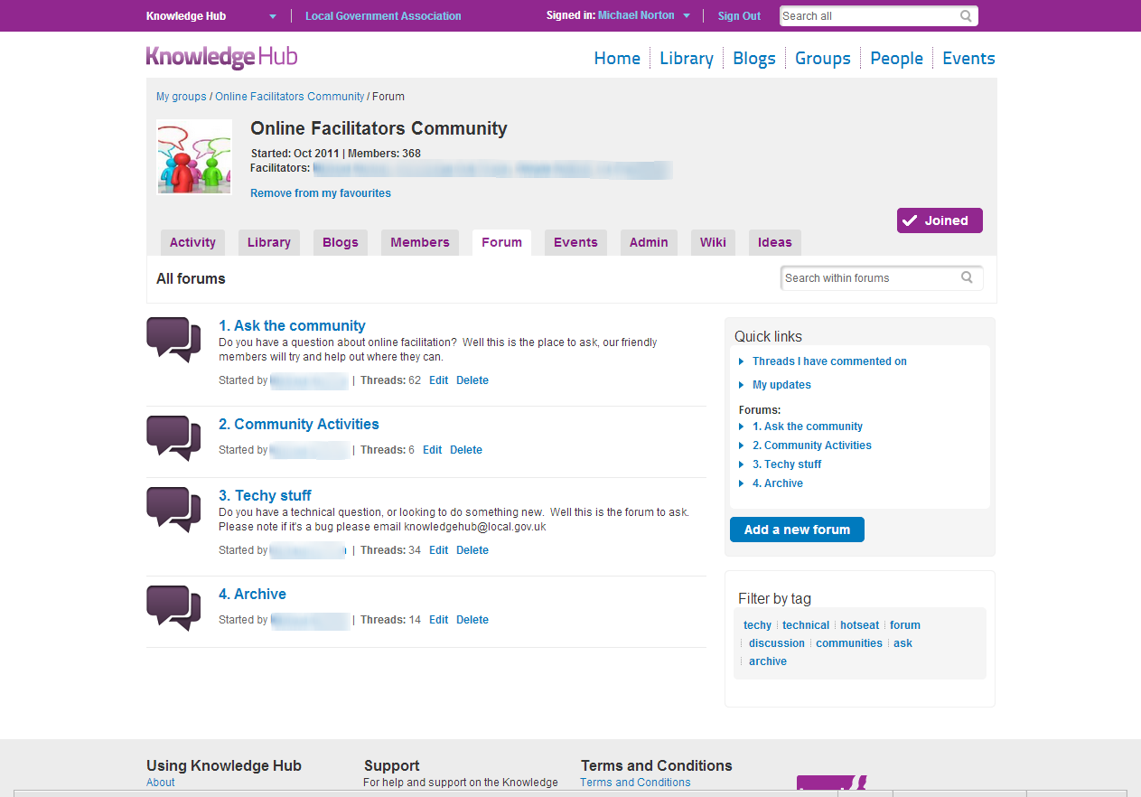
Group - Forum
Forums
The top level area for discussion in your group
Quick links
View the threads you have commented on and you email subscriptions to the forums
Add a new forum
Only available to facilitators to create top level forums
Filter by tag
Filter the forums by tags

Slide 28
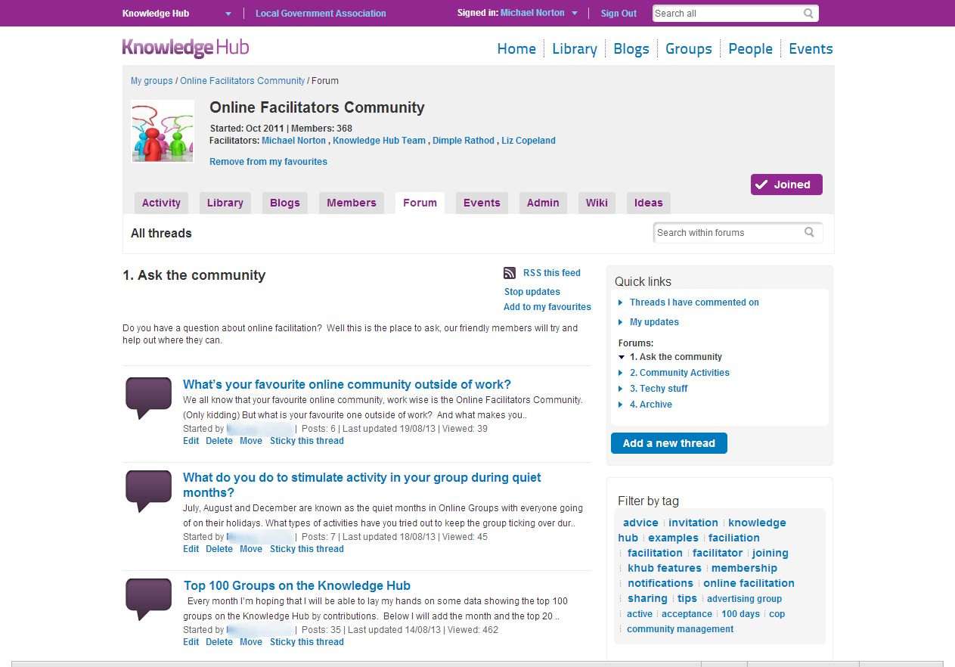
Threads
Threads
You can have multiple threads within a forum
Quick links
View the threads you have commented on and you email subscriptions to the forums
Add a new thread
Any member of the group can add a new thread
Filter by tag
Filter the threads by tags

Slide 29
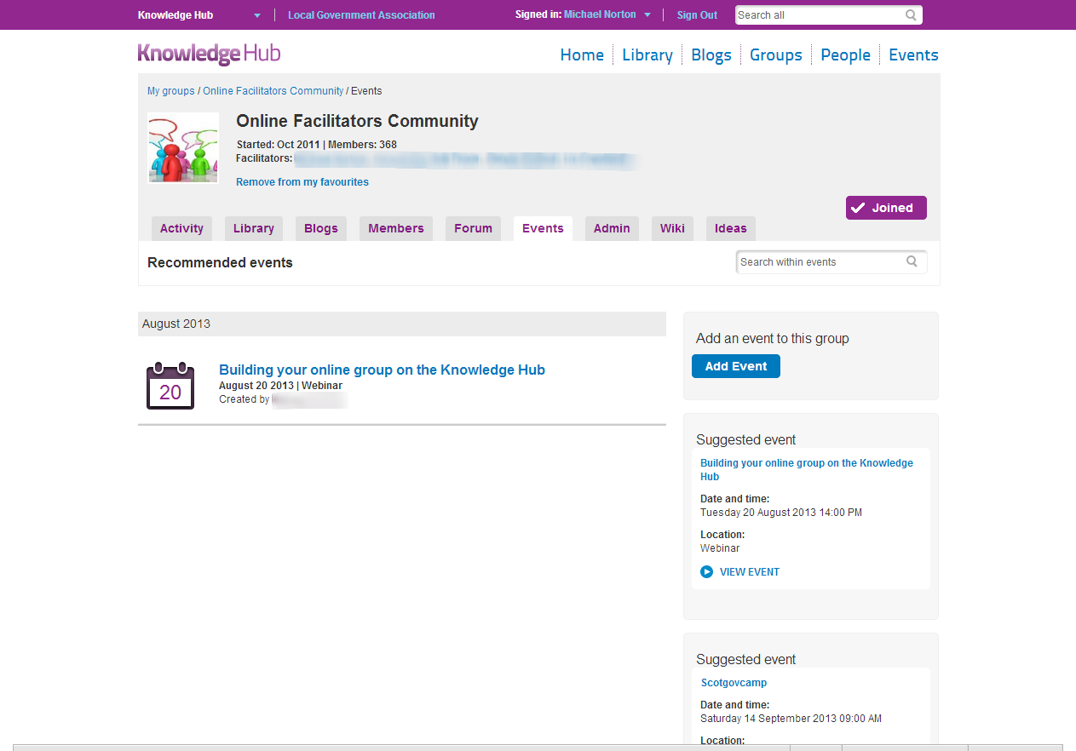
Group - Events
Events
View all the upcoming events from the group
Add event
Add a new event to the group
Featured events
View the featured events for the group

Slide 30
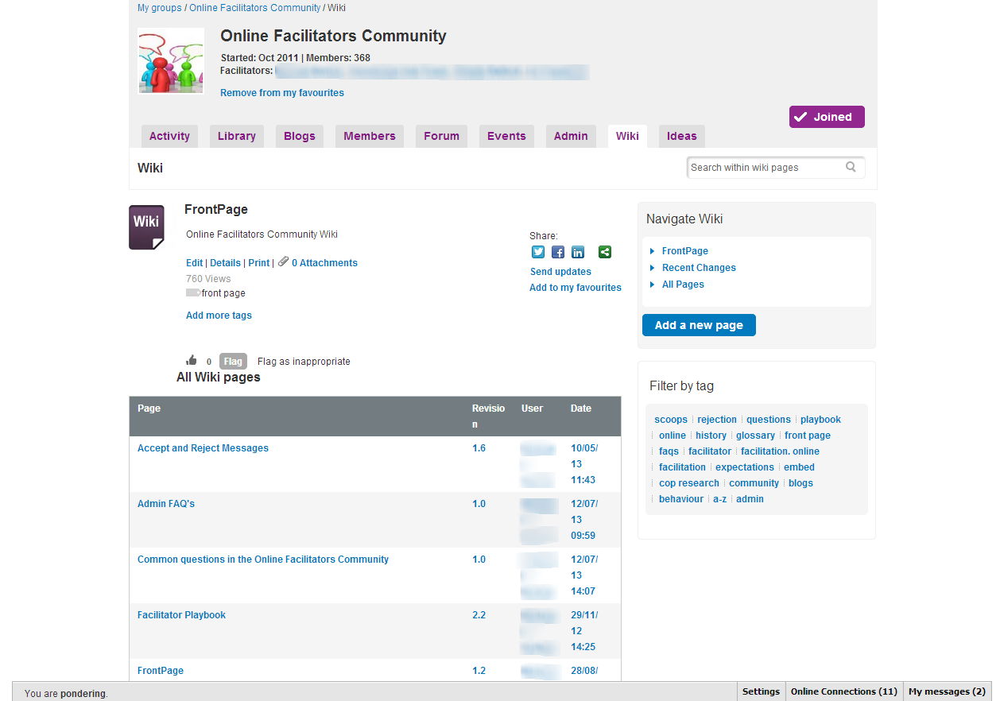
Group - Wiki
Wiki pages
View a list of wiki pages
Add a new page
Add a new wiki page
Filter by tag
Filter the threads by tags

Slide 31
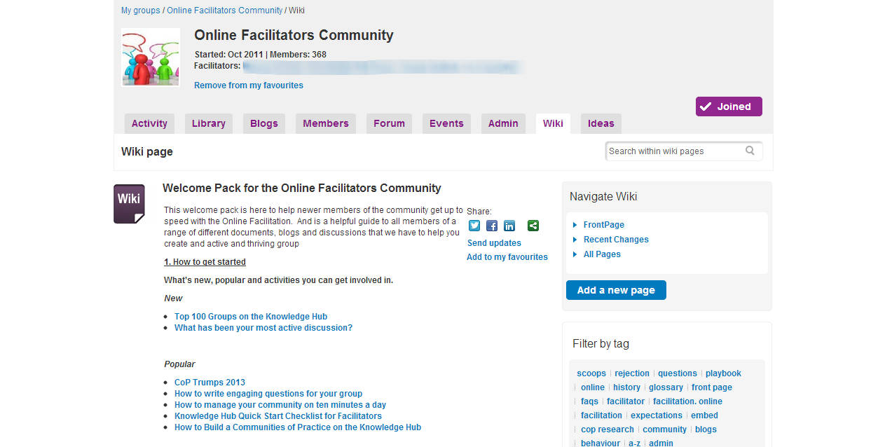
Group – Wiki page
Wiki page
View a the wiki content
Add a new page
Add a new wiki page
Edit / Details
Edit and view the details of who edited the wiki and compare versions

Slide 32
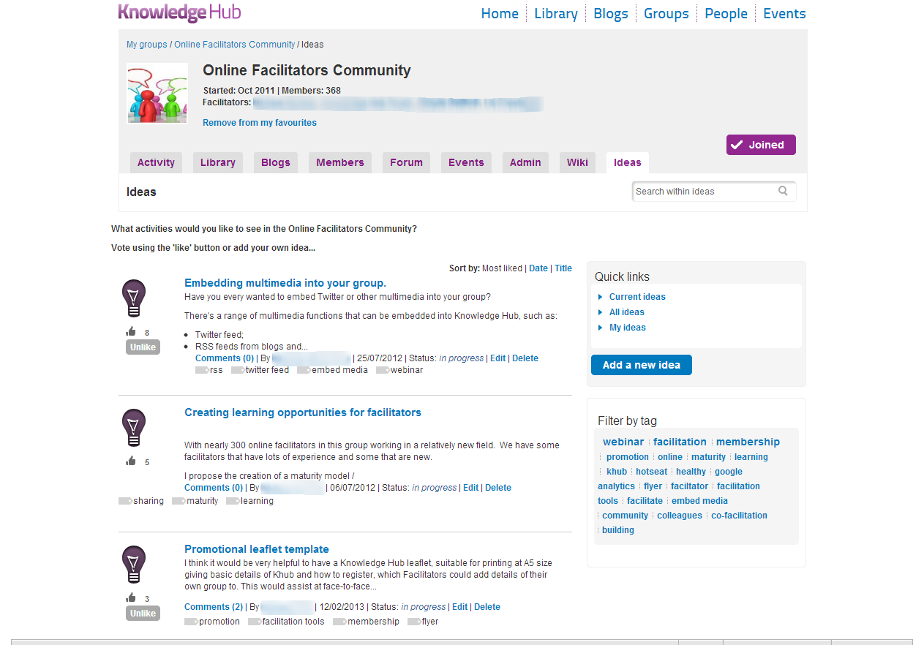
Group – Ideas
Add a new idea
Add a new idea to your group to vote on
Comment on an idea
Add to or comment on an idea
Like an idea
Cast your vote on an idea

Slide 33
Join up and participate on
https://knowledgehub.local.gov.uk

