Slide 1
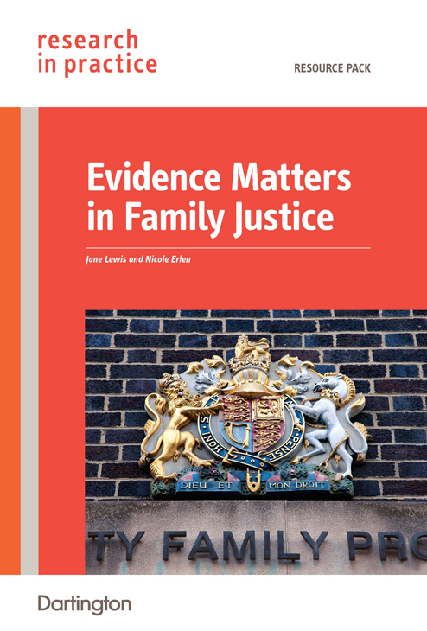
Evidence Matters in Family Justice:
a resource for social workers in a new family justice system

Slide 2
How does research fit in?
‘Social workers use direct observation and evidence from the child, family or others …. They can use evidence from research to inform their analysis … and they can use evidence on effectiveness to guide their plans …. integrating that evidence with the social worker’s own understanding of the child and family’s circumstances and their values and preferences.’
Munro Review, 2011

Slide 3
An organisational approach
National and local policy
Frameworks, assessments, protocols, tools
Theory- and research-based expertise
Specific case-based research

Slide 4
Using research to inform analysis and planning
How is her development being compromised
What theories might explain what I’m seeing
What else might be going on
What negative impacts do I need to look for
What makes her more at risk
What protective and resilience factors are there
What outcomes am I looking for
What needs to change
What approaches might be effective
What might get in the way

Slide 5
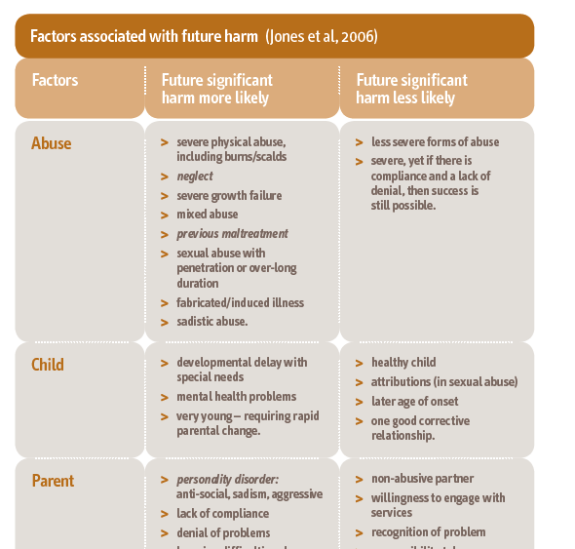
Risk factors - examples
neglect
developmental delay
lack of empathy
childhood abuse without resolution
no professional therapeutic relationship with child
social isolation
violent and unsupportive neighbourhood

Slide 6
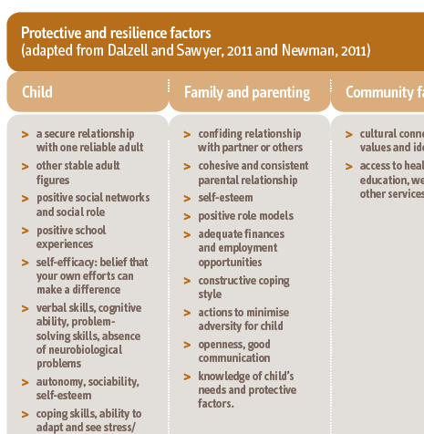
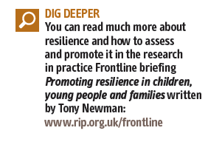
Protective factors - examples
secure relationship with a reliable adult
autonomy, sociability, self- esteem
verbal, cognitive and problem- solving skills
plans and goals
parent understands child’s needs
family has cultural connections and identity

Slide 7
An organisational approach
Giving a strategic lead
Setting expectations
Providing opportunities for learning
Ensuring access to research
Supporting local research and evaluation

Slide 8
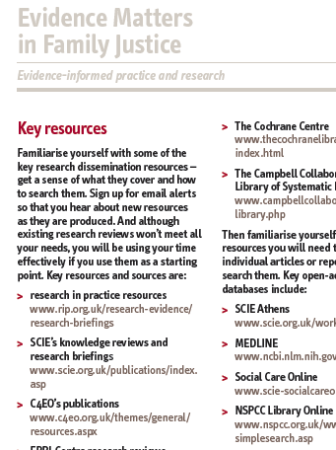
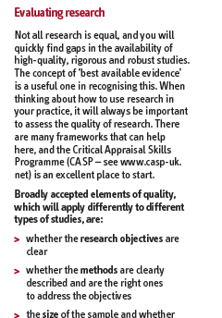
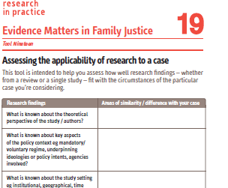
Not all research is equal
reviews rather than single studies
quality
applicability

Slide 9
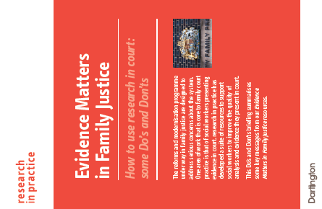
Preparation, preparation, preparation
develop shared evidence base with local family justice system
know your research
keep it simple
acknowledge opposing research and gaps
be objective and unbiased
know the research others are using
use research throughout

Slide 10
