Slide 1
Targeted Meningococcal B vaccination programme in response to Kent outbreak
March 2026
Information for healthcare practitioners advising about or administering the MenB vaccine

Slide 2
Note to vaccinators and trainers
this slide set contains a collection of core slides for both individual use and use or adaptation during the delivery of meningococcal (MenB) vaccination training. Trainers should select the slides required depending on the background and experience of the immunisers they are training and according to the role they will have in delivering the targeted MenB vaccination programme
the information in this slide set was correct at time of publication. Updates to the slide set will be made as necessary so please check online to ensure you are using the latest version
please note that this slide set has been written specifically for the vaccination of those identified as being eligible for vaccination following the outbreak in Kent in March 2026. A separate slide set is available for the infant MenB vaccination programme

Slide 3
Aims of this resource
to raise awareness of invasive meningococcal disease (IMD) epidemiology and symptoms
to support and educate healthcare professionals involved in discussing vaccination against meningococcal B disease
to support the safe vaccination of individuals who present for the targeted meningococcal B vaccine programme

Slide 4
Learning outcomes
At the end of this resource, healthcare professionals will be able to:
describe the aetiology and epidemiology of invasive meningococcal capsular group B disease
be aware of the reasons for offering the meningococcal B vaccine
advise and inform individuals about the meningococcal B vaccine
understand the healthcare professionals’ role in supporting the delivery of the targeted meningococcal B vaccination programme
identify sources of additional information and resources

Slide 5
Significant messages
meningococcal disease is caused by invasive infection with the bacterium Neisseria meningitidis, also known as meningococcus
invasive meningococcal disease most commonly presents as meningitis or septicaemia or both
following the outbreak of invasive meningococcal disease in Kent, in addition to antibiotic prophylaxis, a targeted MenB vaccination programme has been recommended
the MenB vaccine has been offered to UK infants as part of a national immunisation programme as well as at-risk children and adults since 2015 and has a good safety profile
The vaccine does not cover all meningococcal strains or all causes of bacterial meningitis, so following vaccination, individuals should continue to remain alert for symptoms of meningococcal disease and seek medical attention if unwell or concerned

Slide 6
Background to the targeted MenB vaccination offer
an outbreak of invasive meningococcal disease (meningitis and septicaemia) has occurred in the Canterbury area of Kent in March 2026
This outbreak is due to a single strain of group B meningococcus (MenB)
although the MenB vaccine has been available as part of the routine NHS infant immunisation schedule since 2015, individuals aged over 10 years will have not received it
They should already have been offered the MenACWY vaccine at age 14 years as part of the adolescent school immunisation programme which will not protect against MenB
given the severity of MenB disease and the number of cases, a targeted vaccination programme is being offered to those identified as being at ongoing increased risk of the disease
MenB vaccination provides longer term protection where there is a likelihood of ongoing circulation and potential reintroduction of the bacteria to an identified population

Slide 7
Background to the targeted MenB vaccination offer (continued)
a single dose of ciprofloxacin antibiotic prophylaxis is usually offered to close contacts of suspected and confirmed cases, but may be offered more widely during meningococcal outbreaks
the antibiotics work quickly to eliminate carriage, thereby breaking chains of transmission and preventing spread of the bacteria and further cases
vaccine may also be offered in addition to antibiotic prophylaxis for longer term protection for those who are considered to be at ongoing risk

Slide 8
Meningococcal B (MenB) disease

Slide 9
Overview
meningococcal disease occurs as a result of an invasive bacterial infection caused by Neisseria meningitidis, also known as the meningococcus
there are 12 identified capsular groups of meningococcus; MenB is now the most common strain in the UK, accounting for over 80% of invasive infections
Men C, W and Y cases also occur in the UK but at exceptionally low levels following the long-established MenC vaccination programme which was replaced with the highly effective MenACWY teenage vaccination programme introduced in 2015
invasive meningococcal disease (IMD) is rare (less than 1 per 100,000 population per annum) but serious, resulting in significant morbidity and mortality
meningococcal disease most commonly presents as either meningitis or septicaemia, or a combination of both
the highest rates of disease are in children under 2 years, particularly infants, although disease can occur at any age

Slide 10
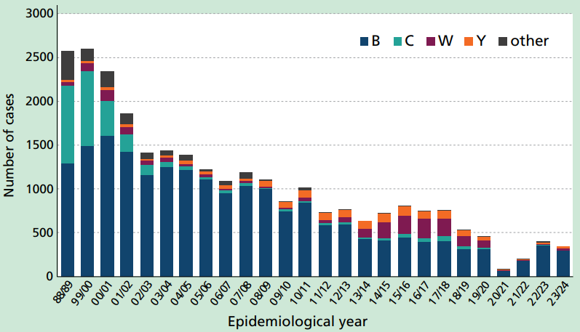
Cases of IMD in England and Wales by capsular group 1998/1999 to 2023/2024
MenB causes the majority of IMD.
Disease due to other serogroups is now rare.
The implementation of social distancing measures and lockdown periods across the UK from March 2020 for the COVID-19 pandemic resulted in a large decline in the spread and detection of IMD but rates have increased since these measures have stopped.
Source: UKHSA Meningococcal Reference Unit, Manchester.

Slide 11
Notified cases of invasive meningococcal disease linked to Canterbury, Kent, March 2026
as of 19 March 2026, UKHSA has been notified of 18 confirmed and 11 probable cases of invasive meningococcal disease with epidemiological links to Canterbury, Kent.
13 of the 18 confirmed cases are meningococcal group B (MenB)
all cases have been hospitalised
there have been 2 deaths
latest update on number of notified cases is available at Notified cases of invasive meningococcal disease - GOV.UK

Slide 12
Carriage, transmission, infectivity and incubation
meningococcal bacteria may be carried harmlessly in the nose and throat of healthy people and rarely go on to cause invasive disease
asymptomatic carriage is more common in adolescents and young adults (around 5 – 10%)
not fully understood why disease develops in some individuals but not in others
age, season, smoking, preceding viral infection and living in ‘closed’ or ‘semi-closed’ communities, such as university halls of residence or military barracks, have been identified as risk factors for developing disease
transmission is through person-to-person spread from respiratory aerosols, droplets or by direct close contact with the respiratory secretions of someone who is carrying the bacteria
infectivity of meningococci is relatively low and requires prolonged close contact, for example with those living in the same household or through direct contact with nose and respiratory secretions such as through coughing, sneezing, kissing, sharing drinks or vapes and smoking
incubation period ranges from 2 to 7 days with the onset of disease ranging from insidious mild prodromal symptoms to sudden and severe symptoms requiring urgent medical treatment

Slide 13
Clinical presentation
invasive meningococcal infection most commonly presents as either meningitis or septicaemia, or both
meningitis is inflammation of the lining around the brain and spinal cord (the meninges)
septicaemia occurs when the bacteria enter the bloodstream, causing blood poisoning which triggers sepsis
less commonly, individuals may present with pneumonia, myocarditis, endocarditis, pericarditis, arthritis, conjunctivitis, urethritis, pharyngitis and cervicitis

Slide 14
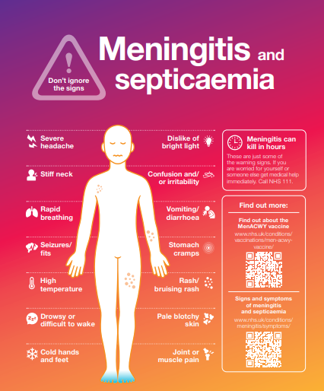
Clinical presentation of Invasive Meningococcal Disease
high temperature
vomiting
severe headache
feeling unwell
limb/joint/muscle pain
stomach pain/diarrhoea
cold hands and feet
shivering
pale or mottled skin
fast breathing/breathlessness
rash
stiff neck
dislike of bright light
drowsiness/difficult to wake
confusion and/or irritability
seizures/fits

Slide 15
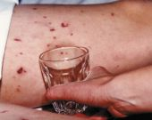
The meningococcal rash
a distinctive red rash can appear anywhere on the body
the darker the skin the harder it is to see a septicaemic rash, so check lighter areas like the palms of the hands and soles of feet, or look inside the eyelids and roof of the mouth
the rash is formed of tiny ‘pinpricks’ also known as petechiae and appears red or brown in colour. The rash may later develop into purple bruising of the skin
the meningococcal rash can be distinguished from other rashes by pressing a drinking glass against it
a meningococcal rash will not fade when the glass is pressed firmly against it
a febrile illness and rash that does not fade is a sign of meningococcal septicaemia
however, absence of a rash does not mean the individual does not have meningitis or meningococcal sepsis – the rash is usually a late sign of sepsis
The ‘tumbler’ test picture courtesy of Meningitis Research Foundation
www.meningitis.org/about-meningitis/symptoms/

Slide 16
Potential complications of meningococcal disease
infection is fatal in 5% to 10% of cases
approximately 20 to 25% will suffer complications as a result
complications can vary in severity and can either be temporary or permanent; the more severe the disease, the greater the risk of complications
long term complications of meningitis can include hearing loss, severe visual impairment, loss of memory and/or concentration, difficulties in co-ordination and balance and seizures/epilepsy. Complications of septicaemia include arthritis, kidney problems and limb amputations

Slide 17
Meningococcal B vaccine

Slide 18
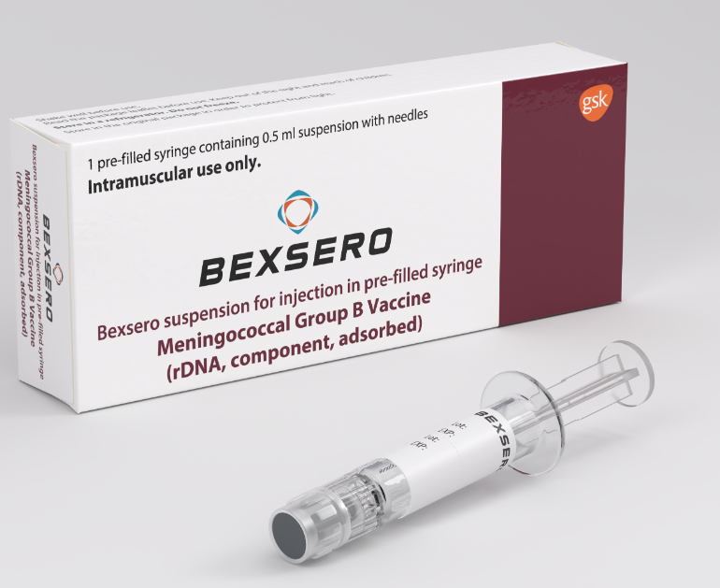
Bexsero Meningococcal Group B Vaccine
Bexsero is a multi-component inactivated vaccine marketed by GlaxoSmithKline
licensed for use from two months of age
supplied in packs of 10
recommended to be administered via intramuscular injection (IM) into the deltoid muscle region of the upper arm (or anterolateral aspect of the thigh where deltoid cannot be used)
for adolescents and adults, 2 doses should be given, a minimum of 4 weeks apart
Bexsero Meningococcal Group B vaccine for injection in pre-filled syringe - Summary of Product Characteristics (SmPC)

Slide 19
Composition of Bexsero
Bexsero is a four-component protein-based meningococcal B vaccine (also referred to as 4CMenB)
It is made from three main N. meningitidis proteins produced by recombinant DNA technology and a preparation of N. meningitidis group B outer membrane vesicles
Composition
Recombinant Neisseria meningitidis group B NHBA fusion protein
Recombinant Neisseria meningitidis group B NadA protein
Recombinant Neisseria meningitidis group B fHbp fusion protein
Outer membrane vesicles (OMV) from Neisseria meningitidis group B strain NZ98/254
Excipients
Sodium chloride
Histidine
Sucrose
Water for injections
Notes:
Manufacturer's summary of product characteristics (SPC)

Slide 20
Bexsero presentation and preparation
the vaccines are supplied in packs containing ten pre-filled syringes each with a volume of 0.5mls of suspension per syringe
the tip cap and rubber plunger stopper of the pre-filled syringe are made with synthetic rubber
during storage, the contents of the syringe may settle with fine off-white deposits being noticeable
before use, the pre-filled syringe must be shaken well to form a homogenous suspension that should be administered immediately
the vaccine should not be administered where there are variations in physical appearance (for example, not a homogenous suspension) or signs of foreign particulate are observed after shaking
Bexsero should be stored in its original packaging in a refrigerator between +2ºC and +8ºC

Slide 21
Further information about Bexsero
Bexsero has been routinely given to infants in the UK since 2015 and to adolescents and adults who are deemed to be at increased risk because of underlying medical conditions
within 3 years of the routine infant MenB vaccination programme, there was a 75% reduction in invasive MenB disease in those eligible for vaccination
studies have shown Bexsero is immunogenic in adolescents and adults
the strain identified as causing recent cases of MenB in Kent is likely covered by both MenB vaccines (Bexsero and Trumenba)
Bexsero (the vaccine use in the UK national infant immunisation programme) will be offered as part of the outbreak controls
Bexsero is a non-live vaccine made using recombinant vaccine technology
it can be given at the same time as, or at any interval from, any other vaccines
it may be given to pregnant or breastfeeding women when clinically indicated
it can also be given to individuals with immunosuppression and human immunodeficiency virus (HIV) infection

Slide 22
Contraindications
Bexsero should not be administered to those who have had:
a confirmed anaphylactic reaction to a previous dose of the vaccine OR
a confirmed anaphylactic reaction to any constituent, excipient or residue from the manufacturing process
there are very few individuals who cannot receive meningococcal vaccines
where there is doubt, appropriate advice from an expert should be sought rather than withholding immunisation

Slide 23
Legal issues
Bexsero is a prescription only medicine and should only be administered using one of the following:
prescription written manually or electronically by a registered medical practitioner or other authorised prescriber
Patient Specific Direction (PSD)
Patient Group Direction (PGD)
A national PGD template for Bexsero MenB vaccine, written by UKHSA, is available which includes the use of this vaccine in an outbreak. This PGD should be reviewed and authorised locally before use.

Slide 24

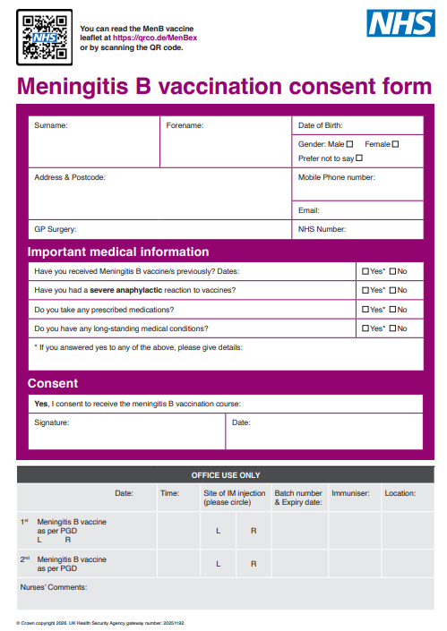
Consent
consent should be obtained before the MenB vaccine is given
the Green Book Consent chapter sets out how consent should be obtained and vaccinators should ensure they are familiar with this
an information leaflet for individuals considering vaccination is available: Meningococcal disease outbreak resources - GOV.UK
a specific meningitis B vaccination consent form is also available: MenB vaccination consent form

Slide 25
Possible adverse reactions
in clinical trials in adolescents and adults, the most common local and systemic adverse reactions observed were pain, swelling and redness at the injection site, malaise and headache
nausea, myalgia (muscle pain) and arthralgia (joint pain) were also commonly reported
although high fever was commonly reported in infants following MenB vaccination in trials, it was not common in adolescents and adults (mild fever may occur)
prophylactic paracetamol following vaccination is not recommended but paracetamol can be taken to alleviate symptoms if required
no increase in the incidence or severity of adverse reactions was seen with subsequent doses of MenB vaccine

Slide 26

Reporting suspected adverse reactions
Yellow card scheme
as with any vaccine, all suspected serious adverse reactions should be reported to the MHRA using the Yellow Card scheme
success depends on early, complete and accurate reporting
report even if uncertain about whether vaccine caused condition
anyone can report on the Yellow Card website Yellow Card | Making medicines and medical devices safer or phone 0800 731 6789
see Vaccine safety and adverse events following immunisation: the green book, chapter 8 - GOV.UK for further details

Slide 27
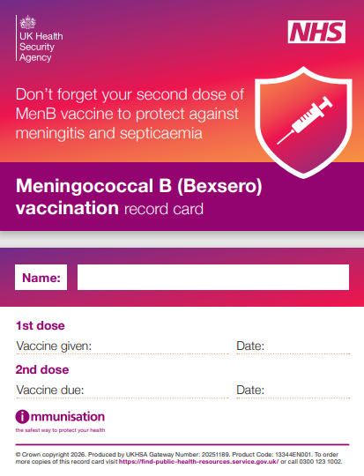
Following vaccination
record all MenB vaccines given electronically (as per local instructions) and complete a record card to give to the vaccinated individual
provide information about possible adverse reactions, how to treat these and when to seek further medical advice
inform individual a second dose will be required (details of this offer to be confirmed)
advise individual that they should remain alert to symptoms of meningitis and septicaemia

Slide 28
Need for continued vigilance following vaccination
the MenB vaccines have been developed to protect against as many common MenB strains as possible but they do not protect against all MenB strains
response to vaccination is also not immediate – it takes time for immune response to be made (at least 2 weeks from 2nd dose to produce antibodies to give a good level of protection)
continued awareness and vigilance is therefore essential, even after vaccination and antibiotic prophylaxis
those who have been vaccinated should remain alert for symptoms of meningococcal disease and seek medical attention if unwell or concerned
unlike many other vaccines, MenB vaccines do not prevent acquisition or carriage of the bacteria so cannot interrupt transmission of the infection within a community or provide indirect (herd) protection to others
MenB vaccine is being given to provide longer term protection where there is a likelihood of ongoing circulation and possible reintroduction of the bacteria to an identified population
prophylactic antibiotics are the most effective way to stop the spread of the disease so should be taken in addition to vaccination during an outbreak

Slide 29
Significant messages
meningococcal disease is caused by invasive infection with the bacterium Neisseria meningitidis, also known as meningococcus
invasive meningococcal disease most commonly presents as meningitis or septicaemia or both
following the outbreak of invasive meningococcal disease in Kent, in addition to antibiotic prophylaxis, a targeted MenB vaccination programme has been recommended
the MenB vaccine has been offered to millions of children, adolescents and adults worldwide for more than 10 years and has a good safety profile
following vaccination, individuals should continue to remain alert for symptoms of meningococcal disease and seek medical attention if unwell or concerned

Slide 30
Useful links
Meningococcal: the green book, chapter 22 - GOV.UK
Outbreak of invasive meningococcal disease, South East England - GOV.UK
Cases of invasive meningococcal disease notified in Kent - GOV.UK
Meningococcal disease outbreak resources - GOV.UK
University vaccine communications toolkit
Meningitis: signs and symptoms leaflet and poster - GOV.UK
Meningitis and septicaemia: information for students - GOV.UK
Meningitis and septicaemia: poster for new university entrants - GOV.UK
Meningitis Research Foundation www.meningitis.org/
Meningitis Now www.meningitisnow.org
Meningitis – NHS

