Slide 1
Taking a good quality dried blood spot (DBS) for children on the selective neonatal hepatitis B pathway
Last update: May 2025

Slide 2
Content
information about the free dried blood spot (DBS) service provided by UKHSA
the importance of taking a good quality bloodspot
what is in the DBS kit and how to complete the forms
how to prepare for and take a good quality bloodspot
how to recognise and avoid taking an incorrect blood spot sample
what to do after taking the sample
actions for healthcare providers
additional sources of information on DBS testing

Slide 3
Learning objectives
By the end of this session, you should be able to:
understand the rationale for the DBS testing for children
understand the importance of taking a good quality blood spot
describe how to prepare for and take a good quality blood spot
understand how to use the tenderfoot safety device
describe what a poor-quality blood spot looks like and how to avoid taking one
understand what to do after taking the sample
understand how to signpost to additional sources of information

Slide 4
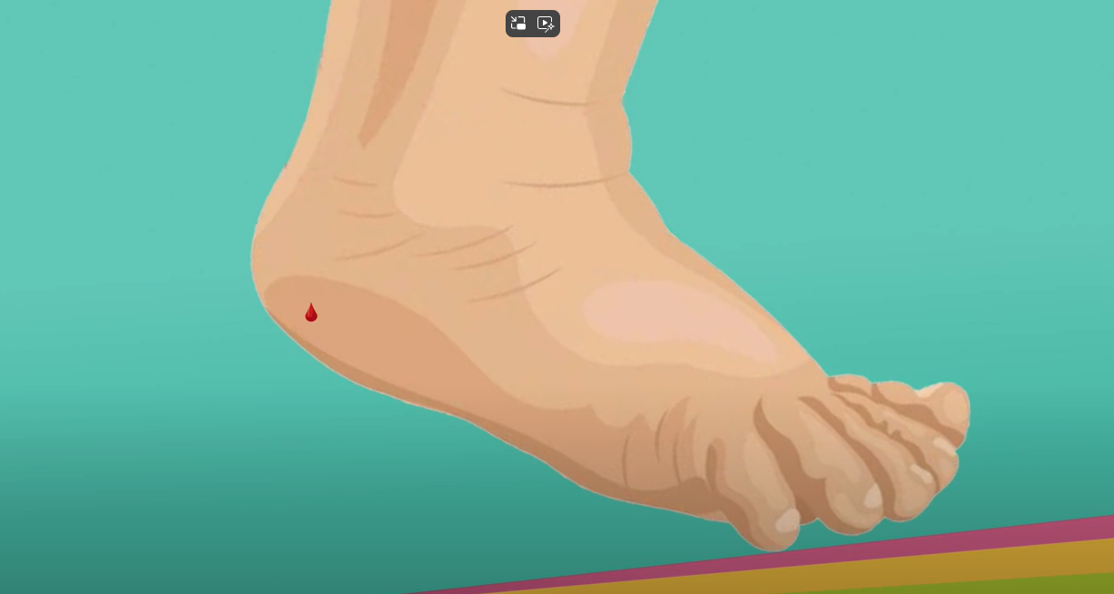


Helpful information to know before taking a DBS
Before taking a DBS, you may find it helpful to familiarise yourself with the following key documents and video:
Selective neonatal Hepatitis B immunisation and screening pathway – YouTube video demonstrating how to take a good quality blood spot. The timing of DBS testing and vaccination changed on 1 July 2025, however the process for DBS testing remains the same.
information and resources on the national DBS testing service Hepatitis B dried blood spot (DBS) testing for infants - GOV.UK
Guidance on the hepatitis B antenatal screening and selective neonatal immunisation pathway has practical information for healthcare practitioners providing advice on the selective neonatal hepatitis B immunisation pathway. It includes the vaccination programme recommendations, details of the DBS service and examples of scenarios that staff may experience when immunising
Protecting your baby against hepatitis B give parents / carers the leaflet and discuss the test, recording the discussion, leaflet provision and parents' choice

Slide 5
Significant messages
taking a DBS sample in general practice has been standard practice since 2014 to support the selective programme
taking of the DBS in general practice is now the norm and isn’t that dissimilar to taking a blood glucose test using a lancet device
any time between 1 year and 18 months of age a diagnostic sample should be taken from the child to check if they have become infected with hepatitis B virus (HBV) via perinatal transmission
a DBS sample taken in primary care is the preferred method of testing, as it is quick and simple and does not require a referral to hospital paediatric phlebotomy services
GPs can arrange for HBsAg testing in a paediatric phlebotomy outpatients' clinic as an alternative method if necessary
further guidance on the pathway, including a step-by-step guide to the practice nurses' actions in relation to DBS testing and immunisation between one year and 18-months of age can be found in the document Guidance on the hepatitis B antenatal screening and selective neonatal immunisation pathway - GOV.UK
should you wish to discuss the pathway further, please contact your local screening and immunisation team who are generally best placed to support you locally

Slide 6
Rationale for the hepatitis B dried blood spot (DBS) testing for children
the aim of the post-exposure hepatitis B immunisation programme is to prevent infants and children acquiring hepatitis B virus from their mothers’ blood and body fluids to which they are exposed during birth
DBS testing provides a simple, safe and easy way to test the child at any time between 1 year and 18 months of age in primary care, for example at an opportunistic healthcare attendance or at a routine appointment
DBS testing is a free service, provided by UKHSA
A good quality DBS is vital to ensure that children who have become infected with hepatitis B are identified and treated early.

Slide 7
Importance of taking a good quality blood spot
to prevent avoidable repeat DBS testing on children
facilitate timely referral of a child who has acquired hepatitis B infection to paediatric liver specialist services
provide reassurance to families that a child has not acquired hepatitis B infection
monitor delivery and surveillance of the selective immunisation programme
inadequate samples = avoidable repeat = costly delays

Slide 8
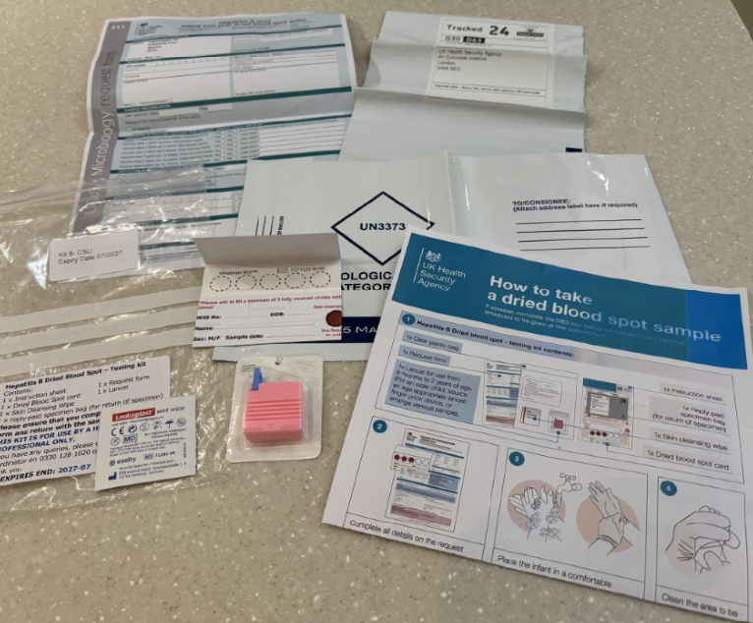
The DBS kit
The DBS testing kit includes:
request form
clear bag
skin cleansing wipe
instruction sheet
reply-paid specimen bag (for return of sample)
automated safety lancet
dried blood spot card
You will also require
child's NHS number & child health record
non-sterile protective gloves / apron
sharps box
cotton wool / gauze
hypoallergenic spot plaster

Slide 9
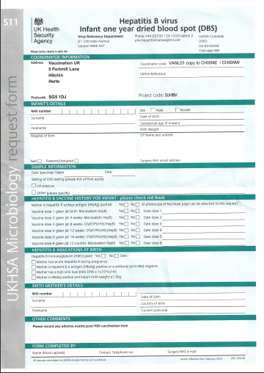
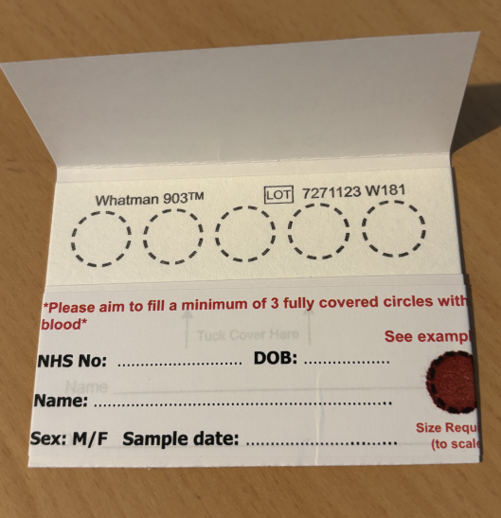
Completing the card & form
Remember ‘SEND’
Sample date
Expiry date – check the card has not expired
NHS number
Date of birth
Complete all fields on the blood spot card and request form, including demographics, child's hepatitis B vaccine history, maternal hepatitis B information and GP details.
Complete the details at the time of sampling and check the completed blood spot card with parents.

Slide 10
Preparing to take the DBS sample
check that consent for screening has been obtained and recorded
ensure the child is warm and comfortable
clean the heel with the skin cleansing wipe
allow the heel to dry completely
wash hands, dry thoroughly and wear appropriate PPE (gloves/apron) during the procedure
additional warming of the foot is not required

Slide 11
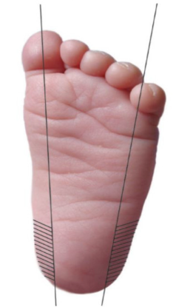
Collecting the blood sample
use the age-appropriate automated safety lancet supplied in the DBS kit
preferred area for the heel prick is the side of the heel - the shaded area
avoid the back of the heel (posterior curvature)
allow the heel to hang down to assist blood flow

Slide 12
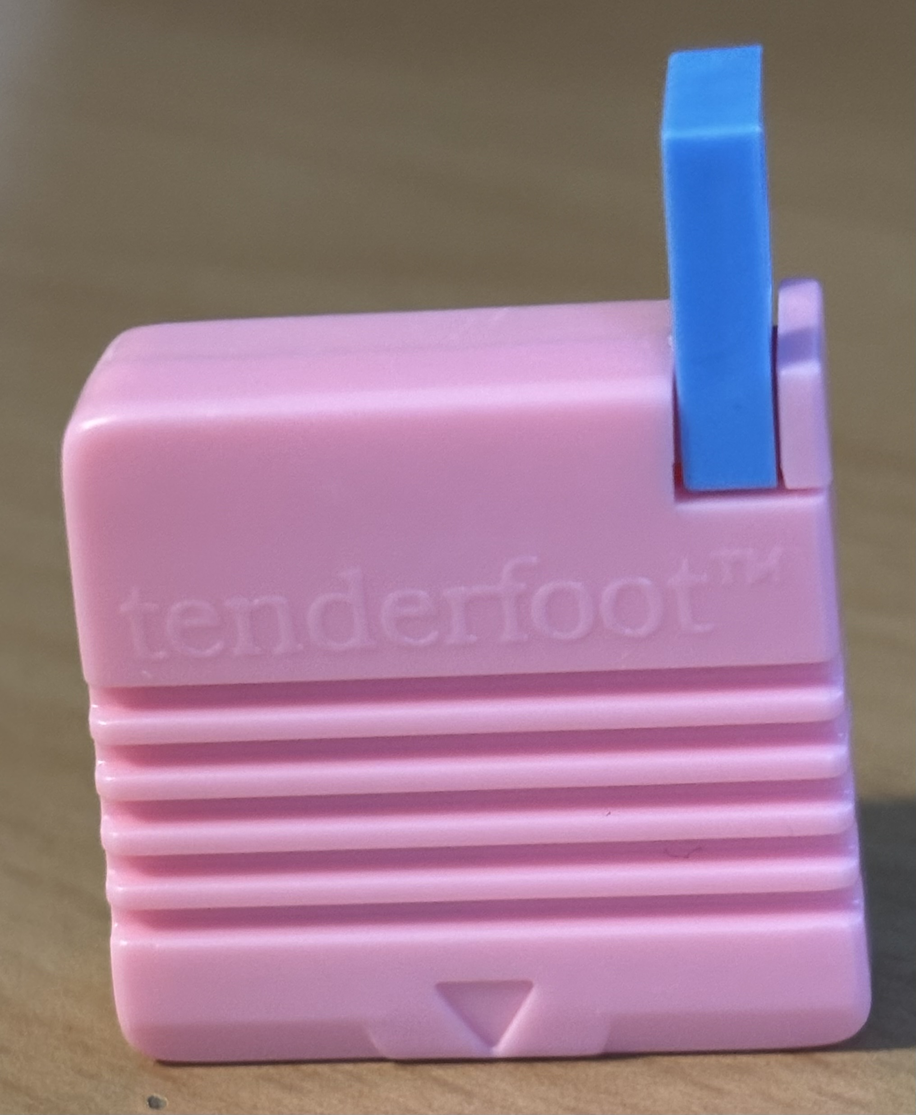
Tenderfoot device
Tenderfoot is a safe, gentle and effective heel incision device, to use:
remove the blue safety clip covering the trigger
place lancet in light contact with the side of the heel with the arrow pointing towards the child’s foot
press the trigger
dispose in a sharps box
The device provided in the DBS kit is suitable for use from 6 months to 2 years of age
For an older child, you will need to source an age-appropriate lancet/finger prick device, or arrange venous sample to be taken via paediatric phlebotomy services

Slide 13
Taking a good quality blood sample
Do
Do not
fill each circle on the card with a single drop of blood (at least three circles)
puncture the heel, wait for the blood to flow and a hanging drop to form
allow one spot of blood to drop onto each of the circles on the form
allow the blood to fill each circle by natural flow and seep through from front to back
squeeze the foot
allow the heel to make contact with the card
compress or apply pressure to the blood spot
apply multiple bloodspots to one circle
contaminate the sample

Slide 14
What to do if the blood stops flowing
wipe away any congealed blood and gently massage the foot, do not squeeze as excessive pressure reduces the density of the blood on the sample
if the child is not bleeding, a second puncture is needed. This should be on the other foot or a different part of the same foot using a new lancet sourced separately (1x lancet supplied per kit)
repeat the heel prick

Slide 15
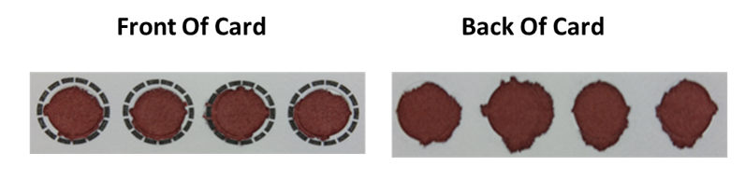
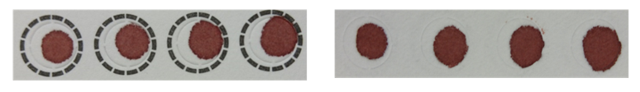
Examples of a good quality bloodspot
a single, evenly saturated drop of blood that fills, or almost fills, the circle and soaks through to the back of the blood spot card
good quality blood spots are essential to obtain a test result

Slide 16
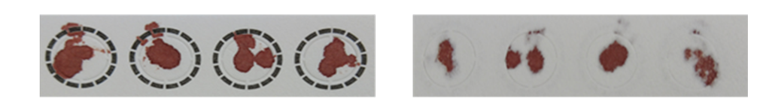
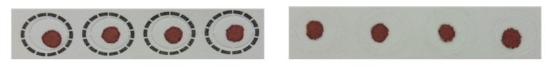
Examples of poor quality bloodspots
Front of card Back of card
inappropriate application of blood (multispotted) – would not be accepted
insufficient sample (too small volume of blood) – would not be accepted

Slide 17
Repeat samples
If a poor-quality blood spot is received or the forms are not completed, the laboratory will request another sample to test the child
Repeat samples can lead to:
children being no longer contactable by services if parents don’t bring them for a repeat test
delayed identification and treatment of a child who has acquired hepatitis B virus
Repeat samples should be taken as soon as possible

Slide 18
What to do after taking the sample
wipe excess blood from the heel and apply gentle pressure with cotton wool / gauze
apply a spot plaster if necessary
allow the blood spots to air-dry away from direct sunlight or heat (up to 10 minutes)
once completely dry, fold the top of the card over the blood spot and place in the clear plastic bag with the fully completed request form
place the clear plastic bag into the tracked prepaid envelope provided
using a Royal Mail post box, dispatch on the same day (or within 24 hours)
ensure the post box is one that is emptied daily (Monday to Saturday)
before posting make a note of the number shown under the barcode (which ends in GB) and record taking the DBS sample in the child’s red book and in GP notes (if applicable)
inform the parent/guardian that their GP will receive the result after 3 weeks

Slide 19
Actions following taking of the DBS sample
GPs and other providers should ensure that:
all eligible children (including those who move into the area after birth) are identified and offered DBS testing
all children whose parents accept DBS are tested
all samples arrive at the laboratory in a timely manner
all children with a positive result receive timely referral into specialist services
all parents / carers receive the DBS result in a timely manner
Any questions – please contact phe.hepatitisbbabies@nhs.net or telephone 0330 128 1020 option 2 Hepatitis B Babies

Slide 20
Resources for healthcare practitioners
information and resources on the national DBS testing service can be accessed via: https://www.gov.uk/guidance/hepatitis-b-dried-blood-spot-dbs-testing-for-infants
Guidance on the hepatitis B antenatal screening and selective neonatal immunisation pathway has practical information for healthcare practitioners providing advice on the selective neonatal hepatitis B immunisation pathway.
Selective neonatal hepatitis B immunisation and screening pathway this short film includes a physical demonstration of the technique to take a dried blood spot test. The timing of DBS testing and vaccination changed on 1 July 2025, however the process for DBS testing remains the same.
Aide memoire for healthcare practitioners
The Green Book: Immunisation against infectious disease: Hepatitis B chapter 18
General information on hepatitis B is available from: https://britishlivertrust.org.uk/information-and-support/liver-conditions/hepatitis-b/
https://www.nhs.uk/vaccinations/hepatitis-b-vaccine/

Slide 21
Resources for pregnant women
Leaflets for pregnant women are available to order now. This includes:
Protecting your baby against Hepatitis B: product code 410230B
Visit the Find public health resources website for availability of resources in different languages and formats

