Slide 1
Introduction of the Measles, Mumps, Rubella and Varicella (MMRV) vaccine into the routine childhood vaccination schedule
Training slides for healthcare practitioners
November 2025

Slide 2
Notes for users
this slide set contains a collection of core slides for both individual use and for use or adaptation during the delivery of MMRV vaccination training
trainers should select the slides required depending on the background and experience of the healthcare practitioners they are training and according to the role they will have in delivering the MMRV vaccine programme
the information in this slide set was correct at time of publication
  updates to the slide set may be required in the future, for example in response to changing epidemiology or vaccination recommendations - please check online to ensure you are using the latest version of these slides
the next slide contains information about the contents, which can be used to select which section(s) you require

Slide 3
Contents
background and outline of the MMRV vaccination programme
information about measles, mumps, rubella and varicella infections
aim, experience and effectiveness of MMRV vaccination
eligibility and scheduling information
information about the MMRV vaccines
MMRV vaccine administration
contraindications and possible adverse reactions
summary and additional sources of information

Slide 4
Aims of this resource
to revise knowledge about measles, mumps, rubella and varicella diseases
to inform healthcare practitioners about the MMRV vaccines and the new MMRV vaccine programme
to support and educate healthcare practitioners involved in discussing immunisation against measles, mumps, rubella and varicella with parents or carers

Slide 5
Learning outcomes
After completing this training, healthcare practitioners will be able to:
describe the aetiology and epidemiology of measles, mumps, rubella and varicella disease with specific reference to the UK
advise and inform parents/carers of those children who are eligible about the MMRV vaccine programme and the importance of receiving this vaccine
identify sources of additional information and resources

Slide 6
Background (1)
the JCVI has been reviewing the latest evidence and considering vaccination strategies for protection against varicella and herpes zoster since 2009
although at this time, they considered both the possibility of a combined varicella and herpes zoster (shingles) vaccination programme, a shingles only vaccination programme was recommended
this was due to a concern that with a varicella vaccination programme resulting in less or no natural exposure to varicella, adults who had previously had varicella would no longer have their varicella immunity boosted
this loss of natural boosting (‘exogenous boosting’) could result in reactivation of the varicella virus and cause them to develop shingles
an older adult shingles vaccination programme was introduced in 2013

Slide 7
Background (2)
the varicella zoster JCVI sub-committee met in 2022 and 2023 to review the latest evidence including:
  varicella disease burden
  potential impact on exogenous boosting
  updated seroprevalence data
  cost-effectiveness modelling
  real-world data from countries who have already implemented a varicella vaccine programme
evidence showed that
  complications from severe varicella were common, costly and placed a burden on health services
  there was no evidence that a varicella vaccination programme would increase herpes zoster incidence

Slide 8
JCVI recommendations
  In October 2023, the JCVI recommended a universal varicella (chickenpox) vaccination programme should be introduced as part of the routine childhood schedule
  They recommended:
  this should be a 2-dose programme offering vaccination routinely at 12 and 18 months of age using the combined MMRV (measles, mumps, rubella and varicella) vaccine
  there should be a catch-up programme for older children without a history of chickenpox following implementation of the routine programme to help accelerate control and to further reduce transmission in the population
  For more information see: JCVI statement on a childhood varicella (chickenpox) vaccination programme - GOV.UK (www.gov.uk)
Notes:
There is more information at the following links:
JCVI statement on a childhood varicella (chickenpox) vaccination programme - GOV.UK (www.gov.uk)
JCVI Minutes of the meeting held on 04 October 2023
JCVI Minutes of the meeting held on 07 February 2024
JCVI Minutes of the meeting held on 04 June 2025

Slide 9
Reminder of recent schedule changes
introduction of MMRV vaccine forms part of the second phase of changes to the childhood immunisation programme
phase one included changes to the infant programme and the introduction of a new appointment at 18-months of age
From 1st July 2025:
the meningococcal B vaccine, previously offered at 8 and 16 weeks, is now offered at 8 and 12 weeks of age
the pneumococcal conjugate vaccine (PCV13), previously offered at 12 weeks of age, is now offered at 16 weeks of age
as manufacturing of Hib/MenC (Menitorix®) vaccine has been discontinued but a dose of Hib vaccine is still required over 12-months of age, a 4th dose of DTaP/IPV/Hib/HepB at a new vaccination appointment at 18 months has been introduced
this new appointment also allowed for the second dose of MMR to be brought forward from 3 years and 4 months to 18 months of age

Slide 10
Changes from 1st January 2026
from 1st January 2026, varicella vaccination will be introduced into the routine childhood immunisation schedule using the combined MMRV vaccine
children due their first or second MMR vaccine from 01 January 2026 should be offered a combined MMRV vaccine instead of MMR
older children (born from 01/01/20) without a history of chickenpox will be offered a dose of MMRV in a catch-up programme to help accelerate control and further reduce transmission of chickenpox in the population
the one-dose MMRV selective catch-up programme will be delivered between 1 November 2026 to 31 March 2028
These changes are detailed in the UKHSA/NHSE letter available on gov.uk website:
“The introduction of a routine varicella (MMRV) vaccination programme for children aged one year and 18 months, with catch-up to age 6 years in England”

Slide 11
Measles

Slide 12
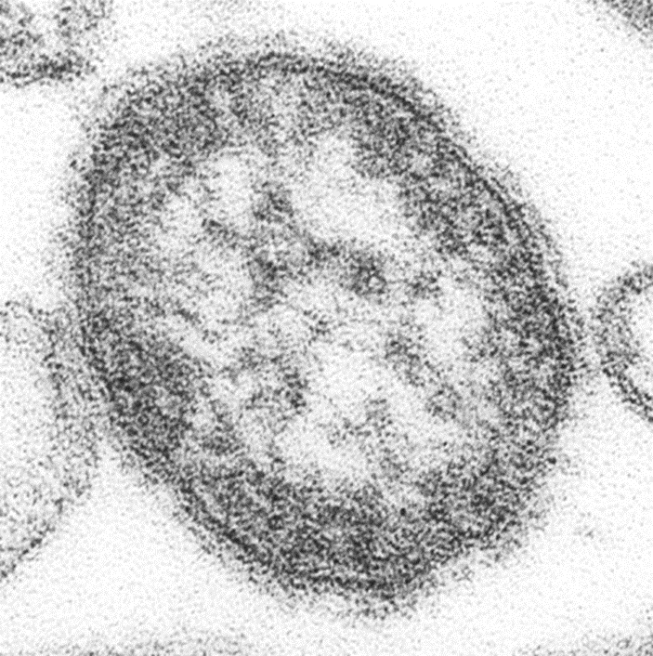
Measles: carriage, transmission, infectivity and incubation
measles is an acute viral illness caused by a morbillivirus of the paramyxovirus family
measles is one of the most highly infectious diseases in the world: one person with measles can infect 9 out of 10 people around them if they are not immune
measles is spread very easily from person to person by respiratory droplets which may persist in the air for several hours
individuals are infectious from when the first symptom appears to 4 days after the appearance of the rash. The risk assessment for exposure includes 4 days prior to rash onset.
the incubation period is about 10 days (ranging between 7 and 18 days) with a further 2 to 4 days before the rash appears
Electron micrograph of measles virus. Image courtesy of CDC/ Cynthia S. Goldsmith; William Bellini

Slide 13
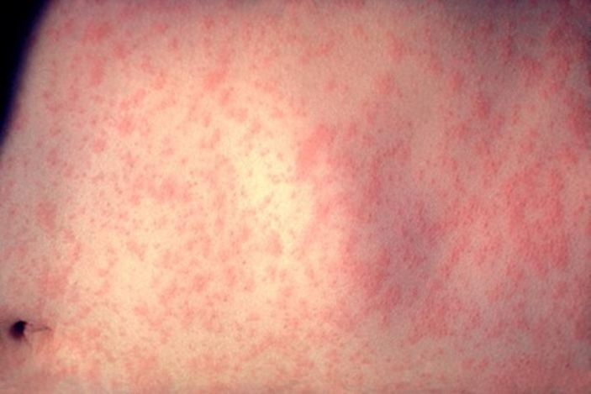
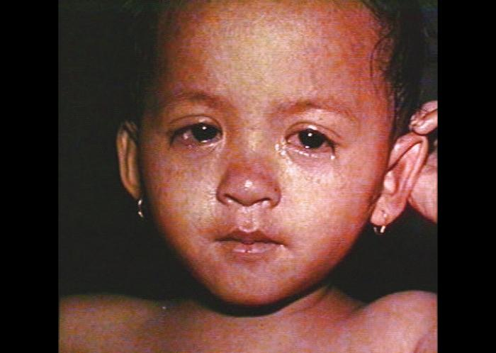
Measles: clinical presentation
the first symptoms to appear (prodromal stage) are fever, malaise, coryza, conjunctivitis and cough
a few days later, a red maculopapular rash appears, starting at the head and spreading to the trunk and limbs over 3 to 4 days
most people will feel better after 7 to 10 days, however measles can lead to complications such as ear and chest infections, fits and diarrhoea and dehydration in younger children
around one in every 15 children with measles will develop more serious complications which may include:
  Otitis media (7 to 9 in 100)
  Convulsions (1 in 200)
  Pneumonia (1-6 in 100)
  Encephalitis (1 in 1000)
  Sub-acute sclerosing panencephalitis (SSPE) (1 in 25,000)
  Death (1 in 1000-5000)
Measles rash. Image courtesy of CDC/ Heinz F Eichenwald, MD
Measles rash and conjunctivitis. Image courtesy of CDC/ Barbara Rice
Notes:
Sub-acute sclerosing panencephalitis (SSPE) is a rare, but fatal, late complication of measles occurring in 1 in 25,000 cases of measles. It occurs at a higher rate in individuals who had measles infection very young. The risk is 16 times greater for measles under the age of one, compared with measles at 5 years or older. Measles is more severe in adults and neonates.
In high-income regions of the world, such as Western Europe, measles still causes death in about 1 in 5000 cases. In the poorest regions, as many as 1 in 100 may die. In the 21st century, in England and Wales, there have been nine acute deaths due to measles. Five of these cases occurred in individuals who rely solely on herd immunity for protection as they had underlying immunological problems and so would not have been able to be vaccinated themselves.

Slide 14
Measles epidemiology
since the introduction of the measles vaccine in 1968, more than 20 million measles cases and 4,500 deaths have been prevented in the UK
however, uptake of the routine childhood vaccinations including MMR has declined in England over the last decade and is well below the 95% target set by the World Health Organization (WHO) in order to prevent outbreaks and achieve elimination
due to this sub-optimal uptake, since 2023 there has been a resurgence of measles in the UK
in 2024 alone there were around 3000 laboratory confirmed measles cases in England, the highest number recorded annually since 2012
the vast majority of cases in this resurgence have been in unvaccinated children under the age of 10 years with many outbreaks linked to nurseries and schools
more than 1 in 10 eligible children under the age of 5 in England haven’t had MMR vaccine or are only partially vaccinated
ensuring children receive MMR-containing vaccine is a priority in order to prevent further measles cases and outbreaks
Notes:
Since the autumn of 2023, regional outbreaks and an overall national exceedance in measles cases led the UK Health Security Agency (UKHSA) to declare a national standard incident. Initially focussed on populations within the West Midlands, outbreaks have occurred in other regions (such as London). Outbreaks and sporadic cases across the country have resulted in the highest number of measles cases in England since 2012 with 63% of cases in children aged 10 years old and under.
More information available at: What is measles and why is it so important we’re all up to date with our MMR vaccine? – UK Health Security Agency and Measles | UKHSA data dashboard

Slide 15
Mumps

Slide 16
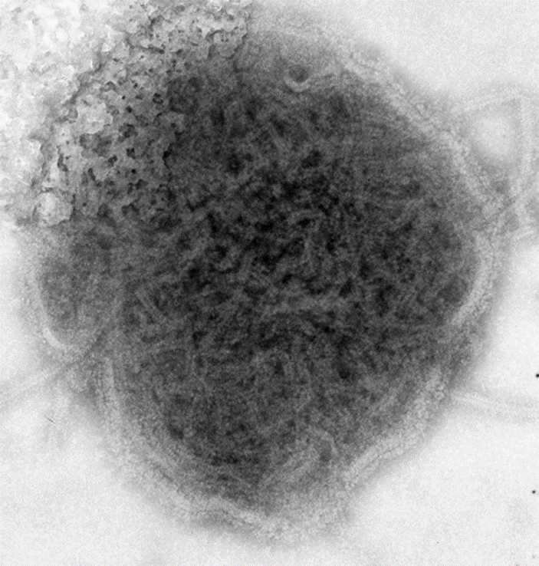
Mumps: carriage, transmission, infectivity and incubation
mumps is an acute viral illness caused by a paramyxovirus
it is spread through respiratory droplets and close contact
the incubation period is around 16 to 18 days (range: 14 to 25 days)
individuals with mumps are infectious from about a week before the onset of parotid swelling to several days after it appears
Electron micrograph of mumps virus.
Image courtesy of CDC/ Dr FA Murphy

Slide 17
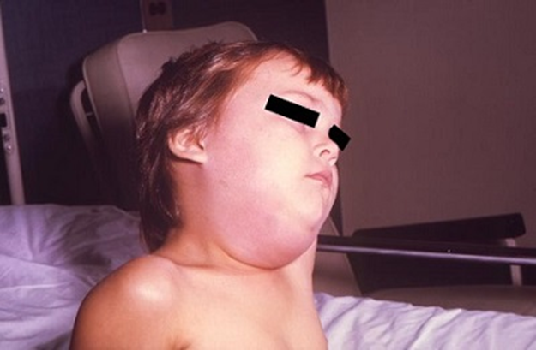
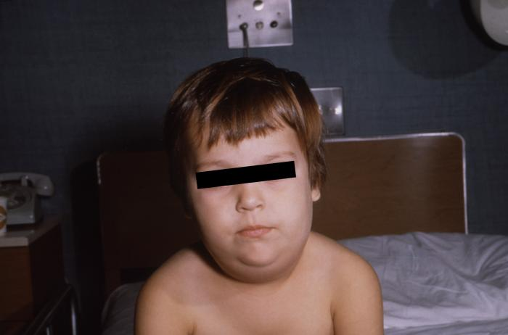
Clinical presentation of mumps
before MMR vaccine was introduced in 1988, mumps caused around 1200 hospital admissions each year in England and Wales and it was the most common cause of both viral meningitis and acquired deafness in children
asymptomatic mumps infection is common (20 to 40% of cases), particularly in children. In individuals who do develop symptoms, these may include:
  bilateral or unilateral swelling of the parotid glands at the side of the face just under ears
  fever
  headache
  malaise
  myalgia
  anorexia
mumps can lead to a wide range of complications, including:
  meningitis: 5 in 100
  encephalitis: 1 in 1000
  epididymo-orchitis 15 to 30 in 100
  transient hearing loss: 4 per 100
  oophoritis (inflammation of the ovaries): 5 per 100
  pancreatitis: 4 per 100
  death: 5 per year in pre-vaccine era (mainly due to encephalitis)
Swelling of the salivary glands in child with mumps.
Images courtesy of CDC/Dr. Charles N. Farmer

Slide 18
Mumps epidemiology
before the MMR vaccine was introduced in 1988, about 80% of the population in the UK developed mumps
high coverage of MMR vaccine resulted in a substantial reduction in mumps transmission in the UK
from 1989, mumps cases dramatically declined in all age groups
since then, there have been several large outbreaks of mumps over the years, with the largest seen in 2005 (with over 43 000 notifications) and more recently in 2019 (with 5042 notifications)
many of these cases were seen in young adults who missed out on the MMR vaccine when they were children due to unfounded concerns about the vaccine or because they didn't have the vaccine as part of the catch-up campaigns or only had one dose
in comparison with years prior to 2020, there have been very few cases of mumps in the past 5 years

Slide 19
Rubella

Slide 20
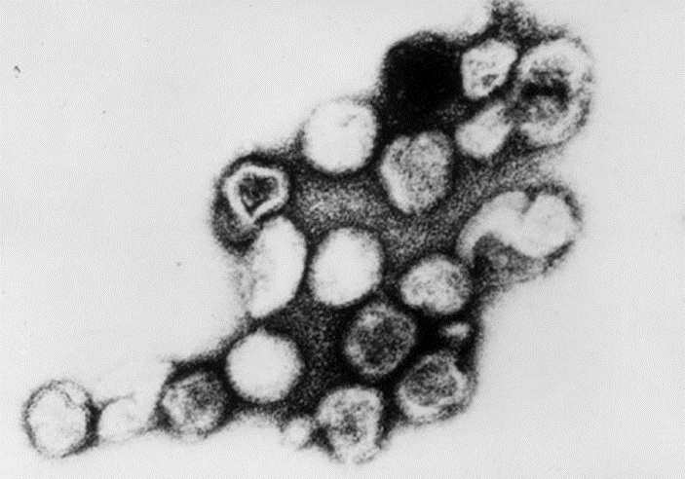
Rubella: carriage, transmission, infectivity and incubation
rubella is caused by a virus in the Togavirus family
transmission of rubella is by direct contact or droplet spread
incubation period is 14 to 21 days, with the majority of individuals developing a rash 14 to 17 days after exposure
infectious period is a week before to a week after onset of the rash
Electron micrograph of rubella virus.
Image courtesy of CDC/ Dr Erskine Palmer

Slide 21
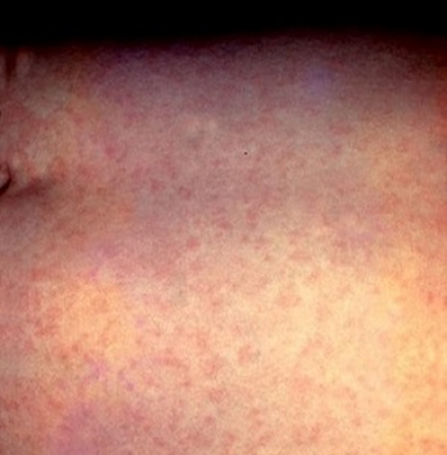
Clinical presentation of rubella
rubella is often asymptomatic with no more than a fleeting rash. If symptomatic, it is usually mild. Symptoms can include:
  mild fever
  cold-like symptoms
  feeling generally unwell
  conjunctivitis
  an erythematous rash, mostly seen on the face and neck
transient arthralgia or arthritis sometimes occurs in adults and adolescents, especially in women and girls
rare complications include idiopathic thrombocytopenic purpura (low platelets) and encephalitis
if a pregnant woman contracts rubella, the foetus can be severely damaged resulting in congenital rubella syndrome (CRS) which can present with one or more of the following:
  cataracts and other eye defects
  deafness
  cardiac abnormalities
  microcephaly
  intra-uterine growth retardation
  inflammatory lesions of brain, liver, lungs and bone marrow
infection in the first 10 weeks of pregnancy is associated with a 90% risk of damage to the developing foetus
Rubella rash.
Image courtesy of CDC

Slide 22
Rubella epidemiology and overview
before the introduction of rubella immunisation, rubella occurred commonly in children, and more than 80% of adults had evidence of previous rubella infection
rubella immunisation was introduced in the UK in 1970 for pre-pubertal girls and non-immune women of childbearing age to prevent rubella infection in pregnancy and congenital rubella syndrome (CRS) in their babies
universal immunisation against rubella using the MMR vaccine was introduced in 1988 with the aim of interrupting circulation of rubella among young children, thereby protecting susceptible adult women from exposure
the introduction of MMR brought a considerable decline in rubella in young children, with a concomitant fall in rubella infections in pregnant women: from 167 in 1987 to 1 in 2003
from 1970 to 2017 it is estimated that rubella vaccination has averted 1,300 CRS births and 25,000 terminations.
the childhood rubella vaccination programme alone is estimated to have averted 1.4 million cases of rubella in the UK
the WHO confirmed that the UK achieved rubella elimination in 2016 and there are now very few confirmed cases of rubella in the UK

Slide 23
Varicella (chickenpox)

Slide 24
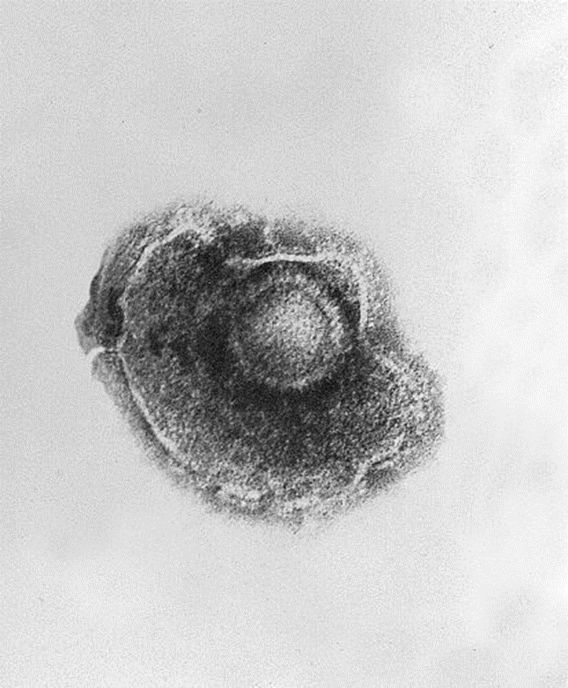
Chickenpox: transmission, infectivity and incubation
chickenpox is a highly infectious disease caused by the varicella zoster virus
the virus is spread by direct contact with the fluid-filled vesicles or inhalation of aerosols generated from vesicular fluid
the incubation period for chickenpox is 14 to 16 days (range 10 to 21 days)
individuals with chickenpox are infectious from up to 24 hours before the rash appears until spots have scabbed over
the secondary infection rate from household contact with chickenpox is approximately 71%
Electron micrograph of the chickenpox virus
Image courtesy of CDC/Dr. Erskine Palmer; B.G. Partin.

Slide 25
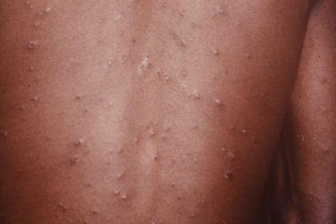
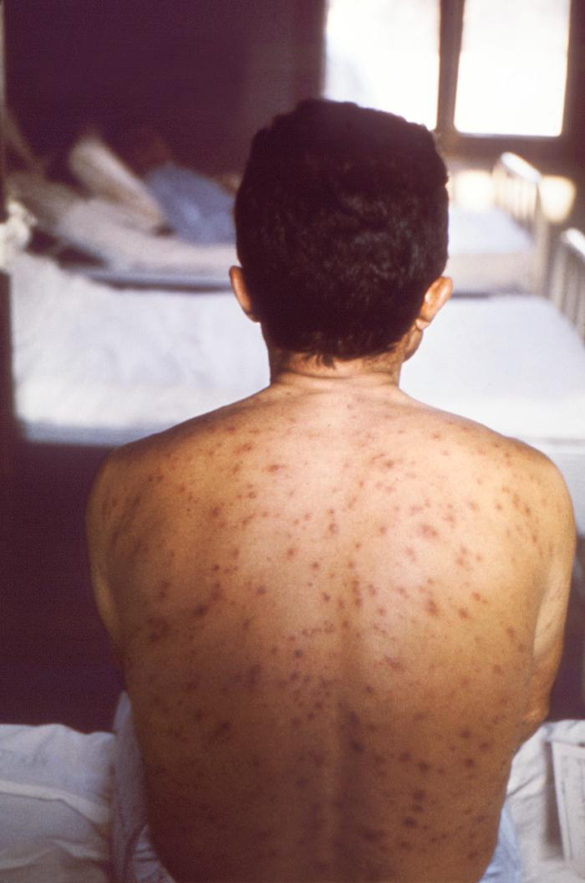
Clinical presentation of chickenpox
infection is characterised by an itchy rash with fluid-filled spots which starts on the face and spreads to the trunk before starting to scab over after 3 to 4 days
there may be a prodrome of fever and malaise 1-2 days prior to rash onset
in most children the disease is unpleasant but has no lasting effects other than scarring at the site of the vesicles, especially if they have been scratched
some individuals have very few spots whilst others have so many they merge together
potential complications of varicella infection include:
  pneumonia
  secondary bacterial infection of the skin with Group A Streptococcus or Staphylococcus aureus; either of these can lead to septicaemia
  encephalitis and ataxia
if a pregnant woman is infected, depending on gestational stage, the baby may develop congenital varicella syndrome (CVS)
CVS can include limb hypoplasia, microcephaly, cataracts, growth retardation and skin scarring or the baby may develop severe varicella; either could result in death
Chickenpox rash on the trunk
Image credit: NHS digital UK
Chickenpox rash to back, head and shoulders
Image courtesy of CDC/John Noble

Slide 26
Chickenpox overview
chickenpox is very common and affects most children during childhood, although it can be caught for the first time at any age
the incidence of chickenpox is seasonal and classically reaches a peak from March to May
90% of individuals raised in the UK are immune by the age of 15 years
most chickenpox cases in children are relatively mild and self-limiting
some children develop complications from varicella which can result in hospitalisation and very rarely may result in death
Varicella zoster virus can reactivate later in life, causing herpes zoster (shingles)

Slide 27
MMRV vaccination programme

Slide 28
Aim of the MMRV vaccination programme
the aim of the MMRV vaccination programme is to continue to protect children from, and reduce the incidence and severity of, measles, mumps, rubella and varicella infections
the programme adds varicella protection to existing protection against MMR
as has been shown in other countries which include varicella in their routine vaccination schedule, the 2-dose schedule for younger children is predicted to rapidly and dramatically decrease the number of cases of varicella seen in childhood
the programme will prevent severe cases of varicella, and other serious complications from the infection, which while rare, may result in hospitalisation or other serious outcomes

Slide 29
Experience of varicella vaccination in other countries
varicella vaccination is included in the routine vaccine schedules of several countries, either as a 2-dose or single-dose strategy, including the USA, Canada, Australia and Germany.
countries that have introduced varicella vaccine programmes have observed significant impact on cases of varicella and resulting hospitalisations
since the varicella vaccination programme was introduced in the USA in 1995, it is estimated that more than 91 million varicella cases, 238 000 hospitalisations, and almost 2000 deaths have been averted
in countries introducing a 2-dose schedule, younger cohorts not eligible for vaccination have also seen reduced incidence because of reduced community transmission
there is no evidence of increased rates of infection among those ineligible for vaccination due to their age following introduction of a vaccination programme

Slide 30
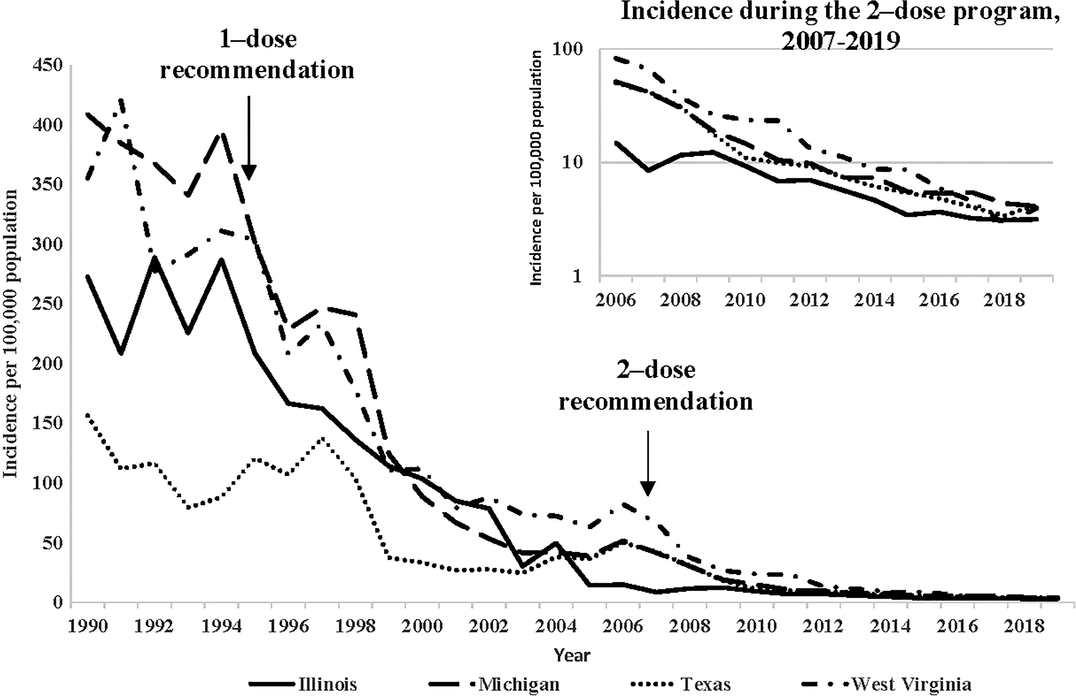
Decline in varicella cases in the USA since varicella vaccination programme introduced
Varicella incidence in 4 US states
1990 to 2019
From: Marin et al. Monitoring Varicella Vaccine Impact on Varicella Incidence in the United States: Surveillance Challenges and Changing Epidemiology, 1995–201.The Journal of Infectious Diseases, Volume 226, Issue Supplement_4, 1 November 2022, Pages S392–S39

Slide 31
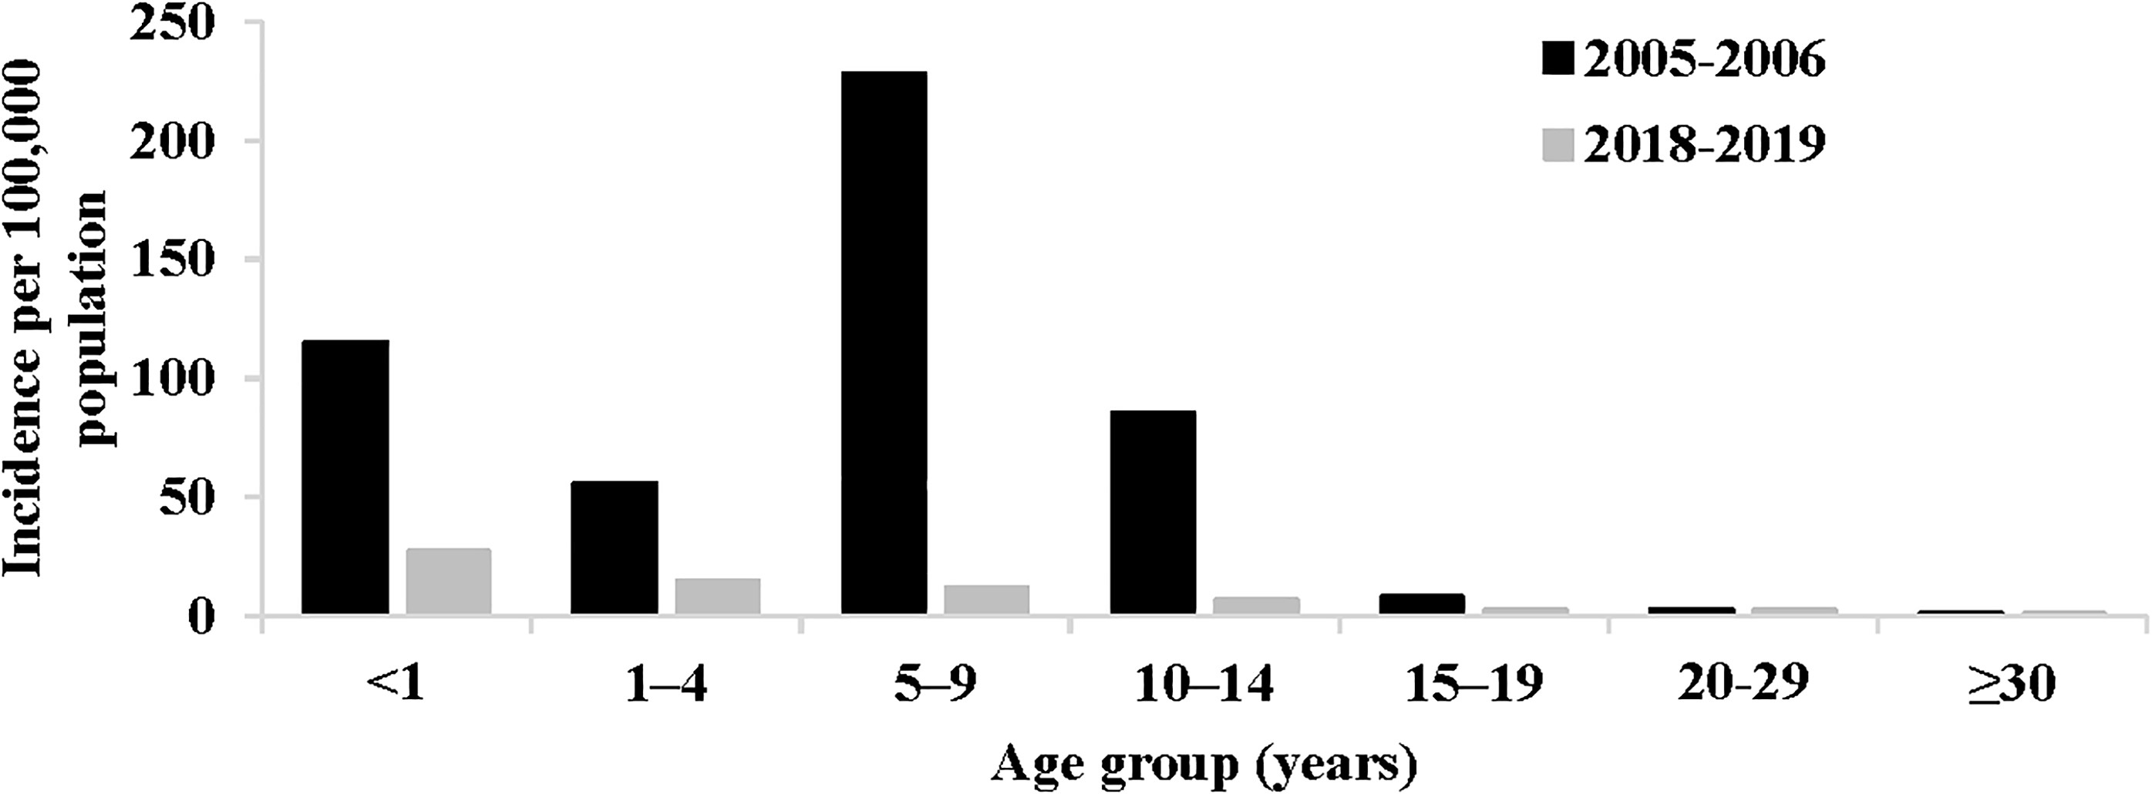
Decline in varicella cases in the USA since 2 dose vaccination programme introduced
Reported varicella incidence, by age group—United States, National Notifiable Diseases Surveillance System data, 2018–2019 compared with 2005–2006
Marin et al. Monitoring Varicella Vaccine Impact on Varicella Incidence in the United States: Surveillance Challenges and Changing Epidemiology, 1995–201.The Journal of Infectious Diseases, Volume 226, Issue Supplement_4, 1 November 2022, Pages S392–S39
Notes:
This graph demonstrates that in the USA, after introducing a 2-dose schedule, the under 1year age group who are not eligible for vaccination have also seen reduced incidence because of reduced community transmission.
It also shows that there is no evidence of increased rates of infection among those not eligible for vaccination (in the older age groups) following introduction of a varicella vaccination programme

Slide 32
Vaccine effectiveness
Effectiveness against varicella
Varicella vaccines are estimated to have effectiveness of 93% after dose 1 and 97% after dose 2
protection is long-lasting:
  a review of studies found vaccine effectiveness against varicella after 2 doses of MMRV or MMR + V in children aged 11 to 22 months was 95% in a 10 year follow-up
  25 years of surveillance in the US has shown no decrease in vaccine effectiveness over time when using a 2 dose schedule
although breakthrough infection can occur, varicella disease is milder in vaccinated children, with fewer lesions and less fever
1 dose of varicella vaccine is extremely effective in protecting against severe varicella disease
since a varicella vaccination programme was introduced in the USA, it is estimated more than 91 million varicella cases, 238 000 hospitalisations and almost 2000 deaths have been averted
Combination with MMR
MMR vaccine is highly effective at preventing measles, mumps and rubella - one dose is 95% effective in preventing measles and this increases further with 2 doses
combination vaccines are carefully studied to ensure safety and effectiveness of all the components is not affected by combining them

Slide 33
Scheduling of routine MMRV programme from
01 January 2026
two doses of MMRV offered to children aged under one year old on 31 December 2025 (DOB on or after 01 January 2025): dose 1 at one year, and dose 2 at the new 18-month appointment
two doses of MMRV offered to children aged from one year up to 18 months on 31 December 2025 (DOB on or after 01 July 2024 to 31 December 2024) at the new 18 month appointment and at the 3 year 4 month routine appointment. These children should have already received dose 1 of MMR at one year
one dose of MMRV offered to children aged from 18 months up to 3 years 4 months on 31 December 2025 (DOB on or after 01 September 2022 to 30 June 2024) at their 3 year 4 month routine appointment (instead of MMR). These children should have already received dose 1 of MMR at one year
any child with an incomplete immunisation history for their age should be managed according to the UKHSA uncertain or incomplete immunisation algorithm and the information provided in the ‘MMRV information for healthcare practitioners’

Slide 34
Scheduling of selective MMRV programme
A one-dose MMRV selective catch-up programme will be delivered between 01 November 2026 to 31 March 2028:
one dose will be offered to any children aged from 3 years 4 months to under 6 years on 31 December 2025 (DOB on or after 01 January 2020 to 31 August 2022) with no history of chickenpox disease or two doses of varicella vaccination
children presenting for the selective catch-up do not require MMRV vaccine if parents volunteer that the child has had previous chickenpox infection or two prior varicella-containing vaccines
there is no requirement for practices to check the history for those who respond to the catch-up offer
there are no safety concerns with giving the vaccine to a child who has already had chickenpox infection or previous varicella vaccination

Slide 35
MMRV vaccination eligibility by date of birth
Date of Birth | Age on 31 December 2025 | New Programme from 01 January 2026 | Child’s full schedule for MMR/MMRV
01/01/2025 or later | Under 1 year | Two doses of MMRV at 12m and 18m | 12m – MMRV 18m – MMRV
01/07/2024 to 31/12/2024 | 1 year to under 18m | Two doses of MMRV at 18m and 3y4m This cohort was eligible to receive dose 1 of MMR at 12m | 12m – MMR 18m – MMRV 3y4m – MMRV
01/09/2022 to 30/06/2024 | 18m to under 3y4m | One dose of MMRV at 3y4m | 12m – MMR 3y4m – MMRV
01/01/2020 to 31/08/2022 | 3y4m to under 6y | Selective catch-up from 01 Nov 2026 to 31 Mar 2028 for those who have not yet had chickenpox infection or two doses of varicella vaccination There is no requirement for practices to check the history for those who respond to the offer | 12m – MMR 3y4m – MMR MMRV catch-up offer
31/12/2019 or before | 6y and older | Not eligible | 12m – MMR 3y4m – MMR
Notes:
The right hand column shows what a child who has been completely vaccinated for age according to the previous and current routine vaccine schedules will have/will receive. If they have missed a dose of MMR, there is no need to give this now – they should be offered MMRV instead so that they receive at least 2 doses of MMR-containing vaccine.
It does not matter that some children will receive 3 MMR-containing vaccines. If they have already made antibodies to measles, mumps or rubella following a previous dose, these antibodies will neutralise the vaccine virus in subsequent doses.

Slide 36
Older children and adults
MMR vaccine will no longer be available for the NHS routine childhood programme from 01 January 2026
MMR vaccine will be available for administration outside of the routine childhood programme e.g. for catching up older individuals (DOB on or before 31 December 2019) who have not received two doses of MMR and are not eligible for MMRV
children aged 6 years and above at the start of the programme (DOB on or before 31 December 2019) are not eligible for MMRV vaccination via the routine NHS MMRV programme: if not fully vaccinated, they should be offered MMR vaccine
some older children and/or adults may be eligible for varicella-only vaccine outside of the national schedule (those who are non-immune healthy susceptible close household contacts of immunocompromised individuals or non-immune healthcare workers)
if MMRV is the only vaccine available at the time an unimmunised individual born on/before 31 December 2019 presents, MMRV should be given if it is felt that the individual would not return if asked to wait until MMR vaccine was available or if immediate protection is required

Slide 37
MMRV vaccines

Slide 38
MMRV vaccines
two MMRV vaccines will be available for the routine immunisation programme: ProQuad (MSD) and Priorix-Tetra (GSK)
ProQuad and Priorix-Tetra are live attenuated vaccines which contain weakened forms of the viruses that cause measles, mumps, rubella, and varicella
as the vaccine virus is ‘weakened’ it does not cause the disease itself, but it does cause the immune system to respond in the same way it does to natural infection, thereby promoting a full, long-lasting antibody response
both vaccines have been licensed for a number of years and are used in several other countries including Australia, Canada and Germany
the vaccines are considered clinically equivalent and interchangeable
the MMRV vaccine offers the same level of protection against measles, mumps and rubella as the MMR vaccine but will also protect against varicella
a ‘varicella-only’ vaccine will not be offered in the NHS routine or selective catch-up programmes

Slide 39
Priorix-Tetra
Priorix-Tetra will be provided in 10 dose packs: 10 x single dose powder in a vial and 10 x single dose diluent (solvent) in a pre-filled syringe
in addition to the live attenuated viruses, Priorix-Tetra also contains
  Amino acids (containing phenylalanine)
  Lactose anhydrous
  Mannitol (E 421)
  Sorbitol (E 420)
  Medium 199 (containing phenylalanine, para-aminobenzoic acid, sodium and potassium)
  This vaccine contains a trace amount of neomycin
the solvent is water for injections
Priorix-Tetra does not contain porcine gelatine
this MMRV vaccine should be offered to children whose parents/carers do not wish them to receive a vaccine containing porcine gelatine

Slide 40
Preparation and administration of Priorix-Tetra
Priorix-Tetra is presented as a powder in a vial with a solvent for solution in a pre-filled syringe
before reconstitution, the powder is a whitish to slightly pink coloured cake, a portion of which may be yellowish
the solvent is a clear colourless liquid
the vaccine is reconstituted by adding the entire contents of the pre-filled syringe of solvent to the vial containing the powder
the reconstituted vaccine should be visually inspected; its colour may vary from clear peach to fuchsia pink due to minor variations of its pH
it may contain translucent product-related particulates which is normal for this vaccine but if the vaccine presents with other colouration or contains other particulate matter do not administer
one reconstituted dose is 0.5mL

Slide 41
Priorix-Tetra
Please note that whilst it states ‘1 dose 0.5ml’ in the bottom right corner of the box and on the side of the box, this refers to the volume of vaccine (0.5ml) which should be given per dose.
The box itself contains 10 doses of MMRV vaccine

Slide 42
ProQuad
ProQuad will be provided in single dose packs: 1 x pre-filled syringe containing solvent + 1 vial of powder + 2 unattached needles
one reconstituted dose is 0.5mL
in addition to the live attenuated viruses, ProQuad also contains:
  Sucrose
  Hydrolysed gelatin
  Sodium chloride
  Sorbitol (E 420)
  Monosodium glutamate
  Sodium phosphate
This vaccine may contain traces of recombinant human albumin (rHA)
the solvent is water for injections
ProQuad contains porcine gelatine
(Priorix-Tetra should be offered to children whose parents/carers do not wish them to receive a vaccine containing porcine gelatine)
  Sodium bicarbonate
  Potassium phosphate
  Potassium chloride
  Medium 199 with Hanks’ Salts
  Minimum Essential Medium, Eagle
  Neomycin
  Phenol red
  Hydrochloric acid (to adjust pH)
  Sodium hydroxide (to adjust pH)
  Urea

Slide 43
Preparation and administration of ProQuad
ProQuad is presented as a powder in a vial with a solvent for solution in a pre-filled syringe
before reconstitution, the powder is a white to pale yellow compact crystalline cake, a portion of which may be yellowish
the solvent is a clear colourless liquid
the vaccine is reconstituted by adding the entire contents of the pre-filled syringe of solvent to the vial containing the powder
gently agitate the vial to dissolve completely
when completely reconstituted, the vaccine is a clear pale yellow to light pink liquid
the reconstituted vaccine should be visually inspected for any foreign particulate matter and/or abnormal physical appearance prior to administration. In the event of either being observed, discard the vaccine
one reconstituted dose is 0.5mL

Slide 44
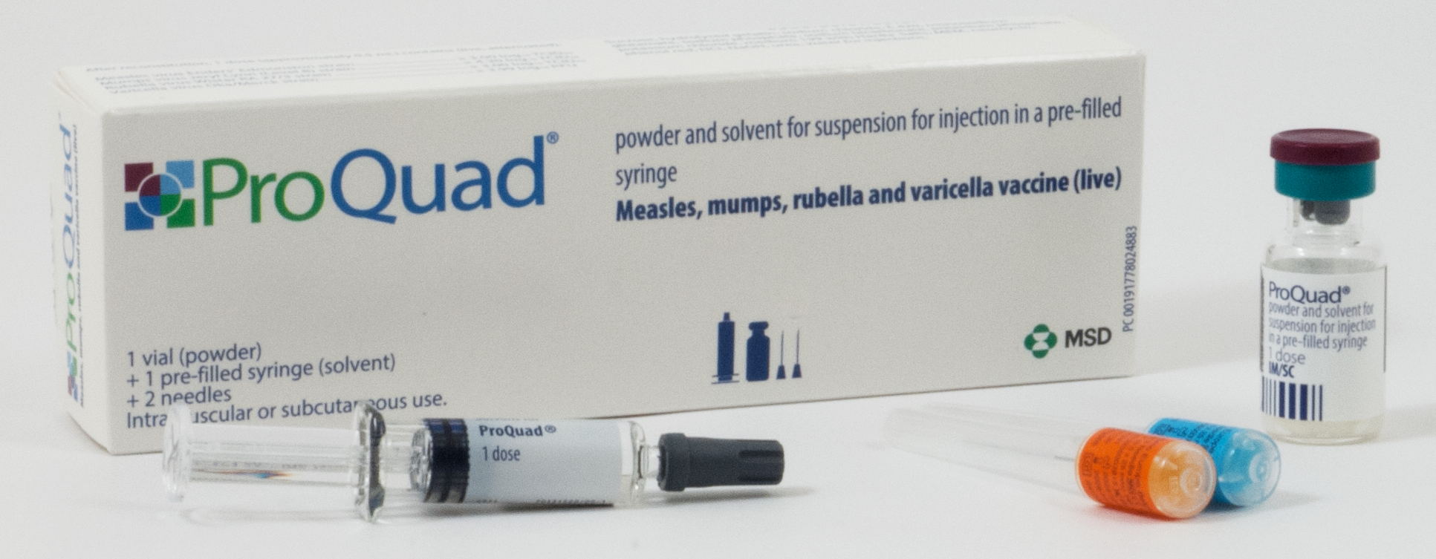
ProQuad

Slide 45
MMRV vaccine administration

Slide 46
Dose and scheduling
both vaccines should be given as 0.5ml intramuscular injections
the routine schedule is 2 doses (children in the selective catch-up programme will receive 1 dose)
doses should be given as per the new routine schedule but where given to catch up a child behind schedule, they can be given a minimum of 4 weeks apart
some children will be eligible to receive three MMR-containing vaccines; there are no safety concerns with this approach
MMRV can be given at the same time as, or at any interval before or after, other live and inactivated vaccines (except for Yellow Fever vaccine where a 4 week interval is required)

Slide 47
MMRV vaccine storage and administration
Storage
both ProQuad and Priorix-Tetra should be stored in a vaccine refrigerator between +2°C and +8°C
they should be stored in their original packaging to
  protect them from light
  ensure that the component parts are kept together
  retain the batch number and expiry date for the entire product which is printed on the outer vaccine carton
Administration
once reconstituted, ProQuad and Priorix-Tetra should be administered immediately
although ProQuad and Priorix-Tetra can be administered via the intramuscular route (IM) or subcutaneously (SC), for the national immunisation programme, it is recommended they are administered IM
MMRV vaccine can be administered into the deltoid area of the upper arm or the anterolateral aspect of the thigh

Slide 48
Legal authorisation
all vaccines are classified as prescription only medicines (POMs)
this means that they are subject to legal restrictions and there needs to be an appropriate legal framework in place before they can be supplied and or administered
any person who supplies and administers a vaccine must have a legal authority to do so
this legal authority may be in the form of a written patient specific prescription, a Patient Specific Direction (PSD) or a Patient Group Direction (PGD)
the UK Health Security Agency (UKHSA) has developed and published an MMRV PGD which will be available to download from the Immunisation PGD templates collection webpage
the UKHSA immunisation PGD templates require further authorisation in Section 2 of the PGD document before they can be used as the PGD is not legal or valid without signed authorisation

Slide 49
Contraindications and possible adverse reactions

Slide 50
Contraindications and precautions
The MMRV vaccine should not be given to:
those who are immunosuppressed (see the Green Book Contraindications and special considerations chapter and Varicella chapter for more detail)
pregnant women (and pregnancy should be avoided for one month following the last dose of varicella vaccine)
those who have had
  a confirmed anaphylactic reaction to a previous dose of the vaccine
  a confirmed anaphylactic reaction to any component of the vaccine, including neomycin or gelatine
Varicella-containing vaccines are not recommended for infants aged under 9 months
Immunisation of individuals who are acutely unwell with a fever should be postponed until they have recovered fully
this is to avoid confusing the diagnosis of any acute illness by wrongly attributing any sign or symptoms to the adverse effects of the vaccine
the presence of a minor illness, such as the common cold, is not a contraindication to immunisation
Notes:
There are very few individuals who cannot receive MMRV vaccine. When there is doubt, appropriate advice should be sought from a consultant paediatrician, the local screening and immunisation team, or consultant in public health rather than withholding the vaccine

Slide 51
Possible adverse reactions
studies conducted worldwide have found varicella-containing vaccines to be well tolerated and rarely associated with serious adverse events
adverse events following MMRV vaccines (except allergic reactions) are typically due to effective replication of the vaccine viruses which can cause subsequent mild illness. Events typically occur:
    six to 11 days post-vaccination (due to measles component)
    two to three weeks post-vaccination (mumps and rubella components)
    three to four weeks post-vaccination (varicella component)
individuals with a varicella-like rash post-vaccination may be infectious to others but individuals with other vaccine-associated symptoms are not
overall rates of adverse reactions after MMRV-containing vaccines are similar or lower in second and subsequent doses compared to first doses
the most common adverse reactions to MMRV include injection site reactions (such as pain/tenderness, redness and swelling), and fever, irritability, and rash (including a measles- or varicella-like rash)

Slide 52
Post-vaccination varicella rash
some individuals may develop a varicella vaccine-associated rash around the site of the injection
children can attend childcare and educational settings but vesicles should be kept covered as a precaution
very rarely, children may develop a varicella-like rash either disseminated or localised away from the site of the injection within 1 month of vaccination
a disseminated rash is more likely to be due to natural varicella infection than the vaccine virus; children should be reviewed by a clinician and recent exposure considered
Transmission
transmission of varicella vaccine virus from immunocompetent vaccinees to susceptible close contacts is possible but the risk is very low
transmission of vaccine virus in absence of a post-vaccination rash has not been documented
if a localised vaccine-related rash develops away from the site of injection, lesions should be covered to further reduce the risk of transmission
if rash is disseminated, the risk is higher, and immunosuppressed people with significant exposure to the vaccinated child should be offered post-exposure prophylaxis in line with guidance
immunocompetent pregnant contacts can be reassured that the risk of infection is very low
Notes:
Full guidance can be found at: www.gov.uk/government/publications/post-exposure-prophylaxis-for-chickenpox-and-shingles

Slide 53
Febrile convulsions
Febrile convulsions
can occur when a child develops a high temperature caused by any typical childhood illness;
are self-limiting with no long-term consequences
most common between 6 months to 6 years of age; 2 to 5% of children will experience febrile convulsions before the age of 5
Risk following MMRV
small increase in risk of febrile convulsions in the 5 to 10 days following 1st dose of MMRV
risk estimated to be approximately 1 per 1,000 doses in the 7 to 10 days following vaccination; this is slightly higher than following the first dose of MMR
risk following vaccination is much lower than the risk following measles infection (1 per 43 cases)
parents should be advised of this low but possible risk and advised to seek medical attention if their child has a febrile convulsion
as fever following vaccination with MMRV vaccine may occur at any point within 2 weeks of vaccination, there is no need for the child to be offered prophylactic paracetamol prior to administration of the MMRV vaccine
children can receive paracetamol if they develop any post-vaccine related symptoms
no increased risk of febrile convulsions associated with 2nd dose

Slide 54
Encephalitis
encephalitis is a known complication of wild-type varicella and measles infections, associated with approximately 2 to 3 in 100,000 cases and 100 in 100,000 cases respectively
post-marketing surveillance of varicella-containing vaccines has found a small number of cases of encephalitis which occurred after vaccination but an association has not been quantified
15 years of surveillance of adverse events following varicella vaccination in the USA recorded 22 cases of encephalitis following MMRV: 0.06 cases per 100,000 doses
varicella zoster virus was detected in 1 of these cases, but was not strain-typed
the risk of encephalitis associated with natural varicella and measles infections is far greater than the risk following vaccination

Slide 55
Idiopathic thrombocytopenic purpura (ITP)
ITP is a blood disorder when the immune system attacks and destroys platelets (which are required for blood clotting)
ITP may occur following MMRV vaccination and is most likely due to the rubella component
this usually occurs within six weeks and resolves spontaneously
ITP occurs in about 1 in 22,300 children who are given a first dose of MMR in the second year of life and this is likely to be similar following MMRV
the risk of developing ITP after MMRV vaccination is much less than the risk of developing it after infection with wild measles or rubella virus
children with previously diagnosed ITP do not have an increased risk of ITP following MMR-containing vaccination
there is no evidence of an association between ITP and the second MMR dose; there is insufficient data on outcomes following the second dose for children who experienced ITP following the first dose
if ITP occurs following the first dose of MMRV then blood should be tested for measles antibodies before a second dose is given
if the results suggest a lack of protection against measles, then a second dose of MMRV is recommended
serological testing for the mumps, rubella, and varicella components is not recommended

Slide 56

Reporting suspected adverse reactions
  all suspected adverse reactions in children to the MMRV vaccine should be reported to the Medicines and Healthcare product Regulatory Agency (MHRA) using the Yellow Card scheme http://mhra.gov.uk/yellowcard
  the MHRA carefully monitor the safety of all vaccines
  the success of the Yellow Card scheme depends on early, complete and accurate reporting
  report even if uncertain about whether the vaccine caused the condition
  the Green Book Surveillance and monitoring for vaccine safety chapter contains further details about adverse event reporting

Slide 57
Summary and resources

Slide 58
Summary
from 1 January 2026, varicella vaccination will be introduced into the routine childhood immunisation schedule using the combined MMRV vaccine
children due their first or second MMR vaccine from 1 January 2026 should be offered a combined MMRV vaccine instead of MMR
older children (born from 1 January 2020) without a history of chickenpox or 2 doses of varicella-containing vaccine will be offered a dose of MMRV in a catch-up programme to help accelerate control and further reduce transmission of chickenpox in the population
children born after 1 January 2025 are eligible for two doses of MMRV at 12 and 18 months of age
children born between 1 July 2024 and 31 December 2024 are eligible for two doses of MMRV at 18 months and 3 years 4 months of age
children born between 1 September 2022 and 30 June 2024 are eligible for one dose of MMRV at 3 years 4 months
children born between 1 January 2020 and 31 August 2022 are eligible for a single dose (to be offered in a catch-up programme between 01 November 2026 to 31 March 2028)

Slide 59
Resources
MMRV programme detailed in the UKHSA/NHSE letter: “The introduction of a routine varicella (MMRV) vaccination programme for children aged one year and 18 months, with catch-up to age 6 years in England” (31 October 2025)
Joint Committee on Vaccination and Immunisation (JCVI) statement on a childhood varicella (chickenpox) vaccination programme November 2023
range of resources and guidance for healthcare practitioners, parents and carers will be published on Immunisation - GOV.UK webpage and Discover the public health resource library
measles, mumps, rubella and varicella Green Book chapters, PGDs and existing resources will be updated
further information about potential questions that may arise will be available in the “MMRV vaccination programme for children Information for healthcare practitioners” guidance on GOV.UK

