Slide 1
Respiratory Syncytial Virus (RSV) vaccination programme for older adults
Training slide set for healthcare practitioners
Version 4
Last update: March 2026

Slide 2
Contents
Learning objectives (slide 3), pre-requisites (4), significant messages (5)
RSV disease: what is RSV (7), transmission (8), symptoms (9), UK epidemiology (10), epidemiology in adults (11), treatment and prevention (12), immunisation (13)
RSV vaccination of older adults’ programme: aim (15), schedule and dose (16), eligibility (2026 programme expansion) (17), when to vaccinate (18)
Abrysvo® vaccine: pharmaceutical information (20), excipients (21), how it works (22), effectiveness (23), safety (24), contraindications & precautions (25), co-administration: flu vaccine (26), other vaccines (27), adverse reactions (28), reporting adverse reactions (29)
Vaccine preparation: pack contents (31), preparing the vaccine (32 - 36)
Resources: patient resources (38), information for healthcare practitioner guidance (39), further information(40)
*this slide set focuses on the RSV vaccination programme for older adults. There is a separate slide set for the RSV vaccination of pregnant women for infant protection on the RSV immunisation page on the gov.uk website

Slide 3
Learning objectives
By the end of this session, you should be able to:
explain what RSV is and be aware of the UK epidemiology
understand the rationale for the RSV older adult vaccination programme
describe how Abrysvo® RSV vaccine works
identify the groups that are eligible to receive an RSV vaccine
describe the process of consent and how this applies when giving vaccines
understand the legal mechanisms by which immunisers can supply and administer Abrysvo® RSV vaccine
describe how to correctly store, prepare and administer Abrysvo® RSV vaccine
communicate key facts in response to questions from individuals and/or their carer(s) and direct them to additional sources of information
Notes:
After working through these slides, users are advised to revisit this list of objectives to check that they have been met

Slide 4
Prerequisites for administering RSV vaccines
Before administering the RSV vaccine, you should have:
undertaken training in the management of anaphylaxis and Basic Life Support (BLS) (adult) as specified by the policy for your local area
undertaken any additional statutory and mandatory training as required by your employer
undertaken theoretical and practical vaccination training and been assessed as competent
undertaken specific training on the RSV vaccination programme and familiarised yourself with the process for preparation of Abrysvo®
accessed and familiarised yourself with the following key documents: the Green Book Part 1: principles, practices and procedures and RSV chapter, Respiratory syncytial virus (RSV) programme: information for healthcare professionals and the vaccine product information in the Summary of Product Characteristics (electronic medicines compendium website)
an appropriate legal framework to supply and administer RSV vaccine in place for example patient specific prescription, Patient Specific Direction (PSD), Patient Group Direction (PGD)
Notes:
The UKHSA template PGD for RSV vaccination of older adults must be further authorised before use. See: Immunisation patient group direction (PGD) templates - GOV.UK.

Slide 5
Significant messages
respiratory syncytial virus (RSV) causes hundreds of thousands of infections across the UK each winter in the young and the old
RSV is an important cause of lower respiratory tract infections in older adults, resulting in illness (including pneumonia), admissions and deaths
RSV vaccine has been offered to individuals aged 75 to 79 years old since September 2024
population-level reductions in RSV admissions have been seen since the introduction of the older adult vaccination programmes in England and Scotland
based on emerging evidence of clinical effectiveness (including international evidence on 80 years and older) and safety, and resultant favourable cost-effectiveness assessment, the JCVI has since advised (July 2025) that the programme be extended
therefore, from April 2026, the programme will additionally include individuals aged 80 years and above and adults (aged 18 years and above) who are resident in care homes for older adults, irrespective of their age
the RSV vaccine protects for at least two years. Studies are ongoing to see how long protection lasts. There are no data currently to support second doses in older adults
those with a role in delivering the RSV vaccine programme need to be knowledgeable, confident and competent in order to promote confidence in the vaccination programme and deliver the vaccine safely
Notes:
See JCVI statements: Respiratory syncytial virus (RSV) immunisation programme for infants and older adults: JCVI full statement, 11 September 2023 - GOV.UK (www.gov.uk); Joint Committee on Vaccination and Immunisation (2025). Respiratory syncytial virus (RSV) immunisation programme for adults aged 80 years and older: JCVI advice, 16 July 2025 (www.gov.uk)
and:
Hardelid P, Pebody R and Andrews N. Mortality caused by influenza and respiratory syncytial virus by age group In England and Wales 1999 to 2010. Influenza and Other Respiratory Viruses 2012: 1(7), 35-45.
Li Y and others. Adjusting for case under-ascertainment in estimating RSV hospitalisation burden of older adults in high income countries: a systematic review and modelling study. Infectious Diseases and Therapy 2023: 12, 1137-1149.
Fleming DM and others. Modelling estimates of the burden of respiratory syncytial virus infection in adults and the elderly in the United Kingdom. BMC Infectious Diseases 2015: 15, 443.

Slide 6
RSV disease

Slide 7
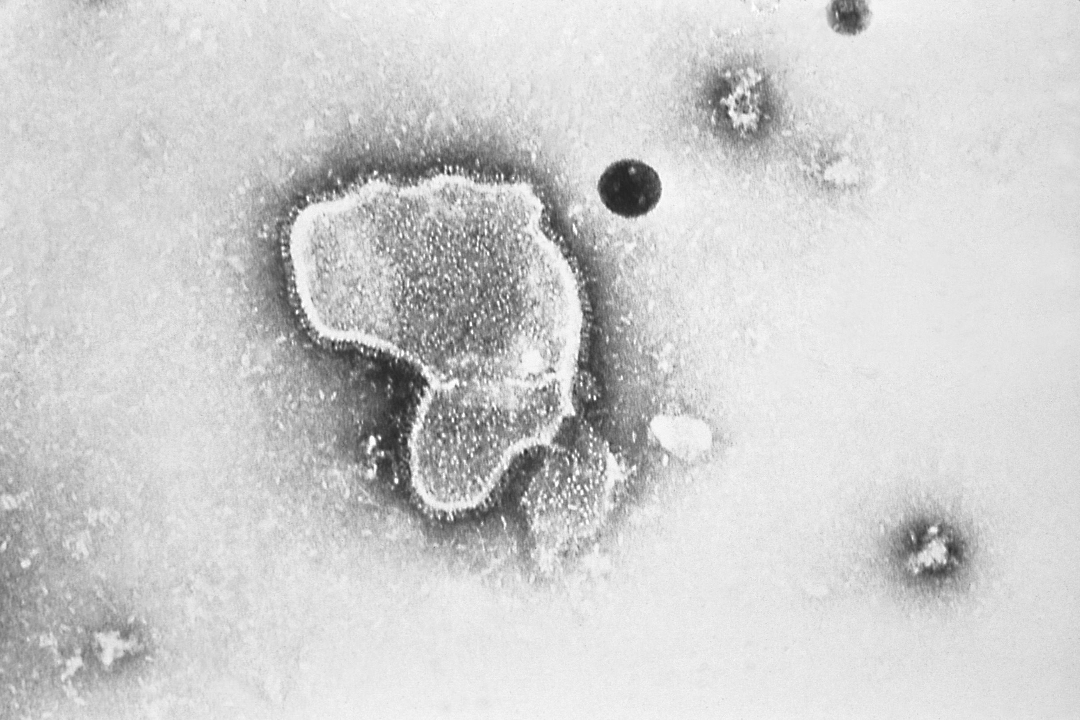
What is RSV
respiratory syncytial virus (RSV) is a common cause of respiratory tract infections
it usually causes a mild self-limiting respiratory infection in adults and children but can cause acute lower respiratory tract infection in infants and older adults, sometimes severely, including pneumonia
RSV is best known for causing bronchiolitis in infants, a leading cause of admissions each winter. RSV disease may be under-recognised in older adults
previous infection by RSV gives only partial immunity to RSV and so individuals may be infected repeatedly with the same or different strains of RSV
older adults may become vulnerable to RSV due to age-related decline of parts of their immune system (T-cell immunosenescence) as well as being more likely to have long-term medical conditions
RSV virion highly magnified by transmission electron microscopic​
Image courtesy of the CDC

Slide 8
Transmission of RSV
RSV is highly communicable (easily spread)
the virus is spread from respiratory secretions following close contact with an infected person via respiratory droplets or contact with contaminated surfaces or objects
humans are the only known host for the virus
the incubation period (time between infection and appearance of symptoms) varies from 2 to 8 days (usually 3 to 5 days)
the virus can survive on surfaces or objects for about 4 to 7 hours

Slide 9
RSV symptoms
for most people, RSV infection causes a mild respiratory illness
RSV can cause a range of symptoms such as rhinitis (runny nose, sneezing or nasal congestion), cough, shortness of breath, fever, lethargy and decreased appetite
symptoms can progress to acute lower respiratory tract infection
short or long-term complications may include respiratory complications and physical deconditioning
RSV may manifest as exacerbations of underlying diseases like COPD

Slide 10
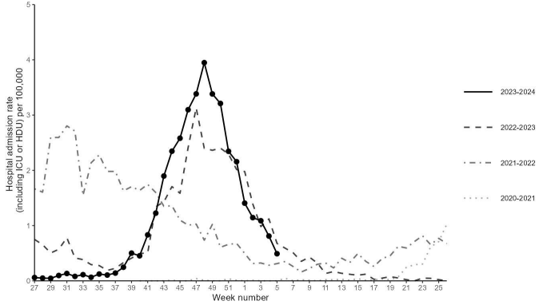
RSV epidemiology in adults
RSV infection is more common in winter, rising from October, peaking in Dec/Jan and declining by March
The latest surveillance data show that for every 200 flu admissions there are in older adults each winter, around 100 adults are admitted for RSV, showing how important it is as a cause of severe disease.
Around one-in-ten older adults admitted for RSV does not survive, which is similar to flu.
RSV has been estimated to account for 175,000 annual GP episodes in those age 65 years and older in the UK
UKHSA monitors levels of RSV activity in England throughout the RSV season - epidemiological data are available at gov.uk/government/collections/weekly-national-flu-reports
Weekly overall hospital admission rates (including ICU or HDU) of RSV positive cases per 100,000 population reported through SARI Watch sentinel surveillance, England
Notes:
The RSV season was interrupted by control measures against the COVID-19 pandemic which resulted in unseasonal RSV activity; this included significant rebound activity in summer 2021 and summer 2022 and a very prolonged period of virus activity in 2022.

Slide 11
Treatment and prevention
there is no specific treatment suitable for RSV and treatment is therefore aimed at supporting the patient and relieving symptoms
transmission can be reduced through standard infection control practices such as respiratory hygiene (including face coverings or surgical masks to reduce droplet shedding), hand washing with soap and warm water, and cleaning of surfaces
ideally, people with colds should avoid close contact with vulnerable older adults, particularly those with weakened immune systems, and co-morbidities (particularly respiratory disease)

Slide 12
Immunisation
the Joint Committee on Vaccination and Immunisation (JCVI) reviewed evidence from manufacturers on the efficacy, safety and duration of protection of the newly available vaccine products, alongside clinical and epidemiological data on the burden of RSV in infants and older adults in the UK, and advised the introduction of 2 RSV immunisation programmes: an older adults’ programme and an infant protection programme
the JCVI has more recently reviewed real-world data of the impact of the older adults’ programme since its introduction in September 2024, as well as emerging international evidence of clinical effectiveness and safety - and resultant favourable cost-effectiveness assessment - in those aged 80 years and above and advised that the programme be extended
    the older adults’ programme will be extended from 1 April 2026 (details in next section)
  the infant protection programme also commenced in September 2024; since then, all pregnant women from 28 weeks' gestation have been eligible for a single dose of vaccine, in every pregnancy, for protection of their newborn child (a separate training slide set and resources are available)
    the infant protection programme is to continue unchanged: all pregnant women should be offered this vaccine from 28 weeks’ gestation in every pregnancy
Notes:
JCVI statements: Respiratory syncytial virus (RSV) immunisation programme for infants and older adults: JCVI full statement, 11 September 2023 - GOV.UK (www.gov.uk); Joint Committee on Vaccination and Immunisation (2025). Respiratory syncytial virus (RSV) immunisation programme for adults aged 80 years and older: JCVI advice, 16 July 2025 (www.gov.uk)
JCVI has previously noted there were few participants age 80 years+ in the pivotal clinical trials, and that further data were required on clinical protection in this group. Based on emerging evidence of clinical effectiveness and safety, and resultant favourable cost-effectiveness assessment, JCVI has since advised (July 2025) that the catch-up campaign be extended to include all adults age 80 years and over, and all residents of care homes for older adults. This has been accepted as Government policy and is detailed in the programme letter: Respiratory syncytial virus (RSV) vaccination programme - GOV.UK
Offer the vaccine to all pregnant women from 28 weeks’ gestation in every pregnancy (please see “RSV vaccination of pregnant women for infant protection Information for healthcare practitioners”, available on the RSV immunisation page)

Slide 13
RSV vaccination of older adults’ programme

Slide 14
Aim
The aim of the programme is to reduce the incidence and severity of RSV disease, and hospitalisation as a result of RSV disease, in eligible older adults.
Notes:
Whilst it is possible that a small number of younger adults may receive vaccine (if they are living in a care home for older adults), the aim of the programme is to protect older adults as they are the most at risk from RSV infection.

Slide 15
Schedule and dose
The vaccine is given to older adults as a single, one-off, 0.5ml dose of Abrysvo® pre-F vaccine (Pfizer), using the full volume of the reconstituted vaccine drawn up into the syringe.
There is not currently data to support second doses in older adults.
Notes:
Two other vaccines are licensed but not in use in the UK: Arexvy and mRESVIA (see Green BOOK RSV chapter). The full duration of protection in older adults for any of these vaccines is unknown but is at least two years. There are no current data to support revaccination of older adults after a first dose. More recent data give greater certainty on the durability and efficacy of Abrysvo (and Arexvy) than mRESVIA.

Slide 16
Eligibility (2026 programme expansion)
from 1 April 2026, the offer of a single dose of RSV vaccine to all individuals from their 75th birthday will continue but an RSV vaccine should additionally be offered to:
  all adult residents in care homes for older adults (irrespective of their age)
  all adults aged 80 years and over – there is no upper age limit
individuals who were or became eligible from 1st September 2024 (individuals with dates of birth on or after 01/09/1949, upon turning 75 years of age) and who have not yet taken up the offer of vaccination remain eligible
individuals who were too old to be eligible when the programme commenced in September 2024 (born before 1 September1944) should now be offered the vaccine
individuals who have already taken up the offer of vaccination do not require a further dose
general practice teams are familiar with their local care homes and will be able to determine which homes this programme applies to
individuals aged less than 18 years of age are not eligible
individuals aged 75 years or above who are temporarily resident in a care home for older adults and who have not previously been vaccinated under the NHS RSV programme should receive a dose of RSV vaccine; adults less than 75 who are temporary residents (planned short stay for respite care or e.g. intermediate care while domiciliary care is arranged) should not ordinarily be considered under the national programme; their risk of being in an RSV outbreak during a short stay is low and as the vaccine takes a number of days to make an immune response it may be of limited benefit
Notes:
When the programme was introduced, individuals turning 80 years of age during the first year of the programme were eligible for vaccination until 31 August 2025. This was to provide sufficient time for individuals to be vaccinated. Following the JCVI statement regarding the expansion of the programme to all individuals over the age of 80, these individuals remained eligible whilst awaiting a policy decision. As the updated policy is that individuals aged 80 and above are now to be included in the programme, from 1st April 2026, anyone in this cohort who has still to take up this offer of vaccination remains eligible for a dose of RSV vaccine.

Slide 17
When to vaccinate
The RSV vaccine is a routine, year-round programme (not seasonal)
RSV vaccine can be co-administered at the same time as, or at any interval before or after administration of most other vaccines (see slide 26); seasonal flu vaccine is an exception (see slide 25)
Although vaccination can be given all year round, vaccinating as many eligible individuals as possible before the onset of the main RSV season in the winter will have the greatest impact. This will provide individuals with protection and could reduce transmission of the virus.
  For those eligible for the catch-up campaign, as many as possible should be vaccinated prior to the expected RSV season.
  For those turning 75 years of age between March and October each year, the vaccine should ideally be given by the end of October before RSV activity increases, otherwise soon after turning 75 if this occurs during the RSV season (November to February).
For operational purposes, it is recommended that during the initial roll out of the programme extension the RSV vaccine is delivered alongside the COVID-19 vaccine as part of the Spring 2026 COVID-19 campaign; delivering both programmes at the same time will reduce the number of appointments/ visits to care homes that are required
the COVID-19 campaign also provides another opportunity to re-offer RSV vaccine to eligible individuals who have not previously received it
eligible individuals who wish to receive both vaccines but decline the option of co-administration should be offered the outstanding dose as soon as practicable (by the end of the campaign for COVID-19 vaccine, no time limit for RSV vaccine)
Notes:
The spring 2026 COVID-19 vaccination campaign commences 13th April 2026. For individuals who are eligible for both vaccines, providers may choose to offer RSV vaccine from 1st April 2026 rather than wait until 13th April but doing so would require additional appointments/ care home visits
Any adult less than 75 years who is newly admitted to a care home for older adults should be offered a single dose of Abrysvo (Pfizer RSV pre-F vaccine). Existing adult residents of care homes for older adults should be offered RSV vaccination as part of the catch-up programme. Revaccination is not currently recommended and people vaccinated against RSV by the NHS as a care home resident prior to the age of 75 years should not be offered an additional dose on reaching that age. Similarly, those being admitted to a care home for the first time above the age of 75 do not require any additional RSV dose, through the admission may be an opportunity to confirm vaccination status. Note that the timing of the offer will be important in ensuring protection ahead of and during any subsequent RSV season. Please see national programme letters for further details.

Slide 18
Abrysvo® vaccine

Slide 19
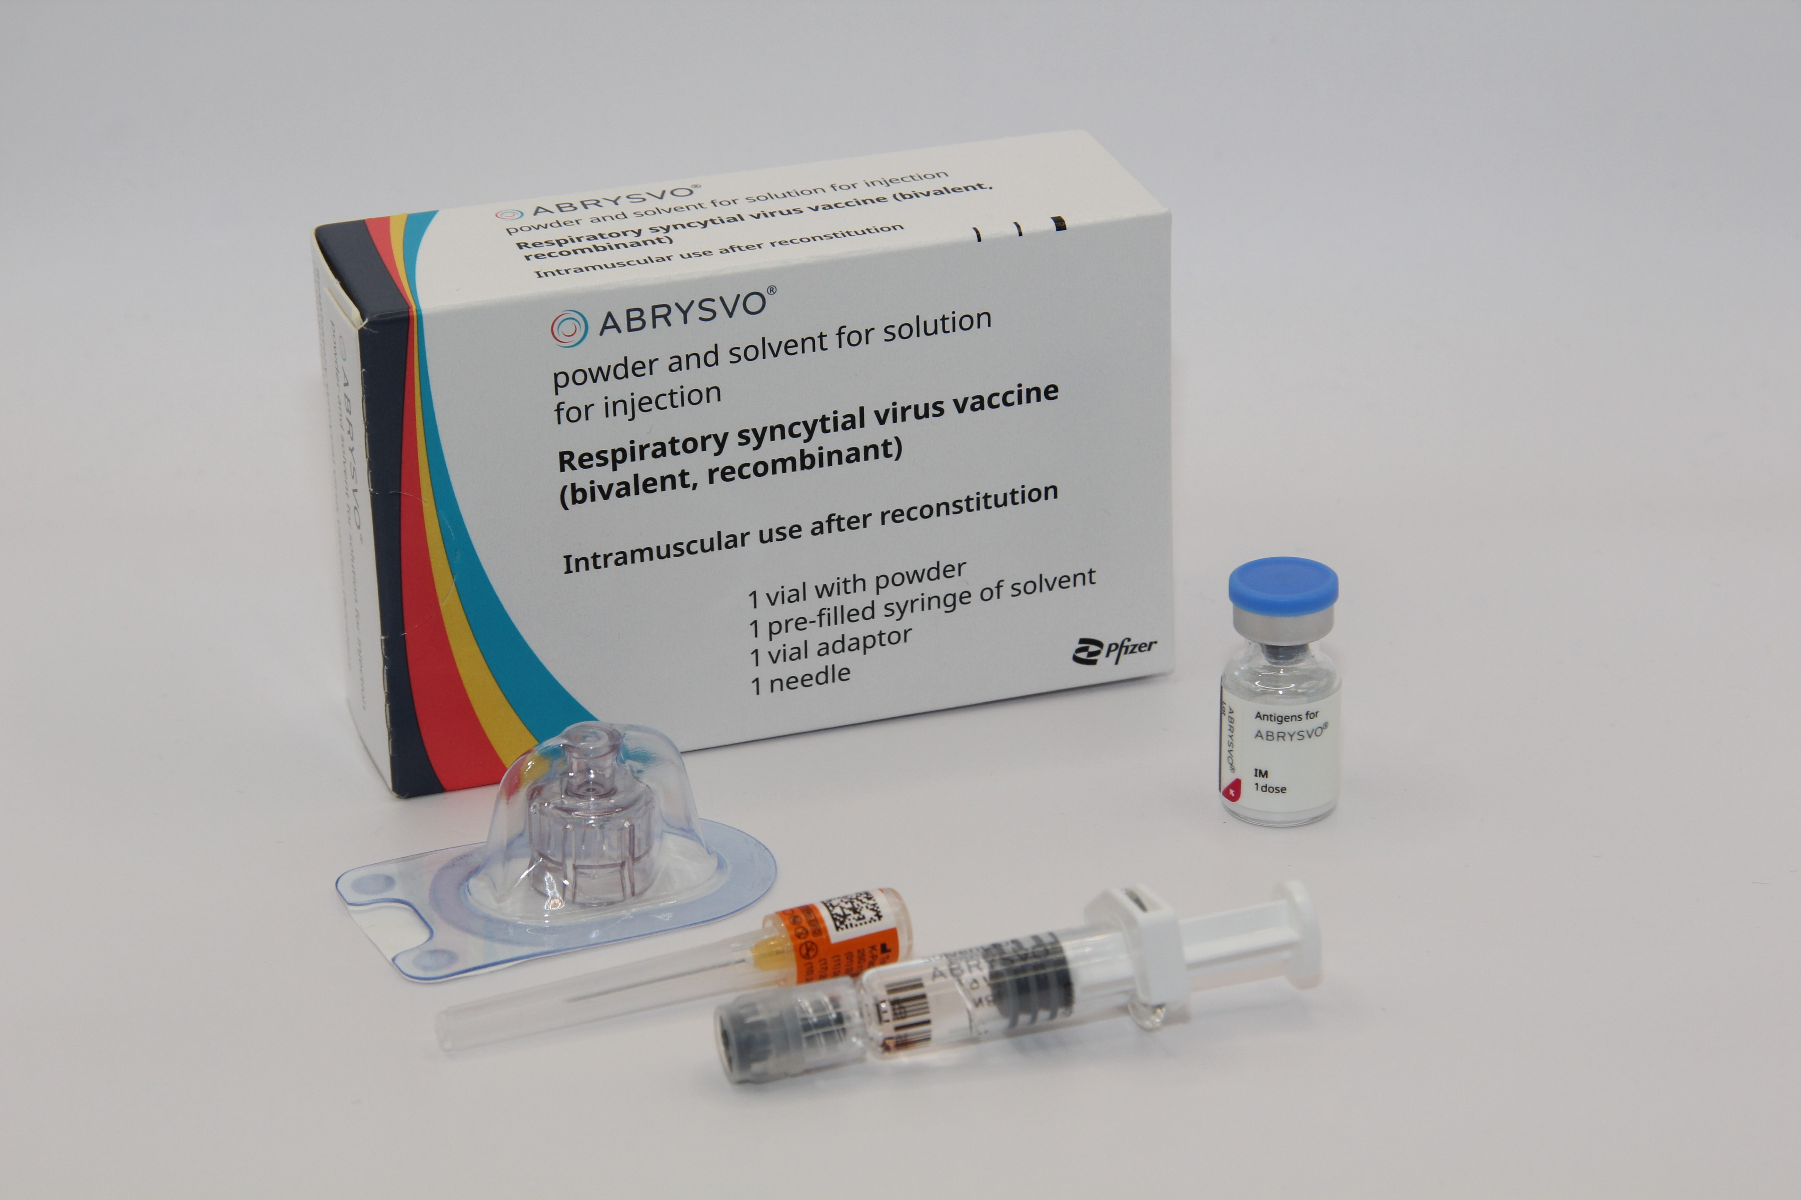
Pharmaceutical information
Abrysvo® is the recommended vaccine for RSV vaccination of older adults and is the only vaccine currently available for use within the national programme in the UK
it is a non-live, bivalent recombinant vaccine
as it does not contain any live organisms, it cannot cause the disease against which it protects and can be given to immunosuppressed individuals
Abrysvo® requires reconstitution prior to administration
after reconstitution, one 0.5ml dose of Abrysvo® contains:
  RSV subgroup A stabilised prefusion F antigen 60 micrograms
  RSV subgroup B stabilised prefusion F antigen 60 micrograms
  Abrysvo® is licensed for active immunisation for the prevention of lower respiratory tract disease caused by RSV in individuals aged 60 years of age and older and individuals aged 18 to 59 years of age who are at increased risk for lower respiratory tract disease caused by RSV (Note: individuals aged 18 to 74, other than those living in older adult care homes, are not included in the national programme.)
Notes:
Abrysvo powder and solvent for solution for injection - Summary of Product Characteristics (SmPC) - (emc) | 15309
Abrysvo is indicated for:
• Passive protection against lower respiratory tract disease caused by respiratory syncytial virus (RSV) in infants from birth through 6 months of age following maternal immunisation during pregnancy. See sections 4.2 and 5.1.
• Active immunisation for the prevention of lower respiratory tract disease caused by RSV in individuals 60 years of age and older.
• Active immunisation for the prevention of lower respiratory tract disease caused by RSV in individuals 18 through 59 years of age who are at increased risk for lower respiratory tract disease caused by RSV.
The use of this vaccine should be in accordance with official recommendations.

Slide 20
Excipients
Abrysvo® contains the following excipients:
Powder vial
trometamol
trometamol hydrochloride
sucrose
mannitol
polysorbate 80
sodium chloride
hydrochloric acid (for pH adjustment)
Solvent
water for injections
  There is no animal content in the vaccine
  Abrysvo® has been certified Halal by The Islamic Food and Nutrition Council of America (IFANCA)
  Rarely, people may be allergic to polysorbate 80. However, polysorbate 80 is widely used in medicines and foods, and is present in many medicines including monoclonal antibody preparations
    some vaccines (such as the main injected influenza vaccines for individuals aged 65 years and above) contain polysorbate 80. It is also commonly used in foods such as ice cream, and other frozen desserts
    it is likely that people will know if they are allergic to it and individuals who have tolerated injections that contain polysorbate 80 are likely to tolerate the Abrysvo® vaccine

Slide 21
How Abrysvo® vaccine works
the RSV vaccine Abrysvo® is a non-live bivalent recombinant vaccine
recombinant means a small piece of DNA from the protein of the virus is taken and inserted into a manufactured cell. As these cells grow the protein is made too. This protein is then purified and put into the vaccine which, when introduced into the body via IM injection, activates the immune system
it is referred to as bivalent because Abrysvo® contains versions of two proteins found on the surface of the virus called ‘RSV subgroup A stabilised prefusion F’ and ‘RSV subgroup B stabilised prefusion F’
the vaccine antigen (prefusion F proteins) stimulates the immune system to produce antibodies. When the individual encounters RSV virus, the antibodies neutralise the prefusion F proteins thus preventing the virus particle from fusing with and entering the host’s cells and causing an RSV infection
the vaccine is sometimes called pre-F because it is based on the prefusion form of the fusion (F) protein which the virus uses to invade human cells
Notes:
How RSV causes infection:
any virus particle consists of a protein shell (capsid) inside which is the nucleic acid (DNA or RNA) – the genome or the genetic code for that virus; RSV is an RNA virus
when a virus particle enters the host’s cells it is able to reproduce and release more virus particles which in turn infect other cells – establishing an infection
RSV virus particles use a special type of protein on the surface of the virus called a fusion (F) glycoprotein to pass through the cell membrane
the F proteins does this by fusing the virus cell membrane and the host’s cell membrane together; this allows the virus to move through the host’s cell membrane and enter the cells
the F protein changes shape as it fuses the RSV virus and human cell membranes together: while on the virus surface before infection, the protein is in a “prefusion” form, but as it interacts with the cell membrane it rearranges into an inactive, “postfusion” form
the prefusion form is antigenic – it stimulates an immune response; the immune system is able to recognise and respond to the presence RSV virus particles with prefusion F proteins on their surface by producing antibodies to combat the infection; the postfusion form is not antigenic
there are two subgroups of the prefusion form: A and B
Recombinant vaccine technolgy
different cells (for example bacteria, yeast, other established laboratory cell culture lines) are used to manufacture the vaccine
a small piece of genetic material (DNA) is taken from the microorganism (virus or bacterium) against which we want to protect and inserted into the manufacturing cells: this results in a “recombinant” version of those cells
the role of these recombinant cells is to help transport the DNA instructions for making the antigen into a host cell
once the recombinant cell enters the host cell line it instructs the host cells to rapidly produce the antigen
this antigen is grown in bulk, collected, purified, and then packaged as recombinant vaccine (the cell line used to manufacture the cells is not in the vaccine)
when the vaccine is injected, the antigen in it triggers the immune system to create antibodies that specifically target that antigen
recombinant vaccines are non-live so they cannot cause disease in the vaccine recipient

Slide 22
Effectiveness
Abrysvo® was licensed in the UK by the MHRA in November 2023 on the basis of safety and efficacy following a clinical trial of over 17,000 immunocompetent adults aged 60 years and above, 52% of whom had at least one stable chronic underlying condition
  at the end of the first RSV season, analysis demonstrated statistically significant vaccine efficacy (VE) for Abrysvo® for reduction of RSV-associated lower respiratory tract illness with 2 or more symptoms of 65.1% and 3 or more symptoms of 88.9%
  in the second season, the efficacy against 2 or more symptoms was 55.7% and against 3 or more symptoms was 77.8%
in the first season, one analysis found effectiveness of vaccination against RSV hospitalisation in the UK of 75% whilst another study, in England, found VE to be 88.6% for LRTI admission overall and an estimated 73% against RSV admission in people with immunosuppression
Abryvso® is licensed for use in Europe, the USA and in many other parts of the world. Over 3 million doses were administered to adults in the USA during winter 2023/2024 and almost 2.5 million doses have been administered to older adults in England (GP data extracted 18 January 2026)
healthcare professionals are asked to report all suspected adverse reactions via the Yellow Card Scheme at: www.mhra.gov.uk/yellowcard
Notes:
Source: Abrysvo powder and solvent for solution for injection - Summary of Product Characteristics (SmPC) - (emc) (medicines.org.uk)
The Green Book RSV chapter (https://www.gov.uk/government/publications/respiratory-syncytial-virus-the-green-book-chapter-27a) contains the following information regarding vaccine effectiveness in older adults:
For older adults, the pivotal phase 3, multi-country, randomised, double-blind, placebo-controlled trial recruited from the age of 60 years to assess Abrysvo’s efficacy against RSV LRTI with 2+ or 3+ symptoms (Walsh et al., 2023). Participants were randomised to receive vaccine (n=18,488) or placebo (n=18,479), stratified by ages 60-69 years (63%), 70-79 years (32%) and ≥80 years (5%). Stable chronic underlying conditions were present in 52% of participants; immunocompromised individuals were excluded. At the end of the first RSV season VE against RSV LRTI with ≥2 symptoms was 65.1% (95%CI: 35.9 to 82.0%) and with ≥3 symptoms 88.9%, (95%CI: 53.6 to 98.7%) (Pfizer 2024). VE estimates by RSV subtype have overlapping confidence intervals (Walsh et al., 2023). In the second season, VE was 77.8% against LRTI with 3+ symptoms (95%CI: 51.4 to 91.1%) and 55.7% (95%CI: 34.7 to 70.4%) against 2+ symptoms (Walsh et al., 2024). Effectiveness of vaccination against RSV hospitalisation was 75% (95%CI: 69 to 80%) in electronic health record analysis of the UK older adult first season (Bucholc et al., in press) and 88.6% (95%CI: 75.6 to 95.6%) for LRTI admission in enhanced surveillance in English hospitals, which also estimated 73% (95%CI: 40 to 89%) effectiveness against RSV admission in people with immunosuppression (Symes et al., 2025b). A Danish single season trial similarly 8 Respiratory syncytial virus 20 January 2026 found 83% (95%CI: 42.9 to 96.9%) effectiveness against RSV ARI admissions and 91.7% (95%CI: 43.7 to 99.8%) against RSV LRTI admissions Lassen et al., 2025b).

Slide 23
Safety
A small number of cases of Guillain-Barré syndrome (GBS) were detected in older adults following vaccination with Abrysvo® in the phase 3 clinical trials and surveillance studies in the USA and UK suggest that RSV vaccines are associated with a small increased risk of GBS in the 6 weeks following administration in older adults:
  GBS is a rare and serious condition that affects the nerves. It mainly affects the feet, hands and limbs, causing problems such as numbness, weakness and sharp pain. In severe cases, GBS can cause difficulty moving, walking, breathing and/ or swallowing. GBS is most common following infection, including campylobacter and influenza; cases of GBS that occur following vaccination may occur by chance
  surveillance studies have found around 10 - 25 cases of GBS for every million doses of Abryvso® administered to older people; this is one case for every 40,000 to 100,000 doses of vaccine administered to older adults; this compares to an annual background rate of GBS of 20 per million per year in 70-79 year olds
Overall, the benefits of RSV protection in preventing hospitalisation and death from RSV in the eligible group are highly favourable relative to the risks of serious adverse reactions (Commission on Human Medicines).
The MHRA has advised that healthcare professionals should be alert to the signs and symptoms of GBS, which may start with pins and needles in the hands, arms, feet or legs, to ensure correct diagnosis in order to initiate adequate supportive care and treatment and to rule out other causes; early treatment can help prevent the most serious syndrome and improve recovery.
Individuals with a history of GBS should be vaccinated if they are eligible; there is evidence from other vaccines to suggest that having had a prior diagnosis of GBS does not predispose an individual to further episodes of GBS following immunisation.

Slide 24
Contraindications and precautions
Abrysvo® is contraindicated following confirmed anaphylactic reaction to a previous dose or to any of the components of the vaccine
Abrysvo® is contraindicated in young children
immunisation of individuals who are acutely unwell with fever should usually be postponed until they have recovered fully to avoid confusing the diagnosis of any acute illness by wrongly attributing any sign or symptoms to the adverse effects of the vaccine
minor illness, such as a common cold, without fever or systemic upset are not valid reasons to postpone immunisation
refer to the Green Book RSV Chapter and Respiratory Syncytial Virus (RSV) vaccine PGD
Notes:
RSV vaccines should not be given to young children, outside of clinical trials.
These RSV vaccines are different from monoclonal antibody immunisations which are given to high-risk children.
A recent clinical trial (Moderna’s mRNA-1345) has shown evidence of enhanced disease in children who were immunologically naive (i.e. they had never been exposed) to RSV and had received RSV vaccine who then went on to catch seasonally circulating RSV
As safety has not been assessed in clinical trials for these children, and due to the possibility of vaccine-associated enhanced disease, RSV vaccine is not recommended in young children

Slide 25
Administering Abrysvo® at the same time as seasonal influenza vaccine
there is some data which shows that in older adults administering Abrysvo® at the same time as seasonal influenza vaccine may reduce the immune response to the RSV vaccine
there is also data that suggests that the response to the influenza A(H3N2) component of seasonal influenza vaccine (the influenza subtype which most severely affects older adults) may be diminished when RSV and seasonal influenza vaccine are co-administered to older adults
the clinical significance of any reduced response is unknown, but influenza immune response is known to correlate with protection against infection, and there is emerging data that RSV immune response also correlates with clinical protection
it is therefore recommended that these vaccines are not routinely scheduled to be given at the same appointment or on the same day
no specific interval is required between administering the vaccines
if it is thought that the individual is unlikely to return for a second appointment or immediate protection is necessary, Abrysvo® can be administered at the same time as the influenza vaccine
Notes:
Reactogenicity for co-administered vaccines is expected to be consistent with the profiles of the individual products.

Slide 26
Administering Abrysvo® at the same time as other vaccines
Co-administration with pneumococcal, Shingrix® (shingles), COVID-19 and other inactivated or non-live vaccines
  in line with general advice about co-administration of inactivated and non-live vaccines, Abrysvo® can be safely given concomitantly with pneumococcal, COVID-19 and/or the Shingrix shingles vaccines
  Abrysvo® can be given at any interval before or after these vaccines or other inactivated or non-live vaccines
Co-administration with a live vaccine
  although live vaccines are not commonly indicated in older adults, Abrysvo® is an inactivated or non-live vaccine so can be given at the same time as any live vaccines
Notes:
When the RSV vaccination was first introduced, there was some concern that co-administration with COVID 19 vaccination and RSV vaccination might
reduce the immune response to the RSV vaccine, although the clinical significance of any reduced response was unknown. It was therefore
recommended that these vaccines should not routinely be scheduled to be given at the same appointment or on the same day unless the individual was
unlikely to return for a second appointment or immediate protection was necessary. This advice no longer applies: COVID-19 vaccines may now be
co-administered with RSV vaccine or given at any interval before or after a dose of RSV vaccine
The standard advice about co-administration applies: where more than one vaccine can be administered at the same time, the vaccines should be given at a separate site, preferably in a different limb; if more than one vaccine is given in the same limb, they should be given at least 2.5cm apart; the sites at which each vaccine is given should be noted in the individual’s health records

Slide 27
Adverse reactions
Vaccinees should be informed of the potential expected reactions to Abrysvo®:
the adverse reactions reported by Abrysvo® clinical trial participants were the expected side-effects commonly reported after any vaccination, reflecting the initiation of the inflammatory and immune responses that lead to vaccine-induced protection against disease
for individuals aged 60 years and above, only vaccination site pain was very commonly reported (reported by 11% of those who received the vaccine in clinical trials)
commonly reported reactions (affecting more than 1 in 100 but not as many as 1 in 10 of those receiving the vaccine) were vaccination site redness and swelling
although headache and myalgia were commonly reported adverse reactions from the clinical trial of younger adults (aged 49 years or below), these were not reported by the 60 years and above age group

Slide 28
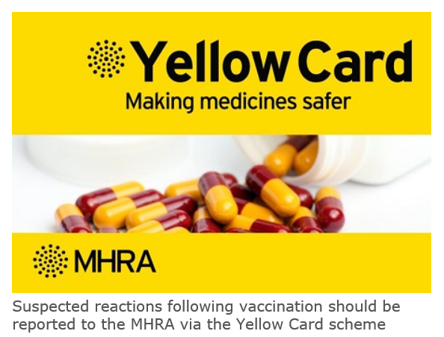
Reporting adverse reactions
Abrysvo® is a relatively newly licensed vaccine in the UK and is subject to additional monitoring under the black triangle labelling scheme. This means that all suspected adverse reactions following administration should be reported to the MHRA using their Yellow CARD reporting scheme at Yellow Card | Making medicines and medical devices safer (mhra.gov.uk).
vaccines are carefully monitored to ensure they are safe, not causing untoward side effects and are suitable for the immunisation programme
MHRA promotes the collection and investigation of adverse reactions through the Yellow Card scheme which is a voluntary reporting system for suspected adverse reactions
anyone (vaccine recipients and HCWs) can make a Yellow Card report, even if they are uncertain as to whether a vaccine caused the condition
Notes:
UK marketing authorisation granted November 2023 – had been authorised/used prior to this e.g. extensively in the USA

Slide 29
Vaccine preparation

Slide 30
Pack contents
Each pack of Abrysvo® RSV vaccine contains:
powder for 1 dose in a vial
solvent (water for injection) in a pre-filled glass syringe with a stopper (synthetic chlorobutyl rubber), luer lock adaptor and tip cap (synthetic isoprene/bromobutyl blend rubber)
vial adaptor
25G 25mm needle (suitable alternatives can be used if required)
Notes:
Abrysvo® should be stored in a vaccine fridge between +2°C and +8°C; do not freeze: discard if the carton has been frozen; further information on vaccine storage and stability is available in the Summary of Product Characteristics (SPC), the Patient Group Direction and from the manufacturer

Slide 31
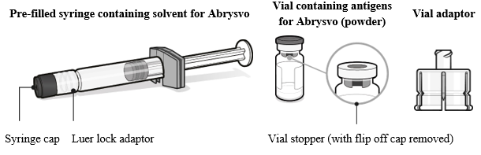
Preparing the Abrysvo® vaccine
Abrysvo® must be reconstituted prior to the administration by adding the entire contents of the pre-filled syringe of solvent to the vial containing the powder using the vial adaptor
the vaccine must be reconstituted only with the solvent provided
Clear instructions on how to prepare the vaccine for administration can be found in the SmPC and the manufacturer's video. Immunisers are strongly encouraged to watch the video in its entirety before preparing the vaccine for the first time.
Image from Abrysvo® vaccine SPC
Notes:
The images on this and the following slides were taken from the previous version of the SPC. The instructions/ images on the latest version have been reduced. The older images/ text have been retained here as they are considered to be useful for those new to this vaccine product and are aligned with the manufacturers video.

Slide 32
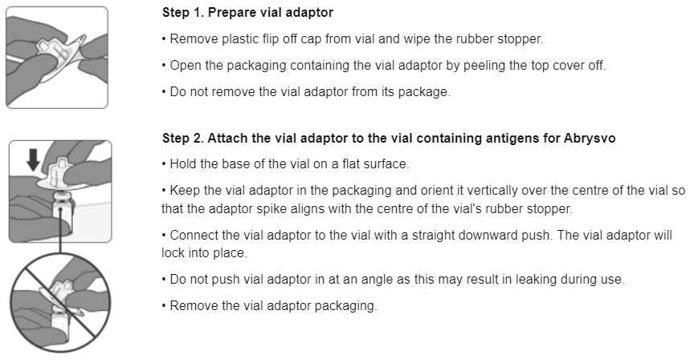
Preparing the Abrysvo® vaccine
Images from Abrysvo® vaccine SPC

Slide 33
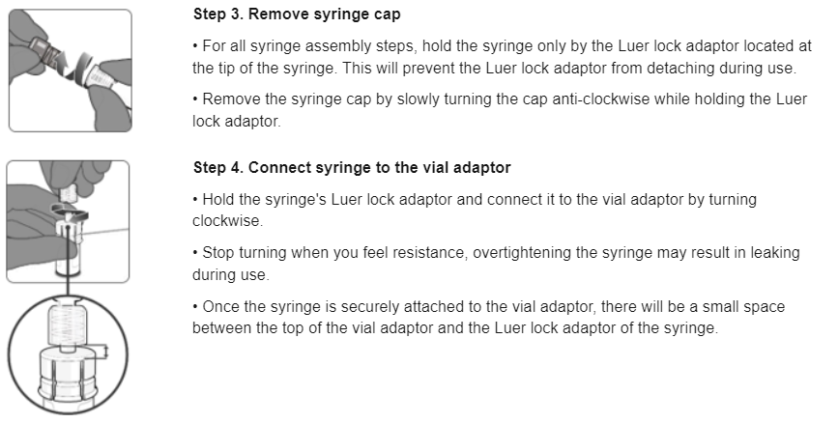
Preparing the Abrysvo® vaccine

Slide 34
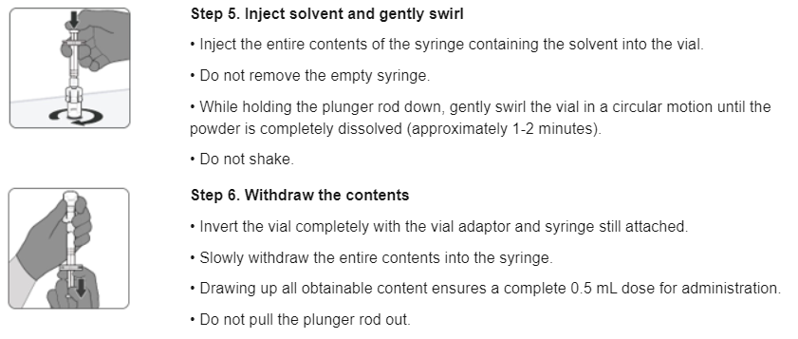
Preparing the Abrysvo® vaccine

Slide 35
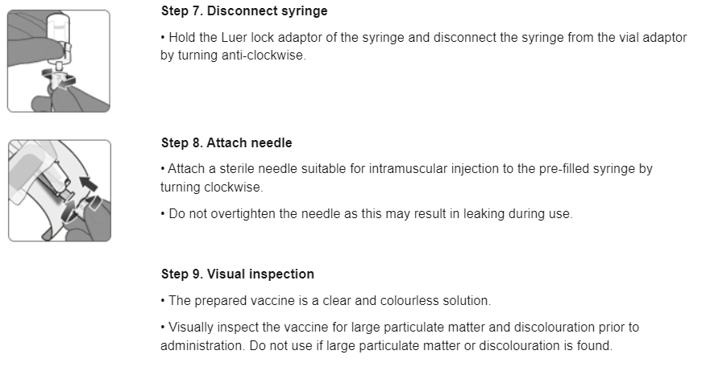
Preparing the Abrysvo® vaccine
Notes:
Abrysvo® should be administered immediately after reconstitution

Slide 36
Resources

Slide 37
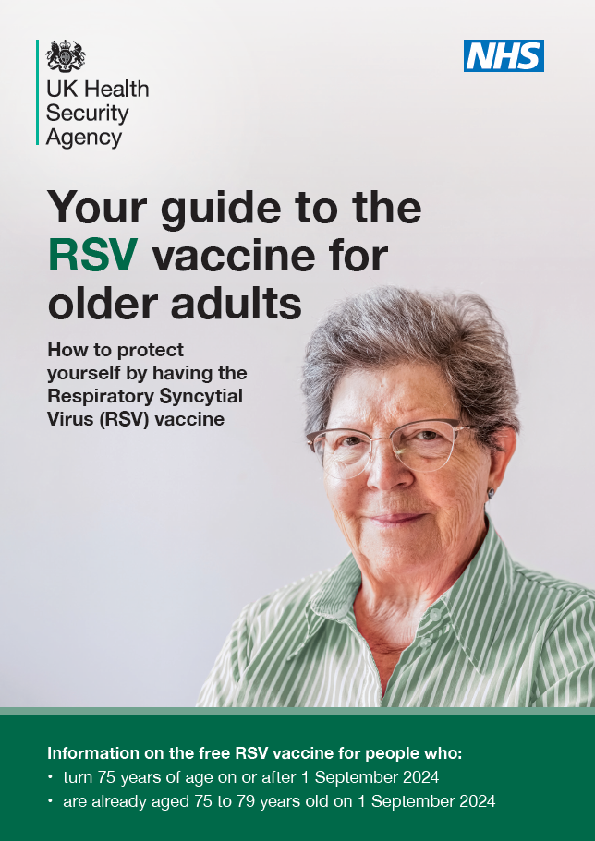
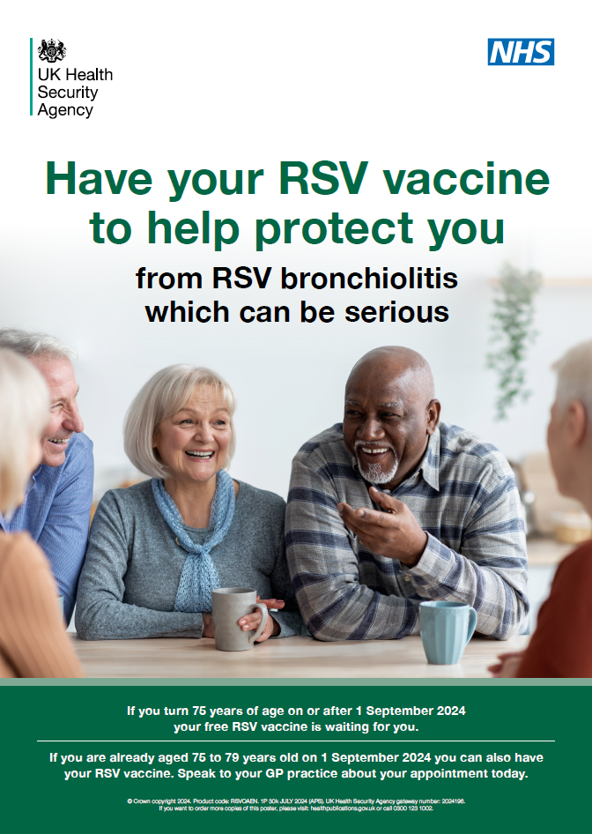
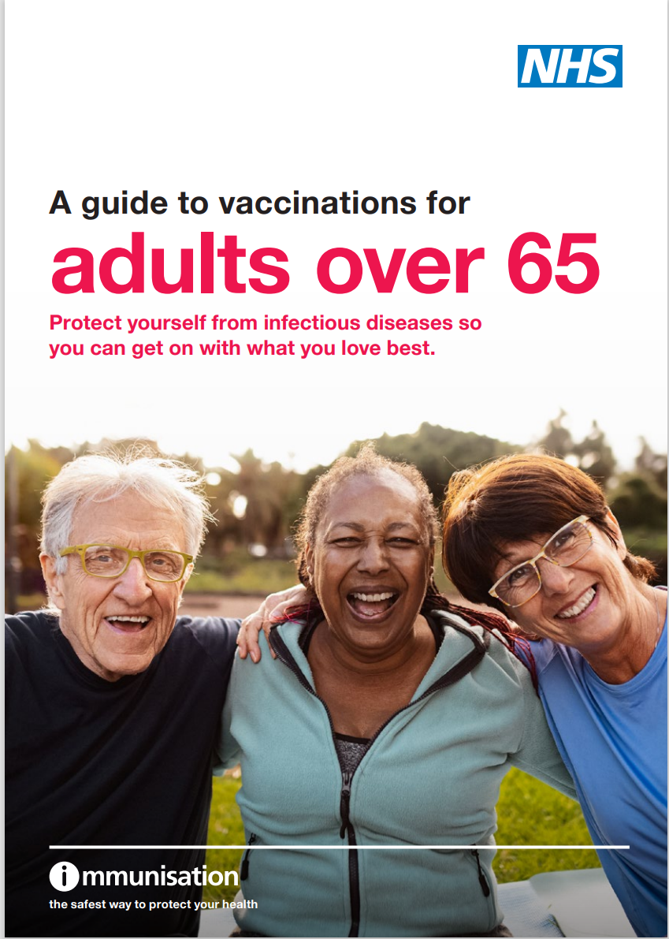
Patient resources
Leaflets and literature for older adults are available. These include:
Your guide to the RSV vaccine for older adults
a section in the forthcoming Guide to vaccinations for adults over 65
Visit the Find public health resources
for availability of resources in different
languages and accessible formats
Older adults leaflet: product code: C24RSV01EN
Older adults poster: product code: RSVOAEN

Slide 38
Information for healthcare practitioner guidance
The information for healthcare practitioners guidance available on the UKHSA RSV vaccination of older adults’ programme collection is recommended reading for anyone involved in RSV immunisation.
This is a practical document for healthcare practitioners administering or providing advice about RSV vaccination of older adults. It includes the vaccination programme recommendations, contraindications, precautions and examples of scenarios that staff may experience when immunising.

Slide 39
Further information
all UKHSA healthcare practitioner resources relating to RSV vaccination for older adults can be accessed in the UKHSA RSV immunisation programme collection. These include the ‘information for healthcare practitioners’ document, RSV training slide set and relevant patient leaflets. A separate training side set and information for healthcare practitioners document is also available for the RSV vaccination of pregnant women for infant protection
Marketing authorisation holder’s Summary of product characteristics
Medicines and Healthcare products Regulatory Agency (MHRA): reporting adverse reactions
The Green Book: Immunisation against infectious disease: RSV Green Book Chapter
UKHSA Patient Group Direction (PGD): RSV vaccine
Pfizer Abrysvo® vaccine preparation instructional video
UKHSA RSV overview: RSV: symptoms, transmission, prevention, treatment

